Slide 1


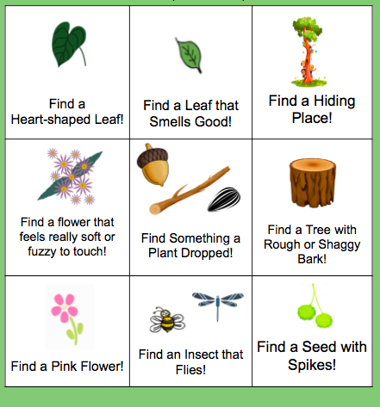





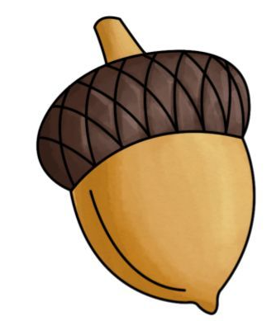








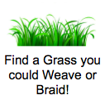


NATURE BINGO
Circle each one that you find… try to find all 9!
Find a Heart-shaped Leaf! | Find a Leaf that Smells Good! | Find a Hiding Place!
Find a flower that feels really soft or fuzzy to touch! | Find Something a Plant Dropped! | Find a Tree with Rough or Shaggy Bark!
Find a Pink Flower! | Find an Insect that Flies! | Find a Seed with Spikes!
Find a [describe your visually stimulating plant here]!
Find a [describe your tactically stimulating (soft or rough feeling) plant here]!
Find a [plant you could use to hide OR a plant you could climb on]!
Find a Fruit Tree or Berry Bush!
Find a Hiding Place!
Find a [describe your garden’s focal point here]!
Find a [describe a seed, branch, or other loose part your plant drops here]!
Find a Flower that feels Soft or Fuzzy to touch!
Find a [describe your smelly plant here]!
Find a [describe a piece of wildlife, like a small mammal or insect, here]!
Find a [tasty plant you don’t mind children trying, or a plant of your choosing]!
Find a [describe a plant you’d like to attract attention to here, or a water feature/water plant]!
Find a Pink or Yellow Flower!
Notes:
Please follow the instructions in the template or use them to help you brainstorm ideas. Then, fit the text box to each square, and insert cartoon images of the plants you are describing if desired. There are various small images to choose from on the next page, if you would like to use them within your personal bingo card or refer to them for inspiration. You may copy them from that page, and paste them on this one.

Slide 2

