Slide 1
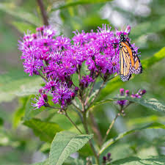
A Native Plant Sensory Garden
Mount Nittany Middle Courtyard

Slide 2

Table of Contents for Proposed Garden Plan
Amy Anderson, Cornell Garden-Based Learning
Planning A Successful Community Garden Program
Slide 3 - Introductory Statement
4 - Program Goals
5 - Logic Model
6-7 -Description of Garden Project
8- List of Potential Partnerships
9-Checklist for a Sustainable Garden Site
10 -Evaluation Plan
11 - Curriculum Concept Map
*14 - Sustainability and Support Plan
12 - Fundraising Plan
13 -Garden Development and Activity Timeline
*14 -Going Further Checklist
*14 -Three or More Goals
*14 -Additional Journals, Resources,

Slide 3
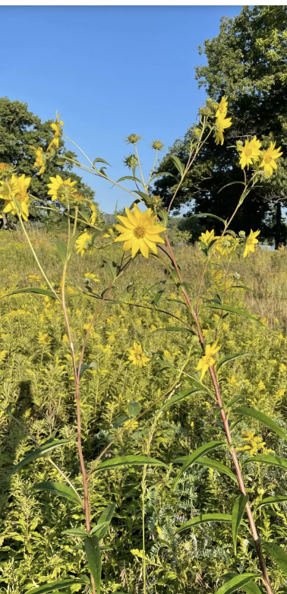
The Native Plant Sensory Garden:
Growing Participation and Cultivating Biodiversity
Introductory Statement
This project centers around the study of ecological principles and restoring biodiversity by using native pollinator plants. It will include multi-sensory features, student art, and the design of accessible pathways through the garden site. Partnerships with community volunteers enrich the teaching of topics such as Ecology, Native plants, and Universal Design. The garden design contributes to a positive, responsive school culture and is accessible to everyone. Students’ experiential knowledge grows as they research, plan, map, sketch, dig, plant, and care for the garden. This emergent, interdisciplinary space extends learning outdoors, promotes social, mental and physical well-being, and encourages collaborative, creativity, problem-solving, and social participation.
Tall Sunflower
Helianthus Giganteus

Slide 4
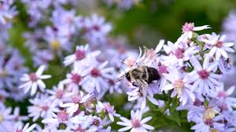
Program Goals link
Planning Partnerships
Education, part 1, planning
This Month (March 2025)
Measure and map site.
Document overgrown site with photographs
Test soil
Gather materials for sheet composting with cardboard to smother grass.
Define site with few containers to demonstrate new beginnings and stimulate curiosity
Create signage and Botanical Art featuring Keystone host plants and Butterflies of Pennsylvania.
1. Build community partnerships: Master Naturalists, Snetinger, etc.
2. Meet up spring 2025 and plan a schedule for the 2026 year.
3. Establish communication with School district, lead teachers, Administration and Staff.
4. Invite Special Education staff and students to meetings and gather input about access and interests.
5. Invite parents and students to participate in planning, designing and creating the garden.
1.Site visit: Measure, Map and test soil.
2. Select and study a butterfly and keystone host plant and sketch designs
3. Document and describe the story of the garden
Wood Aster

Slide 5
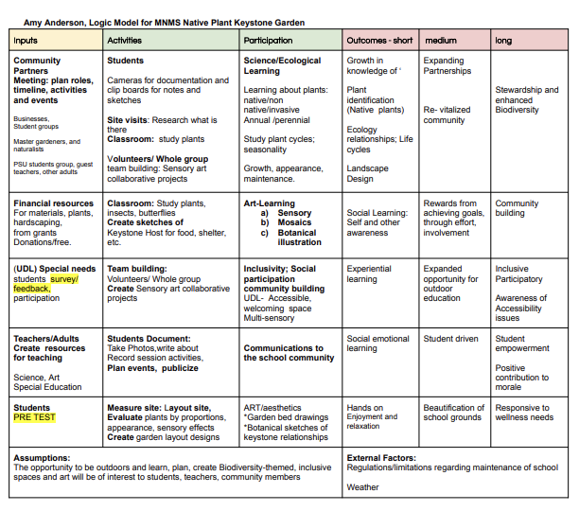
Logic Model link
A logic model is planning chart that is used to gather ‘inputs’ from partners to guide planning.
Much like a unit plan, the logic model helps define the outcome/goals we hope to achieve and the activities that will contribute to attaining these goals.
Link to Logic Model template

Slide 6
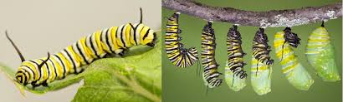
Describing the Vision
Inspiration: As an Educator, I am interested in finding ways to extend learning outside. Garden-based activities provide hands-on ways to learn about ecology, create site-specific Art, to experience social connection through participation in community-based efforts.
Native Plants: The work Douglas Tallamy (an entomologist) inspires me to think about small ways we all can restore biodiversity in our own backyards and communities by planting native plants and support ecological food webs for bugs, birds, and bees and butterflies.
Garden-based Learning: Our school has a wonderful courtyard that has a sunny corner that is currently overgrown. This site can be adapted to feature more ecologically beneficial pollinator plants and native shrubs into aesthetic garden designs. I envision the garden as a site for learning especially during our “Per. 9” activity period, when students can participate in various elective activities. By building partnership with community groups,, like the Master Gardeners, Master Naturalists, The PA Native Plant Society, Xerces Society, and other students groups like Girls Scout and Boys Scouts, as well as with parent volunteers, we can develop a sustainable plan to maintain the garden.
Design and Accessibility: Even though the garden site is small, the intention for the design is that it is welcoming to students with differing abilities, languages, and learning styles. Some students are in wheelchairs, and have aides. These pathways will be accommodating and address ADA guidelines.
Celebrating Though Stories of Involvement: Collaborative involvement in these projects can contribute to a heightened curiosity, motivation, and overall positive perceptions of school. Efforts to document and tell the story of the project can add vibrancy to the days and season of year as we can look forward to how the garden evolves. Our contributions build a more dynamic school culture as we contribute to the biodiversity of our school environment.

Slide 7
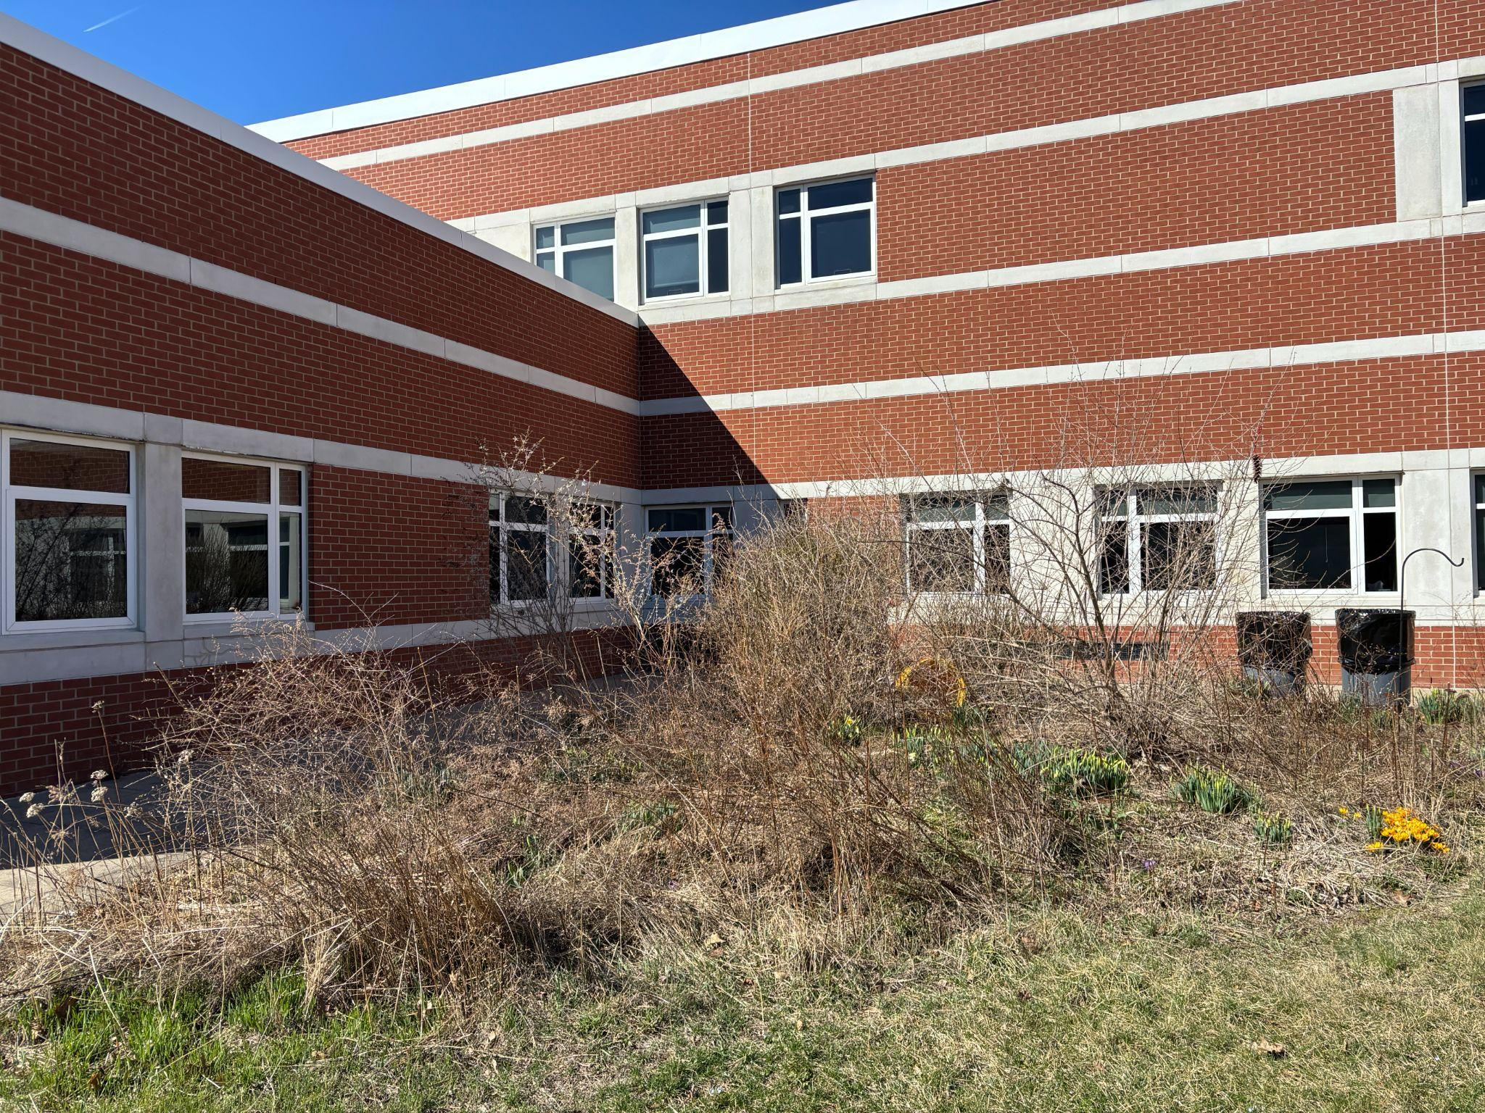
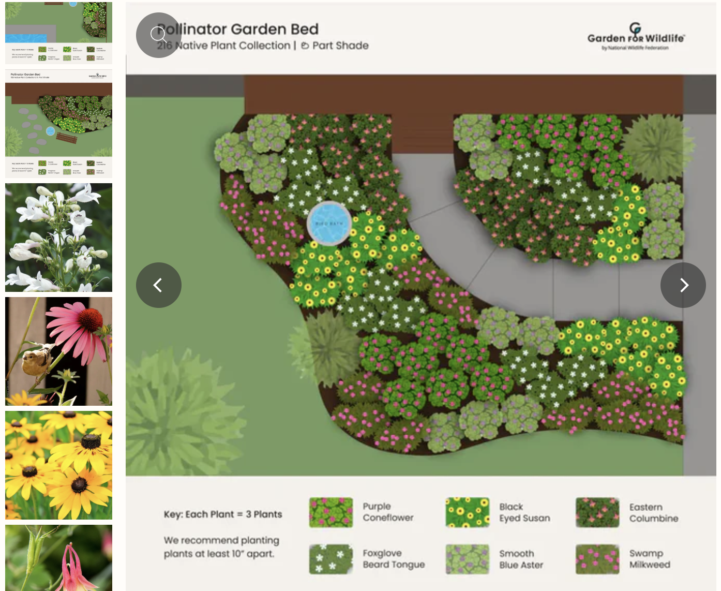
A Native Plant Sensory Garden
Description with pictures:
Mount Nittany Middle School Courtyard
Spring 2025: Reality. Starting with an overgrown corner plot.
Example: aerial view of corner design
with native plants and path.
We will use containers and signage to define the site and generate interest while we smother the grass with cardboard or plastic for 6 mos.

Slide 8
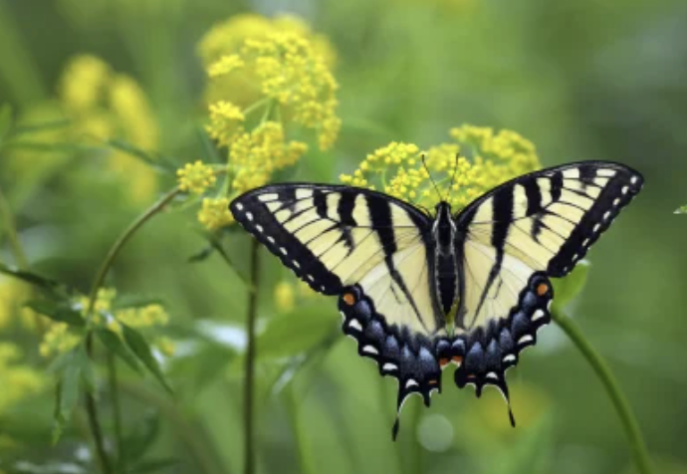
Potential Partnerships link
Master Gardeners
Master Naturalists
Xerces Society
Clearwater Conservancy
Millbrook Marsh
PSU Horticulturalists
and students
Native Plant Nurseries
Spreadsheet (in progress)
Landscape Designer
Landscape Contractors
Hardware Store
Horse farms ( for compost)
Girl Scouts
Boy Scouts
4-H groups
Students, School staff and Parents
This projects is a Biodiversity- themed, Art and Ecology Group.
It is in the early stages of building community partnerships
It will be an offshoot of existing Master Gardener- supported vegetable garden group.
Golden Alexanders,
Zizia Aurea
and is an essential food source for Black Swallowtail caterpillars

Slide 9
Checklist for Sustainable Garden Site Maintenance
Link to Checklist, Spring 2025
Safety, supplies:
Access to water, storage.
Safe; courtyard is enclosed.
restrooms
Site planning and maintenance:
Soil testing
Compost- in place, but education of school needed
Signage about site development
Prepare site by smothering/solarizing grass/weeds.
Planting and monthly care
Funding:
Granting source identified and approved. Will apply Feb 2026.
This is an interdisciplinary learning site and partners work together to develop learning activities.
Curriculum Development:
Biological Science, Ecology
Art and Design
Communications, Expository writing
Photos as documentation to report to school community

Slide 10
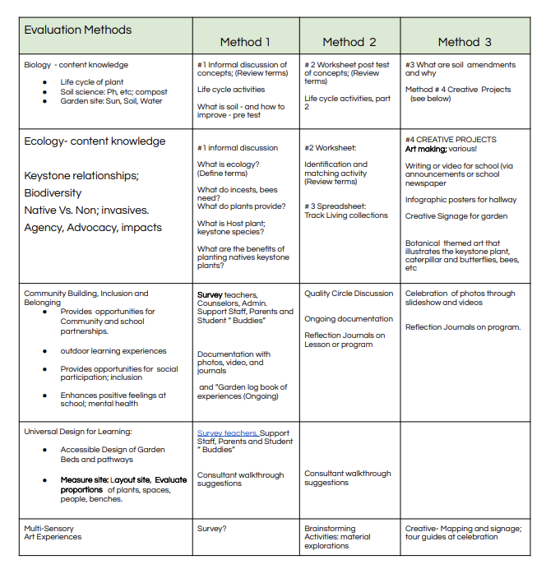

Evaluation
Plans

Slide 11
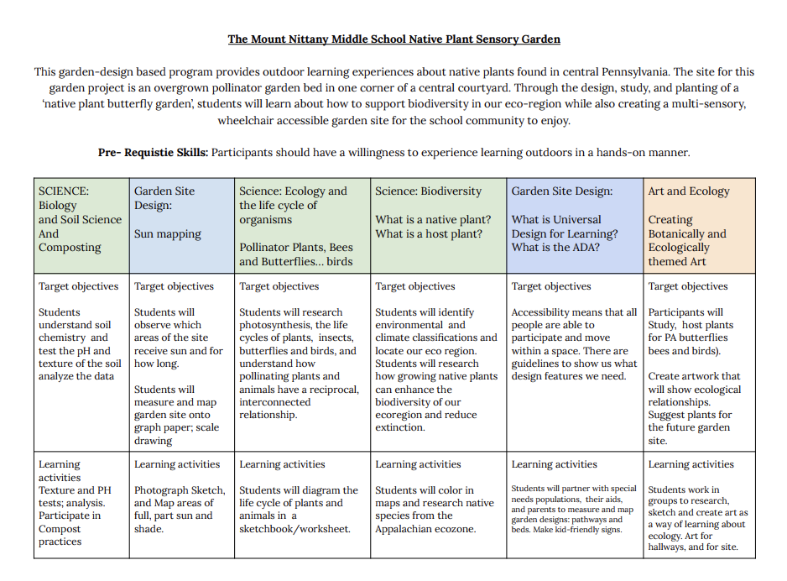
Interdisciplinary
Curriculum
Concept Map
✅

Slide 12

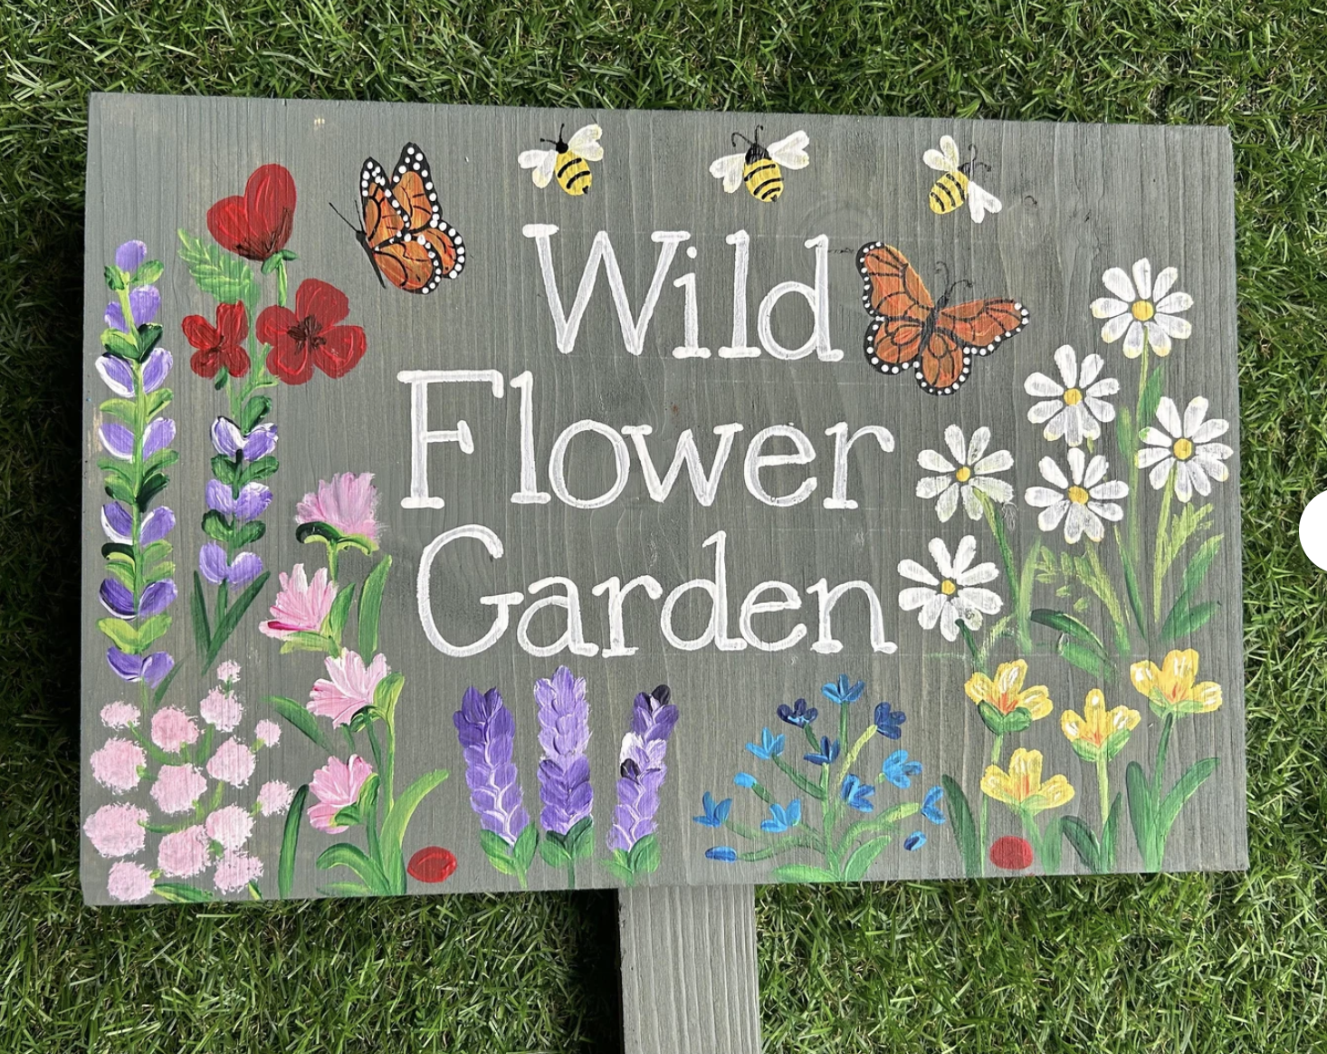
Fundraising Folder - Link
https://www.etsy.com/listing/1713273260/personalised-wild-flowers-garden-plaque?ls=s&ga_order=most_relevant&ga_search_type=all&ga_view_type=gallery&ga_search_query=painted+garden+signs&ref=sr_gallery-1-8&sts=1&content_source=57f4d754787a28bae774b207aabdd858766e8827%253A1713273260&organic_search_click=1&logging_key=57f4d754787a28bae774b207aabdd858766e8827%3A1713273260
Wish List items include:
Plants, Seed, Soil
Soil amendments/Compost
Containers
Gravel, stones, bricks for edging
Wood chips
Landscaping /pavers for pathways
Lumber for benches, raised beds
Art supplies and scrap wood for signs
Letter of Endorsement- (forthcoming)
One page - Project Overview

Slide 13
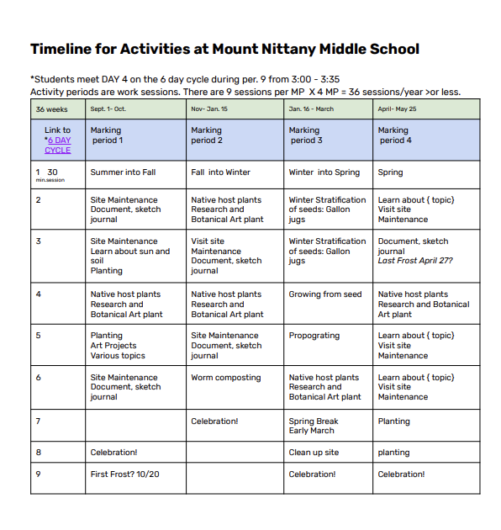
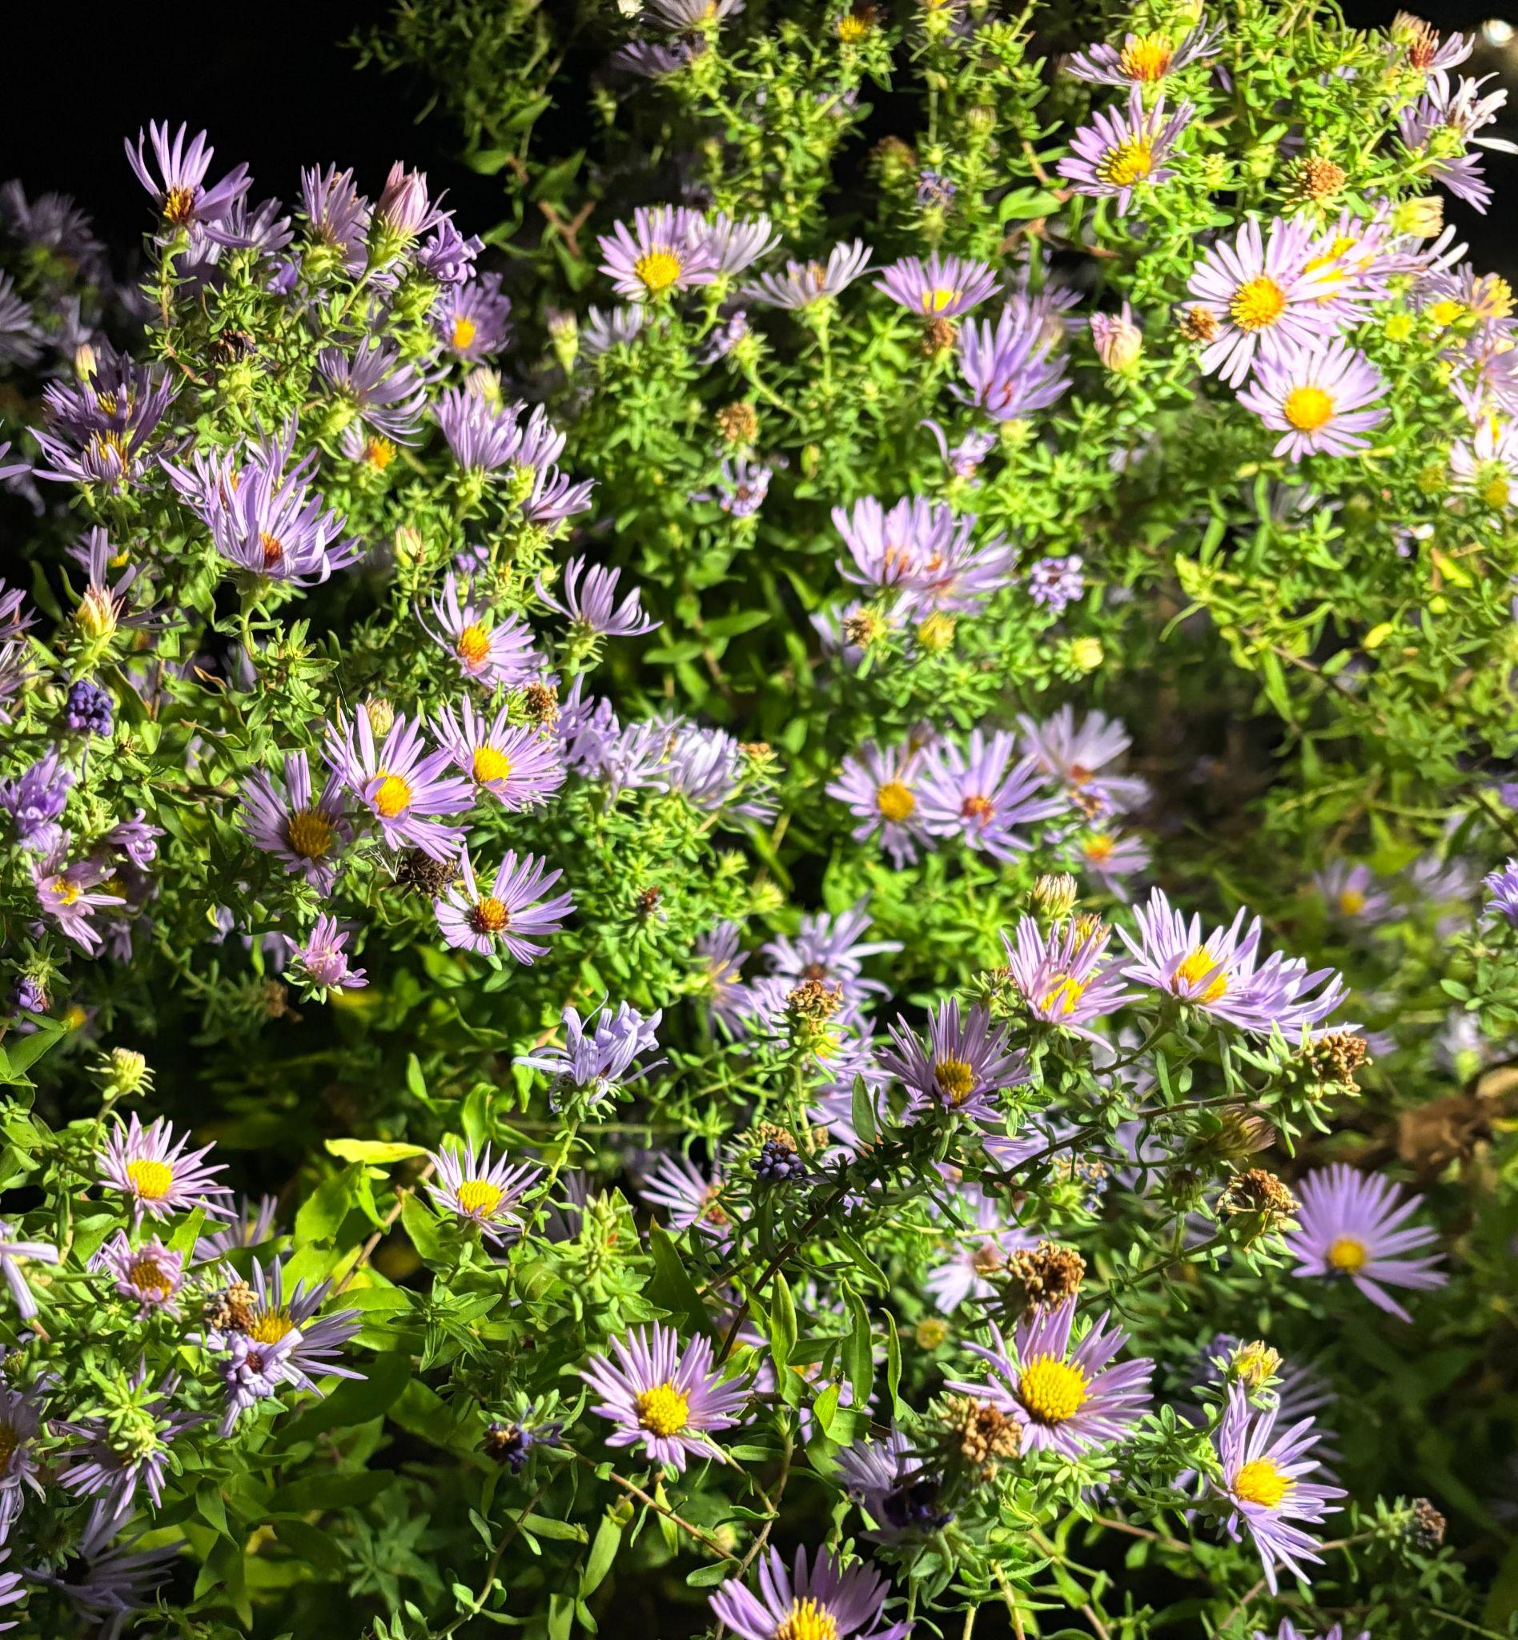
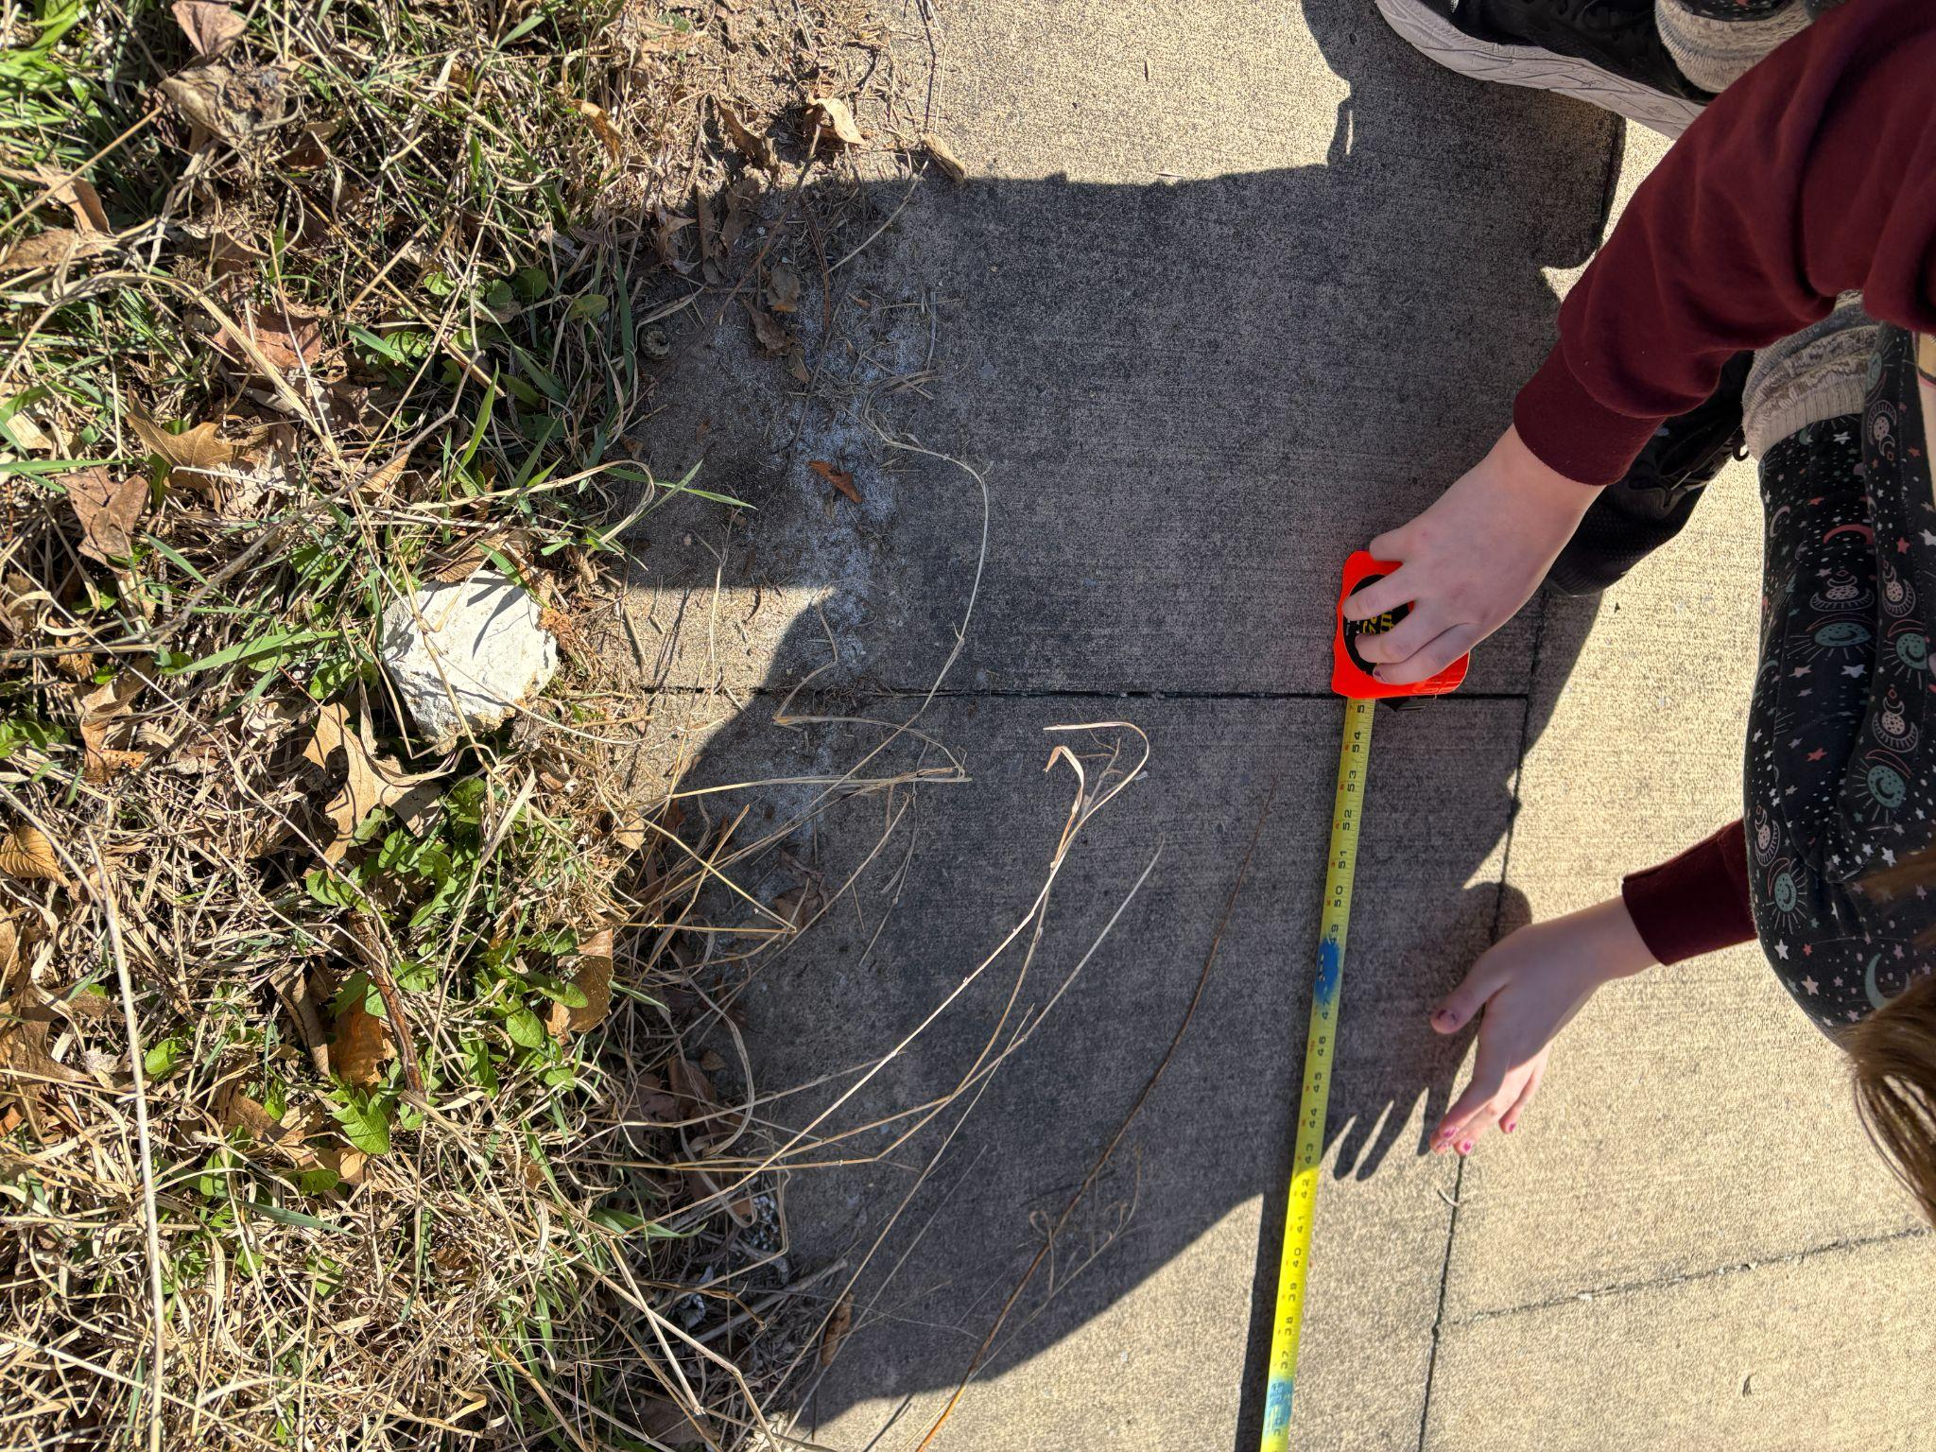
Garden Timelines and Activities, Link
Marking period 2 and 3
Per. 9 is a at when community can meet with students
in 35 min. sessions
X% of total grade
1 quiz each week
XX% of total grade
5 exams during the school year
XX% of total grade

Slide 14
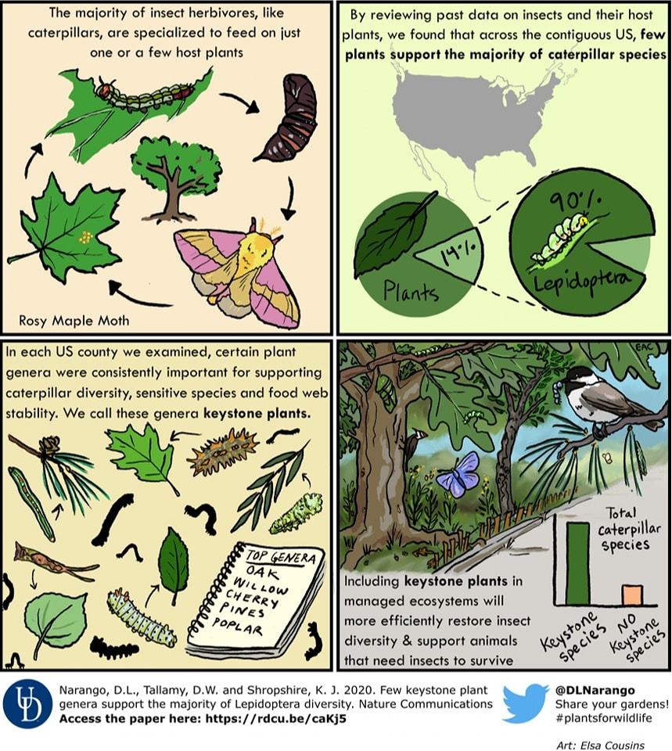
Biodiversity
Resources- link
Going Further Checklist -link
Sustainability Plan
-link (very rough draft)
Three More Goals-link

Slide 15
A Native Plant Sensory Garden
Mount Nittany Middle Courtyard
-Thank you for this learning experience!
I will let you know how the project evolves!
Amy Anderson, March 2025
aandersonart@gmail.com

