Slide 1
Diagnostic Clinic Overview
Jarmila Haseler
Agriculture and Food System Program Educator
Cornell Cooperative Extension | Monroe County

Slide 2
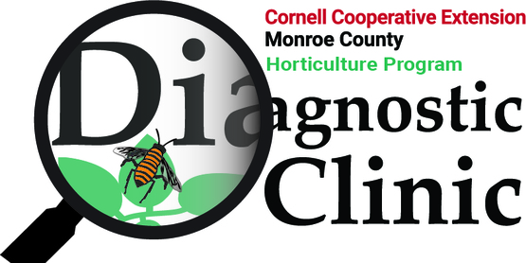
The Diagnostic Clinic through Cornell Cooperative Extension (CCE) is a regional service that identifies
- soil issues
- plant diseases
- insect pests
- weed problems
Direct service for homeowners, gardeners, and commercial growers.
Timely service – striving for high quality and short TAT

Slide 3
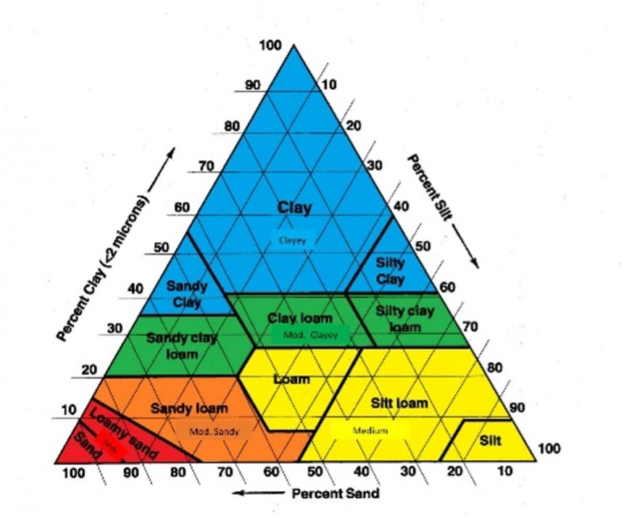
Intake Process - Soil
Providing Soil & Growing Advice - offering guidance on soil samples, turfgrass, trees, shrubs, and vegetable or flower plots.
Water is the most limiting factor in crop production. Soil texture, structure, percent organic matter (OM), and management practices influence the amount of water and nutrients a soil can retain for crop use
How to quickly estimate your soil texture
Clay 10%
Silt 70%
Sand ?
Notes:
The important role of soil texture on water https://cropsandsoils.extension.wisc.edu/articles/the-important-role-of-soil-texture-on-water/

Slide 4
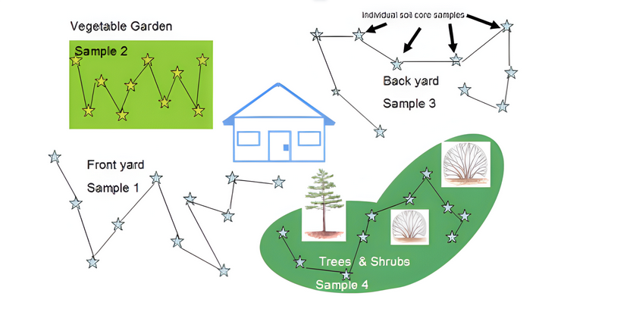
How to take a soil sample
Soil Sampling
Gather a soil sample from 3-4 places at a depth of 4-6” for turf, flower, or vegetable gardens and 12-18” for trees and shrubs.
Collect separate samples for different test sites, e.g., a lawn, vegetable garden, or perennial landscaped area
Mix the soil in a container to create a representative sample. Collect at least one cup.
Label samples. If there were recent soil additions, such as lime, sulfur, organic matter, or peat moss, wait 4 or more weeks before submitting the sample

Slide 5
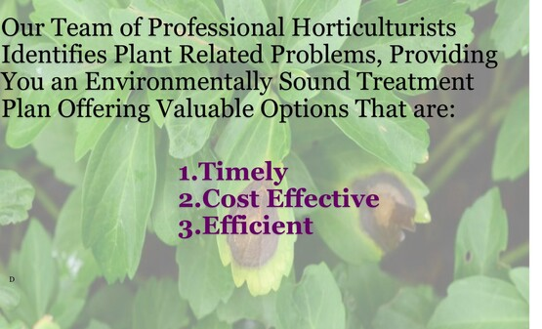
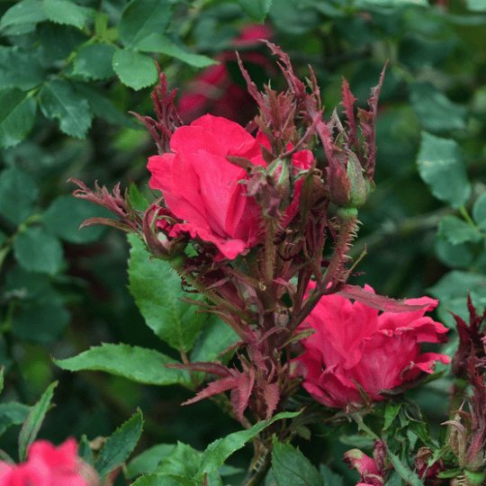
Intake – Plants and Insects
Disease & Pest Identification of plant material and soil samples to detect bacterial, fungal, viral, and nematode pathogens, and other pests.
Diseases caused by:
  Fungal
  Bacterial
  Viral
  Plasma
Plant/weed identification
Insect Identification
Analyses by:
Microscopic inspection
IPM Specialists
Literature and Internet search
Cornell IPM website: https://plantclinic.cornell.edu/services/
Witches' broom in roses looks like several offshoots emerging from a single stem

Slide 6
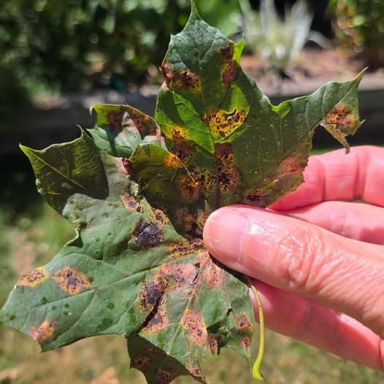
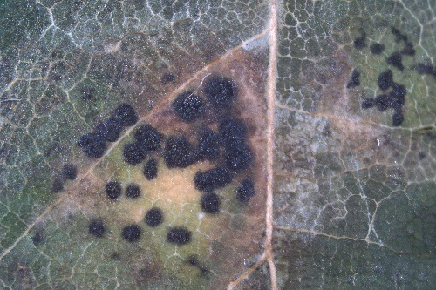
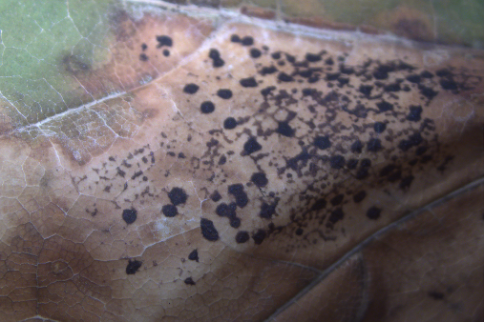
Tar spot - Rhytisma acerinum
Aesthetic damage to maples throughout New York.
Raised, black spots formed on the upper surfaces of maple leaves due to a fungal infection in late spring or early summer as light green to pale yellow spots.
As the season progresses, the yellow intensifies, and black, tar-like spots form within the yellow areas.
Alone, it is rarely serious enough to be detrimental to the overall health of infected trees. But as the infection progresses, trees become unsightly with premature defoliation.

Slide 7
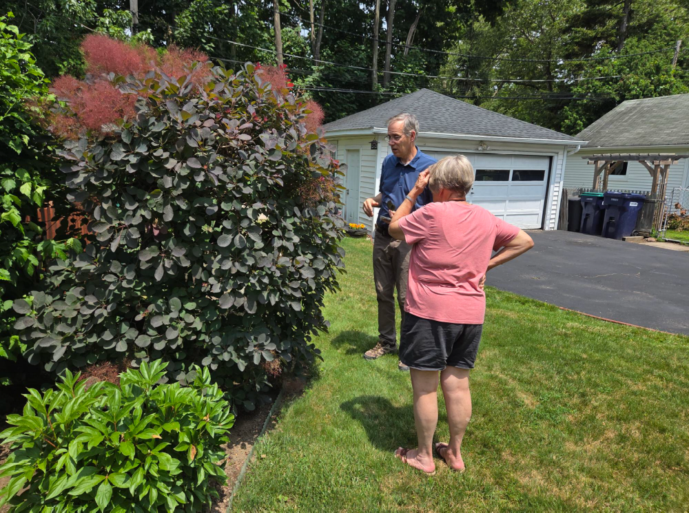
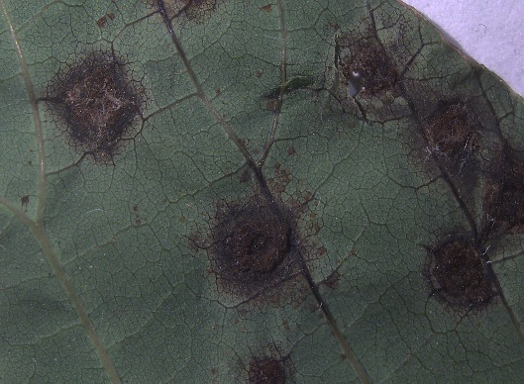
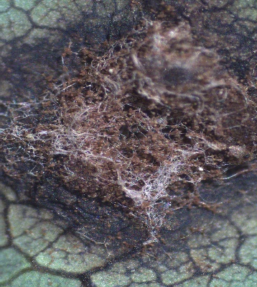
Smoke Tree Rust – (Pileolaria cotini-coggygriae).
An unsightly but generally manageable fungal disease.
Causes necrotic spots on the upper leaf surfaces and raised, rust-colored, or reddish-brown fungal pustules underneath.
Severe infections can cause leaf distortion and premature leaf drop.

Slide 8
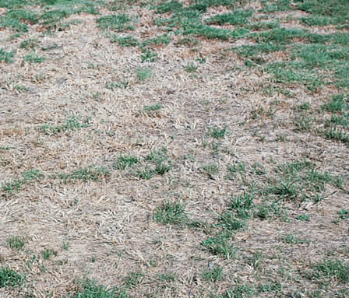
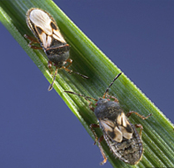
Chinch Bugs
Tiny bugs, chinch bugs, use their piercing mouthparts to suck moisture from grass blades, then inject toxins into the blades that interrupt water movement within the grass, causing the grass to die.
Process:
Appearance – it looks like drought damage – was it dry lately?
Development – sudden or gradual
Spread – gradual vs. sudden, centered vs. around the edges
Correction – grass not greening after being watered
Float test
https://www.domyown.com/chinch-bug-inspection-guide-a-590.html
Notes:
https://www.domyown.com/chinch-bug-inspection-guide-a-590.html

Slide 9
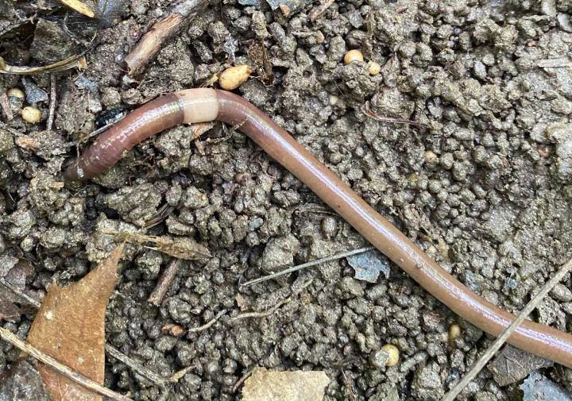
Asian jumping worms (Amynthas spp. or Metaphire spp.)
Often referred to as “Crazy Worms” or “Snake Worms,” due to their frantic, snake-like wriggling when disturbed.
Invasive earthworms originate from Japan and Korea and most likely arrived in North America through contaminated soil, compost, or plant material.
Recognized mainly by their Clitellum or "ring," around their body. The clitellum is a reproductive organ, signaling that the earthworm is in a reproductive stage.
Jumping worms have an annular clitellum, a distinctively smooth, cloudy-white or grayish band that completely encircles the body near the head and is flush (flat) with the skin.

Slide 10
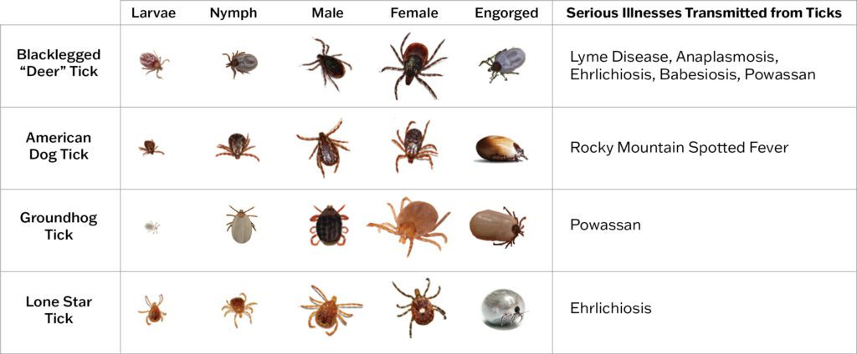
Tick Identification
Most commonly submitted ticks:
Blacklegged deer tick, Ixodes scapularis
American Dog Tick (Dermacentor variabilis)
Lone Star Tick, Amblyomma americanum
Tick species
Life stage
Sex
Level of engorgement - how much blood it has fed on (0-5 scale)
  0=tick had not fed, minimal transmission risk
  1=slight bloodmeal less than 24 hrs. of feeding,
  5=fully engorged more than 60 hours of feeding
We do not test ticks for diseases like Lyme disease
Notes:
Am. Dog tick not a vector of Lyme disease but is a known vector of Rickettsia, a bacterium that causes Rocky Mountain spotted fever in humans.

Slide 11
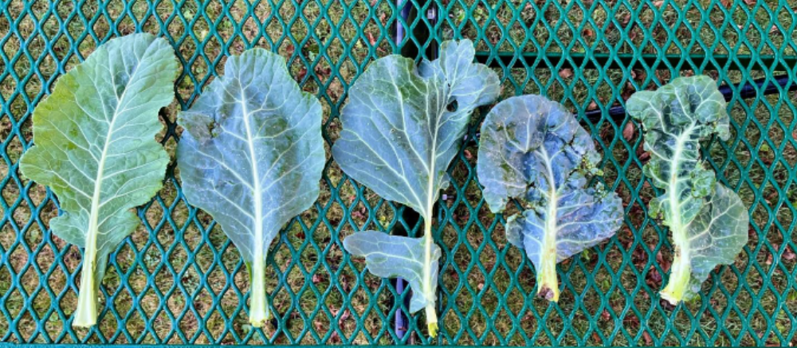
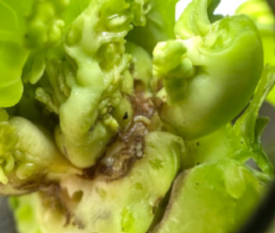
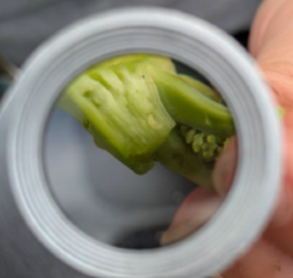
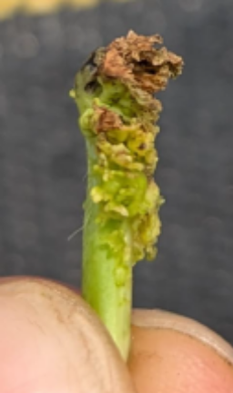
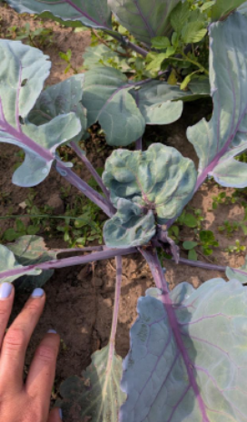
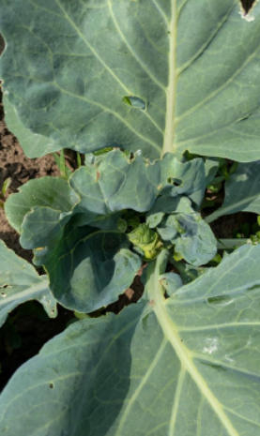
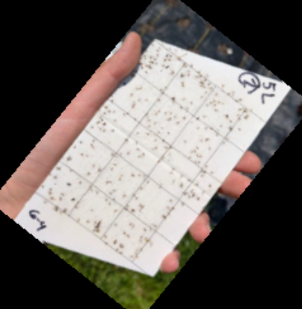
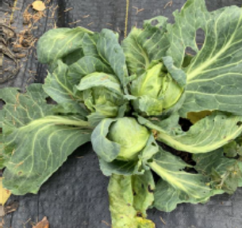
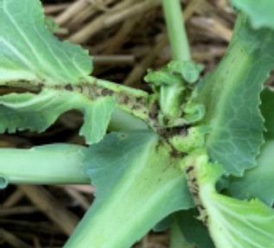
What’s going on with these brassicas?! What symptoms do you notice on these collard leaves?
The wonky symptoms make you do some digging around in the growing point of the plant.
What symptoms do you notice on these purple and green cabbage?
What’s going on at the growing point of with these brassicas?!
Based off what you find, you decide to set up a trap.

Slide 12
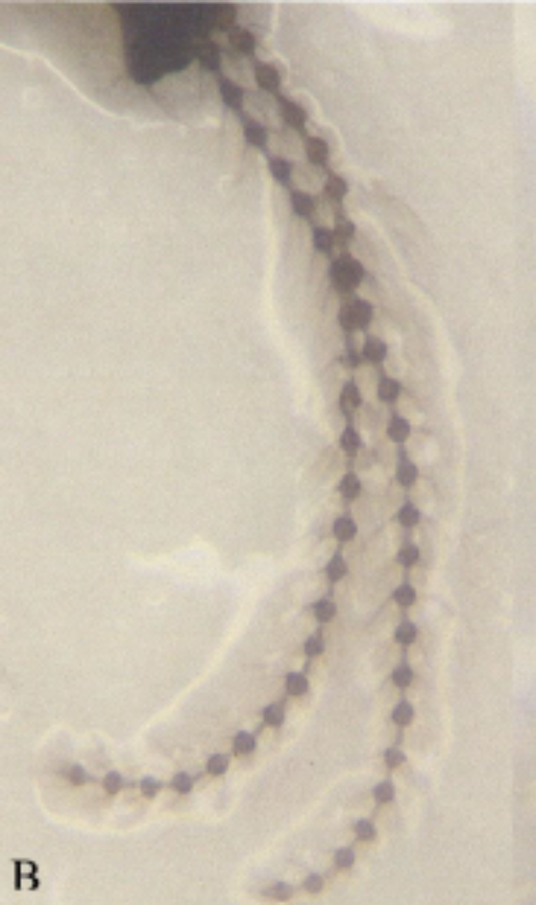
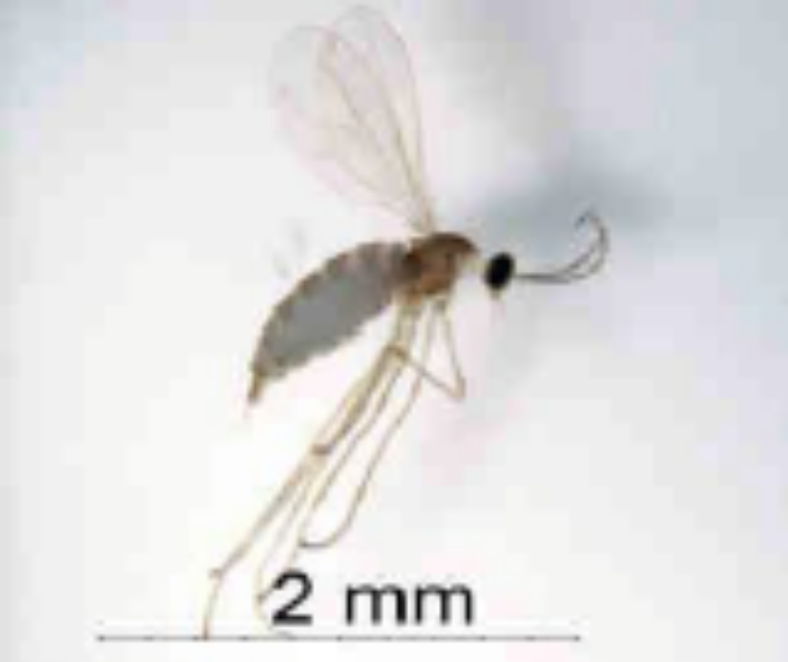
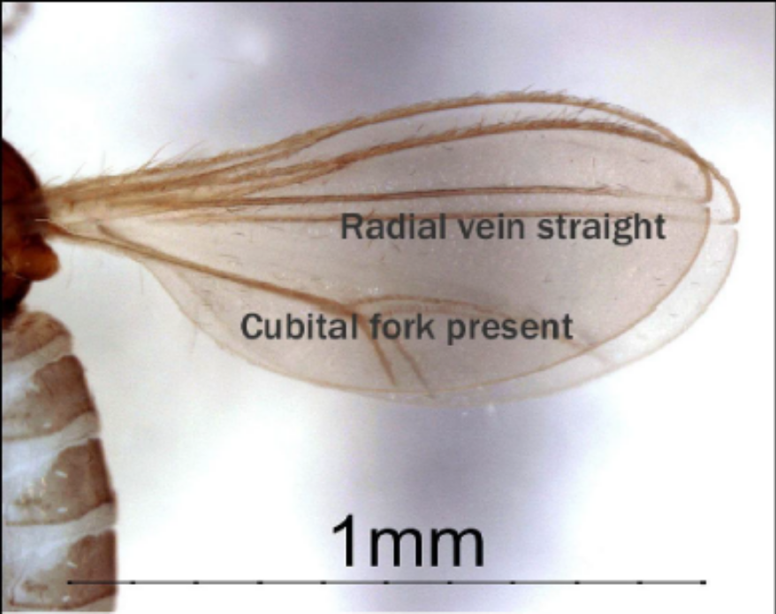
Let’s do a detective work!

Slide 13
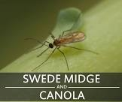
Swede Midge (Contarinia nasturtii)
Tiny, invasive fly native to Europe and Asia that damages plants in the mustard and cabbage family
Larval stage feeds on the growing point of plants in the brassica family, such as broccoli, cauliflower, Brussel sprouts, collards and kohlrabi.
Feeding causes distortion and scarring on leaves and, depending on plant age, will keep heading crops like broccoli from producing a crown, or cause it to grow multiple heads.
Swede midge was first found in Minnesota in 2016

Slide 14


How can you help?
Receiving and logging incoming samples
Organizing data base
Researching new information and updating fact sheets
Website design and updates
Conducting Test and Analyses

