Slide 1

Monroe County
Master Gardener Training
Program 2026-2027
Notes:
Please sign in with Nancy at the registration table
Please pay at the registration table if you have not done so yet
Please fill out and sign the Risk wavier and Photo consent
Please fill out the bio form

Slide 2
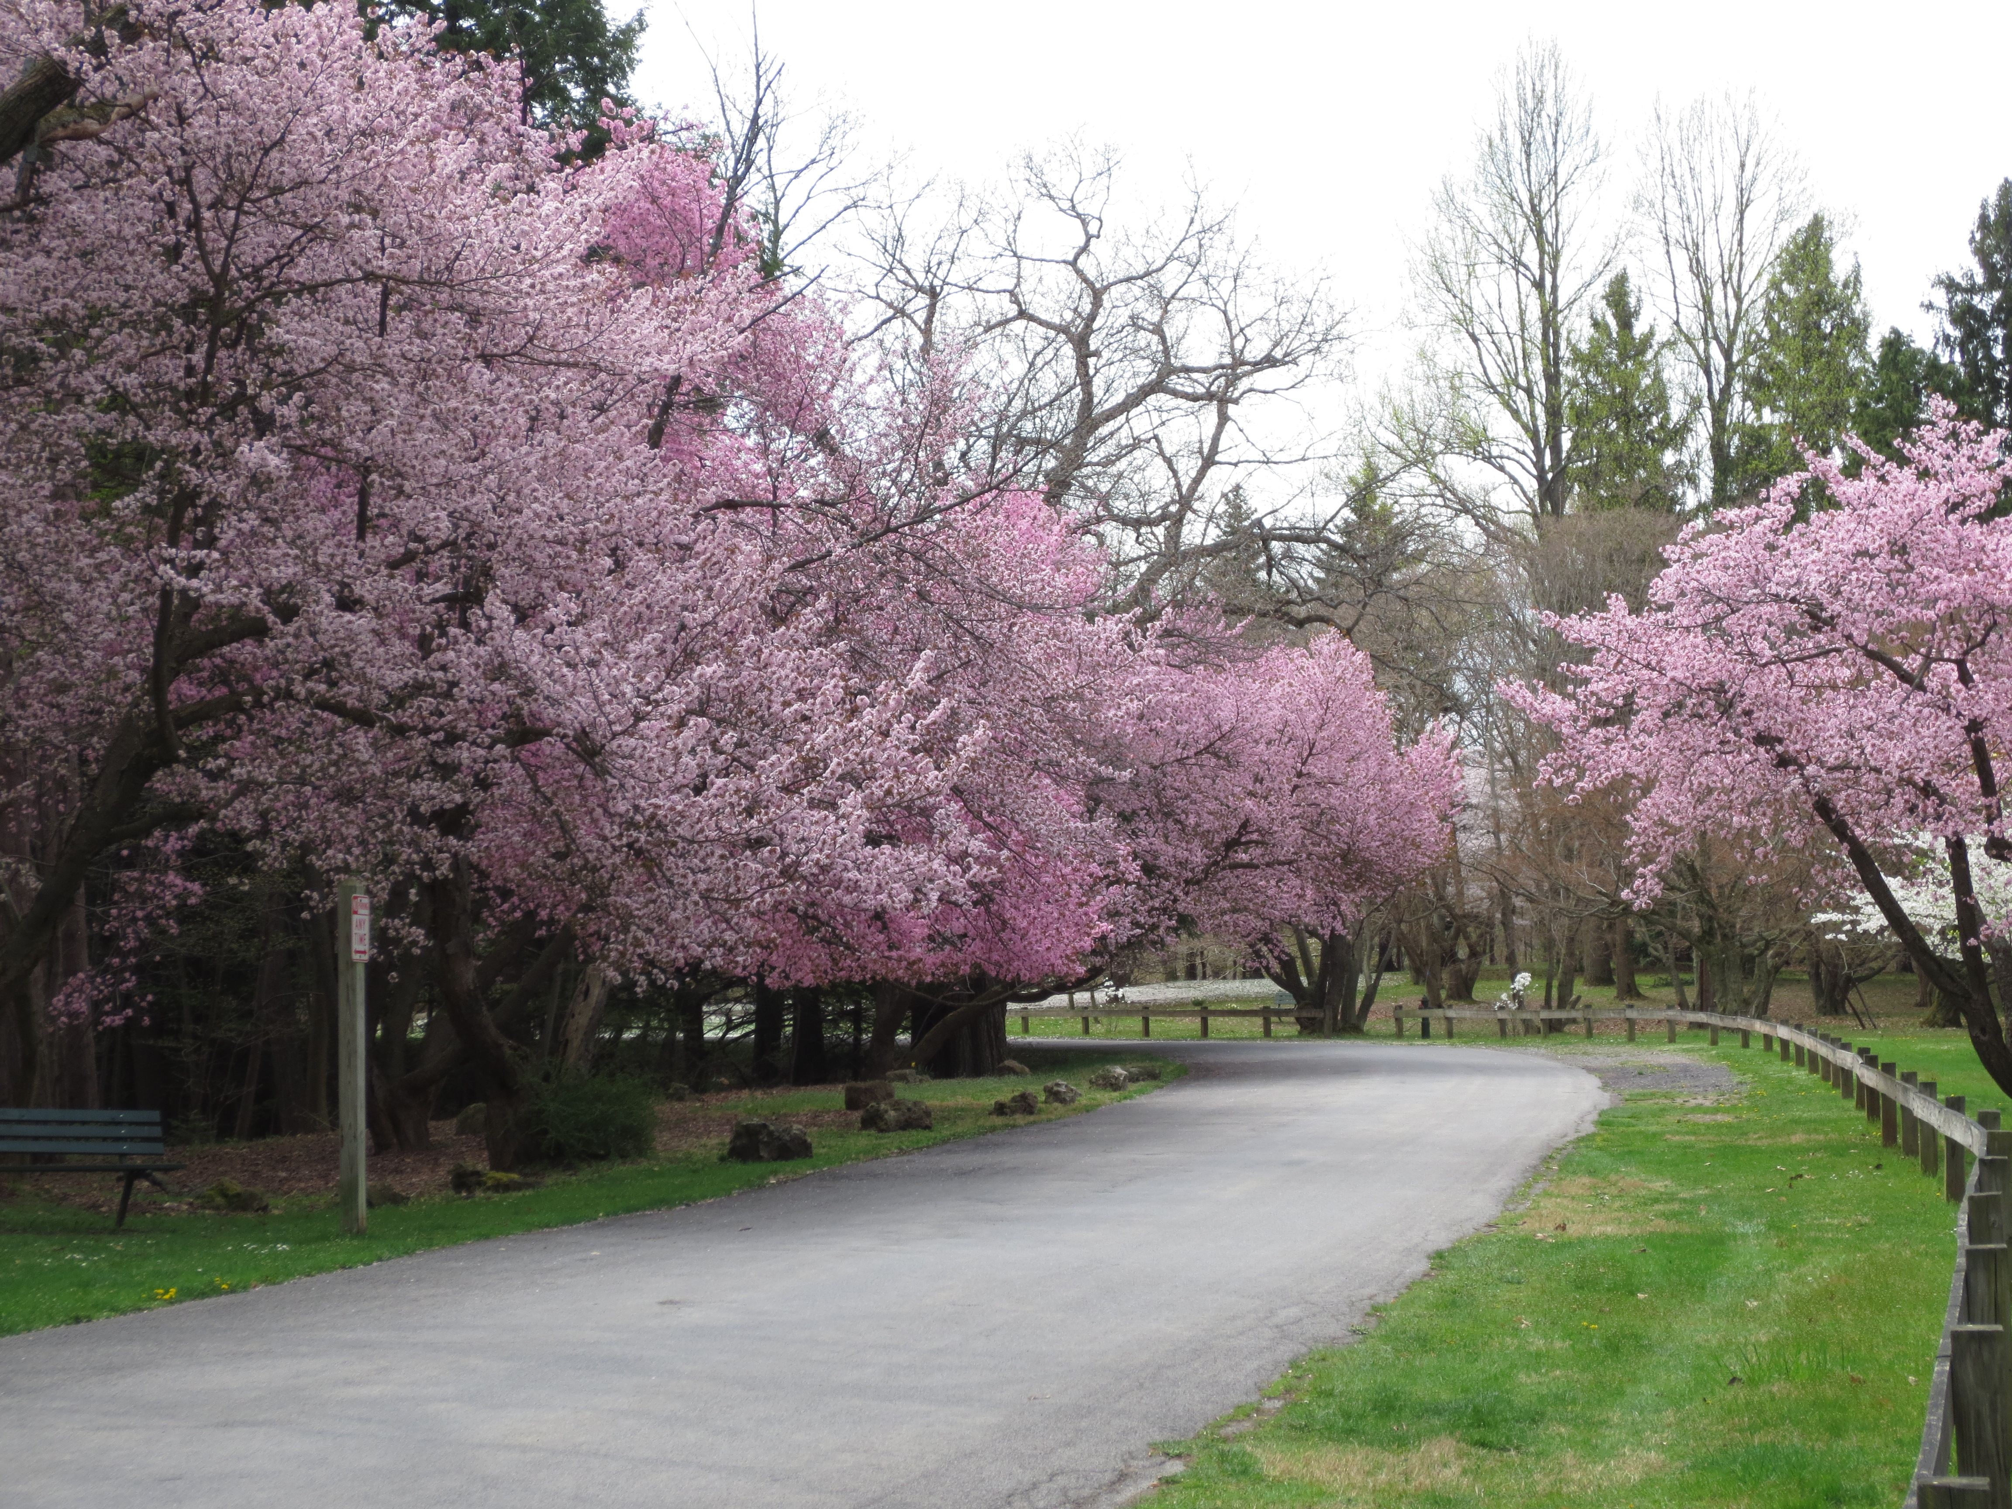
Overview
Welcome
Class introductions
Binder contents
Moodle Walkthrough
Intro to Action Project
Notes:
Welcome, let introduce ourselves to each other. Let's state our name, where about in Rochester we are from and one interesting fact you're willing to share.
Introduce Andrea
MG Program in Monroe County is different from other Counties. If you know MG in other counties you will notice there are differences in policy, prodcedure and approved activities.
Approved activities

Slide 3
Getting Started
Bathrooms
Take a standing break as needed
Walking path outside if you need to stretch your legs on break
Coffee/Tea and snacks
Complete Questionnaire

Slide 4
The Daily
9-9:30 Ashly time ☺
9:30-10:45 Session A
10:45-11:15 BREAK
11:15-12:15 Session B
12:15-12:30 Wrap Up and Final Announcements
Notes:
Pick a partner and swap your knowledge checks, go over the your answers and compare it with the key that will be provided)
Session ‘a’ will be a speaker who will talk about the topics you covered in the previous 2 weeks. The speakers could be a MGV or CCE staff or a real expert on a topic. These presenters will answer questions you might have from your reading or from the videos.

Slide 5
Education Team Introductions
Chris Murray-Coordinator/Board of Directors
Sue Magee-Master Scheduler
Kathy Coyle-Mentor Leader
Mary Hyla-graduating class of 2025
Lynn Miller-graduating class of 2025

Slide 6
Name (contact list)
Where do you live in Monroe County (city, town or village)
What plant has taught you a lesson the hard way?
OR
What’s your biggest gardening “oops”?

Slide 7
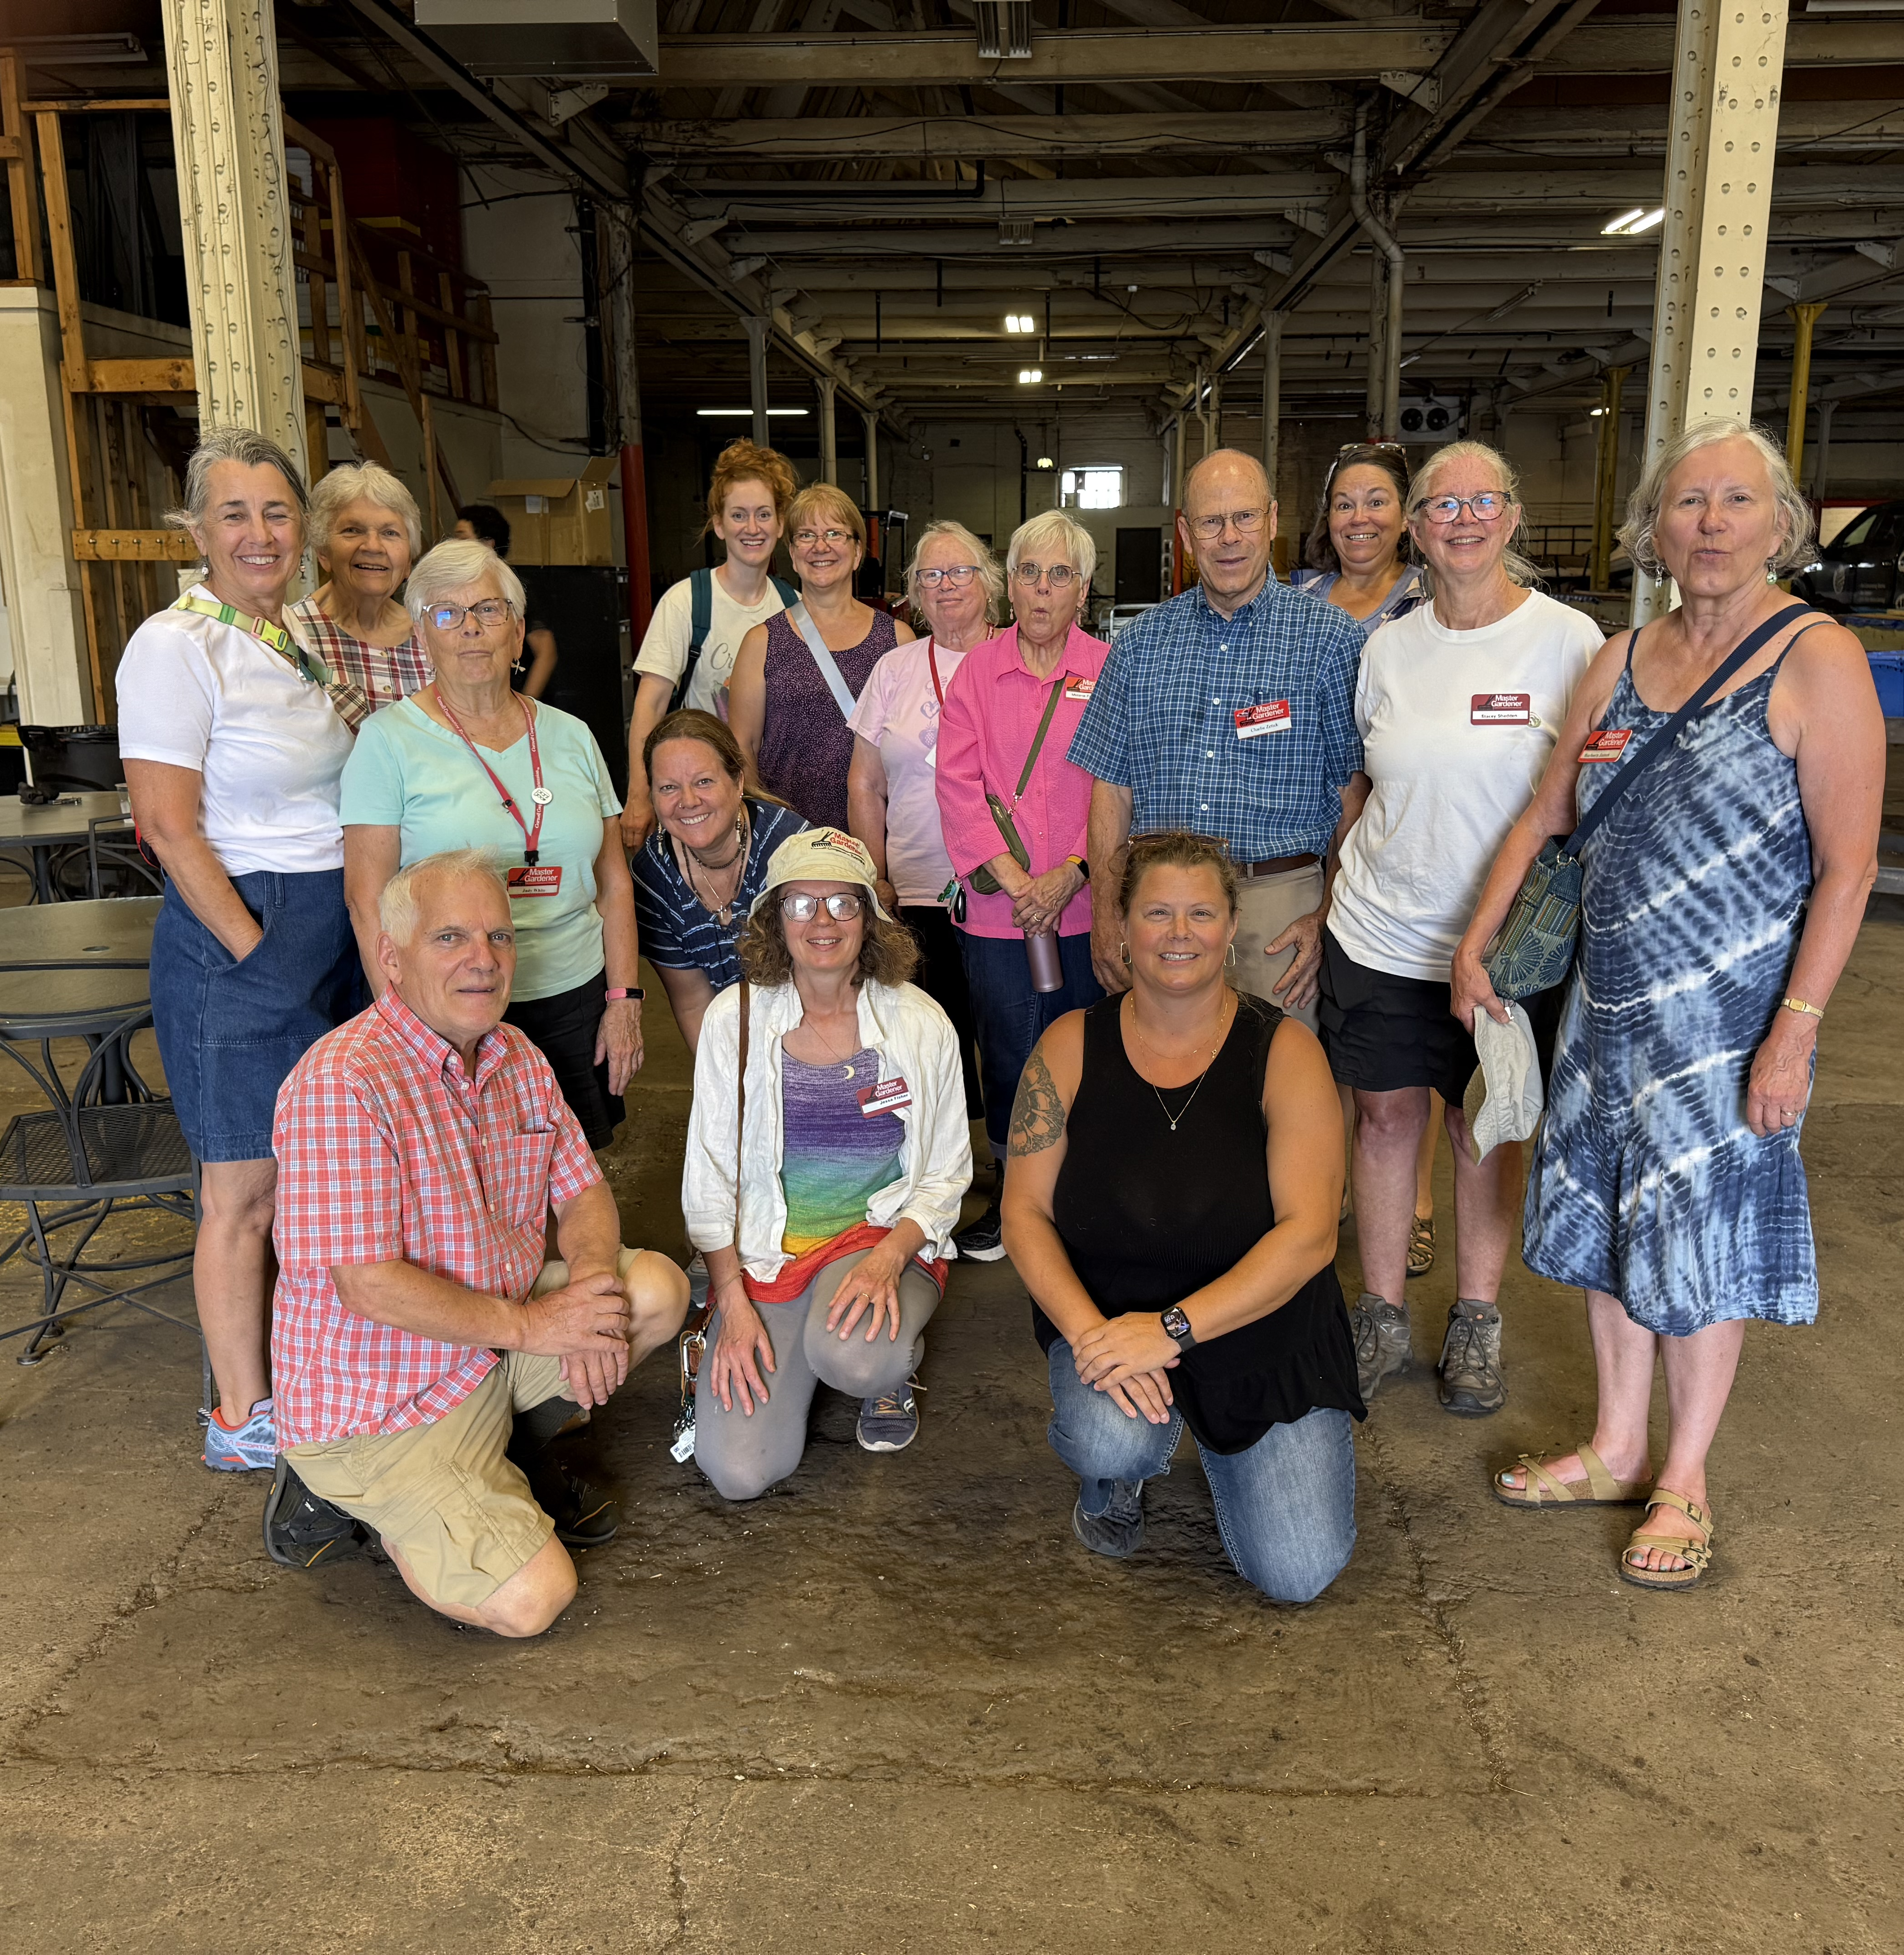
What is the Master Gardener Program?
Mission Statement: We prepare volunteers to be peer educators who build relationships with community audiences to integrate local experience and research-based knowledge in planning for and initiating steps to manage gardens, lawns, and landscapes with an emphasis on food security and environmental stewardship.
Notes:
Here is our mission statement. Its very important to note that we have changed our focus in the past few years to focus on food security and environmental stewardship. Our goal is to provide factual based information to Monroe County in an educational capacity. Throughout the course I will provide information on how that is done and what we do as MGV to ensure we are meeting the needs of the county.

Slide 8
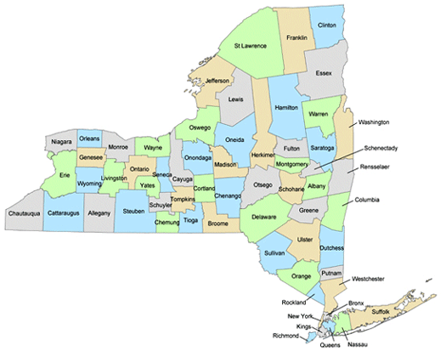
NYS Extension System
Every extension office across NYS is individual of each other, run by a board of director and is a non- profit.
57 total across the state.
Not all have the same programs-
Why is this important to us??
Ashly Piedmont/ Monroe County MG Program

Slide 9
Cornell University connection….
CALS –Cornell Agriculture and Life Science
  https://gardening.cals.cornell.edu/cornell-cooperative-extension-master-gardener-volunteer-program/
Moodle
Statewide programs
Continuing education for Coordinators

Slide 10
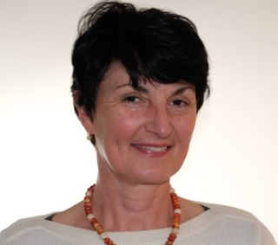
CCE Monroe Program
Agriculture
Liaison between Monroe County farmers and CCE Specialist.
  Lake Ontario Fruit Team
  Vegetable Specialists
Diagnostics Clinic
pH soil testing
Plant and insect diagnostics/identifying

Slide 11
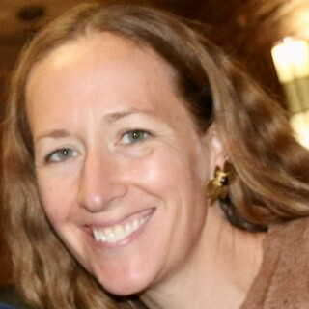
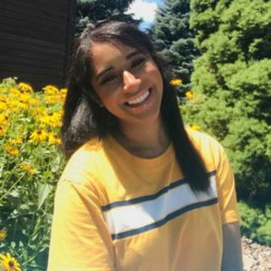
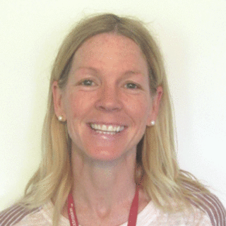
CCE Monroe Program
Nutrition
Offers several varieties of cooking and nutrition education workshops that are available to all residents
Master Food Preserver

Slide 12
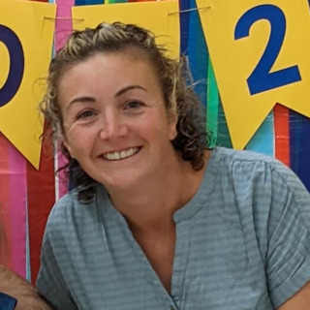
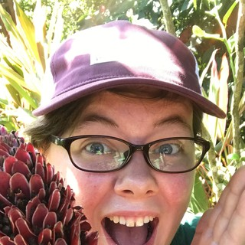
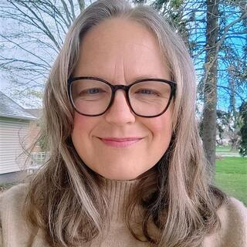
CCE Programs 4-H Youth Development
Leslie Pude
4-H Team Leader
Jessica Reed
4-H Educator
Sarah Snarr
4-H Coordinator

Slide 13
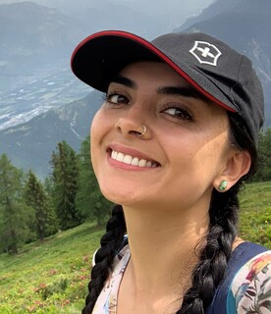
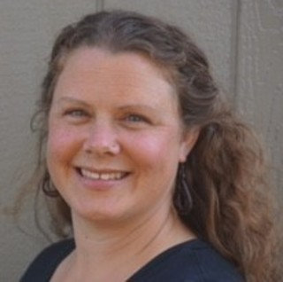
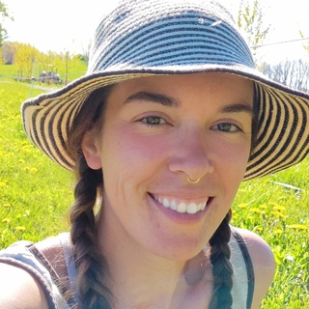
CCE Program- Horticulture Team
Juliana Alvarado
Horticulture Team Leader
Commercial Horticulture and Natural Resources
Ashly Piedmont
Master Gardener Coordinator
Rachel DeVona
Garden Outreach Coordinator/GROWS

Slide 14
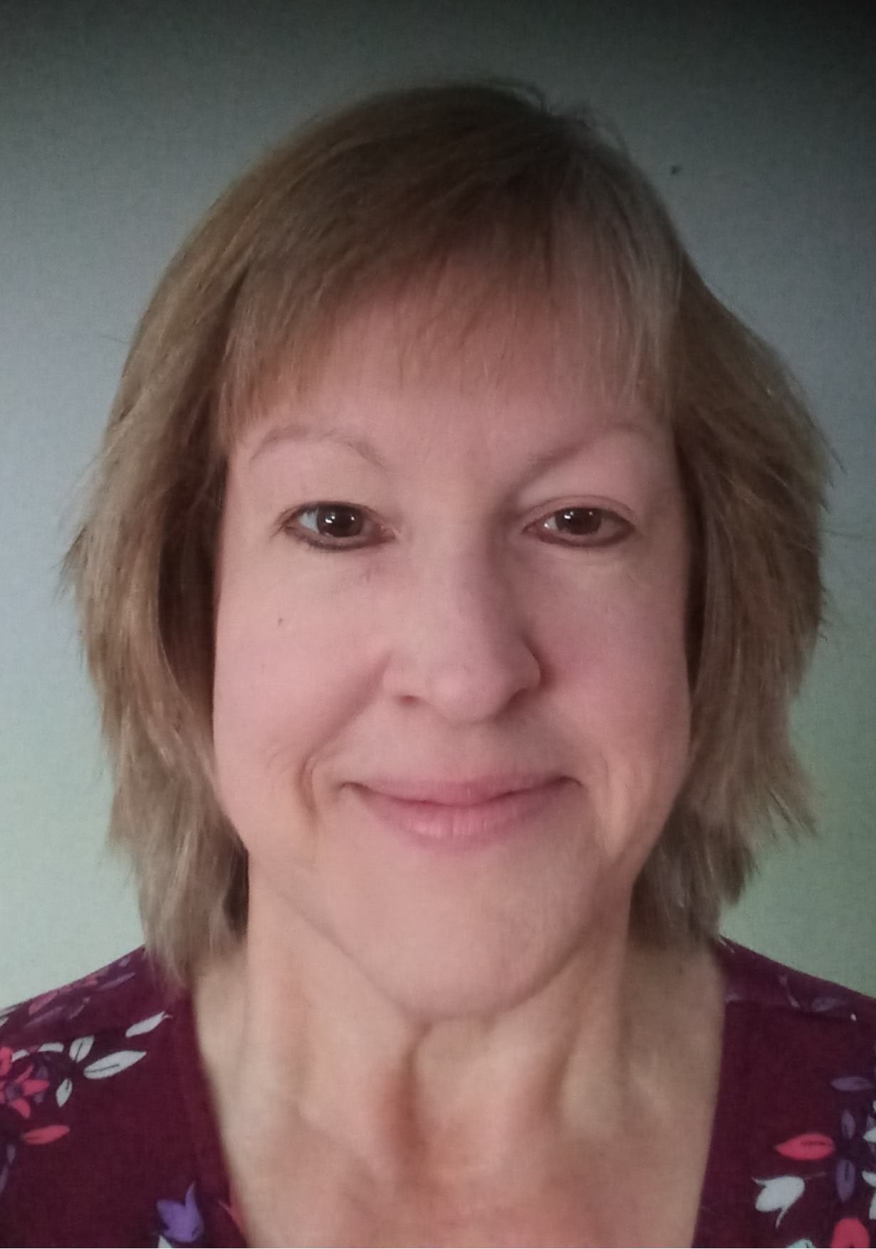
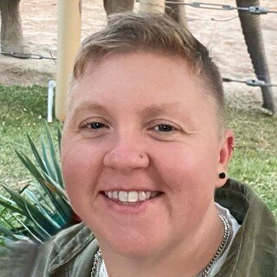
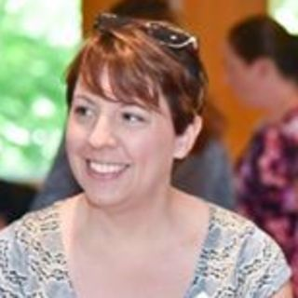
Administration Team
Michelle DeYoung
Front Office Staff
Ann Marie Prudy
Operations and Finance
Andrea Lista
Executive Director

Slide 15
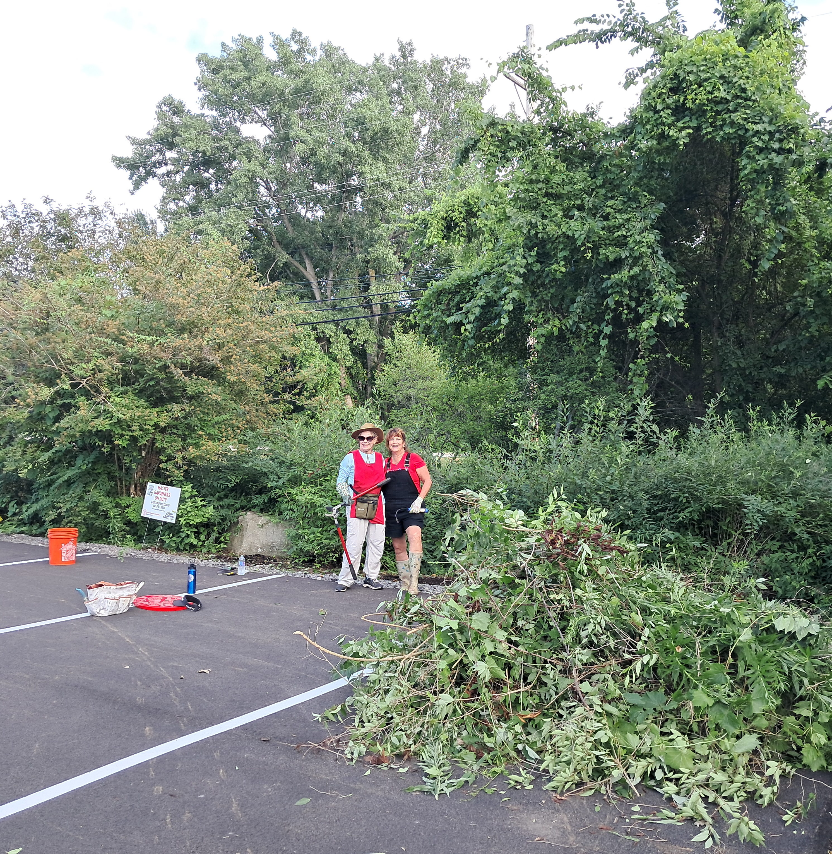
Volunteering
Monroe County
Approved activities list
During internship, BEST to try out a variety of activities
More detail as the class goes on…

Slide 16
Master Gardener Status
Trainee
Starts April 1st, 2027 & Ends September 30, 2028
Active
MGV
30 volunteer hours required annually (October 1st-September 30th)
must submit volunteer hours regularly; we will go over how to submit, what forms to use and how to fill them our accurately
10 hours of continuing education
Required sexual harassment training, code of conduct, and letter of intent, background check (every 3 years)
Hours within approved activities (we will be going over this in more detail)
Moodle course will open and available for you throughout the course and after.
Intern
You will be provided support from the Education Committee throughout the training course
You will be provided a mentor
End March 20, 2026
Mentor will offer opportunities, check in, answer questions
17 months to complete 80 hours (50 for internship and 30 for active master gardener status)
You will have access to monthly meetings (2nd Thursday of the month)
You will be on distribution for MG Newsletter
You can volunteer within any volunteer opportunity; join program and groups
Directory of MG body
Notes:
These are all explained in greater details on page 5-9 in the program handbook
Mentors; we will try to pair you up with a mentor that has similar interest. Their main purpose is to assist you with answering general questions about the MG Program. Our hope is that they will invite you to join them when they are volunteering to give you the chance to shadow and learn. Other things we would ask our mentors to do is to introduce you to the team leader of other programs if you are interested in shadowing within their program area.
For example, if you are really interested in volunteering on the Garden helpline or seeing how that works, maybe your mentor spend most of their time in one of our County Parks, then they will make sure that you have been introduced to a team member on the helpline that you might be shadowing that day. Once assigned it will be both of your responsibility to stay connected and determine how you would like to spend your 50 hours. I highly recommend moving around a bit, seeing all the different aspects of the program. Since we are ending our training in Spring, there will be PLENTY of opportunities!!
There are also other things that you will have access to after your year internship is completed. Such as access to box platfourm, sign up genuis,

Slide 17
Binder Content
Syllabus
Knowledge Checks
Directory
Handbook

Slide 18
Action Projects
Notes:
Hand out action projects ideas page.

Slide 19
Action Projects
An opportunity to practice skills that you will need throughout your volunteer experience.
This project is in leu of a ‘final exam’
Action projects are broken down and can be worked on throughout the whole 6 months
Presentation of projects will be 5 minutes, the last two days
Can be done as a group (up to 4 people) or individually
Zoom check in meetings have been scheduled
Mentors can be great resources
Idea list of needs within the MG Program

Slide 20
Moodle
How many people have created a Moodle account and has enrolled in the course??
How to navigate through the course; when do modules open?
GOAL for today, everyone should have an account and access the course by the end of class.
Notes:
Walk through the moodle platform; pull up the moodle on the screen.

Slide 21
Next Class October 3rd, 2026
Review ½ Module One
Completed knowledge checks: 1.1 and 1.2
Will be collected upon check in and given back after break
Right Plant, Right Place presentation
Soil testing activity
Notes:
Hand out how to take a soil sample.
Please let it air dry

Slide 22
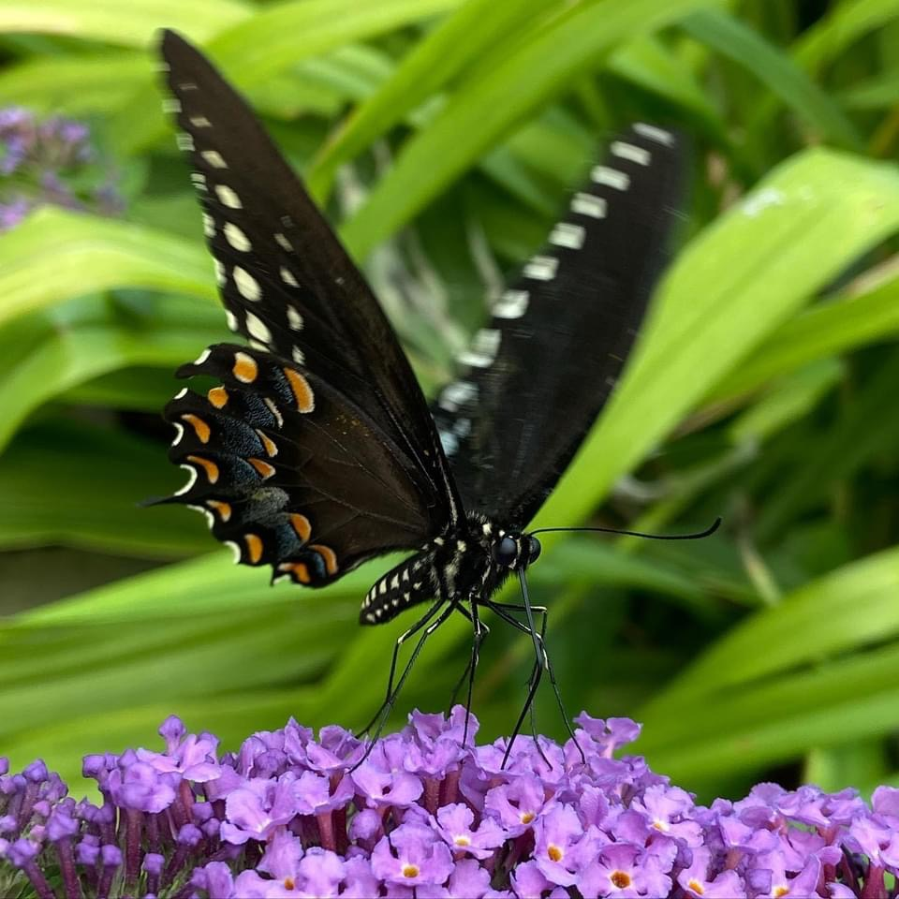
Questions?

