Slide 1
Strawberry Production for home gardens
Anya stansell, small fruit specialist, cornell cooperative extension harvest new york

Slide 2
Introduction to strawberries
Annual or short-lived perennials
Annual: day-neutrals
Perennial: June-bearers
Low-growing plants that send out runners
Need full sun, good drainage, and good weed control
High nitrogen needs. Moderate potassium needs.

Slide 3
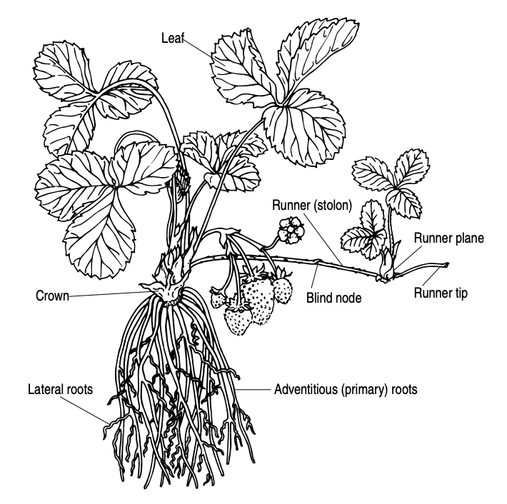
STRAWBERRY ANATOMY

Slide 4
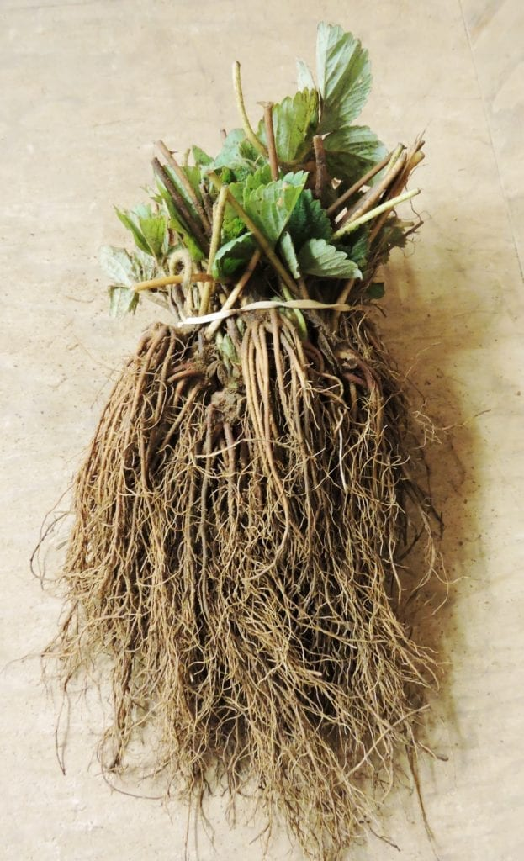
BARE-ROOT PLANTS

Slide 5
NURSERIES
There are few nurseries that propagate plants for sale in the United States:
Indiana Berry & Plant Co (Indiana)
Nourse Farms (Massachusetts)
Lassen Canyon (California)

Slide 6
Varieties to try: June bearers (these varieties have the best flavor!)
Early season: Earliglow, Annapolis (Archer)
Midseason: Flavorfest, Brunswick, Jewel, Sparkle, (Dickens)
Late season: Malwina (Clancy)
Varieties in parenthesis have better disease resistance, but poorer flavor.
We suggest picking 2-4 varieties for a longer season.

Slide 7
Varieties to try: Day neutrals
Mara Des Bois, Albion, (Seascape)
Can only grow 1 variety and have a long season of fruit.
Most varieties will cease fruiting in August when it gets very hot; will pick up again once temperatures go down.

Slide 8
Planting strategies: In-ground
Good weed control is a challenge
Tarping works well. Straw mulch can suppress weeds too.
Only plant in areas that drain well. Avoid heavy clay soil.
Sensitive to black walnuts
Need pH 5.5 – 6.5

Slide 9
Planting strategies: Raised bed
Optimal planting strategy
Try a mix of 1:1 topsoil and mushroom compost.
Plants can do well in soilless potting mixes.

Slide 10
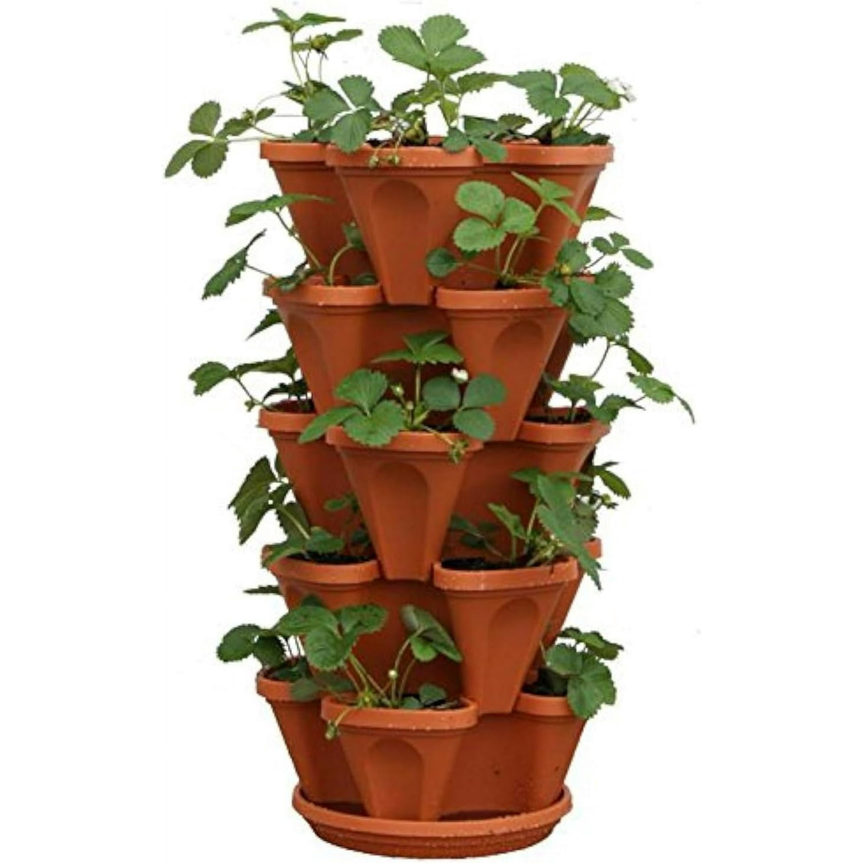

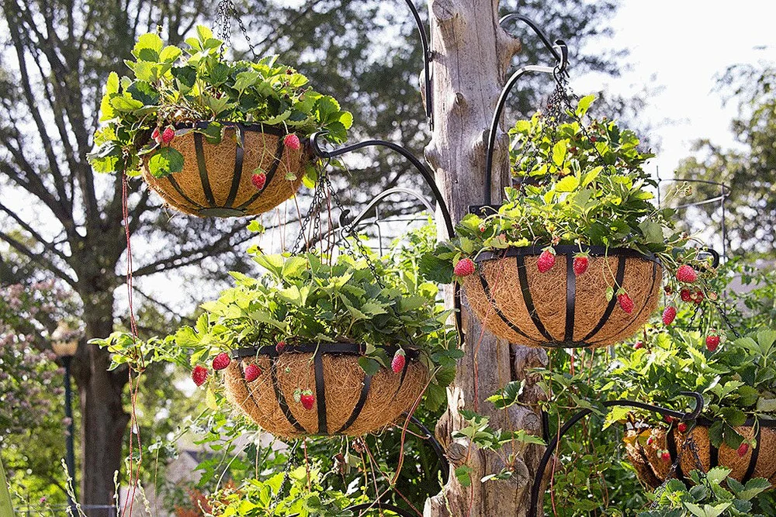
Planting strategies: hanging planter, plant tower
Yes they will look cute, but the roots will get too hot AND too wet OR too dry
Image credit: The Growing Zone.com
Image credit: Walmart.com
Image credit: Elise Parsley

Slide 11
Planting strategies
Strawberries do best in rows
In-row spacing: 6 inches
Between-row spacing: 8 – 12 inches; always more on bare ground, sometimes less in raised beds
Straw mulch between rows keeps fruit clean
Plants for a 6 x 4 raised bed:
  If planting 8 inches apart, will fit 4 full rows into 1 bed.
  Total: 48 plants

Slide 12
fertility
Amend soil well pre-plant with a slow release fertilizer.
Slow release: composted chicken manure (5-3-2), peanut meal (8-1-1), feather meal (12-0-0)
Compost helps too
I recommend amending soil first, and testing soil afterwards
A soil test pre-plant will also tell you if pH needs to be adjusted

Slide 13
Fertility
Fertilize junebearers lightly in April, and heavily in July, August, September, and October with a quick release fertilizer.
Fertilize dayneutrals lightly every 2 weeks from April until October with a quick release fertilizer.
Quick release: blood meal (13-0-0), or conventional fertilizer (10-10-10)
Quick release potassium: organic sulfate of potash (0-0-48); can also be not organic

Slide 14
Fertilizer rates
Shoot for 100 lbs N per acre per year.
June-bearers:
  March or April: mulch off, wait for new leaves to start growing, 20 lbs N
  Nothing from May – July
  July: Mow off leaves after done fruiting, then 20 lbs N
  August: 20 lbs N
  September: 20 lbs N
  October: 20 lbs N

Slide 15
Fertilizer rates
Shoot for 10 lbs N/acre every month, split into 5 lbs N every 2 weeks
Dayneutrals:
  Plant in early April. Wait for plants to grow 4-5 big green leaves, then 5 lbs N
  Mid-late April: 5 lbs N
  Early May: 5 lbs N. Late May: 5 lbs N
  And so on….. Until September, or October if using low tunnels
  When frosts come, pull plants out of the ground and toss into compost.

Slide 16
Fertility
Foliar test in July to see if plants will need more N (or other nutrients) to continue fruiting
In Junebearers, only do foliar test and late summer fertilizing if planning to keep into next summer

Slide 17
How much fertilizer to add?
1. Calculate your planted area in feet and acres
2. Calculate pure N per product concentration
3. Calculate pure N from product for planted area

Slide 18
For example: adding 20 lbs N/acre to a 6’ x 4’ bed using blood meal (13-0-0)
6’ x 4’ bed = 24 square feet of bed
1 acre is 43560 square feet
24 / 43560 = 0.055096418732782364, or 5.51% of an acre

Slide 19
For example: adding 20 lbs N/acre to a 6’ x 4’ bed using blood meal (13-0-0)
We want to add 20 lbs of pure N, diluted over an area of 1 acre.
Our product is 13% N
(amount of N in lbs / % N in our product) x 100 = amount of product to add to acre
(20 lbs/A N / 13% N in blood meal) x 100 = 1.53846153846 x 100 = 153.8 lbs blood meal per acre

Slide 20
For example: adding 20 lbs N/acre to a 6’ x 4’ bed using blood meal (13-0-0)
We’d need 153.8 lbs blood meal per acre to deliver 20 lbs actual N per acre
Our 4’x6’ raised bed is 5.51% of an acre
Lbs product per acre to deliver desired rate / % of acre we have = amount of product to add
153.8 x 0.0551 = 8.45 lbs of blood meal for our raised bed!
… that’s a LOT!

Slide 21
next example: adding 20 lbs N/acre to a 6’ x 4’ bed using urea (46-0-0)
6’ x 4’ bed = 24 square feet of bed
1 acre is 43560 square feet
24 / 43560 = 0.055096418732782364, or 5.51% of an acre

Slide 22
next example: adding 20 lbs N/acre to a
6’ x 4’ bed using urea(46-0-0)
We want to add 20 lbs of pure N, diluted over an area of 1 acre.
Our product is 46% N
(amount of N in lbs / % N in our product) x 100 = amount of product to add to acre
(20 lbs/A N / 13% N in blood meal) x 100 = 0.43478260869 x 100 = 43.48 lbs urea per acre

Slide 23
Next example: adding 20 lbs N/acre to a 6’ x 4’ bed using urea (46-0-0)
We’d need 43.48 lbs urea per acre to deliver 20 lbs actual N per acre
Our 4’x6’ raised bed is 5.51% of an acre
Lbs product per acre to deliver desired rate / % of acre we have = amount of product to add
43.48 x 0.0551 = 2.40 lbs of urea for our raised bed.
More than you’d expect, huh?

Slide 24
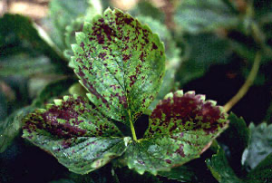
Strawberries love nitrogen!
Insufficient nitrogen is the top limiting factor in yields, from what I see in farm visits.
A foliar test costs around $30 and can help you identify if low yields are due to low N. Only do this if you’re actually interested in spending more $ to correct the issue!
Consider the cost of fertilizer against the benefit of more fruit; most plants will yield at most 2 quarts per plant per season.
Ammonium-based fertilizers applied in hot, wet weather can volatilize and cause a burn pattern like this on the leaves:

Slide 25
overwintering
Dayneutrals have poor tolerance of cold, wet soils; we recommend growing them as annuals.
Junebearers need to be protected from the coldest winter temps in mid-February
3 inches of straw mulch or 2 layers of floating row cover work well
Cover up after 3 consecutive days of below freezing, or after leaves turn reddish and plants look squatter
Uncover once daffodils have emerged; check under mulch for new leaves pushing out

Slide 26
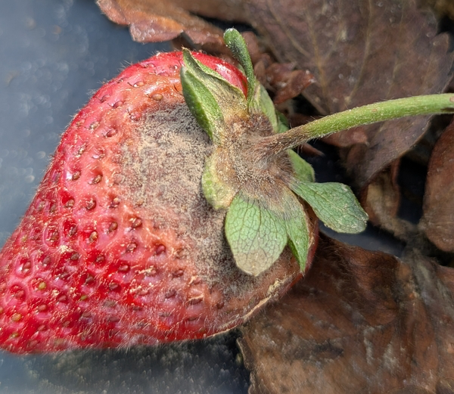
Botrytis gray mold
Botrytis gray mold:
Attacks flowers and fruits.
Spreads by physical contact and wind.
Likes cool wet weather.
To reduce disease, avoid splashing fruit and flowers with water during watering and maintain good airflow in planting
Image credit: Caleb Bollenbacher

Slide 27
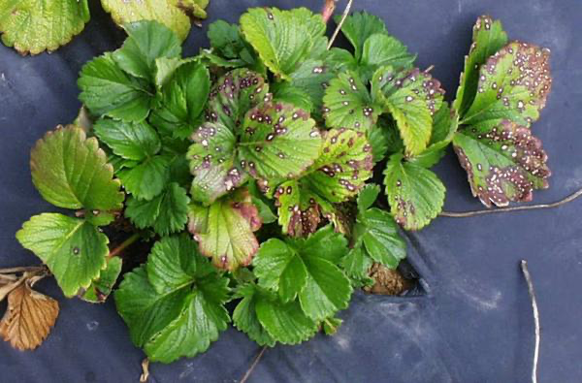
Leaf spot and leaf scorch
Fungal diseases that spread in late summer
Attack leaves
Very common; only a problem if prevalent on over 30% of leaf surfaces
To reduce the spread, mow leaves off in July and keep fertilizer applications high to support new growth
Image credit: Frank J Louws

Slide 28
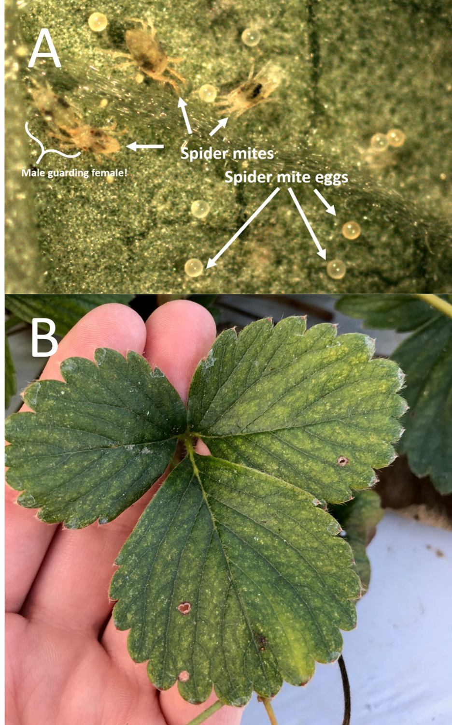
Spider mites
Small mite that sucks sap from strawberry leaves
Like hot, dry weather
Be careful using insecticidal soaps and oils– only use if daytime temps are 70F and below
My advice: wash off plants in hot dry stretches, use insecticidal soap in fall and spring
Image credit: Samantha Willden

Slide 29
Thank you!
Questions? Comments?
aco56@cornell.edu
(607) 752-2793

