Slide 1


SNAP-Ed NY
Southern Tier SNAP-Ed is funded by USDA’s Supplemental Nutrition Assistance Program- SNAP. SNAP provides nutrition assistance to people with low income. To find out more, go to www.myBenefits.ny.gov or contact 1-800-342-3009. This institution is an equal opportunity provider.

Slide 2
Learning Objectives
We will…
Recognize SNAP-Ed nutrition education activities and how garden programs link to their main messages
Identify the ways in which MGVs can partner with SNAP-Ed NY

Slide 3
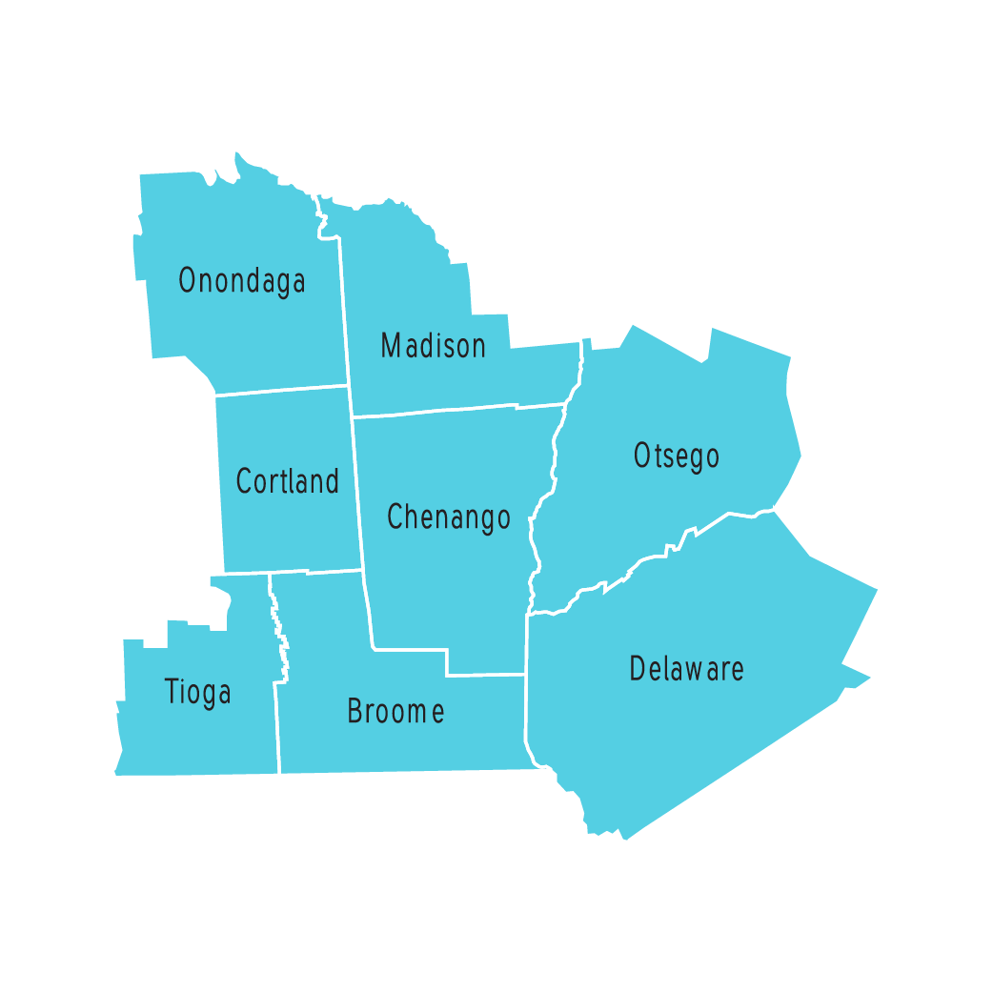
SNAP-Ed Southern-Tier Region, 2022
Note: As of October 1, 2019, Tioga County is no longer in the Southern-Tier Region.
Notes:
FLESNY is a SNAP-Ed nutrition and obesity prevention program
There are 7 regional programs in NYS

Slide 4
SNAP-Ed NY responding to:
In New York, just over 1 in 10 New York households (10.5%) experience food insecurity. (2018)
Nearly 27% of adults in NY are physically inactive.
Nearly 34% of New Yorkers eat less than one serving of fruit, 23% eat less than one serving of vegetables a day.
In 2019, 2,700,000 or 1 in 7 people relied on SNAP to put food on their tables. (2019)
58% of SNAP participants are families with children. (2018)
Notes:
The educators have a minimum of a BS in a health related field such as nutrition, public health or community health
Some regions have bilingual educators
High risk areas were identified within each region based on poverty and obesity statistics.
Typical locations where education is provided include: schools, after-school programs, recreation centers, health clinics, libraries, food pantries, and churches.

Slide 5
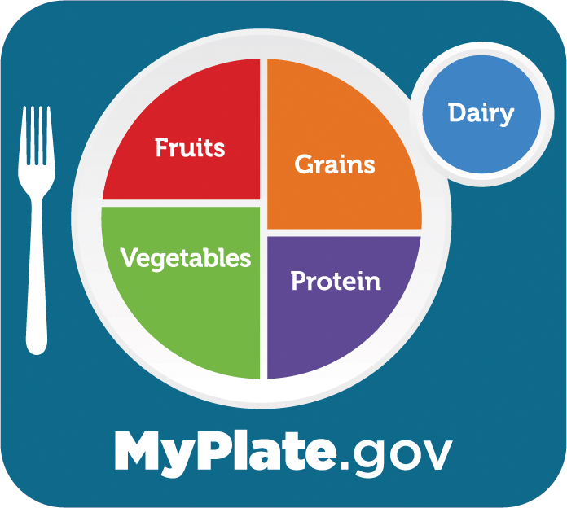
Primary Behavioral Outcomes
Increase consumption of fruits and vegetables
Maintain appropriate caloric balance and physical activity
Reduce the consumption of sugar sweetened beverages

Slide 6
Key Core Messages
Healthy eating is important at every stage of life.
Offer your family a variety of fruits, vegetables, grains, protein foods, and dairy or fortified soy alternatives.
When deciding on foods and beverages, choose options that are full of nutrients and limited in added sugars, saturated fat, and sodium.
Small changes make big difference!
Make every bite count!
Save time, save money, eat healthy!
Life's tight, eat right!

Slide 7
Program Delivery: Nutrition Education
One-time workshops
Series of workshops
Environmental strategies such as School Wellness; & Peer-Led Obesity Prevention
Virtual education which includes both live and recorded lessons
YouTube lessons and food demonstrations
Positive health and nutrition social marketing messages
**Previously we did gardening work and now with the new guidance, we can only work alongside Master Gardeners to teach people how to cook with the produce from the garden.
Notes:
Coordinated Approach to childhood nutrition

Slide 8
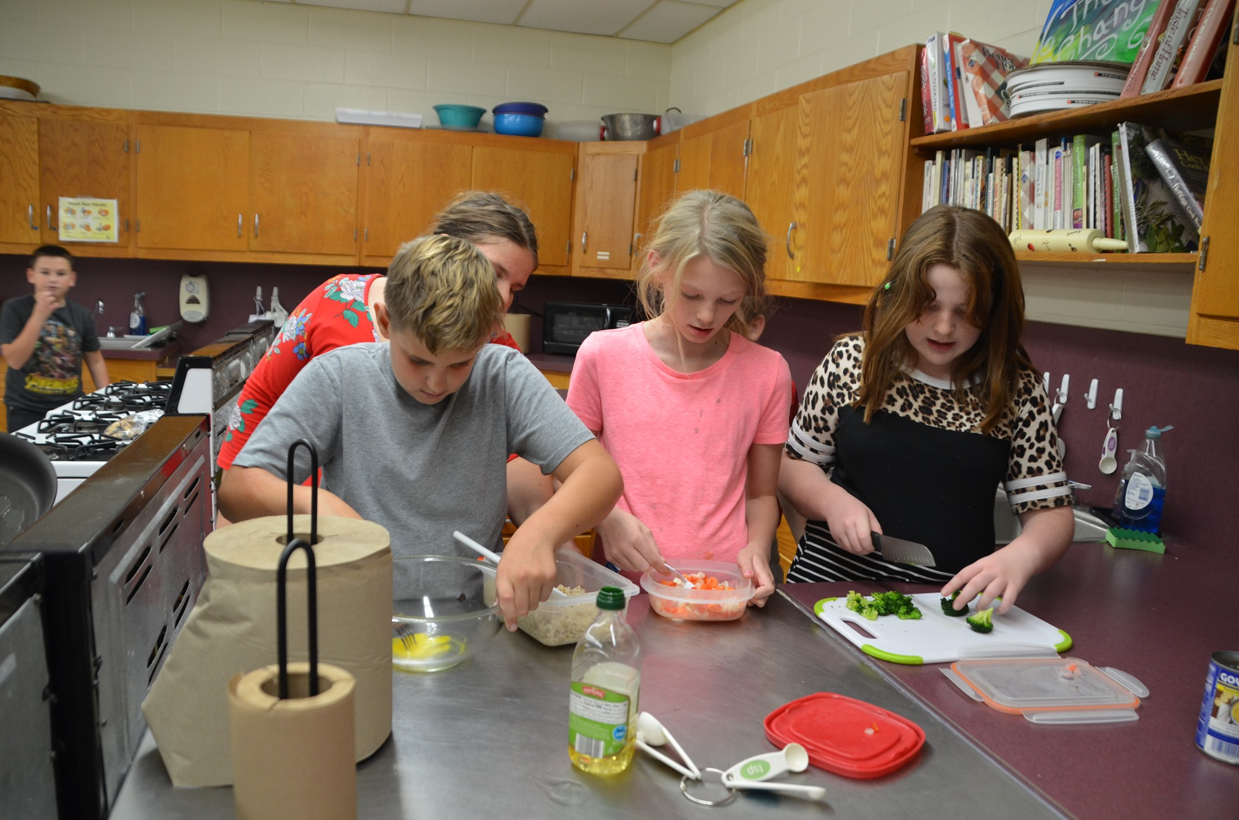
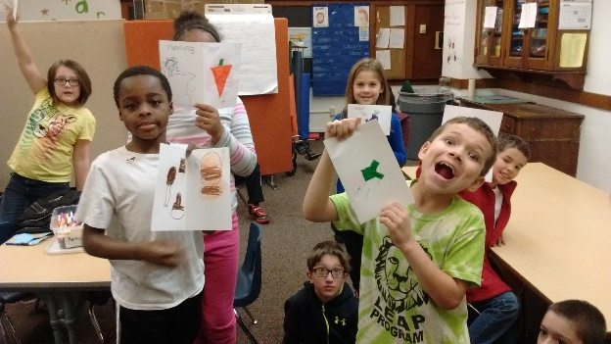
One-time Workshop

Slide 9
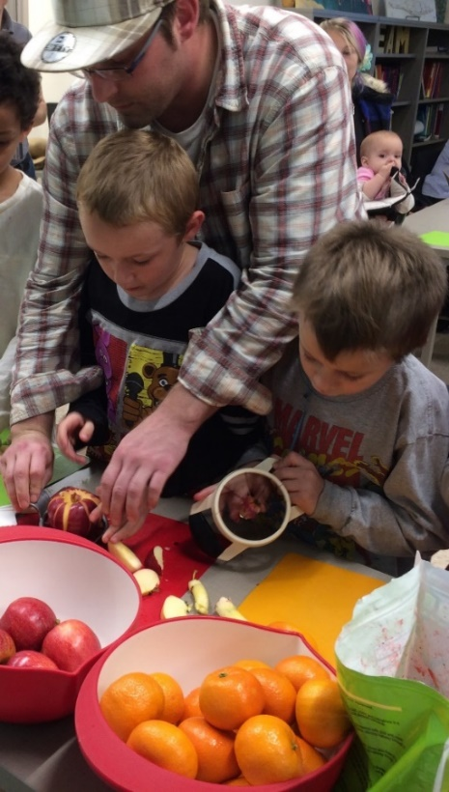
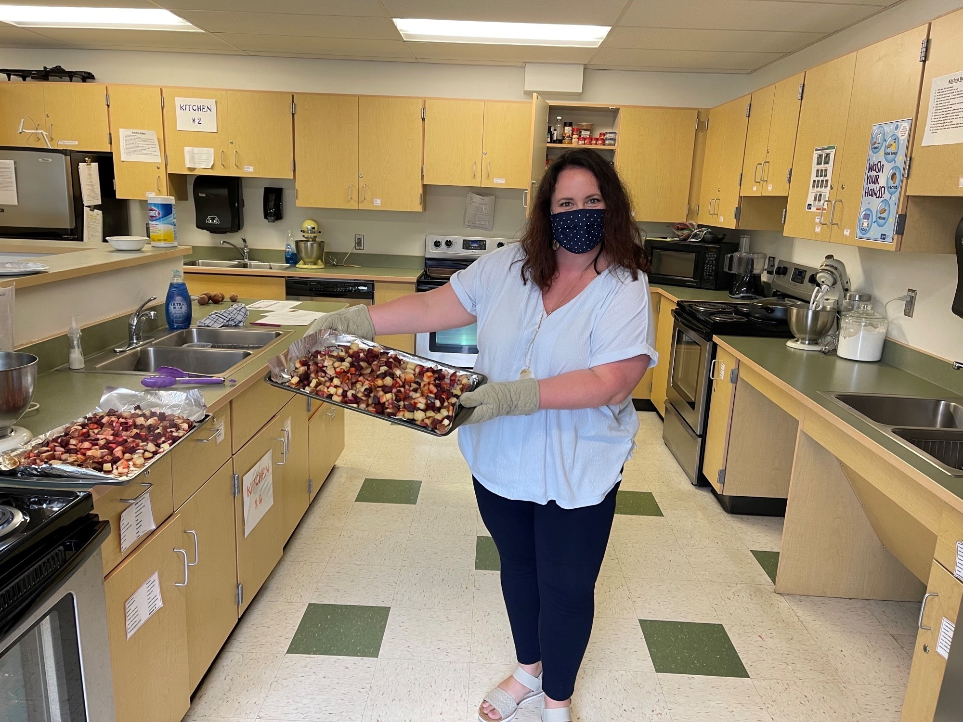
Series of Workshops

Slide 10
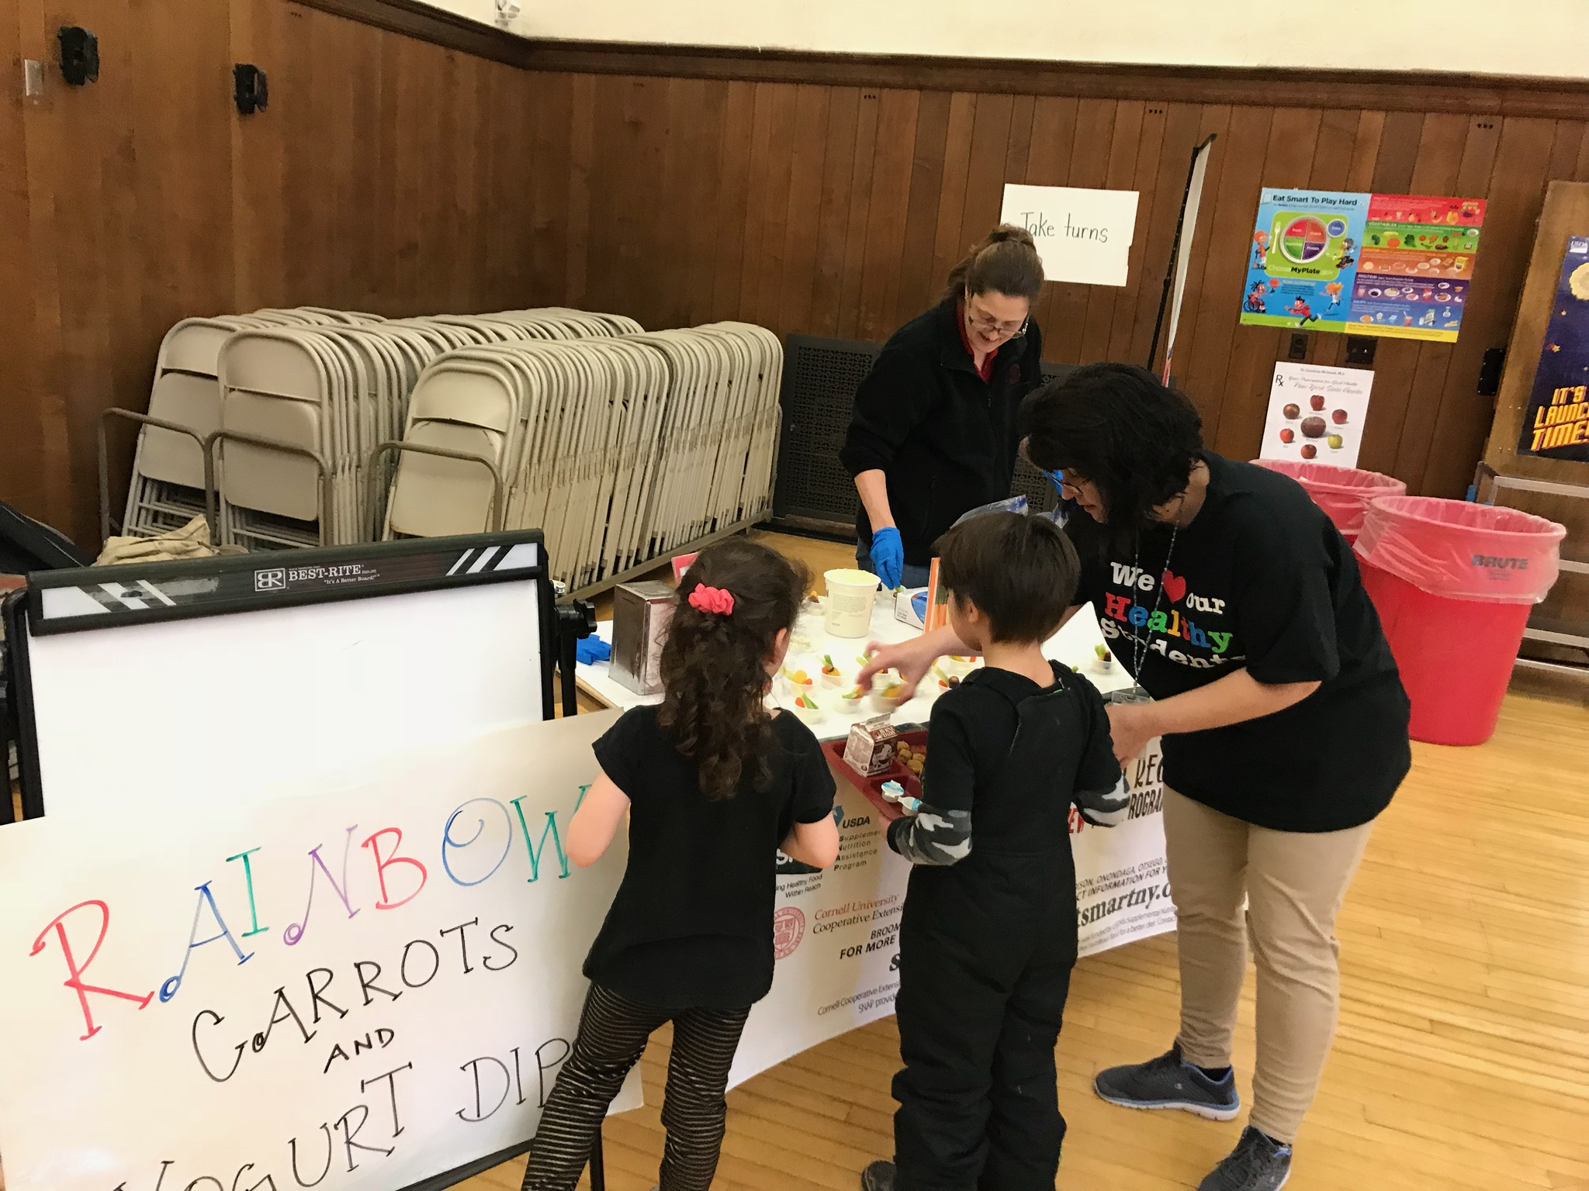
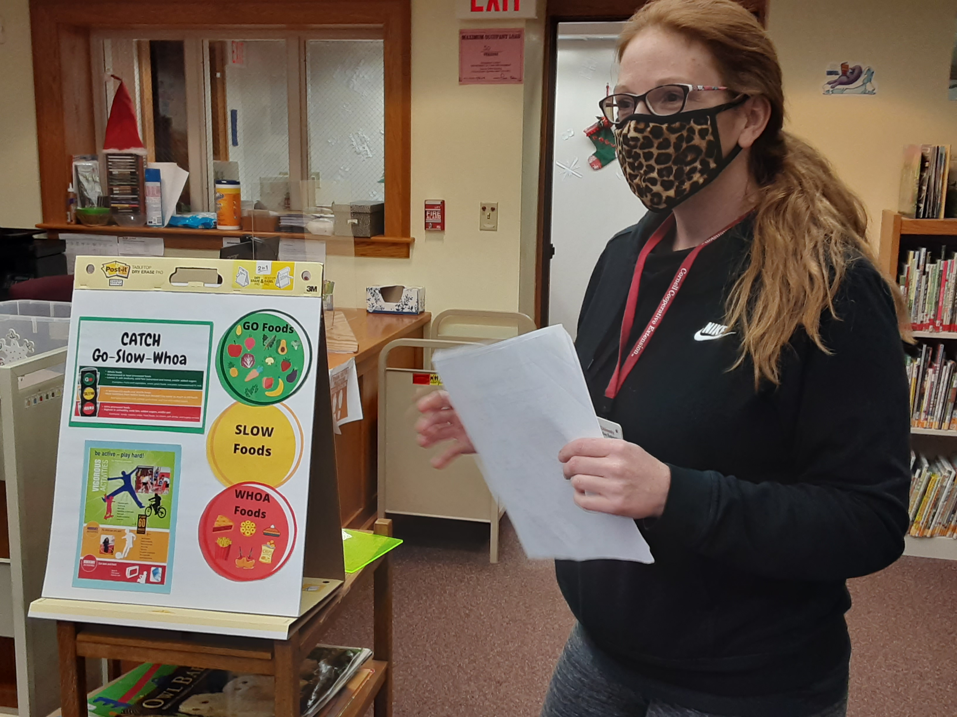
School Wellness

Slide 11
Impact Goals
• Healthy Eating – Increasing the consumption of healthy foods and beverages and decreasing consumption of solid fats and high-sugar foods and beverages.
• Physical Activity and Reduced Sedentary Behavior – Increasing physical activity levels and reducing sedentary time.
• Food Safety – Improving food handling and preparation techniques to prevent foodborne illness.
• Food Resource Management and Food Security – Increasing knowledge and use of budgeting, nutrition labels, coupons and sales, and other techniques to maintain a healthy diet using limited financial resources.

Slide 12
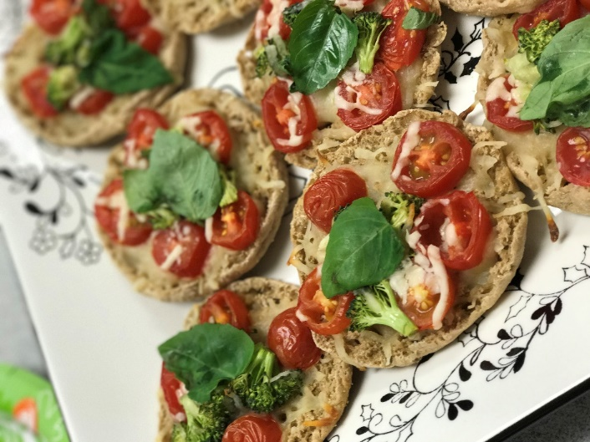
Reinforcement!!
Food Demonstrations & Samplings following a Lesson
Nutrition Reinforcements- with direct education
Tip sheets
Recipe cards
Healthy Messaging
Website: www.snapedny.org

Slide 13
Learn More
Contact: Cornell Garden-Based Learning http://gardening.cals.cornell.edu/
Betty Clark
SNAP-Ed Team Leader
blc28@cornell.edu
(607) 334-5841 ext.1132
Published: March 2022
Author: Betty Clark & Whitney Kmetz
Southern Tier SNAP-Ed is funded by USDA’s Supplemental Nutrition Assistance Program- SNAP. SNAP provides nutrition assistance to people with low income. To find out more, go to www.myBenefits.ny.gov or contact 1-800-342-3009. This institution is an equal opportunity provider.

Slide 14
References
Hunger Solutions NY. (n.d.). Hunger remains a persistent and prevalent reality for many New Yorkers. https://hungersolutionsny.org/resources-action/hunger-in-nys/
USDA. (2021, September). Household Food Security in the United States in 2020. Economic Research Service. https://feedingnys.org/wp-content/uploads/Household-Food-Security.pdf

