Slide 1
Exploring Opportunities in Botanical and Natural Science Illustration

Slide 2
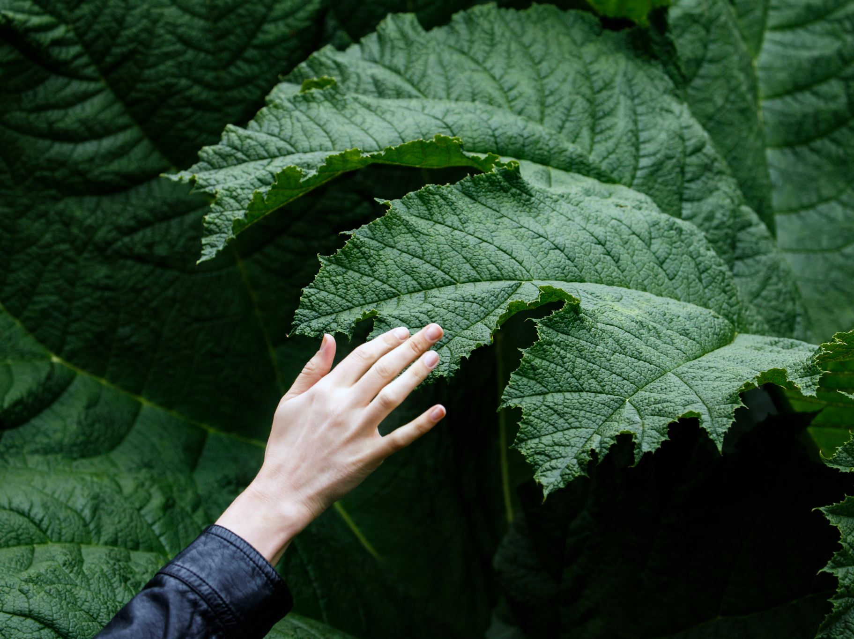
Opportunities for more training….
A la carte programs (online offerings):
Rhode Island School of Design
Art Students League of NY
NC Botanical Garden
Heeyoung Kim Academy
Certificate Programs
Rhode Island School of Design
CalState Monterey Bay (at least some online)
Royal Botanic Garden Edinburgh (2 levels)
NC Botanical Garden

Slide 3
Organizations
American Society of Botanical Artists
https://www.asba-art.org/
Guild of Natural Science Illustrators
https://www.gnsi.org/
Colored Pencil Society of America
https://cpsa.org/

Slide 4


Events and Workshops
Wild Wonder
https://www.w
ildwonder.org/wild-wonder-conference-2025
Exploring Overland
https://www.exploringoverland.com/training-trips
Wendy Hollender (Draw Botanical)
https://drawbotanical.com/workshops/

