Slide 1
2 Causes of Disease:
BIOTIC
ABIOTIC
Means “living”
(these are the contagious diseases)
Means “non-living”
(such as stress factors:
Temperature
Nutrition
pH
Air pollution
(these aren’t contagious!)
(and are far more common)

Slide 2
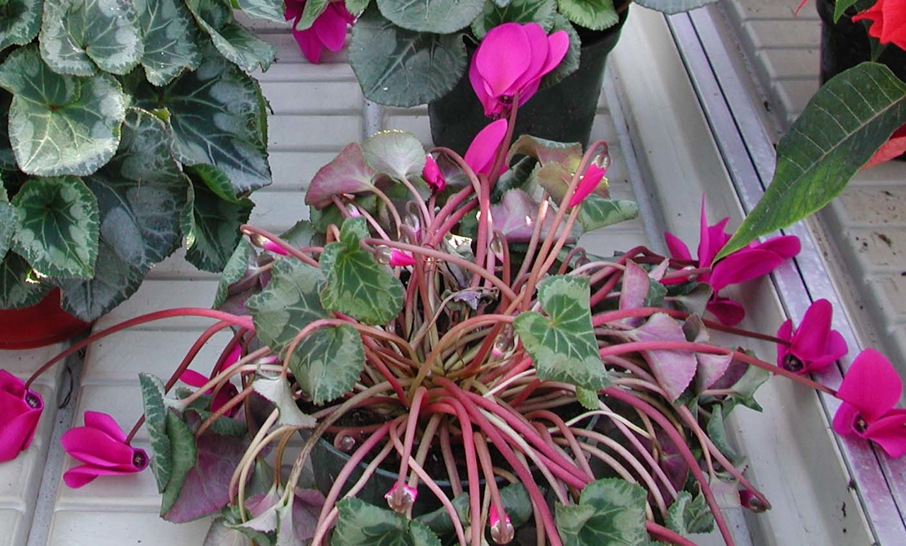
Abiotic or Biotic?
For example, what if a plant is wilting?

Slide 3
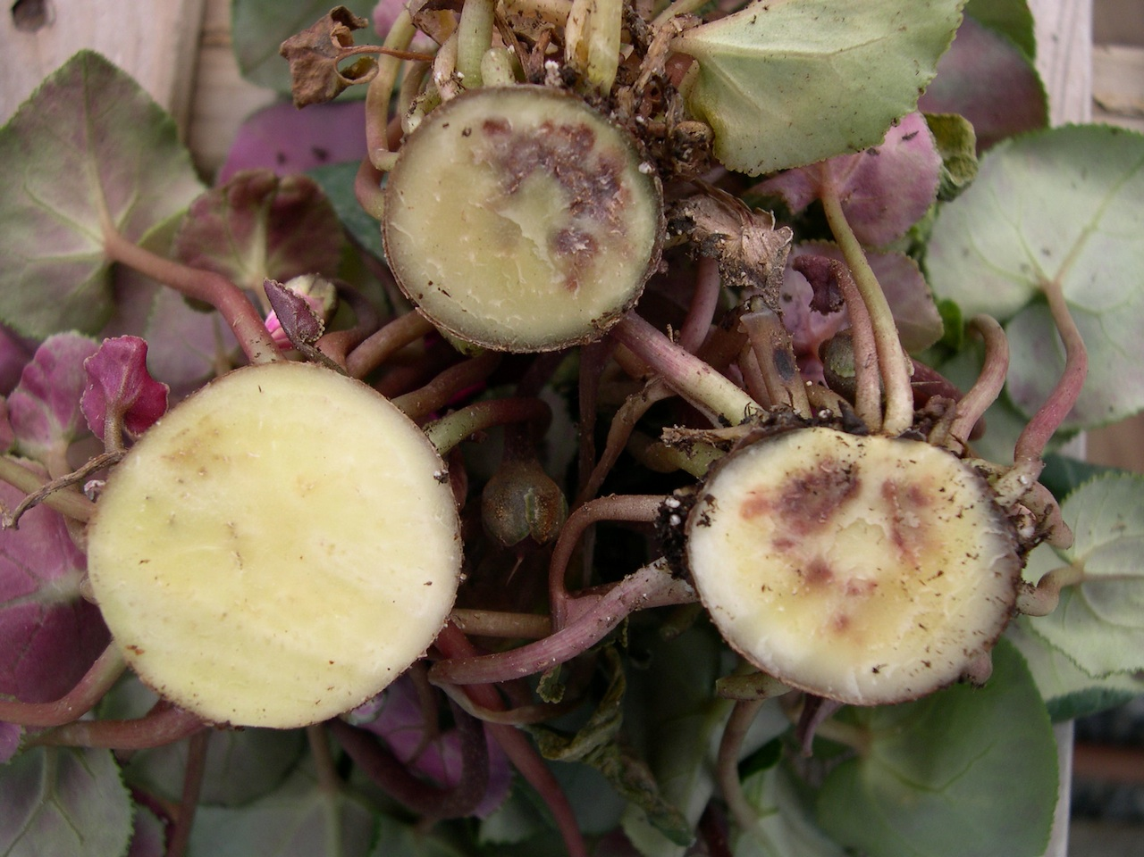
Abiotic disease or Biotic disease – symptoms may be very similar
Not irrigated
in far too long?
(Abiotic)
Fusarium wilt?
(Biotic)
A. R. Chase image

Slide 4
Abiotic Disease = an interaction of 2 factors
PLANT
ENVIRONMENT
Abiotic diseases typically have cultural solutions . . .
They don’t spread
They often affect plants of many species in one area
(but sometimes one cultivar is more prone to a stress)

Slide 5
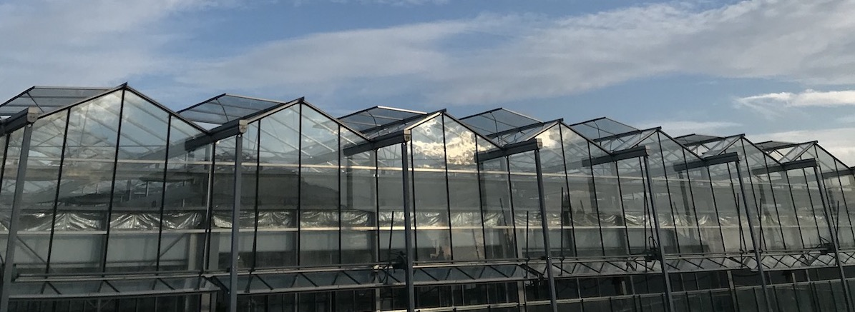
Look at the overall pattern in the greenhouse
Does it fit with an abiotic disease?
Is there an environment-related pattern? One location affected?
Are plants of multiple species affected?
Or are symptoms random & scattered within
one plant species (thus more likely a contagious disease)?

Slide 6
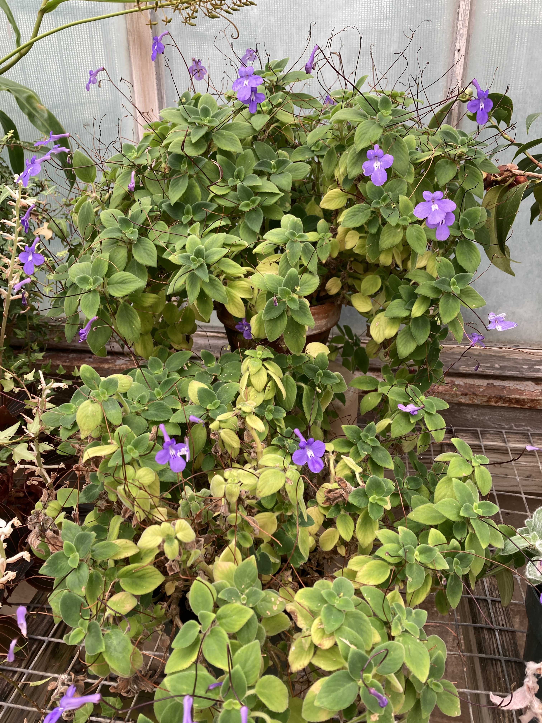
Common Abiotic Problems – Nutrient Deficiencies
Mobile Nutrients:
Symptoms appear on lower leaves FIRST
Nitrogen
Phosphorus
Potassium
Magnesium
Notes:
Fertility problems are one of the more common problems to see in plants. Deficiencies show up when you have too much of a nutrient, while toxicity appears when you have too much of a nutrient. You can broadly separate deficiencies into mobile and immobile deficiencies. Moblie nutrients are transported from older leaves to younger leaves, so that deficiencies show up in mature, older leaves first. The three primary macronutrients (N,P,K) in addition to the secondary macronutrient, Mg are all mobile.

Slide 7
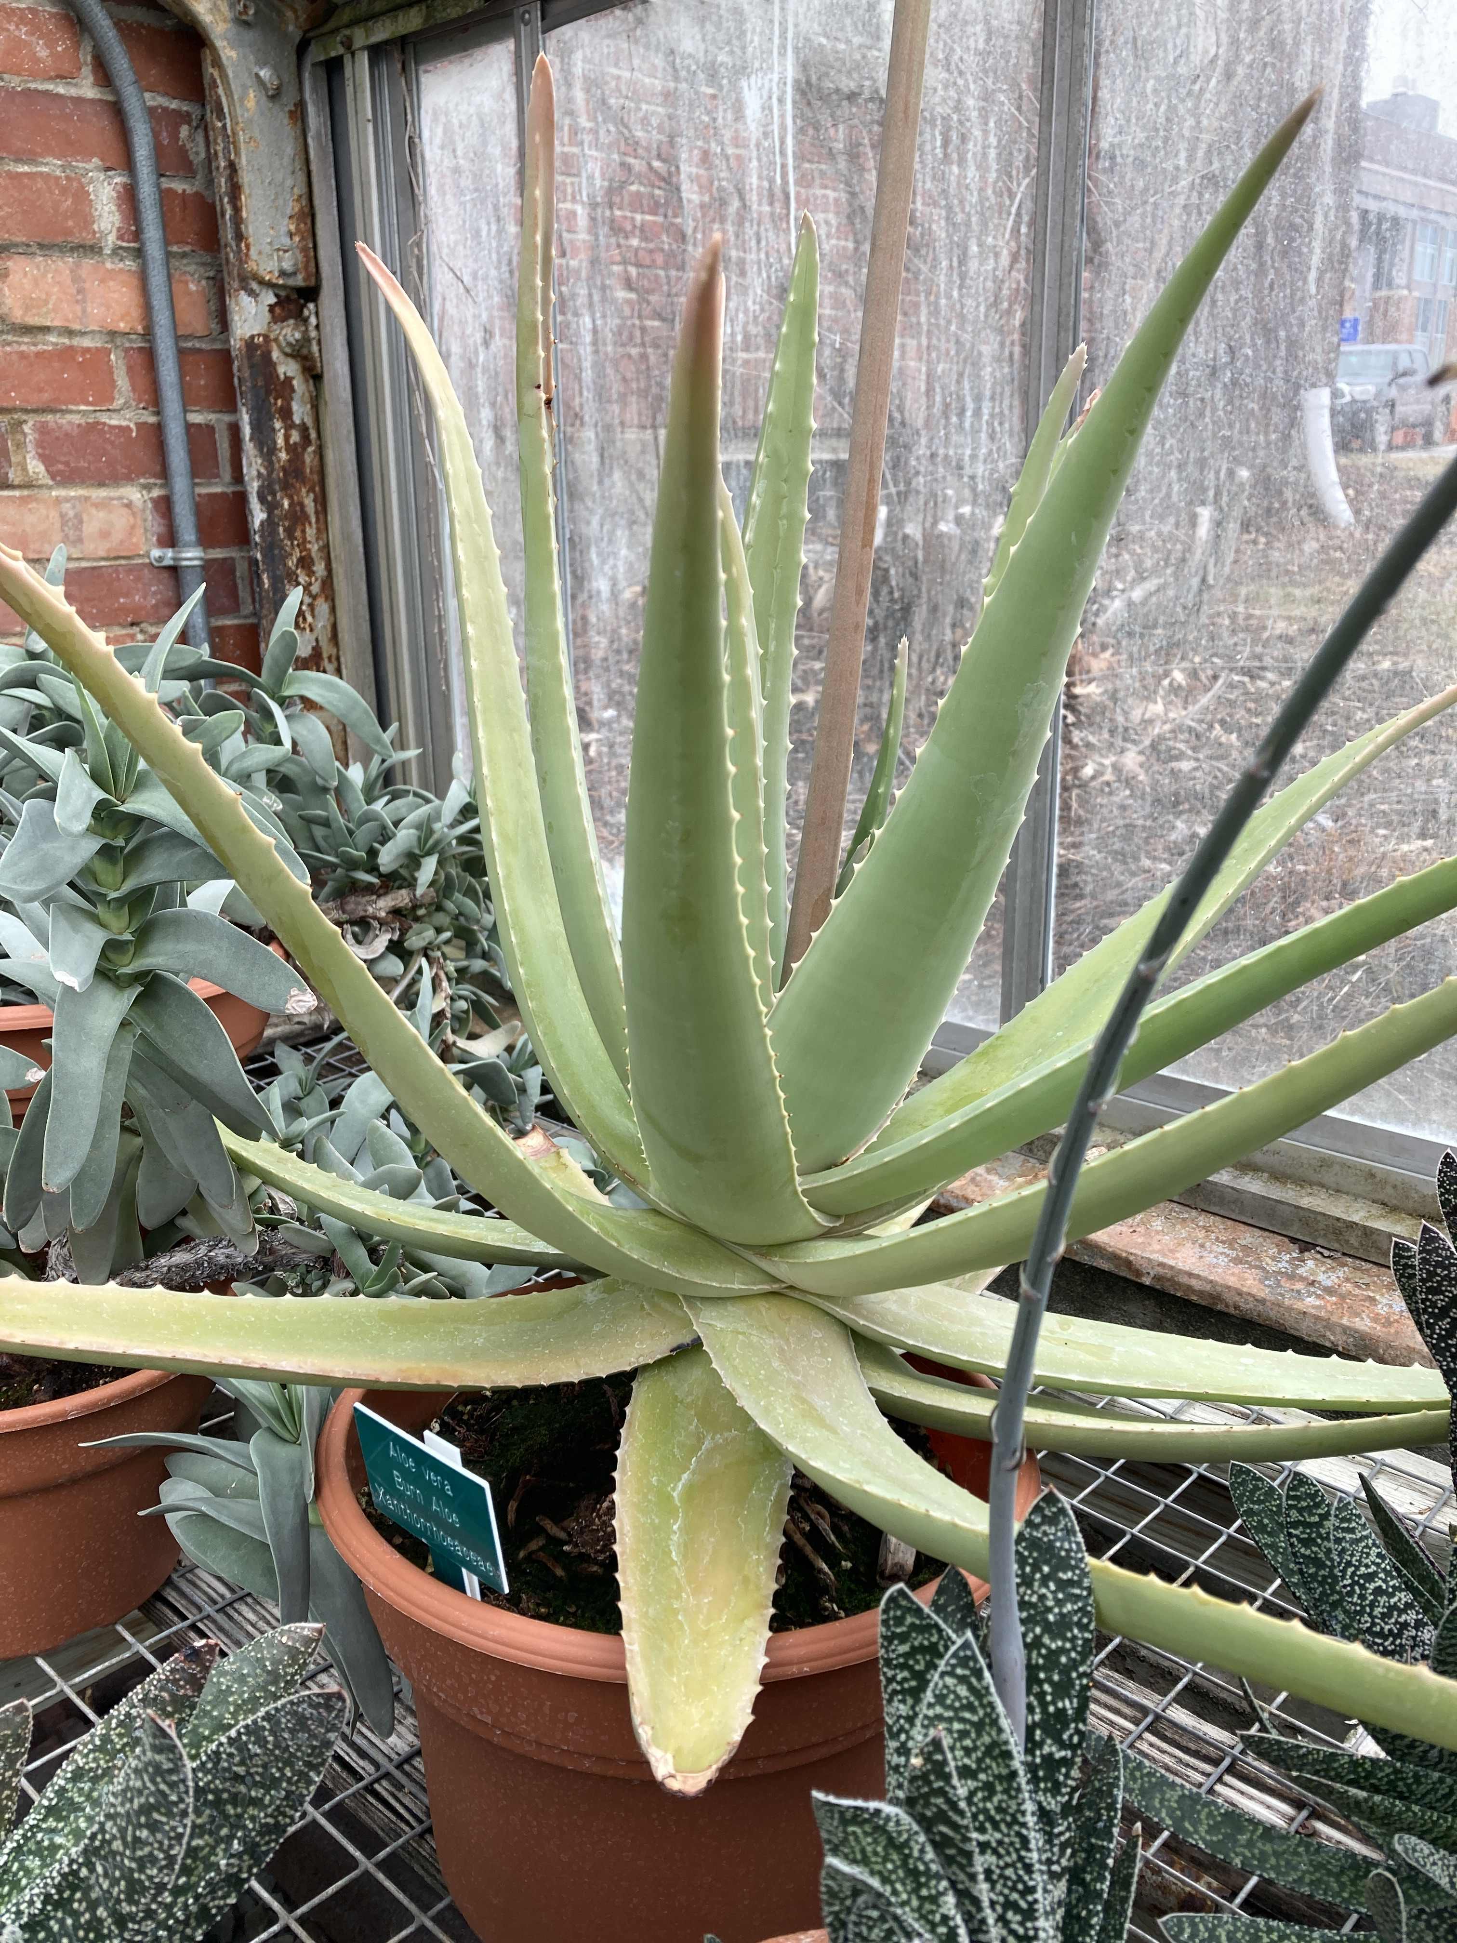
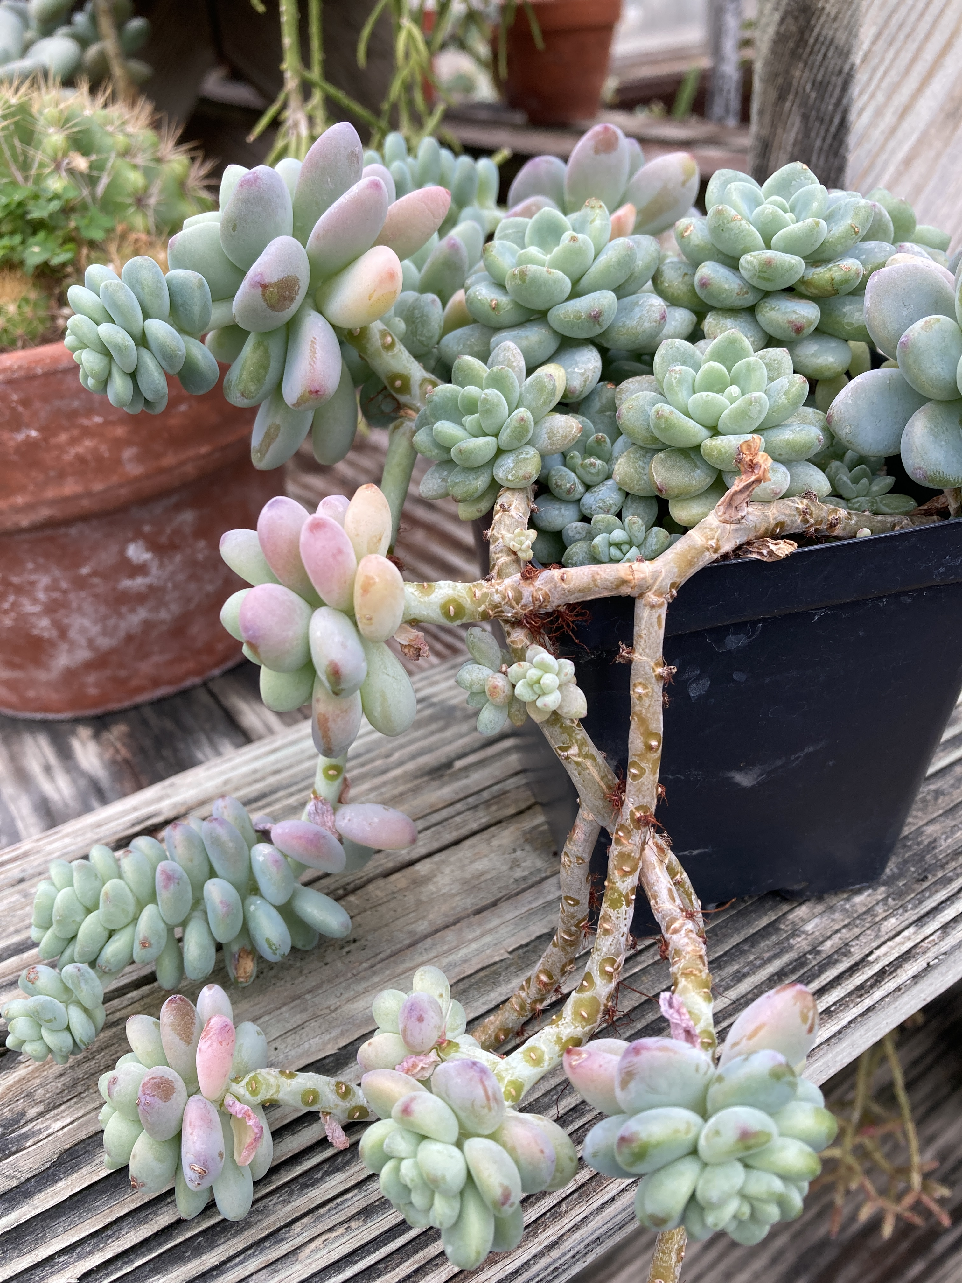
Nitrogen Deficiency - Mobile
Chlorosis or Yellowing on Lower Leaves
Plant drops lower leaves
Notes:
Nitrogen deficiency is very common to see and is something you usually see if plants are just in need of greater amounts of fertilizer. Plants need N more than any other fertilizer nutrient. N usually shows up as chlorosis or yellowing in older leaves, which you can see here in streptocarpella, aloe, and sedum. When the deficiency progresses, plants will lose their lower leaves.

Slide 8
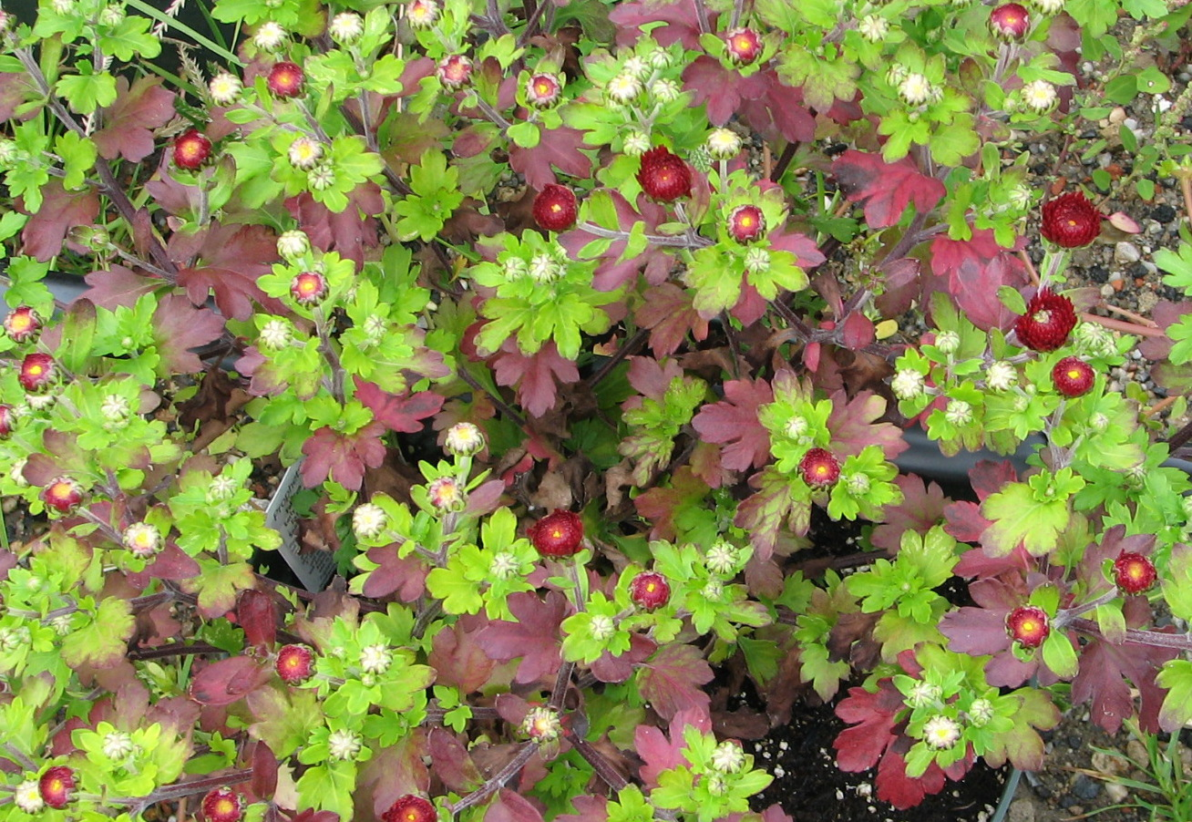
Phosphorus Deficiency - Mobile
Purple leaves
Smaller overall size
Similar to Cold Damage
Photo compliments of Nora Caitlin
Notes:
Phosphorus deficiency is quite unique and easier to spot than many other nutrient disorders. Older leaves are usually purple, and the plant will be smaller overall in size. Roots will be longer. One thing to keep in mind is that we are usually applying enough phosphorus, but availability can be impacted by other environmental factors, notably, cold temperatures. When you are growing too cold, phosphorus will be less available... so, cold stress can look similar to phosphorus deficiency... but, that doesn't mean you need to apply more fertilizer.

Slide 9
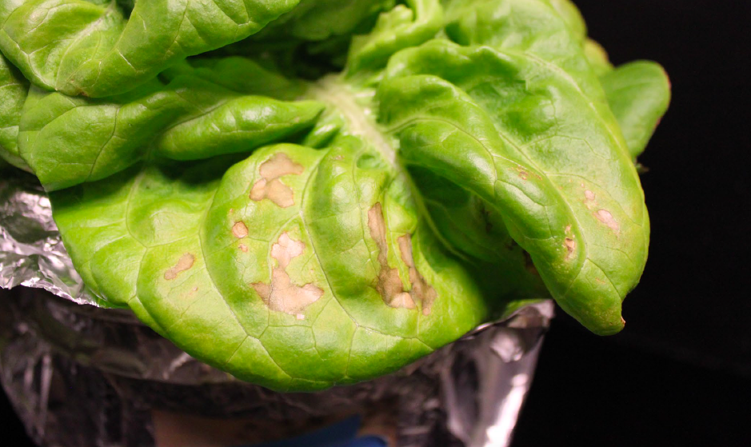
Potassium Deficiency - Mobile
Necrotic (black) spots on leaves
Edges of leaves are necrotic
Photo compliments of Neil Mattson and Tanya Merrill, Cornell University

Slide 10
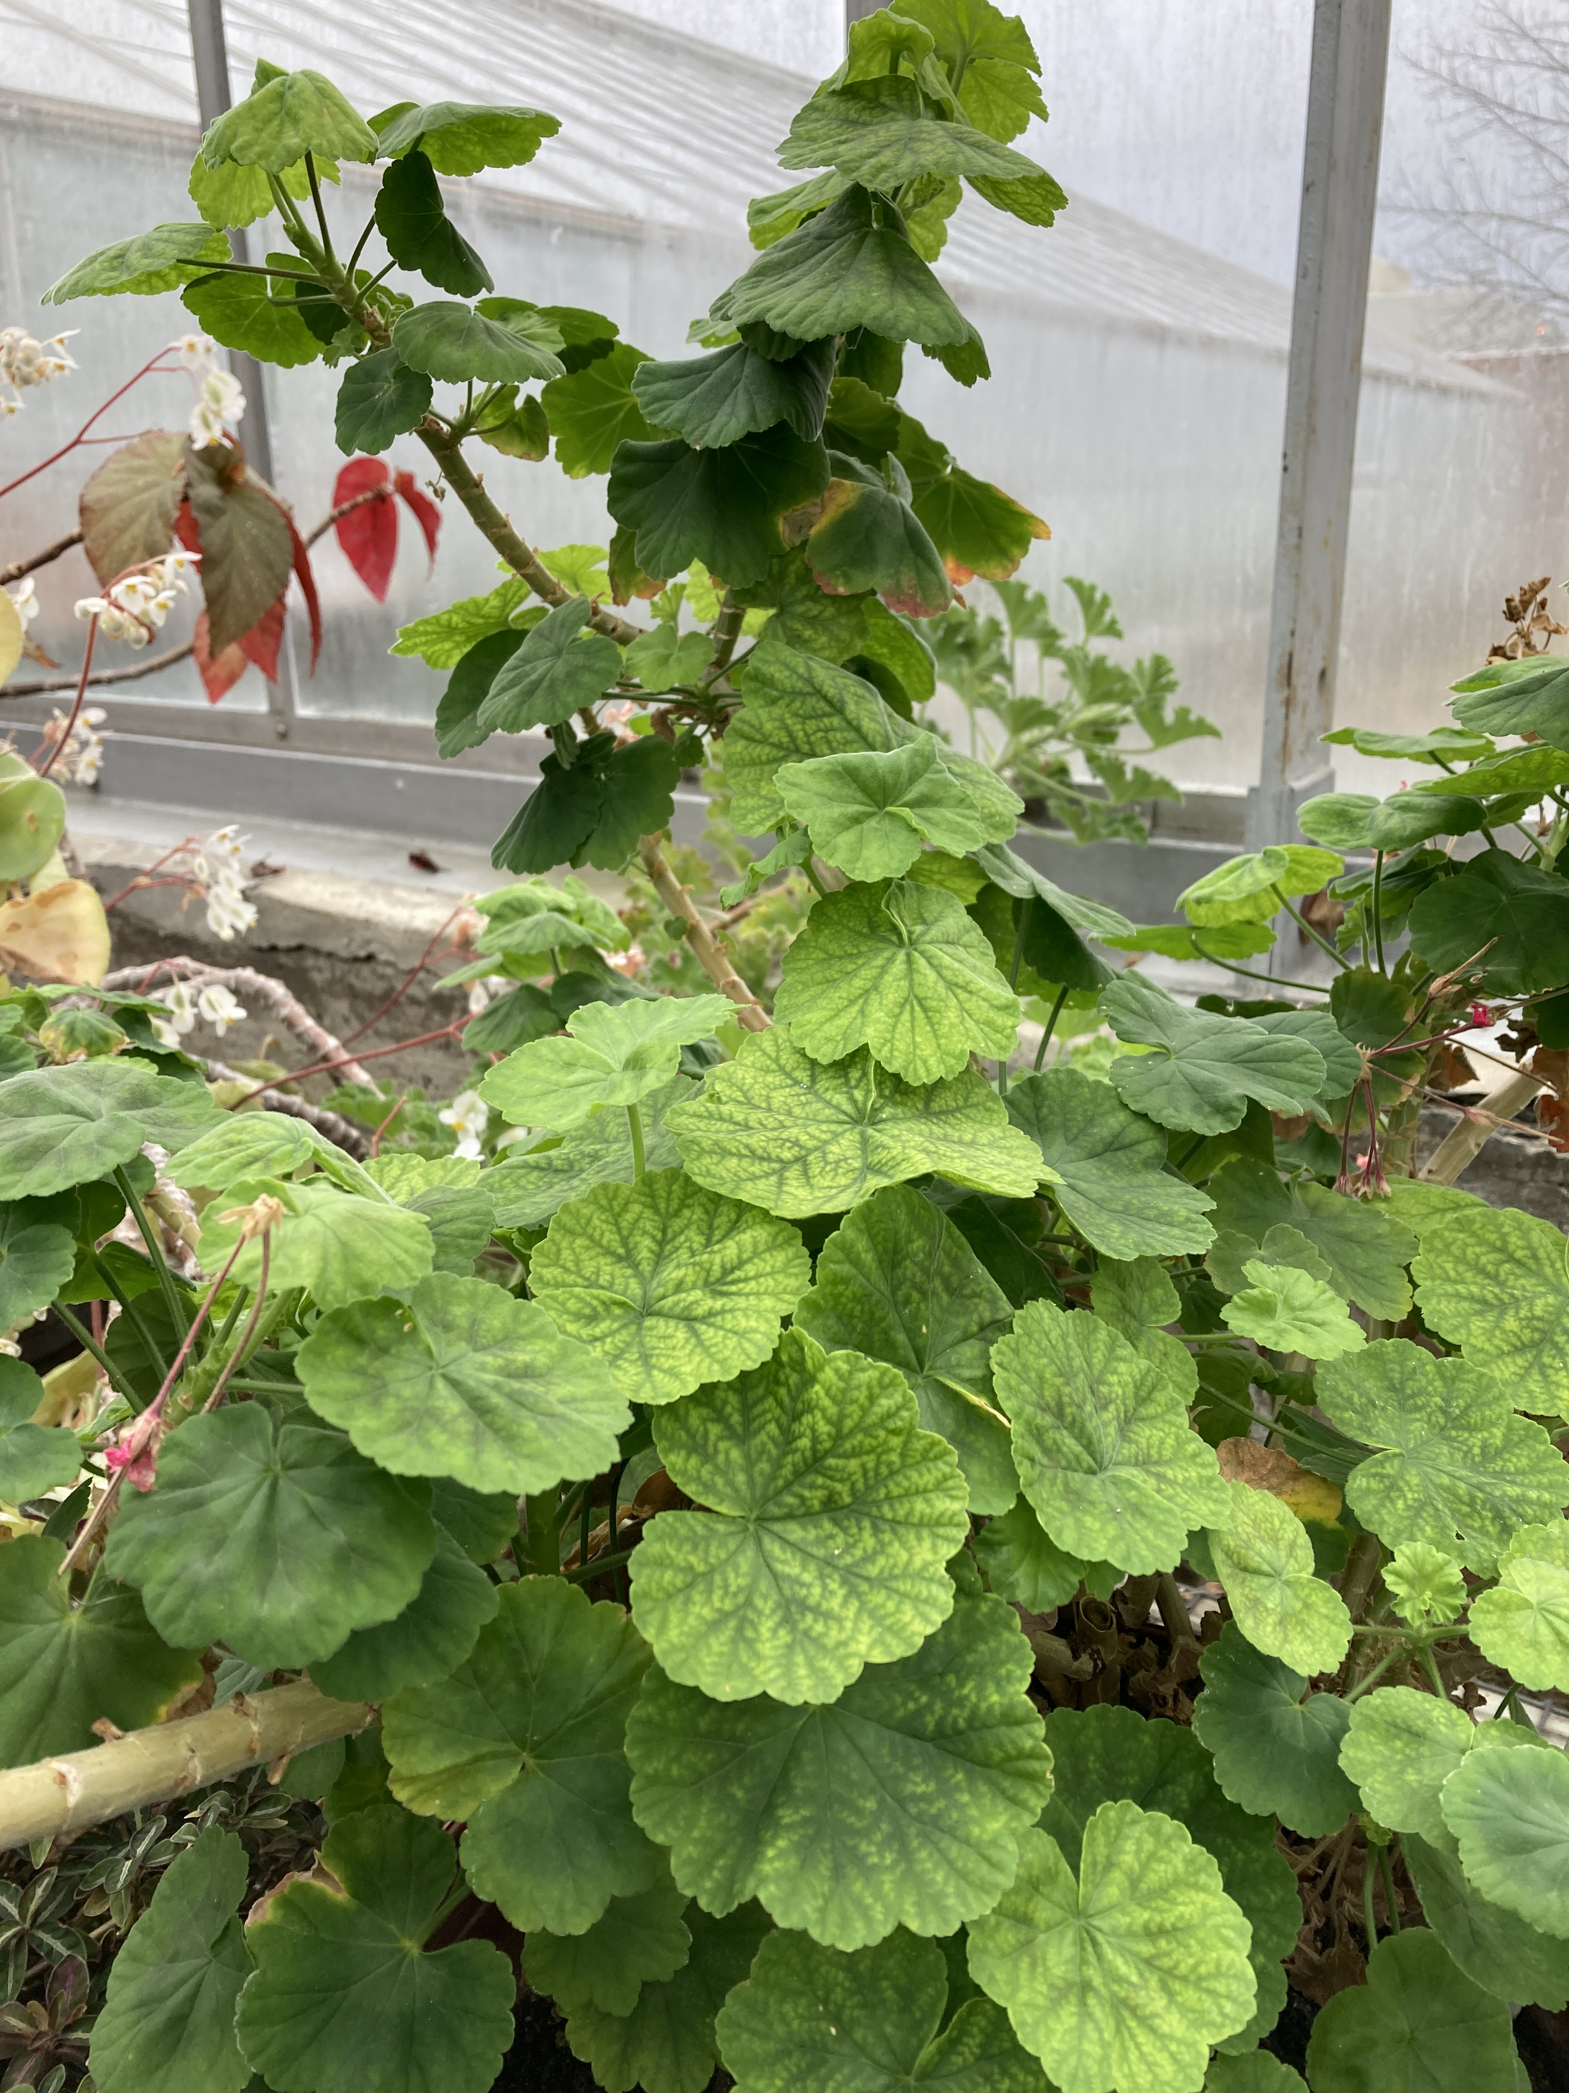
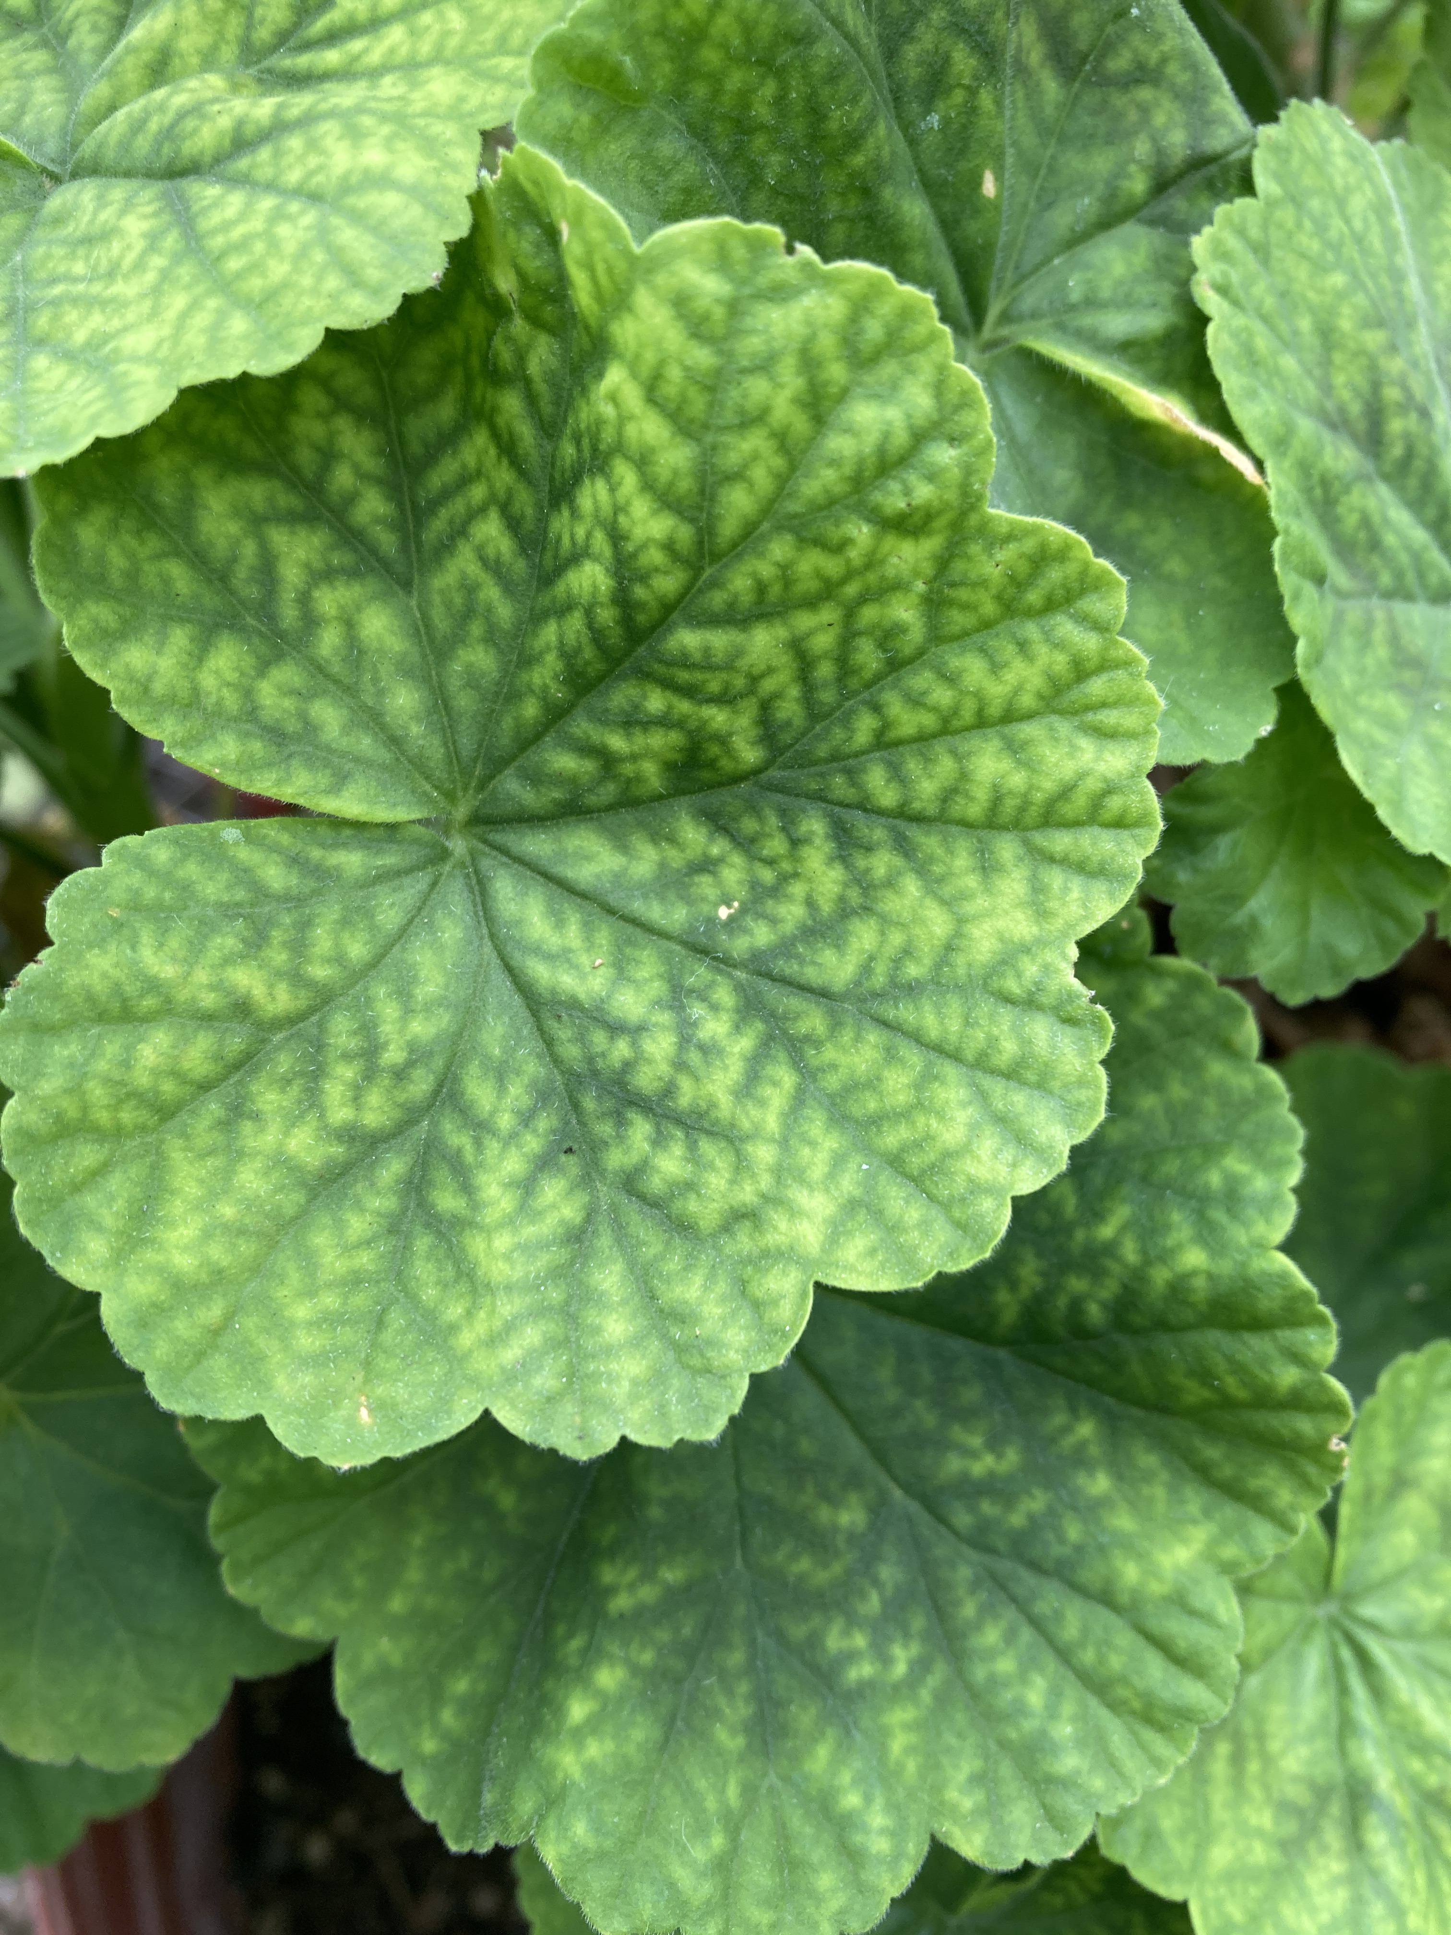
Magnesium Deficiency - Mobile
Interveinal Chlorosis – leaf margins
Red/Purple Leaves (Rare)

Slide 11
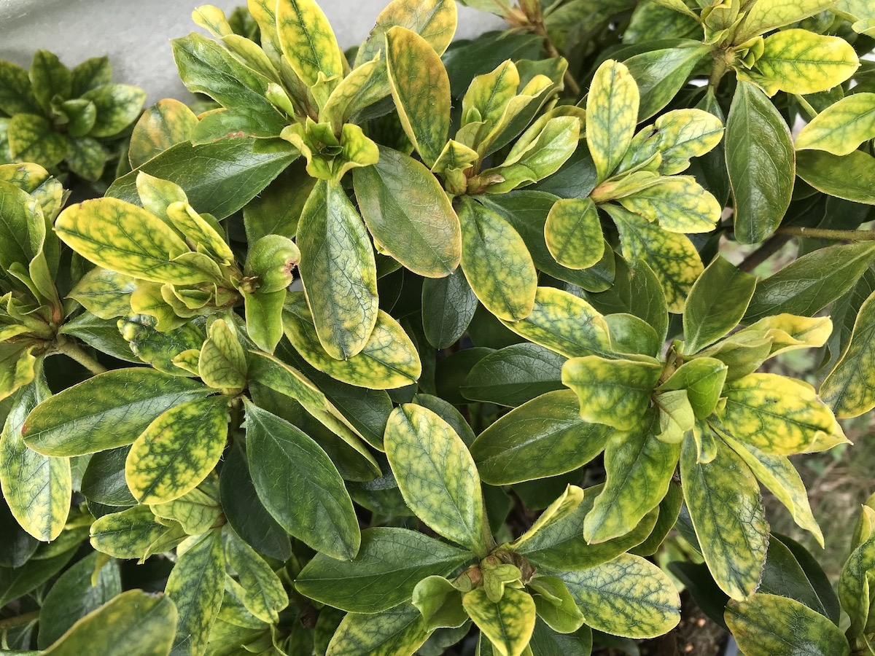
Nutrient Deficiencies
Immobile Nutrients:
Symptoms appear on upper leaves FIRST
Calcium (only macronutrient)
Boron
Iron
Manganese
Copper
Zinc
Molybdenum
Photo compliments of Margery Daughtrey
Notes:
Immobile nutrients have deficiencies that appear in the upper leaves first... these nutrients are not transported from growing tips to older leaves. Most nutrients that appear as deficiencies in upper leaves are micronutrients: boron, iron, manganese, copper, zinc, and molybdenum. The exception is calcium, which appears in upper leaves first.

Slide 12
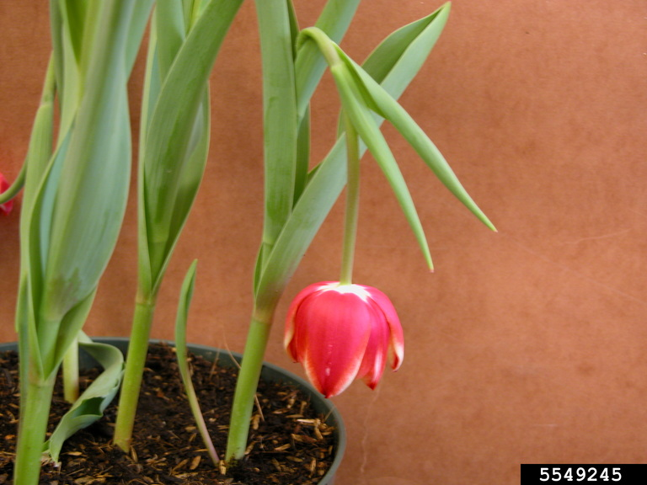
Calcium Deficiency - Immobile
Necrotic leaf edges
Chlorotic leaves (newest growth)
Tulips – Calcium Topple
Photo compliments of Penn State Department of Plant Pathology and Environmental Microbiology

Slide 13
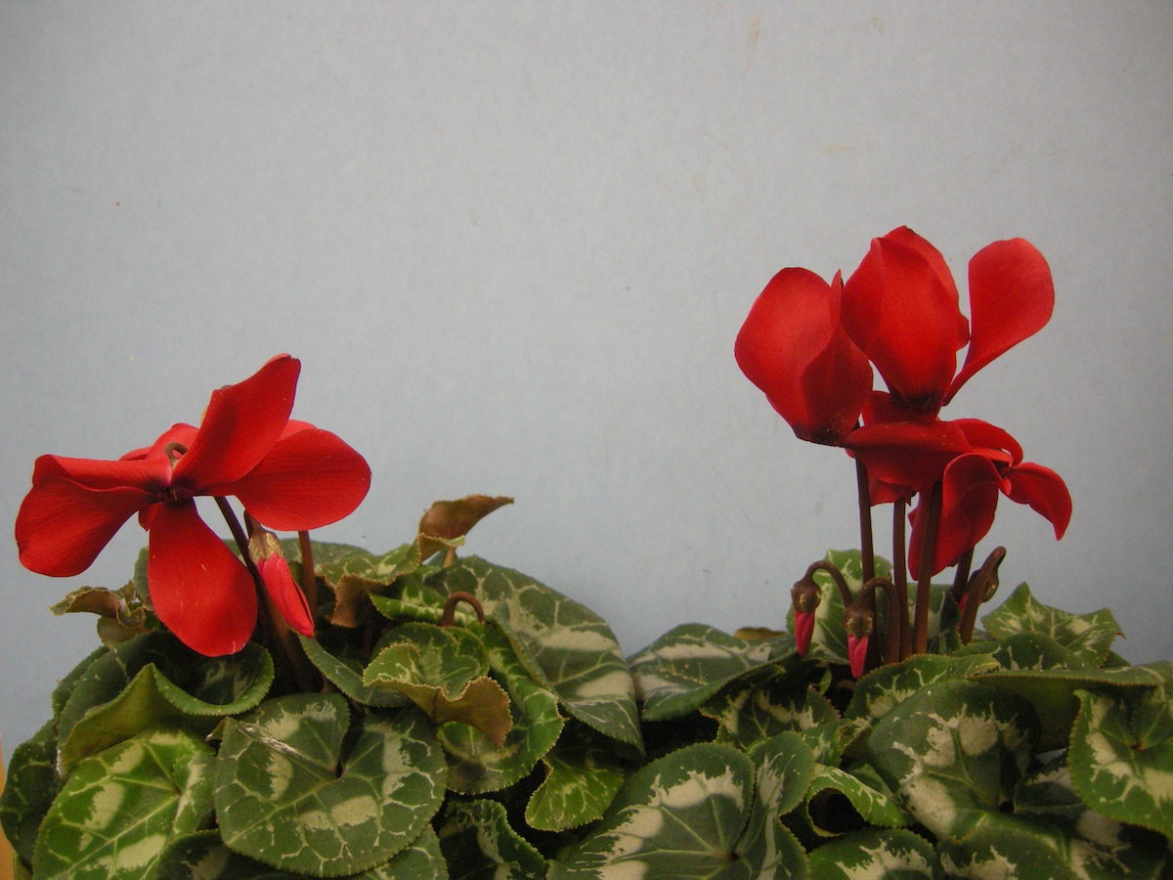
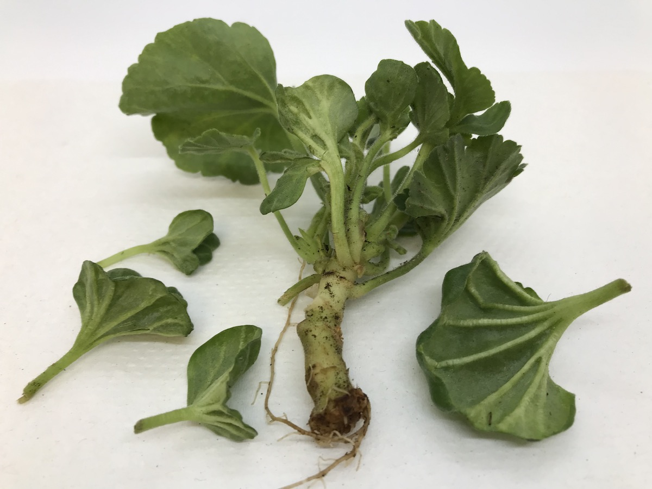
Boron Deficiency - Immobile
Leaf distortion
Loss of apical meristem
Photos compliments of Margery Daughtrey

Slide 14
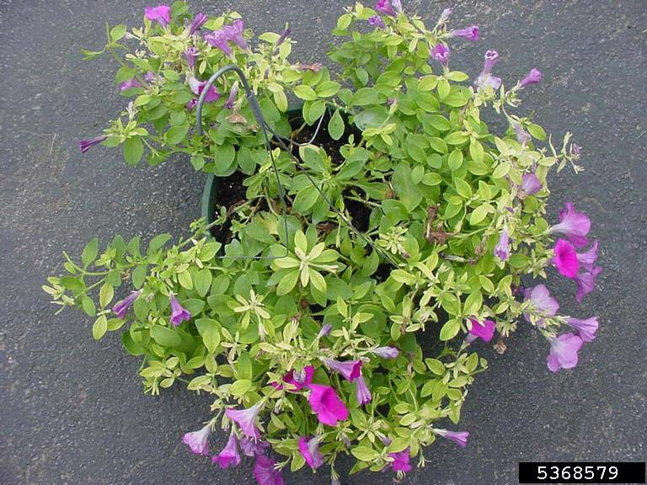
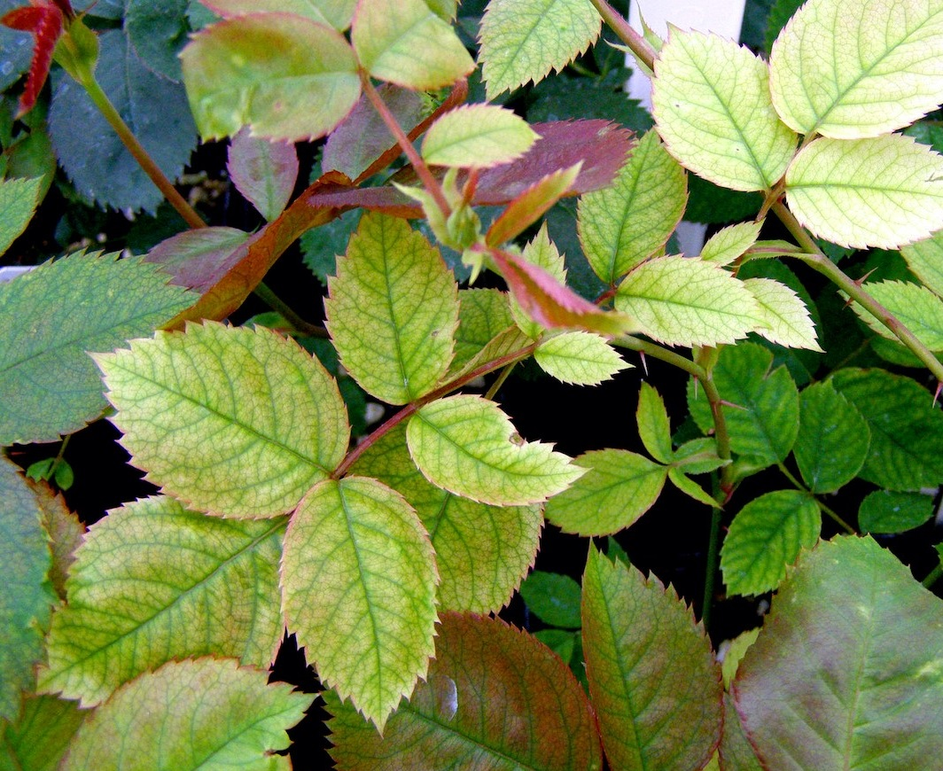
Iron and Manganese Deficiency
Interveinal Chlorosis
Iron – leaves can turn white
Photo compliments of Paul Bachi, University of Kentucky
Photo compliments of Kathleen Holman

Slide 15
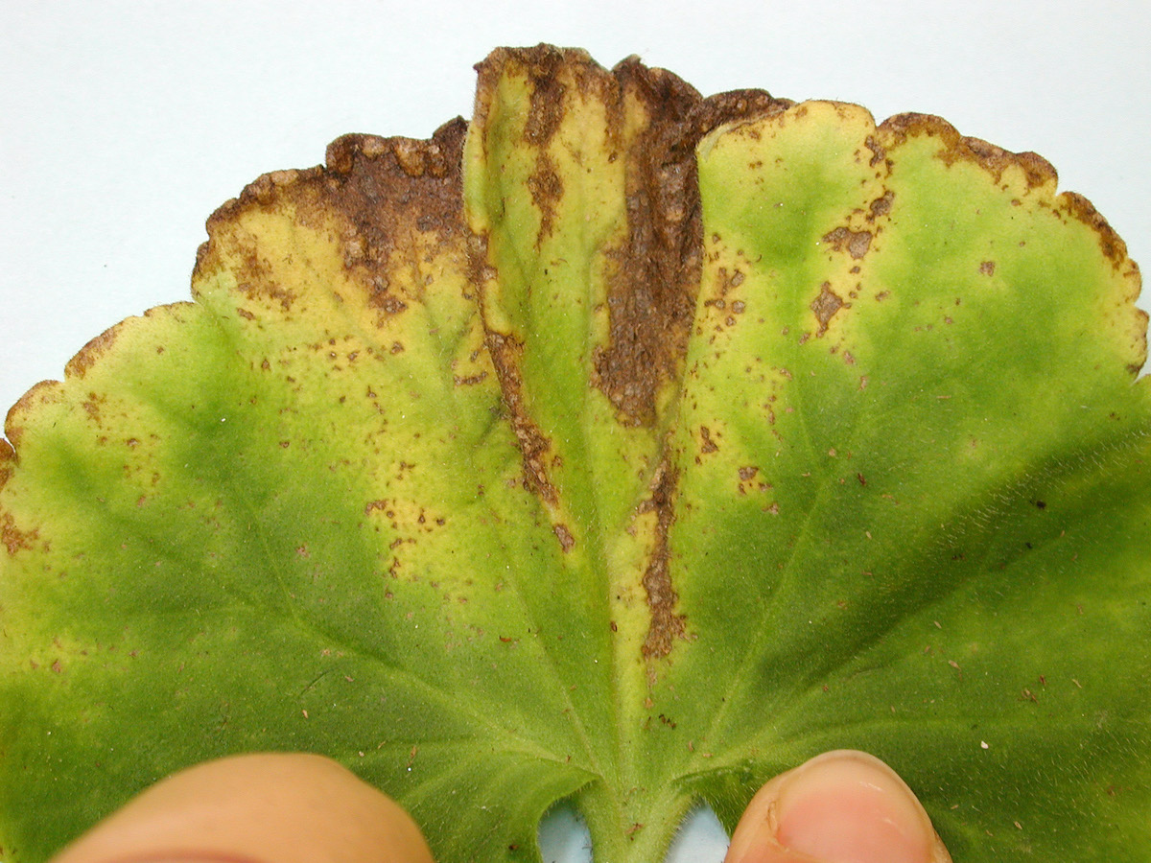
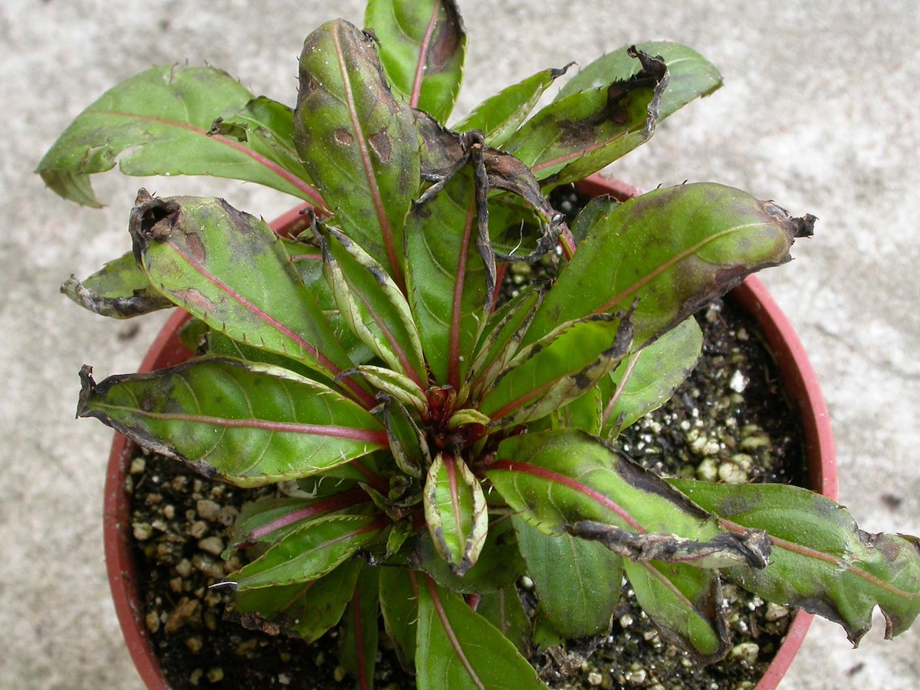
Iron and Manganese Toxicity
Starts as Interveinal Chlorosis
Necrosis on new leaves
Photos compliments of Margery Daughtrey
Notes:
Iron and Manganese Toxicity are quite common and are usually related to pH issues. They can be tricky to diagnose because it starts out looking similar to iron and manganese with interveinal chlorosis. It progresses so that

Slide 16
Low pH
Toxic: Iron, Manganese, Zinc, Copper
Deficient: Calcium, Magnesium
Photo compliments of Margery Daughtrey

Slide 17
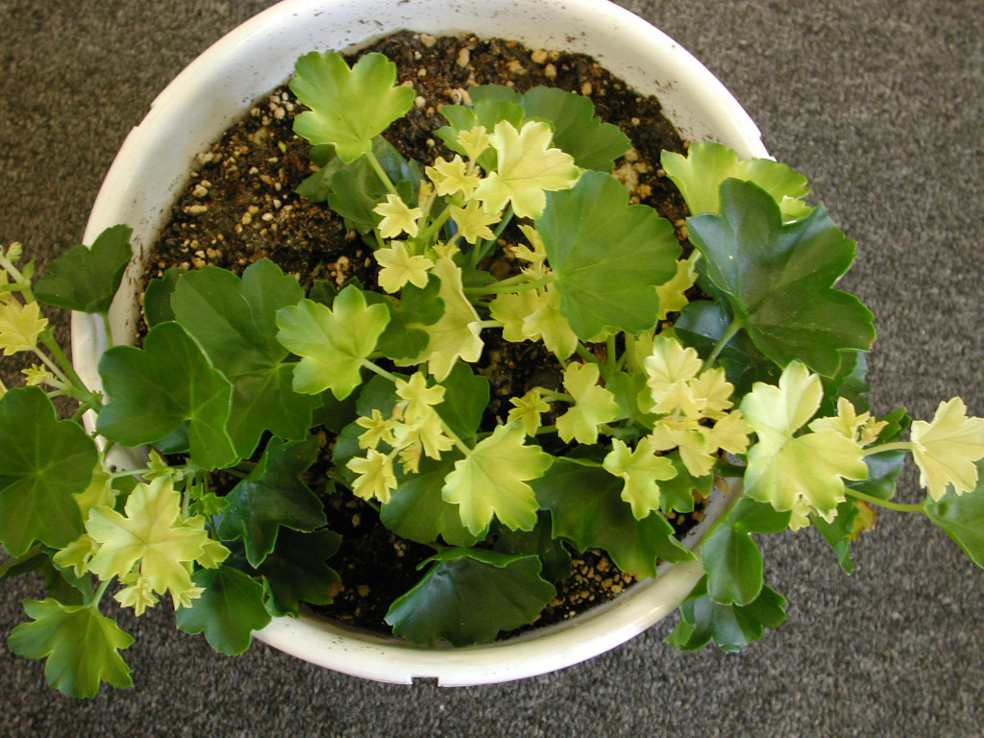
High pH
Deficient: Iron, Manganese, Zinc, Copper, Boron
Photo compliments of Margery Daughtrey

Slide 18
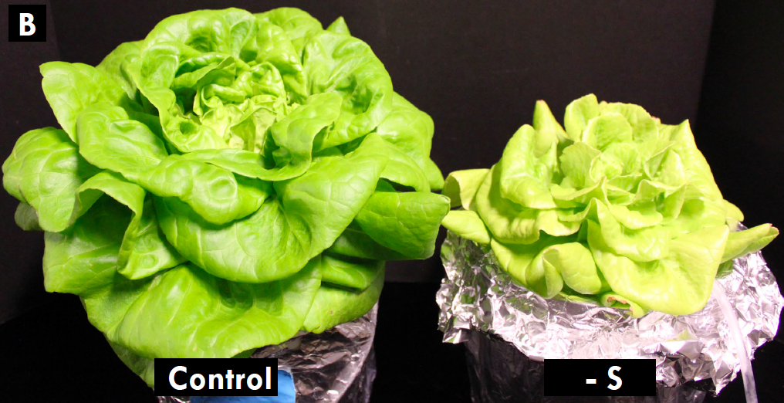
Sulfur – young and old leaves
Chlorosis or leaf yellowing
Symptoms impact both old and young leaves
Photo compliments of Neil Mattson and Tanya Merrill, Cornell University

Slide 19
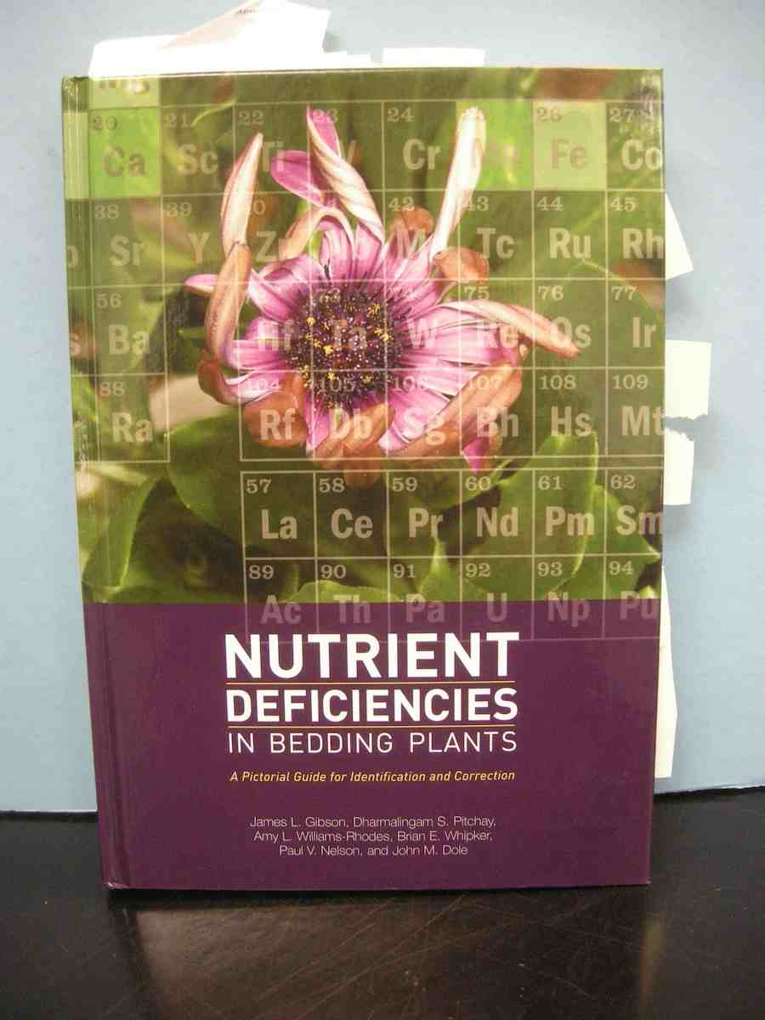
How to know if fertilizer is the culprit?
Fertilizer problems often look like other issues (and vice versa)
Weekly pH/EC testing is recommended
Foliar testing is critical to determine what fertility problem may be present
Photo compliments of Margery Daughtrey

Slide 20
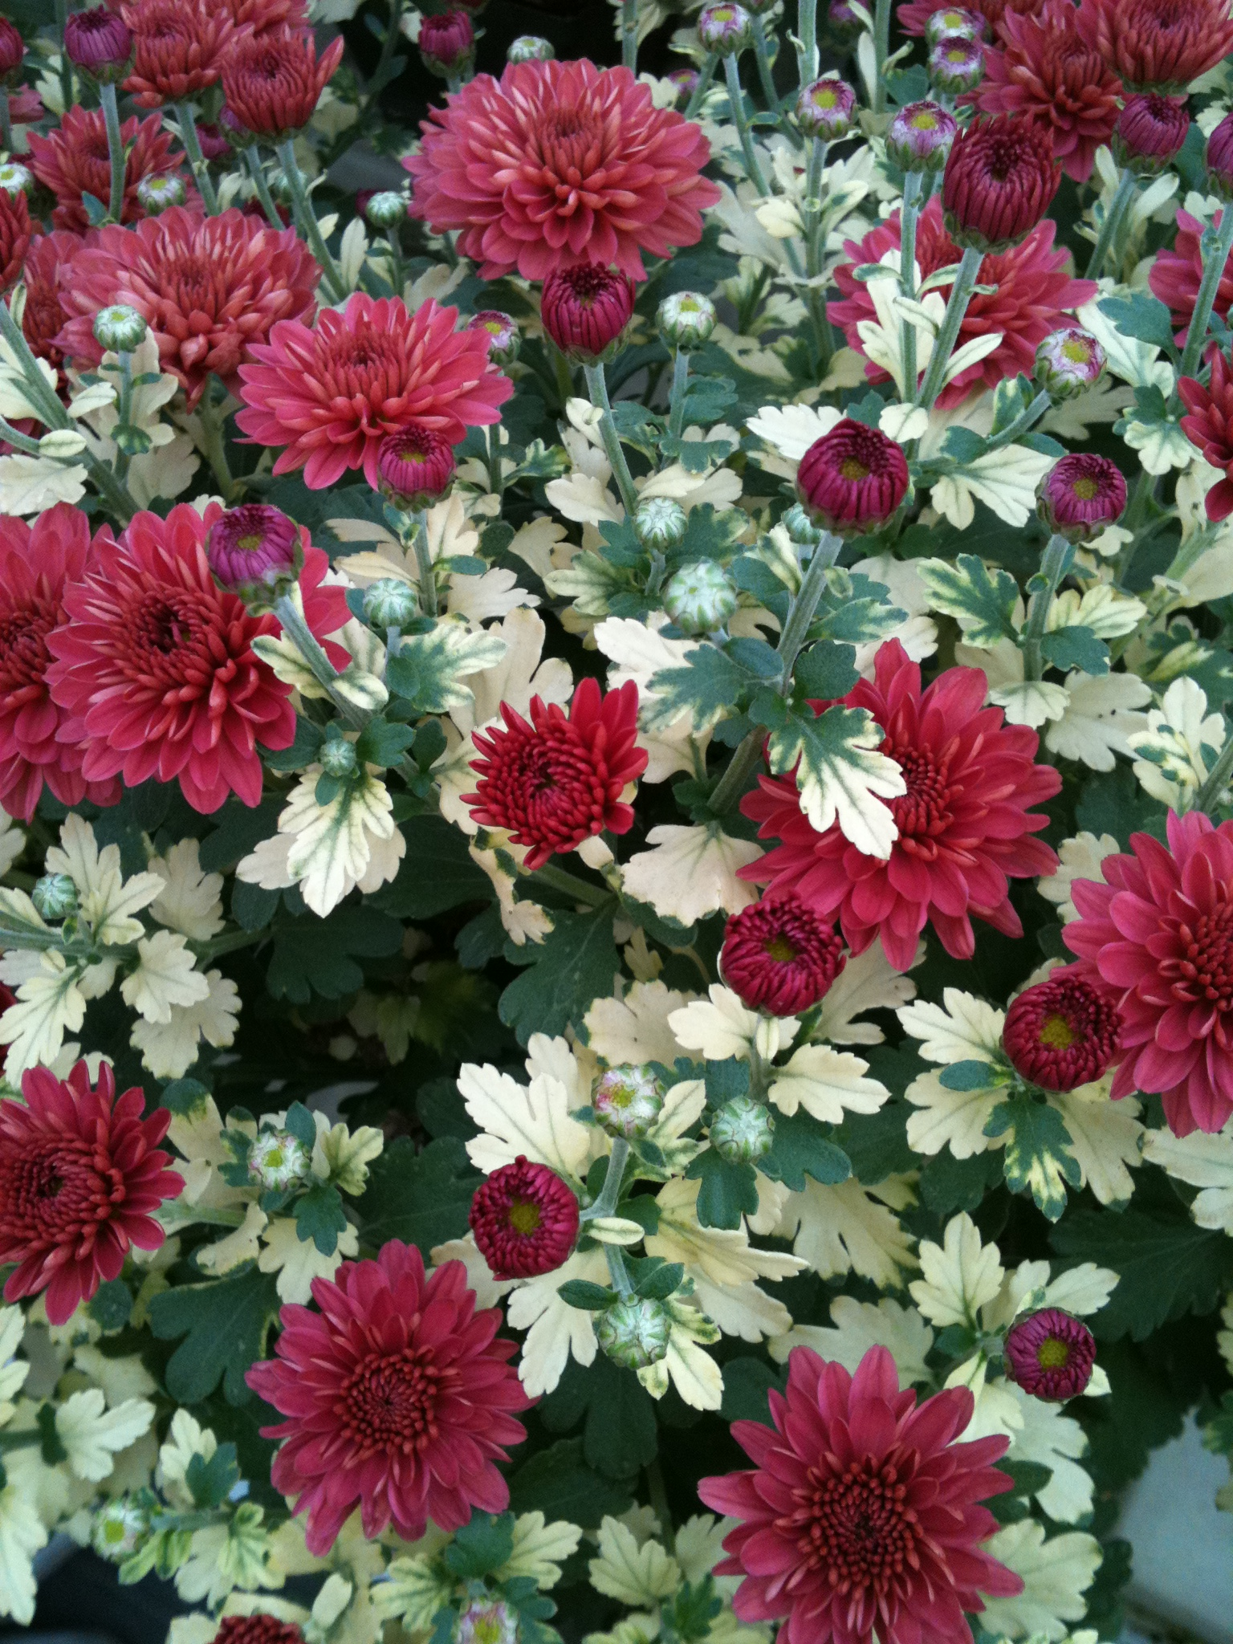
Common Abiotic Problems – Spray Damage
Timing is critical – usually shows up FAST!
Read labels before applying
Take care when spraying hanging baskets
Photo compliments of Cheryl Sullivan

Slide 21
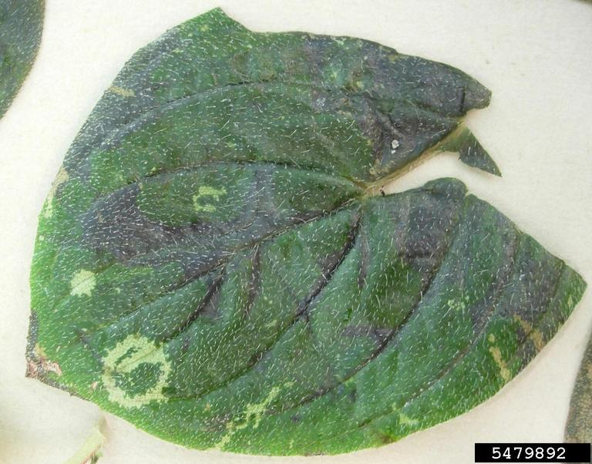
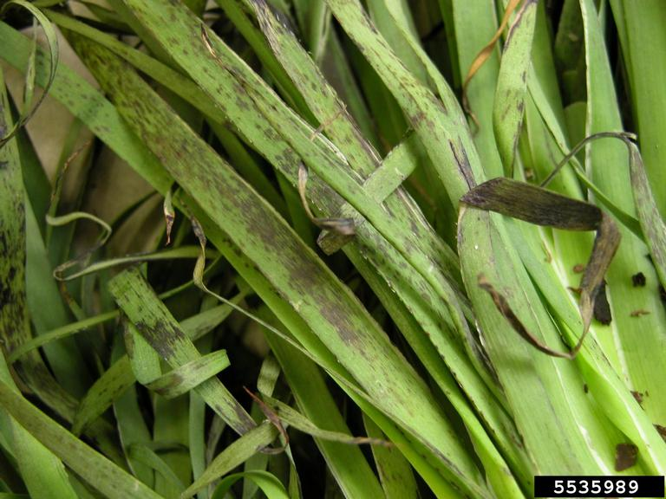
Cold Temperature Stress
Photo compliments of Elizabeth Bush
Photo compliments of John Ruter

Slide 22
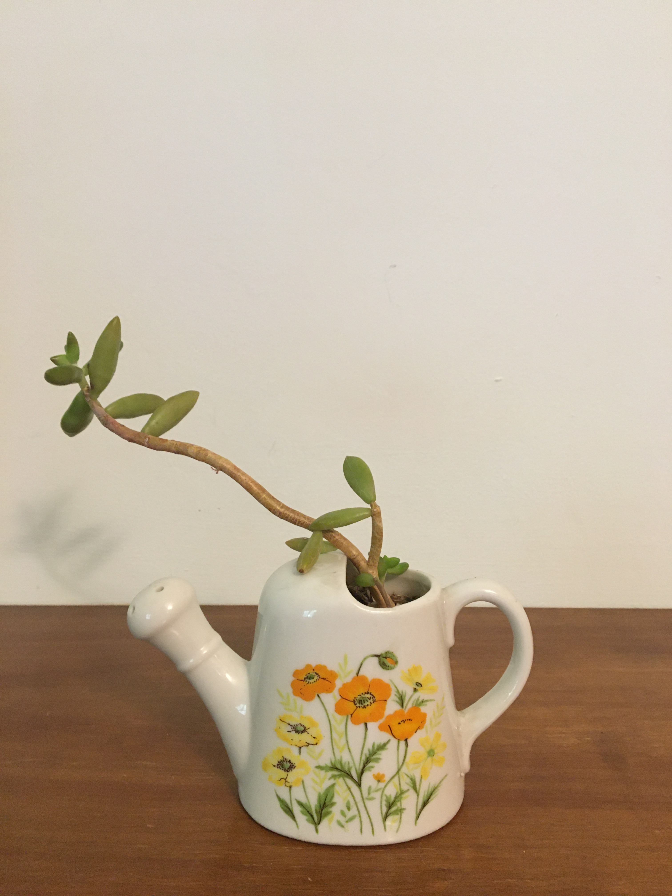
Low Light
Plant drops lower leaves
Larger than normal internodes
Consider spacing!
Common on:
Succulents
Poinsettia
Other sun-loving plants

Slide 23
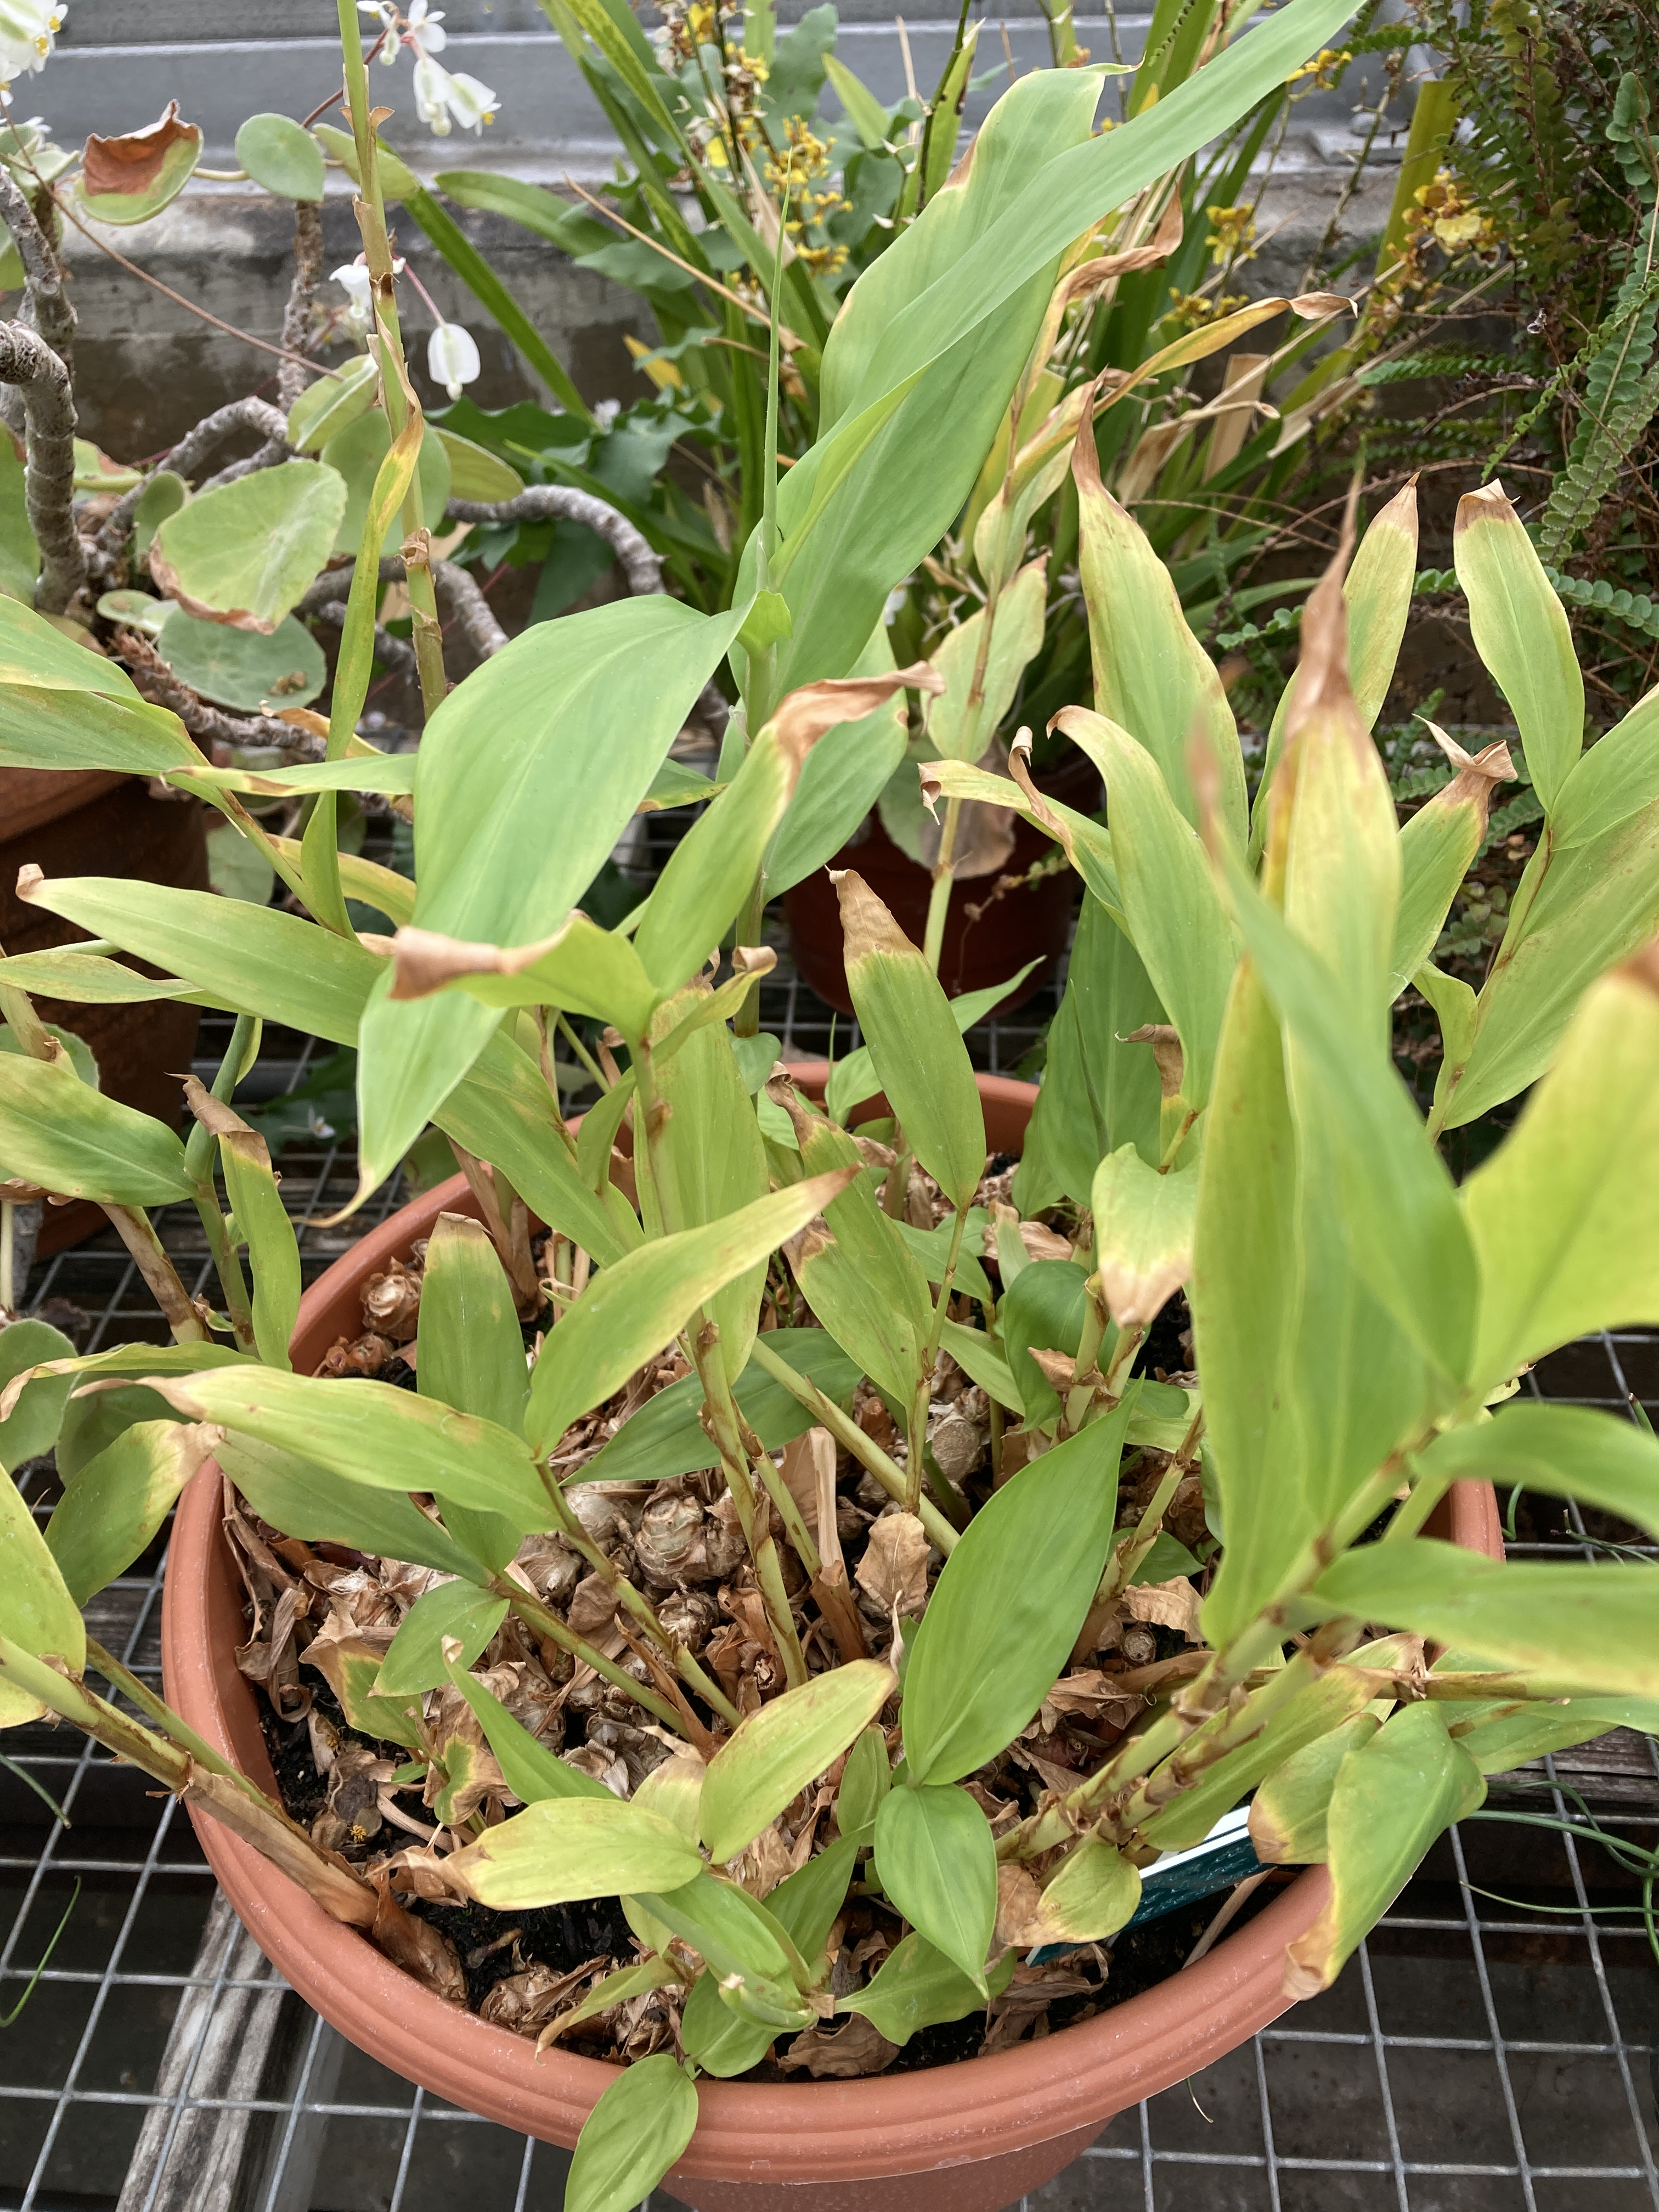
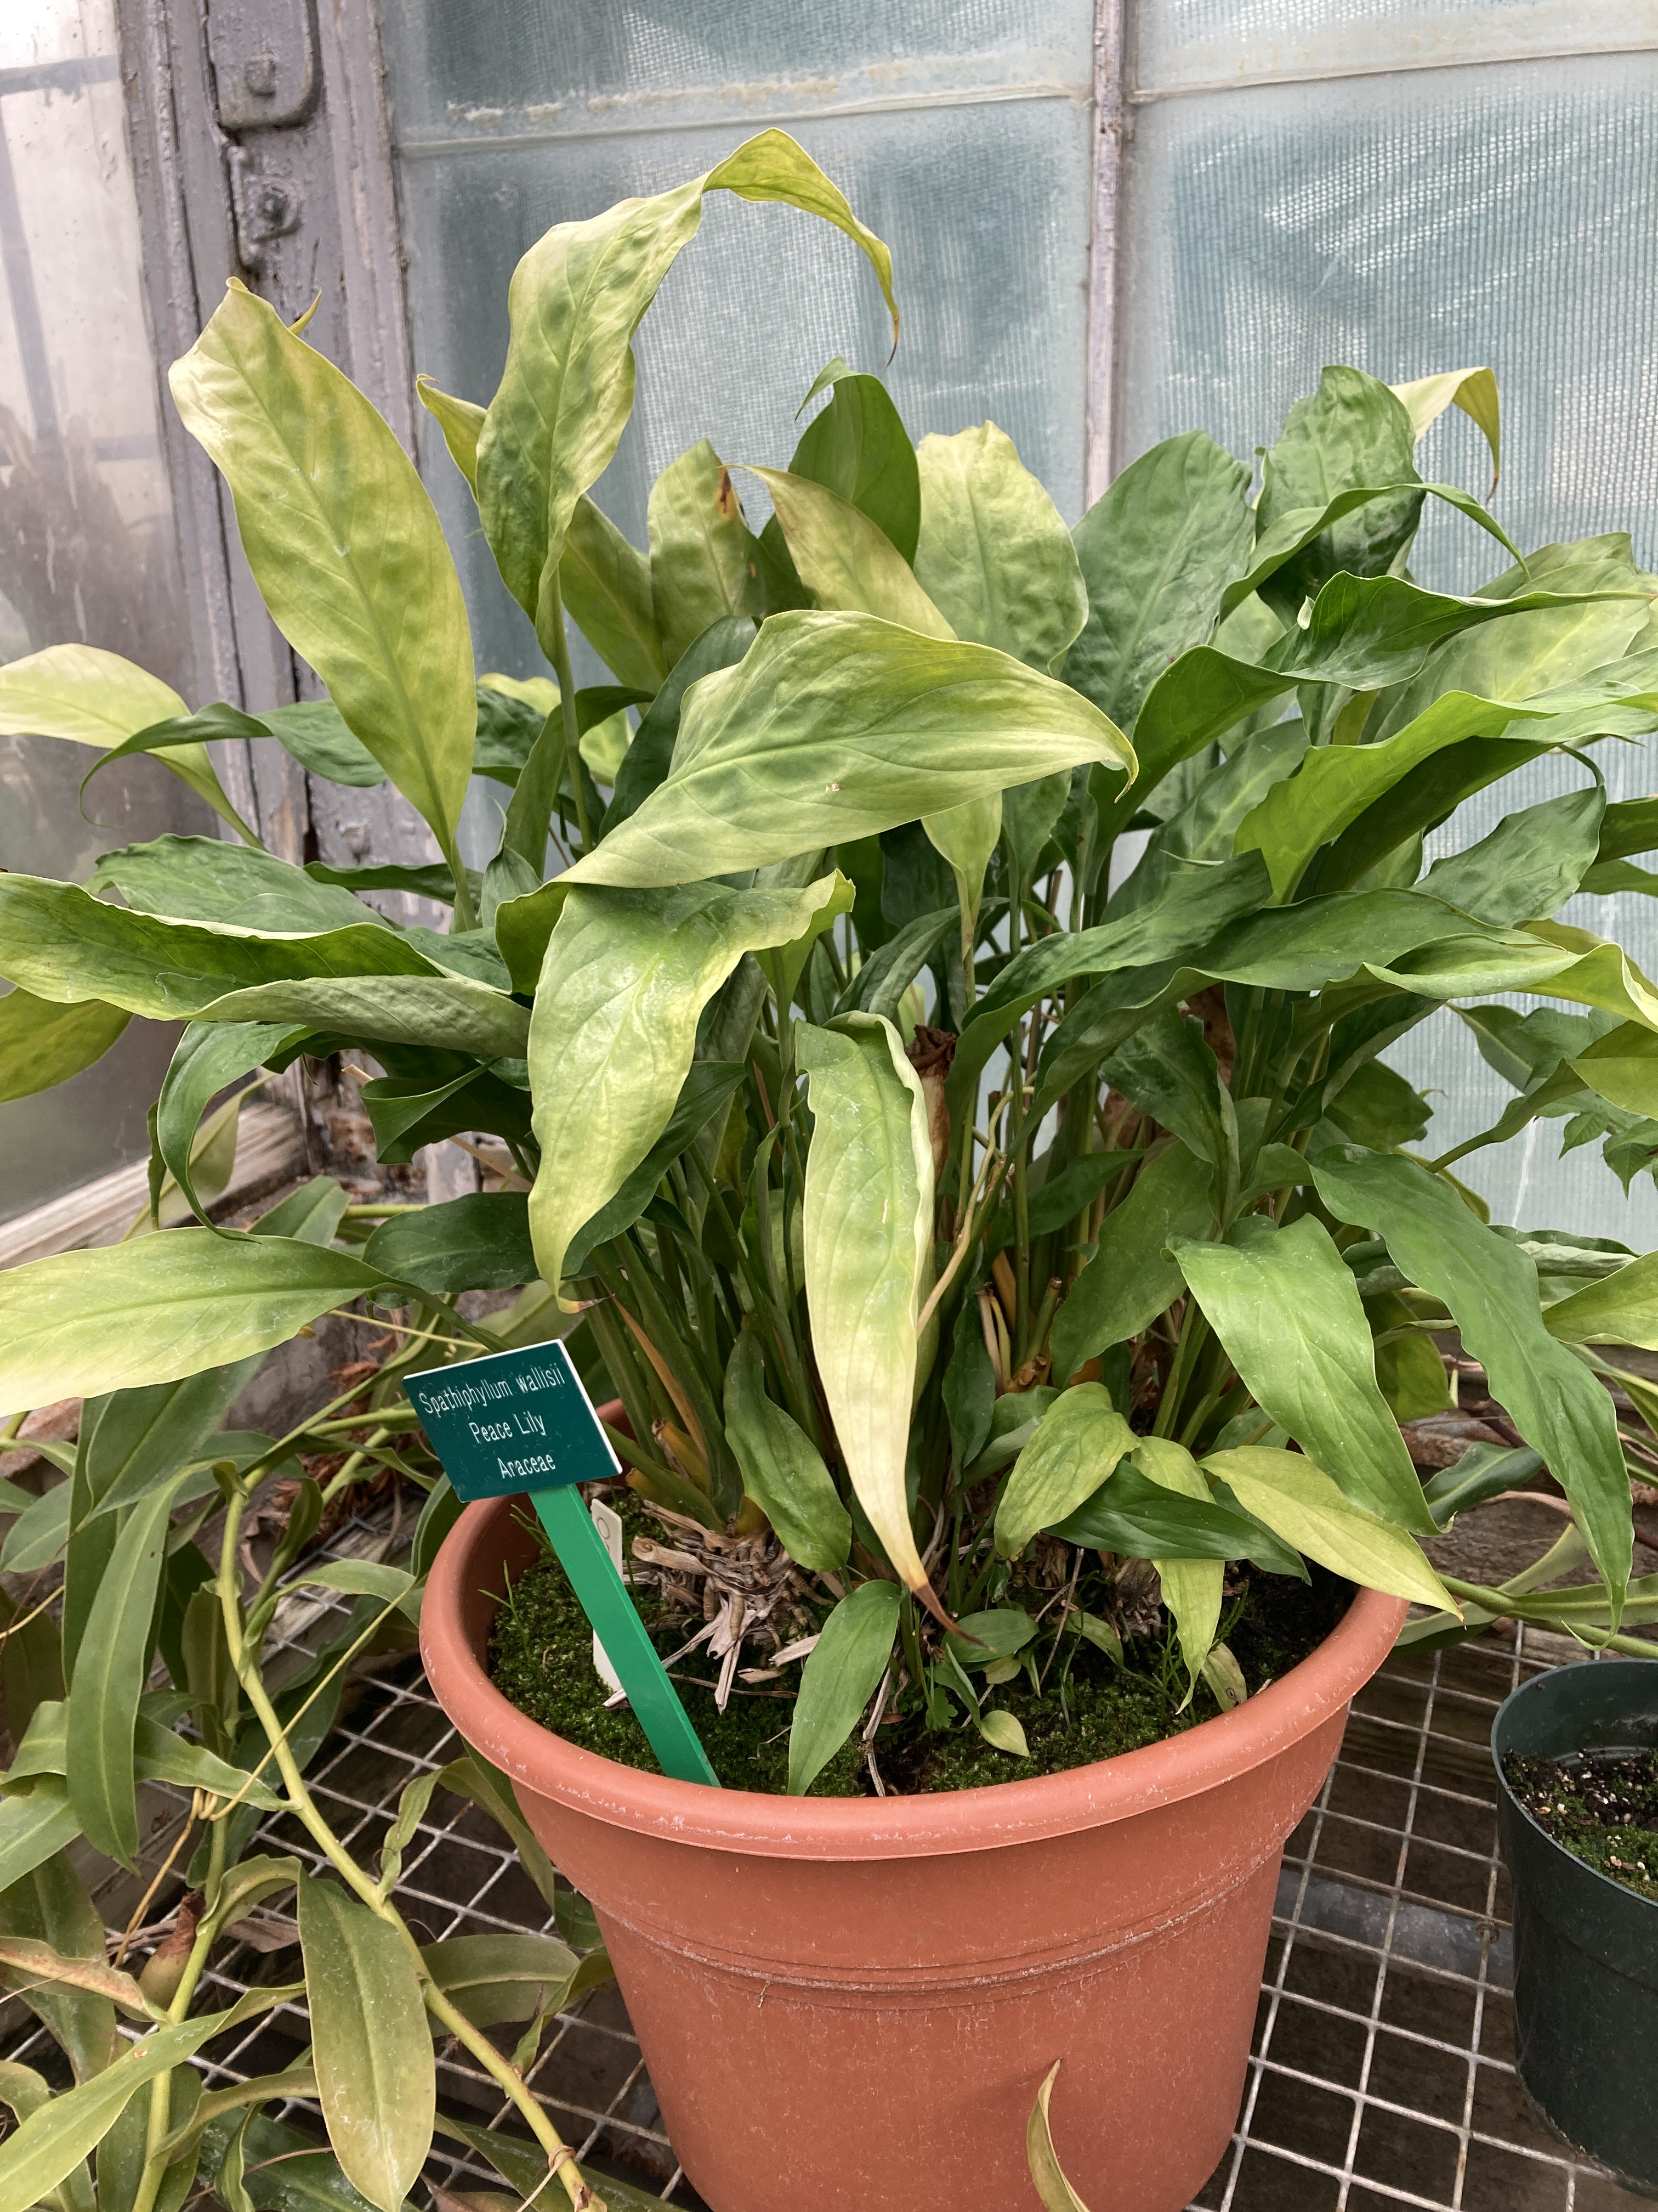
High Light
Scorching on leaf margins
Common on:
House plants
Any shade loving plant

Slide 24
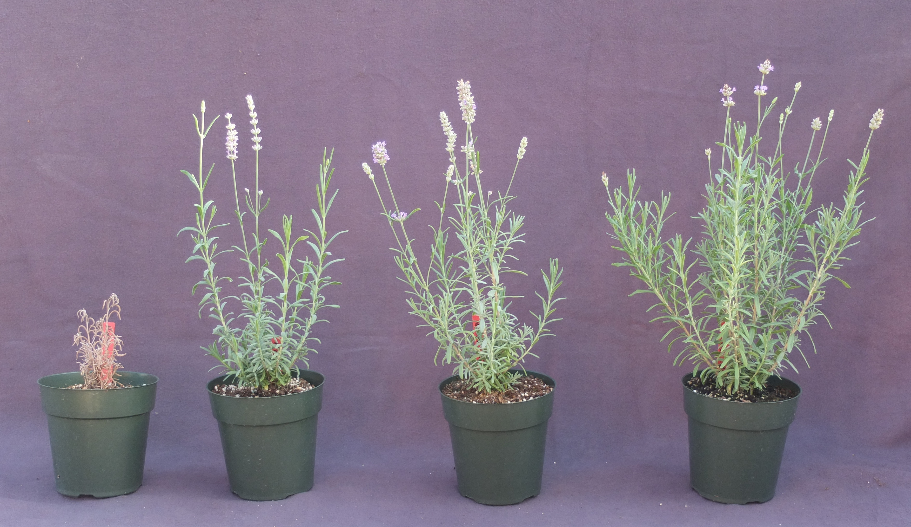
Low Water Stress
Less Water
More Water
Notes:
Low water stress results in smaller plants, fewer flowers, longer roots, and ultimately – dead plants :(

Slide 25
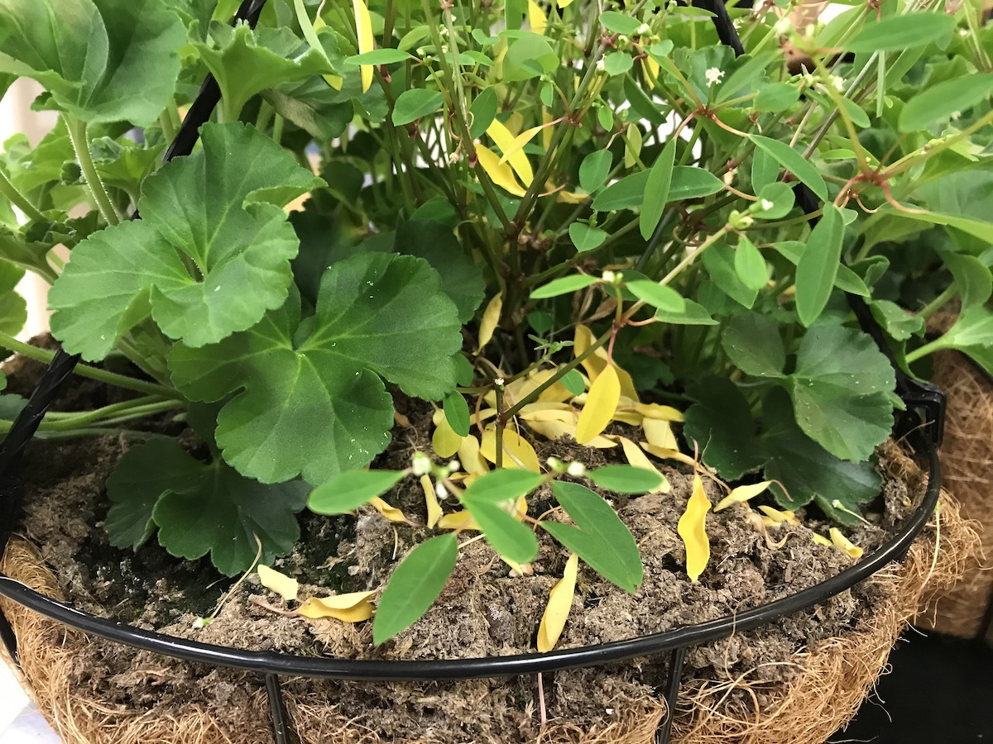
Other Abiotic Problems - Ethylene
Leaf drop or
Flower drop
Seen here on a
Euphorbia
Ethylene may result
from incomplete
combustion

Slide 26
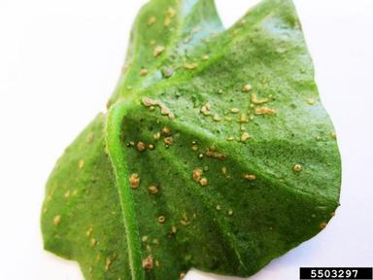
Other Abiotic Problems - Edema
Water uptake faster than transpiration
Cells burst
Lower leaf
Ex: Ivy geranium, tomato
Photo compliments of Sandra Jensen

