Slide 1
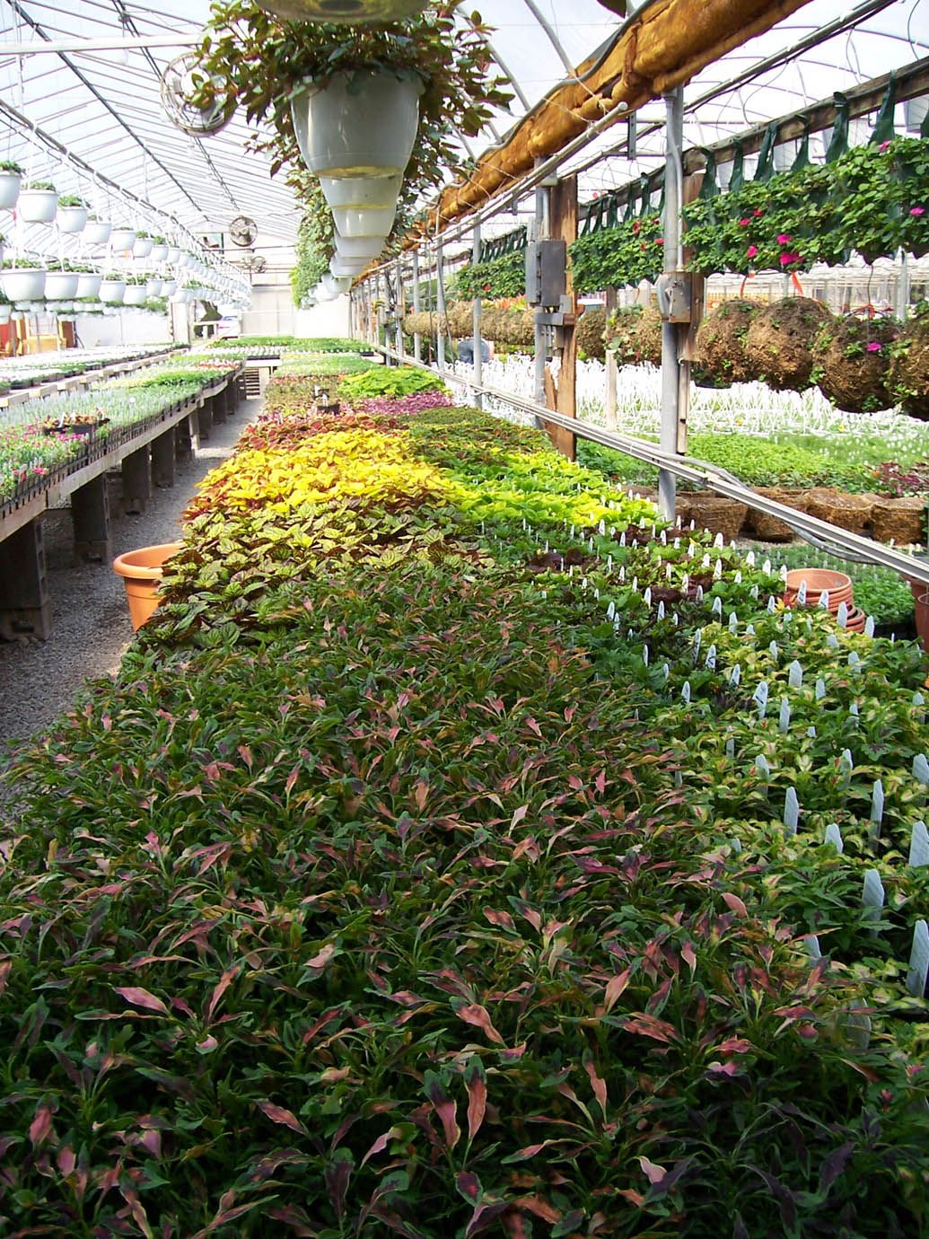

Creating a scouting plan:
The macroview of the greenhouse
February 27, 2025
Elizabeth Lamb

Slide 2
What is a ‘macroview’ of a greenhouse?
Before you even look at the plants, look at the ….
Large scale view
  Structure
  Plants
  History
You are gathering information to make your time scouting more efficient

Slide 3
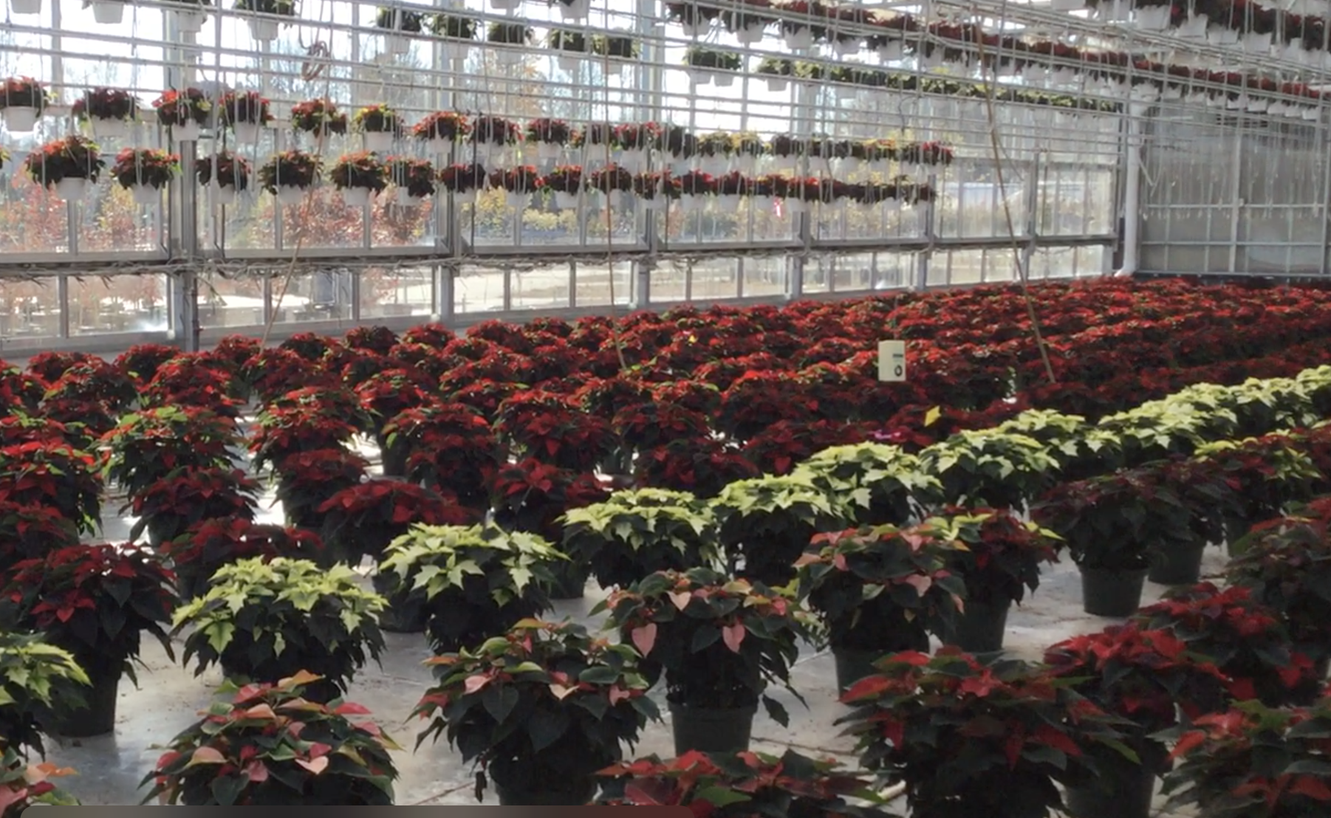
What do you notice in this greenhouse that would possibly affect your scouting?

Slide 4
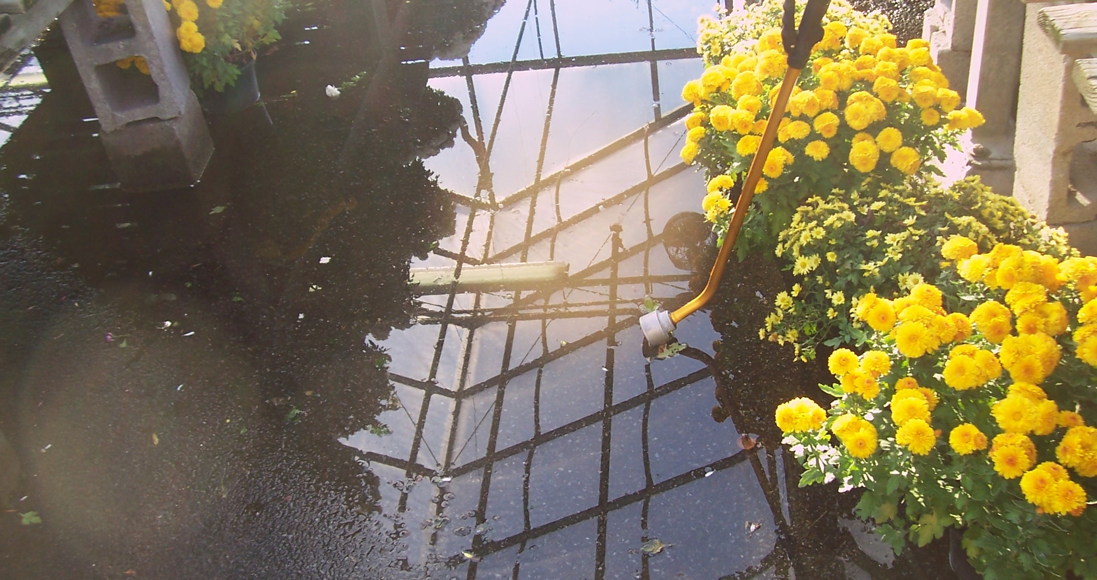
Structure
Floors – concrete vs dirt, clean landscape fabric vs dirty landscape fabric
  Thrips and fungus gnats with dirt floors or even gravel
Size
  Number of sticky cards and where to put them
    1/1000 sq ft PLUS…. for sticky cards
  How many plants are you scouting and where?
Traffic patterns
  How pests might be carried into and around the house by people
  How you might get around to scout the plants
Airflow
  Where does air move in and out of house
    Air intake can be a location for hot spots
  Where do plants dry out first? - spider mites

Slide 5
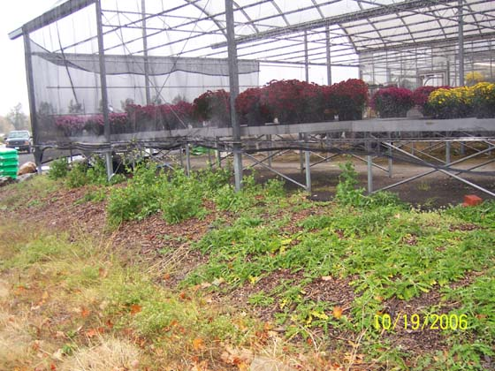
Structure, continued
Water
  Are there drips from irrigation or hose bibs? – shore flies
  Overhead irrigation or drip or watering from below?
    Which diseases would you expect to find?
What is outside the greenhouse?
  Plants that might have pests/diseases that affect the crop
  Weeds with seeds that might come in
  Incidental insects that just get stuck on the cards
  How can they get in from out there?
Add scouting locations where you would expect to find issues

Slide 6
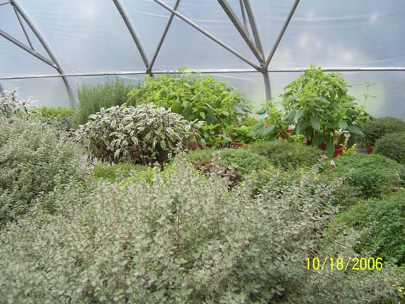
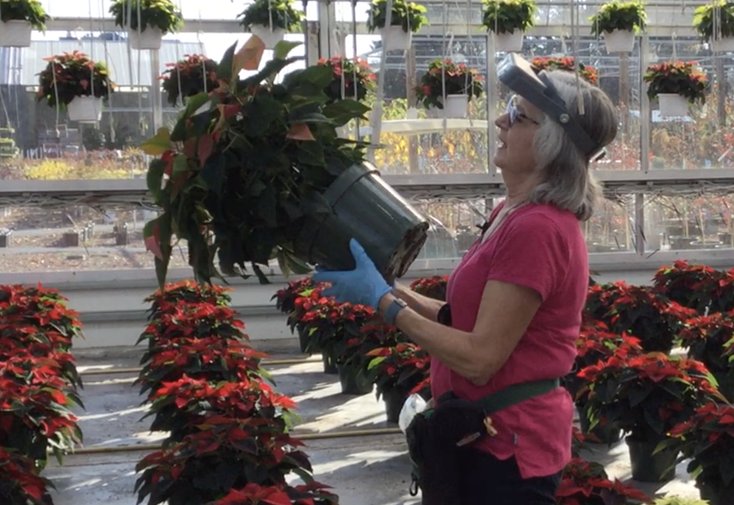
Plants
Patterns in plant appearance across the greenhouse
  Different colors – is this genetic or a disease?
  Light color/direction/amount and time of scouting
Are plants moved from place to place – and how does that affect results?
What can you actually pick up to look at?
Check these more carefully
  Pet or stock plants
  New plants just brought in to greenhouse
  Large or overgrown plants
  Weeds?
Remember to leave things as you found them – irrigation, put plants back into pots carefully…

Slide 7
Some information you need to get from the grower
Previous crops and pests
  What crops were grown there before?
  Where were they - hotspots?
  Are the pests likely to still be there?
    Crop – and weed – free period
    Which pests can survive without a host (including weeds)
      Spider mites
      Fungus gnats
    Temperature extremes are not enough

Slide 8
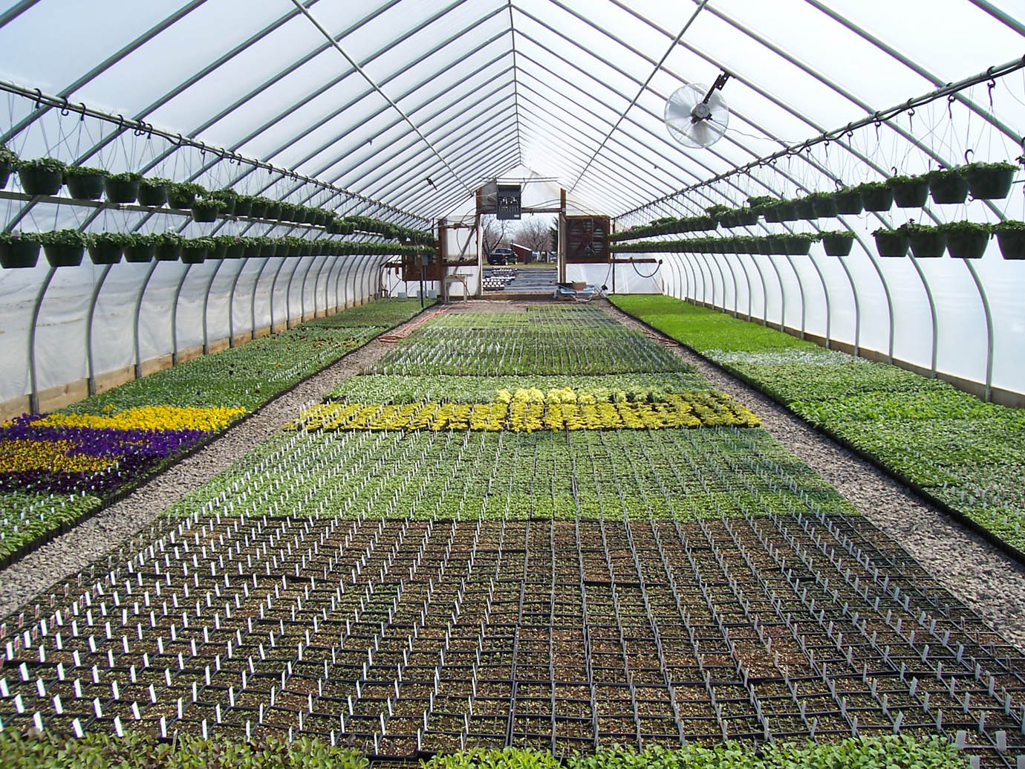
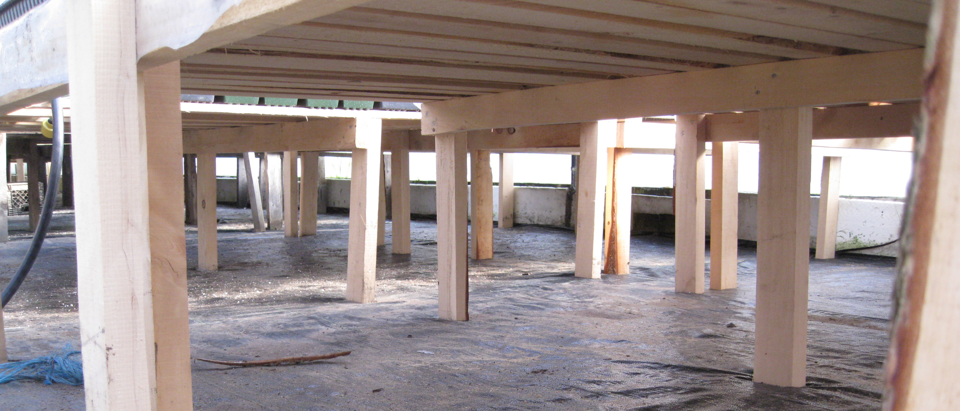
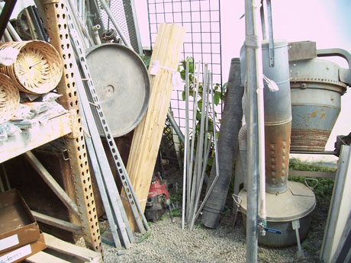
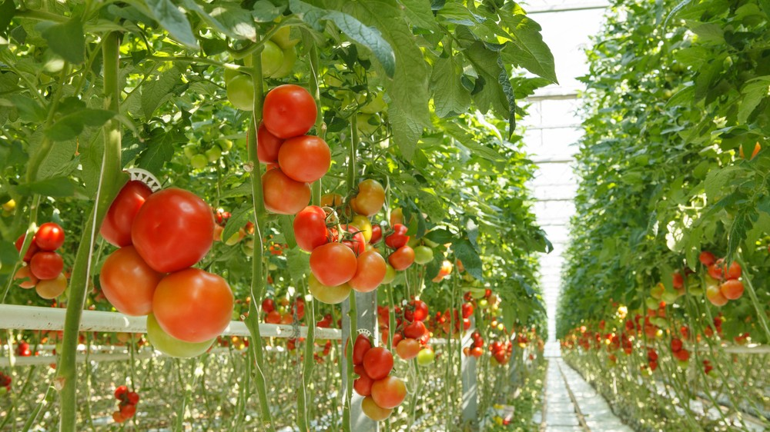
Information and Observation
What looks different or out of place/unusual
  Different angles – look across aisles as well as along them
  Look in 3 dimensions – hanging baskets?
  Experience!
You may need to look in other places

Slide 9
Why is this information important?
So I'm a new scout on a 44 acre greenhouse (grape tomatoes). I can scout 20-40 rows a day (out of 950 rows) depending on how busy the rows are.
I feel like by the time I get to an area it's already infested.
I know industry standard for a greenhouse my size (experienced scout) is around 185 rows a day. (whole house takes 5 days)
I know I lose a lot of time stopping to flag plants and to look with the hand lens, how could I do this quicker?
Use to create a scouting plan
  Where should you be scouting?
Making scouting more efficient
  What should you be looking at
  Where should you be spending your time?

