Slide 1

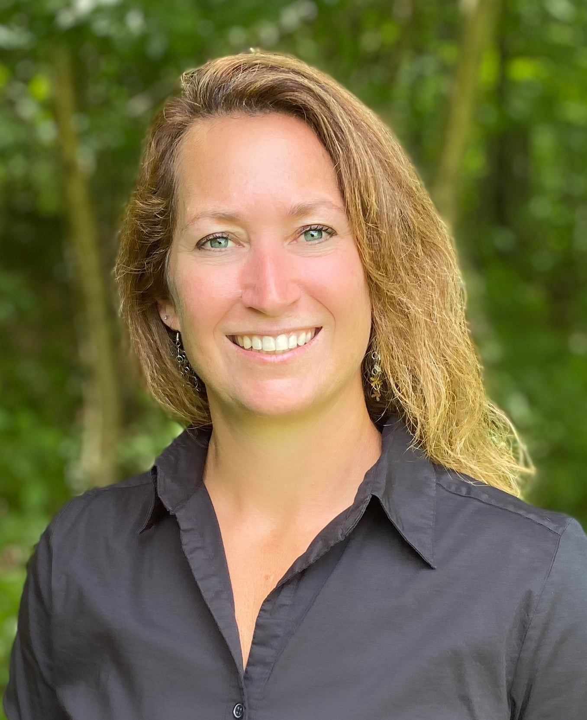

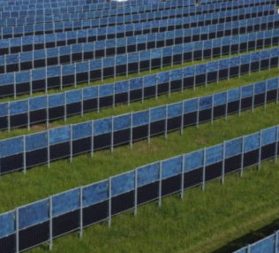
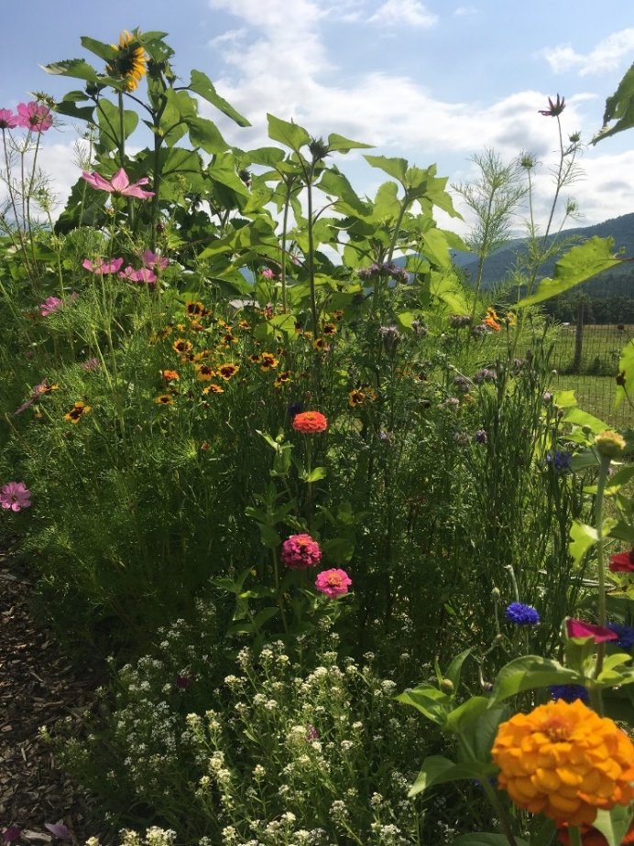
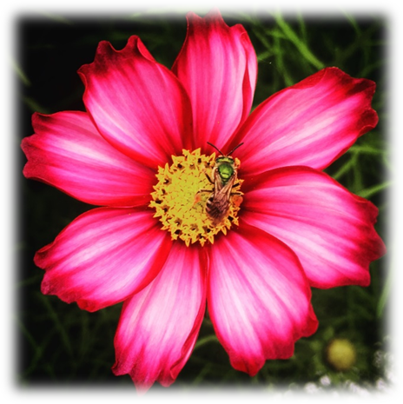
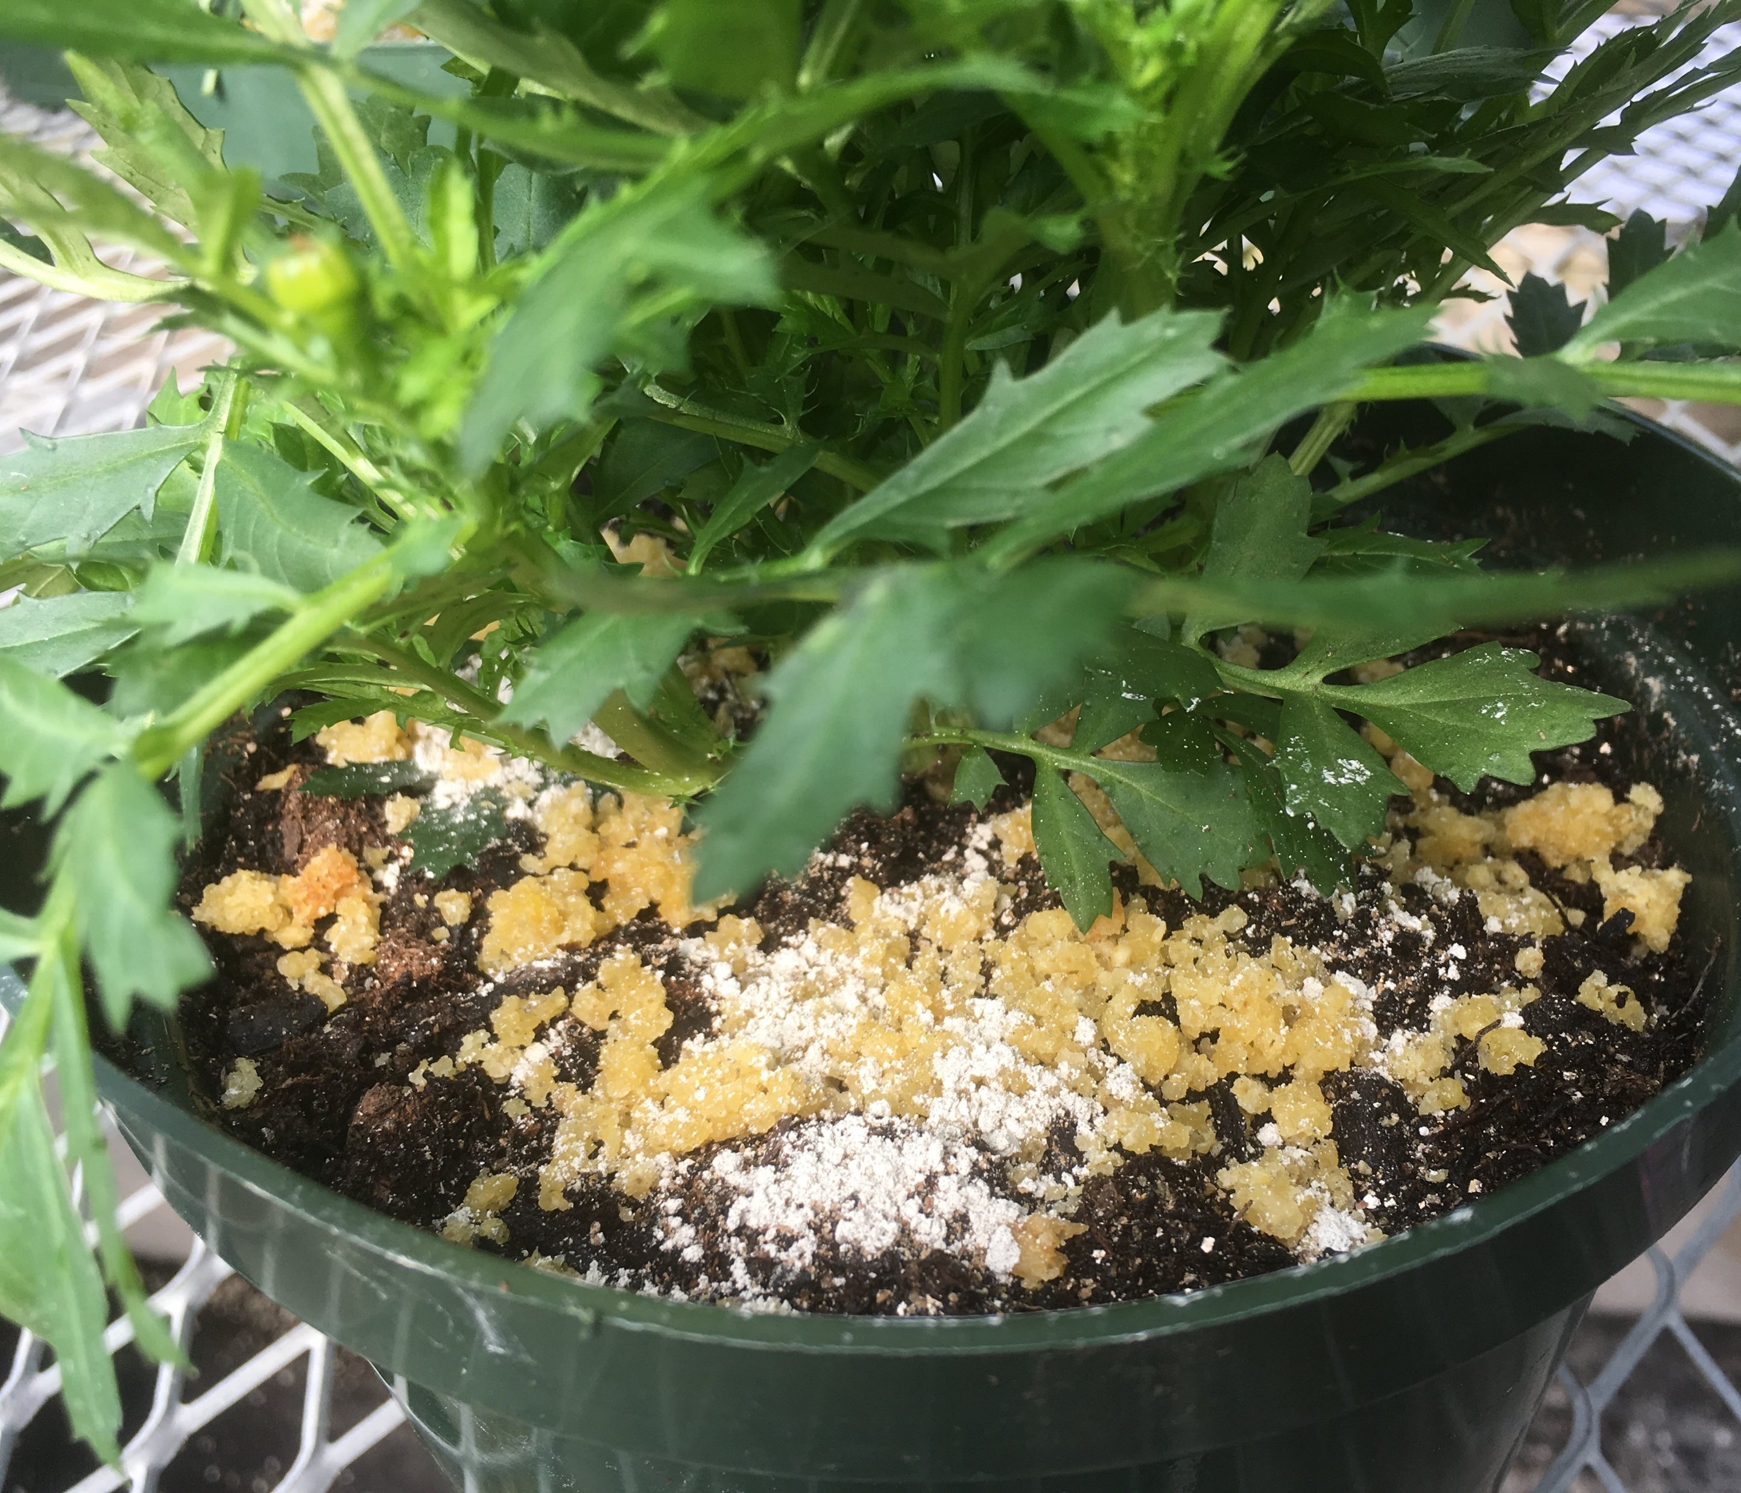
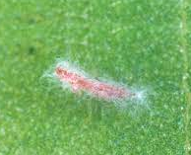
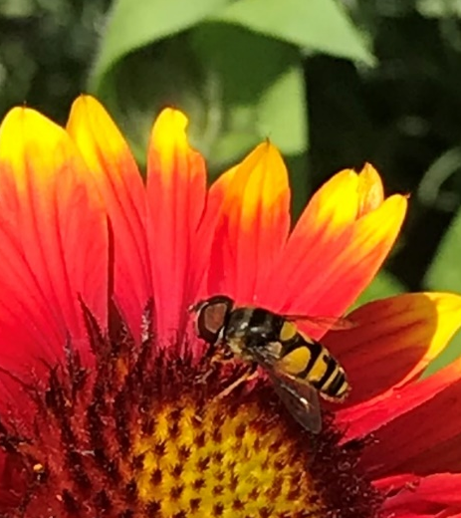
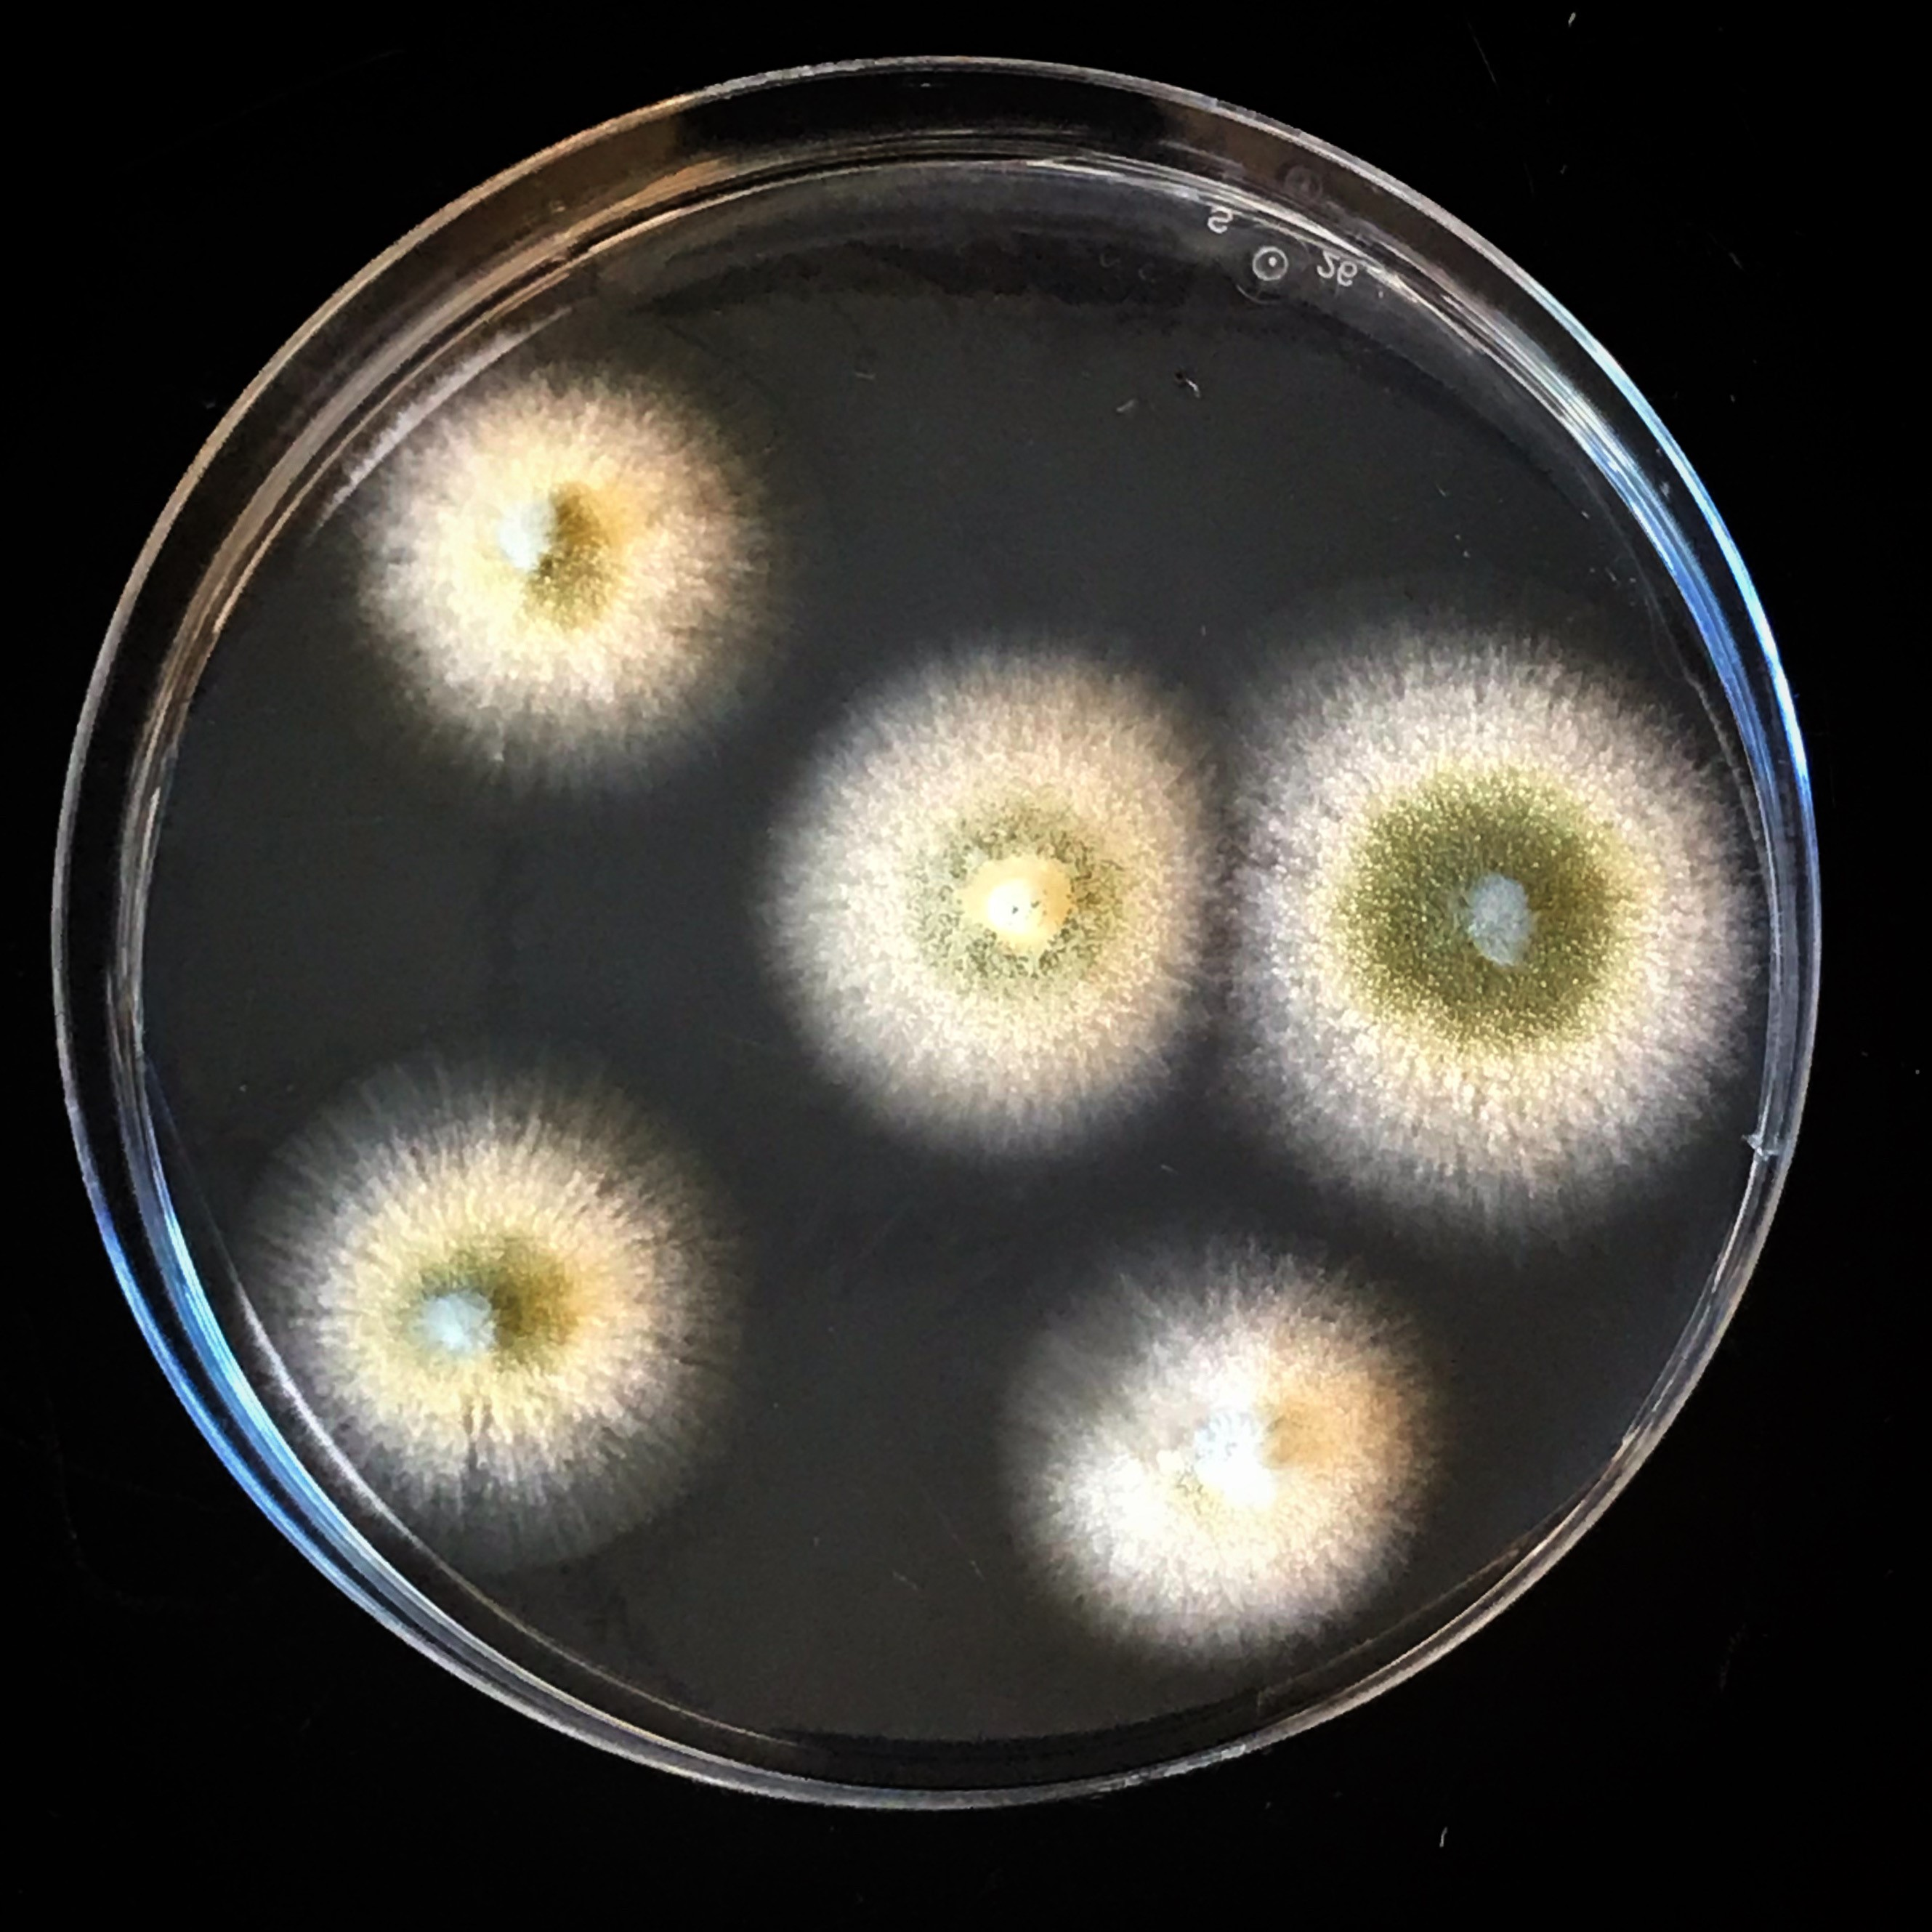
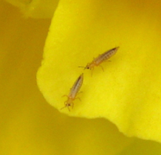
Cheryl Frank Sullivan
Research Assistant Professor
University of Vermont
College of Agric. & Life Sciences
Dept. of Agric., Landscape & Environment
Entomology Research Laboratory
(802) 656-5434 | cfrank@uvm.edu
UVM Entlab | UVM Ticks | Faculty Page
Specialize in the Integrated Pest Management (IPM) of key pests in agricultural, landscape and forest settings.
Saffron Production & Pests
Ticks
Agrovoltaics
Primary emphasis on biological control (parasites, predators and pathogens)
Conservation biological control (habitat plantings for beneficials)
Greenhouse & High tunnel pest research (thrips, whiteflies, spider mites) & Extension Outreach
Entomopathogenic fungi

Slide 2
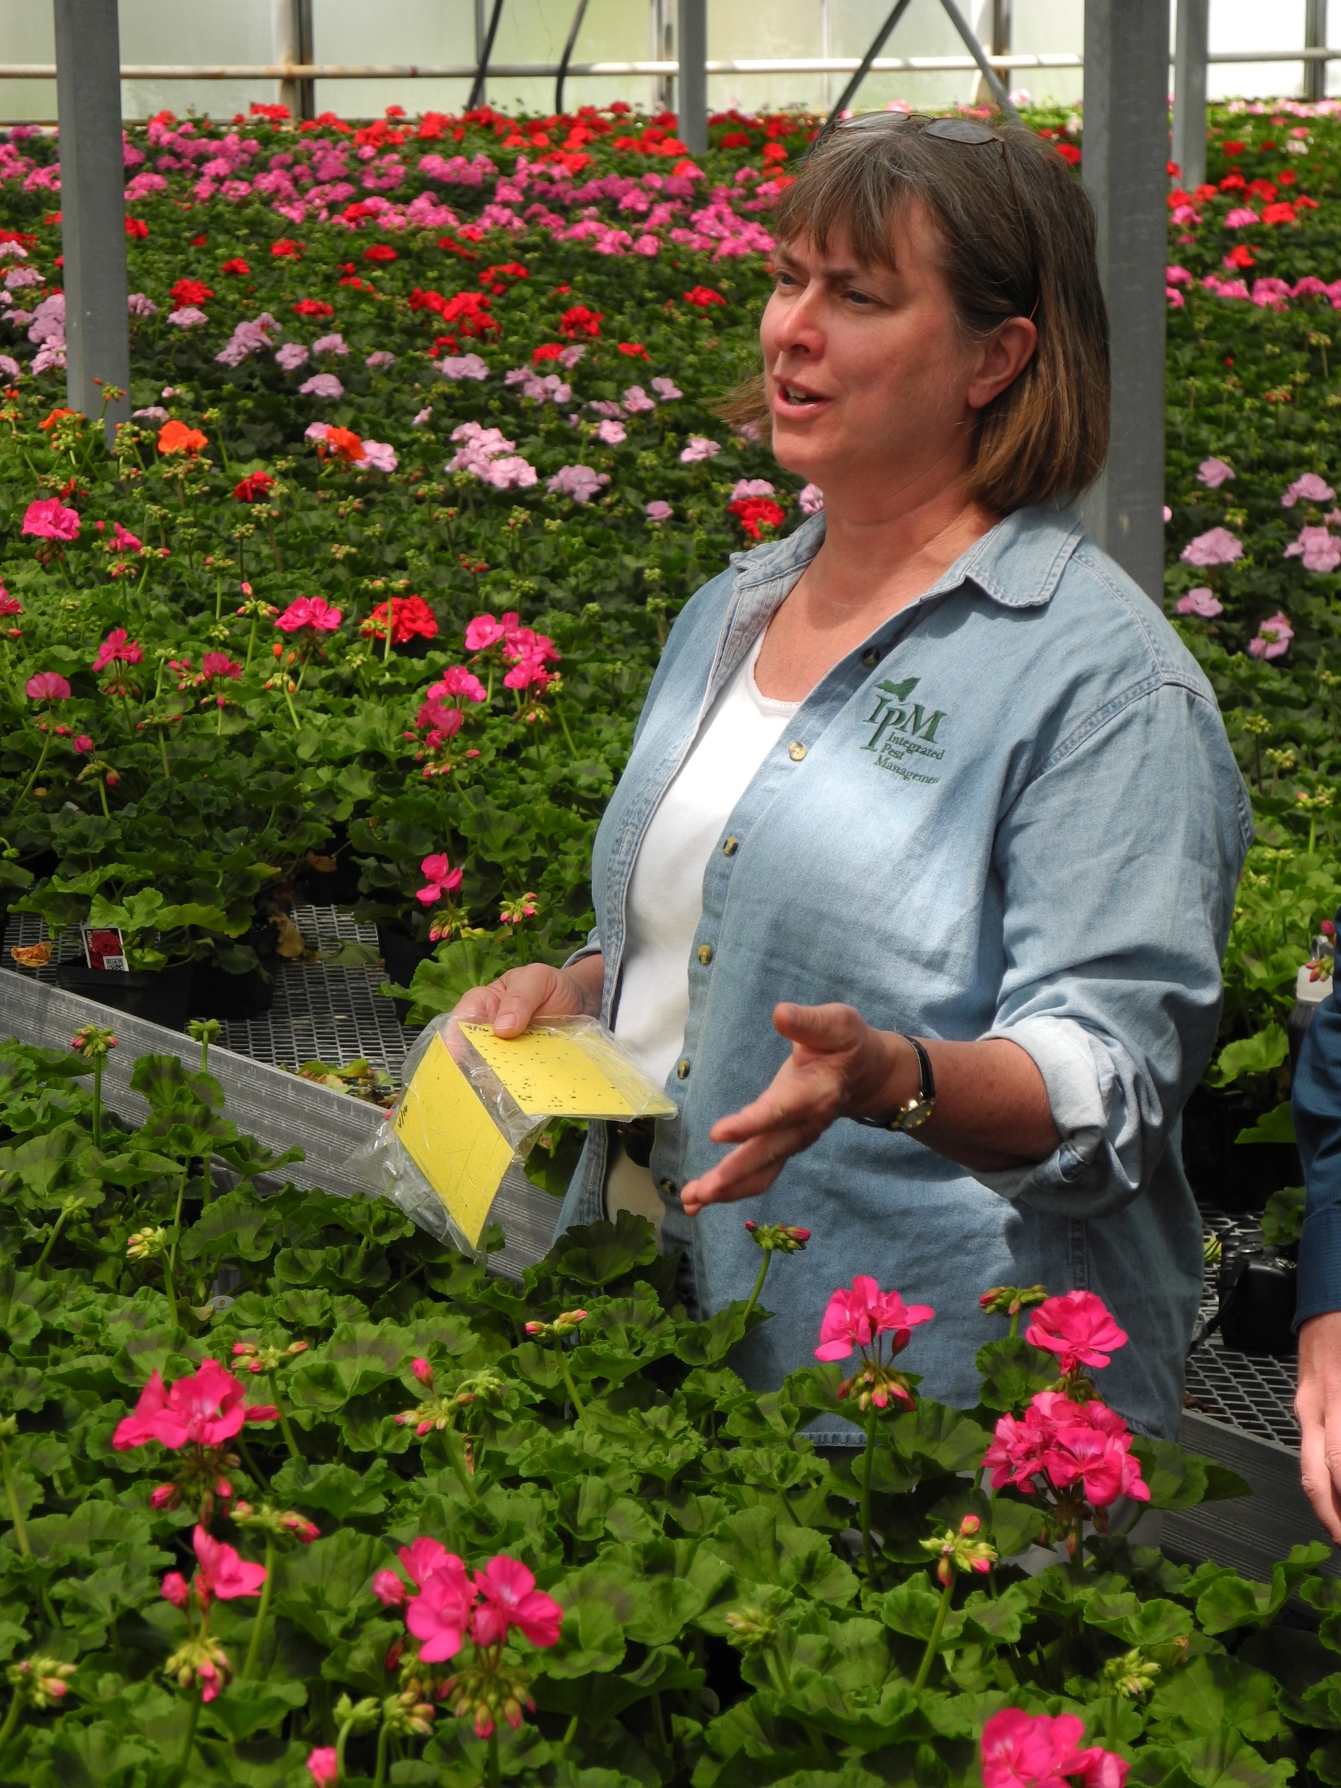
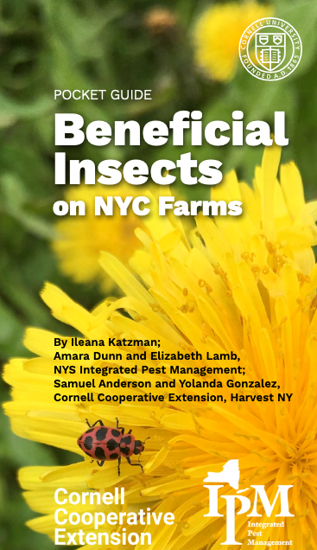
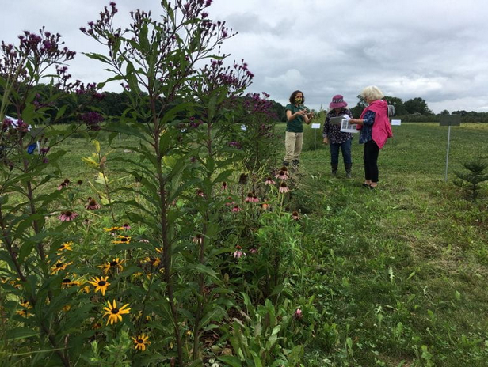
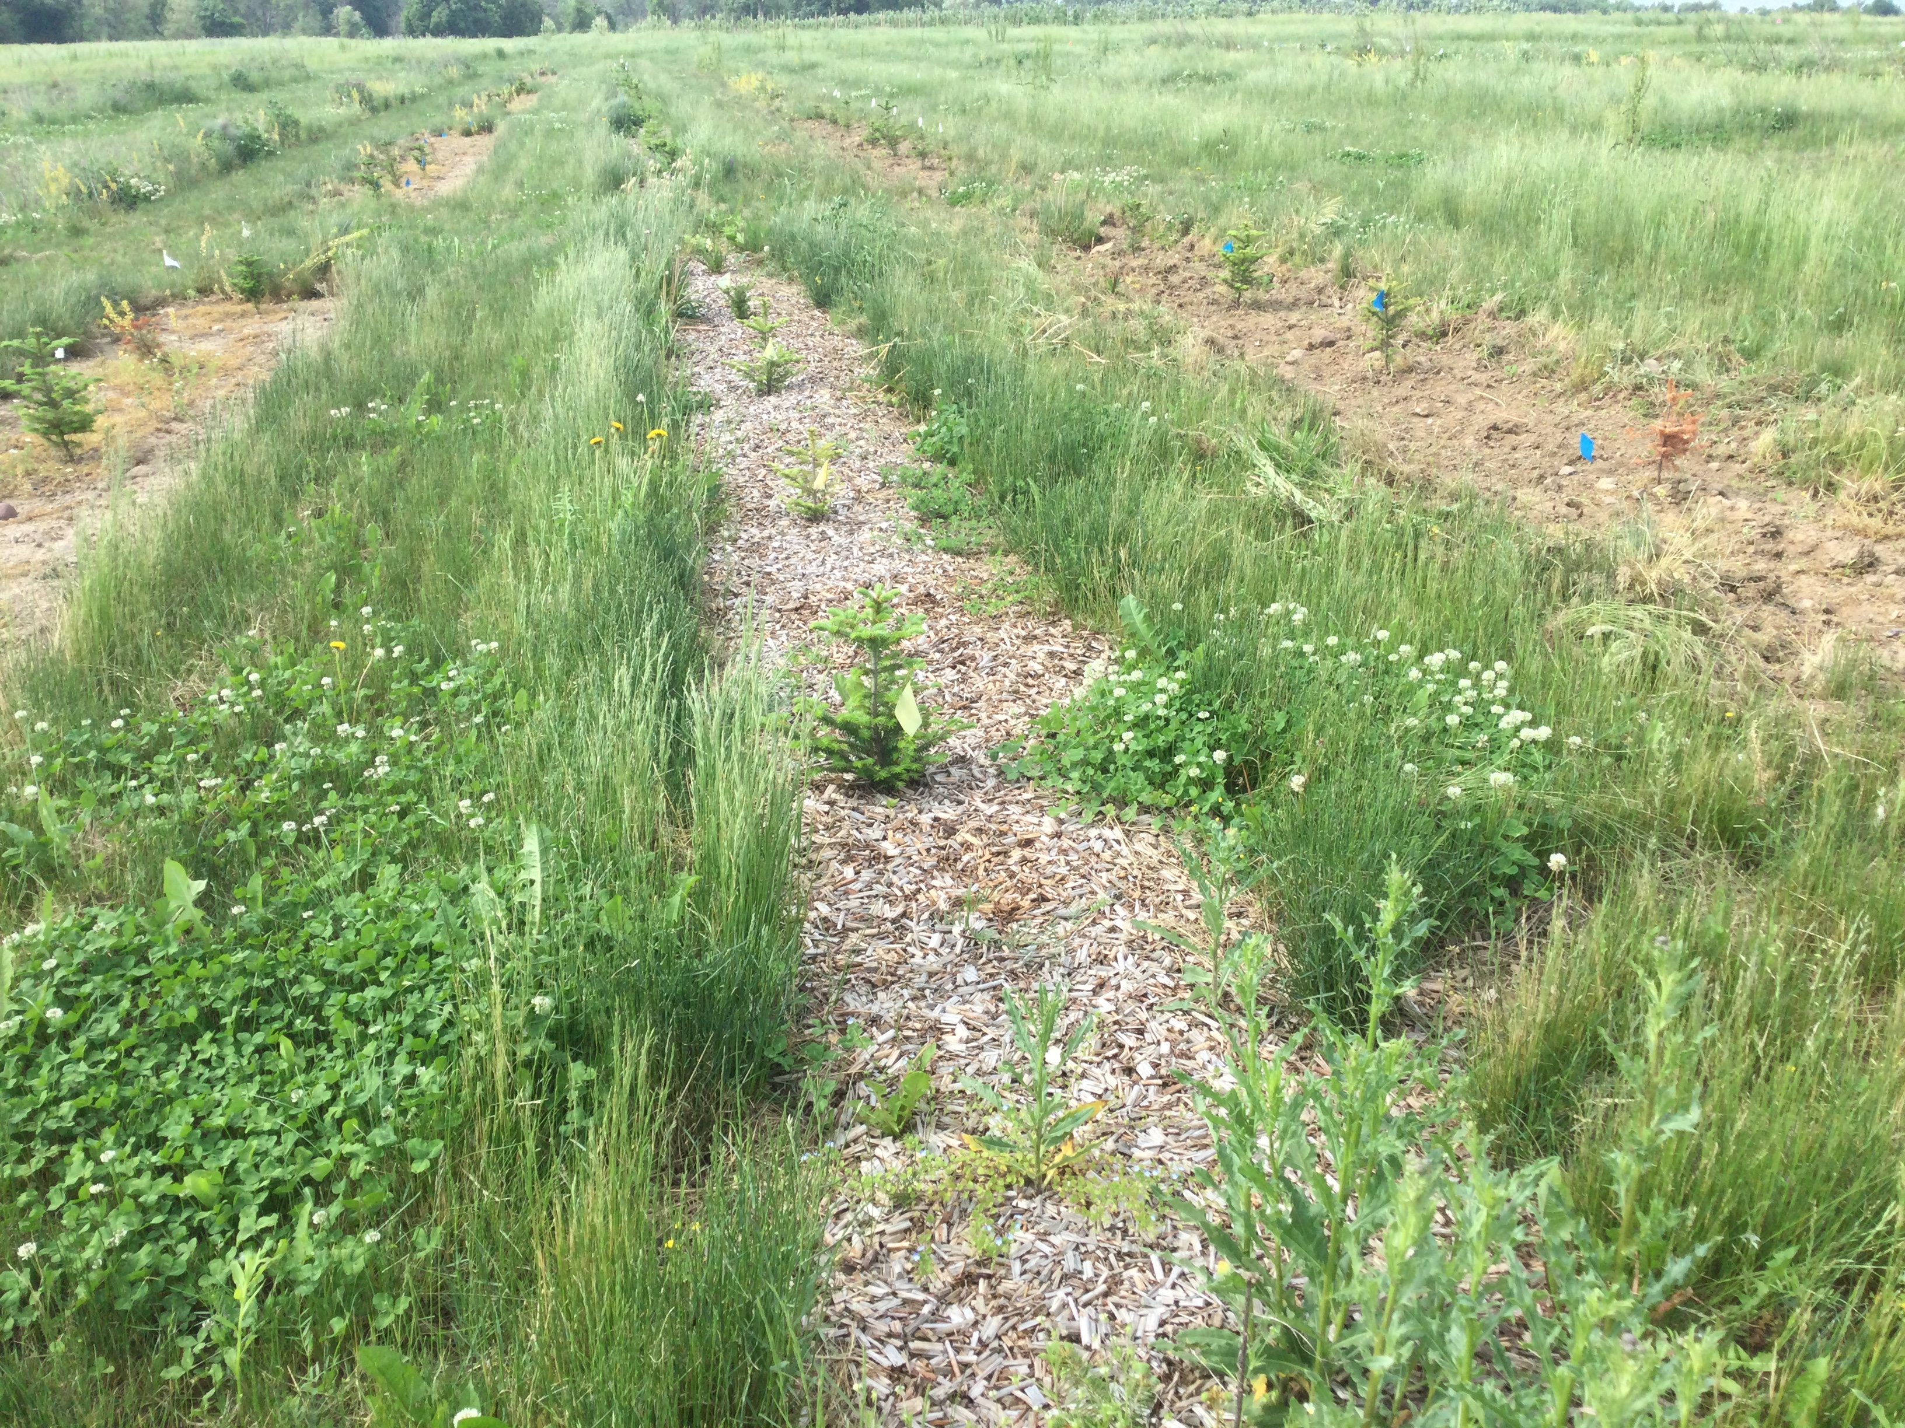
Elizabeth (Betsy) Lamb
Senior Extension Associate
New York State Integrated Pest Management Program
Cornell University
(607) 342-8983
eml38@cornell.edu
Ornamental IPM
Works with growers in greenhouse, nursery, cut flower, and Christmas tree production to find effective, economical, and environmentally sound methods of pest management
Beneficial habitat for pest management in production fields
Pest management in Christmas tree establishment
Development of scouting apps
Beneficial insects on urban farms

Slide 3
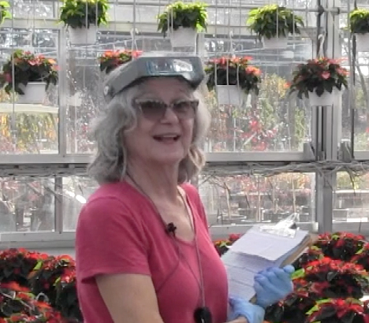
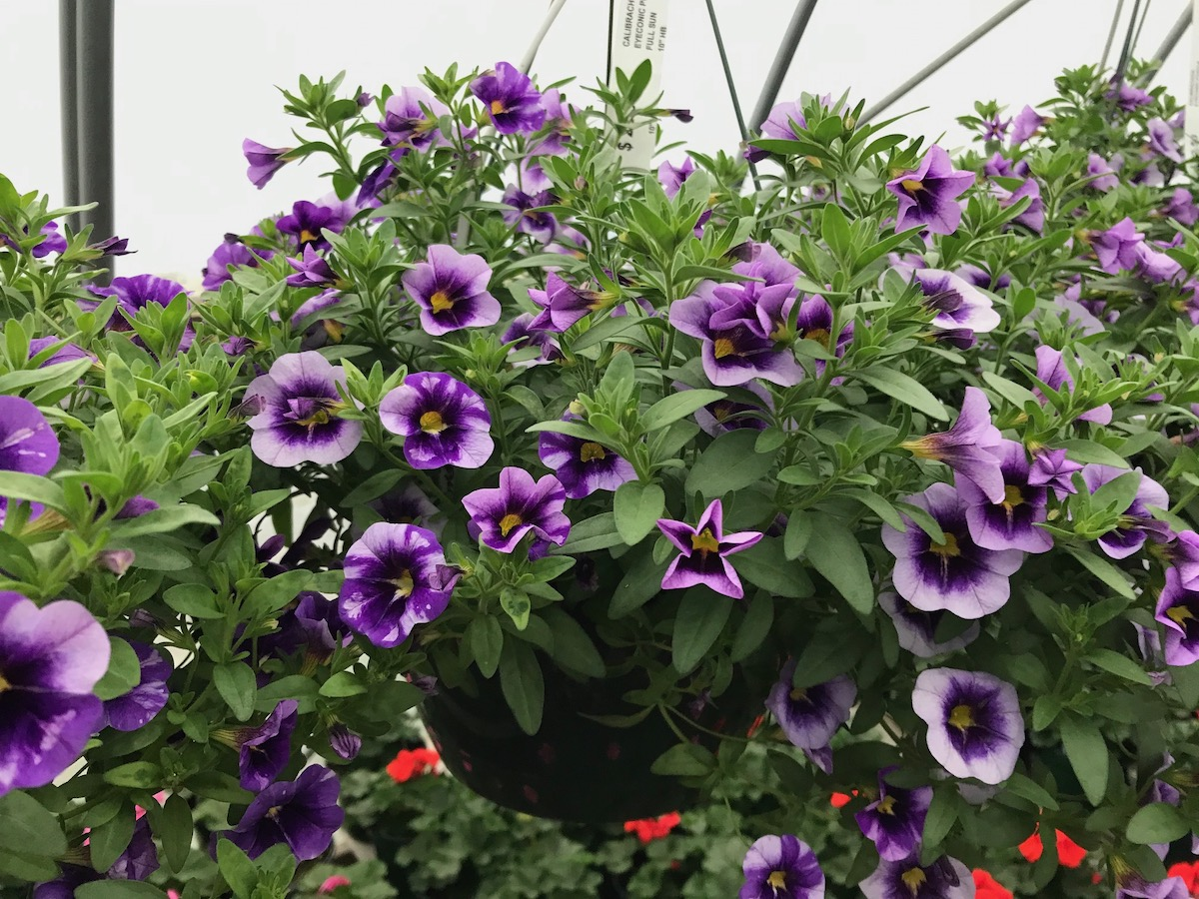
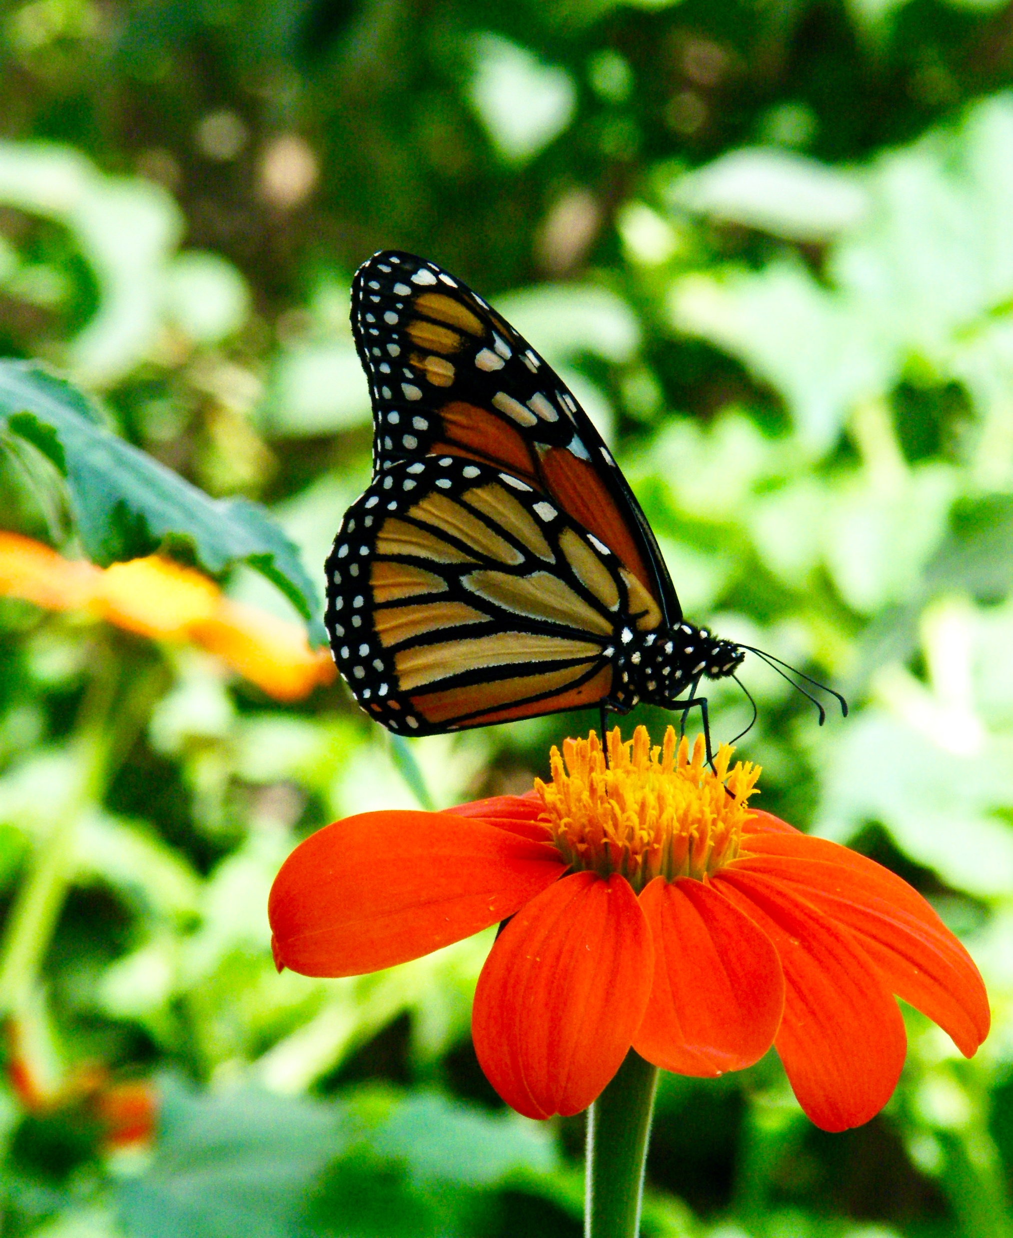
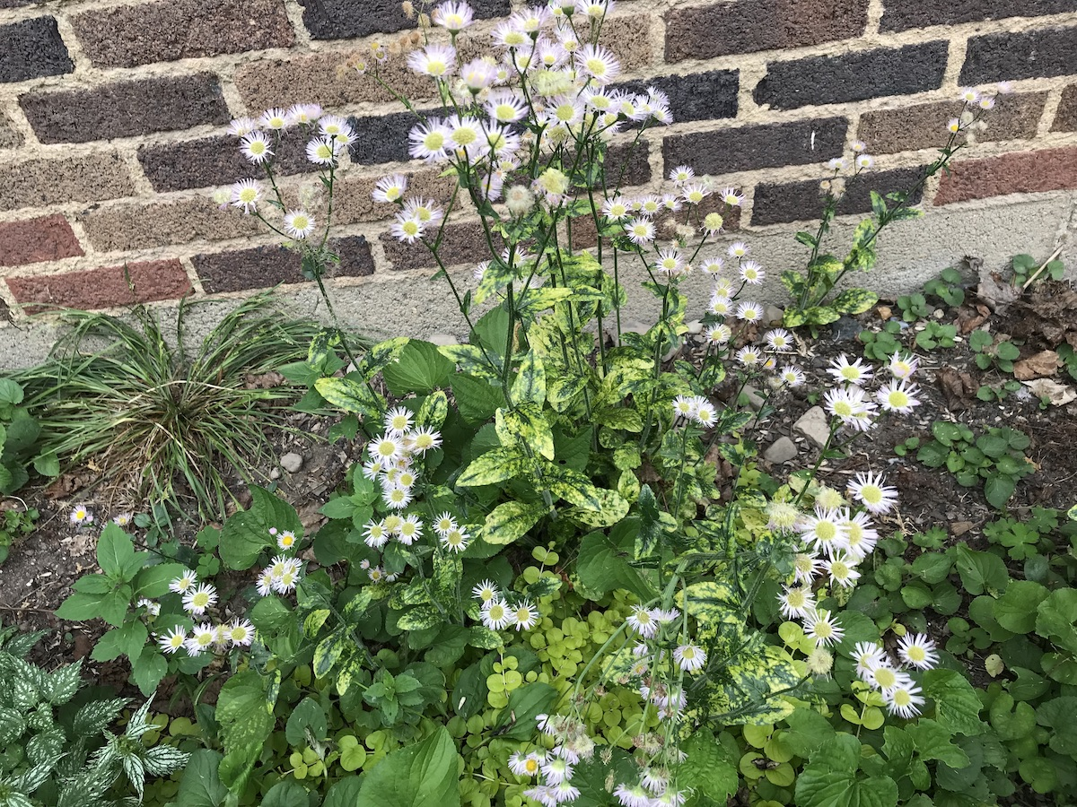
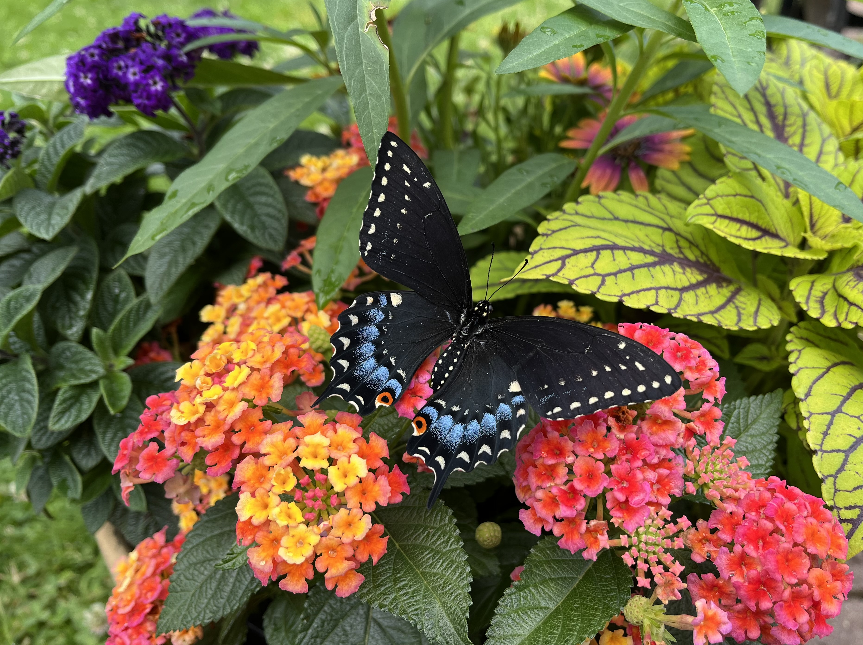
Retired after 35 years as a commercial scout for floriculture and nursery greenhouses
Elise Schillo-Lobdell
The Plant Keeper
ipmelise@gmail.com
Calibrachoa with tobamovirus
Erigeron with torradovirus

Slide 4
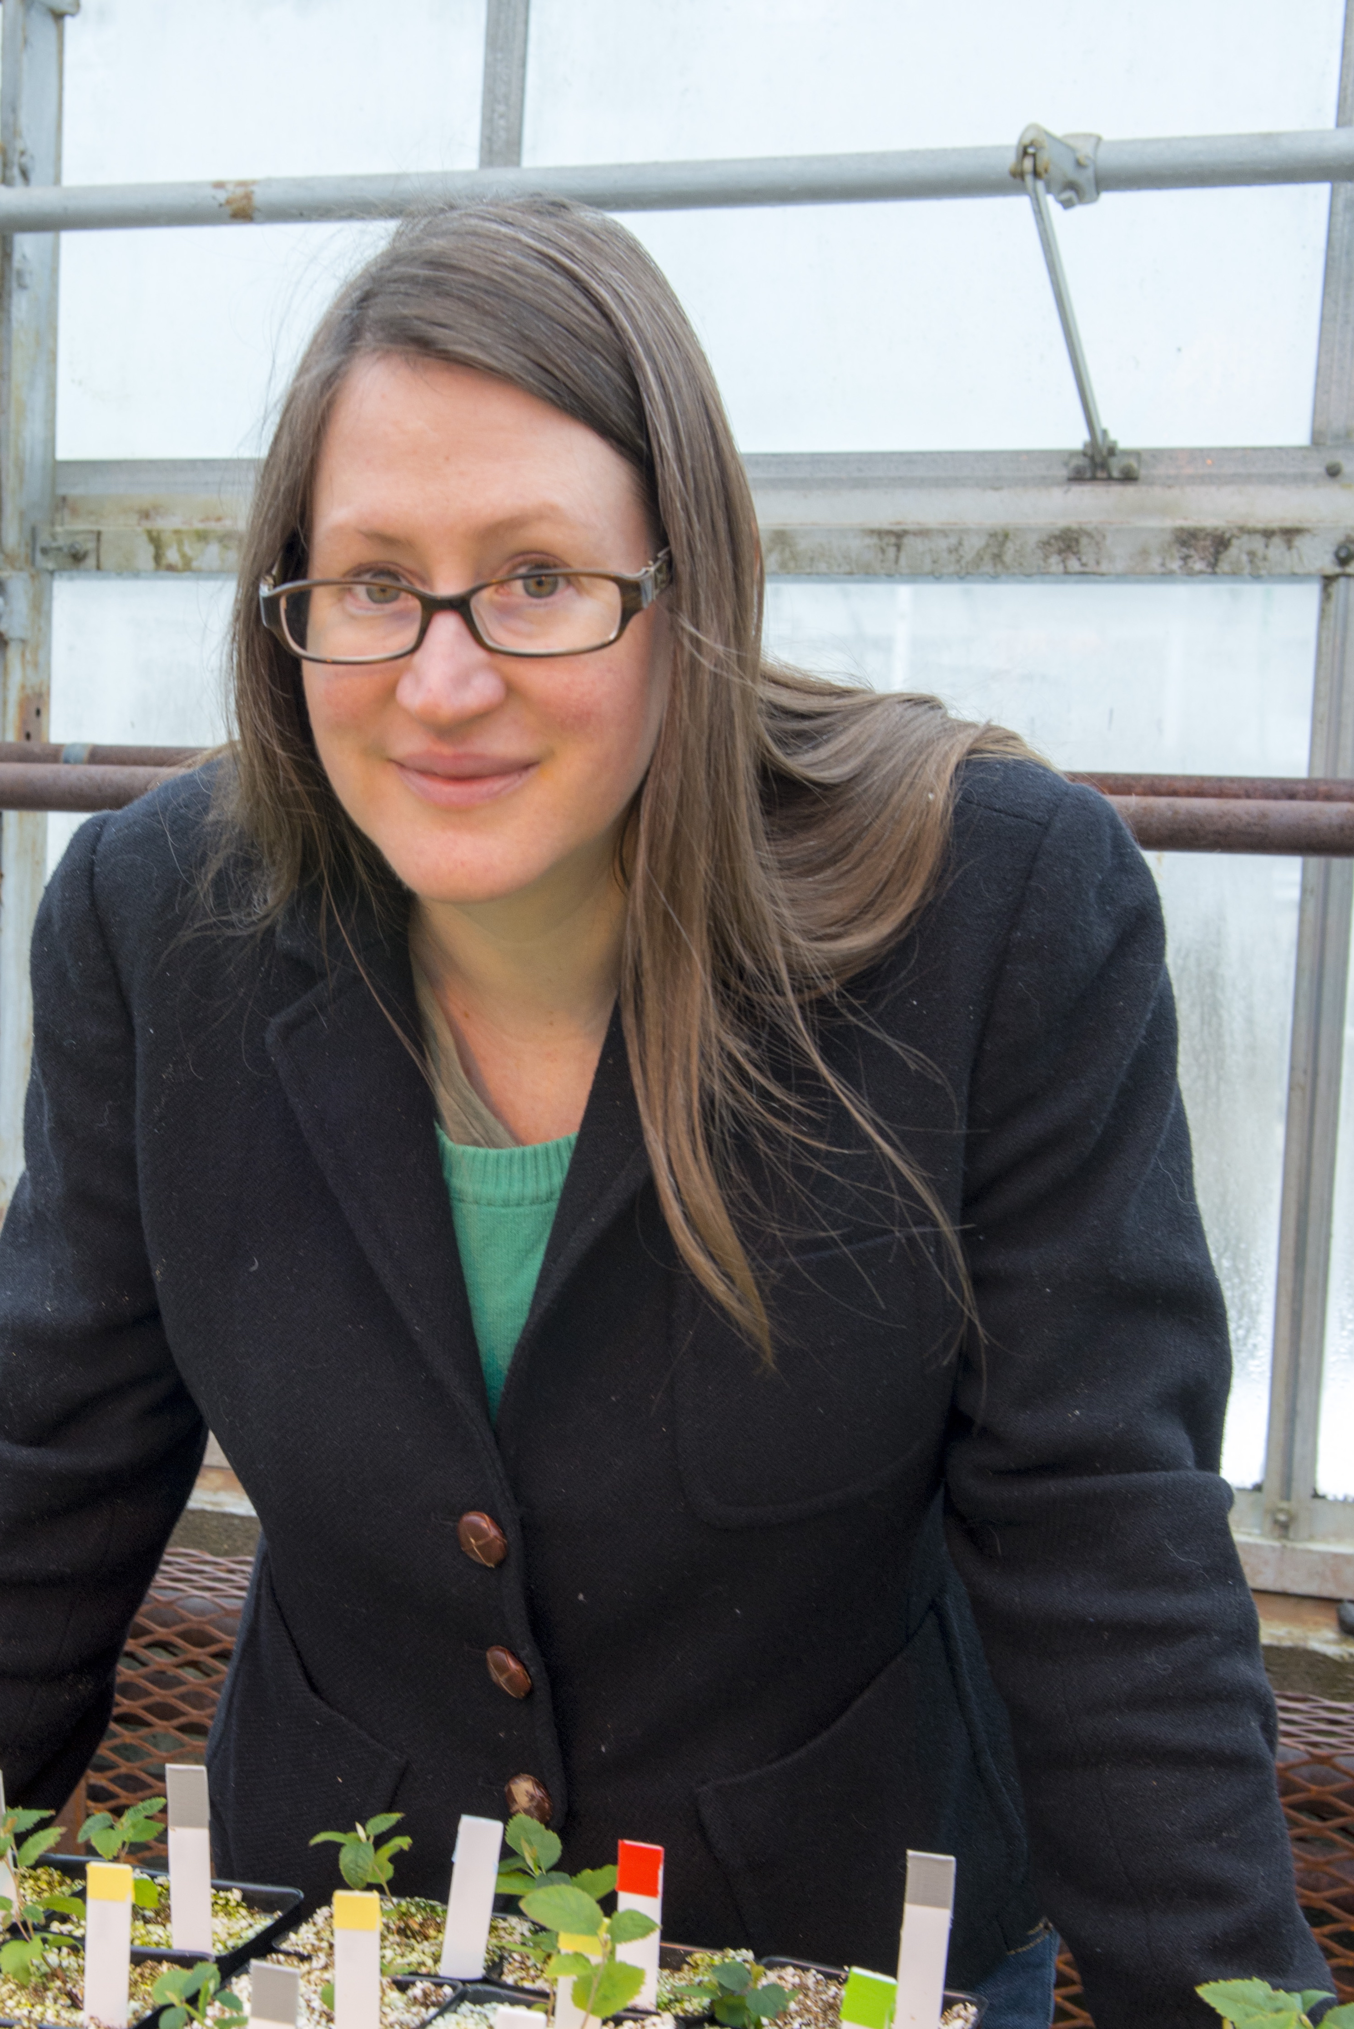
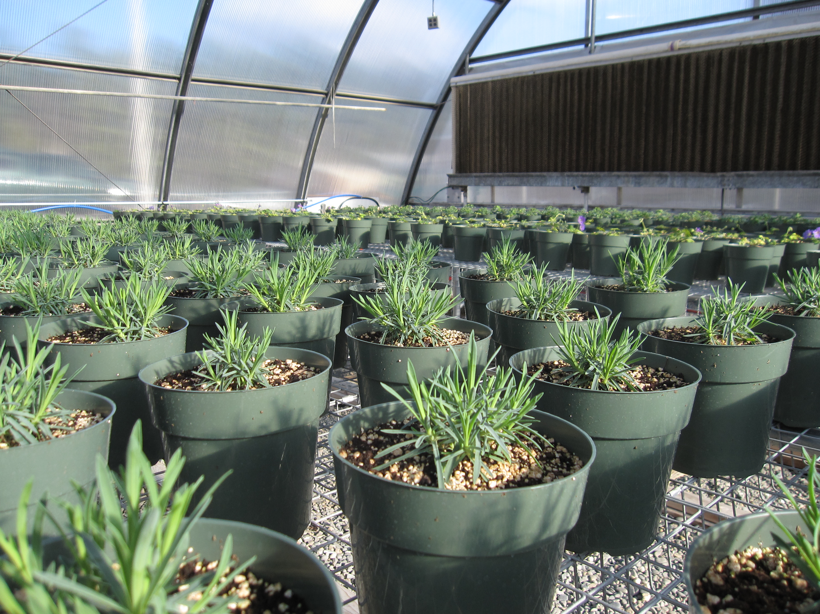
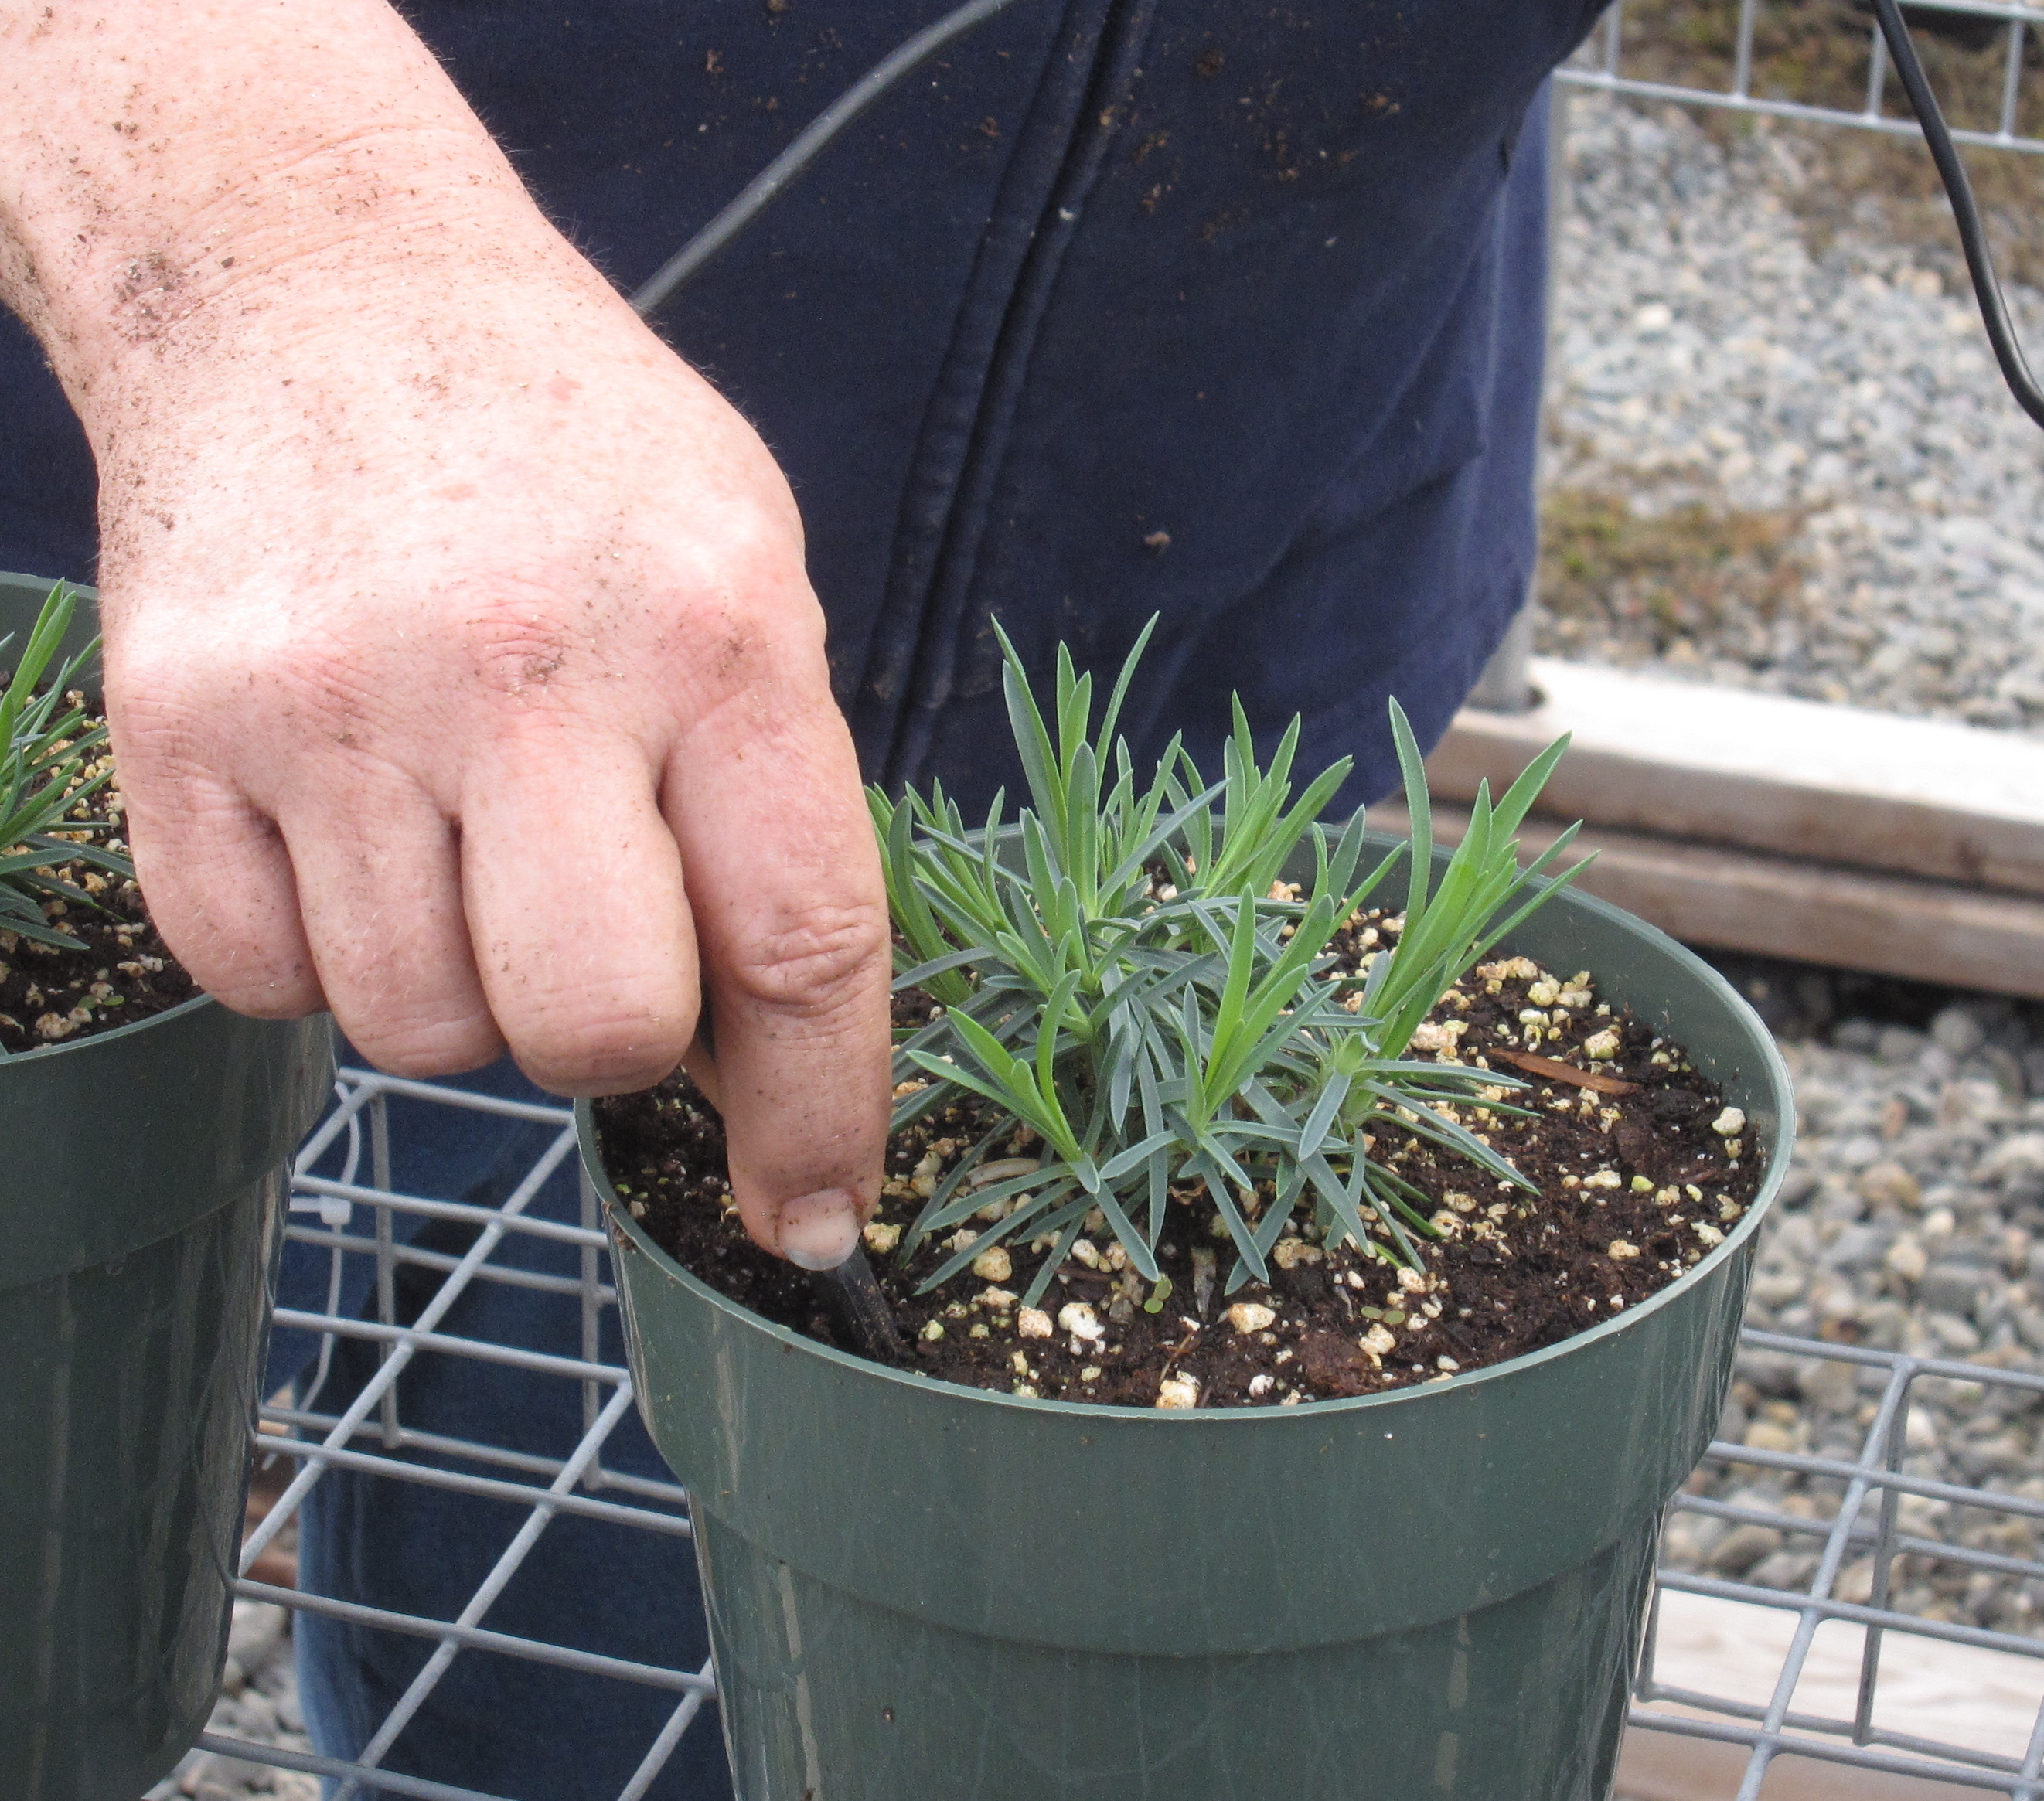
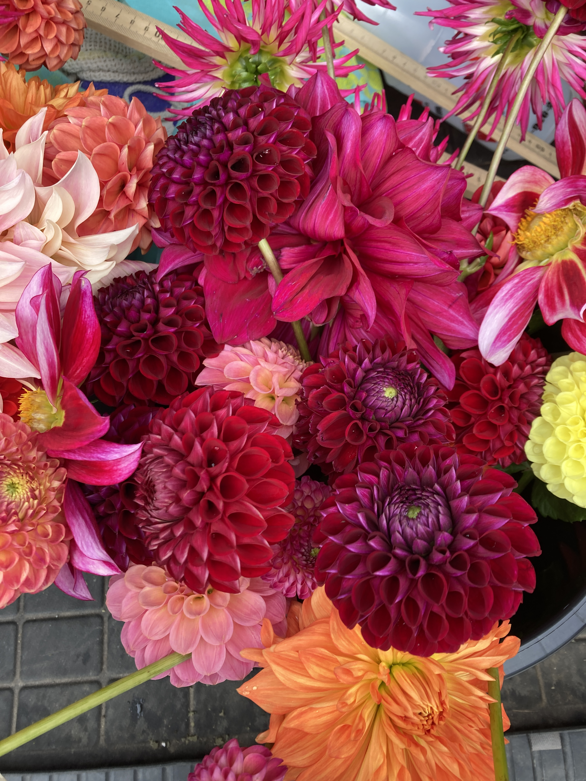
Stephanie Burnett
Professor of Horticulture
School of Food and Agriculture
University of Maine
(207) 581-2937
sburnett@maine.edu
Works on greenhouse production issues, particularly irrigation, and with field grown cut flowers. Instructor for greenhouse management, herbaceous plant identification, and hydroponic food production.
Production of greenhouse crops (herbs, herbaceous perennials)
Moisture sensor automated irrigation
Field grown flowers

Slide 5
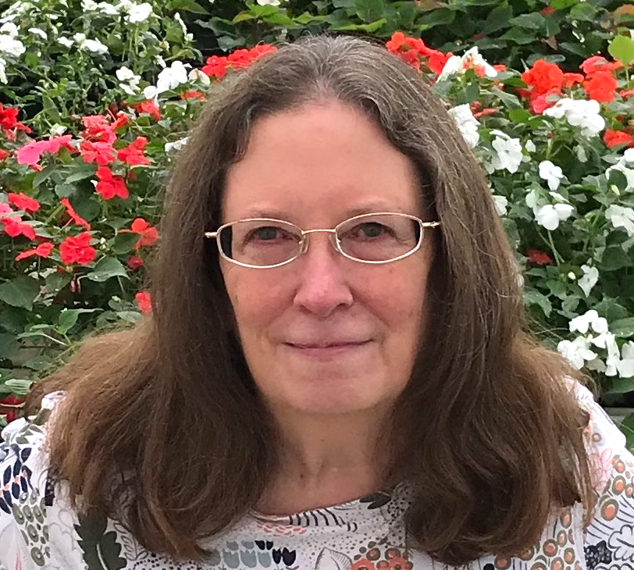
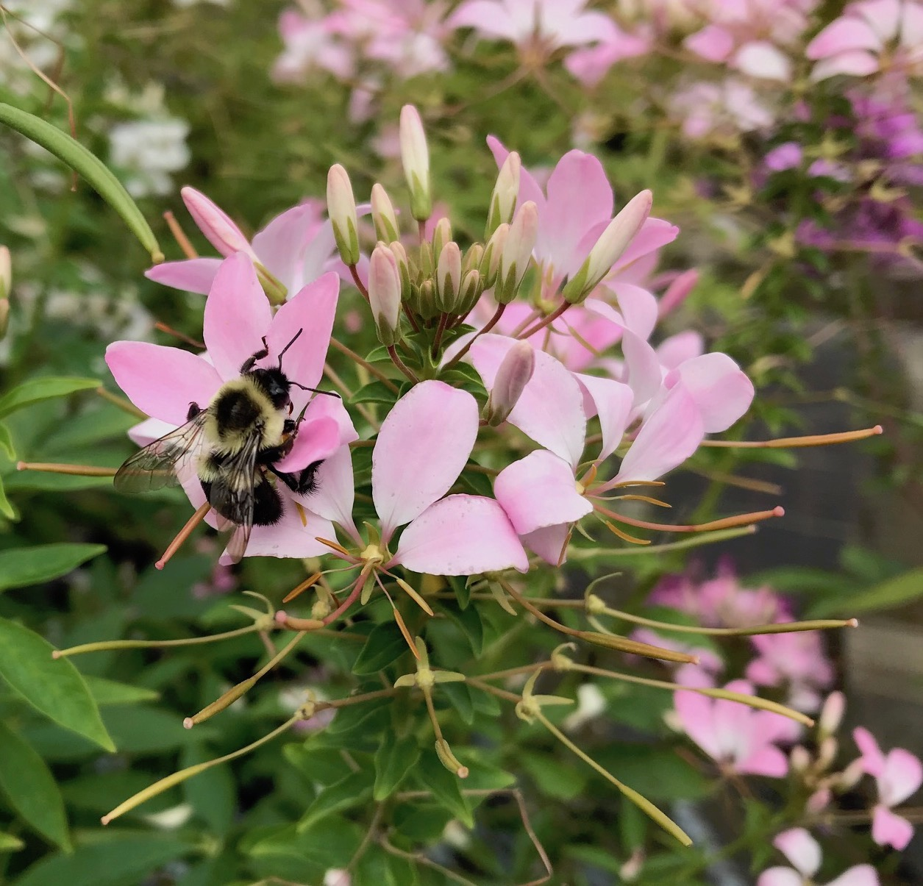
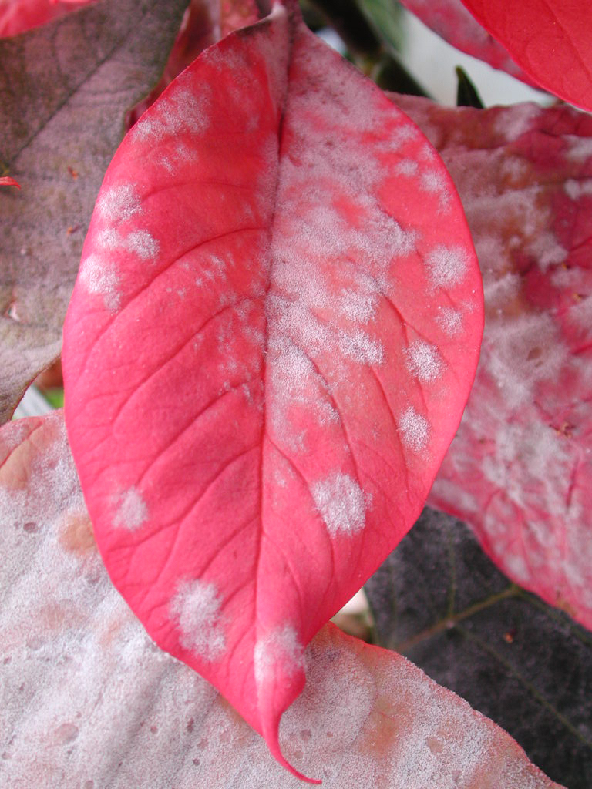
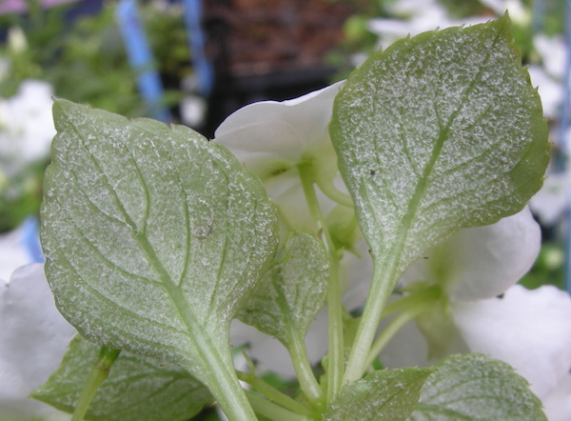
Margery Daughtrey
Senior Extension Associate
School of Integrative Pest Management
Section of Plant Pathology and Plant-Microbe Biology
Cornell University
631-727-3595
mld9@cornell.edu
Works on diseases of greenhouse and nursery crops, doing extension and research.
Downy mildew on impatiens
Cleome without downy mildew
Powdery mildew on poinsettia

Slide 6
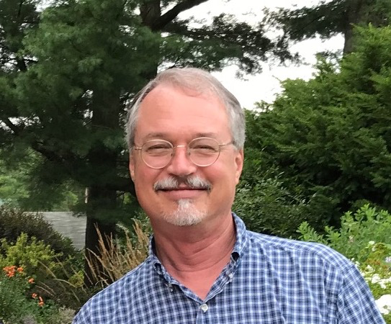
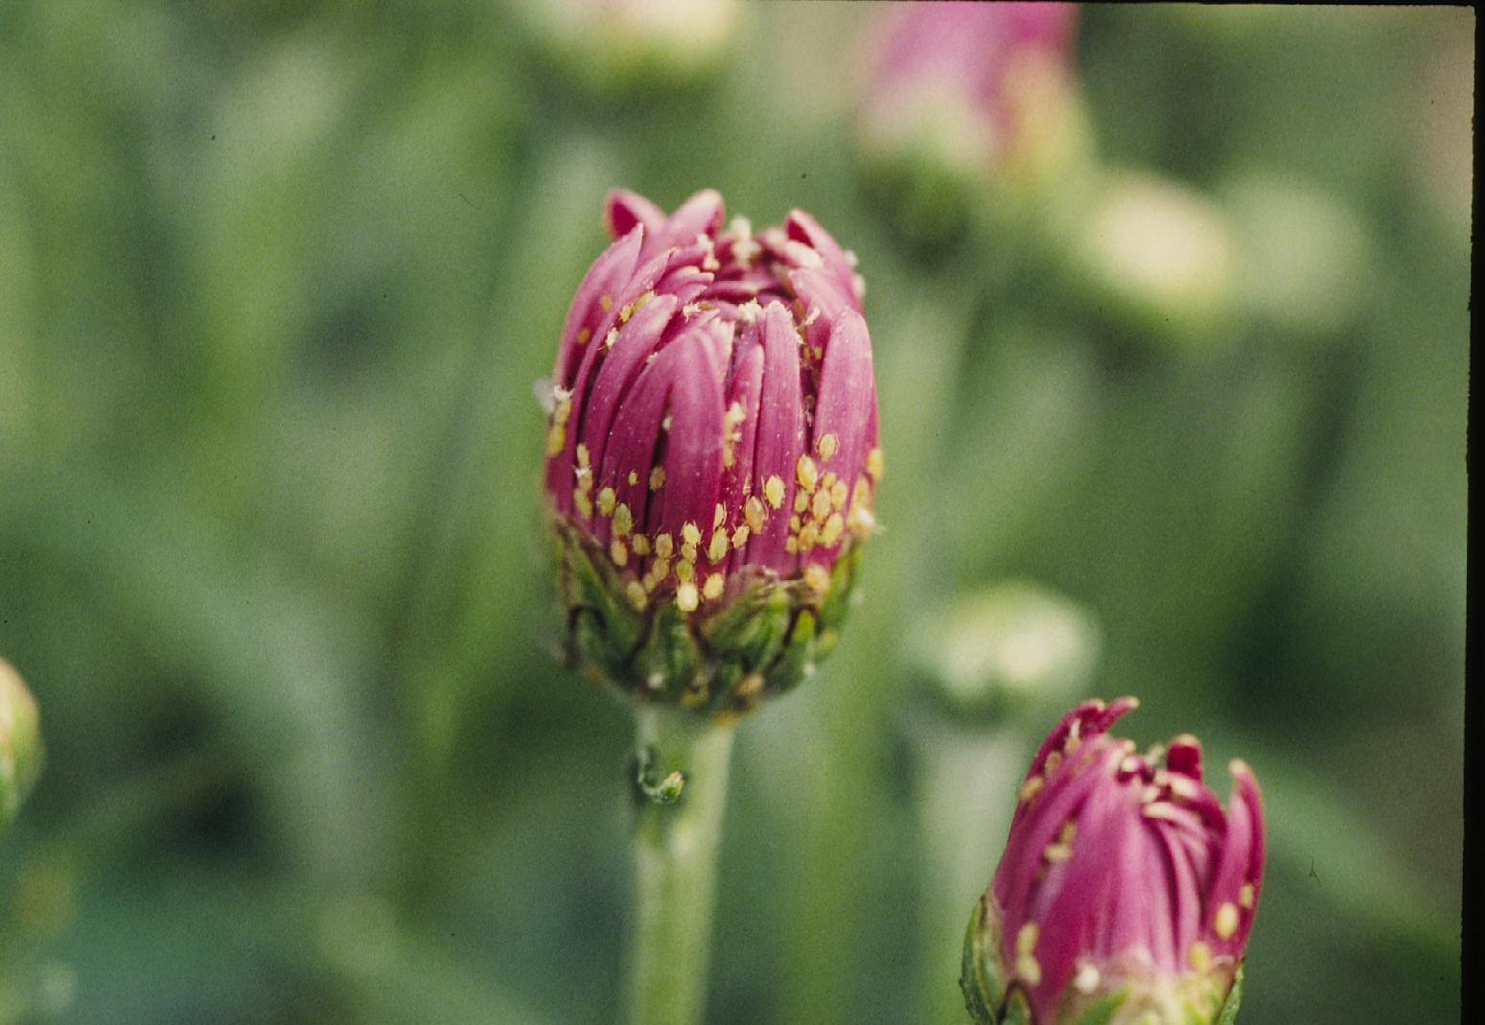
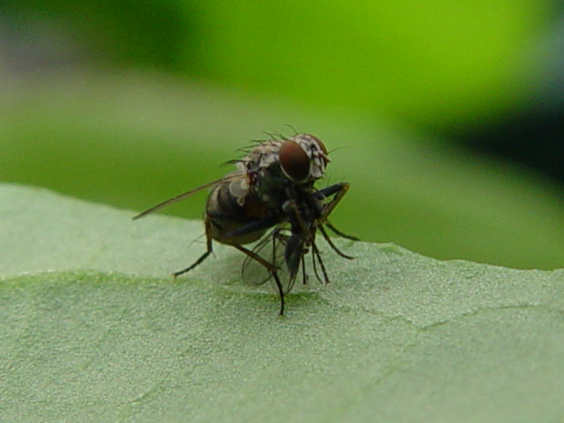
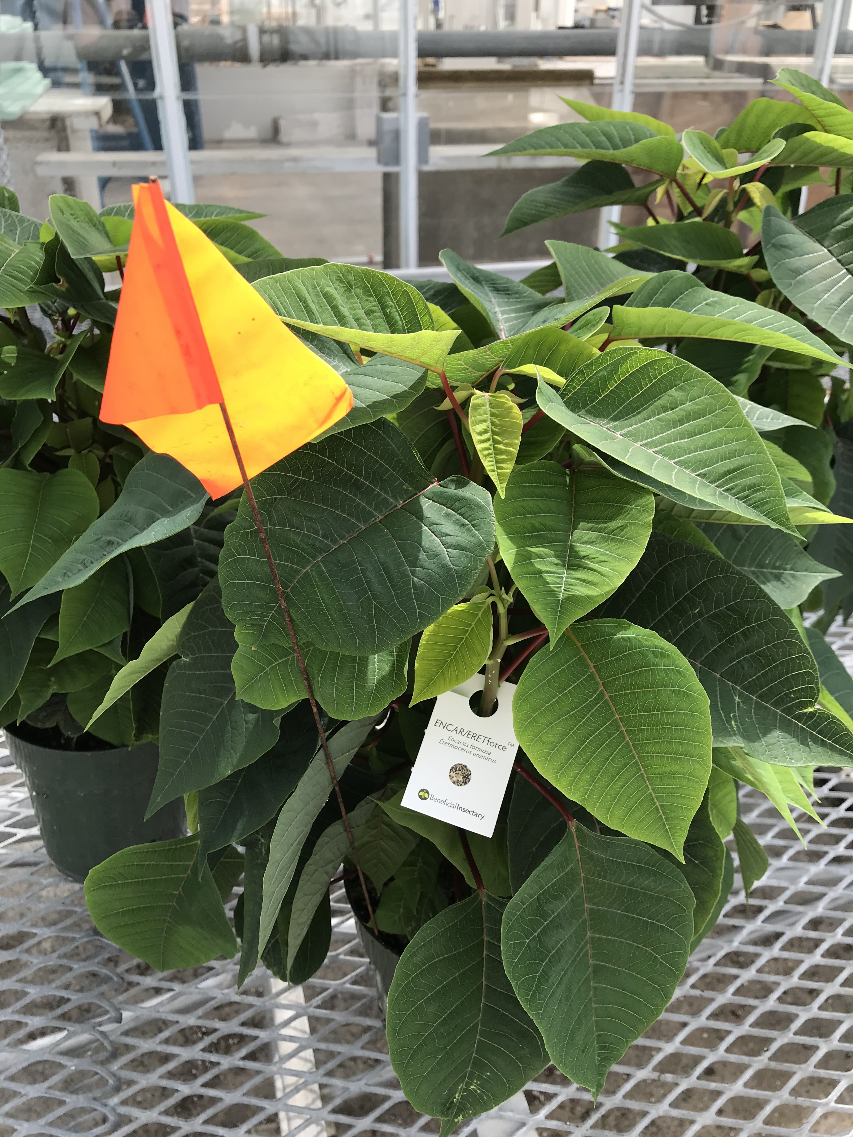
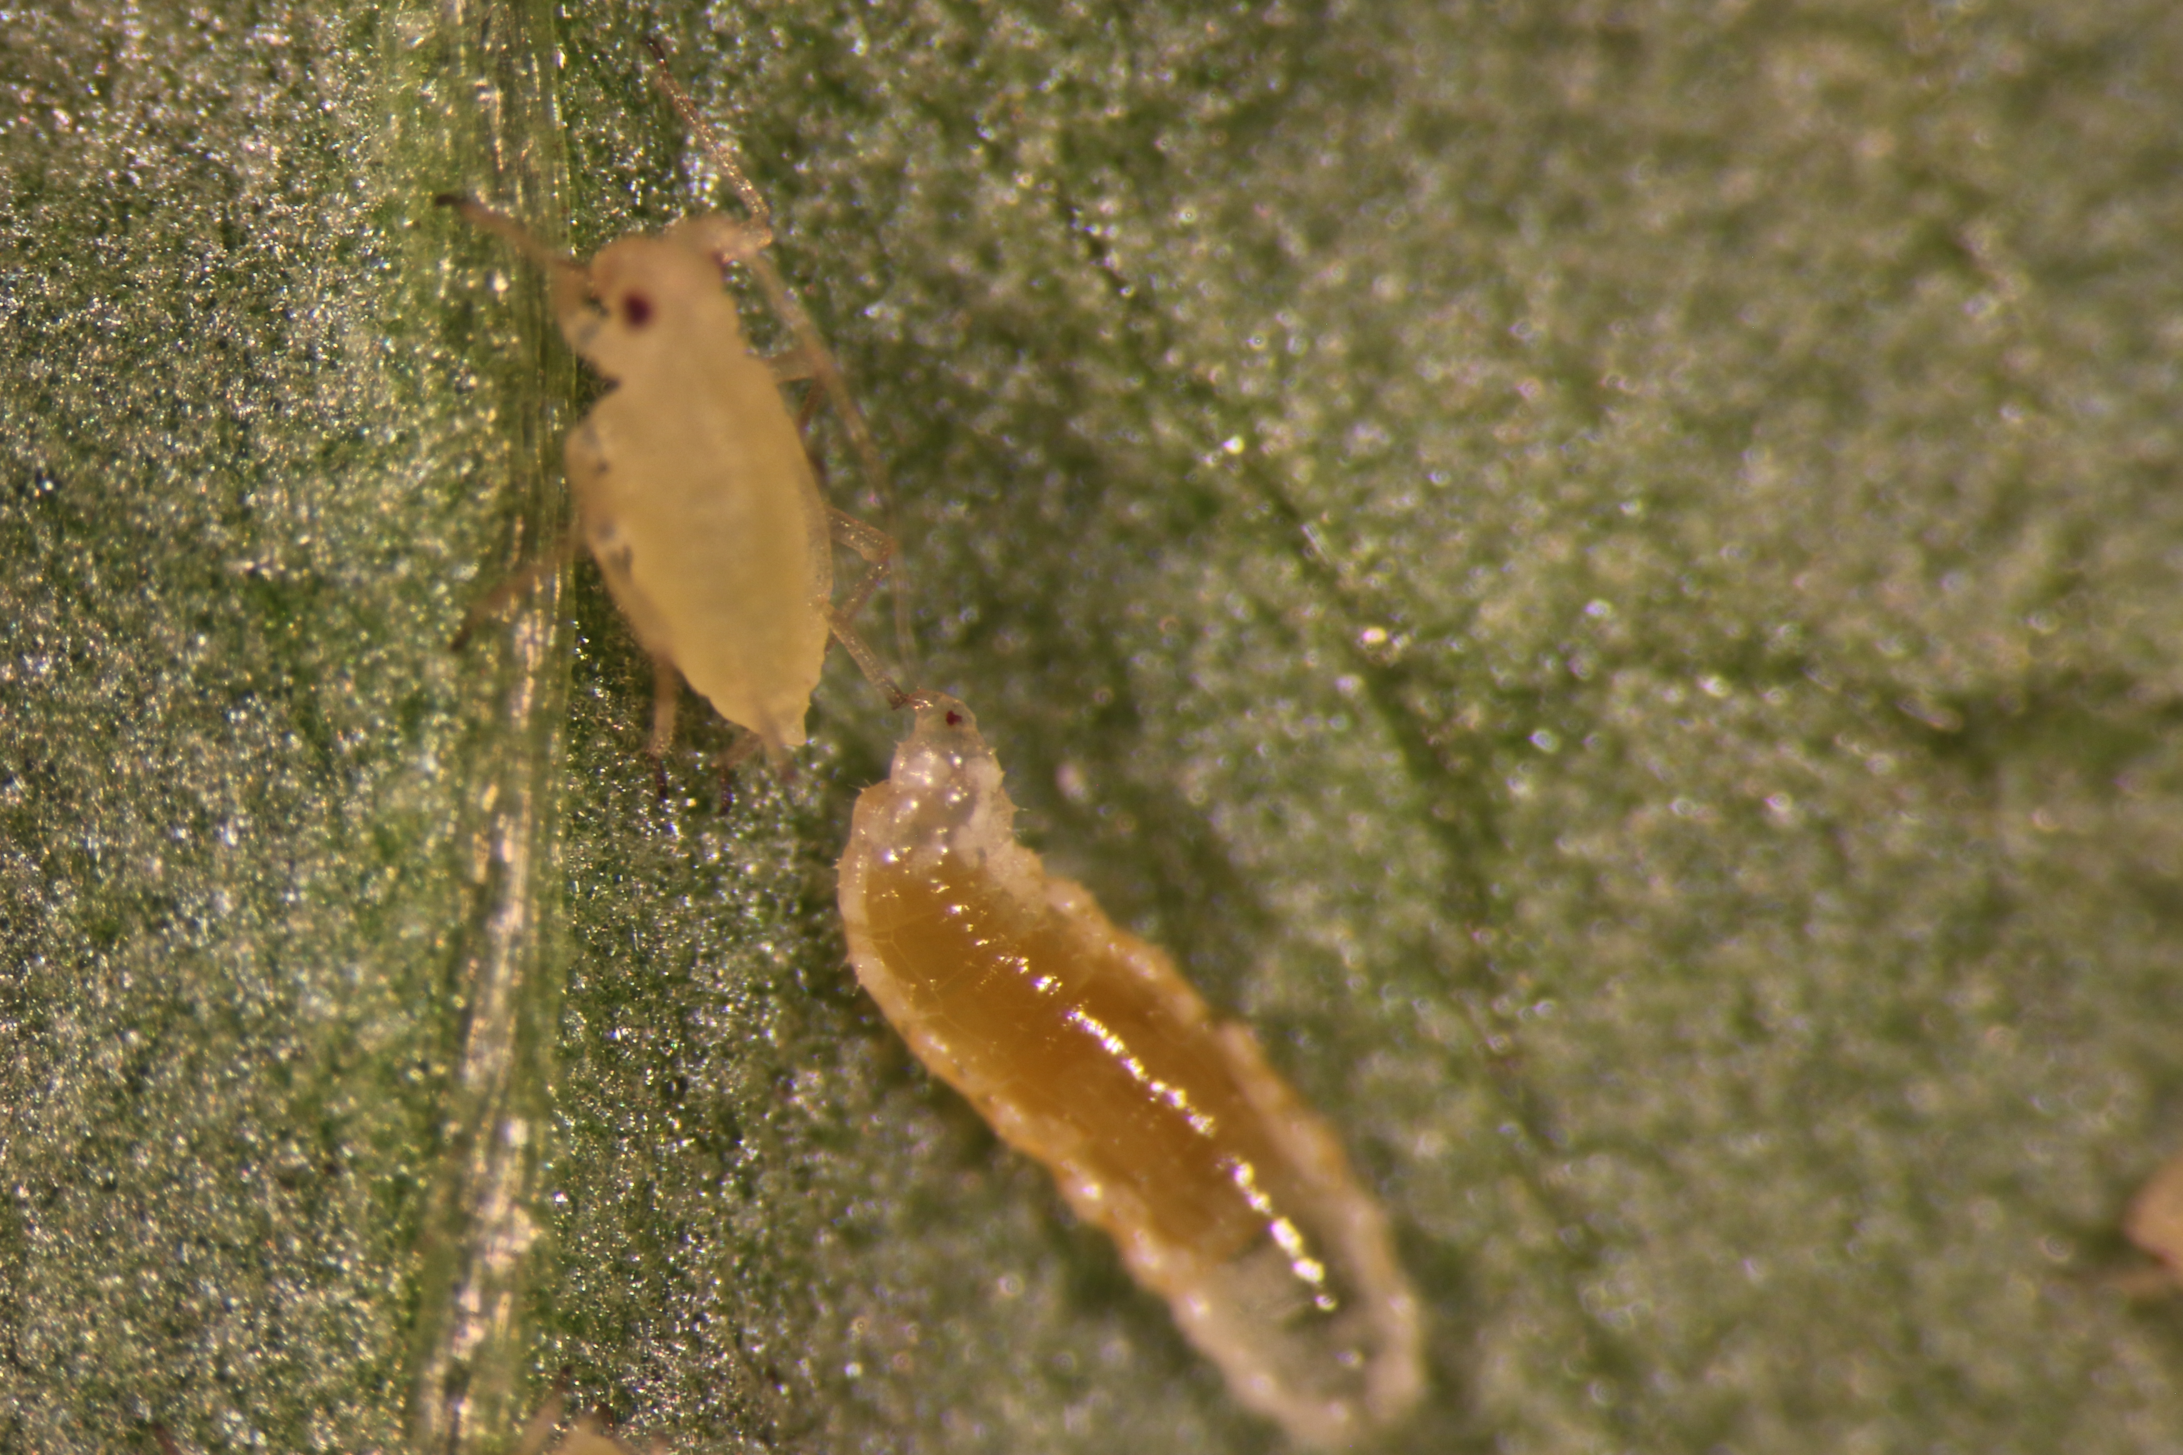
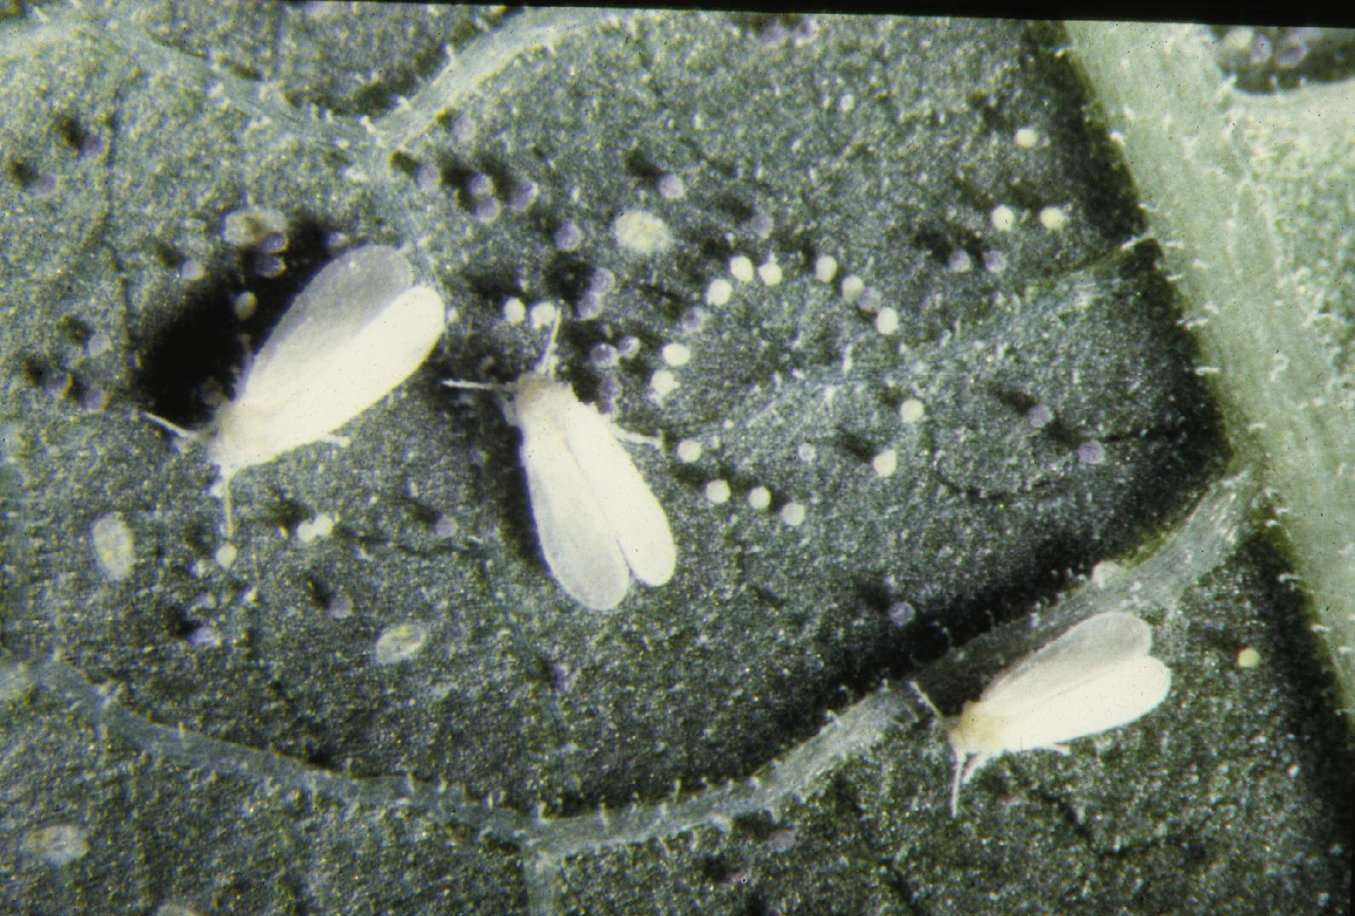
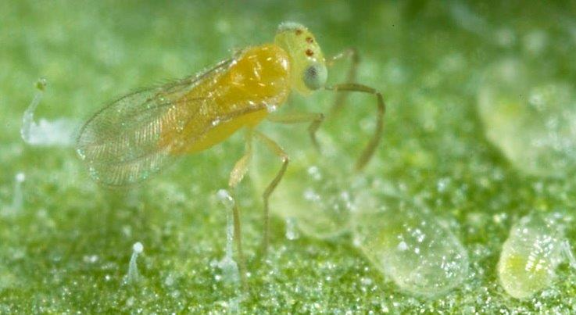
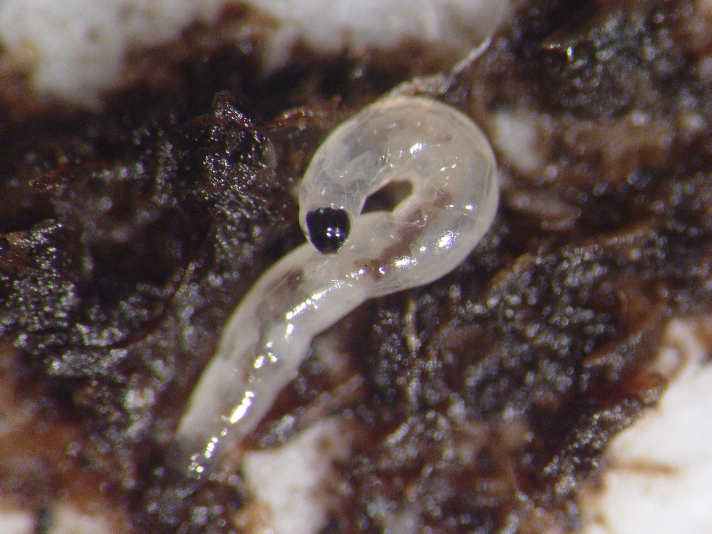
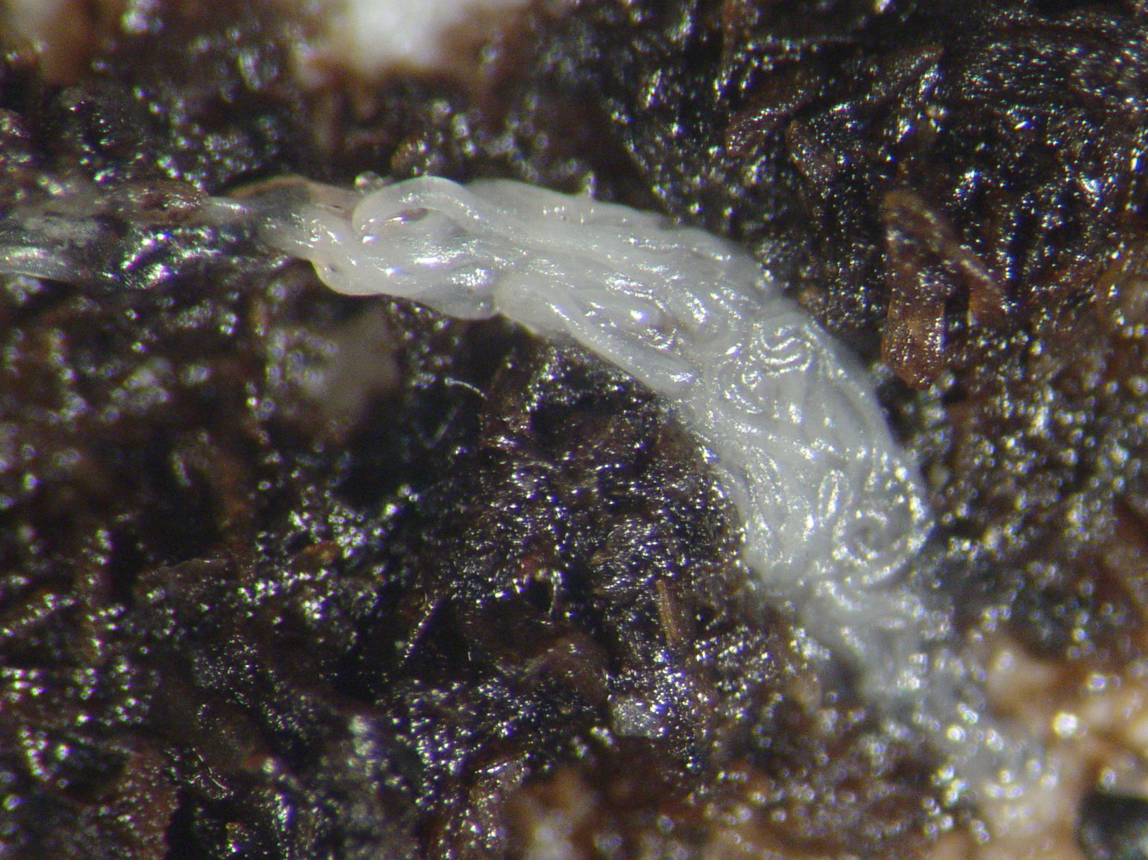
John Sanderson
Professor Emeritus
Department of Entomology
Cornell University
(607) 255-5419
jps3@cornell.
Works on the biology and management of greenhouse pests, with an emphasis on biocontrol, doing extension and research.
Aphid predator,
Aphidoletes aphidimyza
Hunter Fly, Coenosia attenuata
Green Peach Aphids
Research
Whitefly parasitoid, Eretmocerus eremicus
Greenhouse Whitefly
Nematode infection of fungus gnat larva

