Slide 1
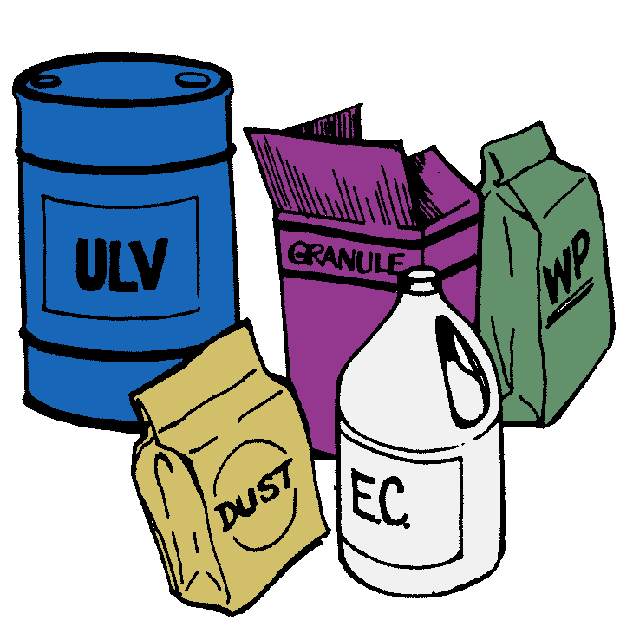
Basic Pesticide Training for Master Gardener Volunteers
Notes:
Pesticides are one tool available for managing pests. If someone decides to use a pesticide, they should understand how to use them properly and safely. As a Master Gardener, you, too, should also have a basic understanding of pesticides to round out your training.

Slide 2
Topics
Pesticide basics
Formulations
Exposure and risk
Personal protection
Environmental concerns
Laws and regulations
Pesticide labels
Notes:
This goal of this module is to familiarize you with pesticides and how to use them appropriately and safely. Topics we will cover during this training are:
Pesticide basics;
Pesticide formulations;
Basic concepts of exposure and risk;
Personal protection when using pesticides;
Environmental concerns with pesticide use.
Federal and state pesticide laws and regulations; and
The pesticide label, including a pesticide label reading activity.

Slide 3
Pesticide Basics
Notes:
Before we get into the details of pesticide use and safety, we need to discuss a few basics about pesticides.

Slide 4
What are pesticides?
Any substance or mixture of substances used to kill pests or to prevent or reduce the damage pests cause
Pest control devices are not pesticides!
Notes:
So what exactly is a pesticide? Simply put, a pesticide is any substance or mixture of substances that is used to kill pests or to prevent or reduce the damage pests cause. Pesticides can be used to kill the pest directly, attract it to a trap, repel it, or even stop it from reproducing.
Any product that controls a pest purely by mechanical or physical means is called a pest control device and is not a pesticide. Examples of pest control devices are mousetraps, fly paper, or bug zappers. Pesticide regulations do not apply to pest control devices. However, if a pest control device is packaged with a substance that helps control the pest, then the combination is considered a pesticide and needs to comply with pesticide regulations.

Slide 5

Sources of Pesticides
Physical environment
Living organisms
Plants
Insects
Microorganisms
Manufactured
Notes:
Pesticides can be derived from a variety of sources. They can be obtained from our physical environment. Some examples include sulfur, which can be used to control certain plant diseases; copper, which can be used to control aquatic plants or fungi; and kaolin clay, a ground mineral that can be used to protect plants and fruit from insect and disease pests.
Pesticides can also be obtained from living organisms. Plants produce chemicals that can be extracted and used for pest control, pyrethrum and rotenone being two examples. Insects produce hormones and pheromones that can be used for insect control. Hormones regulate insect growth and development, such as determining when an insect advances from larva or nymph to the adult stage. By exposing insects to hormones, we can disrupt their normal development cycle to the point where they don’t reproduce or advance to the adult stage. Pheromones are chemical signals between insects and can be used to attract insects to traps, either to monitor or to control them. Keep in mind that hormones and pheromones themselves don’t kill insects. Because they’re used to reduce or prevent insect damage, they’re considered to be a pesticide.
Microorganisms are another pesticide source. One example, Bacillus thuringiensis, also called Bt, is a soil microbe which produces a toxin that disrupts the feeding of mosquitoes, black flies, beetles, and moths. Bt has also been incorporated into plants, such as corn, so that the plant protects itself against pest larvae.
Most pesticides are man-made. Manufactured pesticides have some advantages over naturally-occurring pesticides. They often are easier to produce in large quantities, however, they are fairly expensive to develop. Manufactured pesticides can be easy to handle. Manufactured pesticides can also be designed to meet a particular need such as to control a specific pest or to lower the risk posed to the user or the environment.

Slide 6
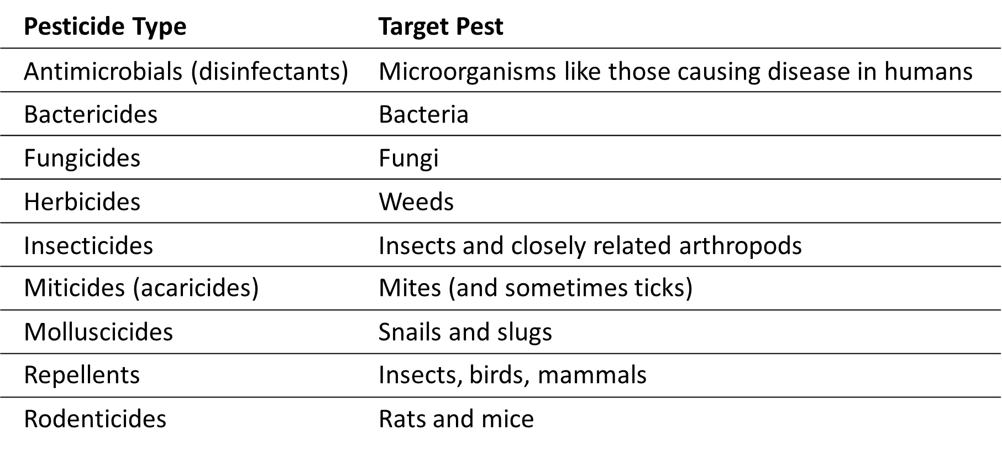
Types of Pesticides
Notes:
There are many different types of pesticides available to both the homeowners and professional pesticide applicators. Pesticides are typically named based on the pest they control. Here is a list of pesticide types commonly available to homeowners. Can you identify the target pest for each type? (Instructor’s note: go through the list of pesticide types and have the students name the target pest for each pesticide type. Each mouse click will reveal the target pest.)

Slide 7
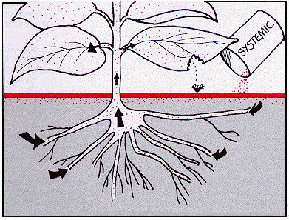
How Pesticides Differ
Mode of action
Insecticides
Duration – Residual, nonresidual
Insect uptake – contact, stomach poison, systemic
Notes:
While it is obvious that there are differences between the types of pesticides discussed in the previous slide, we need to keep in mind that pesticides of the same type have differences between them. Knowing these differences helps the user select the best product for their needs.
Mode of action describes how a pesticide acts on a pest. For example, organophosphate insecticides interfere with proper nerve function. Knowing a pesticide’s mode of action can help you select a pesticide that does the job effectively. Keep in mind that pesticides with the same mode of action act on the pest the same way and, as you’d expect, pesticides with different modes of actions act on pests in different ways. Mode of action is a key component to an effective resistance management program. Using pesticides with the same mode of action repeatedly will eventually lead to resistant pest populations, making those pesticides ineffective.
Insecticides differ in how long they remain effective and how they get into insect pests. The duration of an insecticide can be referred to as residual or nonresidual. Residual insecticides are insecticides that provide control for hours, days, weeks, or longer after they’re applied. Residual insecticides are desirable when a pest poses a constant threat and when the pesticide application will pose little risk to people or the environment. Since the pesticide remains active after the application, the pest doesn’t have to be in the treatment area at the time of treatment.
Nonresidual insecticides are effective only at the time of application or very shortly afterwards. To be effective, the pest must be active in the treatment area at the time of the pesticide application. Nonresidual insecticides are useful where the pest is unlikely to return or where people and pets might be exposed to the insecticide.
Insect uptake will also affect the insecticide selected. As the name implies, a contact insecticide kill insects that come in contact with it. To be effective, the insecticide either is sprayed directly on the pest insect or the pest insect walks on a surface treated with a residual insecticide. A stomach poison only works if it’s swallowed by an insect that has eaten a treated plant or poisoned bait. A systemic insecticide is a special type of stomach poison that is absorbed by and spread throughout the treated plant or animal. The insect is killed when it feeds on any part of the treated plant or animal.

Slide 8
How Pesticides Differ
Fungicides
Protectant
Systemic (eradicant)
Herbicides
Uptake – contact, systemic
Selectivity – selective, non-selective (broad-spectrum)
Rodenticides
Acute
Multidose anticoagulant
Notes:
Fungicides differ in how they control diseases. Protectant fungicides are used to prevent fungi from infecting a plant. This means they need to be applied before disease starts. It’s critical that protectant fungicides completely cover the plant and that new growth be protected, maybe requiring frequent applications. Otherwise, fungal spores will infect new growth or unprotected areas. Protectant fungicides are useful when a disease is almost certain to occur if nothing is done. Systemic fungicides, also referred to as eradicants, enter and move through the plant to control an existing infection. Because these fungicides move through the plant, coverage is not as critical and they may not have to be applied as often as protectants. Occasionally, a systemic may be needed if a protectant isn’t applied in time.
Herbicides vary in their uptake by plants. Contact herbicides kill the plant tissue where it was absorbed by the plant, affecting top growth. This type of herbicide may be most effective at controlling annual and perennial weeds and any type of weed seedling. Perennial weeds that have developed underground structures will regrow if only the top growth is killed. Systemic herbicides, on the other hand, are absorbed by the plant, move through them to the underground structures, and ultimately kill these structures. Systemic herbicides are ideal for controlling established perennial weeds. However, they can be used to control any weed.
Herbicides have different types of selectivity, meaning which plant types they control. A selective herbicide kills only certain types of plants and causes little to no injury to others. For example, some herbicides may control only broadleaf plants in a home lawn, but not the grasses. A non-selective herbicide, also called a broad-spectrum herbicide, will kill any plant they come in contact with. Typically non-selective herbicides are used where you want total plant control, such as in industrial sites, cracks in sidewalks or driveways, or under guardrails along a highway.
Rodenticides can kill rodents two ways. Baits containing acute rodenticides will kill rodents with one feeding. Multidose anticoagulant rodenticides require that a rodent visit a bait many times in order to be killed. Multidose anticoagulant rodenticides have the advantages of being less toxic and lower risk to children and pets and rodents are less likely to avoid the baits since they don’t suspect the bait has killed other rodents.

Slide 9
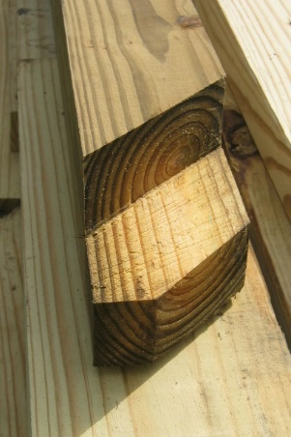
Materials Containing Pesticide
Pesticides can be incorporated into or onto a product
Examples:
Treated seed
Weed ‘n feed lawn care products
Flea and tick collars
Treated lumber
Notes:
Pesticides may also be incorporated into or onto a product. This may be done to protect a product from pest damage, make the pesticide more effective, or make it easier to apply the pesticide. It’s quite possible the public may not be aware that materials they’re using have a pesticide on or in them. Some examples include:
Treated seed is seed with a fungicide (and sometimes an insecticide) applied to it. The pesticide protects the seed and the seedling from pests in the soil. Treated seed is required to be colored with a dye to clearly distinguish it from untreated seed.
Weed ‘n feed lawn care products contain herbicide-impregnated fertilizer. They allow you to fertilize the lawn and control weeds with one product.
Flea and tick collars have insecticide applied to them that’s spread through the animal’s skin to protect it from fleas and ticks.
Treated lumber is wood treated with a wood preservative to protect it from fungi or insect damage.

Slide 10
Pesticide Usefulness
Characteristics that make pesticides useful:
Reasonably easy to handle
Sufficiently safe to handle
In a form that can reach the pest
Chemically stable
Active ingredient alone rarely meet these requirements
Inert ingredients help make the product more usable
Active ingredient + inert ingredient = formulation
Notes:
Now that we have talked about what pesticides are, let’s now look at what makes a pesticide useful. We know that a pesticide contains a substance or mixture of substances that controls a pest. Adequate pest control depends on whether or not the pesticide can be used effectively. To be useful, a pesticide needs to be:
Reasonably easy to handle;
Sufficiently safe to handle;
In a form that can reach the pest; and
Chemically stable.
Rarely will a pesticide meet these requirements if it only contains an active ingredient, that is a substance or substances that actually controls the pest. To be effective, almost all pesticides also contain an inert ingredient, or a substance that makes the entire product more usable. For example, when an active ingredient is combined with inert ingredients, it becomes a formulation.
Note that inert ingredients do not control a pest. However, they may not be harmless to people or the environment. Keep in mind that risks and use precautions for a pesticide are for the entire product.

Slide 11
Pesticide Names
Notes:
Now that we have a basic understanding of what a pesticide is, let’s now talk about pesticide names.

Slide 12
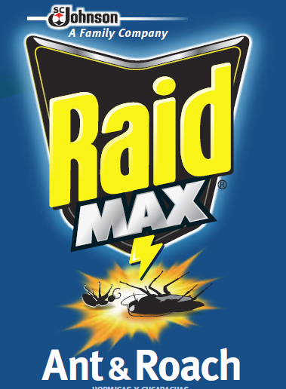
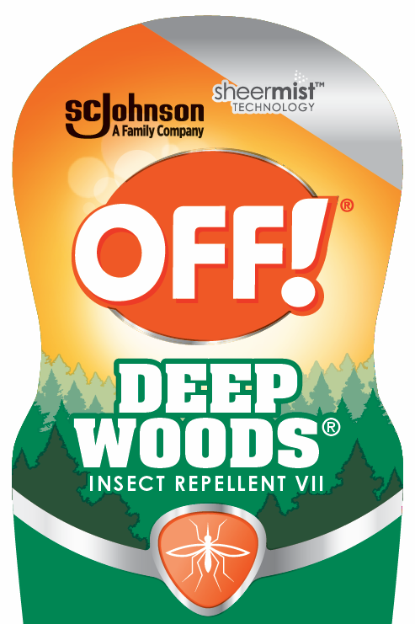
Pesticide Names
Trade, brand, or product name
Examples:
Notes:
Pesticides can be referred to by a variety of names. Sometimes people refer to them by the name they’re sold under. Other times people may refer to them by their active ingredient. Referring to an active ingredient can be confusing because active ingredients can have two names as well. Let’s take a look at both of these in more detail.
A pesticide’s trade, brand, or product name is the name a manufacturer gives the product. It’s the name commonly used to promote and advertise the product. A product’s trade name is also prominently displayed on the front of the pesticide label. A couple of example trade names are Raid Max® Ant and Roach and Off!® Deep Woods Insect Repellent VII.

Slide 13
Pesticide Names
Chemical name
Common name
N,N-diethyl-meta-toluamide
DEET
DEET is the common name for N,N-diethyl-meta-toluamide
Notes:
A pesticide’s chemical name identifies the chemical components in a pesticide as well as the structure of the active ingredient. This usually a complex chemical name such as the example here – N, N-diethyl-meta-toluamide. Every active ingredient has a unique chemical name. This information is listed in the ingredient statement on the front panel of the pesticide label.
Most people don’t refer to this complex chemical name and use a shorter, unique common name. In our example here, DEET is the common name for N, N-diethyl-meta-toluamide. As you can see, the common name is much simpler and may be easier to remember. Have you heard of DEET before? Most likely you have. To maintain consistency, only common names approved by the US EPA may be used on a pesticide label.
In some cases the chemical name is simple enough that it also serves as the common name. Sulfur is one example.

Slide 14
Making Sense of Pesticide Names
Same active ingredient(s) can be used in multiple products
Example: DEET - used in 100+ pesticides
Multiple trade names may indicate:
Different manufacturer(s)
Different amounts of active ingredient
Additional active ingredients
Different uses
Different products may have different risks and safety requirements!
Notes:
We’ve learned that a pesticide has a trade name and contains one or more active ingredients that have their own common name. This makes it sound like it’s fairly straightforward to understand what’s in a pesticide. However, this is not the case. If you don’t look at both the trade name and active ingredient, you may end up with the wrong product! Here’s why.
Let’s first talk about active ingredients. An active ingredient can be used in more than one pesticide product. That means the same active ingredient can be used in pesticides with different trade names. Let’s use the active ingredient DEET as an example. At the time this presentation was developed, there were around 100 different products registered in New York State containing DEET. This also means there are also around 100 different trade names for products containing DEET!
Multiple trade names may be an indicator that something is different between the pesticide products. The products might be made by a different company, have different amounts of active ingredient, include additional active ingredients, or have different uses. These variations may also mean there are different safety and risk precautions between each product. Just knowing the active ingredient in a product is not enough. You need to read the label to make sure the product meets

Slide 15
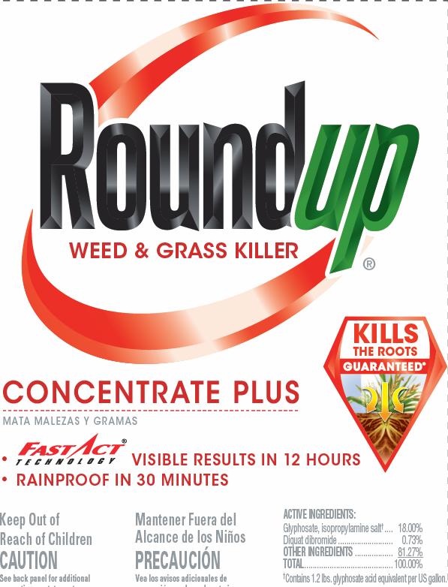
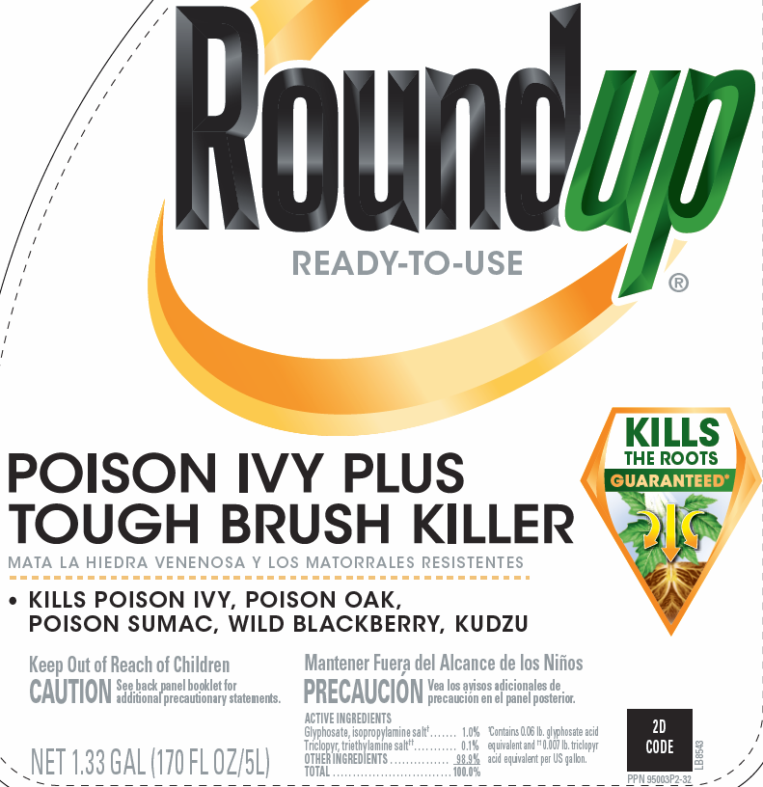
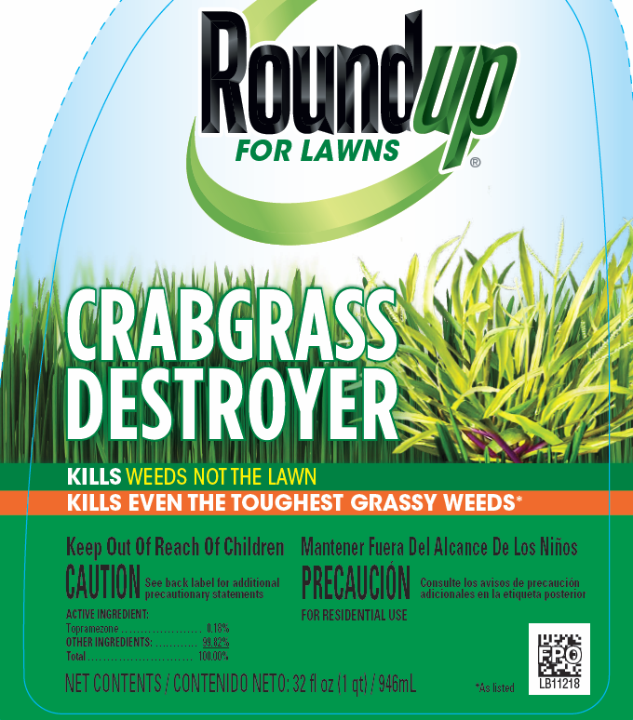

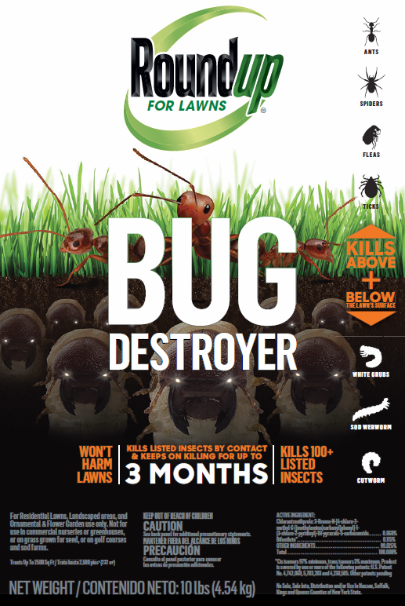
Making Sense of Pesticide Names
Pesticides with similar trade names may be very different!
Example:
Roundup®
25 different products
Contain any combination of 11 different active ingredients
Includes both herbicides and insecticides
Notes:
Now let’s talk about pesticide trade names. Pesticides may have similar trade names but can be quite different. So why is this? Manufacturers often want to take advantage of a well recognized brand name to market their products.
Let’s take the name Roundup® as an example. Roundup® is used in the trade name of around 25 different products. These 25 products contain one or more of 11 different active ingredients. With so many different active ingredients, this suggests there may be different safety and risk precautions. It also suggests there may be different uses for each of these products. In fact, further investigation shows that one Roundup® product is an insecticide, contrary to most people’s understanding that Roundup® is an herbicide

Slide 16
Take-home message…
Look beyond the trade name and common name(s).
Read the entire label!
Notes:
The take-home message from this is that you need to look beyond the trade name and common name(s) to select the proper product. You need to read the entire pesticide label to know if the pesticide is appropriate for your need and to understand how to use the pesticide properly.

Slide 17
Pesticide Formulations
Notes:
Earlier we talked about active ingredients often not often being useful by themselves. They often need to be be mixed with some other ingredient into a pesticide formulation. So what what’s the importance of a pesticide formulation and what kinds of formulations are typically available to homeowners?

Slide 18
Pesticide Formulations
Formulation affects:
Exposure risk
How a pesticide can be used
Application equipment
Need to measure and mix
Notes:
A pesticide’s formulation is important because it affects:
Exposure risk. Some formulations have a higher exposure risk to the pesticide applicator, the environment, or non-target species than others.
It also affects how the pesticide can be used. Some formulations are better suited to reach the pest than others. Some may cause undesirable staining of treated surfaces.
Application equipment needed is formulation-dependent. Some formulations require certain types of application equipment to apply them. Others may require the equipment to be durable enough to hold up to the chemical or physical characteristics of the formulation.
Formulations determine the need to measure and mix. Some formulations require measuring and mixing with water. Others come ready to use out of the container.
Let’s now look at some common formulations available to homeowners.

Slide 19
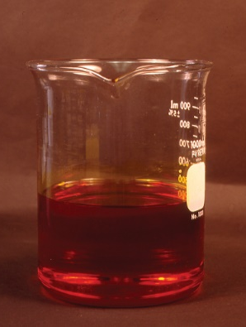
Liquid Formulations
Ready-to-use (RTU)
Ready-to-spray (RTS)
Concentrates
Aerosols
Notes:
Many homeowner pesticides come as liquid formulations. Some liquid formulations can be used directly from their container; others require that you measure and mix them with water before applying them.
Ready-to-use, or RTU, formulations don’t require dilution before using and can be used directly from their container. An RTUs container has the application device built in, such as a hand-held sprayer. RTUs contain a small amount of active ingredient mixed in an organic solvent and may require shaking before and during use. RTUs have a high cost per unit of active ingredient, primarily due to the cost of the container. The organic solvents in RTUs also harm foliage so they can’t be used as a plant spray.
Ready-to-spray, or RTS, are liquid pesticides sold in a specialized container that attaches to a garden hose. The container has a sprayer built in that meters the amount of pesticide applied. Water from the garden hose flowing through the container dilutes the pesticide as it is sprayed. RTSs are commonly used for treating lawns and outdoor trees and shrubs.
Concentrates require you to mix the pesticide with water in a sprayer before they can be applied. Concentrates can have a relatively high amount of active ingredient which requires accurate measurement to mix the proper amount of pesticide. Concentrates are ideal when treating large areas. However, mixing products for small areas may be difficult.
Aerosols are a type of ready-to-use formulation. Aerosols have a low percentage of one or more active ingredients in a solvent that is packaged in a pressurized container. Pesticide is released when the attached nozzle valve is triggered. Aerosols are used indoors and in limited situations outdoors. Because the nozzle creates fine droplets, the pesticide is difficult to contain to the treatment area. Also, aerosols pose an inhalation risk and are hazardous if punctured or exposed to heat.

Slide 20
Dry Formulations
Dusts
Notes:
Homeowner pesticides can also come in dry formulations. Dry formulations are typically ready-to-use but in some situations, may need to be mixed with water to properly apply them.
Most dusts contain relatively low amounts of active ingredient, typically less than 10 percent. However, you may find a few products available with a higher percent of active ingredient. Dusts consist of the active ingredient plus a very fine talc, chalk, clay, nut hull, or volcanic ash inert carrier that helps distribute the active ingredient. Dusts are used as seed treatments, crack and crevice or spot treatments, and to treat pets and livestock. Advantages of dusts include only simple equipment is required to apply and they can be used in hard-to-reach spaces or where moisture from a spray may cause damage. Dusts also have some disadvantages. Since dusts consist of fine particles, they are easily moved off target by wind or other air currents during application and by water and air currents after application. They also don’t stick to surfaces like liquids. Moisture causes them to clump. It’s also difficult to get a uniform distribution of dust on surfaces. Dusts also pose inhalation and skin exposure hazards and may irritate the eyes, nose, throat, and skin.

Slide 21
Dry Formulations
Dusts
Granules
Photos Courtesy Purdue Pesticide Program
Notes:
Granules are larger and heavier than dusts. The active ingredient coats or is absorbed into coarse particles made from materials like clay, corncobs, or walnut shells. The amount of active ingredient in granules ranges from 1 to 15 percent. They are used to control weeds, insects, and nematodes living in the soil or for uptake by plant roots. Granules release the active ingredient slowly with some requiring soil moisture to do so. Advantages of granules are that they are ready to use with basic application equipment, their weight carries them directly to the target, they pose less risk of drift and applicator exposure than sprays, and they can break down more slowly if they have a slow-release coating. Disadvantages include difficulty applying them uniformly and at a proper rate, they don’t stick to foliage or uneven surfaces, and they may require moisture to release the active ingredient, making use in drought conditions less effective. Also, birds can be at risk because they may feed on the seed-like granules.

Slide 22
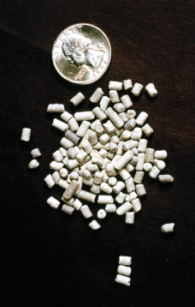
Dry Formulations
Dusts
Granules
Pellets
Photos Courtesy Purdue Pesticide Program
Notes:
Pellets are similar to granules except they are manufactured to have a fairly uniform shape and weight. Like granules, pellets reduce the risk of applicator exposure and drift. One disadvantage pellets have over granules is that they may roll on steep slopes, possibly harming non-target vegetation or contaminating surface water.

Slide 23
Other Formulations
Baits
Animal systemics
Notes:
Not all formulations fit nicely into either the liquid or solid category.
Baits contain a low percentage of active ingredient mixed with food or some other substance. They come in liquids, gels, pastes, or solids. Baits can either attract a pest or are placed where the pest can find it. The pest is killed by eating the bait. The bait used is determined by what’s attractive to the pest you want to control. For example, liquid ant baits use a sugar-based solution inside a bait station to attract sugar-feeding ants. Baits come ready to use and can be placed in specific areas. Keep in mind that baits can be attractive to children, pets, and wildlife if they’re not properly placed. Dead rodents may eventually give off odors or could poison other animals that feed on them. As old bait becomes ineffective, it may actually become a food source for pests.
Animal systemics are products that protect animals against blood-feeding insects. These materials are applied as pour-on liquids, liquid sprays, or dusts and are absorbed by the animal and move throughout their body. Animal systemics are typically used under the supervision of a veterinarian.

Slide 24
Choosing a Formulation
What/where you’re treating and the pest is on the label
Whether the formulation will stay in place long enough for control
Risks to you, the environment, and the treated site
Application equipment needed
Personal protective equipment needed
Handling and measurement needs
Dilution needs
Whether you can use all of the product
Notes:
Now that we’ve talked about the common formulations available for homes and gardens, how do you decide what formulation to use? The first, and most important, consideration is to be sure the pesticide label lists what or where you’re treating (called the site of application) and the pest you want to control for that particular site. This is a legal requirement. Once you’ve determined this, then consider:
Whether the formulation will stay in place long enough to provide the desired control;
The risks the formulation poses to you, the environment, and the treated site;
Whether you have any necessary application equipment to apply the pesticide;
Any specific personal protective equipment needs and whether you have them or can obtain them.
How easy it is to handle and measure the formulation;
Whether the formulation requires dilution or can be used as is; and
Whether you can use all of the product within a reasonable amount of time and not have to store it.
Keep in mind that formulations may be limited in their availability. Be prepared to make adjustments!

Slide 25
Pesticide Exposure and Risk
Notes:
By now you should recognize that a pesticide is used to harm a pest. If a pesticide can harm a pest, it’s possible a pesticide can harm the user or others. So what contributes to our risk of using pesticides? Let’s take a look at pesticide exposure and risk.

Slide 26
Risk, Toxicity, and Exposure
What is risk?
Potential to cause harm
What is toxicity?
Ability to cause harm
Property of: active ingredient, concentration, and formulation
Not source dependent
What is exposure?
Two types – acute and chronic
Risk
Toxicity
Exposure
Notes:
Before we can understand the risk of using a pesticide, we first need to understand a few key terms.
So what is risk? Risk is the potential of a pesticide to cause harm. It is affected by two factors – the toxicity of a pesticide and your exposure to it.
Toxicity is a measure of a pesticide’s ability to cause harm. It’s a property of the pesticide’s active ingredient, concentration, and formulation. You can’t change a pesticide’s toxicity. However, you can choose a pesticide that has a lower toxicity compared to another pesticide. A pesticide’s toxicity does not depend on where it comes from. Pesticides from plants, insects, microorganisms, minerals, or man-made do not determine it’s toxicity to us. Be aware that sometimes the term “hazard” is used in place of toxicity.
Exposure is when you get a pesticide in or on your body. There are two types of exposure. Acute exposure is exposure to a single dose of a pesticide. Chronic exposure is repeated exposure to a pesticide or a group of related pesticides over a long period of time.

Slide 27
Risk, Toxicity, and Exposure
Exposure’s contribution to risk:
Dose
Time
Dose/time relationship
Notes:
Exposure’s contribution to risk is affected by two factors. The first factor is the dose, or how much pesticide you’re exposed to in an exposure event. The dose is also directly affected by how long you’re exposed to the pesticide and by the concentration of active ingredient in the product or spray mix you’re exposed to. The second factor is time, or the number of times the exposure occurs. If we look at how these two factors interact, we can see that if the dose and/or the frequency of exposure increases, your risk increases as well. This is called the dose-time relationship and it is used to measure pesticide toxicity.

Slide 28
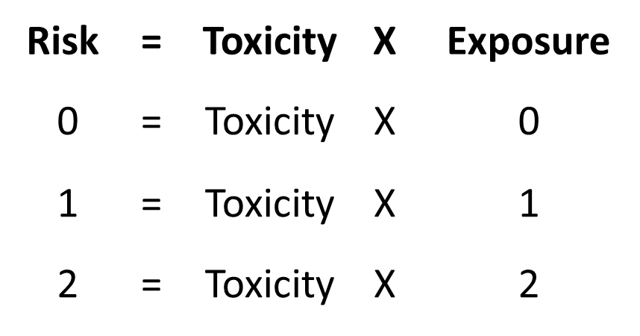
Risk, Toxicity, and Exposure
Notes:
The relationship between risk, toxicity (or hazard), and exposure can be represented by the equation: risk equals toxicity times exposure. Using this equation, it’s fairly easy to see how toxicity and exposure affect risk. For example, if our exposure to a pesticide is zero, then regardless of the pesticide’s toxicity our risk is zero. If the toxicity of the pesticide remains the same (like when using the same pesticide routinely) as the number of exposure events increases, then our risk increases.

Slide 29
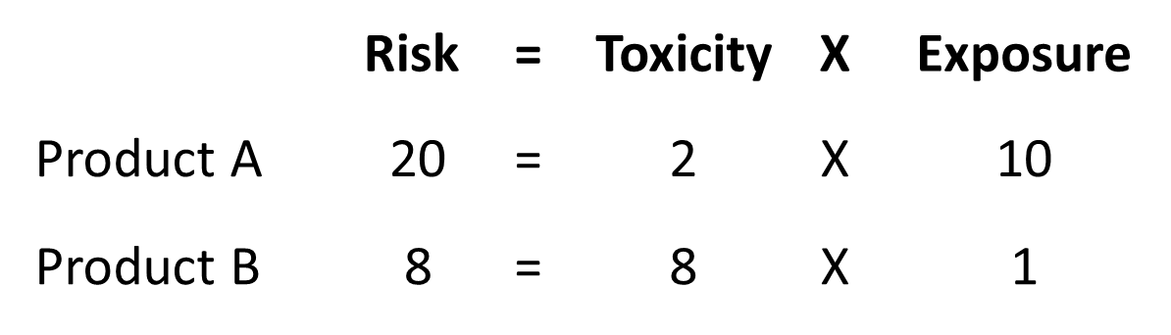
Risk, Toxicity, and Exposure
Notes:
Many people consider “toxicity” and “risk” to be the same, which they aren’t. This leads them to think that the “least toxic” pesticide means the “safest” pesticide. However, this thinking ignores the role that exposure plays in risk. It’s quite possible that a lower toxicity pesticide may actually pose more risk than a pesticide that has a higher toxicity! Here’s why.
Let’s consider two pesticides that could be used against the same pest. Product A has a low toxicity which we’ll give a value of 2 on a 10 point scale. Product B has a relatively high toxicity, which we’ll say is an 8 on our 10 point scale. The label directions for Product A require a person to apply it ten times to adequately control the pest meaning there would be 10 exposure events. Using the risk equation, Product A’s risk would be calculated as 20.
Now consider Product B. The label for this product says to make one application, which equates to one exposure event. Again, using the risk equation, the calculated risk would be 8. If we look at this graphically, you can see that the risk for using the lower toxicity Product A is actually 2.5 times higher that the higher toxicity product B due to the number of exposure events. Sometimes a lower toxicity doesn’t mean lower risk!

Slide 30
Risk, Toxicity, and Exposure
Individual differences affect risk:
Weight
Age
Gender
Health conditions
Environment
Notes:
While the risk equation is a good way to see how toxicity and exposure can contribute to your risk of pesticide poisoning, it doesn’t mean that everyone’s risk will be the same. Individual differences can affect a person’s risk of being harmed by a pesticide. These differences include:
Weight. The heavier a person is, the more pesticide that needs to enter the body to cause harm.
Age. Younger and older populations are more sensitive to pesticide exposure.
Gender. Males and females respond differently to a pesticide exposure. Gender also plays a role where a pesticide may affect the reproductive system.
Health conditions. If a person is sick or pregnant, the risk of pesticide poisoning can be greater.
Environment. Exposure to other chemicals in a person’s environment can increase the risk of pesticide poisoning.
These differences pertain not only to the pesticide user, but also to those who may be exposed to the pesticide after it’s been applied. We need to think about the safety of both the user and others!

Slide 31
Routes of Entry
Dermal
Most pesticide exposure
Transmits pesticide to bloodstream
Formulations and active ingredient concentration affect absorption
Some areas absorb pesticides better than others
Skin condition affects absorption
Some causes of dermal exposure:
Not using gloves or personal protective equipment
Not washing hands
Splashing or spilling pesticide on skin
Exposure to spray or dust drift
Applying in windy weather
Touching treated plants or soil
Notes:
The effects of pesticides on humans often depends on how it gets on or enters the body. Called routes of entry, there are four ways pesticides can get into the body.
Dermal exposure is when pesticides contact the skin. The skin receives the most pesticide exposure - about 97% of all pesticide exposure when spraying pesticides is by skin contact. When absorbed by the skin, pesticides can enter the bloodstream and be carried throughout the body. Generally speaking, oil-based pesticides are more easily absorbed than water-based and liquid formulations are more easily absorbed than dry formulations. (Note that dry formulations can get on your hands and possibly lead to oral exposure if you don’t wash them.) Also, the higher the active ingredient concentration, the more active ingredient that can be absorbed. The scalp, forehead, ear drums, and groin area absorb pesticides more quickly than other areas of the body. Cuts, scrapes, and other skin abrasions can absorb pesticides more readily than healthy, intact skin. Also, hot, sweaty skin absorbs pesticides faster than cool, dry skin.
Dermal exposure is commonly caused by not wearing gloves or other personal protective equipment; not washing hands before using the toilet; splashing or spilling pesticide on the skin; exposure to spray or dust drift; applying pesticides in windy weather; and touching treated plants or soil.

Slide 32
Routes of Entry
Eye
Extremely absorbent
Blood vessels are close to the surface
Sensitive to many pesticides
Some causes of eye exposure:
Rubbing eyes with contaminated hands or gloves
Splashing pesticides in eyes
Handling dry formulations without eye protection
Applying pesticides in windy weather.
Notes:
Eye exposure is when pesticides are splashed into the eyes. Eyes are extremely absorbent. Blood vessels are very close to the surface and can easily absorb and transmit pesticides to the bloodstream. Eyes are also very sensitive to pesticides, some of which are corrosive and can cause severe eye damage or blindness.
Some common causes of eye exposure include: rubbing the eyes with contaminated hands or gloves; splashing pesticides in eyes; handling dry formulations without eye protection; and applying pesticides in windy weather.

Slide 33
Routes of Entry
Inhalation
Occurs from breathing dusts, gasses, and fumes
Large particles stay on nasal and throat passage surfaces
Small particles can go directly to the lungs
Can damage linings of noes, throat, lungs, organs, and tissues
Some causes of inhalation exposure:
Using pesticides in confined or poorly ventilated areas
Handling dusts or powders
Exposure to spray or dust drift
Notes:
Inhalation exposure comes from breathing in dusts, gasses, and fumes. Large particles that are inhaled tend to stay on the surface of the nasal and throat passages. However, smaller particles can be inhaled directly to the lungs. Once absorbed by the lungs, the chemical can enter the bloodstream and be distributed to the rest of the body. Inhaled pesticides can also damage the linings of the nose, throat, and lungs. Pesticides that enter the bloodstream by inhalation can damage organs and tissues throughout the body.
Some causes of inhalation exposure include: using pesticides in confined or poorly ventilated areas, handling dusts or powders, and exposure to spray or dust drift.

Slide 34
Routes of Entry
Oral
Can be very dangerous
Rare occurrence – usually result of carelessness
Typically result of splashing or drifting and not washing hands after use
Notes:
Oral exposure can be very dangerous. Swallowing large amounts of pesticide is a rare occurrence and it’s almost always the result of carelessness such as storing pesticide in a drink container. Oral exposure more typically is the result of pesticide splashing or drifting into your face or when you don’t wash your hands before eating, drinking, or smoking after using pesticides.

Slide 35
Non-applicator Exposure
Same exposure concerns as a pesticide applicator
Examples:
Touching treated surfaces
Inhaling vapors
Pesticide-treated food crops
Pesticide users must prevent or reduce non-applicator exposure and risk
Notes:
So far, we’ve focused on a pesticide user’s exposure to pesticides. However, non-applicators can be exposed to pesticides and the risks related to them. Non-applicators might touch treated surfaces or inhale pesticide vapors. They may also be exposed to pesticides remaining on food crops at harvest. All of these situations pose risks to non-applicators. Pesticide users must be aware of ways non-applicators can be exposed to pesticides and work to prevent or reduce this exposure.

Slide 36
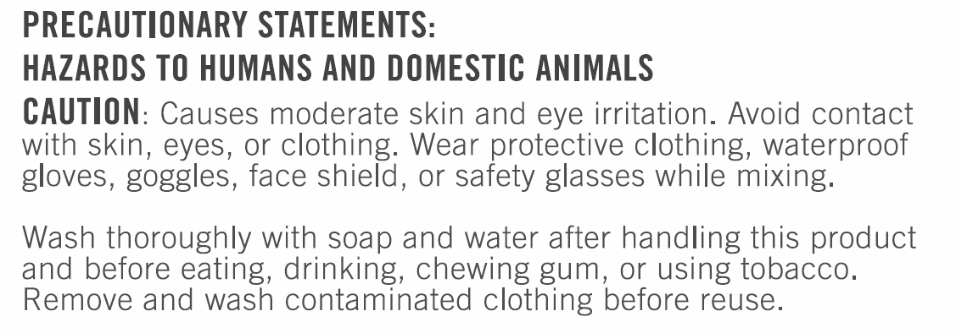
Finding Exposure Hazard Information
Read the label
Look for the Precautionary Statements section on the label
Will note the route or routes of exposure
Usually under the heading “Hazards to Humans and Domestic Animals”
Notes:
Exposure hazard information can be found on the pesticide label. It’s located under the title “Precautionary Statements.” This section will indicate the route or routes of exposure you should be concerned about. Any warnings will appear under the heading “Hazards to Humans and Domestic Animals.” (Instructor: use the sample Precautionary Statements section on the slide and have students identify the routes of exposure that are of concern for this particular pesticide.)
You should note that some pesticides may not have a “Hazards to Humans and Domestic Animals” section. These products aren’t required to display this information because they meet the requirements for EPA’s lowest toxicity category or aren’t skin sensitizers.

Slide 37
Toxicity of Pesticides
Notes:
Earlier we talked about pesticide toxicity. But what does it mean to a pesticide user?

Slide 38
Harmful Effects of Pesticides
Three ways pesticides harm humans:
Pesticide poisoning
Pesticide injury
Allergic effects
Notes:
Earlier we defined toxicity as the ability of a pesticide to cause harm. It is important to know that this harm can affect humans in three ways.
Pesticide poisoning is when a pesticide makes you ill or has some sort of adverse effect on a body system. Pesticides disrupting a person’s nervous system is an example.
Pesticide injury is when a pesticide directly damages tissue. An example of this is a burning sensation when splashing a pesticide on your skin.
Allergic effects are ways people react to a pesticide that’s not caused by it’s toxicity. Pesticide allergy symptoms are similar to other allergy symptoms – red or itchy eyes, respiratory discomfort, skin reactions, and the like. Pesticide allergies can be caused by any ingredient in a pesticide, not just the active ingredient. There is no way to predict who will develop allergies to any specific pesticide product.

Slide 39
Harmful Effects of Pesticides
Contact/systemic
Acute/delayed (chronic)
Reversible/irreversible
Notes:
The harmful effects of pesticides can appear in several ways and at various times.
Contact effects appear at the site of exposure. These effects can include skin irritation (such as blistering, rashes, or burns) and eye irritation or injury. The most common contact effects are swelling, stinging, and burning of the eyes, nose, mouth, or throat. Contact skin effects are the most common form of pesticide injury or poisoning to applicators.
Systemic effects appear at sites other than where the pesticide entered the body. Our similarities to animals can affect this. One example is an insecticide that affects an insect’s nervous system also affecting a person’s nervous system if the dose is sufficient enough. Similarly, a rodenticide that targets the bloodstream of rodents may also affect humans. It’s also possible that pesticides that aren’t targeted towards animals or insects may cause systemic effects. An example is the herbicide paraquat, which is deadly to people in small doses. Symptoms of systemic effects include nausea, vomiting, diarrhea, or stomach cramps; headache, dizziness, weakness, or confusion; excessive sweating, tearing, chills, or thirst; chest pains; breathing difficulties; or body aches and muscle cramps.
Acute effects are those that happen within 24 hours of an exposure to the pesticide. Delayed effects appear days, weeks, months, and even years after an acute or chronic exposure. Effects that occur after long-term exposure are called chronic effects. Keep in mind that acute and delayed effects don’t depend on where the pesticide affected the body. Acute and delayed effects can result from either contact or systemic effects.
We also need to be aware of reversible and irreversible effects. Reversible effects are those that are not permanent and can be changed or fixed. Skin rashes, nausea, eye irritation, and dizziness are examples. Irreversible effects are permanent and can’t be undone. Examples include birth defects, cancer, mutations, and nervous system injury.

Slide 40
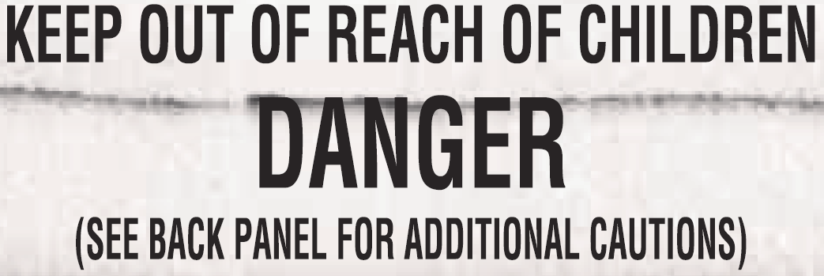
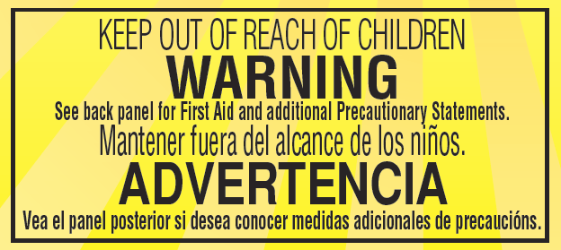

Toxicity and the Pesticide Label
Signal word indicates acute toxicity
Set by lab testing and EPA criteria
Highest measured acute toxicity and corrosiveness/irritation sets signal word
Notes:
At this point you’re probably asking yourself, “How do I determine the toxicity of a pesticide?”
Nearly every pesticide has a signal word on the front panel of it’s label indicating the acute toxicity of the pesticide. Signal words are usually in bold, capital lettering to make it stand out from the other text on a label. Can you tell what the signal words are in the examples shown here? (Instructor note: ask the students to respond to the question. Answers are: DANGER, WARNING, and CAUTION.) These signal words help you determine the relative toxicity of pesticides.
A pesticide’s signal word is based on acute toxicity testing done in the laboratory and how these results fit into the toxicity categories set by the US Environmental Protection Agency. The signal word is assigned based on the highest measured dermal, inhalation, and/or oral acute toxicity and the corrosiveness or irritation ability of the pesticide. Keep in mind that acute toxicity testing is done using the actual pesticide. This means signal words may vary between pesticides containing the same active ingredient. Let’s take a closer look at what the signal words mean.

Slide 41
Toxicity and the Pesticide Label
DANGER - POISON
WARNING
CAUTION
Category 1 – Highly toxic
Oral, dermal, or inhalation toxicity
Very low dose could kill a person (a few drops to 1 teaspoon)
DANGER
Category 1 – Highly toxic
Corrosive – permanent or severe skin, eye, or respiratory damage
Based on corrosive or irritant properties of the product
Moderate skin, eye, or respiratory damage
Small to medium dose could cause death, illness, or skin, eye or respiratory damage (1 teaspoonful to 1 ounce)
Category 2 – Moderately toxic
Mild skin, eye, or respiratory irritation
Medium to large dose could cause death, illness, or skin, eye, or respiratory damage. (Over 1 ounce to 1 pint or 1 pound)
Category 3 – slightly toxic
CAUTION or no signal word
Category 4
Slight concern for skin, eye, or respiratory injury
Slight to no toxicity concern (over 1 pint or 1 pound)
Notes:
A pesticide with a DANGER – POISON signal word indicates a highly toxic pesticide. These pesticides have high oral, dermal, or inhalation toxicity. A very small amount, as little as a few drops, could kill a person. Pesticides with this signal word will also have a skull and crossbones on their label.
Pesticides with a DANGER signal word also are highly toxic. However, the concern with these pesticides is their being corrosive or an irritant. These pesticides can cause permanent or severe skin, eye, or respiratory damage.
A WARNING signal word indicates a moderately toxic pesticide that can cause moderate skin, eye, or respiratory damage. A small dose of these pesticides, anywhere from 1 teaspoon to 1 ounce, could cause death, illness, or skin, eye, or respiratory damage.
A CAUTION signal word indicates a slightly toxic pesticide. These pesticides can produce mild skin, eye, or respiratory irritation. It takes a medium to large dose, more than an ounce up to a pint or pound, to cause death, illness or skin, eye, or respiratory damage.
You may find that some pesticides don’t have a signal word on their label. This is because they meet the criteria for the EPA’s lowest toxicity category and aren’t required to have a signal word on the label. They have a slight concern for skin, eye, or respiratory injury and little to no toxicity concern. While a signal word isn’t required for these products, some companies choose to list a CAUTION signal word on the label.
As you can see from these descriptions, the signal word is a way to compare the relative toxicity between pesticides you’re considering. Ideally you should choose the pesticide with the signal word meeting the lowest toxicity category that will provide adequate pest control.

Slide 42
Additional Notes on Toxicity
Check “Precautionary Statements” for routes of entry
Chronic toxicity
Notes:
While the signal word on a pesticide label gives you an idea of the acute toxicity of the product, it doesn’t necessarily tell you what the specific concerns are. You will want to read the “Precautionary Statements” section of the label to learn about specific routes of entry you should be concerned about and ways to protect yourself.
Chronic toxicity is a bit harder to predict than acute toxicity. Laboratory tests are conducted by exposing animals long-term to the pesticide active ingredient for about 2 years. If a product is found to cause chronic effects in laboratory animals, the manufacturer is required to put chronic toxicity warning statements on the pesticide label.

Slide 43
Protecting Yourself when Using Pesticides
Notes:
So far, we’ve talked about the harmful effects of pesticides, how pesticides can enter the body, and pesticide toxicity and risk. So what can a pesticide user do to protect themselves when using a pesticide? Let’s now look at ways to protect yourself from pesticide exposure.

Slide 44
General Precautions
Don’t eat, drink, chew gum, or use tobacco products
Wash your hands after handling pesticides, touching treated surfaces, or before going to the bathroom
Follow all label directions on personal protection
Don’t wipe gloves on your clothes
Launder pesticide-exposed clothes separately from household laundry
Use common sense!
Notes:
There are some general precautions pesticide users should take when using a pesticide to reduce their exposure:
Don’t eat, drink, chew gum, or use tobacco products while using pesticides or before washing up. Doing so may contribute to oral exposure as the hands may be contaminated with pesticide.
Wash your hands after handling pesticides, touching treated surfaces, and before going to the bathroom.
Follow all label directions about personal protection including using any label-listed protective equipment.
Don’t wipe gloves on your clothes. Doing so will contaminate your clothing and pesticide could soak through to your skin.
Launder pesticide-exposed clothes separately from household laundry to reduce cross-contamination.
While it might seem very simple, use common sense!

Slide 45
Personal Protective Equipment (PPE)
PPE = clothing and devices worn to protect from pesticide exposure
Effective PPE:
Keeps pesticides away from your body
Resists punctures and tears
Sealed at the seams
Comfortable
Notes:
The general precautions give us guidelines on what a pesticide applicator can do to protect themselves. However, each pesticide often will require the user to take specific precautions. Using personal protective equipment, also called PPE, is one of them.
PPE is any clothing or device worn to protect yourself from pesticide exposure. PPE can reduce your exposure to pesticides but may not necessarily eliminate it. To be effective, PPE must:
Keep pesticides away from your body the whole time you’re using a pesticide;
Be resistant to punctures and tears while using it;
Be well sealed at the seams; and
Be comfortable enough without restricting movement so you will use it.

Slide 46
PPE Materials
Protection varies with material type and thickness
Chemical resistant versus waterproof
Levels of chemical resistance vary
PPE breakdown:
Penetration
Permeation
Degradation
Notes:
PPE protection varies with the material it is made from and how thick the material is. The pesticide label will tell you which level of protection is needed.
Some pesticide labels will say that the user must use PPE made from chemical resistant materials. Others will say to use PPE made from waterproof materials. So what’s the difference? Chemical resistant means that there is no measurable movement of a pesticide through the material in a certain period of time. Waterproof material, on the other hand, keeps water-soluble pesticides out. Unlike chemical resistant materials, waterproof materials may not be effective for oil solvent-based products.
The level of chemical resistance varies depending on the material. Some materials resistant to one pesticide might not be resistant to others. Materials that are resistant to a particular pesticide might not provide the same level of protection for different lengths of time. Cotton, leather, canvas, and similar materials are not chemical resistant because they tend to absorb pesticide, drawing it closer to the skin, increasing the risk of exposure. Powders and dusts may also move through cotton or other woven materials and may even remain in the fibers after repeated washings. This is why you should not use a hat with a cloth or leather sweatband, cloth or cloth-lined gloves, footwear, or aprons when using pesticides.
The PPE barrier can breakdown in three ways:
Penetration is when the pesticide leaks through the PPE layer. This can be through seams, pinholes, tears, or other breaks in the material. If you expect to be working around sharp items or plants with thorns, you should select a material that’s less likely to be penetrated.
Permeation is when a pesticide seeps through the material. This depends on the material, the pesticide’s chemical characteristics, how long the material is exposed to the pesticide, the pesticide concentration, and temperature. Since permeation isn’t detectable until the pesticide reaches your skin, you should only use the PPE as long as the manufacturer or the pesticide label recommends.
Degradation is when PPE physically breaks down. This can be caused by exposure to a pesticide the material is not designed for. Signs of degradation include changing color, becoming soft or spongy, swelling or bubbling up, cracking or getting holes in it, or becoming stiff or brittle. If these occur, discard the PPE and select one that has better resistance.

Slide 47
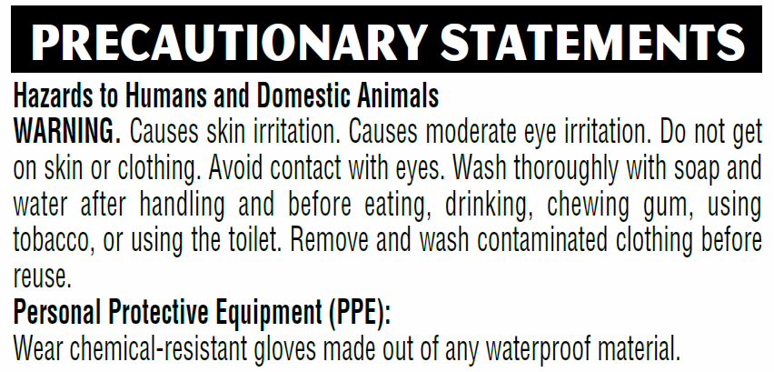
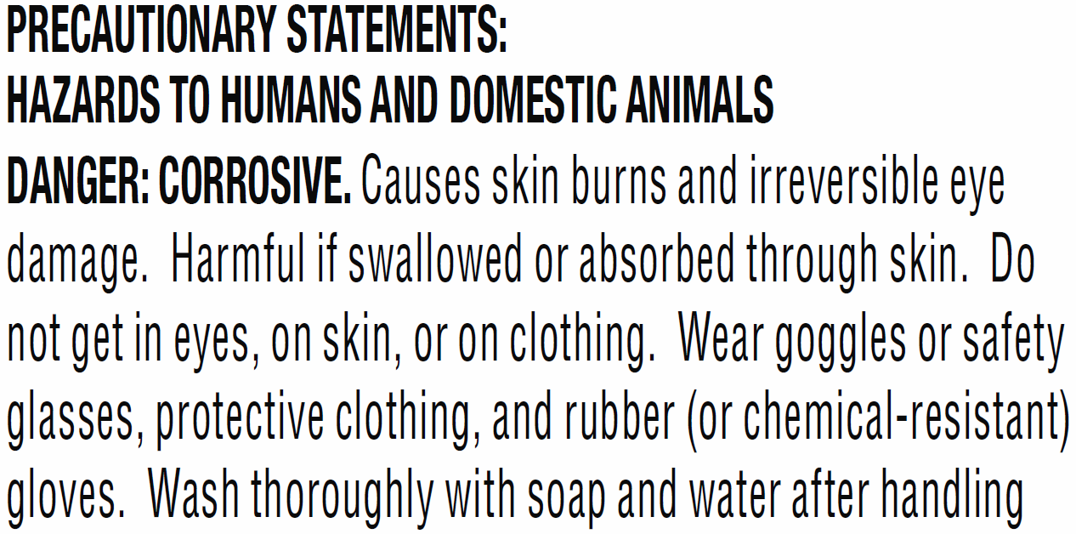
PPE and the Label
PPE listed under “Precautionary Statements” section of label
Labels list minimum PPE you need to use
Notes:
As we’ve mentioned, the label will tell you what types of PPE are required when using a particular pesticide. PPE requirements will be listed under the “Precautionary Statements” section of the label. As you can see in the highlighted example on the left, this label has a specific PPE section that lists chemical-resistant gloves made out of any waterproof material as required PPE. Some labels may list PPE requirements along with the “Hazards to Humans and Domestic Animals” information like the example on the right.
Keep in mind that the PPE listed on the label are the minimum you are required to use. You can always use more if you feel there’s a need. If the label says to use chemical-resistant materials but doesn’t specify a type, consult the pesticide’s or PPE’s manufacturer. At a minimum, you should wear long-sleeved shirt, long pants, and socks when working with pesticides.

Slide 48
Skin Protection - General
Most pesticide exposure is to the skin
Reduce skin exposure as much as possible
Wash with soap and water after use and if pesticide contacts your skin
Notes:
As we said earlier, dermal, or skin, exposure is the most significant route of entry. Because of this, you should take as much effort as possible to prevent skin exposure when working with or around pesticides. This includes using, at a minimum, long sleeved shirts, long pants, socks, and waterproof shoes. It also includes using chemical resistant gloves.
Wash up with soap and water after using a pesticide or when pesticide contacts your skin. In cases where pesticide gets inside any PPE you’re using, it will be trapped against your skin so you’ll need to remove and discard the PPE, wash the exposed area thoroughly with soap and water, and treat the exposed area as needed. Of course, you’ll need to put on clean PPE to finish up the pesticide application.

Slide 49
Skin Protection - Clothing
Clothing should be sound and sturdy
Coveralls
One- or two-piece options
Can be waterproof and/or disposable
Chemical-resistant options
Notes:
Clothing worn during a pesticide application should be made of sturdy materials and not have holes or tears in them. Tightly woven fabrics are better at protecting you than loose weaves as they prevent pesticide from moving through the fabric. At a minimum, you should wear a long-sleeved shirt, long pants, socks, and waterproof shoes when applying certain types of pesticides.
Coveralls can be used to protect against pesticide exposure. They come in one- or two-piece garments that fit over your regular clothing, covering the entire body except for the hands, feet, and head. Two-piece coveralls are designed for the jacket to stay outside of the pants and extend below the waist. Coveralls can be made waterproof and disposable.
Some coveralls are chemical-resistant. They can be used in situations where large amounts of pesticides could be deposited on your clothing. Chemical-resistant coveralls typically come as one-piece garments. If choosing to use coveralls, you should keep in mind that some manufacturers produce both chemical and non-chemical resistant versions. This means pesticide users will need to make sure they get the right type.

Slide 50
Skin Protection - Gloves
Typically the hands and forearms have the most exposure
Wear waterproof or chemical-resistant gloves when pesticides may contact the hands
Wear gloves properly according to hand position:
Mostly lowered – sleeves over gloves
Above your head – gloves over sleeves, glove cuffs rolled up 1-2 inches
Arms raised and lowered – cuffed tightly outside sleeve with tape or an elastic band
Wash gloves thoroughly before removing
Notes:
Pesticide handlers get the most pesticide exposure on their hands and forearms. To reduce this exposure, waterproof or chemical-resistant gloves need to be worn anytime pesticides might get on your hands. This may be when you’re mixing pesticides, working with contaminated application equipment, or touching a treated surface. Use gloves that go over your wrist and at least halfway to your elbow in order to better protect the forearm.
Your hand position will determine how to wear gloves. If your hands are in the mostly lowered position, the glove should be tucked under the sleeves of your shirt to prevent pesticide from running down into the gloves. If your hands are primarily above your head, you’ll want to leave your gloves outside your shirt sleeves and fold the cuff of the gloves up 1 or 2 inches to catch pesticide before it runs down your arm. In situations where you’ll be raising and lowering your arms, you can have the glove cuff outside of your shirt sleeve and use heavy-duty tape or an elastic band to close off the cuff of the glove.
Before removing gloves, wash them thoroughly to prevent contaminating the inside. You also need to wash your hands thoroughly and dry them before touching anything. It’s a good idea to have extra gloves available if the ones you’re using become damaged or if you think the inside has been contaminated.

Slide 51
Skin Protection - Footwear
Sturdy closed-toe shoes and socks
Chemical-resistant footwear
Properly wear footwear
Wash contaminated footwear before removing
Notes:
You also need to consider how to protect your feet during a pesticide application. Normally, sturdy shoes and socks will suffice. Sandals and open-toed shoes are not an option as they don’t provide enough protection. Also, fabric, canvas, or leather shoes and boots aren’t appropriate as they absorb pesticides easily, holding it closer to your skin.
Chemical-resistant footwear is available and may be required by the pesticide label. In situations where you’re likely to get pesticide on your lower legs or feet, use chemical-resistant boots that extend at least halfway up to your knee.
To avoid contaminating your feet, wear your pant legs outside of the footwear to prevent pesticide from running down into your footwear. Wash off your footwear before removing them.

Slide 52

Skin Protection – Headgear
Use to reduce exposure from overhead or airborne particles
Chemical-resistant type may be required by the label
Do not use headgear that contain absorbent material
Notes:
If you’re applying pesticides over your head or may be exposed to overhead or airborne particles, wear wide-brimmed protective headwear to reduce head exposure. It’s possible the pesticide label may require you to use chemical-resistant headgear. When choosing headgear, do not use hats or other headgear that contain absorbent material like cotton, leather, or straw. These materials can hold pesticide close to your skin, increasing your exposure.

Slide 53
Eye Protection
Labels may require protective eyewear
Typically includes shielded safety glasses, goggles, or face shields
Contact lens wearers should be cautious
Notes:
As we said earlier, your eyes can easily absorb pesticides. Some pesticide labels may tell you to use protective eyewear. The specific type of eyewear may be listed on the label and is based on the pesticide formulation and the exposure concern.
For homeowners, shielded safety glasses or goggles can be used to provide protection. Shielded safety glasses have shields along the brow line and on the sides. Safety glasses without these shields will not protect the eyes. Goggles that fit tightly against the face are an appropriate choice if there is the chance for being enveloped in spray, mist or dust. In some situations, a face shield might be beneficial. Select one that bends inward towards the throat to provide better protection.
Contact lens wearers should be aware that the lenses might trap pesticide against the eye. Your eye doctor or physician can help you decide if you need to be concerned about this.

Slide 54
Respiratory Protection
Pesticide label may require respiratory protection
No label requirement – consider using respirator when label says do not breathe vapors or spray mist
Use only NIOSH certified respirators
Follow directions
Notes:
Pesticides that create dusts or mists when mixing or applying can be inhaled, exposing the lungs to the pesticide. If there is concern for respiratory exposure, pesticide labels will tell you to use a respirator. The label will also specify what type of respirator to use.
In situations where the label doesn’t require respiratory protection, you should consider using a respirator if the label says to not breathe vapors or spray mist or harmful or fatal if inhaled.
The National Institute for Occupational Safety and Health, referred to as NIOSH (pronounced ny-osh), is responsible for certifying respirators used with pesticides. When purchasing a respirator for pesticide use, read the package and look for the NIOSH certification number on the box.
Be sure to follow the manufacturers directions for using respirators.

Slide 55
Maintain PPE
Store in a clean area away from:
Sunlight
Moisture
Extreme temperatures
Pesticides and other chemicals
Wash off PPE before removing
Disposable PPE
Reusable PPE
Replace PPE
Notes:
Like you, PPE must be properly cared for in order for it to function properly. Any reusable PPE should be stored in a clean area away from sunlight, moisture, extreme temperatures, and pesticides or other chemicals. Before removing any PPE, be sure to wash the outside of gloves with detergent and water. Wash any other PPE before removing it to prevent contaminating the inside surfaces.
If you use disposable PPE, like certain types of gloves or non-woven coveralls, they need to be disposed of after use. They’re not intended for long-term use.
Reusable PPE, like protective clothing, eyewear, or respirators, are meant to be used several times. These items should be cleaned according to the manufacturer directions after each use. Wash these items separately from the family laundry to prevent transferring pesticide to other clothes. It’s also a good idea to let the person doing the laundry know of the exposure risks and even have them use protective gloves to reduce exposure when handling the contaminated PPE.
Reusable PPE should be replaced regularly since its ability to resist pesticides can degrade over time and with each use. Pesticide residues that remain on the PPE may penetrate the material, potentially exposing you to the pesticide. Since your hands have the greatest exposure to pesticides, it’s a good idea to replace gloves frequently. Obviously, if PPE becomes damaged, it should be replaced immediately.

Slide 56
Pesticide Poisoning/Injury
Notes:
There may be situations where you or someone else has been poisoned or injured by a pesticide. What do you do in these cases?

Slide 57
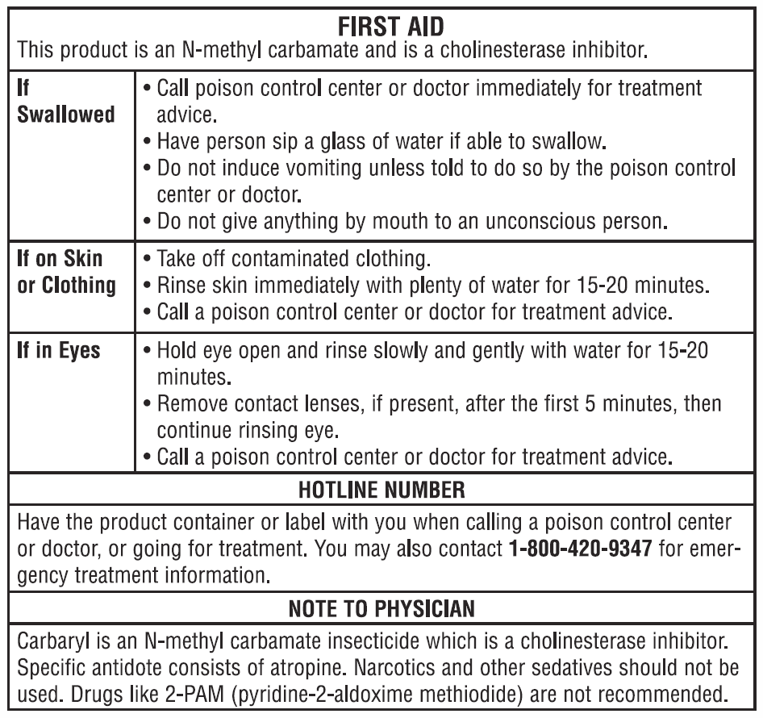
Pesticide Poisoning/Injury
Information on pesticide label
Knowing when to act
Bring a copy of the label with you
Notes:
The first place to turn to for help in a pesticide poisoning or injury situation is the pesticide label. The First Aid or Statement of Practical Treatment section of the label will give you instructions on what to do in various situations. You need to familiarize yourself with this information before you use a pesticide. That way you’ll know what to do in an emergency. Being able to act fast will lower the risk for injury.
Knowing when to act is also key. Symptoms of pesticide poisoning can resemble other ailments like a cold or even a hangover. If symptoms arise while using or soon after using a pesticide, play it safe and assume they are related to using the pesticide and seek help. There are times you’ll also need to respond before symptoms develop such as getting pesticide on your skin. In these cases, you should move away from the source of the exposure, apply first aid, and seek medical attention as necessary.
When seeking medical treatment, you’ll need to bring a copy of the pesticide label with you. The label will give the medical provider information about the pesticide you’ve been exposed to. Some labels, such as the example here, will also provide specific treatment information the physician will need to know. Don’t bring the actual pesticide container with you as that may unnecessarily expose others to the pesticide.

Slide 58
First Aid
Review label for procedures
Have a source of clean water available
Get away from source of exposure
After first aid, seek medical advice/treatment if necessary
Notes:
First aid is the initial step in helping a victim before seeking medical help. It’s a critical step in order to avoid more serious poisoning or injury down the road.
Successful first aid depends on you knowing what to do. Before using a pesticide, you should familiarize yourself with the first aid procedures listed on the pesticide label. In an emergency, you most likely won’t have time to look up this information. If you’re the victim, it’s possible you might not be able to read the label.
You should also have a source of clean water available when working with pesticides. Treatment of most pesticide exposures require water for such things as rinsing of exposed skin or flushing eyes.
The first step in first aid is to get the victim away from the source of the exposure. This could be a simple as removing the person from the treated area or removing any pesticide-contaminated clothing. Be sure to protect yourself from exposure to the pesticide so that you, too, don’t become a victim.
After administering first aid, you should seek medical advice or treatment if necessary. Generally speaking, you should seek medical attention whenever someone:
Becomes ill while using or soon after using a pesticide or has been in a pesticide-treated area;
Swallows a pesticide;
Gets pesticide in their eyes;
Has symptoms of injury appear following dermal or inhalation exposure; or
Has experienced enough dermal or inhalation exposure that common sense says to seek help, even if symptoms are not present yet.

Slide 59
First Aid
Skin exposure –
Remove contaminated clothing
Drench area with water
Wash with soap and water and rinse well
Dry skin and wrap, if necessary
Cover any chemical burns with a loose, clean, soft cloth
Don’t use any ointments, powders, etc. without medical guidance
Notes:
As we said earlier, first aid is the first step in helping a victim before seeking medical attention. Let’s now take a look at some basic first aid procedures for various exposure situations.
First aid for skin exposure involves removing any contaminated clothing, drenching the affected area with water, washing with soap and water, and rinsing well. Don’t scrub hard as you can cause abrasions which increases pesticide absorption through the skin. After washing, you should dry the skin and wrap the affected area, if necessary. If a chemical burn is present, cover the area with a loose, clean, soft cloth. Don’t use ointments, powders, or other treatments unless directed by medical personnel.

Slide 60
First Aid
Eyes –
Hold eyelids open and flush with clean water
Don’t use eye drops or other chemicals unless instructed by medical personnel
Cover the eye and seek medical attention after rinsing
Notes:
In the case of eye exposure, you should act quickly as eyes are especially sensitive to injury. As we’ve said before, they also readily absorb pesticides.
First aid for eyes includes holding the eyelids open and flushing the eyes with a gentle stream of clean water. If only one eye has been exposed, be careful not to contaminate the other eye. You should flush eyes for at least 15 minutes, directing the water across the eyes and under the eyelids.
When rinsing eyes, don’t use eye drops or other chemicals in the rinse water unless directed to do so by a medical personnel.
After rinsing, cover the eye or eyes and seek medical attention as soon as possible.

Slide 61
First Aid
Inhalation –
Get to fresh air
Loosen any tight clothing
Avoid chills/overheating
Keep chin up to ensure air passages remain open
Notes:
If someone has experienced inhalation exposure, you should move them to fresh air quickly. Don’t make the person walk; carry them. Have the victim lie down and loosen any tight clothing. Don’t let the victim become chilled or overheated. To help with breathing, keep the chin up to ensure that air passages remain open.

Slide 62
First Aid
Oral –
Not swallowed – rinse out with plenty of water and drink 1 quart of water or milk
If swallowed, contact Poison Control Center (800-222-1222) or a medical professional
Induce vomiting only if the label AND the Poison Control Center or medical professional says to do so
Seek medical attention
Notes:
In cases where pesticide has gotten in to the mouth but hasn’t been swallowed, rinse the mouth out with plenty of water. After rinsing, the person should drink about 1 quart of water or milk to dilute any pesticide that may have been swallowed during rinsing.
If the victim has swallowed the pesticide, a decision needs to be made about whether to induce vomiting or not. Contact the Poison Control Center or a medical facility for advice on what to do. The phone number for the Poison Control Center is listed here. You should be prepared to relay label information about inducing vomiting when making this phone call. Vomiting should be induced only if the pesticide label AND the Poison Control Center or a medical professional says to do so. Keep in mind this is only a first aid measure. The victim should be taken to a hospital as soon as possible.

Slide 63
Pesticides and the Environment
Notes:
Up until now our attention has been primarily focused on the pesticide applicator. But there are also environmental concerns you need to be aware of when using pesticides.

Slide 64
Environmental Considerations
Consider:
Where the pesticide goes once it is applied and
What effects the pesticide can have in the environment
Notes:
The term environment includes everything around us – soil, water, air, people, plants, animals, buildings and the like. A pesticide user needs to be aware of how pesticides affect the environment. Two things need to be considered: where the pesticide goes once it’s applied and the effects the pesticide has in the environment. By keeping these in mind, a pesticide user can better understand the potential adverse effects of pesticides and take steps to minimize them.

Slide 65
Effects in the Environment
Plant injury (phytotoxicity)
Pollinators and other beneficial insects
Animals
Notes:
So what are some possible effects of pesticides in the environment? First, there are concerns about plant injury. Called phytotoxicity, this can be the result of a pesticide not being applied correctly. Plants can be harmed by: too much pesticide being applied, the pesticide being applied at the wrong time, or the environmental conditions aren’t appropriate at the time of application. Phytotoxicity can occur on any plant part, including leaves, stems, flowers, and fruit.
Pollinators and other beneficial insects can be affected by pesticides, particularly insecticides. Preventing harm to them is the pesticide user’s responsibility. Pesticide labels will have directions on how to protect pollinators, in particular bees. Pesticides containing certain types of active ingredients will have a special bee icon on their label. This icon is to draw your attention to very specific directions you must follow for protecting bees.
Animals are also affected by pesticides. Pesticide-polluted water can kill fish. Birds can ingest pesticide granules, baits, or treated seeds or be exposed directly to sprays. Animals can mistake granular or pelleted pesticide formulations for food. In some cases, animals can feed on plants or animals that have been exposed to pesticides, exposing them to the pesticide. Pesticides in or on dead animals can harm predators that feed on them. Called secondary poisoning, pesticide labels will warn you if there are concerns with this. Some pesticides accumulate in the fatty tissue of animals which then is then passed up through each level of the food chain.
The effects of pesticides in the environment need to be kept in mind. That way you can take efforts to minimize the impacts.

Slide 66
Pesticide Movement in the Environment
Pesticide characteristics
Solubility
Adsorption
Persistence
Degradation
Volatility
Notes:
When a pesticide is released into the environment, pesticides can move into soil, air, surface water, and ground water. Certain characteristics of pesticides affect this movement.
Solubility is a pesticide’s ability to dissolve in a solvent. Pesticides that are highly soluble in water dissolve easily and are more likely to move with water across the soil surface or seep into it.
Adsorption is when a pesticide binds to soil particles. Pesticides that adsorb to soil particles are less likely to move off site than those that don’t.
Persistence is when a pesticide remains present and active in it’s original form before breaking down. Persistence can be helpful when it provides long-term pest control, reducing the need for additional applications. Persistence can be harmful if it exposes non-target organisms to the pesticide.
Degradation is the breakdown of a pesticide in to simpler, often less toxic, compounds. Degradation affects persistence in that pesticides that degrade quicker are less persistent than those that don’t degrade as fast. Degradation rates can vary from a few hours or days to many years.
Volatility is the tendency of a pesticide to turn into a gas or vapor. Volatility increases when temperature and wind increase as relative humidity decreases. Volatility can be a factor in pesticide drift.

Slide 67
Pesticide Movement in the Environment
Air
Water
Runoff
Leaching
Drift
Objects and organisms
Notes:
There are several ways pesticides move in the environment. Pesticides can be transported by air movement away from the application site in wind or air currents. This movement is called drift. Pesticides can drift as spray droplets, vapors, or solid particles. Keep in mind that drift not only occurs outdoors but can also happen inside as a result of air currents caused by heating and air conditioning systems. Pesticides that adsorb to soil can move long distances on wind-blown soil.
Water can also transport pesticides. This often occurs either by surface movement of water, called runoff, or by water moving through the soil, called leaching. Runoff can move pesticides into drainage systems, streams, ponds, or other surface water, allowing the pesticide to be transported long distances. Pesticides that leach into the ground can contaminate groundwater, which is a source of drinking water in many locations. In addition to runoff and leaching, pesticides drifting off the application site can also contaminate water.
Movement by water isn’t limited to the outdoors. Indoors, water that has pesticides in it can flow into floor drains, contaminating water systems. Dumping pesticide down a sink or toilet could contaminate an entire wastewater treatment system.
Objects and organisms can transport pesticides if they move or are moved off site. This movement may expose others to the pesticide.

Slide 68
Special Environmental Concerns
Sensitive areas
Endangered/threatened species
Notes:
Now that we’ve talked about how pesticides can move in our environment, there are a couple of special situations a pesticide user should be on the lookout for and take precautions to protect.
One of these concerns are what we’ll call sensitive areas. Sensitive areas are locations that can easily be injured by pesticides. Some examples of outdoor sensitive areas include surface water, areas where pets or other livestock may be kept, and apiaries. Examples of indoor sensitive areas include areas where people live, work, or are cared for; where food is prepared or stored, or where pets may be living. You’ll want to check the pesticide label for any special restrictions related to sensitive areas.
Endangered or threatened species are another special environmental concern. Endangered species are species that are on the brink of extinction. A threatened species is one that is likely to become endangered in the future. The Endangered Species Act is a federal law that makes it illegal to kill, harm, or collect endangered or threatened species. It also requires federal agencies to make sure that any action they carry out or authorize doesn’t jeopardize the existence of any endangered or threatened species. Because of this requirement, the EPA, which regulates pesticides nationwide, must make sure that all pesticide uses will not jeopardize endangered or threatened species. Pesticide labels may direct the user to read special bulletins about endangered or threatened species that may be affected by the pesticide and ways to protect them. It’s the pesticide user’s responsibility to read and follow these bulletins.

Slide 69
Protecting Water
Notes:
We’ve already discussed some basics on how water can be affected by pesticides. Since water is so important to us, it’s worth taking some extra time to learn more about how pesticides can contaminate water and ways it can be protected.

Slide 70
Surface Water Contamination
Includes ditches, ponds, lakes, streams, and rivers
Increase runoff, increase risk of surface water contamination
Factors affecting runoff:
Slope
Vegetative cover
Soil characteristics
Temperature
Rainfall/irrigation
May be a concern for most outdoor pesticide applications
Notes:
We briefly mentioned surface waters earlier in the presentation. Surface waters include ditches, ponds, lakes, streams, and rivers. Conditions that increase the chances for runoff from an area treated with pesticides increases the risk for surface water contamination. Runoff is affected by:
The slope of ground. Steeper slopes contribute to greater runoff.
Vegetative cover helps slow down water moving over the ground. Less vegetation creates greater runoff.
Soil characteristics determine how much water soaks into the ground rather than running off. Coarser soils, such as sandy soils, allow more water to seep into the ground, compared to finer soils like clay. This means that soils containing more clay allow more water to stay on the surface, leading to runoff.
Temperature also affects runoff. Frozen soils don’t allow water to soak into the ground, increasing the likelihood of runoff.
Excess rainfall or irrigation after a pesticide application can contribute to runoff since the water won’t be able to soak in to the soil fast enough.
Runoff may be a concern for most outdoor pesticide applications. Pesticide users need to be make sure that runoff doesn’t carry pesticide into surface waters or other sensitive areas.

Slide 71
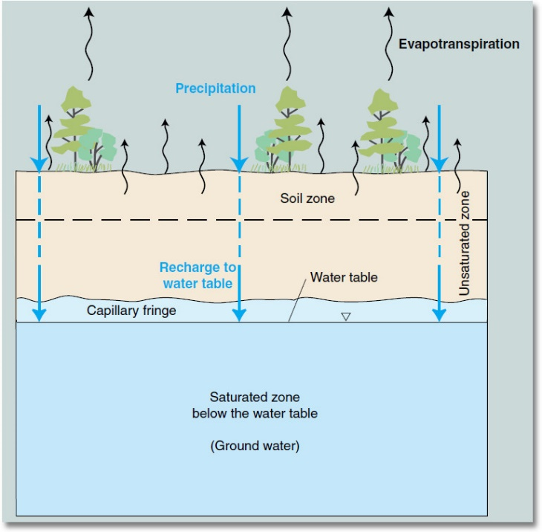
Groundwater Contamination
What is groundwater?
Recharge
Leaching
Notes:
Groundwater is also vulnerable to pesticide contamination. To review, groundwater is water that’s below ground in cracks in bedrock and in the space between sand grains, gravel, and rocks. As the illustration here shows, these layers are completely saturated with water. Above this is the unsaturated zone where some of the space between the soil particles is filled with water and others are filled with air. The interface between these two zones is called the water table.
Recharge is the process of precipitation filtering through the unsaturated zone to the water table. During recharge, water moving through the unsaturated zone can carry pesticides with it in a process called leaching. Leaching can ultimately contaminate groundwater. Because of this, we need to be careful how pesticides are handled on the surface. Once groundwater is contaminated, its extremely difficult, if not impossible, to correct.

Slide 72
Groundwater Contamination
Pesticide characteristics and leaching:
High solubility
Persistence
Adsorption
Label statement noting these concerns
Notes:
The chemical and physical characteristics of a pesticide will affect it’s leaching. Generally speaking, high solubility, persistence, and adsorption affect leaching.
Pesticides that are highly soluble in water will dissolve easy in soil water, making leaching more likely.
Pesticides that are more persistent will be more likely to reach groundwater before they break down into non-toxic compounds.
A pesticide that adsorbs itself strongly to soil particles won’t be free to move in soil water and won’t reach groundwater. By contrast, a pesticide that binds loosely to soil or doesn’t bind to the soil at all will be cause for concern.
If there are concerns with these three characteristics, the pesticide label will have statements letting you know this.

Slide 73
Groundwater Contamination
Site characteristics:
Soil texture and structure
Organic matter
Depth to groundwater
Geology
Notes:
Besides a pesticide’s chemical and physical characteristics, the characteristics of the site where the pesticide is applied affects leaching.
Soil texture is the proportion of sand, silt, and clay that are in the soil. Soils having a higher percentage of sand are more prone to leaching since water can easily move through them and they don’t adsorb pesticides as well. Soils with a higher percentage of clay may leach, but may be less prone to it.
Soil structure is the shape or arrangement of soil particles. It plays a role in the size of the pores that water moves through. Soil structure can also be affected by worm holes and root channels, which may allow water to pass through more easily.
Organic matter in the soil affects leaching by holding more water and adsorbing more pesticides than those with low organic matter.
Depth to groundwater has an effect on groundwater contamination. Areas with a shallow depth to the water table are more likely to allow pesticides to reach the groundwater. This is because there isn’t enough soil depth to act as a filter where the pesticide can be degraded or adsorbed.
Geology affects the flow of water between the surface and groundwater. Gravel deposits allow water and pesticides to move rather quickly downward. Layers of less permeable clay slow water’s downward movement.

Slide 74
Preventing Water Contamination
Read the label!
Use “best management practices”
IPM
Identify vulnerable areas
Mix/fill away from wells or surface water
Avoid back-siphoning
Avoid overflow
Watch the weather
Product selection
Handle pesticides safely
Notes:
There are several ways you can protect water from pesticide contamination. First, read the label. The label directions will provide ways to reduce the risk of water contamination. Typically this is included in the “Precautionary Statements” section. Note that the label may have additional New York-specific requirements related to water protection.
Best management practices to avoid contaminating water include:
Using IPM practices by using non-pesticide methods whenever possible or practical. You should select products that are less likely to leach or runoff. You can also reduce amounts used within label limits or spot spray rather than treat an entire area.
Identifying vulnerable areas like sandy soils, wells, streams, or shallow groundwater. Also avoid storm sewers, streets, ditches, and other potential sources of runoff. Don’t mix or fill a sprayer near a well!
Avoiding overflow when filling a sprayer.
Watching the weather and avoiding applications when rainfall is forecast.
Selecting products that are less likely to leach/runoff.
Handling pesticides safely by mixing and filling application equipment away from water sources; following label for proper clean up and disposal; sweeping granular products from sidewalks/driveways or other areas back onto treatment area; and cleaning sprayers at the application site and away from water sources.

Slide 75
Pesticide Laws and Regulations
Notes:
Pesticides, like many things in our daily lives, are regulated by federal and state laws and regulations. Laws and regulations are in place to protect ourselves and our environment. Everyone is required to follow pesticide laws and regulations – even homeowners! Let’s take a look at how pesticides are regulated by federal and state agencies.

Slide 76

Federal Laws and Regulations
Federal Insecticide Fungicide and Rodenticide Act (FIFRA)
Pesticide registration
Testing
Label
Restricted-use pesticides
Tolerance
Notes:
At the federal level, the Federal Insecticide Fungicide and Rodenticide Act, or FIFRA, is the federal law that governs all things pesticides. This law covers the federal registration of pesticides, pesticide applicator training and certification, and other issues related to pesticide use in the United States. The Environmental Protection Agency, or EPA, is the agency charged with administering and enforcing FIFRA. Through cooperative agreements with the EPA, states also have responsibility for enforcing the provisions of FIFRA.
All pesticides and their uses must be registered by the EPA before a pesticide can be used in the US. The registration process includes analyzing the pesticide’s risks versus benefits. The process requires pesticide registrants to conduct several tests, including toxicity, efficacy/performance, degradation/mobility/residue, and environmental effects for a pesticide. Pesticide registration doesn’t mean there are no risks associated with pesticide use. The registration process determines whether there is “reasonable certainty of no harm” to the user, non-user, and the environment.
A pesticide registrant also submits a pesticide label for review as part of their registration application. The EPA reviews this label to make sure it is written based on the test data. If there are any unreasonable risks of using the pesticide, the EPA can require certain wording be placed on the label to mitigate these concerns. Note that the EPA will register a pesticide only if the label is approved as well. That is, the pesticide label is registered just like the pesticide itself.
If a pesticide is found to pose unreasonable risks, the EPA can classify and register a pesticide as restricted-use as a way to mitigate the risk. Pesticides classified as restricted-use can only be used by a trained and certified applicator or someone working under their direct supervision. Restricted-use pesticides are not available to homeowners and homeowners should not have access to them. Pesticides classified as restricted-use by the EPA will have a notice on the top of the front panel of the label stating so. Pesticides that are not classified as restricted-use are commonly referred to as a general-use pesticides and are available to the general public.
Pesticides applied to human or animal food will leave behind residues. Excess residues can be harmful to humans or animals. Because of this concern, the EPA will establish a tolerance, or the maximum amount of residue that can legally remain on the food or feed product when it is ready for market or feeding. Tolerances pertain to both domestically produced and imported food and feed. While a pesticide tolerance is set by the EPA, the US Food and Drug Administration and the United States Department of Agriculture are responsible for enforcing them. Food and feed that have residues exceeding the established tolerance cannot be sold. If a food or feed has residues of a pesticide that doesn’t have a tolerance established or an exemption from the requirement for a tolerance, then that food or feed cannot be sold either.

Slide 77
Federal Laws and Regulations
Minimum-risk pesticides
Contain only active and inert ingredients listed in the federal regulations;
List on the label the name and percentage (by weight) of each active ingredient and the name of each inert ingredient;
Having no claims to control organisms that pose a threat to human health or insects carrying a specific disease or diseases;
Listing the name and contact information of the producer or company the product was produced for on the label; and
Have no false or misleading claims on the label.
Notes:
Minimum-risk pesticides are pesticides that the EPA has determined pose little to no risk to humans and the environment as long as they meet certain conditions. These conditions include:
Containing only active and inert ingredients approved by the EPA and listed in the federal regulations;
Listing on the label the name and percentage (by weight) of each active ingredient and the name of each inert ingredient in the product;
Having no claims to control organisms that pose a threat to human health or insects that carry a specific disease or diseases;
Listing the name and contact information of the producer or company the product was produced for on the label; and
Not having false or misleading claims on the label.
Minimum-risk pesticides are not required to be registered with the EPA. This means they do not have an approved label and are not reviewed by EPA. It also means that product efficacy testing isn’t conducted and any safety and use information on the label isn’t reviewed. Even though minimum-risk pesticides are not registered by the EPA, they’re still legally pesticides and must be used according to the label. Keep in mind that if a minimum-risk pesticide doesn’t meet the requirements listed here, then the product must go through the formal registration process.

Slide 78
Federal Laws and Regulations
Pesticide re-registration
Data reviewed based on current laws and regulations
Conducted every 15 years
Pesticide applicator certification
Certification required to purchase and use restricted-use pesticides
Two types – private and commercial
Federal regulations outline requirements for certification
States administer EPA-approved certification programs
Notes:
All registered pesticides periodically go through what’s called re-registration. Re-registration involves EPA reviewing data from the registrant to determine if a pesticide meets current safety and health standards and labeling requirements to determine if the pesticide can continue to be registered. This process is also a way for EPA to make sure older pesticides meet current safety and health standards and labeling requirements and that any risks are mitigated. EPA is required to review every registered pesticide on a 15 year cycle.
The federal government also regulates pesticide applicator certification. As we mentioned earlier, certification is required to purchase and use or supervise the use of restricted-use pesticides. FIFRA identifies two types of certified applicators – private and commercial. Private applicators use or supervise the use of restricted-use pesticides in the production of an agricultural commodity (such as crops, nursery stock, greenhouse plants, or livestock) on property they or their employer owns, rents, or leases. Commercial applicators are people who use or supervise the use of restricted-use pesticides in situations that aren’t defined as a private applicator. The definition of commercial applicator can vary by state. Federal rules establish pesticide applicator training requirements which are administered by states on behalf of the EPA. Often, Cooperative Extension provides applicator training and the state agency responsible for pesticides administers the testing and certification program and enforces pesticide laws.

Slide 79

New York State Laws and Regulations
Environmental Conservation Law (ECL)
Pesticide registration
Restricted-use
Prohibited pesticides
Location prohibitions
Determining registration status (NYSPAD)
Notes:
In New York State, the Environmental Conservation Law, also known as the ECL, provides the general framework for the distribution, sale, use, and transportation of pesticides in New York State. The New York State Department of Environmental Conservation, or DEC, is responsible for administering and enforcing New York pesticide laws and regulations.
New York State law requires that a pesticide be registered with the DEC before it can be sold, distributed for sale, used, or transported in New York State. Minimum-risk pesticides that we discussed earlier, do not require registration. However, these pesticides are still pesticides and are regulated as such.
Prior to registering a pesticide, the DEC reviews the same data a registrant provides to the EPA as well as the EPA-approved label. The DEC review is to determine if there are any unreasonable risks to using the pesticide under New York State conditions and that the uses comply with state laws, regulations, and policy. If concerns are found, the DEC will often work with the registrant to mitigate the concerns. If concerns are successfully mitigated, the product will be registered. If not, the registration application will be denied.
States are allowed to be more restrictive than the EPA, including making pesticides considered general-use by the EPA restricted-use. Pesticides containing certain active ingredients, pesticides applied to surface water, or pesticide labels that have certain statements may automatically be restricted-use in New York and require the buyer or user to be a certified applicator. The DEC can also restrict who has access to pesticides if there are other concerns, such as groundwater, to protect humans or the environment.
During the DEC registration review, there may be concerns about using a particular pesticide in a geographic location in New York State. This often is due to concerns about groundwater contamination due to very porous soils. For example, Long Island has very sandy soil that pesticides can easily leach through, contaminating the groundwater that serves as the drinking water for millions of Long Island residents. In order to protect Long Island’s groundwater, some pesticides may be prohibited from use in Nassau and Suffolk Counties. This restriction will be noted on the pesticide label.
The DEC maintains a database of all currently registered pesticides and approved product labels. Called the New York State Pesticide Administration Database, or NYSPAD for short, this database can be used to determine a pesticide’s registration status. NYSPAD can also be used to view the approved label for the pesticide. Let’s take a brief look at NYSPAD.

Slide 80
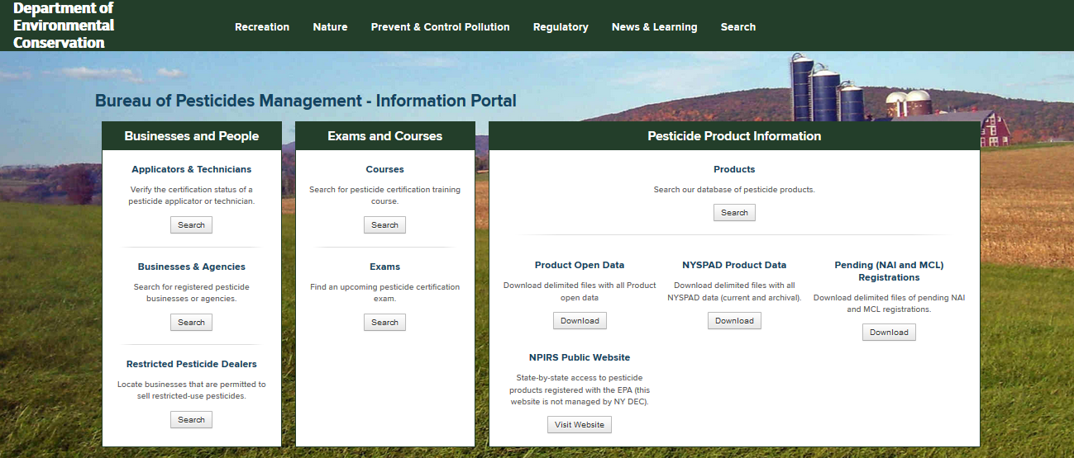
http://www.dec.ny.gov/nyspad
Notes:
NYSPAD is accessed via the website shown at the top of the screen. To look for pesticide registration information, you’ll want to look under the “Pesticide Product Information” heading and click the “Search” button under “Products”. This is shown here by the circle.

Slide 81
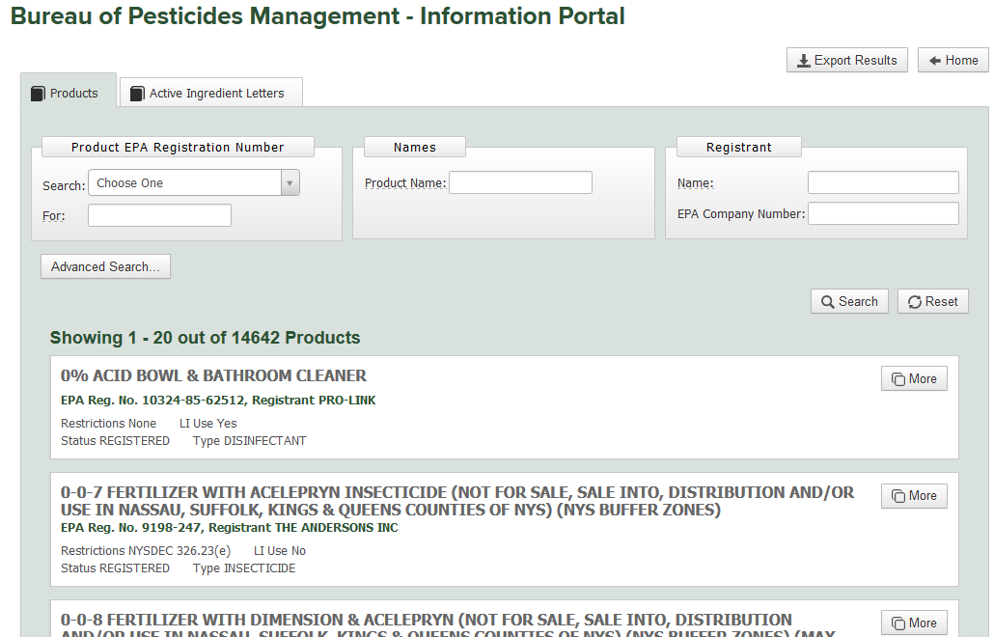
Notes:
After selecting “Search,” you’ll get this screen. Across the top of the page are ways you can search for a pesticide. The easiest way to search for a pesticide is either by the EPA Registration Number or using the product’s name.
To search by EPA Registration Number, use the search box at the top left-hand corner of the screen, indicated by the black circle. Simply click the down arrow next to “Choose one”, select “EPA Reg. No.” from the list, and then type the EPA Registration Number of the product in the “For” box. If you wish to search by product name, use the “Names” search at the top center of the page, indicated by the red circle, and type in the product name. After you enter either of these search terms, click the “Search” button, which is circled in yellow, to search the DEC’s product registration data. If the product you are searching for is registered, you will get a box, like those shown at the bottom of the screen, that has basic information about the product. If the product is not registered, no results will be shown. When searching make sure to use either the EPA Registration Number or the name search, not both. Entries in both boxes may not return any results!
I mentioned earlier that NYSPAD allows you to view the New York State-approved labels for a pesticide. To view them, click the “More” button next at the right-hand side of the results box and…

Slide 82
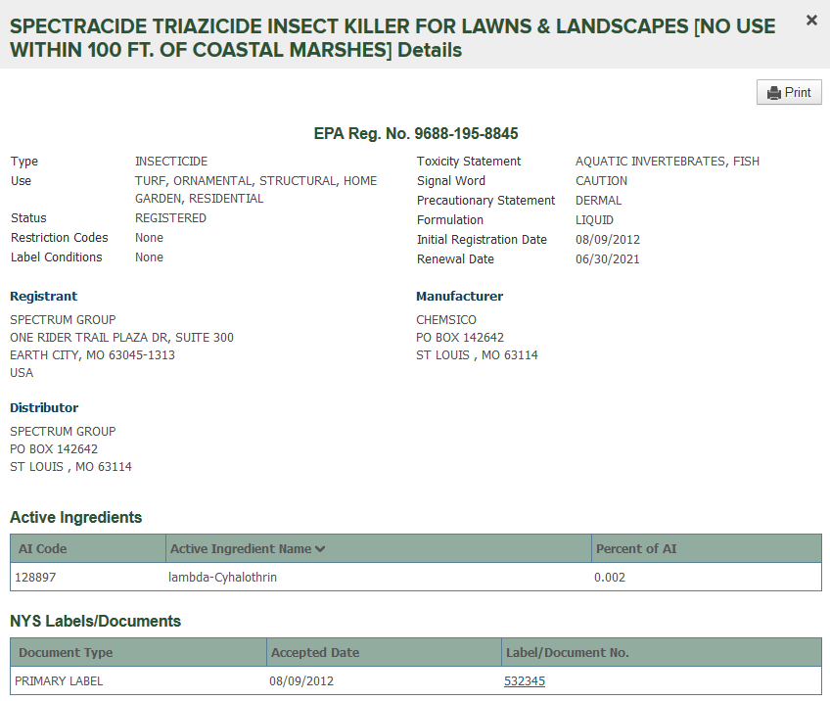
Notes:
…you’ll get a pop-up window that looks like this. To view any approved labels, click the number under the “Label/Document No.” column at the bottom of the screen. The most recently approved label is listed first. When you click the number, a PDF version of the label will open for you to read.
Note that this screen also gives you additional information about the pesticide, including the manufacturer, when the New York State registration expires, and any restrictions about using the product in New York State.

Slide 83
New York State Laws and Regulations
Environmental Conservation Law (ECL)
Pesticide registration
Restricted-use
Prohibited pesticides
Location prohibitions
Determining registration status (NYSPAD)
Applicator certification/recertification
Notes:
State laws and regulations also govern applicator certification and recertification. They set the types of certification categories, the qualifications to become a certified applicator, how long a certification lasts, and what’s required to maintain certification, including continuing education requirements.

Slide 84
Unique NY Pesticide Requirements
Label requirements
Site and pest
Rates
Backflow prevention
Aquatic pesticides
Notifications
Structural use
Lawn use
Neighbor notification
Notes:
New York State also has some very unique pesticide use requirements. State law requires a pesticide to be used according to the label directions. Because of this, the site and the pest must be on the label in order for the use to be legal. This means that the pest needs to be listed in the proper combination with the site to be treated. Similarly, homeowners can only use the product at the rates listed on the label. Going higher or lower than what’s listed is a violation of the law!
Backflow is the movement of water from the sprayer through the filling hose to the water source and can lead to water contamination. When filling a sprayer with water, New York State requires the use of a backflow prevention device to prevent water from being contaminated. Two options are allowed - either a special anti-siphon valve fastened to the faucet or an air gap between the hose end and the sprayer fill hole.
Pesticides that are used in surface waters like ponds and lakes are automatically restricted-use in New York State meaning that only properly certified pesticide applicators can apply them. Additionally, most aquatic pesticide applications require permits from the DEC, adding another layer of complexity to the task. There are minimal aquatic pesticides that homeowners can use. These are limited to pesticides applied to containerized water like bird baths.
New York State also requires notification of pesticide applications in certain situations. State law requires a pest control company to supply the occupant of a one- or two-family dwelling or the occupant of a multiple-dwelling unit a copy of the label for each pesticide they will be applying within the dwelling. This label can be in either written or electronic form. In all other cases, the property owner or owner’s agent will receive a copy of the label.
Lawn pesticide applications by a “for-hire” company require a signed, written contract between the company applying the pesticide and the property owner. The contract will include the dates that the applications will occur, the number of applications to be made, and the total cost. Lawn applications also require that the applicator gives the customer information on what pesticides will be applied; the company’s name, address, phone number, and business registration number; and the applicator’s certification identification card number. The applicator must also give a copy of the label to the property owner. If the pesticide application is within 100 feet of a dwelling, multiple dwelling, public building, or public park, the applicator will also place visual notification markers on the property. These are the yellow signs you may see around town placed in flower beds or along roads and streets in residential neighborhoods.
Neighbor notification is a state law that counties can opt in to and not all counties have done so. This law affects both “for-hire” applicators and homeowners. The basic requirements of the law are:
48 hour notice is given to neighbors for certain types of lawn applications;
Posting of visual notification markers for most residential lawn applications;
Providing notice to occupants of multiple dwellings and other occupied structures; and
Posting of an information sign by retailers who sell general use lawn pesticides.
Additionally, the Neighbor Notification Law added new sections to state education and social services law requiring notification of pesticide applications at schools and daycare facilities. These notification requirements are required state-wide.

Slide 85
Pesticide Storage and Transportation
Notes:
At some point, a pesticide user will have to store and transport a pesticide. Let’s now shift gears and look at what one should keep in mind when storing and transporting pesticides.

Slide 86
Pesticide Storage
Check the label for any specific requirements
Always store in the original container with the label intact
Cool, dark, dry area away from temperature extremes
Keep away from heat sources
Keep away from food, seeds, and protective clothing
Keep out of reach of children and pets
Notes:
When storing pesticides, the first thing you should do is consult the label for any specific requirements. The label will tell you such things as keeping the pesticide away from heat or open flame or protecting it from freezing.
Other general guidelines for storing pesticides include:
Storing pesticides in their original container with the label intact. That way you’ll know exactly what’s in the container;
Keeping pesticides in cool, dark, dry areas away from temperature extremes;
Not storing pesticides near heat sources;
Keeping pesticides away from food, seeds, and protective clothing to protect them from accidental contamination; and
Keeping pesticides out of the reach of children and pets.

Slide 87
Transporting Pesticides
Transport in non-passenger area of vehicle
Keep away from groceries/household items
Keep container lids fastened
Keep containers upright and secured
Protect from temperature extremes
Don’t leave unattended
Notes:
Transporting pesticides has similar concerns as storage with the goal of preventing accidental exposure to the pesticide. Some things to keep in mind when transporting pesticides:
Don’t transport pesticides in the passenger area of vehicle. Ideally they should be placed in the trunk or in the bed of a truck. If you must transport a pesticide in an open vehicle like a mini-van, keep the pesticide in the back away from passengers and pets;
Keep the pesticide away from groceries and household items, including not bagging pesticides with these items. You should avoid carrying pesticides in the same area of the vehicle as groceries or household items to prevent accidental contamination;
Keep container lids fastened to avoid spills and leaks;
Keep containers upright and secured to avoid spills;
Protect pesticides from temperature extremes; and
Don’t leave pesticides unattended in a vehicle.

Slide 88
Pesticide Spills and Waste
Notes:
Responsible pesticide use includes knowing how to handle a spill and dispose of pesticide wastes properly. Lets now discuss some general considerations for handling pesticide spills and waste.

Slide 89
Pesticide Spills
Best to prevent spills
Check the label for specific guidance
Use label-listed PPE
Three “Cs”:
Controlling the spill
Containing the spill
Cleaning up the spill
Wash up afterwards
Notes:
Ideally, the best way to handle a spill is to avoid them in the first place. However, accidents do happen.
You should read the pesticide label for guidance on how to clean up a spill. This information is located in the “Storage and Disposal” section.
When cleaning up a spill, be sure to use any label-listed PPE to protect yourself from exposure to the pesticide.
Spill cleanup involves using what we’ll call the 3 “Cs”:
Controlling the spill or leak. If a container has tipped over, turn it right-side up. If a small container is leaking, put it into a larger chemical resistant container to stop further release of the pesticide. Keep unprotected people, children, and animals from entering the area.
Containing the spill. While controlling the spill, keep it from spreading and in as small an area as possible. For liquids, use cat litter, newspaper, or paper towels to soak up all of the product. In some cases, you might need to build a dike out of sod, soil, or absorbent material to contain the spill. For dry pesticides, you can lightly mist them with water or cover the spill with a plastic tarp. Be careful not to over water and cause clumping or release the pesticide.
Cleaning up the spill. Don’t wash down spilled pesticides with a hose. Always keep pesticides out of water bodies or pathways that lead to water. After liquids have been absorbed, sweep up or collect the contaminated absorbent materials and seal them in a heavy-duty plastic bag for disposal. Dry pesticides can be swept up, placed in a heavy-duty plastic bag and disposed of. Dispose of any pesticide contaminated materials in trash that’s kept outside of the home.
After cleaning up a spill, wash your hands and any other areas that have been exposed with soap and water.

Slide 90
Pesticide Waste
Prevent/minimize pesticide waste:
Purchase what’s needed
Use up the product according to label directions
Follow directions under “Storage and Disposal” section of the label
Never pour unwanted or leftover pesticides down the drain, in a storm sewer, or on the ground
Contact county solid waste agency for disposal options
Pesticide containers cannot be reused
Notes:
When we talk about pesticide waste, this includes both unused or unwanted pesticides as well as empty pesticide containers. Managing pesticide waste really starts by preventing or minimizing the amount of waste you generate. There are two ways to accomplish this. You should only purchase enough pesticide for the need and use the product up according to label directions.
The pesticide label will give you directions on what to do with leftover pesticide and empty containers. These instructions are found in the “Storage and Disposal” section of the label.
You should never pour unwanted or leftover pesticides down the drain, in storm sewers, or on the ground as it can lead to environmental contamination or even interfere with the proper operation of waste water treatment systems.
Contact your county solid waste agency for leftover pesticide disposal options. Many counties run household hazardous waste collection events where you can drop these off.
Pesticide containers cannot be reused. They are only for holding pesticides and nothing else.

Slide 91
Pesticide Labels
Notes:
The pesticide label is a very important part of using pesticides. If you think back on what we’ve talked about during this training, we’ve made several references to the label. Essentially, most everything a pesticide user needs to know is found on the label. Now, let’s talk more specifically about pesticide labels and what they mean to the pesticide user.

Slide 92
The Pesticide Label
What is a pesticide label?
Important to many people:
Manufacturer – permission to sell
Regulators – way to control use, sale, distribution, and disposal
Health Care Provider – treatment directions
Applicator – use directions
Notes:
The first question we need to answer is “What is a pesticide label? Simply put, the label is the printed information attached to a pesticide’s container or package. The label contains information about a pesticide’s characteristics and proper use. The label is also a legal document that you must follow. Not doing so is a violation of the law.
Pesticide labels are important to many different people. For the manufacturer, it gives them permission to sell the pesticide. For regulators, it’s a way to control the use, sale, distribution, and disposal of a pesticide. For health care providers, it gives them information on how to treat a person who has been exposed to a pesticide. For the pesticide applicator, it provides directions on how to use the pesticide.

Slide 93

Role of the Label
Primary communication between manufacturer and user
Four key pieces of information:
Information about the pesticide
Safety and health precautions
Environmental concerns
Directions for use
Notes:
The role of the label is an important one. It’s the primary way information is relayed from the manufacturer to the user.
Pesticide labels are designed to convey four key pieces of information:
Information about the pesticide;
Safety and health precautions;
Environmental concerns; and
Directions for use.
Let’s take look at these pieces of information in more detail.

Slide 94
Product Information
Trade, brand or product name
Notes:
Probably the most recognizable and visible part of the label is the trade name. This is on front panel, typically in big, bold lettering. As we discussed earlier, products can have similar sounding trade names so it’s important to know what’s in the product.

Slide 95
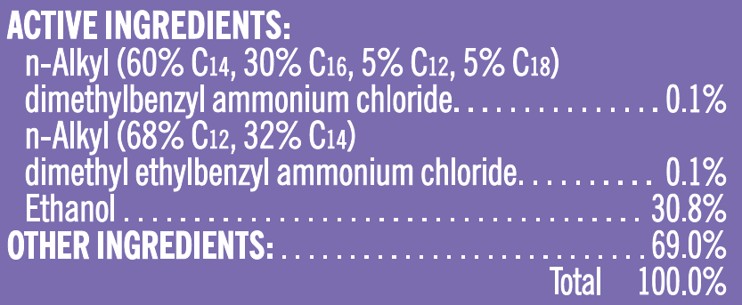
Product Information
Ingredient statement
Active ingredients
Inert (or other) ingredients
Notes:
The way to identify what’s in a pesticide is to look at the ingredient statement. This is typically on the front panel of the label. The ingredient statement will have two parts. First, it will list the names and amount of the active ingredient on a percent basis in the pesticide. Note that the percent of active ingredient is listed on a weight-to-weight basis.
Second will be the amount of inert, or other, ingredients in the product. As we noted earlier, reading the ingredients is important in order to avoid brand name confusion.

Slide 96
Product Information
Type of pesticide
Net contents
Manufacturer name and address
EPA Registration Number:
EPA Reg. No. 248-1945
Manufacturer
Product
Notes:
The label will also let you know the type of pesticide in the package. This may be stated directly on the label by using words such as insecticide, fungicide, disinfectant, and the like. The type of pesticide may also be indicated by wording that says “for control of insect pests” or other similar type wording that implies the type of pesticide it is.
All pesticide labels are required to show the weight or volume of product in the container. This may be listed in pounds or ounces if sold by weight or quarts or fluid ounces if sold by volume.
The label will also list the name and address of manufacturer. That way if you have any questions about the product, you’re able to get in touch with them. Often a phone number is listed as well.
Each pesticide has a unique identification number called the EPA Registration Number. This number is assigned by the EPA to each pesticide product. The EPA Registration Number has at least two sets of numbers. The first set of numbers identifies the manufacturer, which is unique to each manufacturer. Each pesticide manufacturer has their own number. In the example here, the manufacturer number would be 248. The second set of digits is the product number. In our example here it’s 1945. Sometimes a third set of numbers may be listed. This indicates that the product is distributed by a different company than the manufacturer. The number identifies this distributor.

Slide 97
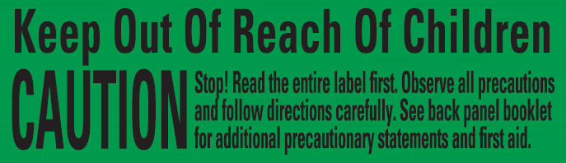

Safety Information
Signal word
Quick reference word for relative toxicity
Notes:
The label also gives us various pieces of safety information we need to be aware of. The signal word is one of those pieces. Recall our earlier discussion about acute toxicity and signal words. We said that the signal word is a way to tell the user the relative toxicity of a pesticide. Based on the signal words shown here, which one indicates the lower acute toxicity? (Answer: CAUTION.)

Slide 98
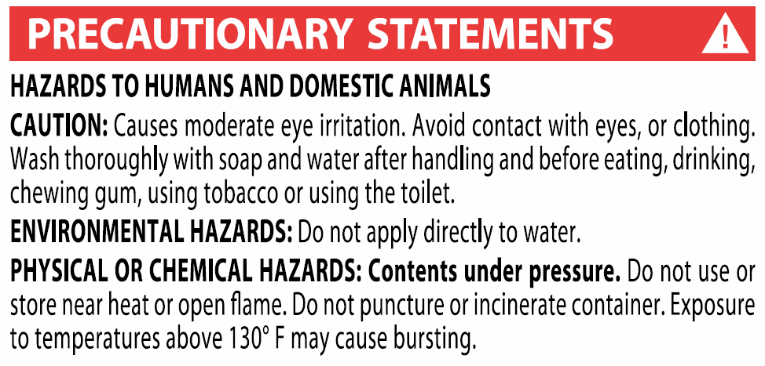
Safety Information
Physical or chemical hazards
Flammable
Corrosive
Other
Notes:
The label also lets us know about any physical or chemical hazards with the pesticide. This can include telling us if a pesticide is flammable or if it’s corrosive. This information is listed under the “Precautionary Statements” section of the label. In the example shown here, are there any physical or chemical hazards? (Answer: Yes. They include: not using or storing the product near heat or open flame; not puncturing or incinerating the container; and not exceeding temperatures of 130°F or the container may burst.)

Slide 99
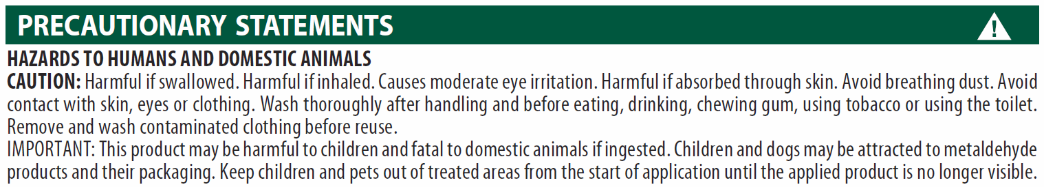
Safety Information
Routes of entry statements:
Avoid breathing vapor or spray mist
Avoid contact with skin, eyes, or clothing
Harmful if swallowed, inhaled, or absorbed through skin
Notes:
The label will also tell us ways the pesticide might injure people or animals. Labels will indicate which routes of entry may be hazardous by using various statements like:
Avoid breathing vapor or spray mist;
Avoiding contact with skin, eyes, or clothing; or
Harmful if swallowed, inhaled, or absorbed through the skin.
(Instructor note: Ask the students which routes of entry each of the three example statements relate to. Answers: Bullet #1 – inhalation; bullet #2 – dermal (skin) or eye; bullet #3 – oral, inhalation, and dermal (skin).)

Slide 100
Safety Information
Personal protective equipment (PPE)
Labels list minimum PPE.
You can always choose to use more!
Notes:
Labels will tell you what types of personal protective equipment, or PPE, the applicator or other pesticide handlers will need to use to reduce their exposure. Keep in mind that the PPE listed on the label are the minimum you’re required to use. You can always choose to use more than what’s listed.

Slide 101
Safety Information
Other precautionary statements:
Do not contaminate food or feed
Remove contaminated clothing before reuse
Wash thoroughly after handling and before eating or smoking
Do not allow children or domestic animals into the treated area
Notes:
Labels will often list other precautionary statements including:
Do not contaminate food or feed;
Remove contaminated clothing before reuse;
Wash thoroughly after handling and before eating or smoking; or
Do not allow children or domestic animals into the treated area.
Even if these statements are not on the label, it’s a good idea to follow them.

Slide 102
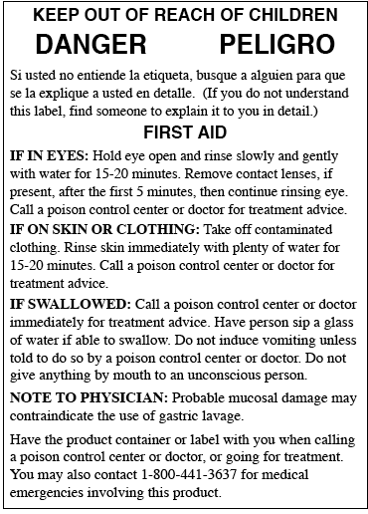
Safety Information
First aid statement
Information for treating poisoning and accidental exposure
Emergency telephone number also included
Bring label when seeking medical attention
Notes:
Each pesticide label will have a first aid statement. As we said earlier, you should become familiar with this information before you use a pesticide.
The first aid statement tells you what to do in case of a poisoning or accidental exposure. These directions may say something like:
If swallowed, call a poison control center or doctor immediately for treatment advice.
If on skin or clothing, take off contaminated clothing, rinse skin immediately with plenty of water for 15-20 minutes, and call a poison control center or doctor for treatment advice.
Some labels will also list an emergency contact phone number you can use for more information and assistance.
When seeking medical treatment for a pesticide exposure, be sure to bring the label with you. It will have important information the medical provider may need to properly treat the exposure. Labels for products with a DANGER signal word and some other product labels, will also have specific information for physicians about any antidotes or other medical procedures.

Slide 103
Safety Information
Re-entry statements
Tell when it’s safe to enter the treated area
Located under the “Directions for Use” section of the label
May be listed under “Non-agricultural uses” section or elsewhere
Notes:
So how do you know when is it safe for you or others to enter a treated area? Label re-entry statements will tell you this. These statements will say things like “People and pets must not enter treated areas until spray has dried” or “Allow dusts to settle in treated areas before reentering.”
Re-entry statements are located under the “Directions for Use” section of the label. They can be listed most anywhere, including the “Non-agricultural Uses” section or elsewhere on the label. This means it’s important that you read the label to find this information.

Slide 104
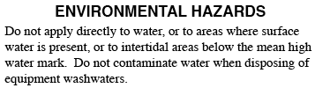
Environmental Information
General statements such as:
Do not apply when runoff is likely to occur
Do not contaminate water by disposing of rinse water and other pesticide wastes
Do not apply when weather conditions favor drift from treated areas
Notes:
We’ve talked about how labels provide information on ways we can protect ourselves and others from pesticide exposure. But what about protecting other areas of our environment like water and wildlife?
Nearly every pesticide label will have an “Environmental Hazards” section that lists general statements on how to protect the environment. These statements may tell you to do such things as not applying the product when runoff is likely to occur, to not contaminate water when disposing of rinse water or other pesticide wastes, or to not apply the pesticide when weather conditions favor drift from the treated area. While these may seem like common sense things to do, they’re there as a reminder of what you need to do to protect our resources.

Slide 105
Environmental Information
Product specific environmental impact statements:
Highly toxic to honeybees
Extremely toxic to fish and aquatic invertebrates
ENVIRONMENTAL HAZARDS
This product is highly toxic to bees exposed direct treatment on blooming crops or weeds. Do not apply this product or allow it to drift to blooming crops or weeds while bees are actively visiting the treatment area.
Notes:
Some pesticides may have specific environmental concerns needing attention. These may appear on the label as statements telling you that the product is highly toxic to honeybees or that it’s extremely toxic to fish and aquatic invertebrates. When you see these statements, you need to take extra precautions to avoid causing harm. Some examples include “Highly toxic to honeybees” or “Extremely toxic to fish and aquatic invertebrates.” Like the more general environmental hazard statements, these more specific concern will also be addressed in the “Environmental Hazards” section of the label.

Slide 106
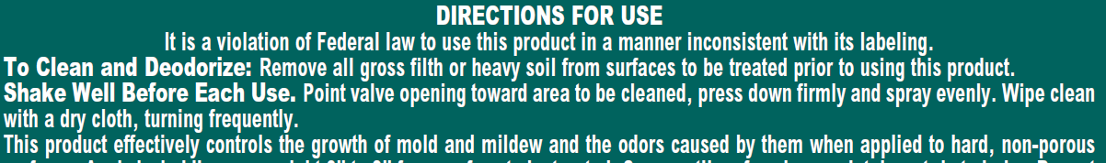
Directions for Use
Tell you how to use the product
Notes:
So far, we’ve talked how a pesticide label tells us what the pesticide is, what the hazards are with using the pesticide, and what we need to do to protect ourselves, others, and the environment when using the pesticide. So now we need to figure out how to use the pesticide. How to use the product is covered in the “Directions for Use” section of the label. This information typically takes up the largest portion of label.

Slide 107
Directions for Use
Where can the product be used?
Site must be listed
Use Sites | Pest Controlled
Home lawns, golf courses, athletic field and recreational turf; non-grazed and non-crop areas, parks, cemeteries, picnic areas, uncultivated non-agricultural areas, including airports, roadsides, highway right of ways, utilities right of way, campgrounds, and industrial sites; Institutional sites defined as areas around properties of facilities providing a service to public or private organizations including, but not limited to, hospitals, nursing homes, schools, universities, colleges, museums, libraries, sport facilities, and office buildings. | Imported fire ants - Solenopsis spp.
Notes:
The use directions give us a piece of very important information – where we are allowed to use the pesticide. Where the pesticide can be used is called the site. In order for a pesticide application to be legal, the site must be listed on the pesticide label for the product you want to use. If the site isn’t listed, then you cannot use the pesticide on the site and will need to find one that’s properly labeled.
In the example shown here, can you name some of the sites this pesticide can be used on? (Instructor note: Have students name sites the product can be used on. Anything listed in the “Use Sites” column is correct.)

Slide 108
Directions for Use
Pest information
The target PEST must be on the label when you
apply a pesticide in New York.
BLACKFLIES. HOUSEFLIES. GNATS. CERTAIN OTHER NUISANCE INSECTS - SMALL FLYING MOTHS. CRANE FLIES, MIDGES, ADULT STABLE FLIES (Dog Flies) in Residential Areas, Municipalities, Woodlands, Livestock Pastures, Feed Lots and Pastures including Dairy cattle.
Notes:
The use directions will also tell you the pests the pesticide can be used against. Some labels will have very specific lists of pests, others may list very broad categories.
As a reminder, in New York State the pest you want to control must be on the label in combination with the site you’re planning to treat in order for the use to be legal. Not all states have this requirement.

Slide 109
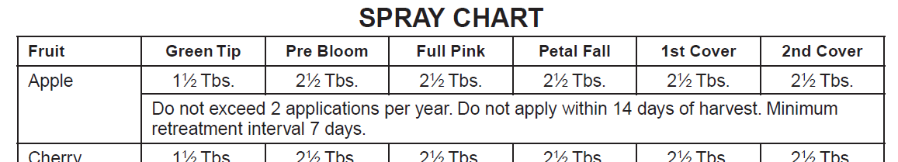
Directions for Use
How much to use (rate)
Usually listed with the sites and pests
Frequency of the application
How close to harvest the pesticide can be applied
Notes:
The use directions will also tell you how much pesticide to use to control the pest. This is called the rate and is usually listed near or alongside the sites and pests on the label. Rates can be expressed several ways including an amount per square foot or an amount per plant. Keep in mind that you must follow the rate listed on the label. Going over or under the listed rate is against the law! You should also be aware that sometimes the rates are different depending on the pest or even the growth stage of a plant.
Labels will tell you the frequency, or how often, you can make a pesticide application. This can rage from as little as one application to several spaced days apart.
For pesticides that are used on fruits and vegetables, the label will tell you how close to harvest you can make the last application. As long as label rates have been followed, this means pesticide residues will be within approved tolerances.
Instructor note: To reinforce finding rate, frequency and pre-harvest information on the label, have the students answer the following questions using the spray chart shown:
What is the rate used for apple at green tip? (Answer: 1 ½ tablespoons.)
What is the rate for an apple 1st cover spray? (Answer: 2 ½ tablespoons.)
What is the spray frequency? (Answer: at least 7 days with no more than 2 applications per year.)
How close to harvest can you make the last pesticide application? (Answer: 14 days.)

Slide 110
Directions for Use
How the product is to be applied
The type of application equipment
Timing of the application
Any other limitations on using the product
Notes:
Other information the use directions will tell us is:
How to apply the product, such as using a certain application method;
The type of application equipment to use, such as a hand-held sprayer or the applicator provided with the pesticide;
When to apply the pesticide, such as a certain plant or pest growth stage; and
Other limitations on using the product.

Slide 111
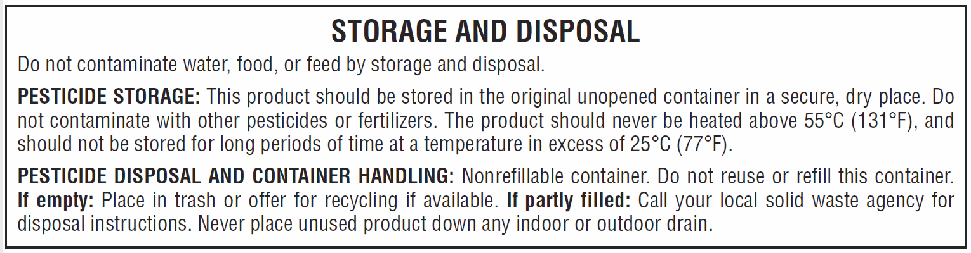
Directions for Use
Storage/disposal directions
Notes:
Earlier we talked about pesticide storage and disposal and how this information is included on the pesticide label. Here is an example of how the information might appear. Pesticide storage directions may include keeping the product at a certain temperature, not storing with certain other chemicals, or other product-specific storage requirements. Pesticide disposal and container handling directions will tell you how to handle empty or partially filled containers. There may also be directions on needing to rinse the empty container prior to disposal.

Slide 112
Directions for Use
Labels say:
Not following the label is called misuse.
“It is a violation of federal law to use this product in a manner inconsistent with its labeling.”
Notes:
The statement “It is a violation of federal law to use this product in a manner inconsistent with its labeling” appears on all pesticide labels. This statement means that the user needs to read, understand, and follow the directions closely. It also means that the user is not allowed to deviate from the label directions. Doing so is called misuse and puts the user in violation of federal and state law. Besides being illegal, not following the directions may cause harm to you, to others, or the environment.

Slide 113
Pesticide Misuse
Any use not on the label is prohibited
Consultants, sales people, and others cannot recommend uses not on the label
No one is exempt from following the label – not even the general public
Ask if you don’t understand the label
Notes:
As we’ve said, you must use a pesticide according to its label. Any use that’s not on the pesticide’s label is prohibited.
Consultants, sales people, and others such as Extension staff and Master Gardeners cannot recommend uses that aren’t on the label. Doing so might put an unknowing pesticide user in violation of the label.
No one is exempt from following the label, not even the general public who uses general use pesticides. It’s important that they understand this and that they need to follow the label.
Labels can be very complicated documents. If you don’t understand the label, ask for help. Manufacturers, Extension specialists, staff at the Pesticide Management Education Program at Cornell, and state pesticide control specialists are folks you can turn to if you have questions.

Slide 114
Stricter State Laws and Regulations
State laws and regulations can be more strict
Examples:
Modifying EPA-approved labels
Making general-use pesticides restricted-use
Interpreting label statements more strictly
Must follow the most restrictive rule
Notes:
FIFRA allows states to have stricter pesticide laws and regulations than the federal government. Some examples of ways states may have stricter requirements are:
Modifying the EPA-approved label to meet state needs. An example of this in New York State is the DEC requiring a statement on the labels of homeowner pesticides containing imidacloprid saying that sale, distribution, and use in Nassau, Suffolk, Kings, or Queens County is prohibited.
A state can classify a general-use pesticide as restricted-use, limiting who has access to it.
Interpreting label statements more strictly. For example, New York State law requires a product whose label limits use to commercial pesticide applicators to be a restricted-use pesticide in New York, whether classified so by the EPA or not.
The take home message is that you must follow the most restrictive rule.

Slide 115
When to Read the Label
Four times you should read the label:
Before buying
Before mixing and/or using
Before storing
Before disposing
Notes:
We’ve talked quite a lot about what’s on a pesticide label throughout this portion of the presentation. Reading the label isn’t a one-time event. You should read the label often to refresh your knowledge of the product and how to use it. There are four key times to read the label:
Before buying a pesticide, read the label to check:
That the site you plan to treat and the pest you wish to control are on the label.
The suitability of the pesticide for your conditions.
For any use restrictions.
For any PPE requirements.
On how much to purchase based on the label-listed rates and directions.
Before mixing and/or using, read the label to check on what PPE you need to be using. If the product needs to be mixed, you can read how the product is mixed and how much you’ll need to use. Reading the label before using the pesticide is the time to find out safety precautions you need to take, when and how the pesticide is applied, what application equipment is needed, any environmental warnings you need to follow, and how to respond in case of an accident. Re-read the label before each use. Don’t rely on your memory!
Before storing, reading the label to learn how to properly store the pesticide. Remember, there may be special storage requirements noted on the label.
Before disposing of unused pesticide and empty containers, read the label to find out what you need to do to prevent environmental contamination and hazards to people. Be aware that some products may have special disposal requirements.

Slide 116
Final Thoughts…
Label is a legal document
Remember to read and follow the label
The user is responsible for any misuse.
Notes:
As we end our discussion on the pesticide label, here are some final take-home thoughts.
Always keep in mind that the label is a legal document. You need to read and follow the it closely. Not doing so may cause harm to you, others, or the environment, not to mention it is also a violation of the law. Ultimately, the pesticide user is responsible for any misuse of the pesticide.

Slide 117
Label Reading Exercise
Notes:
(Instructor note: At this point, students will have a chance to read through an actual pesticide label and answer several questions. A generic set of questions has been provided that can be used with any pesticide label. Encourage participants to work together in small groups on the questions. After everyone has had a chance to read the label and answer the questions, bring the group back together to discuss their answers.)

Slide 118
CCE & Pesticide Recommendations
Notes:
Depending on county association policy, some Master Gardener Volunteers may be allowed to recommend pesticides to clients. Making pesticide recommendations involves a great deal of responsibility. Additionally, providing recommendations also exposes county associations to liability concerns if the recommendations aren’t made according to pesticide laws and regulations as well as CCE policies. Let’s now look at what’s expected of CCE staff and Master Gardener Volunteers who make pesticide recommendations.

Slide 119

Notes:
Cornell Cooperative Extension Administration has developed the Cornell Cooperative Extension Financial Operations Resource Manual, abbreviated FORM, that covers all kinds of information county Extension associations need to operate. In this manual, FORM Code 1501 addresses CCE association risk management, including pesticide recommendations made by CCE staff and volunteers. FORM Code 1501 addresses specific needs, including where to obtain recommendations and how to properly document them.

Slide 120
CCE & Pesticide Recommendations
Recommendations should be from documented authoritative sources
Use most current Cornell Crop and Pest Management Guidelines or updated Cornell department fact sheets
Materials need to have been reviewed by PMEP
Can use other sources provided they’ve been reviewed by PMEP
Minimum-risk (or 25(b)) pesticides
Can be recommended
Need to vet through PMEP first on compliance and use
Inform user they are not subject to EPA safety and efficacy testing
Overview of 25(b)s are in Code
Notes:
So what does FORM Code 1501 say about making pesticide recommendations? The first thing is that CCE staff and volunteers need to use recommendations from documented authoritative sources. What might these sources be? They would include the most current editions of the Cornell Crop and Pest Management Guidelines or updated Cornell department fact sheets. Any materials used need to have been reviewed by the Pesticide Management Education Program, or PMEP (pronounced pea-mep) at Cornell University to make sure they comply with current New York and federal pesticide laws and regulations.
CCE staff and volunteers can use recommendations from other sources, including publications from land-grant colleges or Extension systems in other states. However, these recommendations must be reviewed by PMEP for legal accuracy. Other states have different rules than New York so these publications may discuss pesticides or pesticide uses that aren’t allowed in New York State.
Minimum-risk pesticides, also called 25(b) pesticides, can be recommended to clients as a pest control option. Before recommending a minimum-risk pesticide, the specific product needs to be vetted by PMEP for legal compliance and use. Additionally, when recommending a minimum-risk pesticide, CCE staff and volunteers need to inform the user that these particular pesticides are not subject to EPA safety and efficacy testing. (Recall this from our discussion earlier.) The FORM Code also includes an overview of what minimum-risk pesticides are.

Slide 121
CCE & Pesticide Recommendations
Refer to manufacturer’s label – it’s the final word
Make sure any pesticide you recommend is labeled for use prescribed
Encourage the applicator to have a copy of the label and to read and follow it
Don’t recommend a pesticide that you don’t have a label for
Include the disclaimer in the FORM Code on fact sheets or written recommendations for general public
Notes:
When making a pesticide recommendation, you should refer to the manufacturer’s label as it’s the final word in how a pesticide can legally be used. Related to this, you need to make sure that any pesticide you recommend is labeled for the use being prescribed. Otherwise, you’re placing the user in jeopardy of misuse, which is a violation of the law.
When providing recommendations, you should encourage the applicator to have a copy of the label and to read and follow it. You might even remind the applicator that the law requires them to read the label and to follow the directions.
You should never recommend a pesticide that you don’t have a label for. Without the label, how would you know if the recommendation is a legal one?
If you’re involved in creating fact sheets or written recommendations for the general public, you should include the disclaimer from the FORM code. This disclaimer is part of CCE’s liability protection.

Slide 122
CCE & Pesticide Recommendations
Documentation:
All recommendations – written or verbal
Include date, client’s name, summary of situation, and details of recommendation
For minimum-risk pesticide recommendations – record notifying client that products aren’t subject to EPA efficacy/safety testing
Can use Recommendations Record Book Form or computer file
Records must be kept for a minimum of 7 years
Notes:
When providing a pesticide recommendation, you must document what recommendation was made. A record is required for both written and verbal recommendations. Ideally the record should include enough detail to clearly describe the reasons for the recommendation if you had to go back and refer back to it a year later.
At a minimum, the specific details you should record include the date, client’s name, a summary of the situation, and specific details of the recommendation including the specific product or products recommended along with any specific rates recommended. For minimum-risk pesticides, you also need to document that you told the client that these pesticide products aren’t subject to EPA efficacy or safety testing.
Recommendation records can be recorded using the “Recommendations Record Book Form” found in the FORM Code 1501 online or in a computer file. Note that if a computer file is used, it should be saved as “read only” to preserve authenticity.
All recommendation records must be kept for at least 7 years, according to records retention regulations.

Slide 123
References
Article 33 – Pesticides. (2019). Retrieved from http://public.leginfo.state.ny.us/lawssrch.cgi?NVLWO:.
Buhler, W. (n.d.). Pesticide environmental stewardship – homeowner. [Website]. Retrieved December 4, 2019 from https://pesticidestewardship.org/homeowner/.
Martin, A., Whitford, F., and Jordan, T. (2011). Pesticides and formulation technology. Retrieved June 18, 2019 from Purdue Pesticide Programs Web site: https://ppp.purdue.edu/wp-content/uploads/2016/08/PPP-31.pdf.
National Pesticide Information Center. (n.d.) Active ingredient fact sheets. [Website]. Retrieved December 6, 2019 from http://npic.orst.edu/ingred/specchem.html.
Nelson. W. N. (Ed.) (2014). Pesticide guidelines for managing pests around the home. Ithaca, NY: Pesticide Management Education Program, Cornell University.
New York State Department of Environmental Conservation. (2001). Protective clothing for handling pesticides. [Brochure}. Albany, NY: Author. Retrieved October 7, 2019 from: http://www.dec.ny.gov/docs/materials_minerals_pdf/pm6.pdf.
New York State Department of Environmental Conservation. (n.d.). New York State pesticide administration database (NYSPAD). [Website]. Retrieved December 6, 2019 from http://www.dec.ny.gov/nyspad.
Part 325 Rules and Regulations Relating to the Application of Pesticides. (2019). Retrieved December 6, 2019 from https://govt.westlaw.com/nycrr/Browse/Home/NewYork/NewYorkCodesRulesandRegulations?guid=Ic6cbc220b5a011dda0a4e17826ebc834&originationContext=documenttoc&transitionType=Default&contextData=(sc.Default).
Part 326 Registration and Classification of Pesticides. (2019). Retrieved December 6, 2019 from https://govt.westlaw.com/nycrr/Browse/Home/NewYork/NewYorkCodesRulesandRegulations?guid=Ic75898d0b5a011dda0a4e17826ebc834&originationContext=documenttoc&transitionType=Default&contextData=(sc.Default).
United States Environmental Protection Agency. (n.d.). Pest control and pesticide safety for consumers. Retrieved December 6, 2019 from https://www.epa.gov/safepestcontrol.
United States Environmental Protection Agency. (2018). Label review manual. [PDF file]. Retrieved June 4, 2019 from: https://www.epa.gov/sites/production/files/2018-04/documents/lrm-complete-mar-2018.pdf.
University of Wisconsin – Pesticide Applicator Training Program. (n.d.). Storing and disposing of pesticides. [Brochure]. Madison, WI: Author. Retrieved December 6, 2019 from: https://s3-us-west-2.amazonaws.com/pat-tools.cals.wisc.edu/tools/HomeOwner/Handout/hp_4.pdf.
Wixted, D. (2012). Pesticide applicator training manual – Northeast core manual (3rd Ed.). Ithaca, NY: Pesticide Management Education Program, Cornell University.

