Slide 1
Course 5:
Innovative Production

Slide 2
USDA’s description of innovative production
“Innovative production is a diverse and dynamic area of agriculture, including indoor controlled environment agriculture, rooftop farms, outdoor vertical production, green walls, high-tech vertical farms, greenhouses, and hydroponic, aeroponic, or aquaponic farms.”

Slide 3
USDA’s description of innovative production, pt. 2
“These operations are creating new and better markets, enhancing the competitiveness of specialty crops, and creating economic opportunities for the next generation of agricultural producers.”

Slide 4
USDA’s description of innovative production, pt. 3
“They also support climate resilient food systems by extending the growing season, conserving water, and providing local and regional food options.”

Slide 5
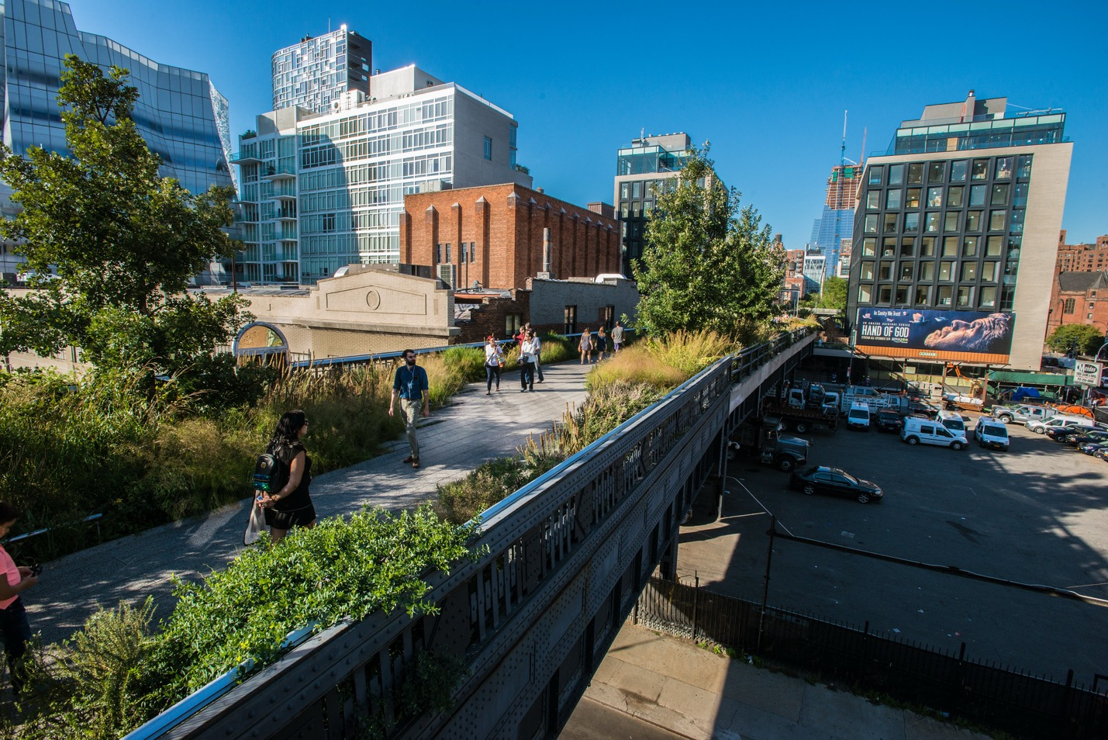
Urban greenery as part of sustainable urban design

Slide 6
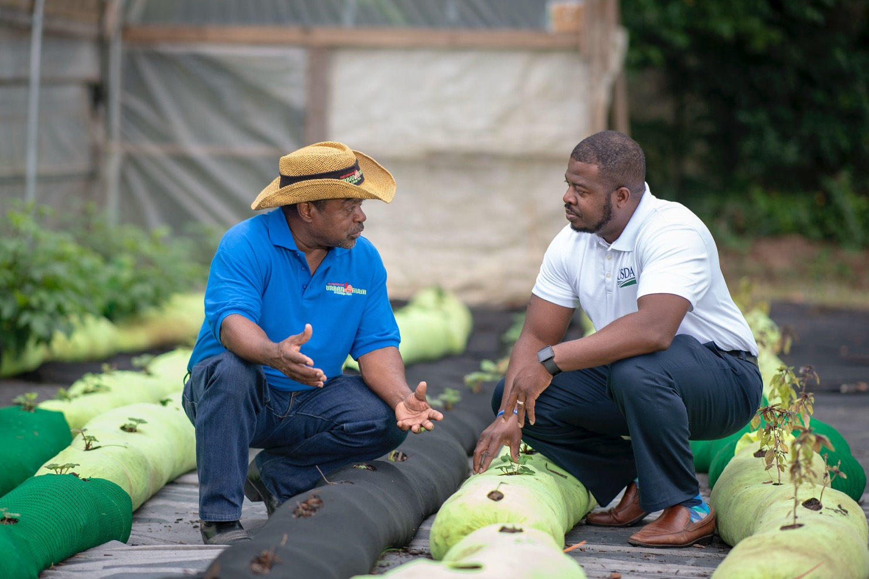
Innovative doesn’t always mean ”new”

Slide 7
Course 5 learning objectives
You will:
Identify and distinguish between different types of innovative production
Evaluate the various benefits of innovative production
Examine how the USDA can support innovative producers

Slide 8
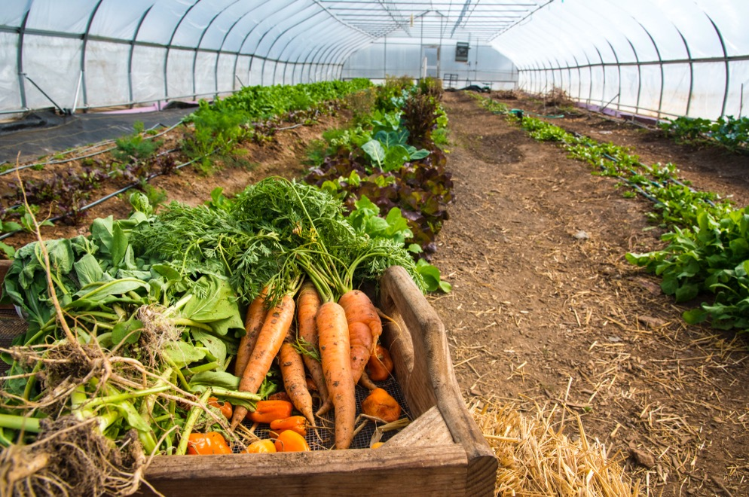
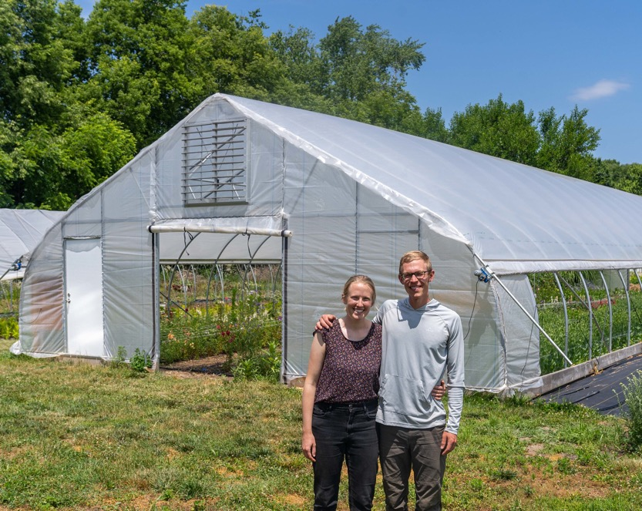
Soil-based agriculture

Slide 9
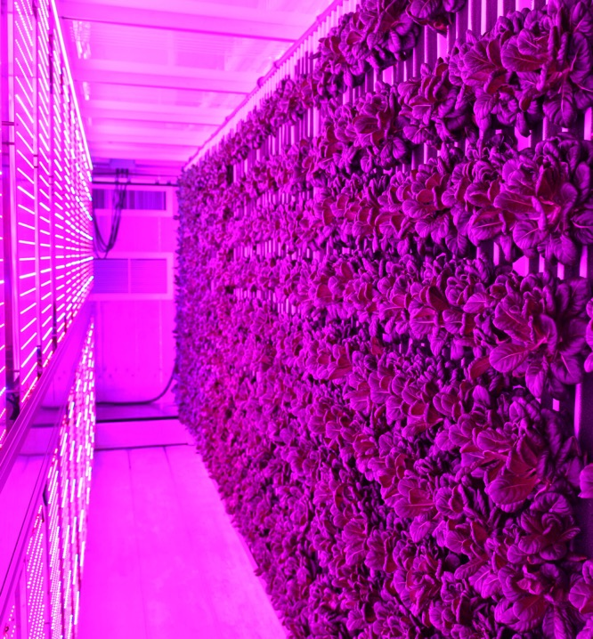
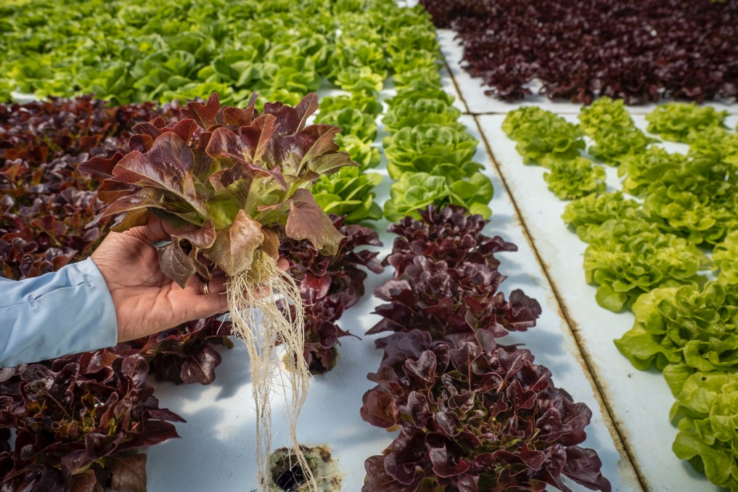
Non-soil-based agriculture

Slide 10
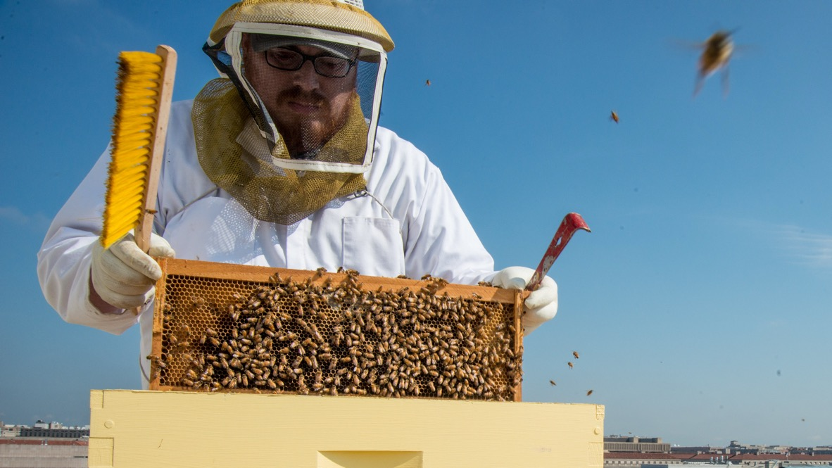
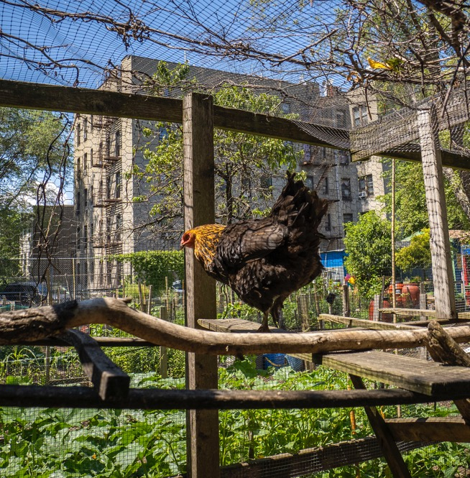
Animal agriculture

Slide 11
Intensive planting strategies

Slide 12
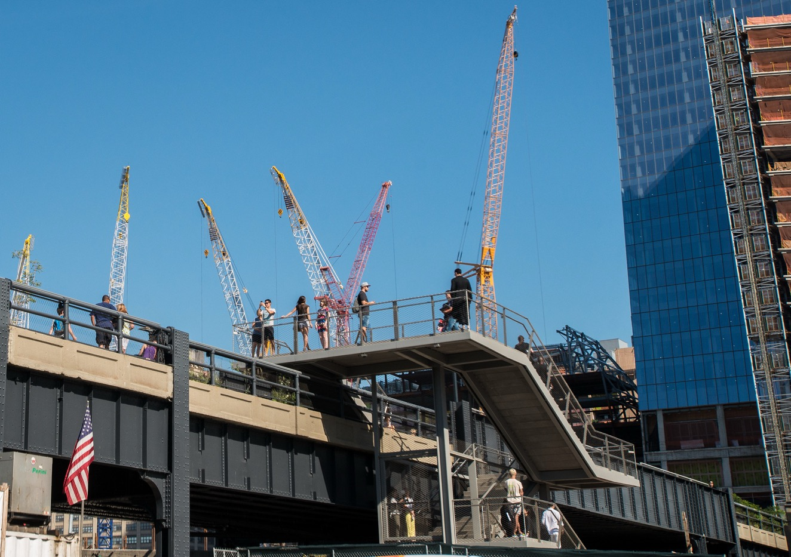
Land access limited by development

Slide 13
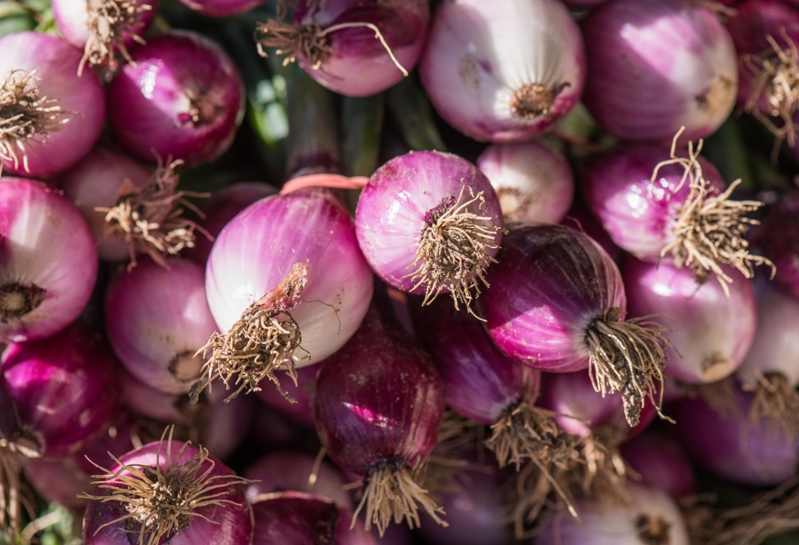
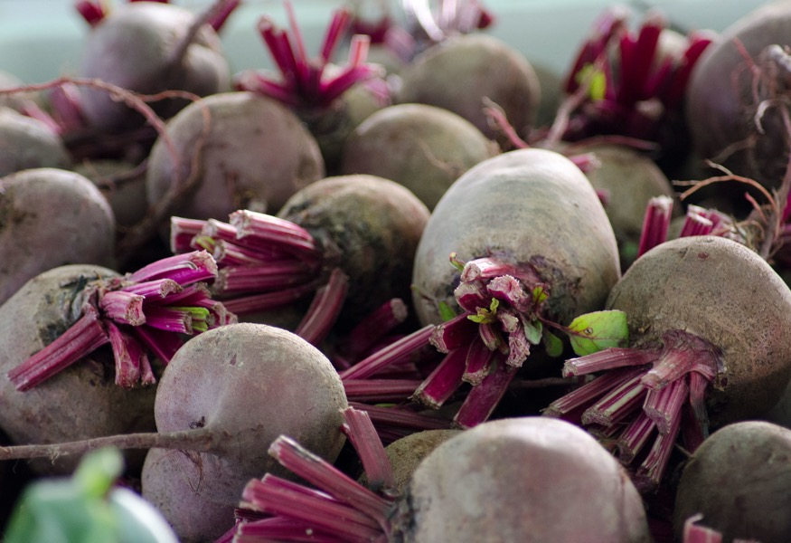
Succession planting

Slide 14
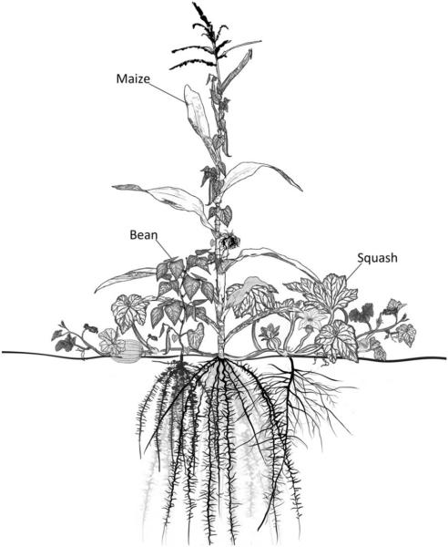
Intercropping
Source: Lopez-Ridaura, S. et al., via USDA

Slide 15
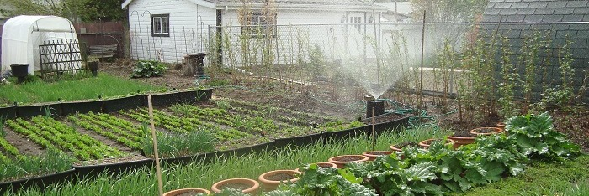
SPIN Farming

Slide 16
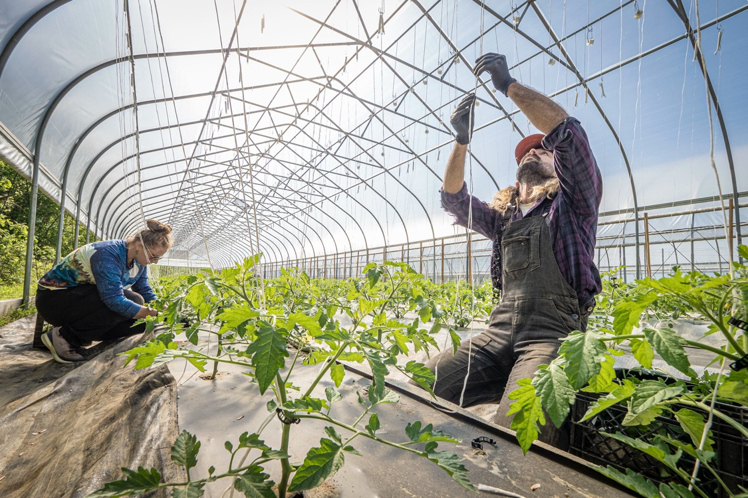
Vertical farming

Slide 17
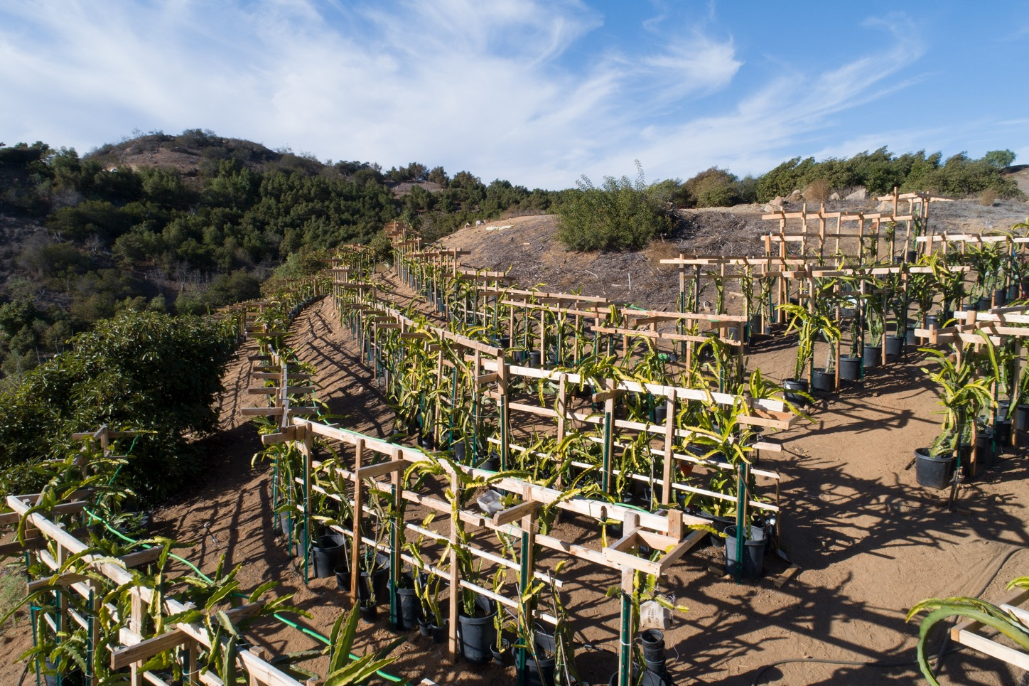
Vertical farming, pt. 2

Slide 18
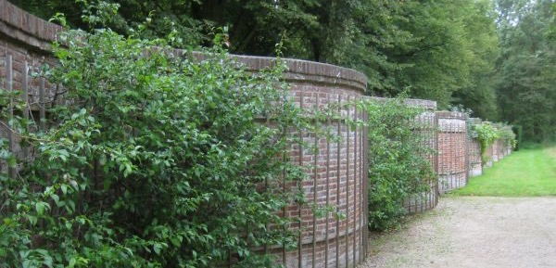
Vertical farming pt. 3
Source: 99% Invisible

Slide 19
Controlled environment agriculture

Slide 20
Controlled environment agriculture (CEA)
systems that allow producers to control factors such as temperature, air flow, light exposure, and/or precipitation

Slide 21
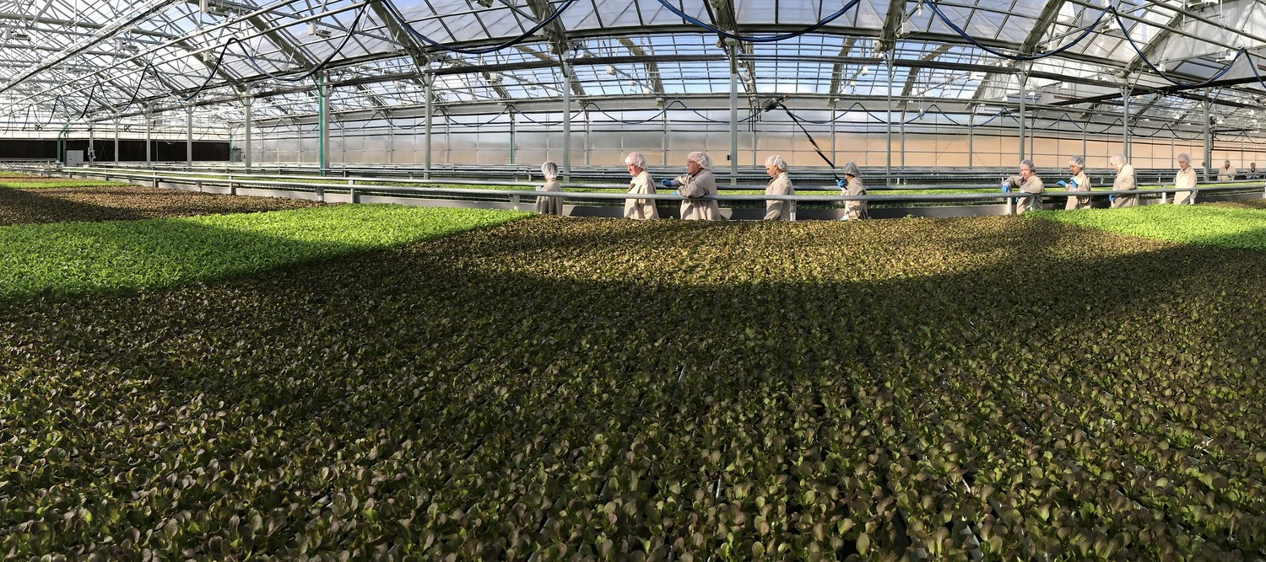
A CEA operation like a clean room

Slide 22
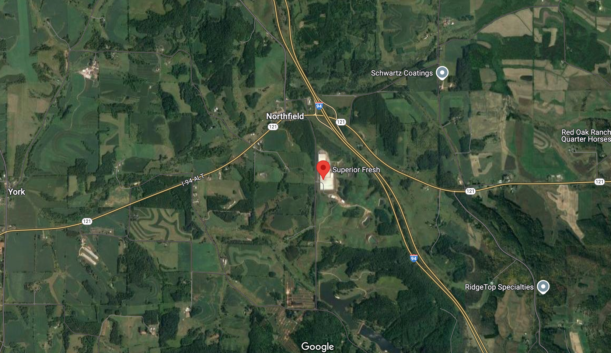
CEA operations are not exclusive to urban areas
Source: Google Maps

Slide 23
Hydroponics
soilless growing systems in which nutrient-infused water feeds plant roots directly, sometimes in combination with the use of inert substrates that anchor plants within the system

Slide 24
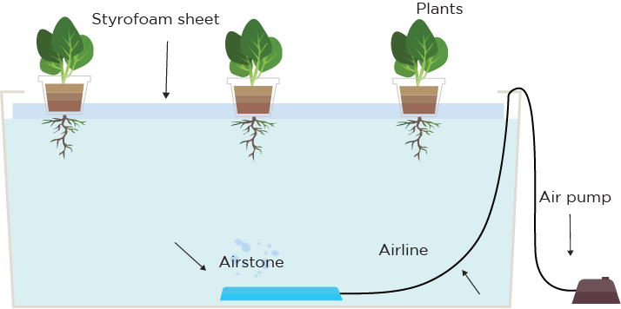
Deep water cultivation (DWC)
Source: Agritecture

Slide 25
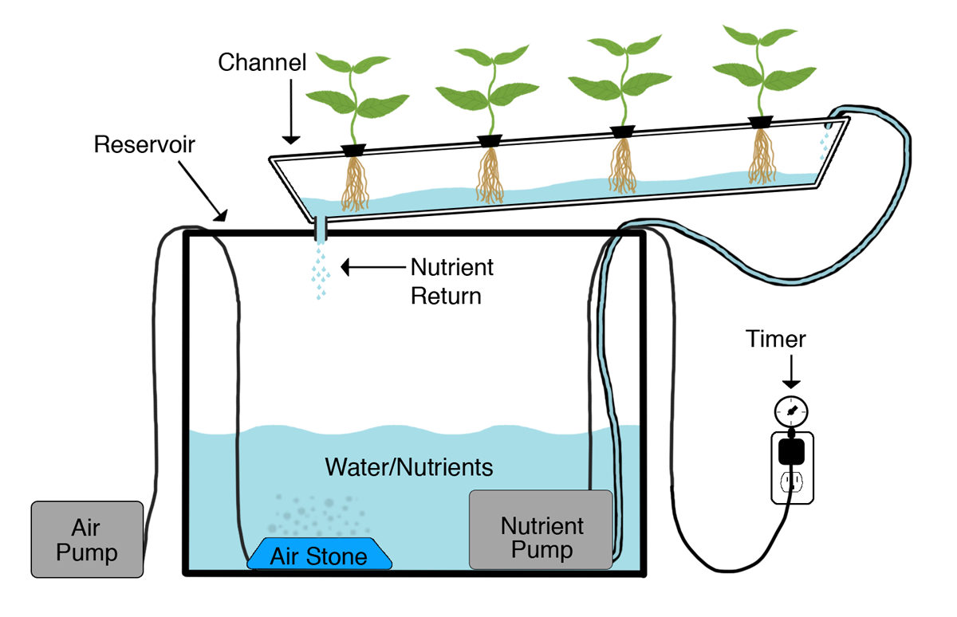
Nutrient film technique (NFT)
Source: Agritecture

Slide 26
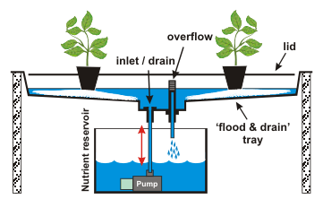
Ebb and flow/ flood and drain
Source: Agritecture

Slide 27
Aeroponics
a specific type of hydroponics in which plant roots dangle freely, rather than being anchored in an inert substrate, and are misted with nutrient-rich water

Slide 28
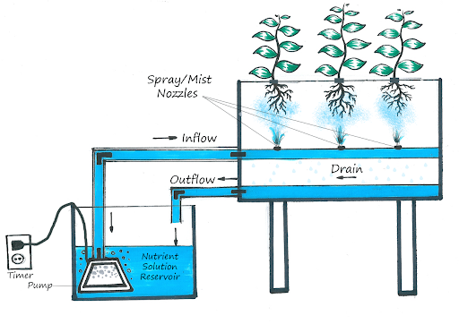
Aeroponics rendering
Source: Agritecture

Slide 29
Aquaponics
a type of aquaculture and a type of hydroponics in which plants and fish are cultivated concurrently in the same water-based system

Slide 30
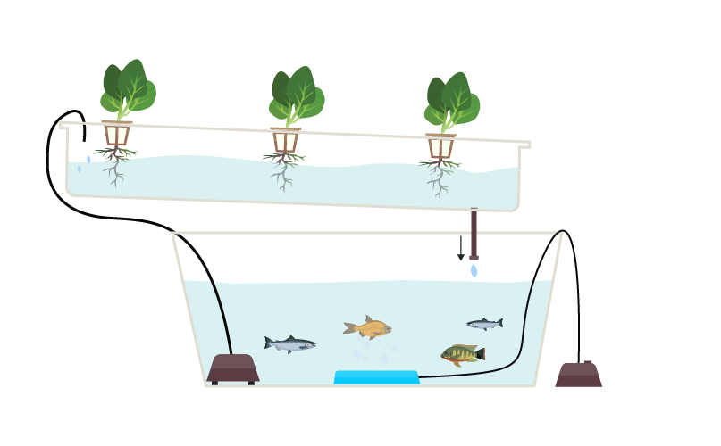
Aquaponics rendering
Source: Agritecture

Slide 31
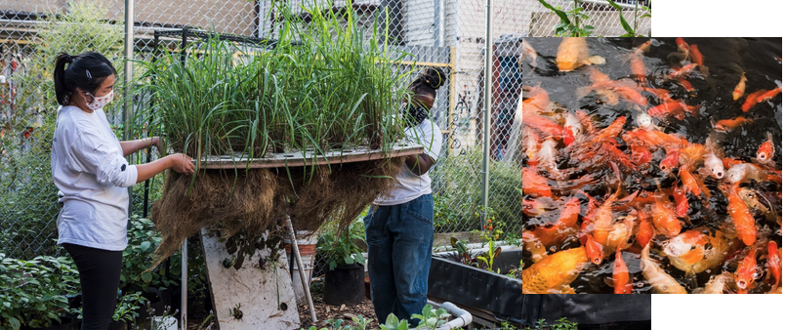
Aquaponics at Oko Farms
Source: Oko Farms

Slide 32
Rooftop farming and building-integrated systems

Slide 33
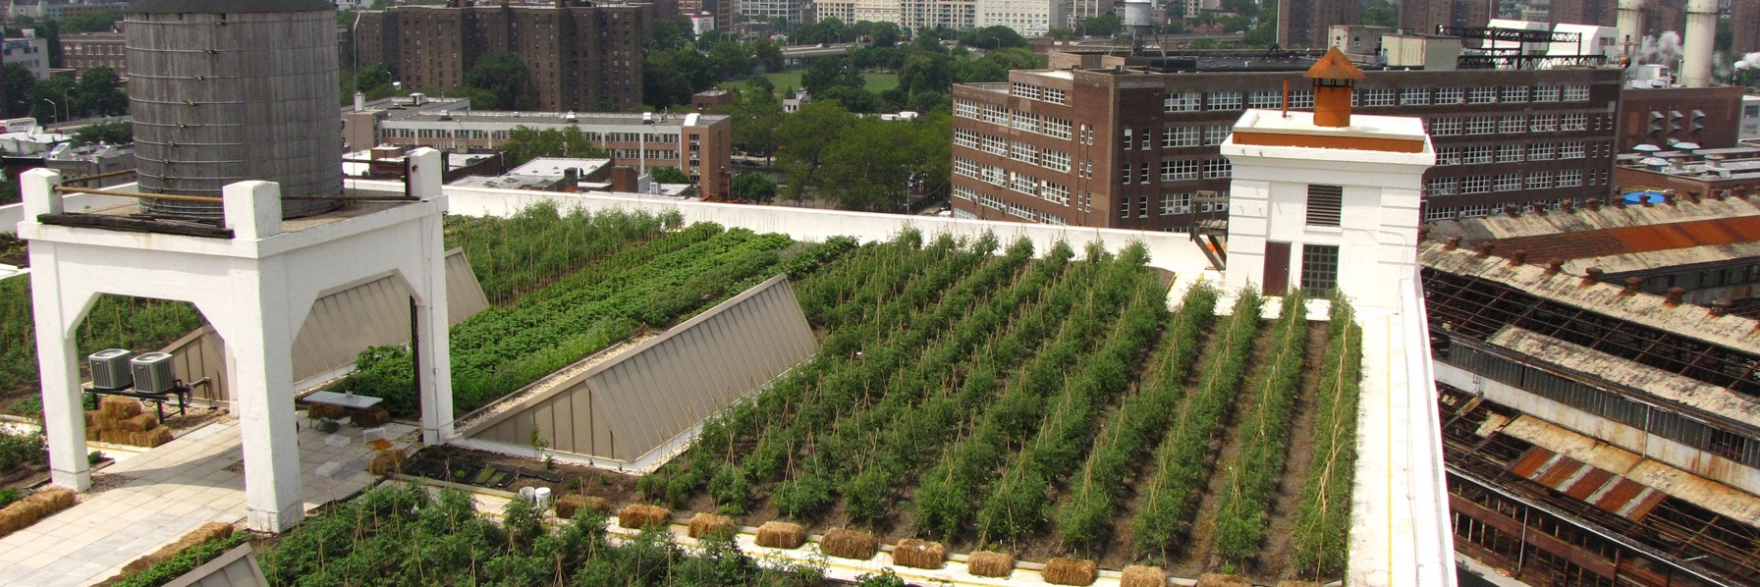
Rooftop farming
Source: Greenroofs.com

Slide 34
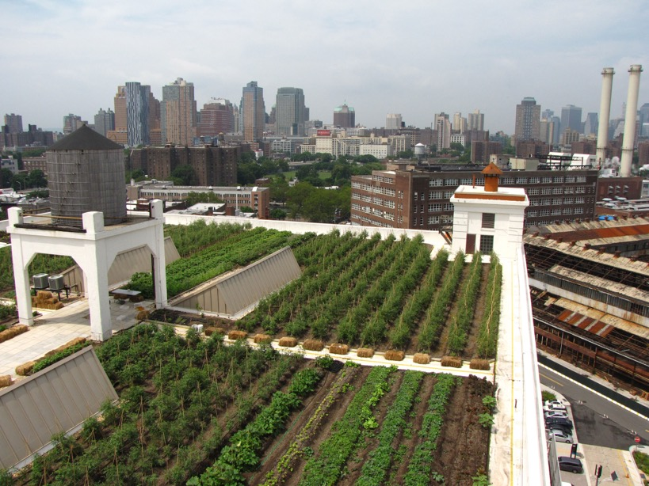
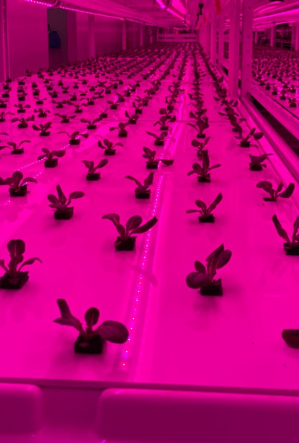
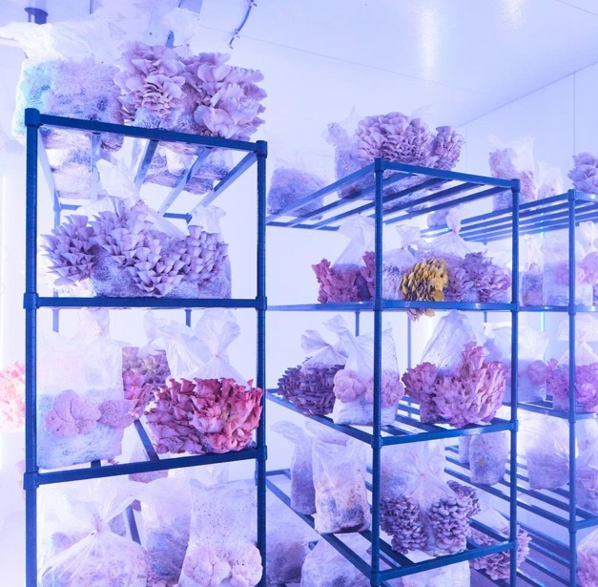
Building-integrated systems
Source: Forbes (mushroom photo, from Smallhold)

Slide 35
Urban food forests

Slide 36
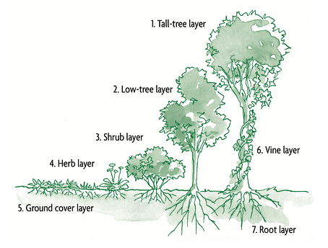
Urban food forests
Source: Chelsea Green

Slide 37
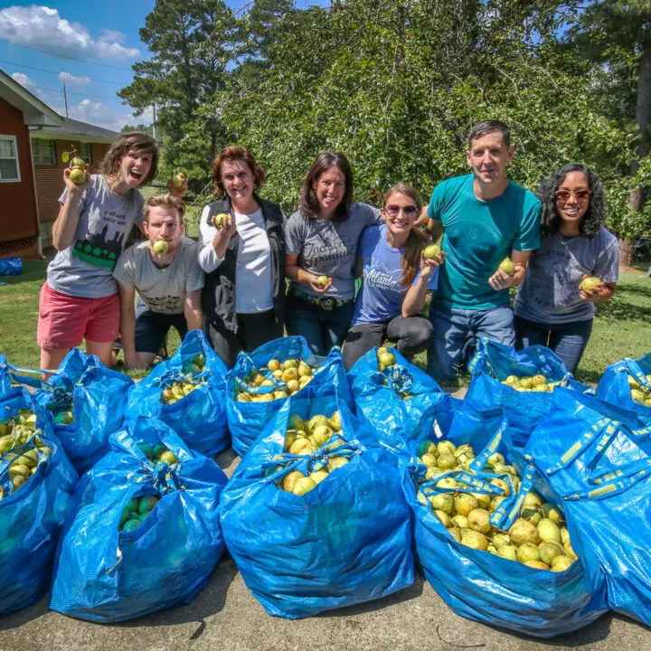
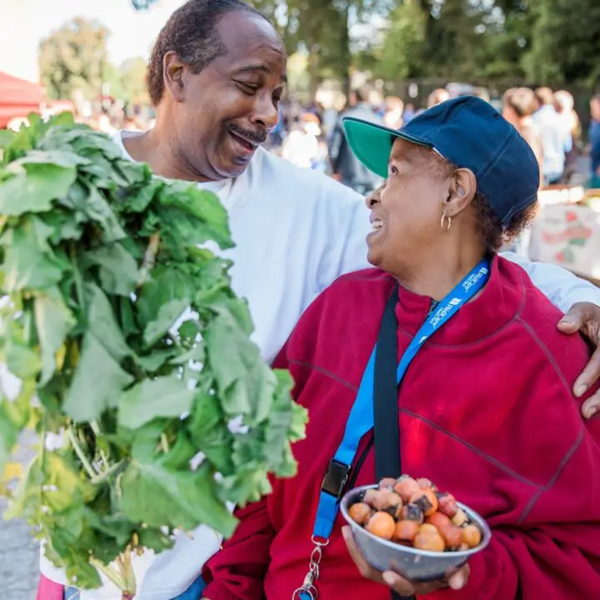
Urban food forests, pt. 2
Source: Concrete Jungle, Atlanta, GA

Slide 38
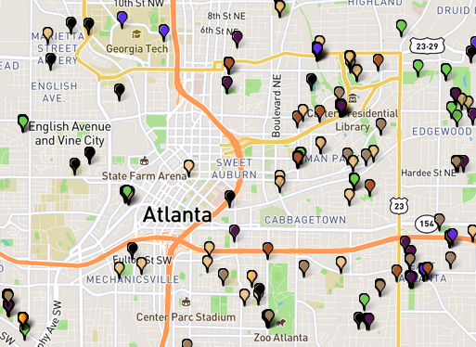
Urban food forests, pt. 3
Source: Concrete Jungle

Slide 39
Agrihoods

Slide 40
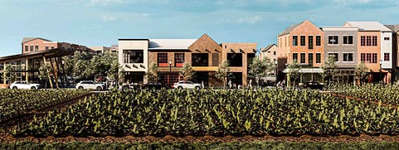
Agrihoods
Source: Cultivate Land

Slide 41
Urban pollinator habitats

Slide 42
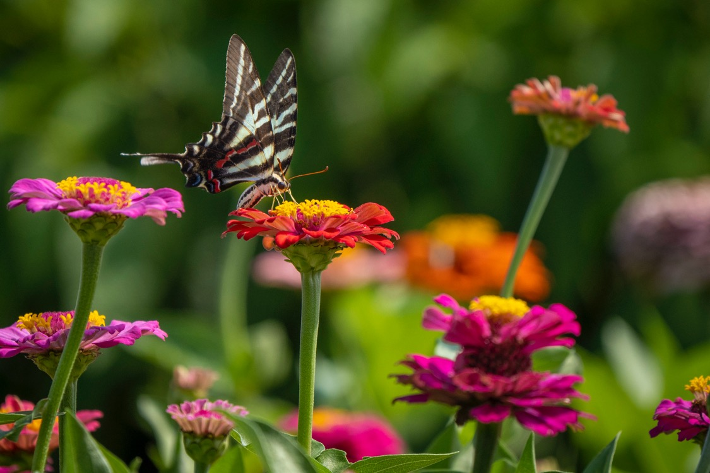
Urban pollinator habitats

Slide 43
Innovative animal agriculture

Slide 44
Insect agriculture
the cultivation of insects for a variety of uses, including fertilizer, feed for other livestock, or protein for humans

Slide 45
Vermicomposting
a system leveraging earthworms to convert organic material into a soil amendment

Slide 46
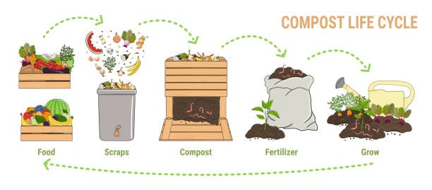
Vermicomposting at work
Source: Uncle Jim’s Worm Farm

Slide 47
Course 5 recap and next steps

Slide 48
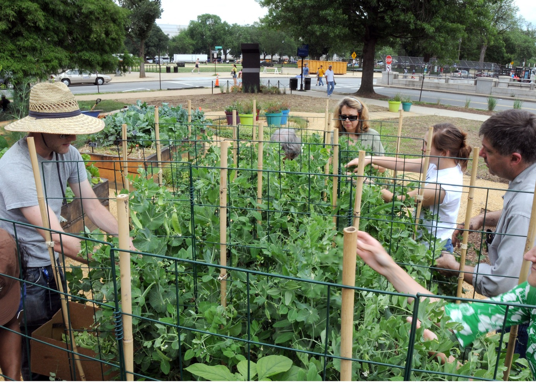
Urban agriculture connects consumers to their food system

Slide 49
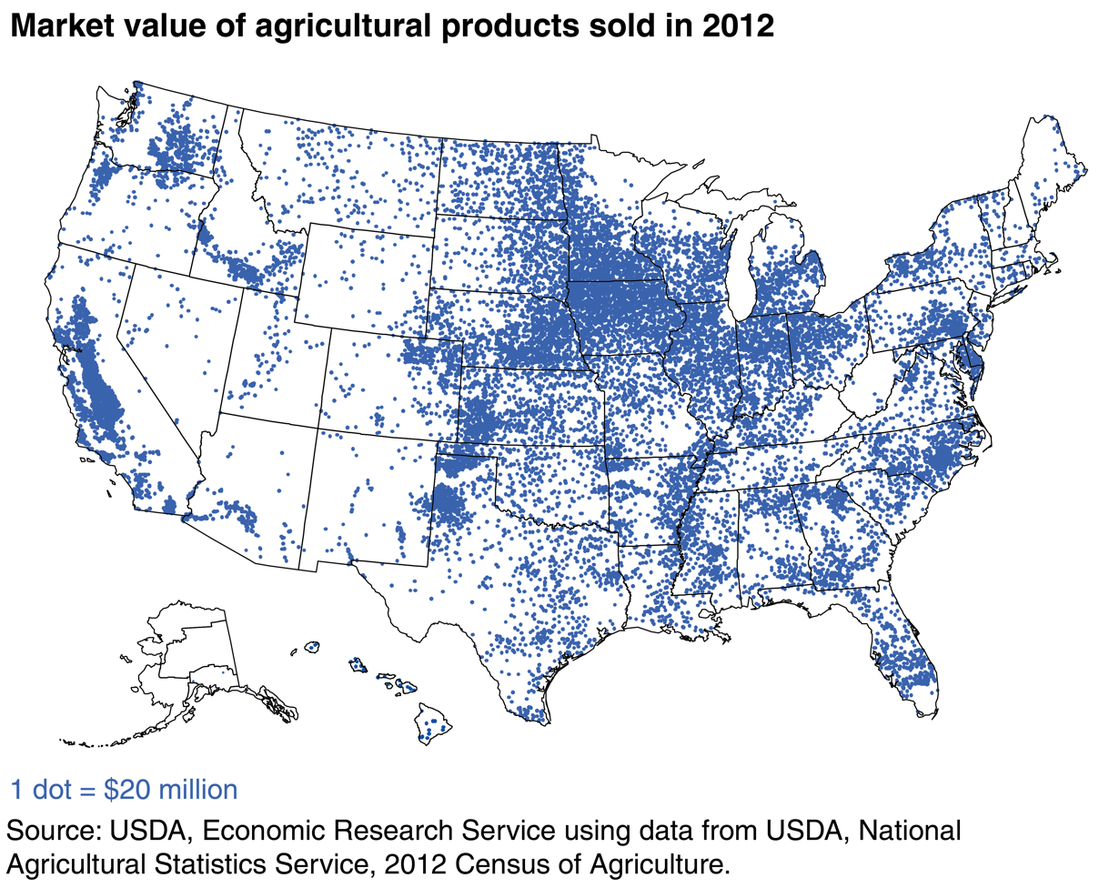
Geographic distribution of agricultural production in the United States
Source: ERS

Slide 50
Geographic distribution of US population
Source: US Census

