Slide 1
Course 4: Urban Agriculture Benefits

Slide 2
Benefits of urban agriculture include
Economic benefits
Food provision
Community development
Ecosystem services

Slide 3
Course 4 learning objectives
You will identify the benefits of urban agriculture and evaluate the value of urban agriculture based on those benefits.
You will evaluate how the benefits of urban agriculture inform the various motivations that drive urban growers.
You will analyze how urban agriculture could be scaled to create more resilient urban communities and urban food systems.

Slide 4
The benefits of urban agriculture

Slide 5
Economic benefits

Slide 6
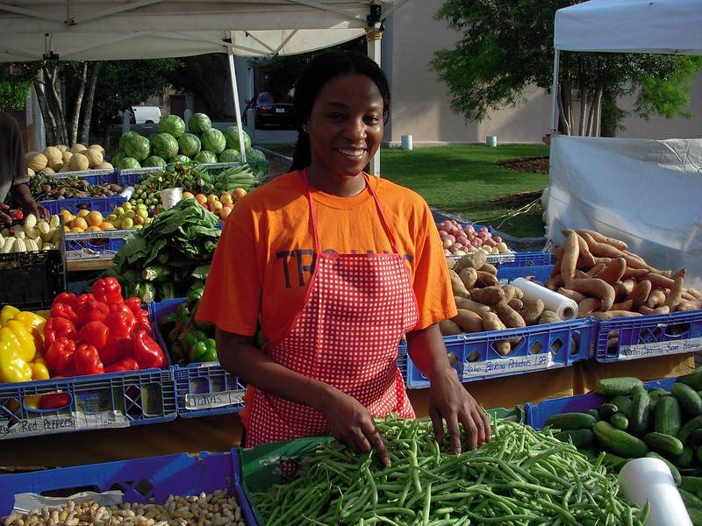
Economic benefits of urban agriculture include revenue generation and job creation

Slide 7

On-Farm Endeavors
Notes:
Source: https://www.thesideyardpdx.com/events/

Slide 8
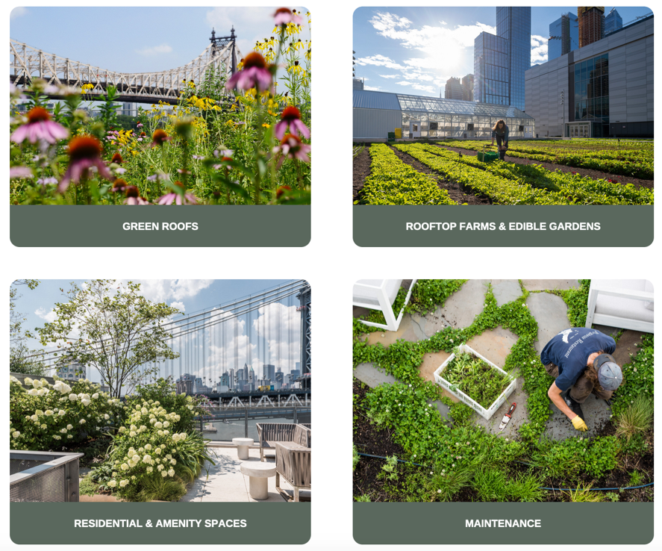
Off-Farm Services

Slide 9


Example: Growing Home workforce development

Slide 10
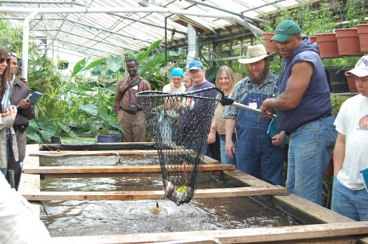
Example: job creation at Growing Power

Slide 11
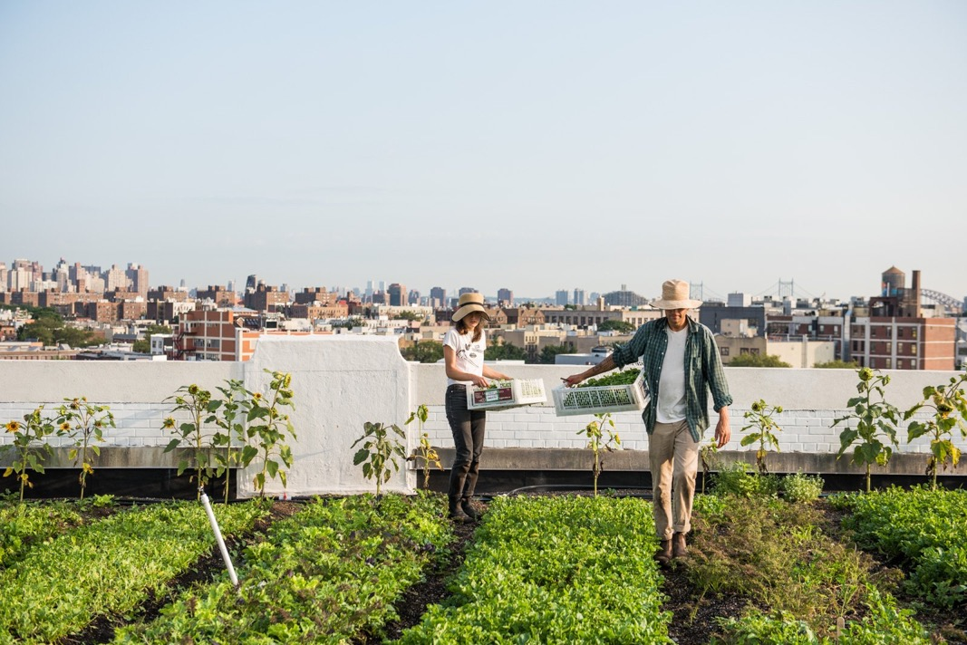

Example: profit generation and job creation at Brooklyn Grange

Slide 12
Food provision

Slide 13
Urban agriculture produces an estimated 5-10% of the global food supply
5% - 10%

Slide 14
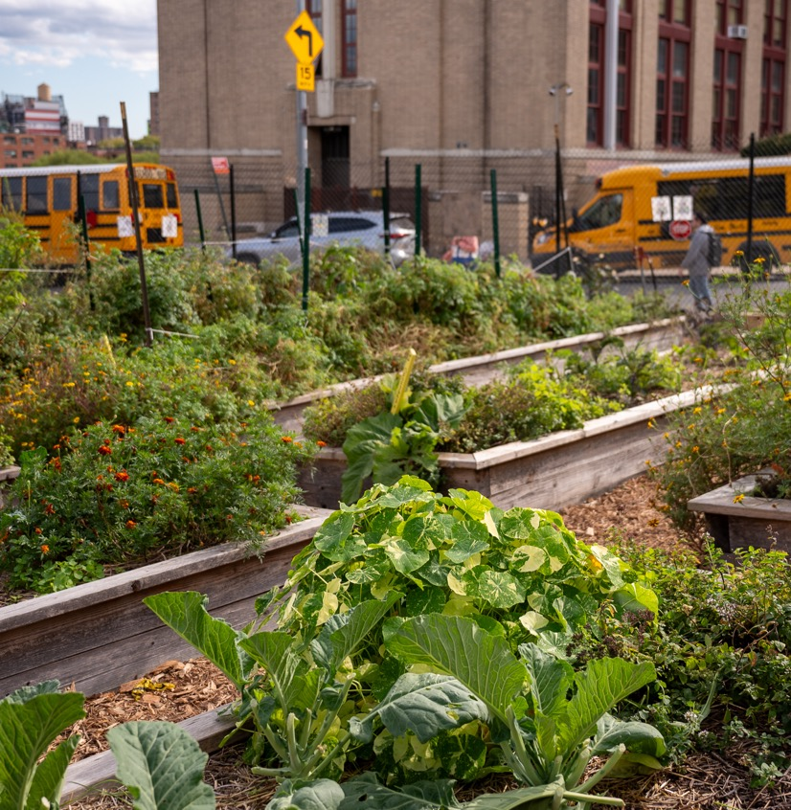
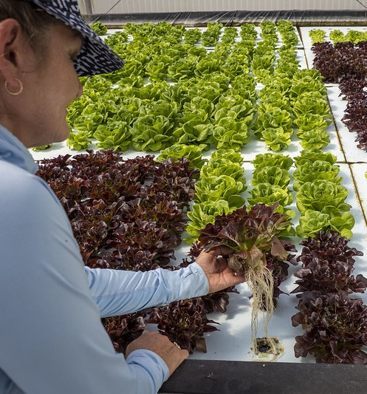
Urban agriculture can produce higher yields than conventional agriculture

Slide 15
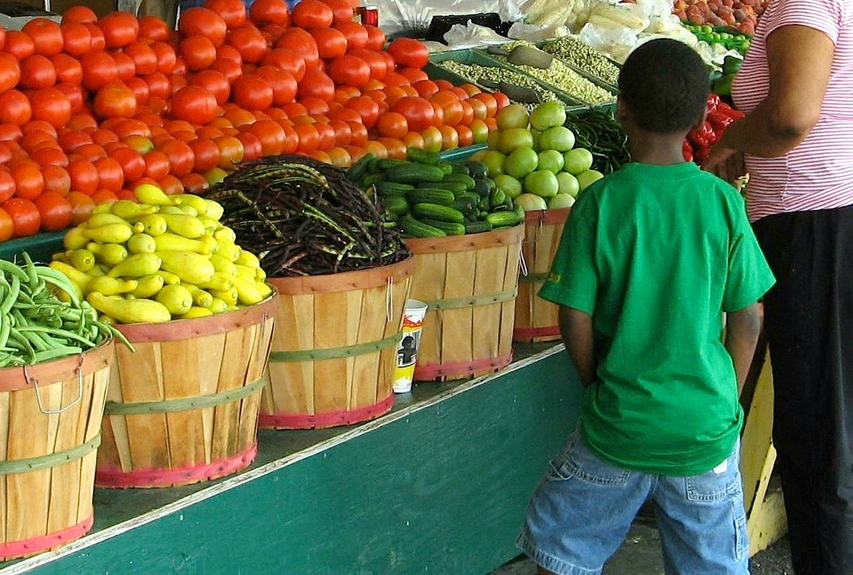
Urban agriculture can increase food diversity and nutrition access

Slide 16
Community development

Slide 17
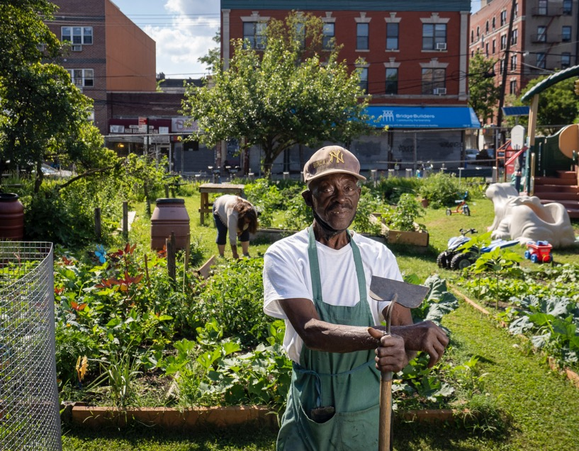
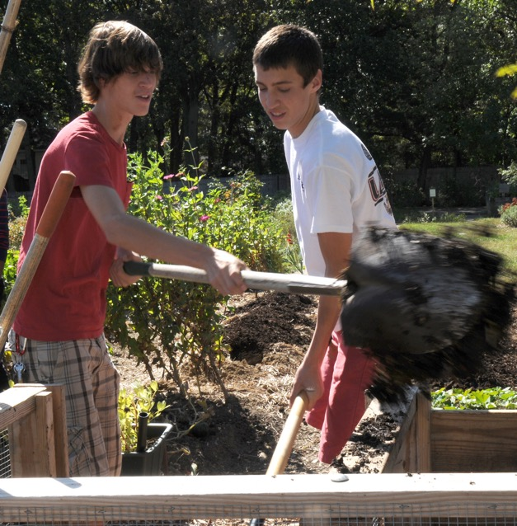
Urban agriculture improves mental and physical outcomes

Slide 18
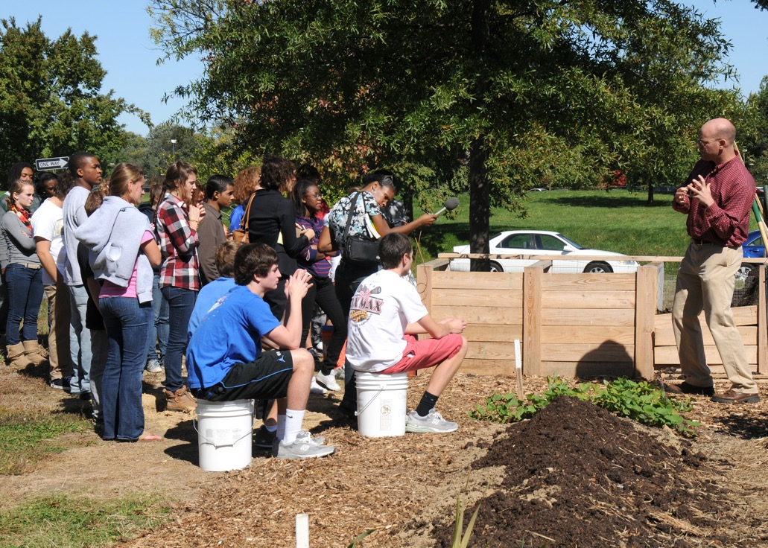
Urban agriculture creates gathering spaces and encourages community development

Slide 19
Ecosystem services

Slide 20
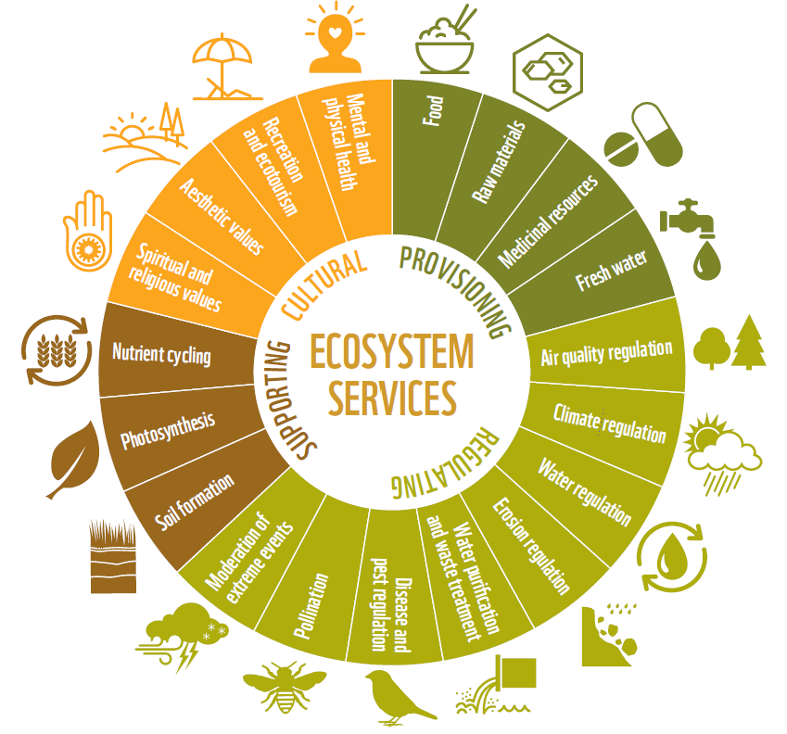
Urban agriculture provides ecosystem services
Notes:
Source: Living Planet Report, WWF 2016

Slide 21
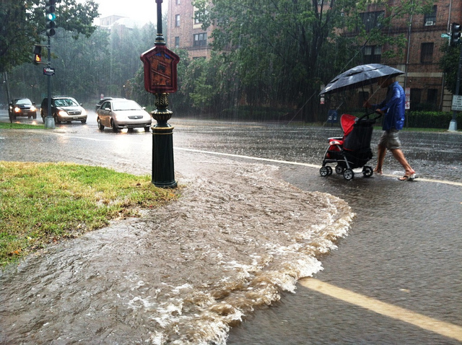
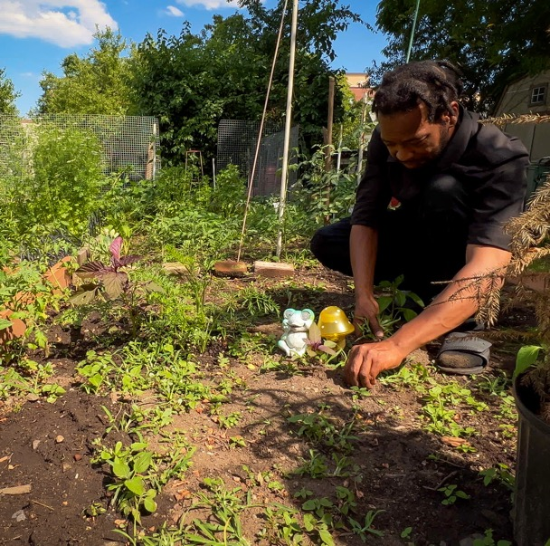
Stormwater runoff mitigation
Notes:
Source: https://www.americanrivers.org/2019/12/how-to-guide-for-stormwater-credit-trading/

Slide 22
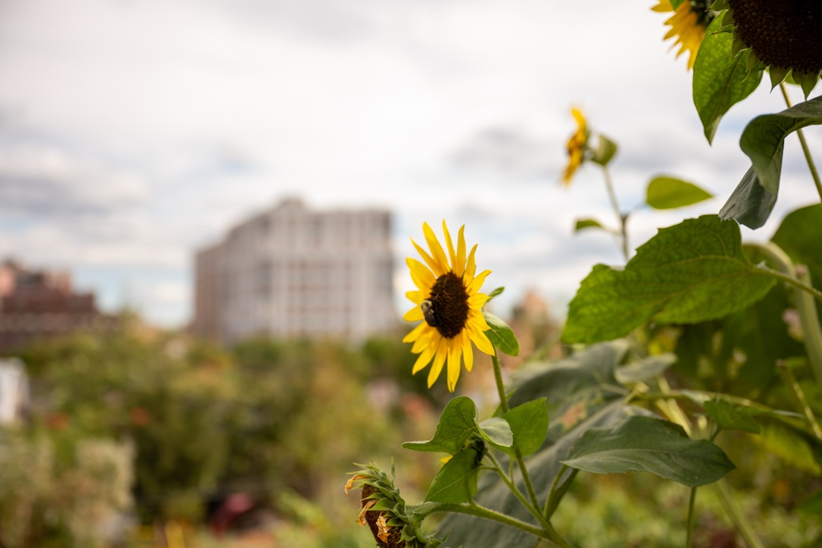
Pollinator habitats
Notes:
Source: RJ Anderson 2024, New Roots Community Farm in the Bronx, NYC

Slide 23
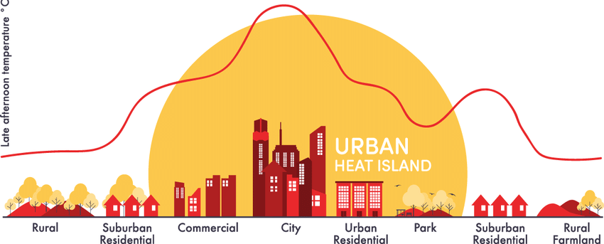
Mitigating the heat island effect
Notes:
Source: https://community.wmo.int/en/activity-areas/urban/urban-heat-island

Slide 24
Food deserts
Defined by the USDA as areas where people have limited access to a variety of healthy and affordable food

Slide 25
Grower motivations include
Food production
Community and economic development
Urban livability

Slide 26
Course 4 recap and next steps

Slide 27

Urban growers wear many hats

