Slide 1
Course 3: Recognizing Urban Agriculture

Slide 2
Urban agriculture definition
No one definition

Slide 3
USDA’s description of urban agriculture
USDA assists urban, small-scale, and innovative producers with growing, processing and selling. We provide technical and financial assistance for a variety of growing operations, including community farms and gardens, rooftop, indoor, and vertical farms, and hydroponic, aeroponic, and aquaponic facilities. These operations provide healthy, local food, encourage economic development, provide employment and on-the-job training, expand community greenspaces, foster community collaboration, build climate and disaster resilient communities, and are an essential part of a resilient diversified food system.

Slide 4
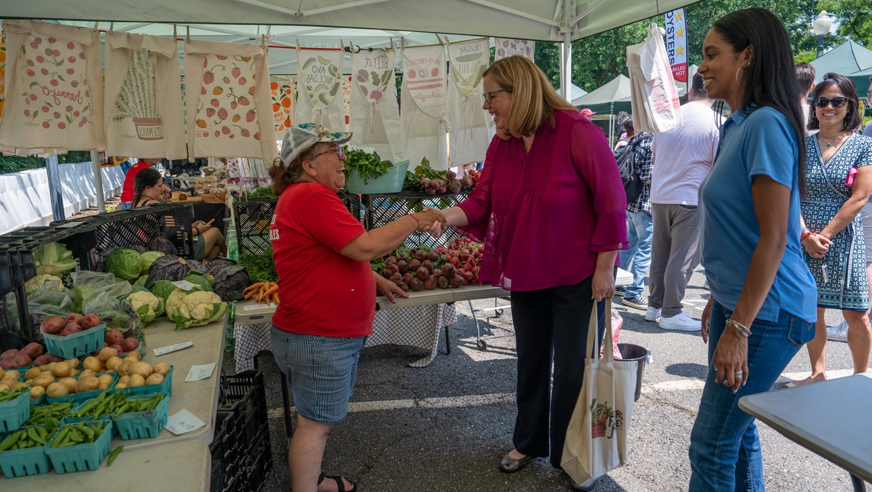
Urban agriculture builds community

Slide 5
Course 3 topics
Production practices
Markets
Business structures

Slide 6
Course 3 learning objectives
Identify and distinguish between the production typologies, markets, and business structures common to urban agriculture operations
Evaluate how diversified production methods and models contribute to resilient food systems
Assess how urban production typologies, markets, and business structures may affect USDA program delivery

Slide 7
Production typologies

Slide 8
Production typologies include the following:
Soil-based
Non-soil-based
Animal agriculture

Slide 9
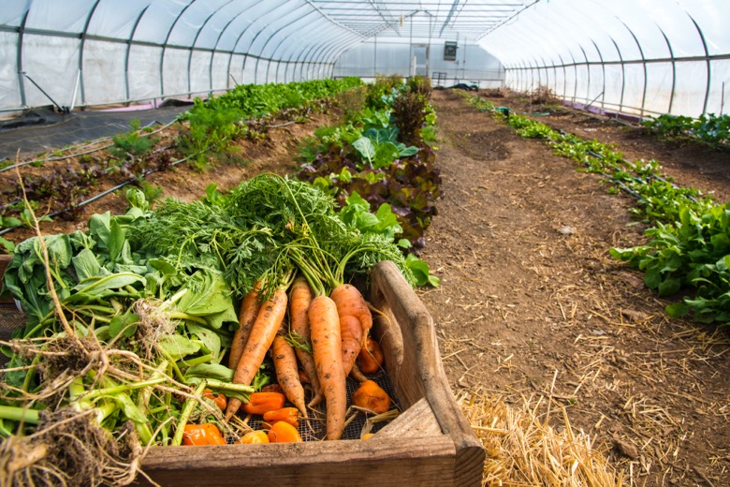
Soil-based agriculture

Slide 10
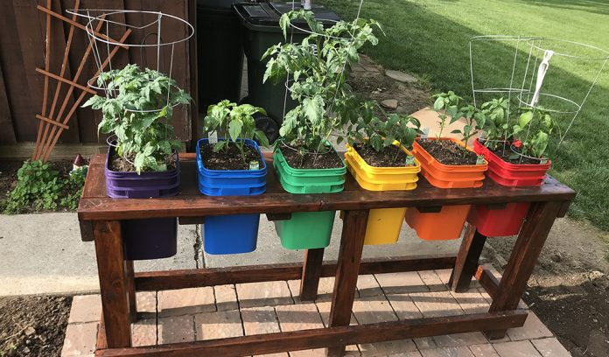
Containers (I)
Containers
Notes:
Source: https://www.farmanddairy.com/top-stories/how-to-avoid-common-problems-growing-vegetables-in-containers/666564.html

Slide 11
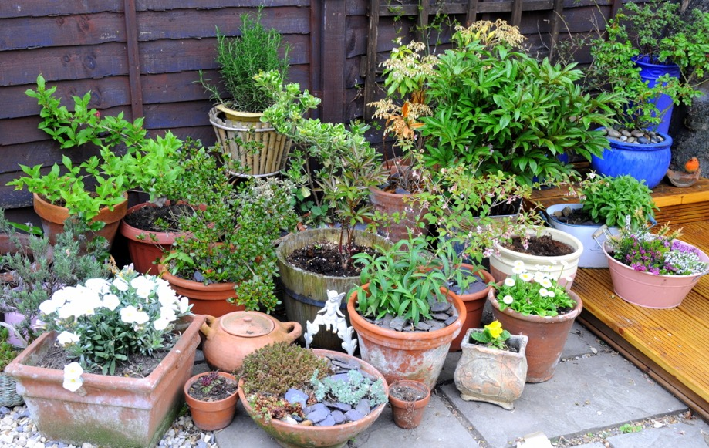
Containers (II)
Containers
Notes:
Source: https://celebrateurbanbirds.org/learn/gardening/container-gardening/

Slide 12
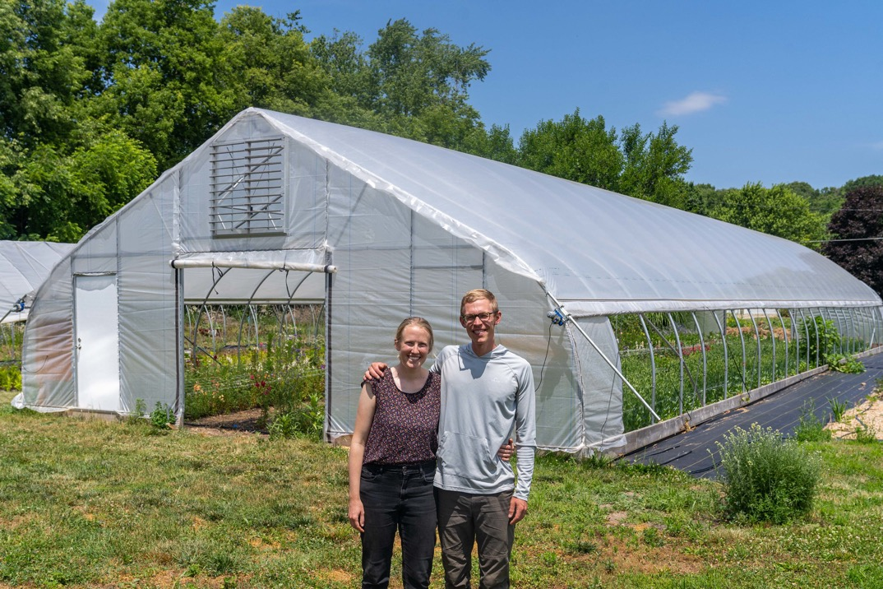
Example of a high tunnel

Slide 13
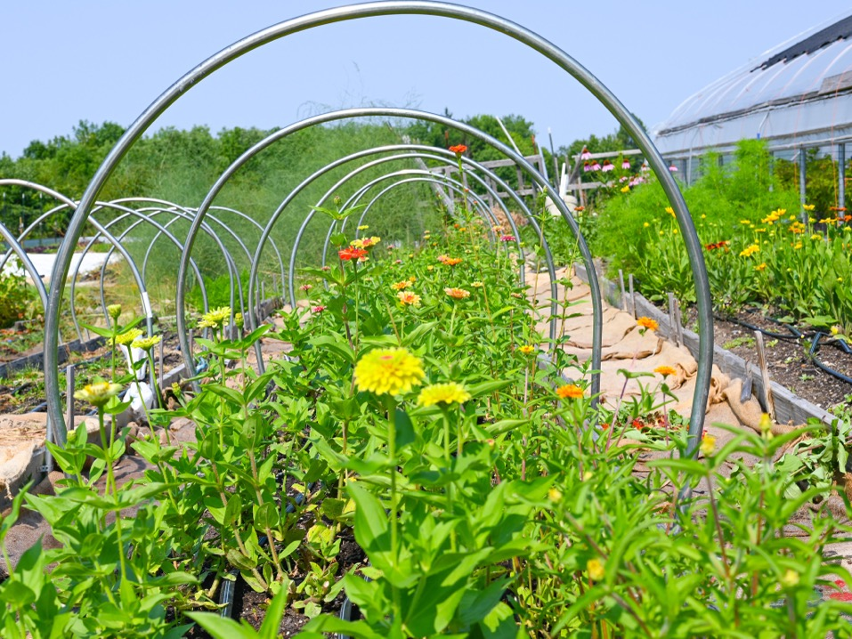
Example of a low tunnel

Slide 14
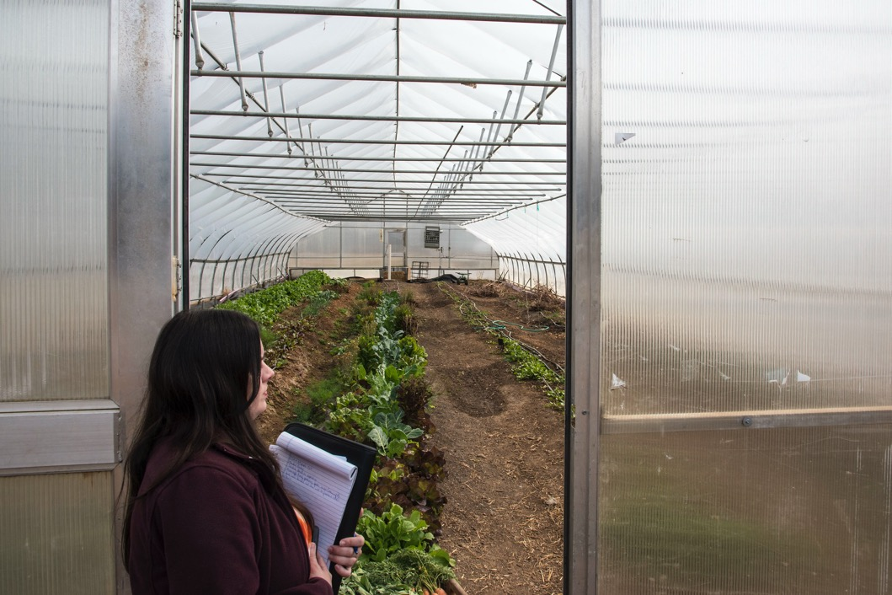
Growing in ground in a greenhouse

Slide 15
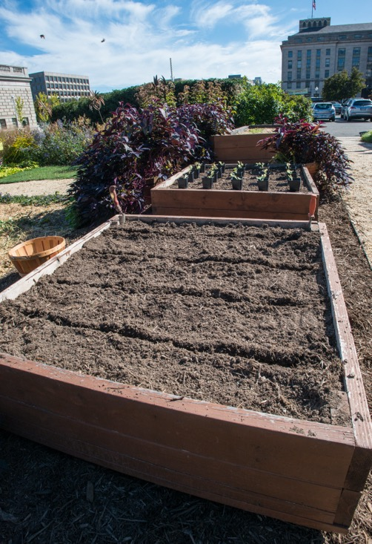
Raised beds

Slide 16
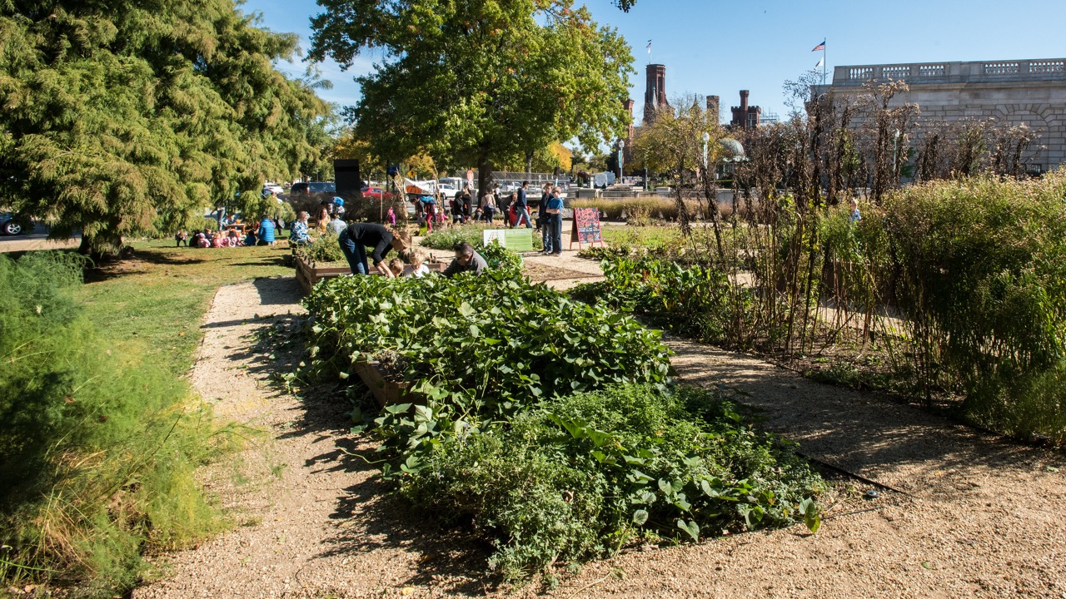
An example of in ground agriculture

Slide 17
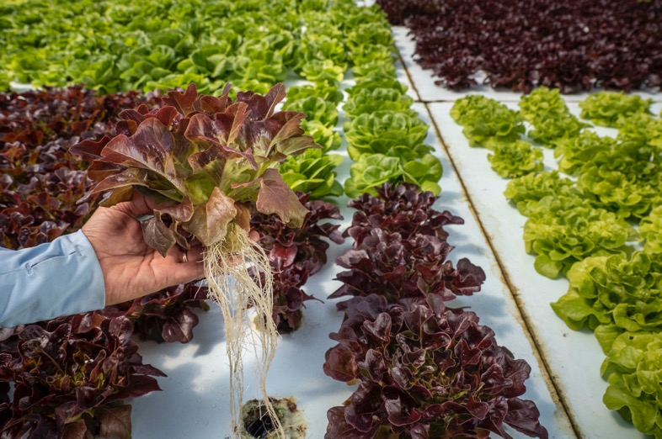
Non-soil-based agriculture

Slide 18
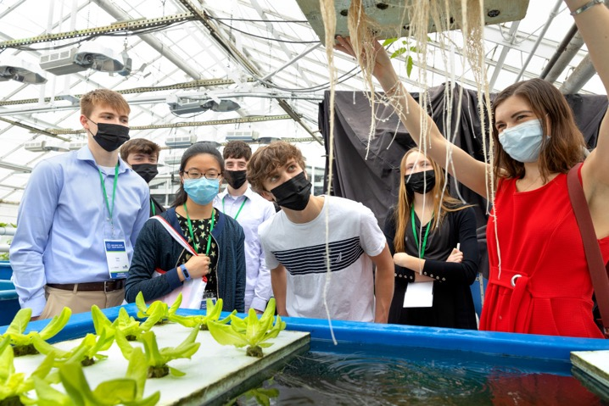
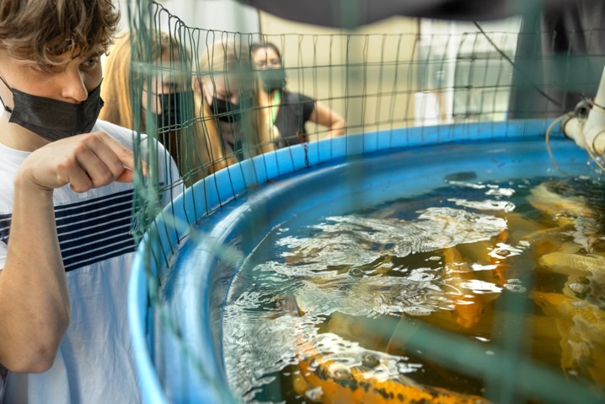
Hydroponics and aquaponics
Notes:
Source: Cornell University, Sreang “C” Hok

Slide 19
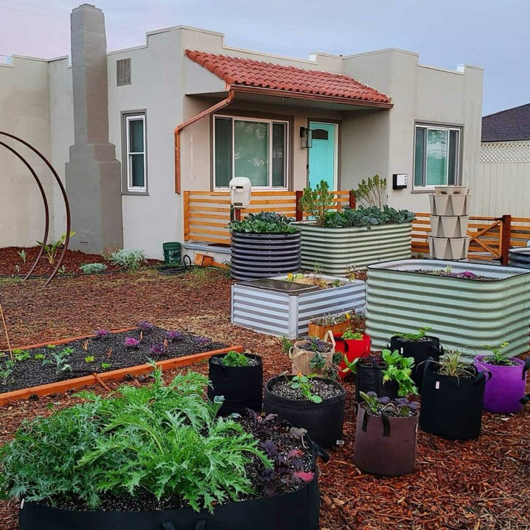
A mix of grow bags and raised beds
Notes:
Source: https://melissaknorris.com/podcast/using-vegetable-grow-bags-in-the-garden/

Slide 20
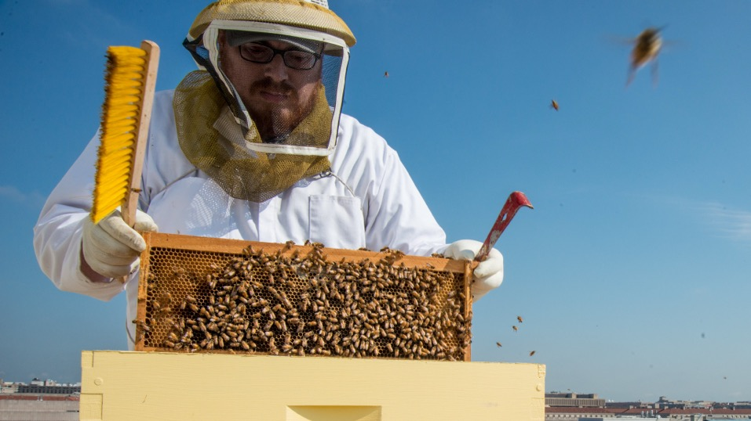
Animal agriculture

Slide 21
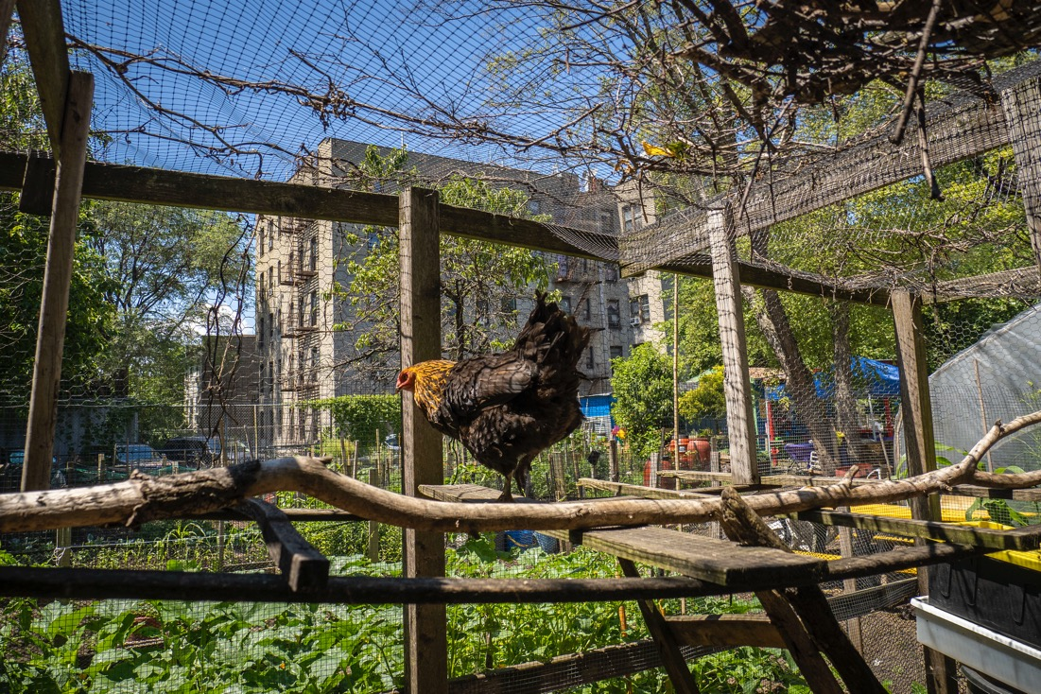
Raising chickens in urban areas

Slide 22
Urban production in practice

Slide 23
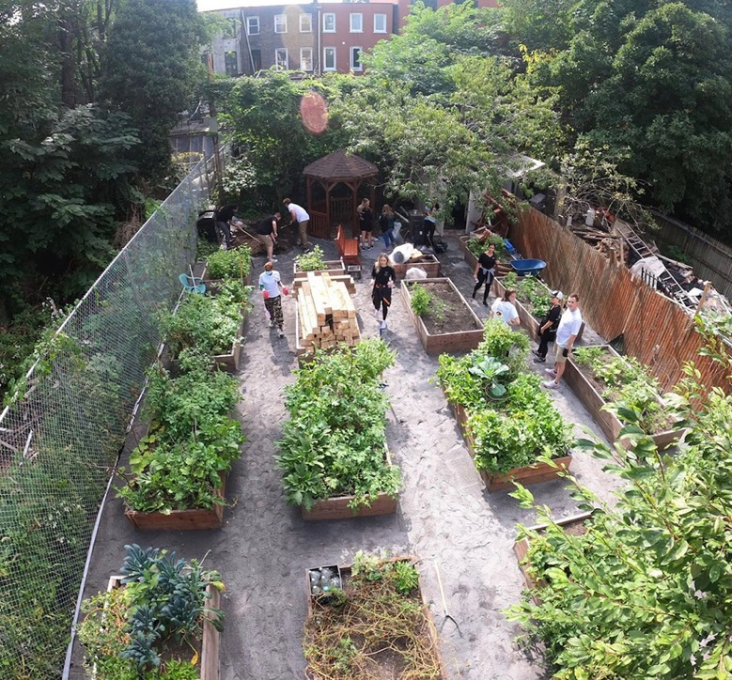
Raised beds in a vacant lot
Notes:
Source: https://gothamtogo.com/nyc-parks-greenthumb-continues-support-for-community-gardens/

Slide 24
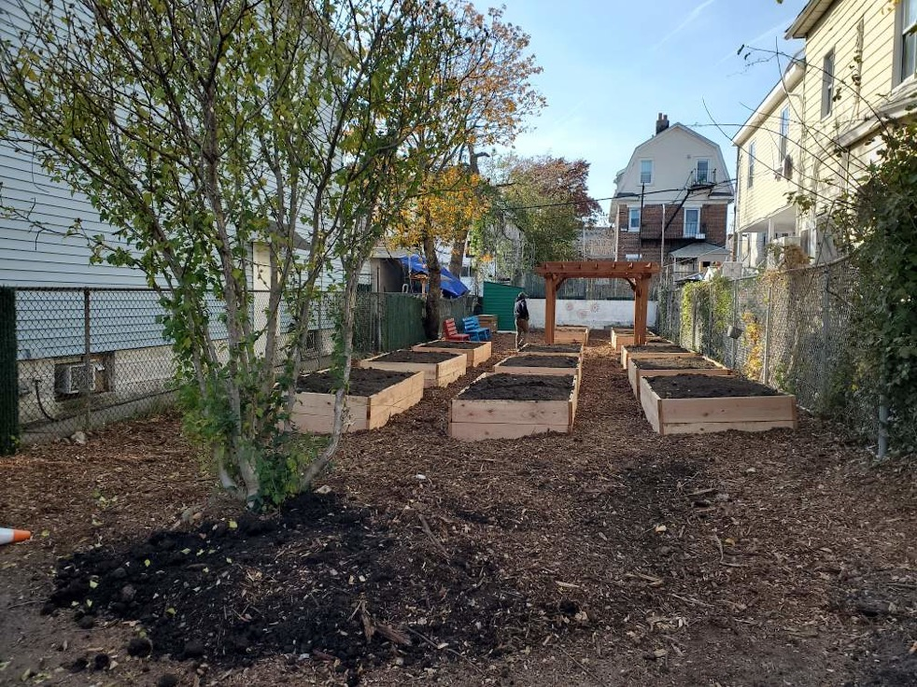
Another example of raised beds in a vacant lot
Notes:
Source: https://gothamtogo.com/nyc-parks-greenthumb-continues-support-for-community-gardens/

Slide 25
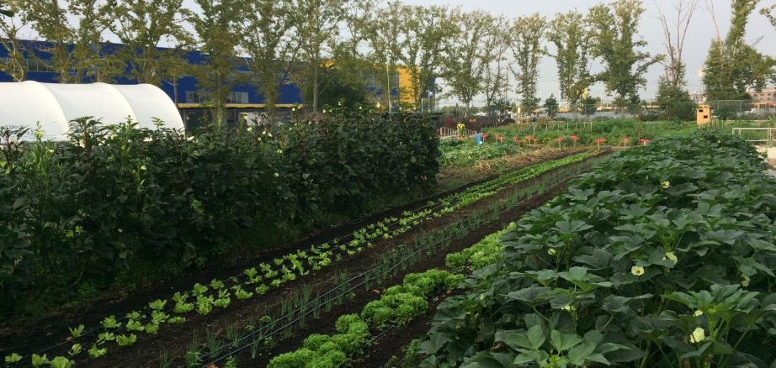
Red Hook Farms: One Raised Bed
Notes:
Source: https://rhicenter.org/red-hook-farms/the-farms/

Slide 26
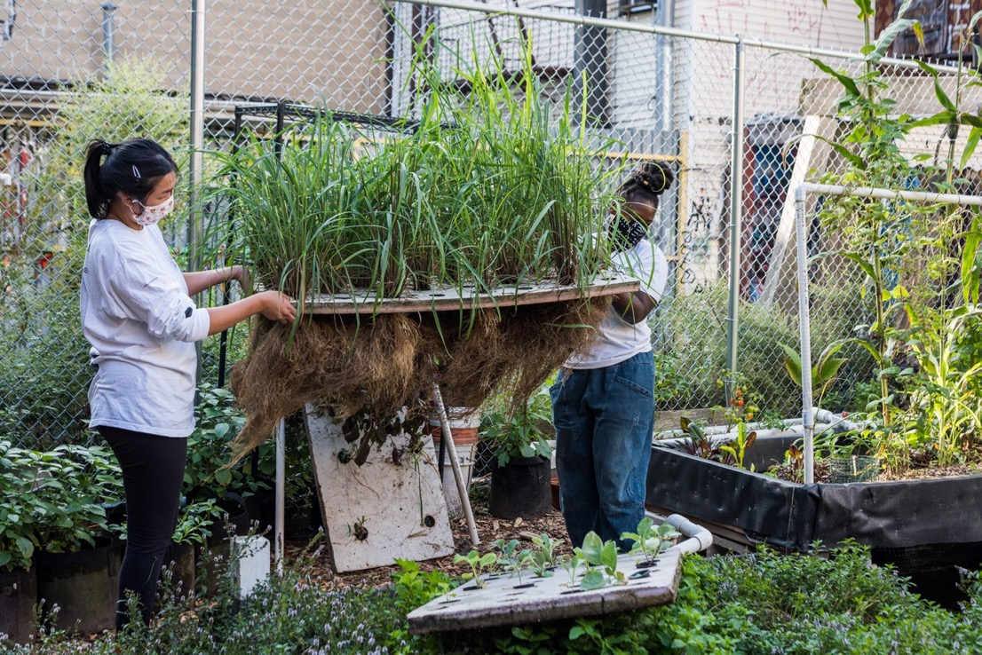
An outdoor aquaponics system
Notes:
Source: https://www.okofarms.org/aquaponics-intensive

Slide 27
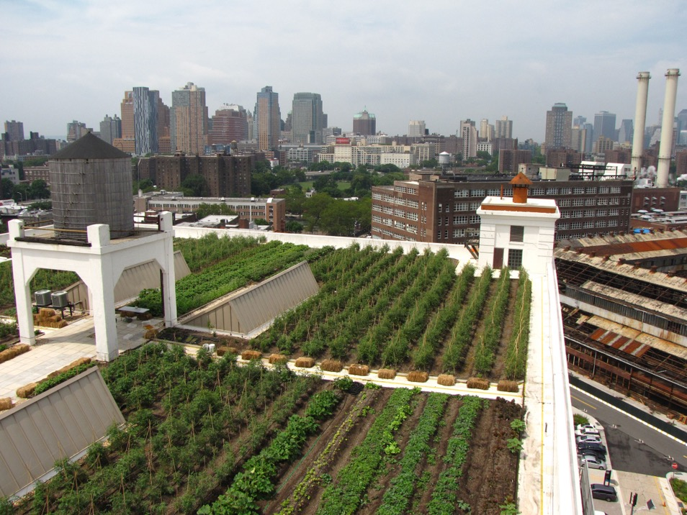
Outdoor rooftop farming
Notes:
Source: https://www.greenroofs.com/projects/brooklyn-grange-rooftop-farm-2-at-brooklyn-navy-yard-building-no-3/

Slide 28
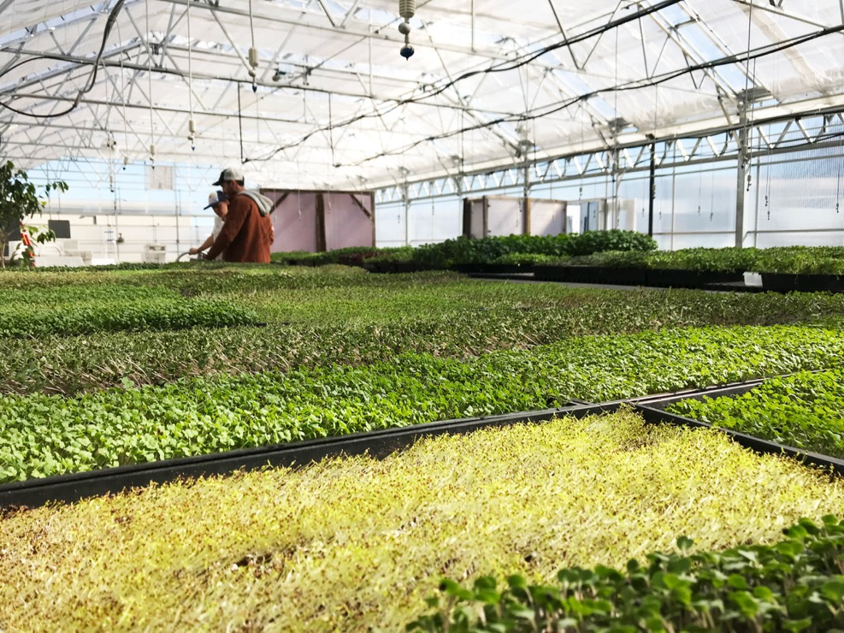
Greenhouse hydroponics on a rooftop
Notes:
Source: https://www.brooklyngrangefarm.com/sunset-park

Slide 29
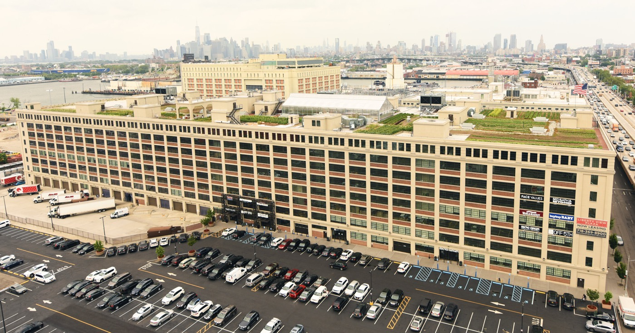
Rooftop farming can comprise multiple production typologies
Notes:
Source: https://www.brooklyngrangefarm.com/sunset-park

Slide 30
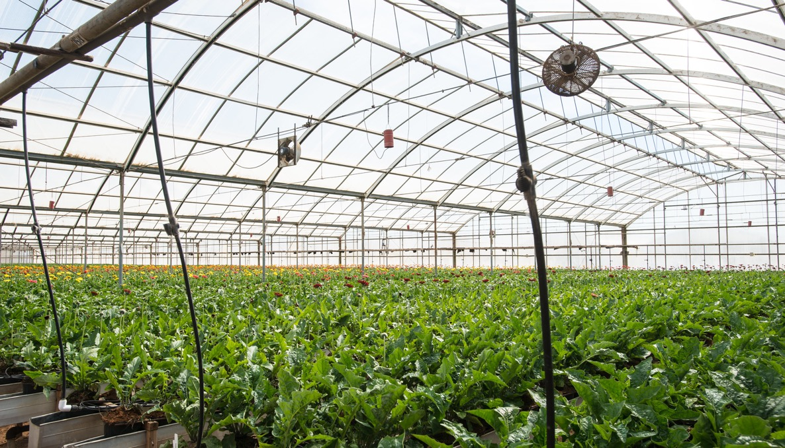
Indoor agriculture

Slide 31
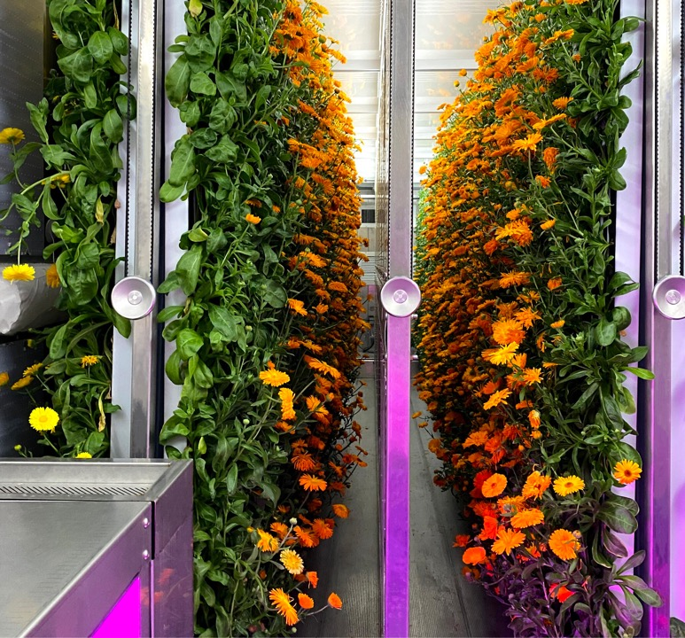
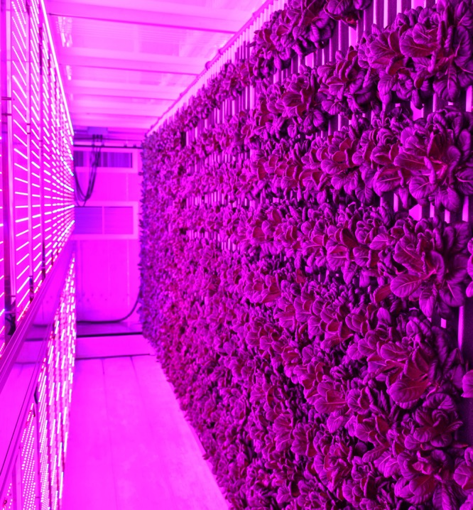
Indoor vertical farming
Notes:
Source: https://www.freightfarms.com/new-gallery/6vbokt8iqscgz74nmc8jwdo9zy92jo

Slide 32
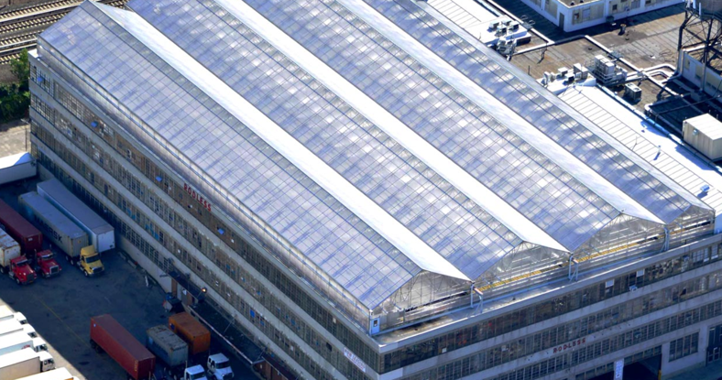
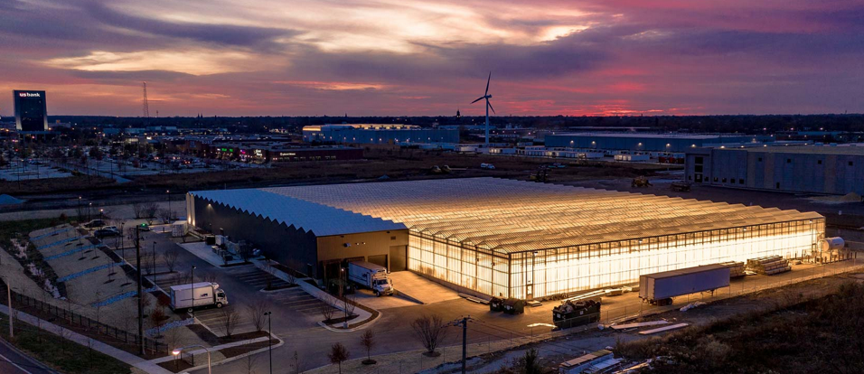
Large greenhouse facilities
Notes:
Source: https://www.gothamgreens.com/our-farms/

Slide 33
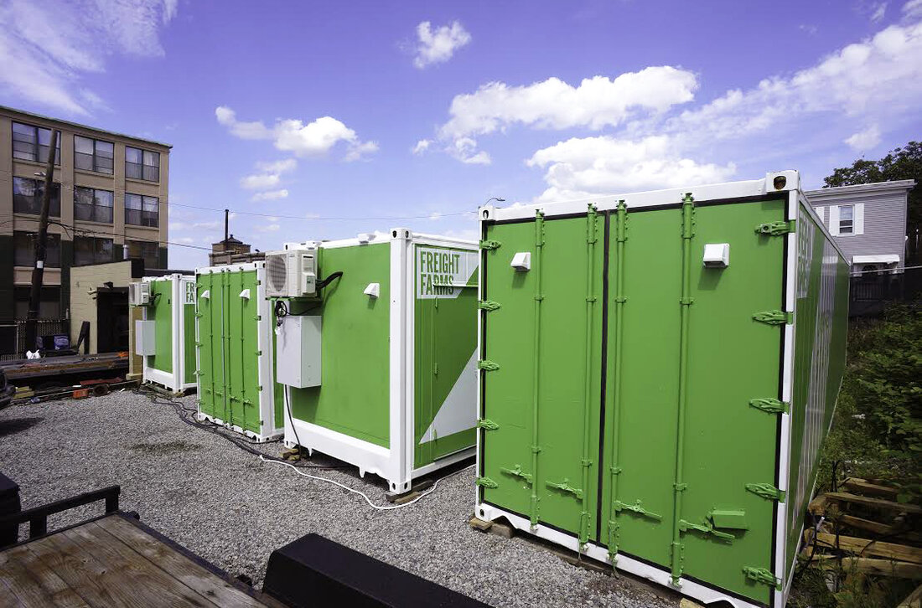
Shipping container farming
Notes:
Source: https://www.npr.org/sections/thesalt/2015/02/23/388467327/-freight-farms-grow-local-flavor-year-round

Slide 34
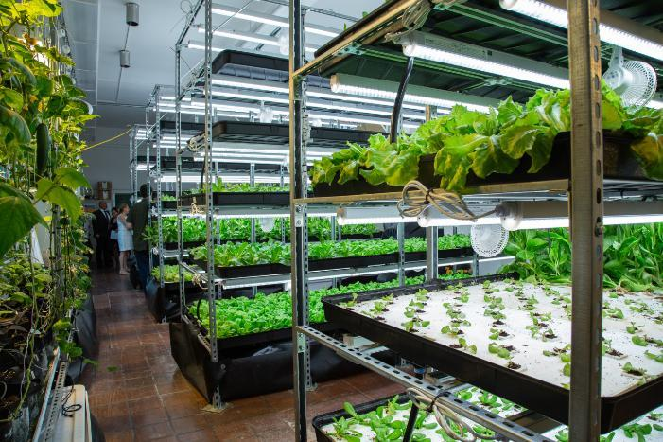
Indoor vertical farming in a classroom
Notes:
Source: https://www.tc.columbia.edu/tisch/food-ed-hub/news/food-ed-hub-coalition-spotlight-teens-for-food-justice/

Slide 35
Other production considerations

Slide 36
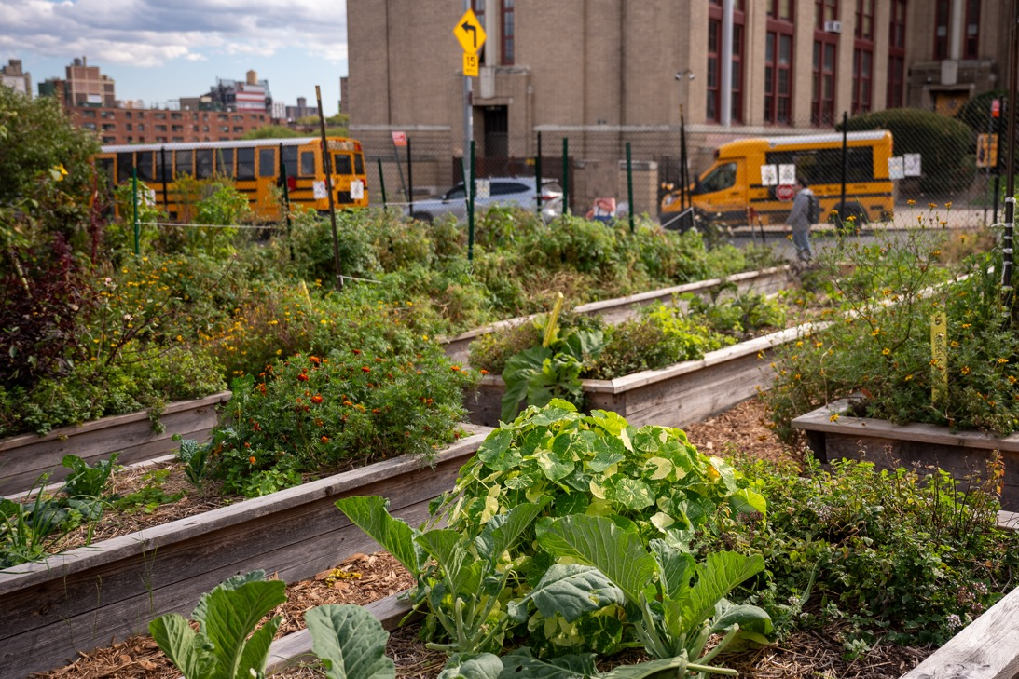
Urban growing in small spaces necessitates greater use of hand-labor
Notes:
Source: RJ Anderson, Cornell Cooperative Extension, 2024

Slide 37
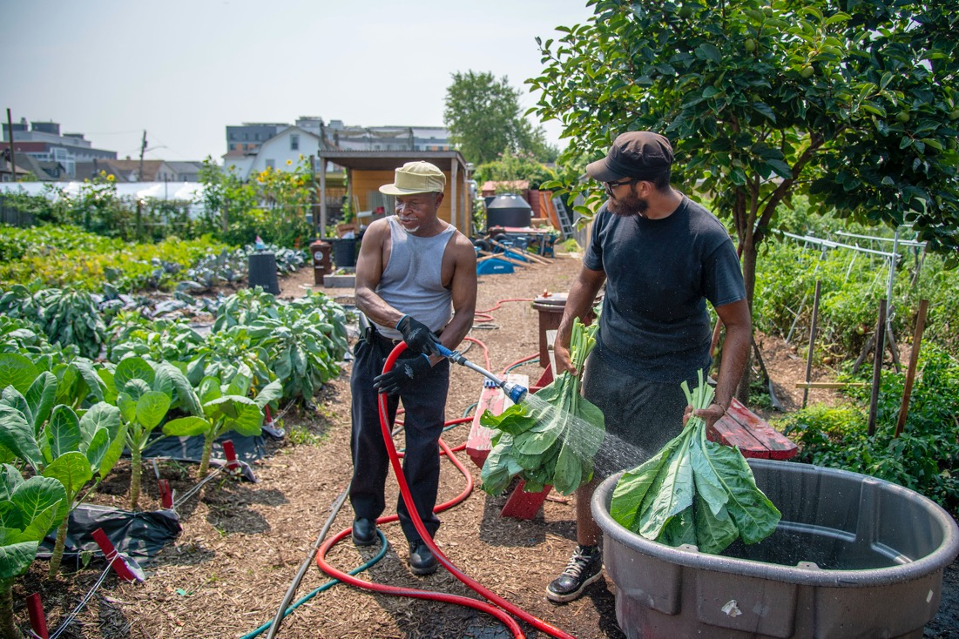
Labor requirements of urban agriculture

Slide 38
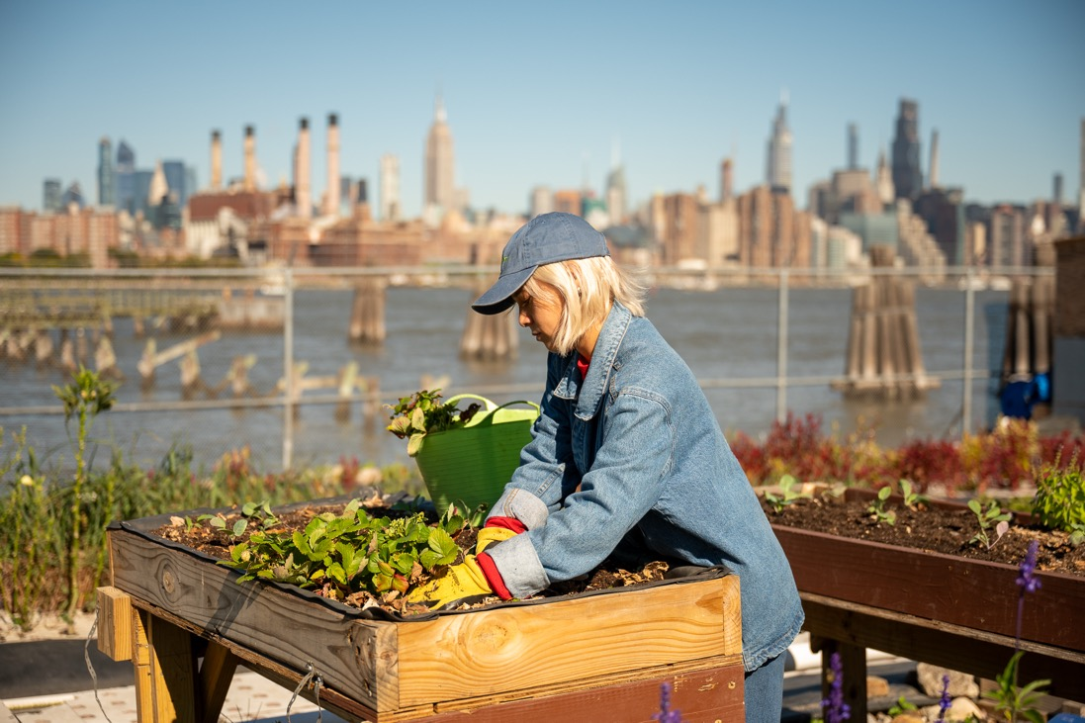
Urban growers often practice integrated pest management strategies
Notes:
Source: RJ Anderson, Cornell Cooperative Extension, 2024

Slide 39
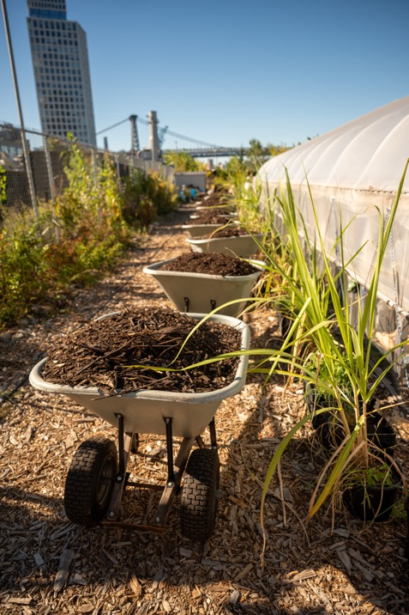
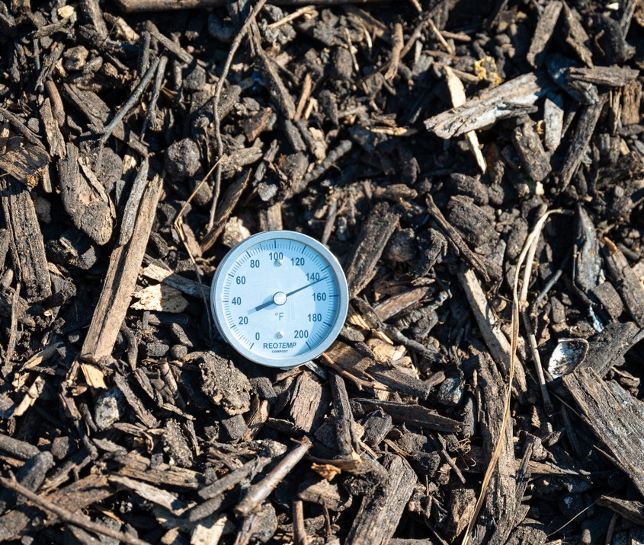
Compost creation and use is common on urban agriculture operations
Notes:
Source: RJ Anderson, Cornell Cooperative Extension, 2024

Slide 40
Markets

Slide 41
Types of markets
Commercial
Non-commercial

Slide 42
Commercial markets
Wholesale
Direct-to-consumer
Supplemental

Slide 43
Wholesaling
a component of food marketing in which goods are assembled, stored, and transported to customers, including retailers, food service operators, other wholesalers, government, and other types of businesses
Notes:
Source: (Byrne & Zeballos, 2023)

Slide 44
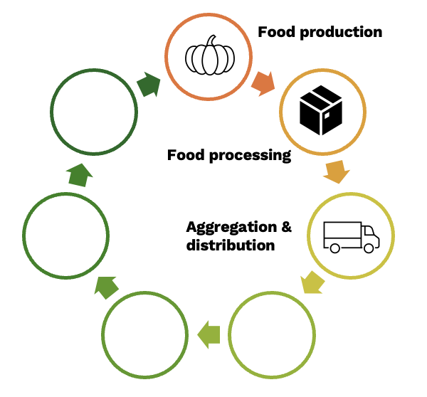
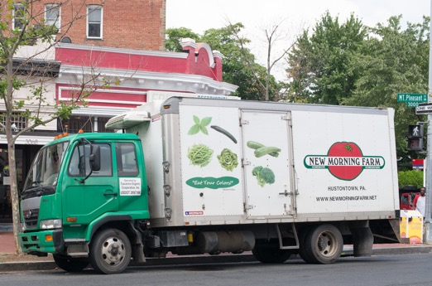
Distribution as part of the food system
Notes:
Source: based on Food System Elements diagram from Texas Center for Local Food

Slide 45
Direct-to-consumer
direct-to-consumer (DTC) sales happen directly between the farm and the consumer through a variety of sub-market types

Slide 46
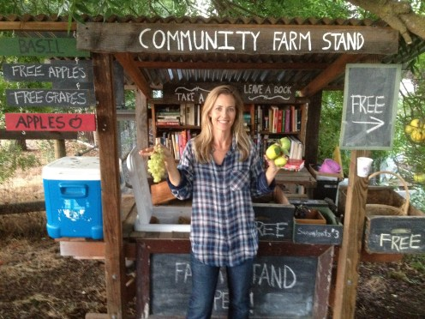
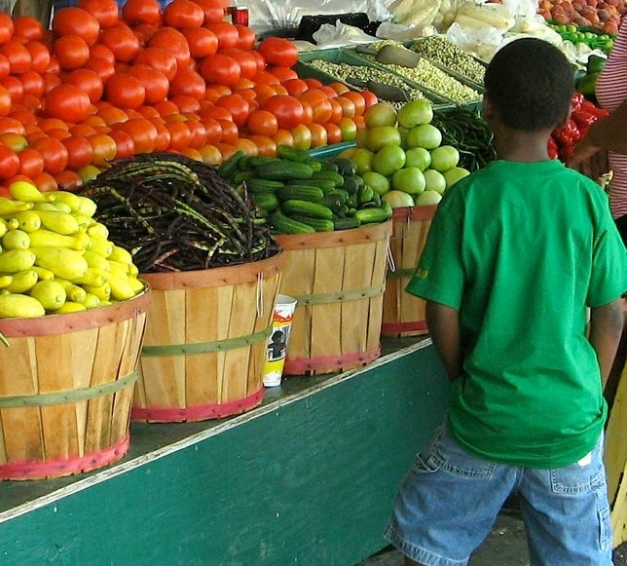
Types of DTC outlets
Notes:
Source: https://urbanfarmstands.org/

Slide 47
Direct-to-consumer marketing over-indexes in urban areas
57% of farms marketing food directly were located in metropolitan counties

Slide 48
Direct-to-consumer farms are a cornerstone of direct sales in urban areas
These farms accounted for 62% of all direct food sales

Slide 49
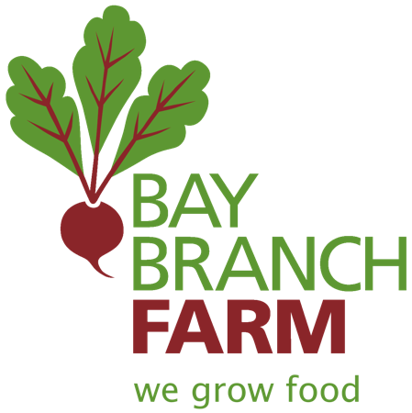
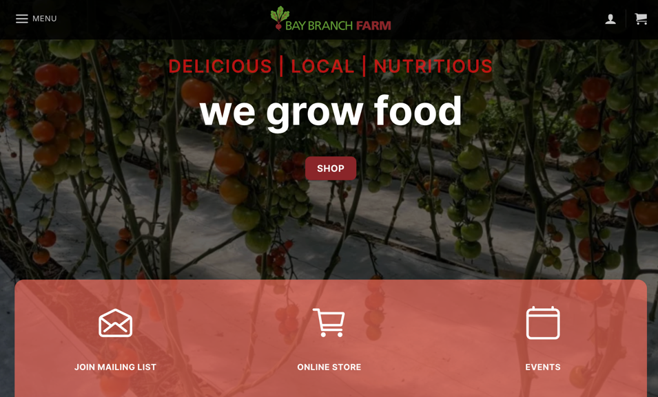
Bay Branch Farm online sales
Notes:
Source: https://baybranchfarm.com/

Slide 50
Community supported agriculture (CSA)
CSA is, at its core, a system for building a network of support around a farm business. Generally, before the growing season, customers buy a membership or share in a farm operation by sponsoring the farm costs that year. As a return for their money, they then receive products regularly during the growing season: traditionally, a box full of vegetables each week. If the farm, for any reason, should face a bad year and production drops, the members share in that risk.
Notes:
Source: Prial, 2019

Slide 51
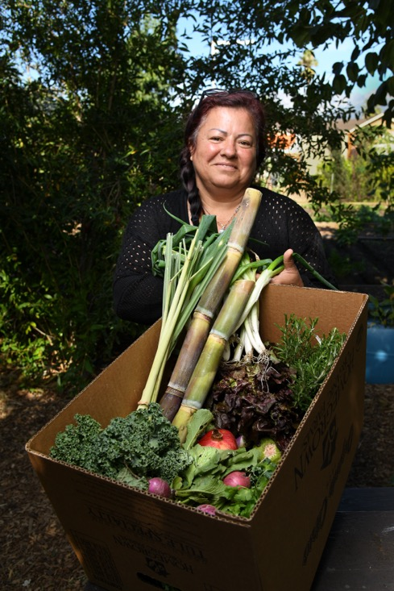
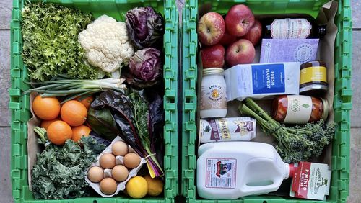
Examples of CSA boxes
Notes:
Source: https://www.ajc.com/things-to-do/food-and-recipes/how-to-shop-for-produce-online-support-atlanta-area-farms/427Q6QZJZZG45OLXUGYEPDM63M/

Slide 52
Supplemental markets

Slide 53
Agritourism
a form of commercial enterprise that links agricultural production and/or processing with tourism to attract visitors onto a farm, ranch, or other agricultural business for the purposes of entertaining or educating the visitors while generating income for the farm, ranch, or business owner
Notes:
Source: National Agricultural Library, n.d.

Slide 54
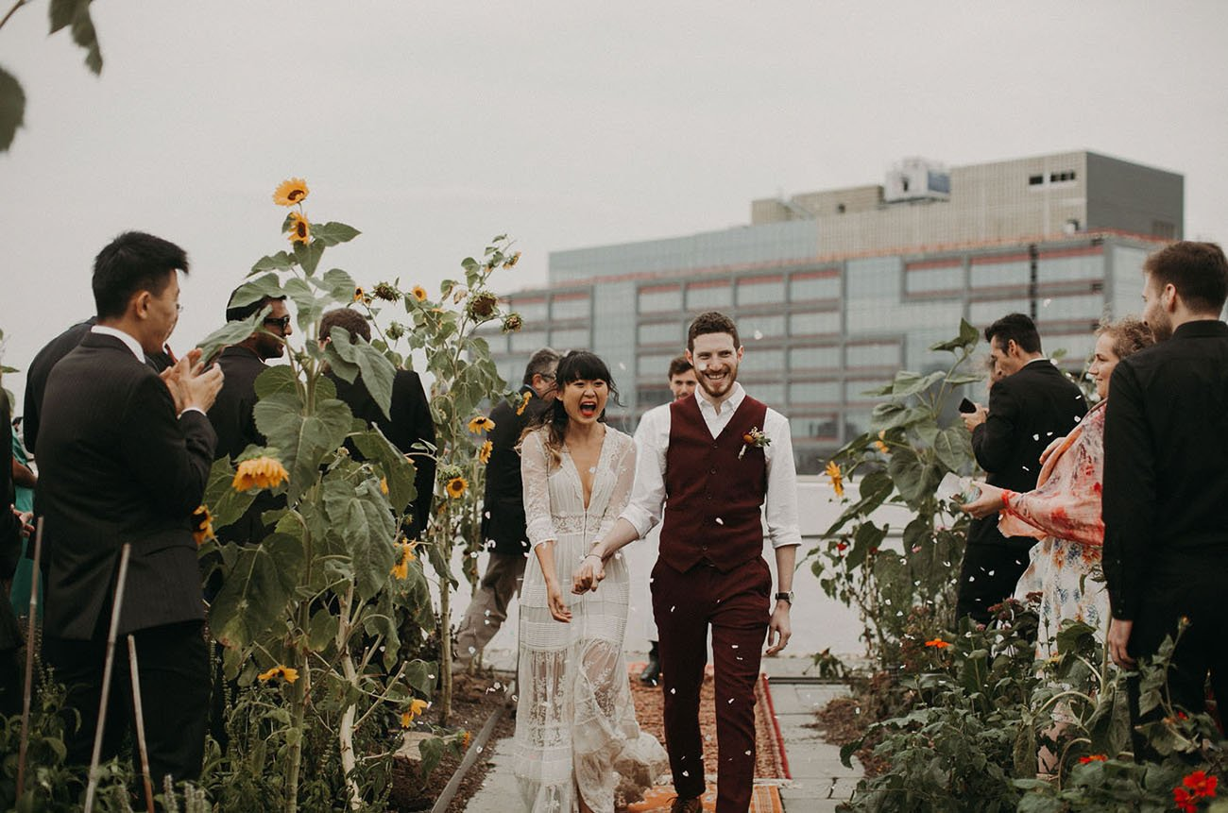
Weddings
Notes:
Source: https://www.brooklyngrangefarm.com/weddings

Slide 55
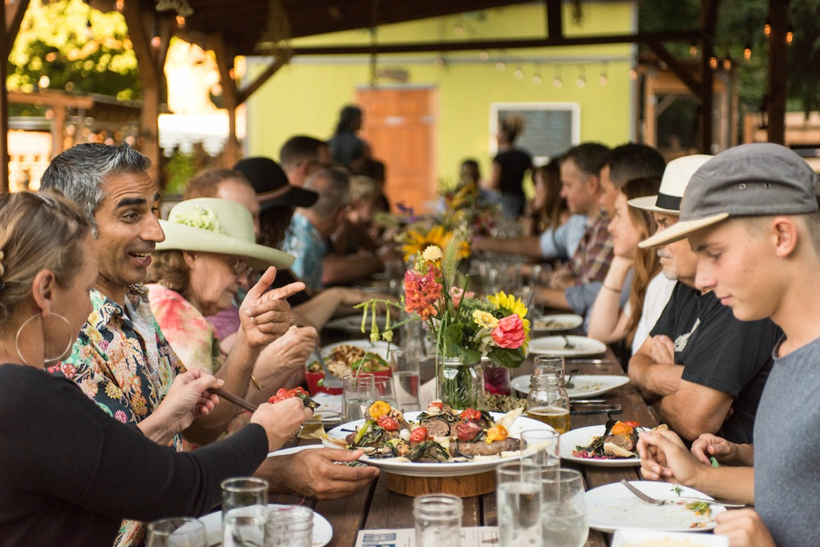
Farm dinners and other events
Notes:
Source: https://www.thesideyardpdx.com/events/

Slide 56
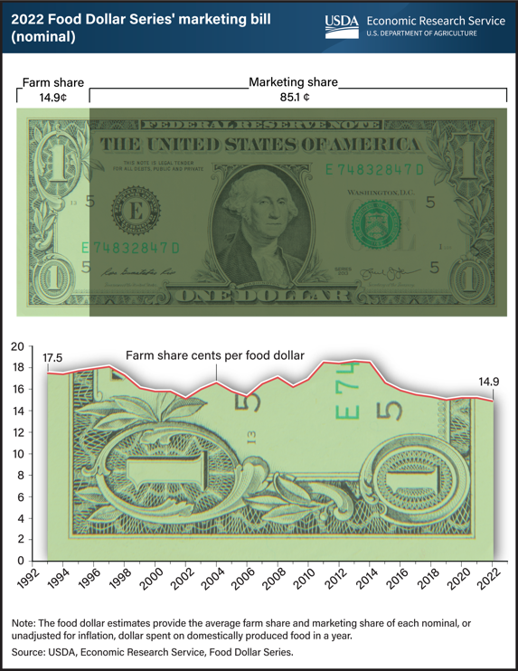
Farm dollar shares
Notes:
Source: https://www.ers.usda.gov/webdocs/charts/107831/2022-Food-Dollar-Shares.png?v=811.8

Slide 57
Value-added products
are those products that change the physical state or form of a product (like milling wheat into flour or making strawberries into jam), among other qualifications
Notes:
Source: University of Maryland Extension

Slide 58
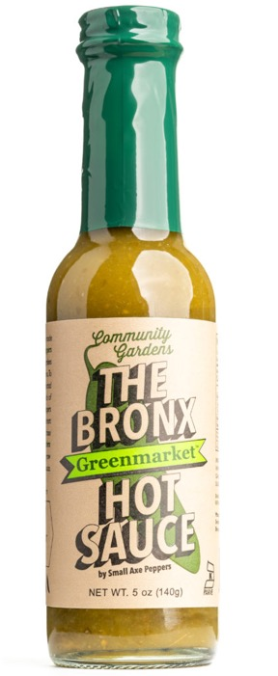
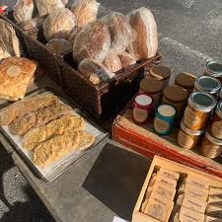
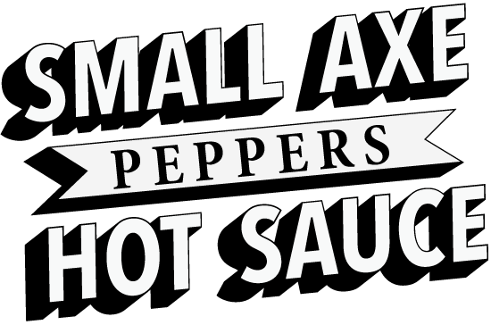
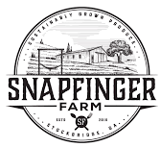
Value added products

Slide 59
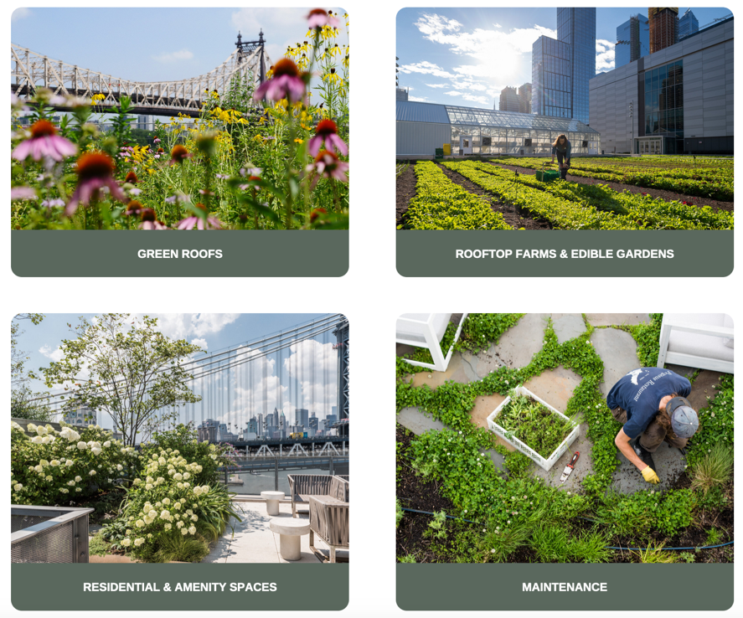

Services

Slide 60


Non-commercial markets

Slide 61
“Community-based” enterprises
are enterprises for which the primary objective is to create space to practice community development and engagement through food production as well as the provision of services like entrepreneurship training, nutrition education, ecological literacy, and more
Notes:
Source: Rangarajan & Riordan, 2019

Slide 62

Collaboration is key at the New Roots Community Farm
Notes:
Source: RJ Anderson, Cornell Cooperative Extension, 2024

Slide 63

Food bank donations

Slide 64
Social enterprises
are businesses that take an entrepreneurial approach to solving widely experienced social or ecological problems
Notes:
Source: Rangarajan & Riordan, 2019

Slide 65

Red Hook Farms
Notes:
Source: https://rhicenter.org/red-hook-farms/the-farms/

Slide 66


Example: Growing Gardens
Notes:
Source: https://www.growing-gardens.org/lettuce-grow

Slide 67
Business structures
For profit
Non-profit
Cooperatives

Slide 68
For profit structures
Sole-proprietorships
Limited liability companies (LLCs)
Partnerships
C-Corps
S-Corps
Cooperatives

Slide 69
Non-profit structures
Charitable organizations
Churches and religious organizations
Private foundations
Political organizations
Other

Slide 70

Cooperatives
Producer cooperatives
Worker cooperatives

Slide 71

Cooperative gathering and decision making

Slide 72
Course 3 recap and next steps

Slide 73
Urban agriculture, USDA description
Urban agriculture generally refers to the cultivation of agricultural products in urban and suburban settings as defined by the U.S. Census Bureau, including vertical production, warehouse farms, community gardens, rooftop farms, hydroponic, aeroponic, and aquaponic facilities, and other innovations. Urban producers work among diverse populations to expand access to nutritious foods, foster community engagement, provide employment opportunities, educate communities about farming, and expand green spaces.

Slide 74
Some programmatic definitions may be required
For Farm Loan Program purposes and according to the 2020 Census, an urban area will comprise a densely settled core of census blocks that meet minimum housing unit density and/or population density requirements. This includes adjacent territory containing non-residential urban land uses. To qualify as an urban area, the territory identified according to criteria must encompass at least 2,000 housing units or have a population of at least 5,000.

