Slide 1
Course 2: Food System Fundamentals

Slide 2
Course 2 learning objectives
Illustrate the relationship between systems and wicked problems
Apply systems thinking to food systems
Analyze food systems

Slide 3
Introduction to systems thinking

Slide 4
Systems
comprise multiple networks of interacting variables
Source: Cabrea & Cabrea, 2015

Slide 5
Systems thinking

Slide 6
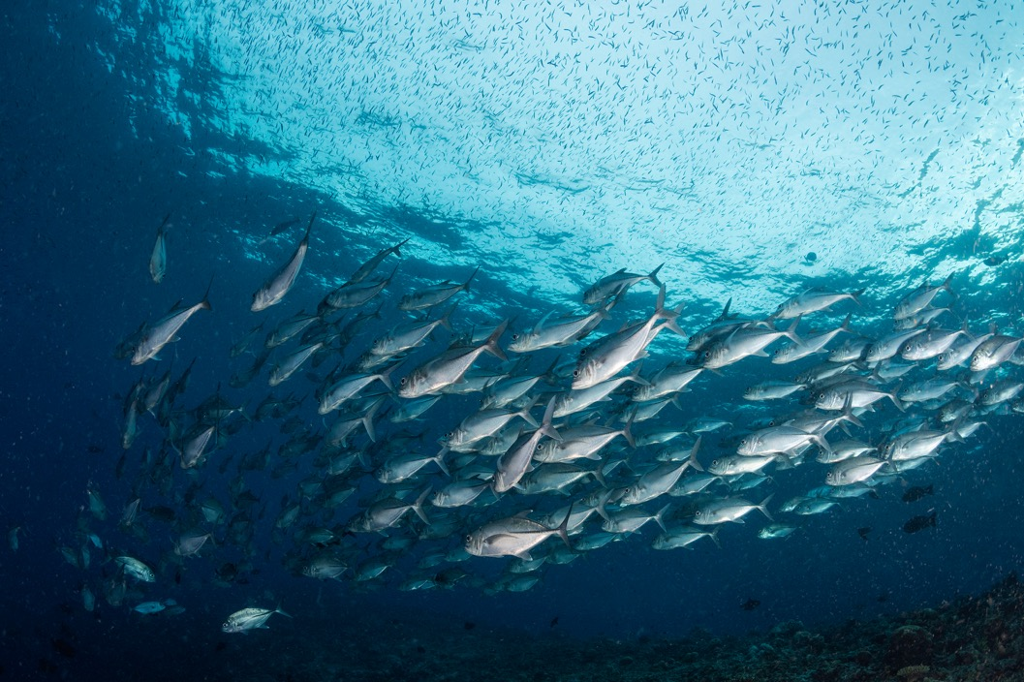
Introduction to systems

Slide 7



Extension as a system example
Publishes research
Feedback
Shares research
Collaborate
Shares
research
Creates
programs
Feedback
Feedback

Slide 8
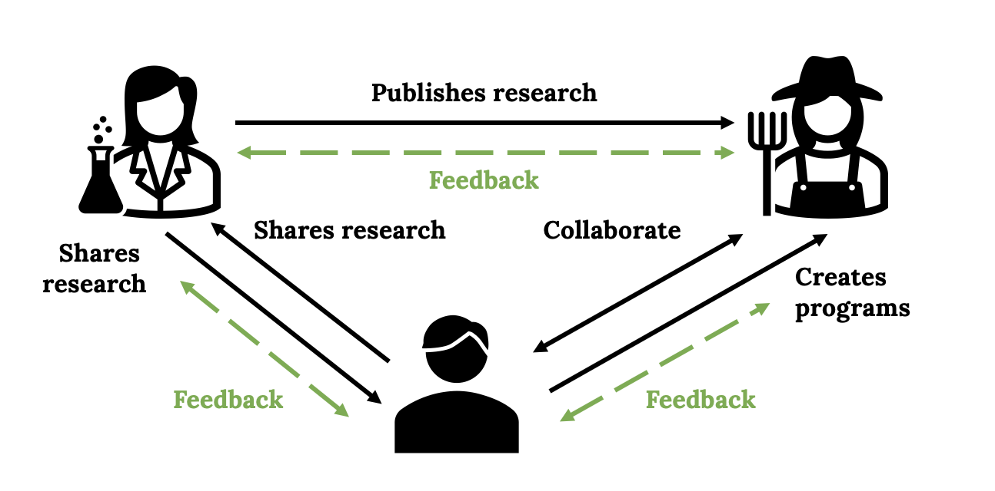
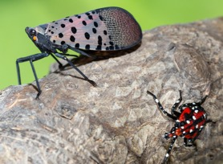
Introducing a pest to the first Extension system

Slide 9
Wicked problems
issues that seem to be the most urgent, the most important, but also the most difficult to solve
Source: Cabrea & Cabrera, 2015

Slide 10
Food systems

Slide 11
Food systems
a food system consists of all processes and infrastructure involved in feeding a population
Source: Giarratano & Biasillo, 2024

Slide 12





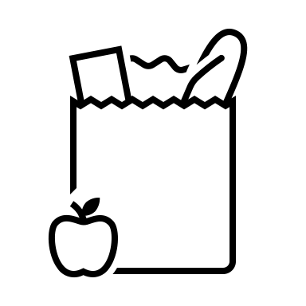

Example of a simplified food system
Food production
Resource &
waste recovery
Food processing
Preparation &
consumption
Aggregation &
distribution
Markets &
purchasing
Marketing
Source: Based on Food System Elements diagram from Texas Center for Local Food
Notes:
https://texaslocalfood.org/food-system/

Slide 13
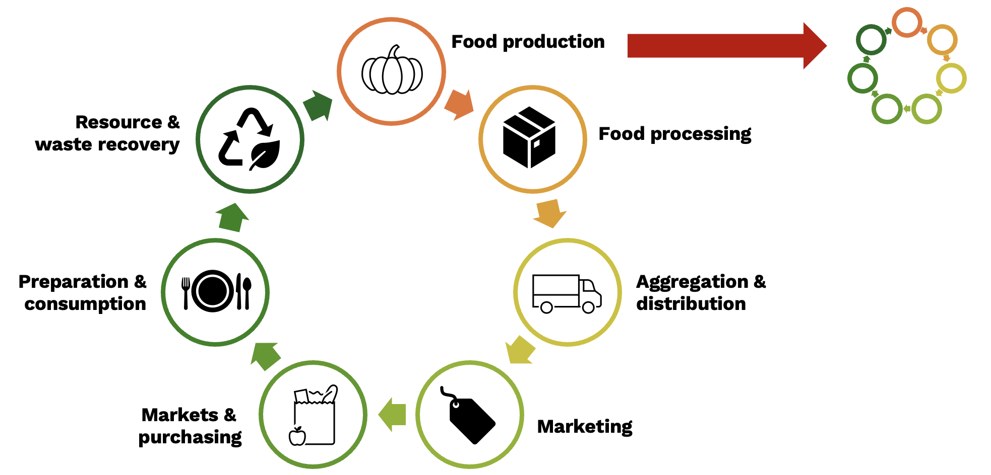
Food systems are systems of systems

Slide 14
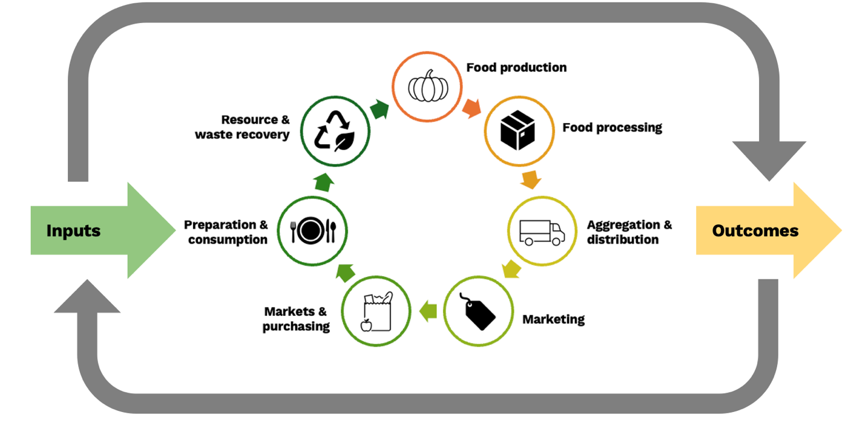
Food systems are systems within systems
Source: based on Cornell University’s PTRCCE101 Food Systems – Module 1

Slide 15
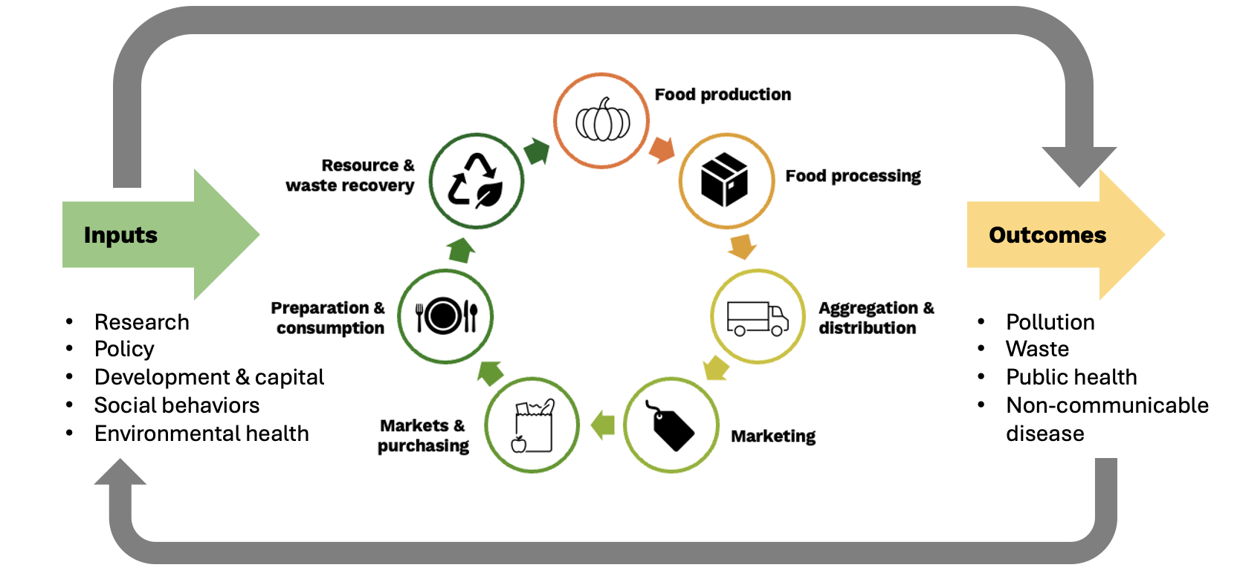
Food systems are informed by inputs and generate outcomes

Slide 16

USDA

Slide 17
Urban food systems

Slide 18
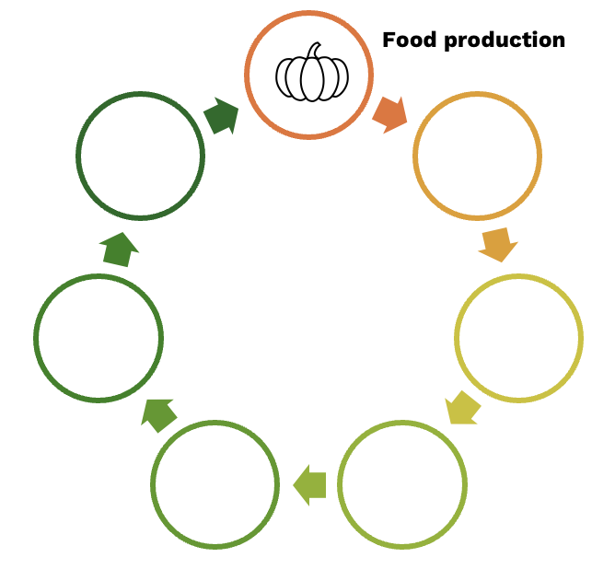
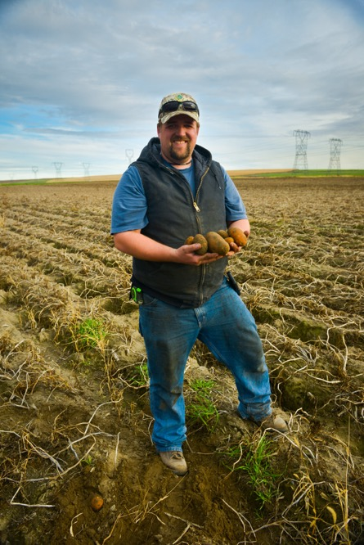
Urban food systems: food production

Slide 19
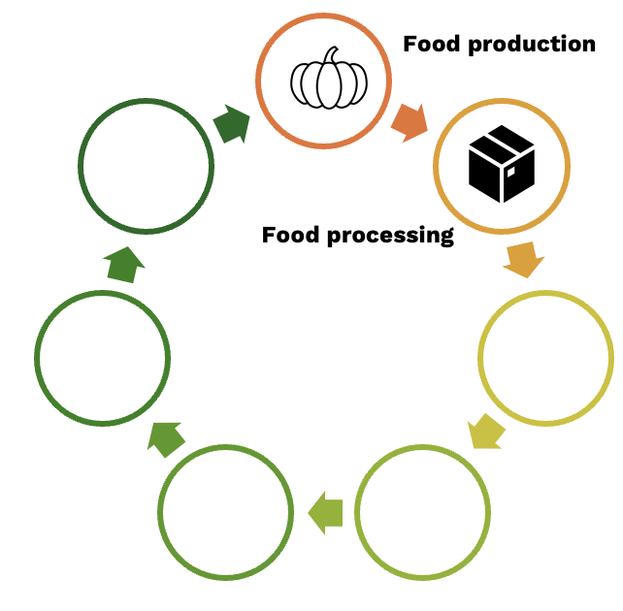
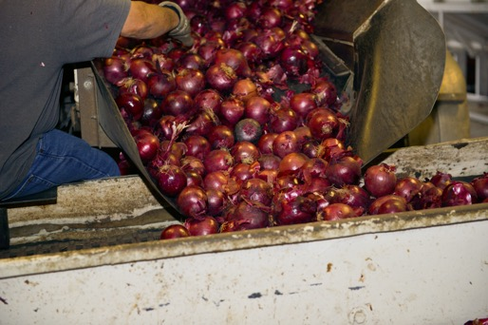
Urban food systems: food processing

Slide 20
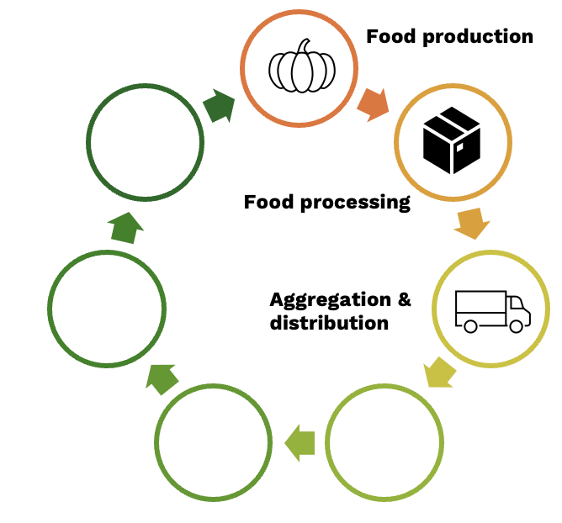
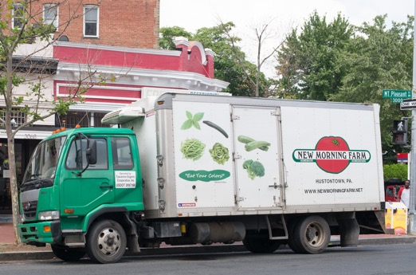
Urban food systems: aggregation and distribution

Slide 21
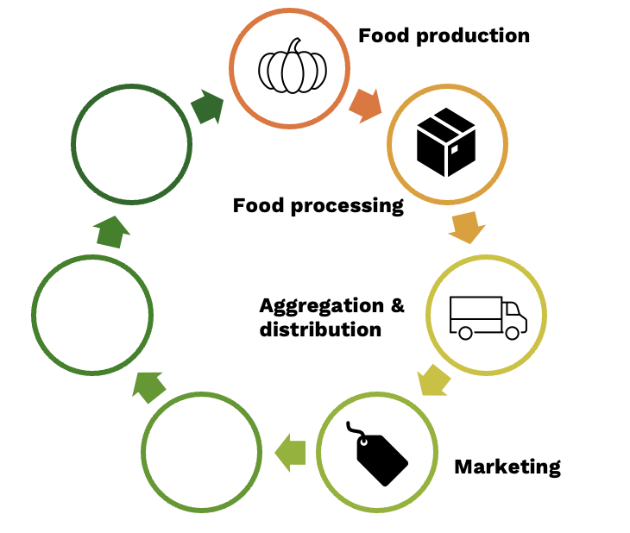
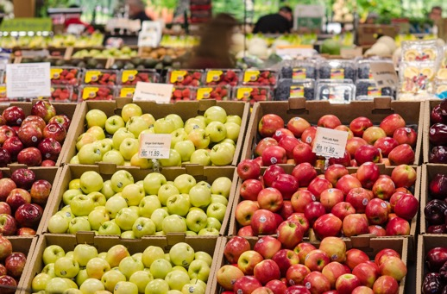
Urban food systems: marketing

Slide 22
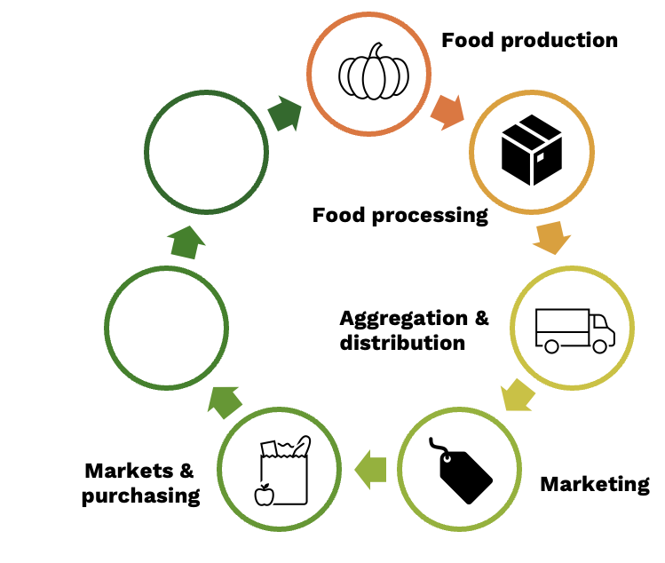
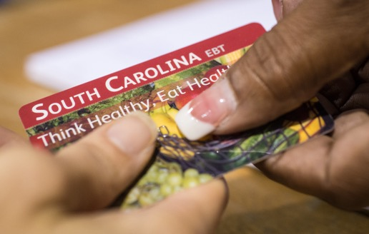
Urban food systems: markets and purchasing

Slide 23
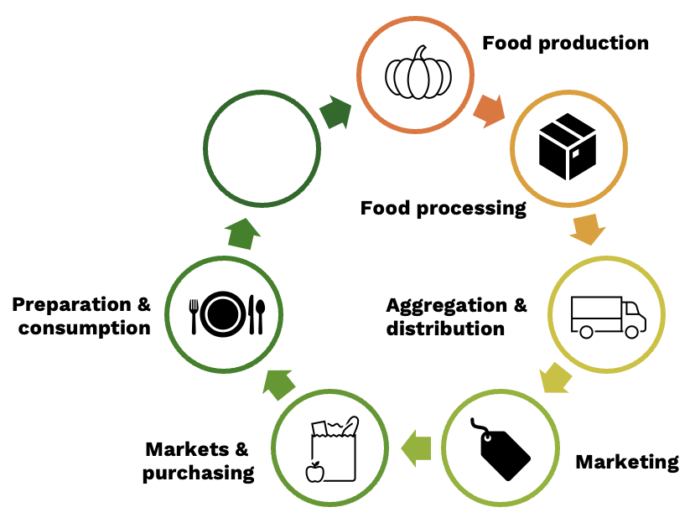
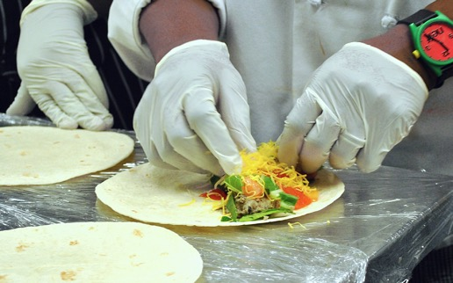
Urban food systems: preparation and consumption

Slide 24
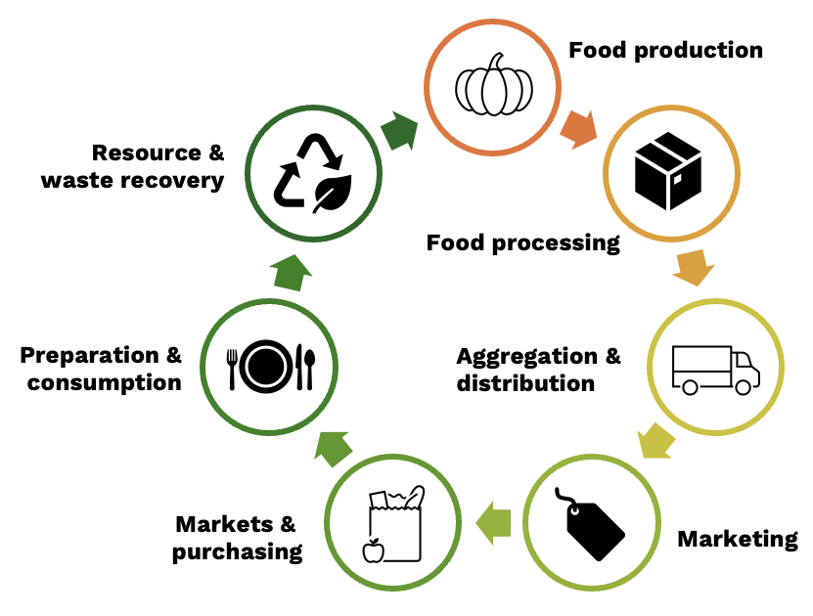
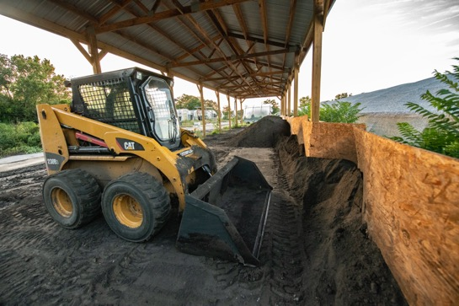
Urban food systems: resource and waste recovery

Slide 25
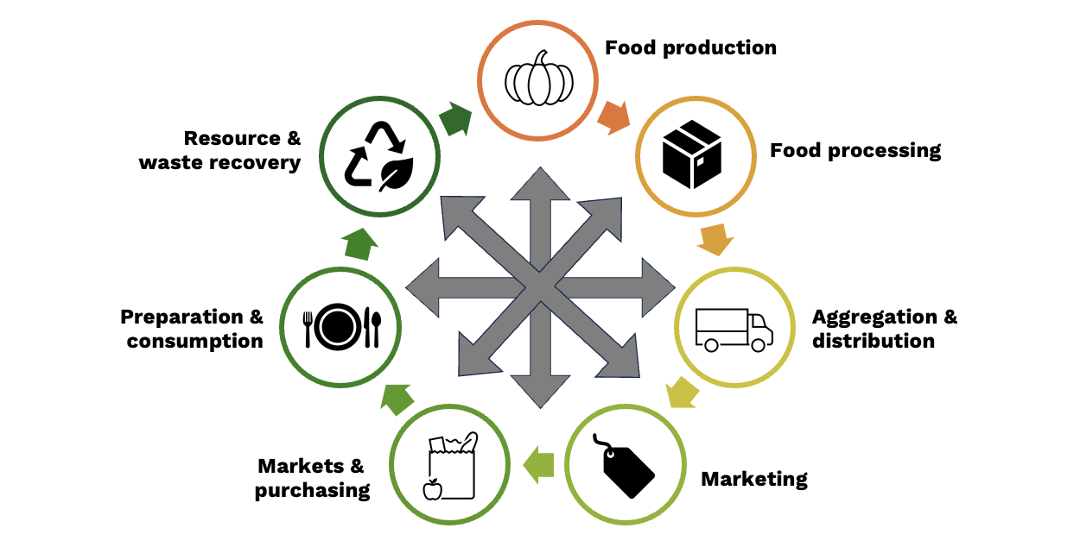
Food systems are complex

Slide 26
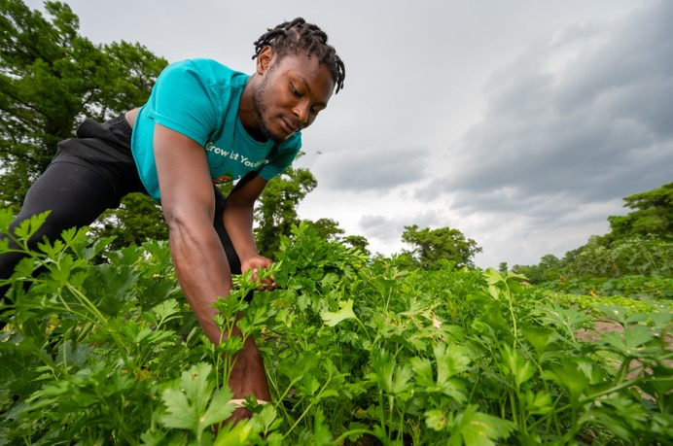
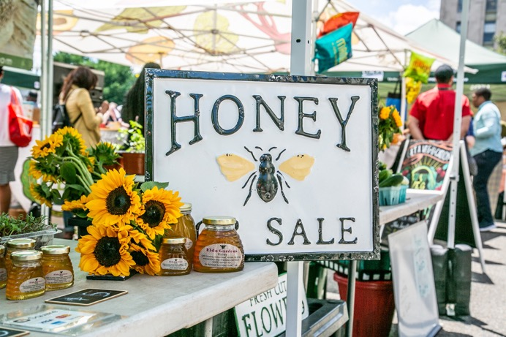
Some farm products are grown in urban areas

Slide 27
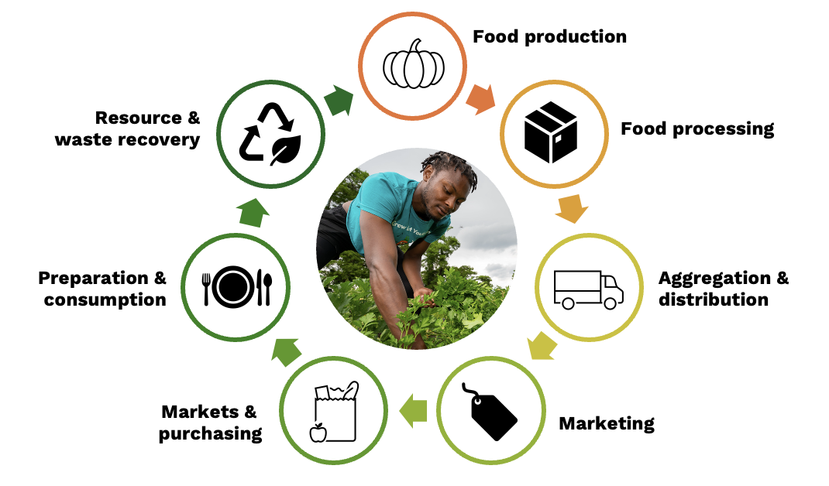
Example of a fully-urban food system

Slide 28
Local and regional food systems
place-specific clusters of agricultural producers of all kinds – farmers, ranchers, fishers – along with consumers and institutions engaged in producing, processing, distributing, and selling foods
Source: USDA, n.d.

Slide 29
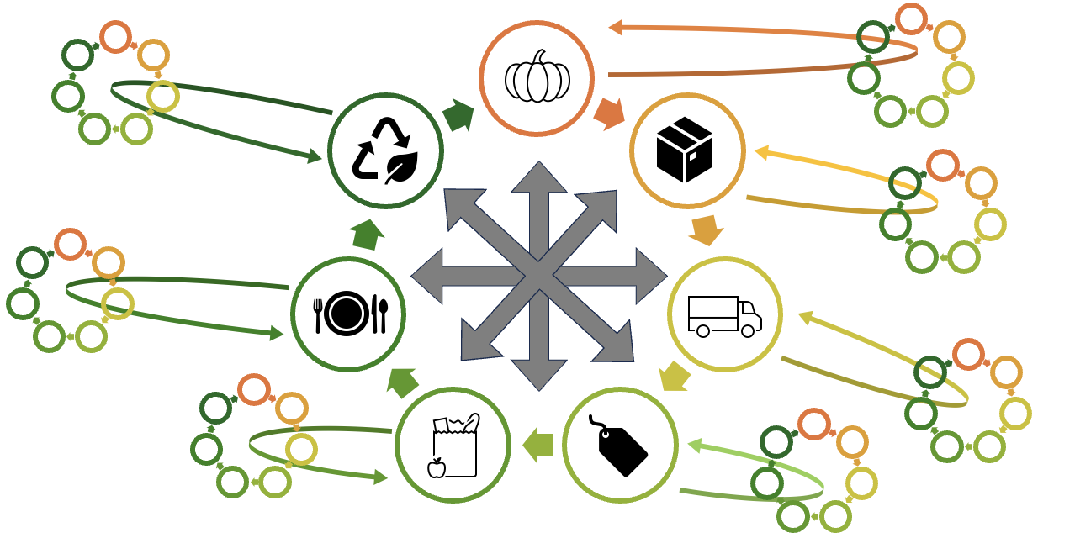
More resilient food systems are more complex

Slide 30
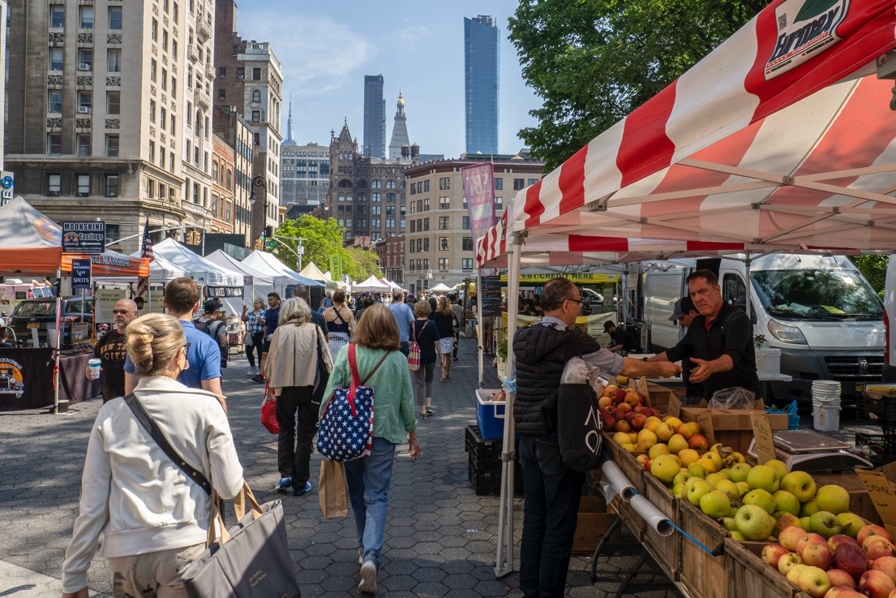
Consumers turned to farmers markets during the COVID-19 pandemic

Slide 31
Course 2 recap and next steps

