Slide 1
Course 1: Introduction to the National Urban Agriculture Training

Slide 2
Urban agriculture

Slide 3
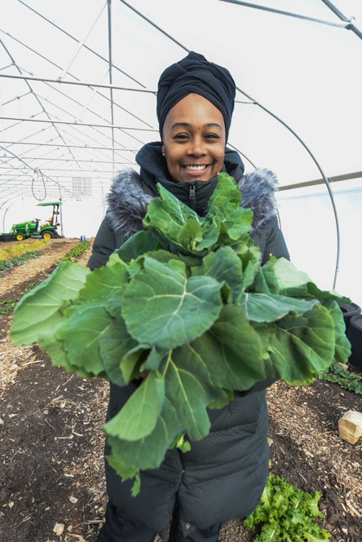
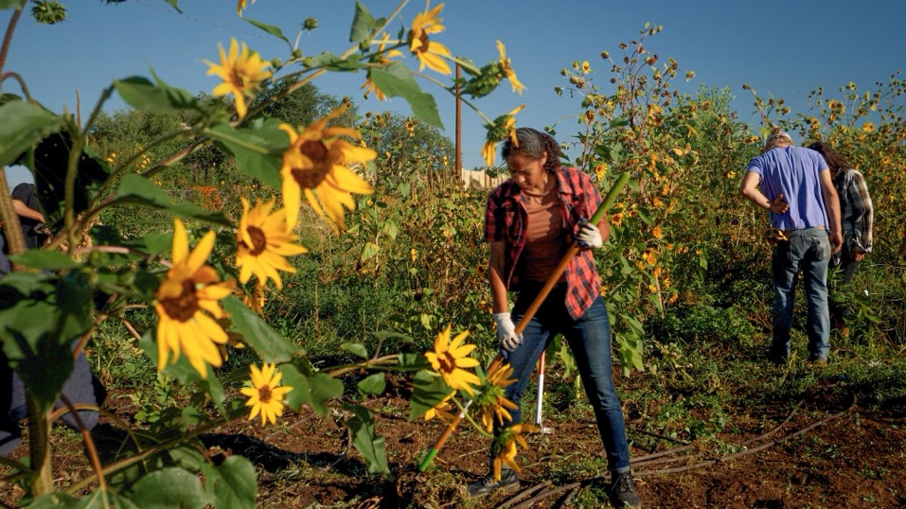
Urban growers create a multitude of benefits

Slide 4
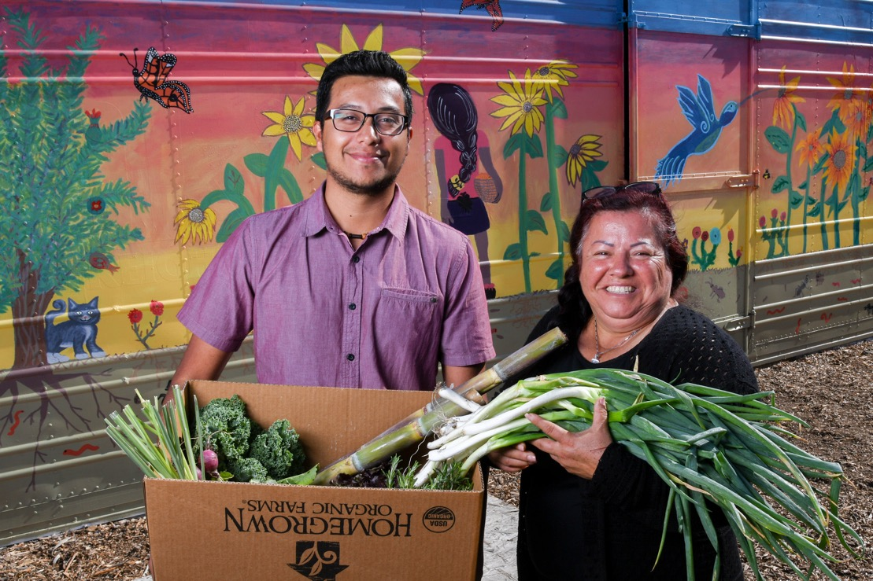
Urban growers contribute to local economies

Slide 5
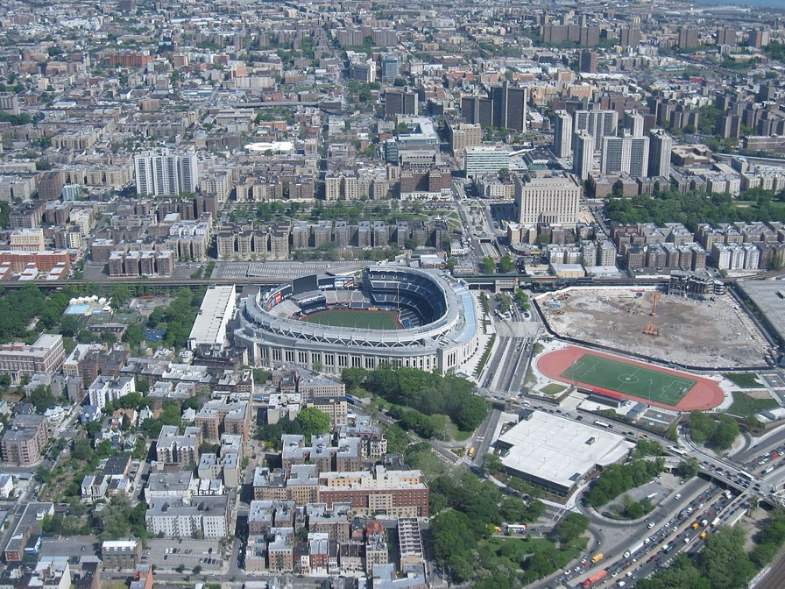
The Bronx, NY
Population:
1.4 million people

Slide 6
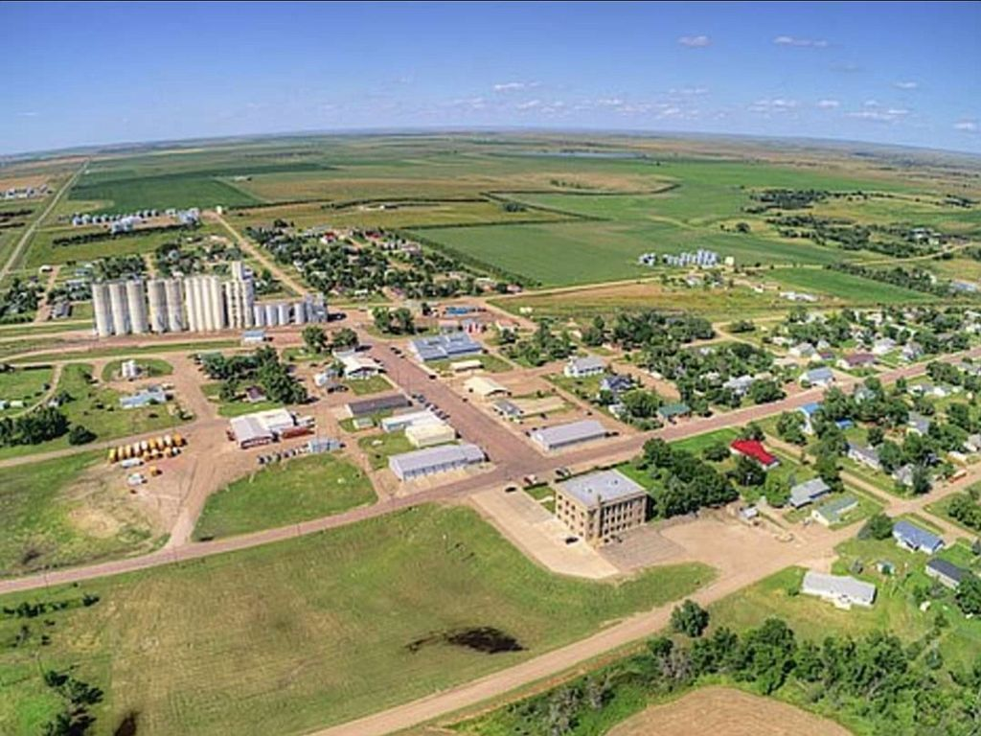
Kennebec, SD
Population:
283 people

Slide 7
Training goals
Foundational urban agriculture knowledge
Increase outreach to and engagement with urban and innovative growers

Slide 8
Learning objectives
Identify the benefits of urban agriculture and innovative production
Identify the factors that support successful urban agriculture and innovative production
Describe the characteristics and conditions that are unique to urban agriculture and urban food systems
Examine opportunities for the USDA to encourage and promote factors that contribute to successful urban agriculture and innovative production
Design a personalized action plan
Increase engagement with urban and innovative producers

Slide 9
National Urban Agriculture Training
Program 1:
Introduction to Urban Agriculture
Course 1: Introduction
Course 2: Food System Fundamentals
Course 3: Recognizing Urban Agriculture
Course 4: Urban Agriculture Benefits
Course 5: Innovative Production
Course 6: Food System Resilience
Live Zoom session
Program 2:
Urban Agriculture Application
Course 7: Creating Conditions for Success
Course 8: Digging Deeper: Land Access
Course 9: Stakeholder Engagement
Course 10: USDA Application

Slide 10
Course 1 learning objectives
Become familiar with the scope, purpose, and function of the National Urban Agriculture Training
Understand how this training connects to your work
Evaluate the relationship between urban agriculture’s history and areas of opportunity for the USDA to support urban growers

Slide 11
Pre-training assessment

Slide 12
A history of urban agriculture in the United States

Slide 13
Early history: colonization (1600s – 1800s)

Slide 14
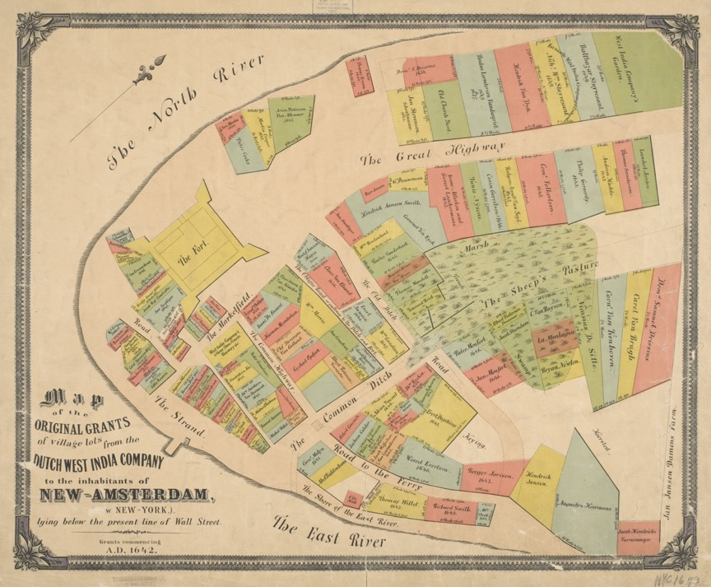
A map of early New York City
Notes:
Source: New York Public Library; Map of the original grants of village lots from the Dutch West India Company to the inhabitants of New-Amsterdam (now New-York) lying below the present line of Wall Street, 1642

Slide 15
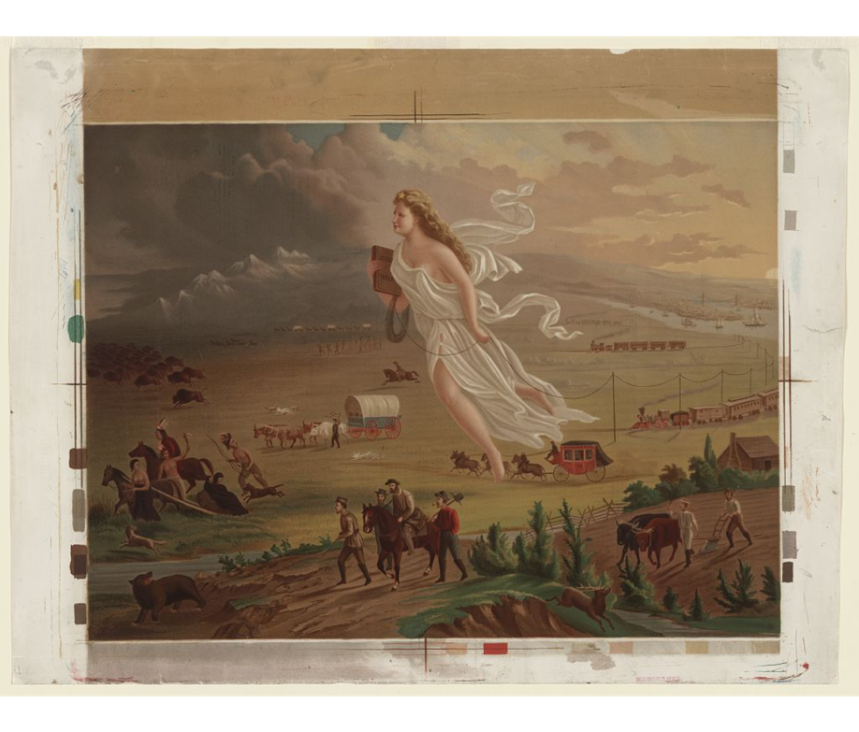
Early American expansion
Notes:
Source: Library of Congress; Crofutt, George A. American Progress. 1873.

Slide 16
Industrialization
(1800s – early 1900s)

Slide 17
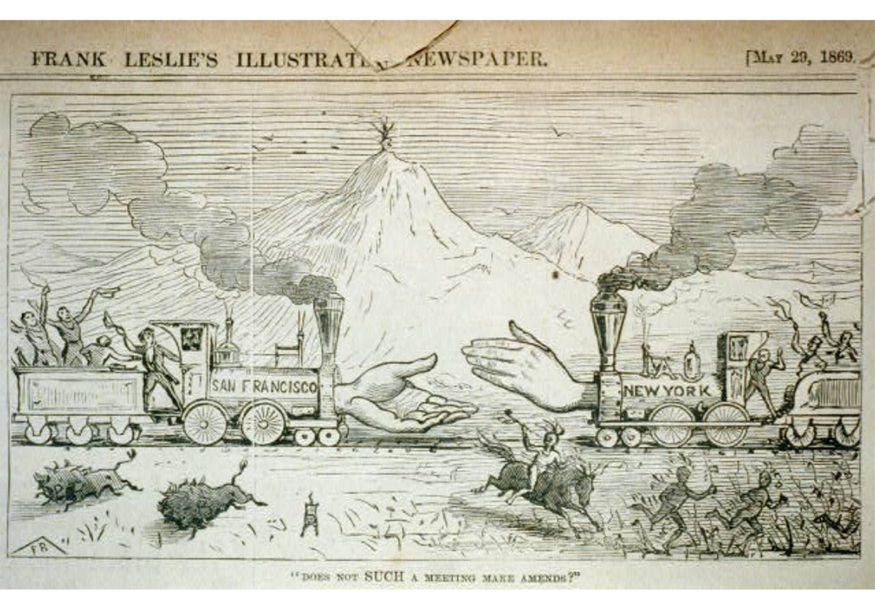
The first intercontinental railroad
Notes:
Source: Library of Congress; Beard, Frank. "Does not such a meeting make amends?” 1869.

Slide 18
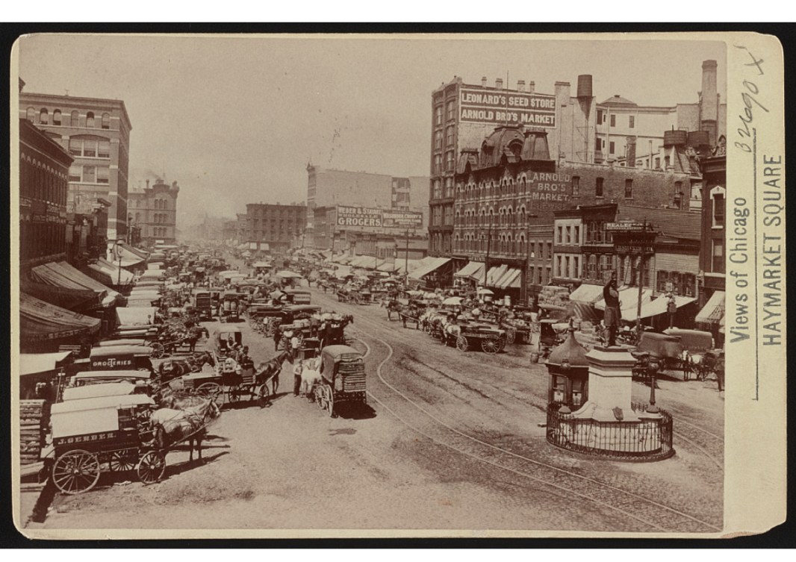
Chicago’s early population growth
Notes:
Source: Library of Congress; Views of Chicago, Haymarket Square; Publisher not identified. Between 1889 – 1910.

Slide 19
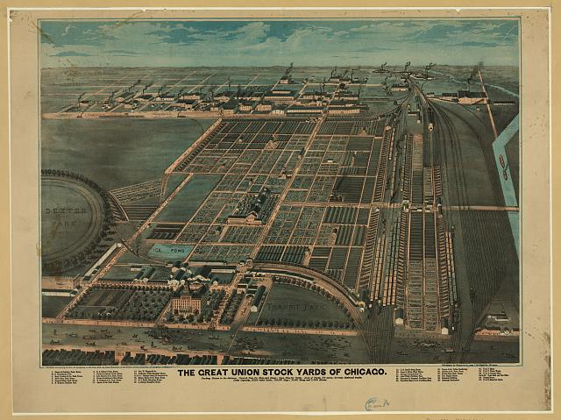
Chicago’s meatpacking and stockyard infrastructure development
Notes:
Source: Library of Congress; The Great Union Stock Yards of Chicago, Charles Rascher, 1878

Slide 20
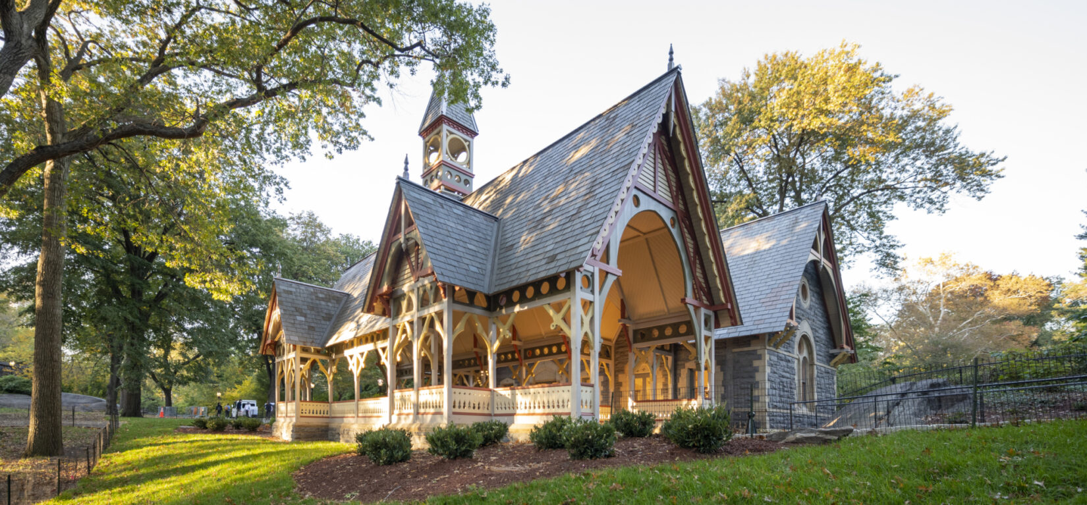
The Central Park Dairy Visitor Center
Notes:
Source: Central Park Conservancy, Dairy Visitor Center & Gift Shop

Slide 21
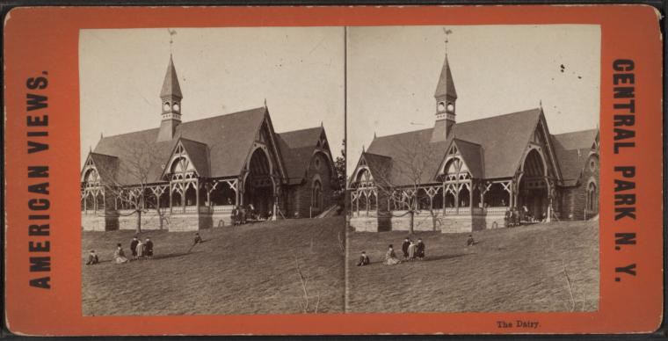
The Central Park Dairy
Notes:
Source: New York Public Library; Central Park Dairy

Slide 22
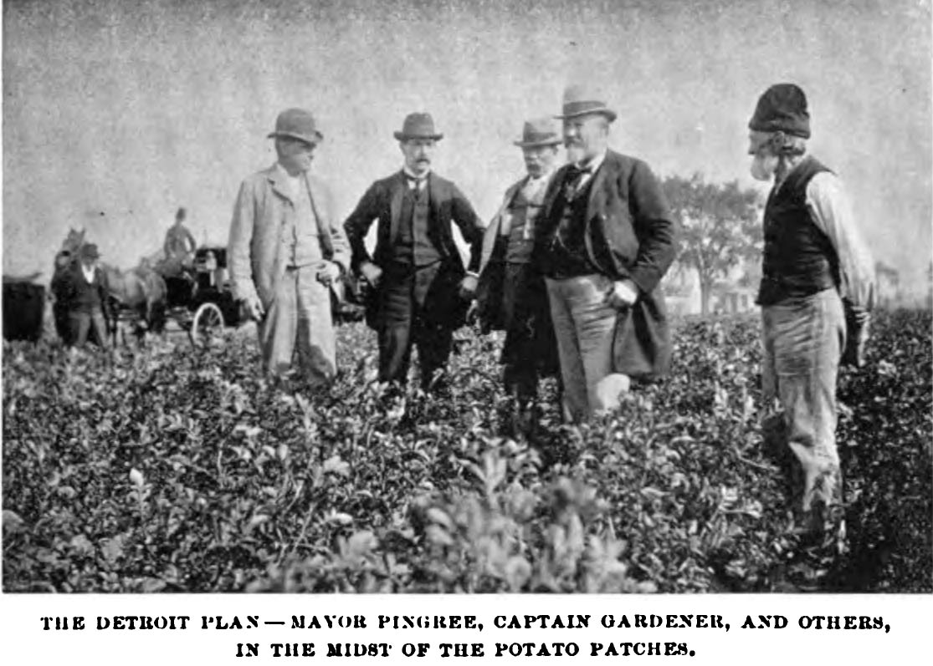
Pingree’s Potato Patch Program
Notes:
Source: "Pingree’s Potato Patches," Community of Gardens Story Collection, December 4, 2013. Smithsonian Gardens. Retrieved December 11, 2024, from https://gardens.si.edu/collections/community-of-gardens/

Slide 23
World wars, the Great Depression, and suburbanization
(early 1900s – 1970s)

Slide 24
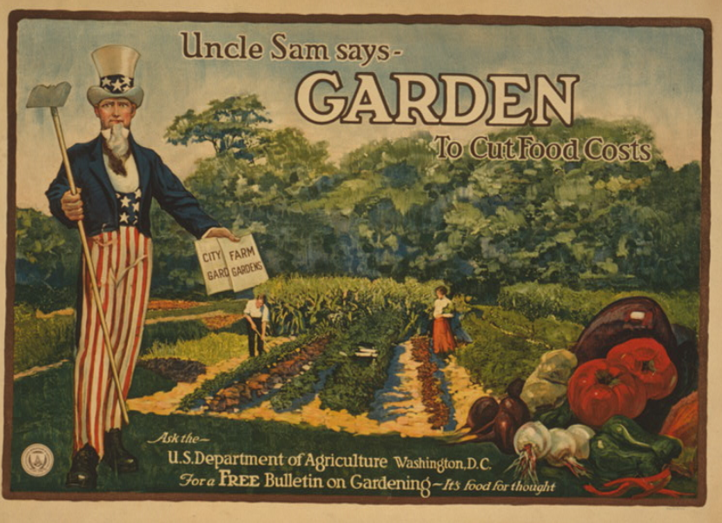
Federal marketing of home gardening
Notes:
Source: Library of Congress; Uncle Sam says - garden to cut food costs Ask the U.S. Department of Agriculture, Washington, D.C., for a free bulletin on gardening - it's food for thought / / A. Hoen & Co., Baltimore. 1917.

Slide 25
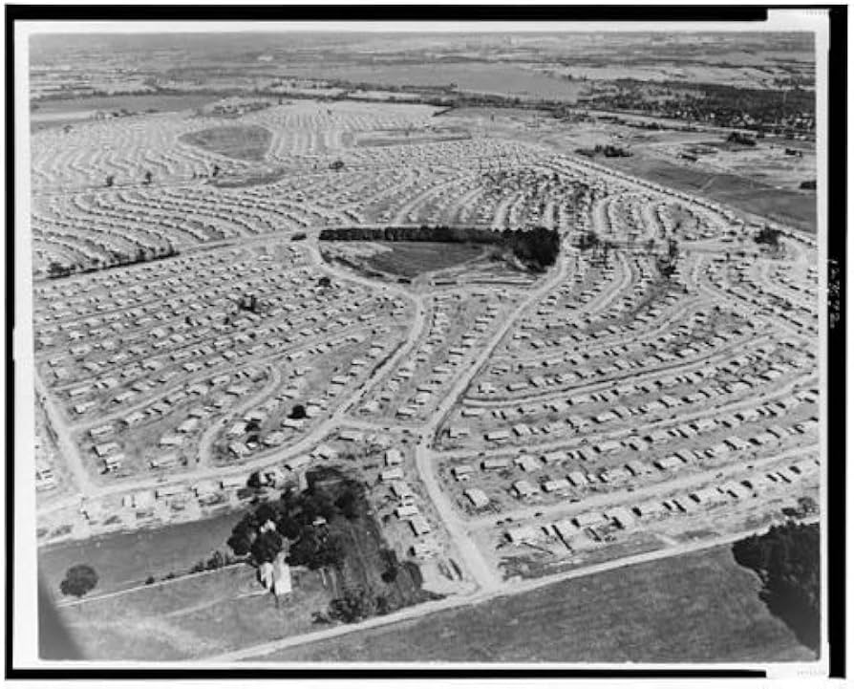
Early suburbanization in the United States
Notes:
Source: Library of Congress; “Aerial view of a planned pre-fabricated housing development in Levittown, Pennsylvania.” 1951 or 1952.

Slide 26
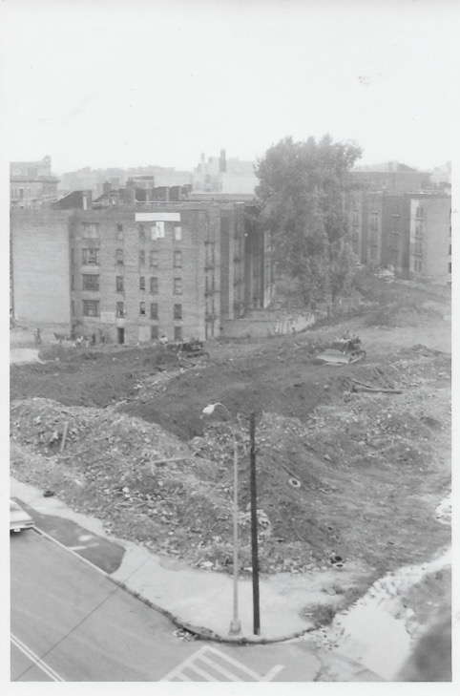
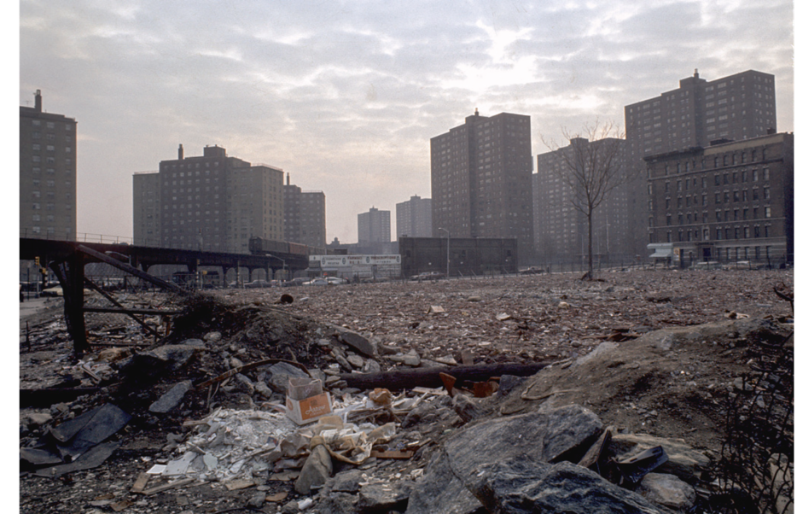
Real estate owners burned and abandoned land in the Bronx
Notes:
Source: Banana Kelly Archives, from Bruce Zeines; The Bronx circa 1970s.
Source: Library of Congress; “South Bronx, 1973,” Vergara, Camilo J. 1973.

Slide 27
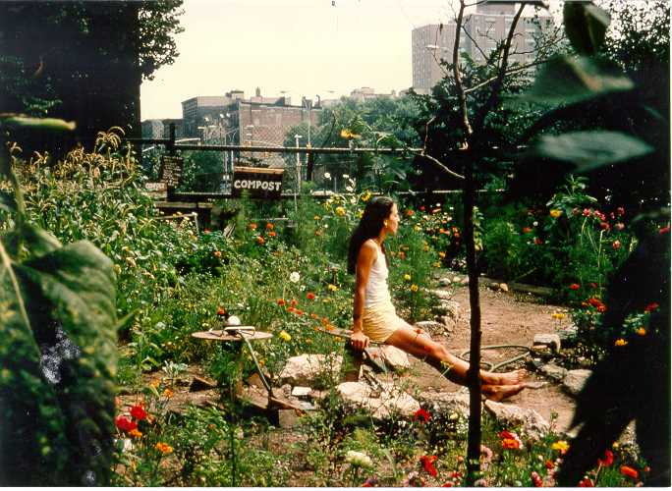
The Liz Cristy Garden
Notes:
Source: Liz Christy Garden; circa 1970s, New York City; http://www.lizchristygarden.us/lcbh_files/Images/LCBH5.JPG

Slide 28
Urban agriculture today
(1970s – present)

Slide 29
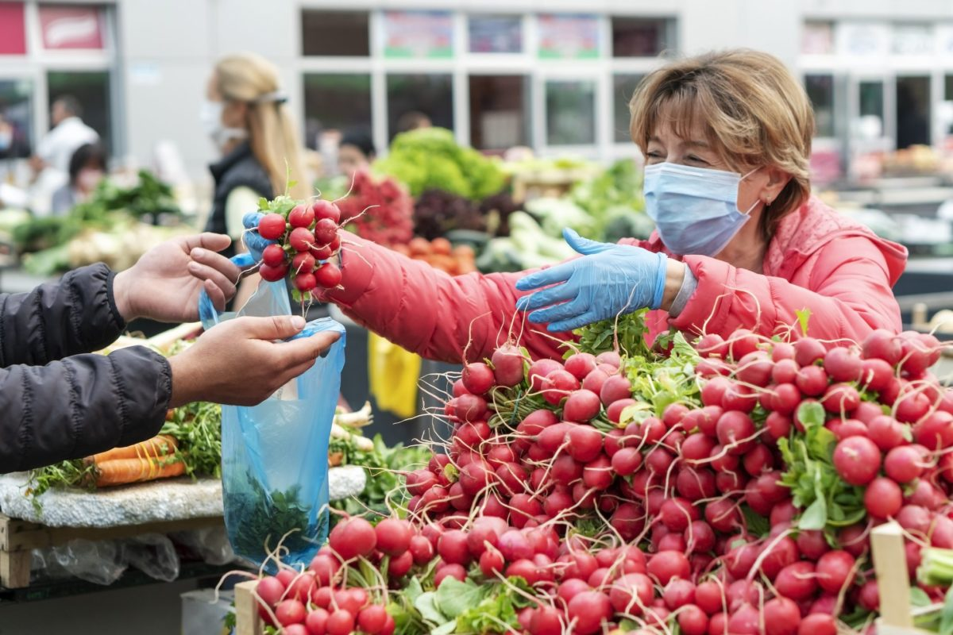
Farmer’s markets during the COVID-19 pandemic
Notes:
Source: North Central SARE; COVID-19 Sales and Marketing Resources; https://northcentral.sare.org/about/covid-19-sales-and-marketing-resources/

Slide 30
Urban agriculture and the USDA

Slide 31
A timeline of USDA urban agriculture initiatives
1962
First urban conservation district
1976
Urban Garden’s Program established
1993
1994
Urban Resources Partnership begins
1999
Urban Garden’s Program ends
Urban Resources Partnership ends
2012
Hoop houses funded in urban areas

Slide 32
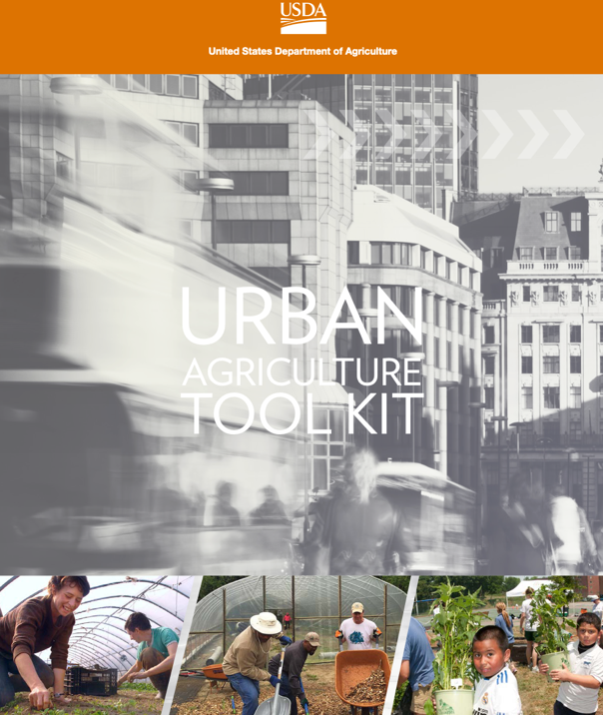
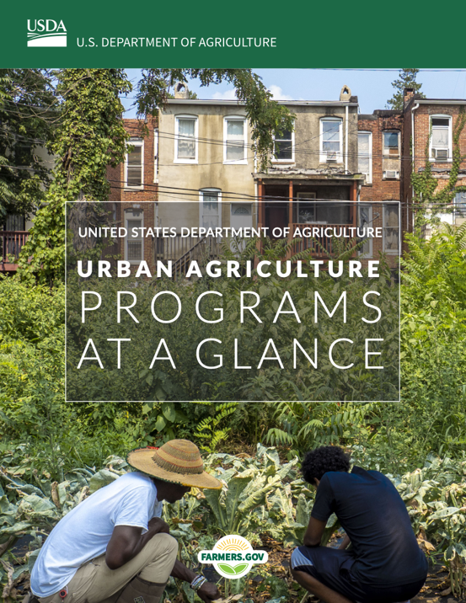
The early Urban Agriculture Toolkit
Notes:
Source: USDA; https://www.ams.usda.gov/sites/default/files/media/urbanagriculturetoolkit.pdf; 2016. USDA; https://www.farmers.gov/sites/default/files/202205-usda-urban-ag-at-a-glance-redesign-v7.pdf; 2022.

Slide 33
A continuation of the timeline of USDA urban agriculture initiatives
2016
Urban Agriculture Toolkit released
2018
Agriculture Improvement Act of 2018
2022
Urban Agriculture at A Glance updated

Slide 34
2018 farm bill authorizations
Establish the Office for Urban Agriculture and Innovative Production (OUAIP)
Administer urban agriculture grants
Administer community compost and food waste reduction projects
Establish a federal advisory committee for urban agriculture and innovative production
Establish at least 10 new Farm Service Agency (FSA) pilot county committees in urban areas

Slide 35
Urban agriculture and the USDA today

Slide 36
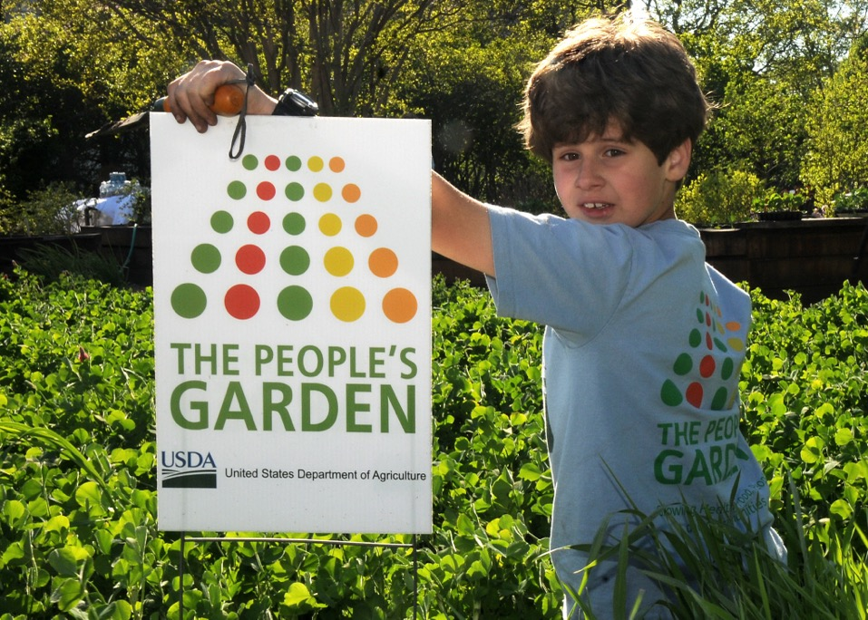
The People’s Garden
Notes:
Source: USDA Flickr

Slide 37
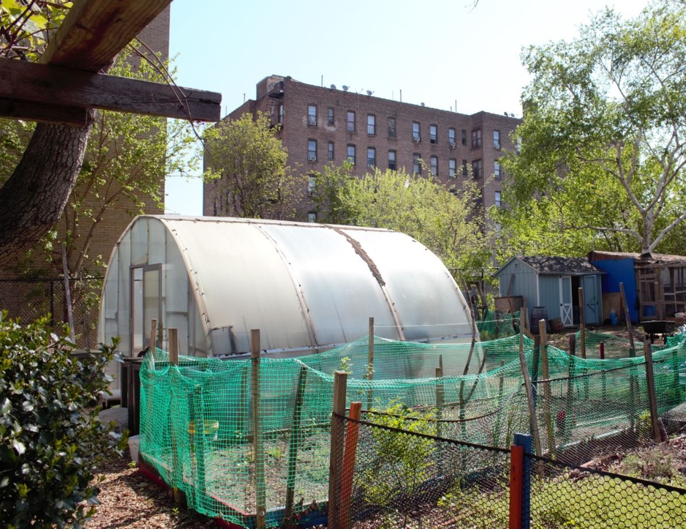
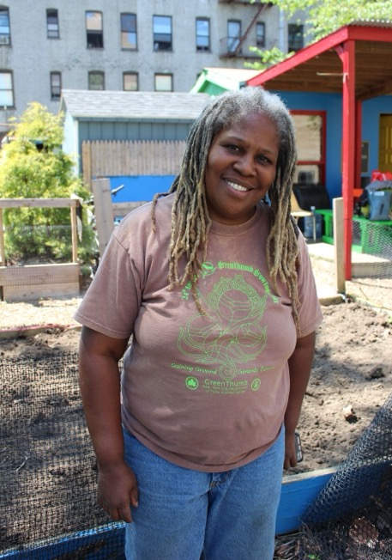
Karen Washington and the high tunnel at the Garden of Happiness
Notes:
Source: https://nrcs.maps.arcgis.com/apps/Cascade/index.html?appid=70a334d6fa9c48f9a04a2089b6942522

Slide 38
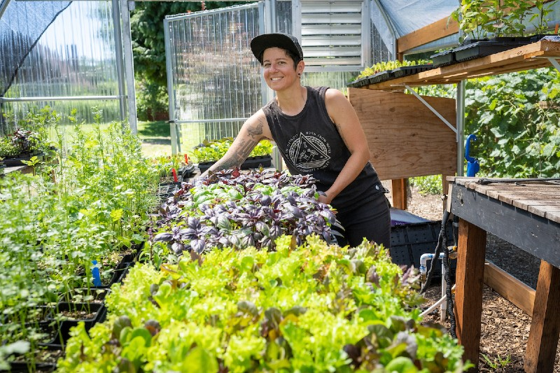
Stacey Givens in her greenhouse
Notes:
https://www.farmers.gov/blog/fridays-on-farm-cultivating-love-local-food-in-portland

Slide 39
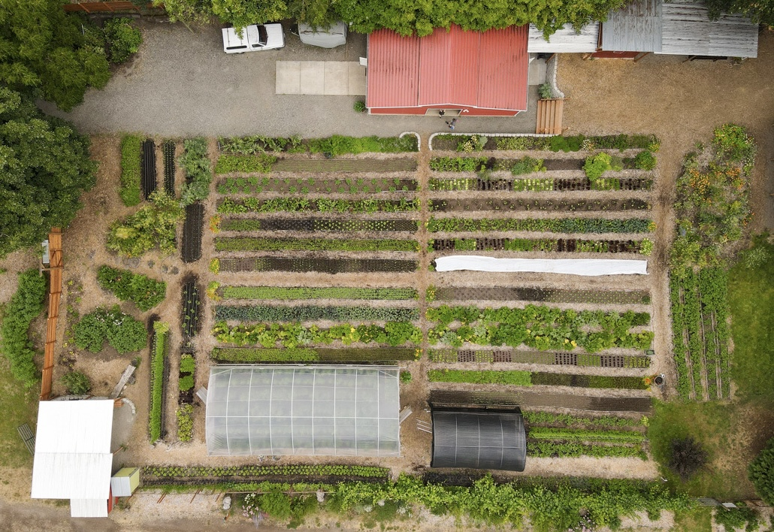
Side Yard Farm and Kitchen
Notes:
https://www.farmers.gov/blog/fridays-on-farm-cultivating-love-local-food-in-portland

Slide 40
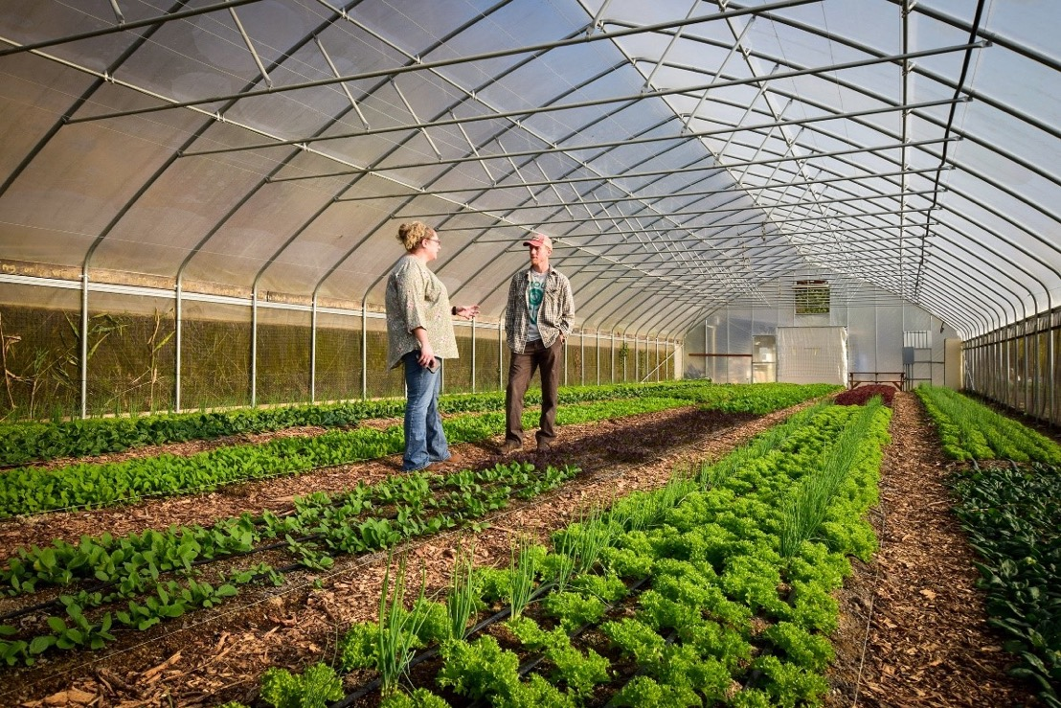
Urban agriculture in West Virginia
Notes:
https://www.farmers.gov/blog/fridays-on-farm-boosting-urban-agriculture-in-west-virginia

Slide 41
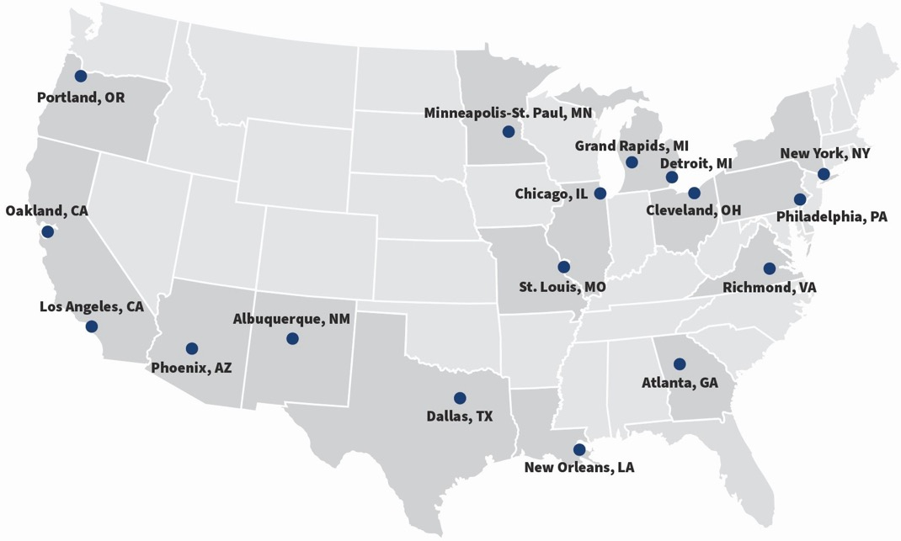
The 17 initial pilot cities for the USDA’s national urban agriculture initiative

Slide 42
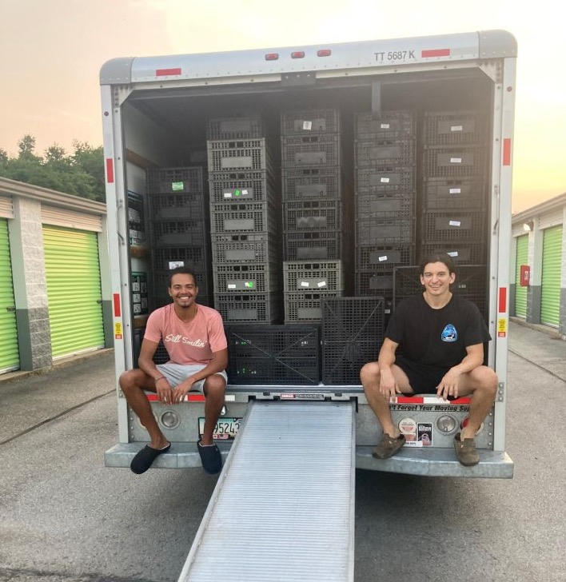
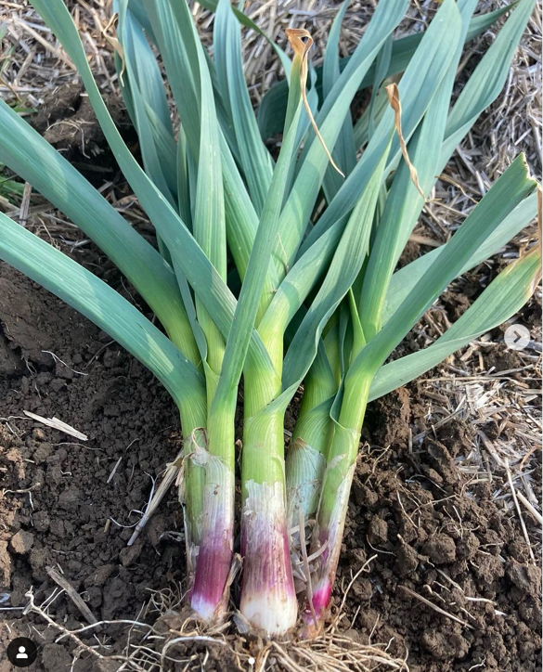
USDA’s St. Louis urban service center team supports local urban agriculture

Slide 43
All 27 pilot urban agriculture locations

Slide 44
2024 statement from Ducehneaux and Cosby
“The zip code or size of a community should not determine whether families can purchase healthy, locally grown food. Through programs like these, USDA is investing in America’s urban and suburban communities and strengthening local food systems.”

Slide 45
Course 1 recap and next steps

