Slide 1
Course 6:
Food System Resilience

Slide 2
Course 6 learning objectives
You will:
Examine the training content in the context of food system resilience
Evaluate urban agriculture’s contribution to more resilient food systems

Slide 3
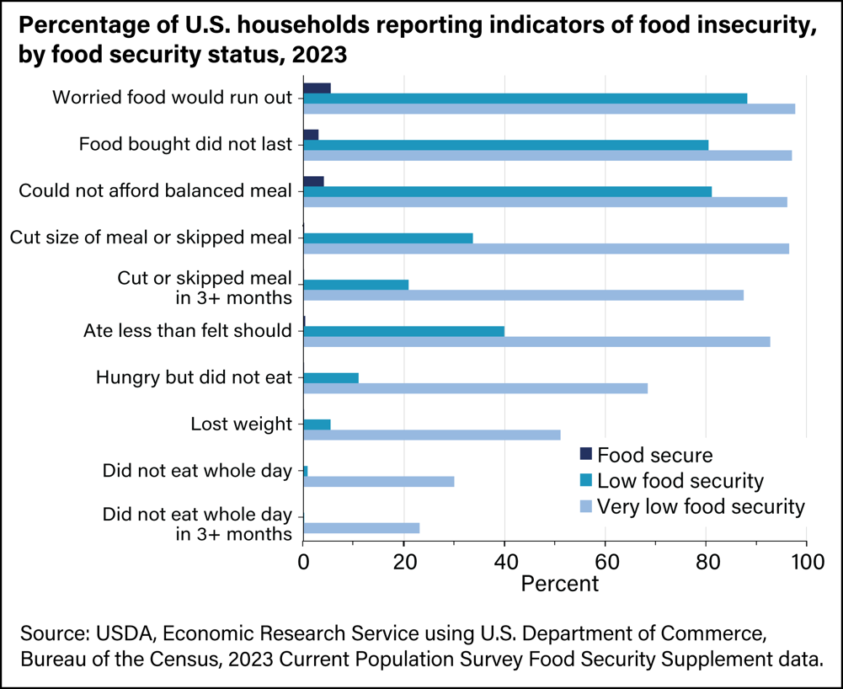
Food insecurity in the United States
68% reported experiencing hunger but not eating because they could not afford enough food.
Source: USDA, Economic Research Service, 2023

Slide 4
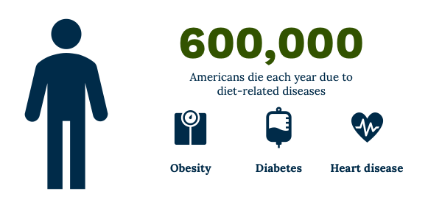
Poor nutrition is a leading cause of illness in the United States
Source: USDA, Food and Nutrition Service

Slide 5

Urbanization and supply chain vulnerabilities
Source: RJ Anderson, Cornell Cooperative Extension

Slide 6
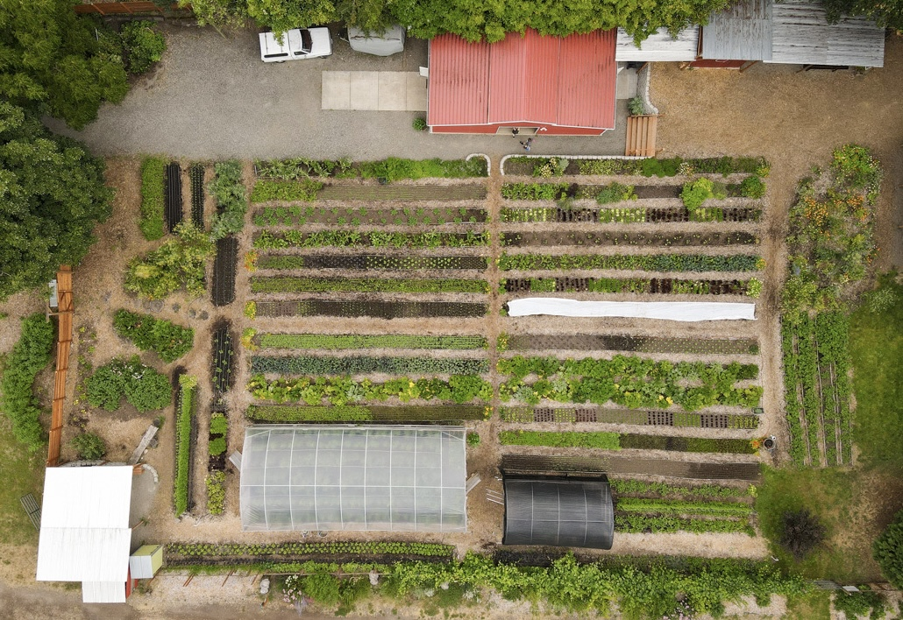
Urban agriculture is necessary for resilient local food systems

Slide 7
Resilient urban food systems
Diversification
Ecosystem services
Community development
Economic development
Proximity
Innovation

Slide 8

Scaling urban agriculture: USDA programs

Slide 9
Wrapping Up Program 1

Slide 10
Next steps
Program 1 vocabulary
Question for urban grower
Action Plan
Program 1 toolkit
Zoom session with urban grower
Enroll in Program 2

Slide 11
National Urban Agriculture Training
Program 1:
Introduction to Urban Agriculture
Course 1: Introduction
Course 2: Food System Fundamentals
Course 3: Recognizing Urban Agriculture
Course 4: Urban Agriculture Benefits
Course 5: Innovative Production
Course 6: Food System Resilience
Live Zoom session
Program 2:
Urban Agriculture Application
Course 7: Creating Conditions for Success
Course 8: Digging Deeper: Land Access
Course 9: Stakeholder Engagement
Course 10: USDA Application

