Slide 1


Bringing the Protective Factors Framework
to Life in Your Work
Introduction to the
Protective Factors Framework

Slide 2
Overview
Introduction to the PFF
Parental Resilience
Knowledge of Parenting
Concrete Connections in Times of Need
Social Connections
Social and Emotional Competencies
Questions
Notes:
Create a brief agenda for the entire training session. We recommend that you do not include times on the agenda, as doing so creates anxiety with the participants.

Slide 3

Goals of Strengthening Families Protective Factors Framework
Strengthened families
Optimal child development
Reduced likelihood of child abuse and neglect
Goals of the Introduction Course
List five protective factors that help keep families strong and prevent child abuse and neglect.
Identify multiple key strategies and concrete everyday actions that help families build those protective factors.
Understand what it means to work with families in a strength-based way.
Become familiar with the Strengthening Families Self-Assessment and explore ways that it can be used.
Notes:
Share the three goals of Strengthening Families Protective Factors Framework and the four goals of the Introduction Course.
This is a good time to share that the Strengthening Families™ Protective Factors Framework is not another program to add to an agency’s to-do list. It doesn’t come with detailed instructions for implementation, either. Rather, it is a different approach to working with families that can be interpreted and applied in a variety of settings. In most cases, Strengthening Families is implemented through a series of “small but significant changes” to daily practice, rather than large-scale program modifications.

Slide 4
The Protective Factors Framework in Different Fields
NO!
Is the Strengthening Families™ Protective Factors Framework only for Early Childhood?
This training and framework is designed to be used with anyone who works with children and families – in any field.
Center for the Study of Social Policy (CSSP) has developed materials to help explain why building protective factors in families should be important to multiple disciplines including:
Businesses
Educators
Primary health partners
Notes:
Many or most of you may be training early childhood professionals and staff. However, the Protective Factors Framework and this training is designed to be used with ANYONE who works with children and families – in any field. This training offers a mix of examples of from early care and education settings, child welfare settings, and family interactions. Consider providing your participants the “Using the Protective Factors in Different Fields” handout available in the participant packet.
Point out to participants that no matter where their work with children and families falls within the spectrum of various systems, it is important to view the building of protective factors in a holistic manner. Understanding concrete ways you can support the building of protective factors in your own field may be illuminated by the challenges experienced in other fields as well.
The Center for the Study of Social Policy (CSSP) has developed materials to help programs and states initiate discussions with new stakeholders around how Strengthening Families relates to their work. The idea is to bring the message to new groups of professionals who interact with children and families on a regular basis: Business, Educators & Primary Health Partners. These handouts are available through the Center for the Study of Social Policy (CSSP) website.

Slide 5

Using a different lens – “Human Walking Program”
Notes:
Video: “The Human Walking Program”
Time: 5 minutes
Materials: Play the YouTube video, “The Human Walking Program”
At the top of the slide you see the phrase “Using a Different Lens”
Synopsis: The Lost Dogs Home – Human Walking Program: An adoption campaign where the dogs did the rescuing
In one Australian city, their version of the Humane Society – The Lost Dog’s Home – developed a campaign that encouraged city workers to get out from behind their desks and be “rescued” by their four-legged friends, the adoptable dogs from the local shelter. In this way, workers can get out of their offices, benefit from a short walk and make a new best friend. The hope was that the two-legged participants would become so enamored of the experience that they would eventually decide to adopt their companion. In this framing of the message to give shelter dogs a new home, it is the dogs that are doing the rescuing. This helped change the way that people viewed shelter dogs. Over 5,000 office workers were “rescued” and every single dog was adopted.
Rationale: This story should start participants thinking about how we can make simple changes that become significant.
Discussion:
What is your reaction to this video and what do you think it has to do with “Using a Different Lens?”
This video shows:
Turning a need into a strength
Turning a burden into a benefit
They re-framed it and re-named it!

Slide 6

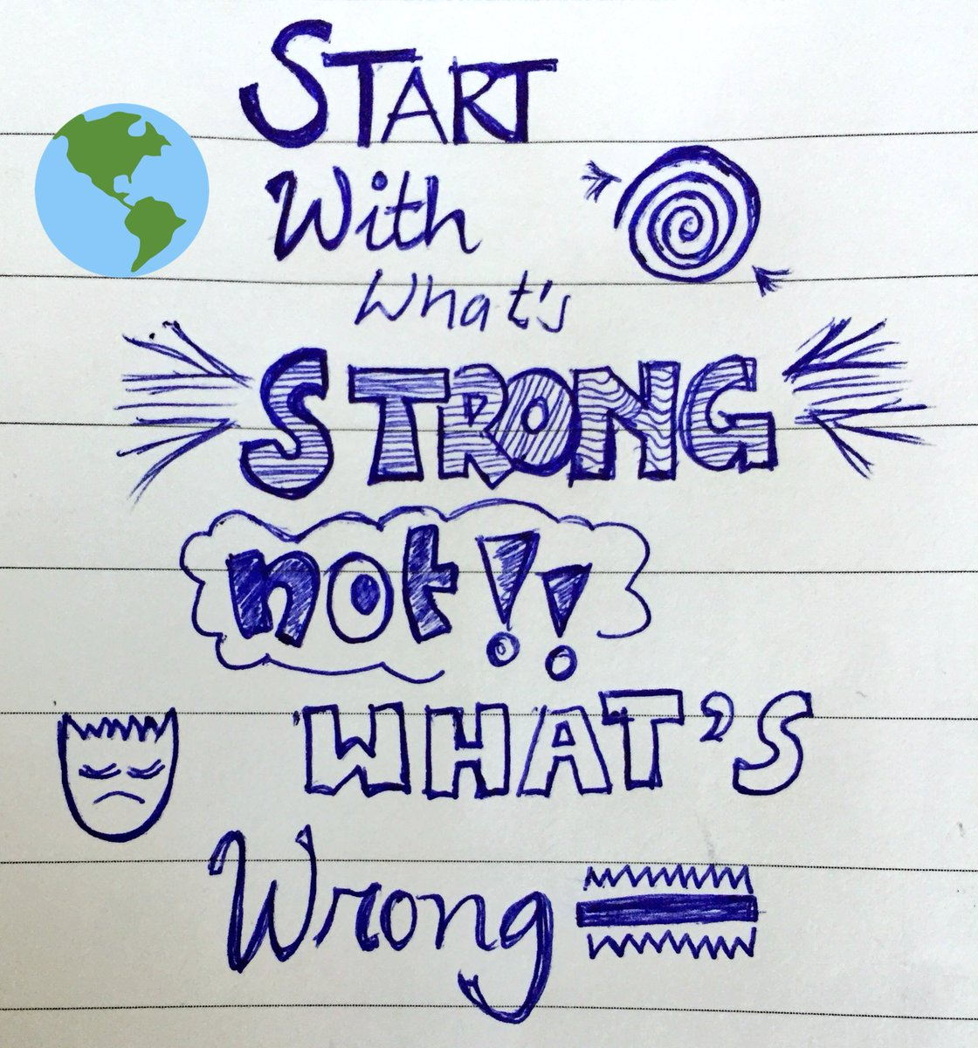
Strength-Based Theory:
Looking at Families Through a Different Lens
Focus on what’s strong, not what’s wrong!
Notes:
Discussion on Strength-Based Theory
The lens we want you to look at families through is a Strength-Based Lens.
*CLICK* We want you to focus on what is STRONG in families, and not what’s WRONG with families.
Occasionally, you will get some push-back from participants that say – “I have to focus on what is wrong with my families – that is my job!”
Strength-Based Theory does not mean that we ignore weaknesses and problems.
Finding solutions to problems and addressing the risk factors in families is certainly important! It prevents failure and helps families SURVIVE.
HOWEVER, if we always singularly focus on FIXING – families will always be in survival mode.
*CLICK* If we want families to THRIVE – We must concentrate on what families are doing well and build on that. We must LOOK AT FAMILIES THROUGH A DIFFERENT LENS and focus on what is STRONG so that they can THRIVE!
This work is not linear – meaning we must help families SURVIVE before we help them THRIVE. The Strengthening Families Protective Factors Framework outlines strategies that help us address risk factors while all the time building PROTECTIVE FACTORS.
“What will happen when we think about what is RIGHT with people rather than fixating on what is WRONG with them?” This quote is from Donald O. Clifton.

Slide 7
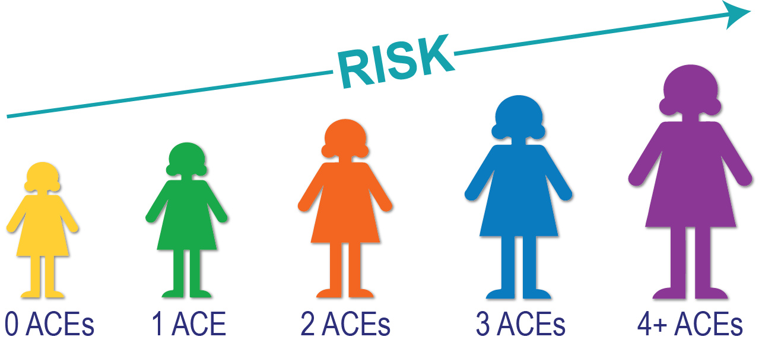
What Impact Do ACEs Have?
As the Number of ACEs Increases,
So Does the Risk for Negative Health Outcomes

Slide 8
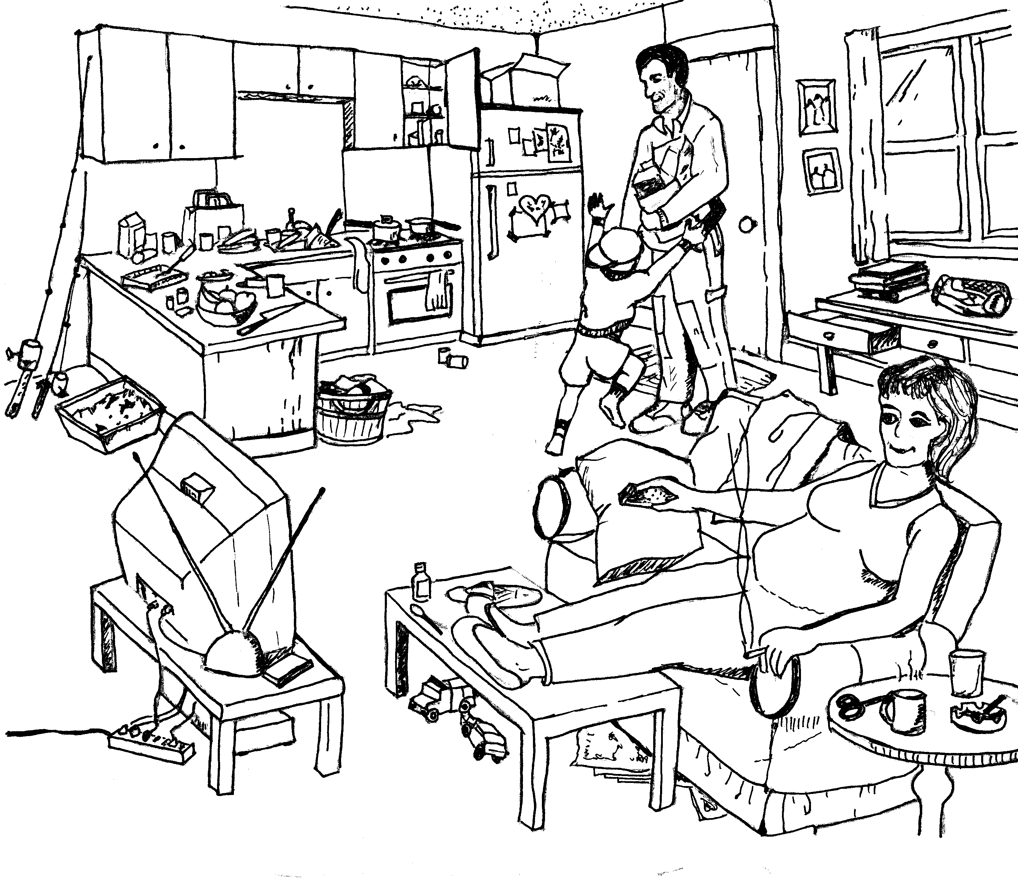
Changing Our Focus
Notes:
Activity: Changing Our Focus
Time: 10 minutes
Materials: The “Risk/Protective Factors Sketch” handout in the participant packet available for download at the Trainer Support Site link. Pencils to circle items.
Give participants a copy of the risk/protective factors sketch. Spend some time asking them to circle the risk factors they see and talk about them as a group. Once that discussion has taken place, remind them about “looking at families through a different lens” and ask them to talk about what is good in the picture.
Rationale: This activity is intended to show – rather clearly – how much we focus on risk factors and how much different it feels to look for positives. It is also a segue into the next topic where we define some of those “good things” they see as protective factors.
You may adapt this activity as long as you reach the same rationale.

Slide 9

Resilient Typewriter Artist
Notes:
Video: “Resilient Typewriter Artist”
Time: 5 Minutes
Materials: Play the video, “Resilient Typewriter Artist”
Synopsis: Paul Smith creates intricate works of art with only 10 keys on a manual typewriter, although he is severely limited by his physical disorder – cerebral palsy. Paul and those around him focus on what he can do, as opposed to what he cannot do. Many people respond when they see Paul’s art – “I could never do that!” To that, Paul responds, “What can you do?”
Rationale: This video prompts participants to consider “what is strong, not what is wrong.”

Slide 10
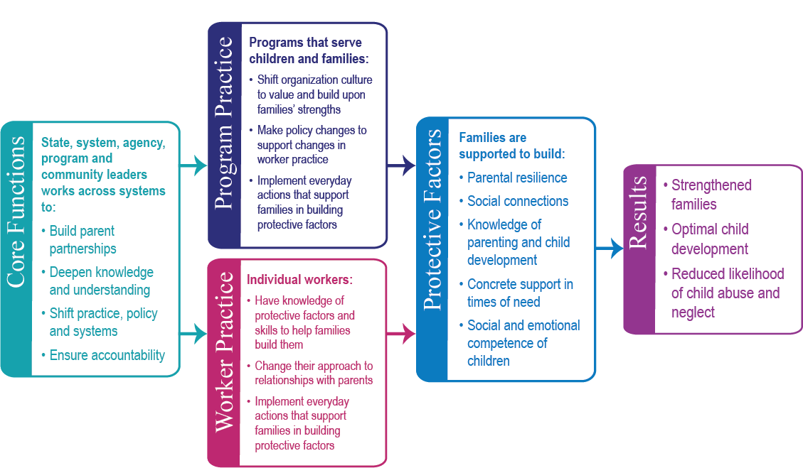
Pathway to Improved Outcomes for Children and Families
Strengthening Families™
Protective Factors Framework Logic Model
Notes:
Introducing the Pathway to Improved Outcomes for Children and Families
This is a good opportunity to remind the participants of the three goals of the framework and introduce the five Protective Factors.
A protective factor is a characteristic that makes a parent, child or family more likely to thrive and less likely to experience a negative outcome. A protective factor is like the flip side of a risk factor. You can also think of protective factors as what help children and families thrive despite whatever risk factors they might face.
Discuss the Program Practice, Worker Practice and Core Functions.

Slide 11
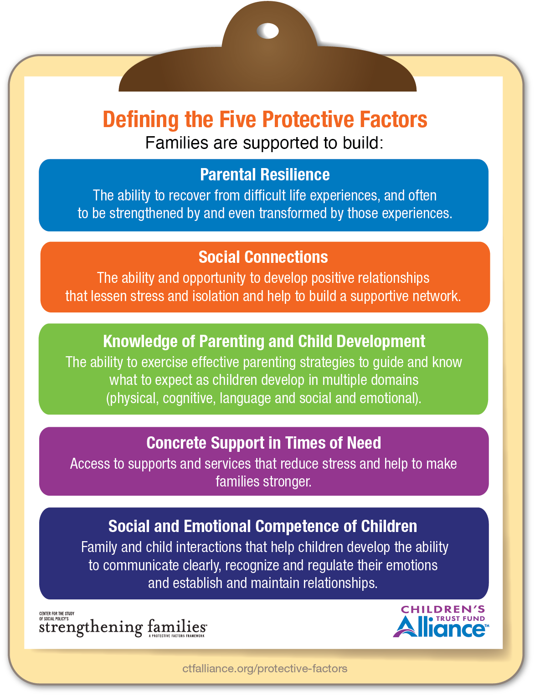
Defining the Five Protective Factors ctfalliance.org/protective-factors
Notes:
ctfalliance.org/protective-factors
The five Strengthening Families protective factors were chosen on the basis of extensive research about children and families. They are not the only protective factors that keep families strong. They were selected because they can be built through interaction with the people and systems that families encounter in their day-to-day lives. In Strengthening Families, all families are included, because all families need some support in building the following protective factors:
Parental resilience – The ability to recover from difficult life experiences, and often to be strengthened by and even transformed by those experiences.
Social connections – Positive relationships that provide emotional, informational, instrumental and spiritual support.
Knowledge of parenting and child development – Understanding child development and parenting strategies that support physical, cognitive, language, social and emotional development.
Concrete support in times of need – Access to concrete support and services that address a family’s needs and help minimize stress caused by challenges.
Social and emotional competence of children – Family and child interactions that help children develop the ability to communicate clearly, recognize and regulate their emotions and establish and maintain relationships.

Slide 12
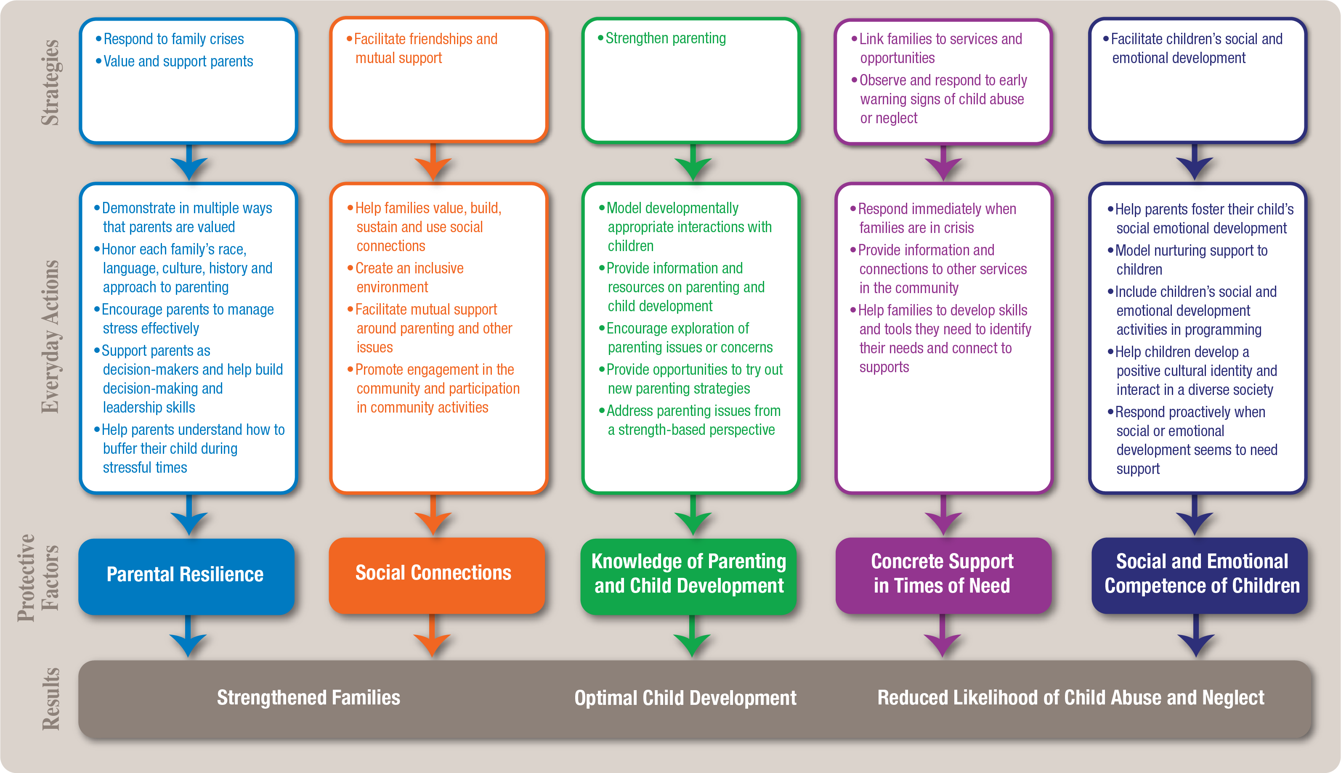
Strategies and Everyday Actions that Help Build Protective Factors
Notes:
The Strengthening Families protective factors were chosen on the basis of extensive research about children and families. They are not the only protective factors that keep families strong. They were selected because they can be built through interaction with the people and systems that families encounter in their day-to-day lives.
Strategies and Everyday Actions that help build Protective Factors
The word strategy is defined as “a well thought out plan.” The Strengthening Families approach is a prime example of a well thought out plan. The originators at CSSP asked the question: “How do we build these protective factors into our work and into the families we serve?” Their solution is explained in the logic model they created. In addition, CSSP has identified “everyday actions” that help build these protective factors.
How do we build these protective factors into our work and support the families we work with every day to intentionally build them? It is likely that you are already implementing many of these strategies and everyday actions in your current work. Perhaps you simply need to be more intentional as you plan and prioritize your time and other resources.
Small but Significant Changes
3 Results
5 Protective Factors
7 Strategies
MANY Everyday Actions
The Protective Factors Framework is not like most approaches to child abuse and neglect prevention. Often, programs target specific families to participate because of the risk factors they face. In Strengthening Families, all families are included, because all families need some support in building protective factors. Those families who need intensive support are more likely to be identified and to accept help (such as referrals to other programs and services) when we begin by being open and reaching out to all families.

Slide 13



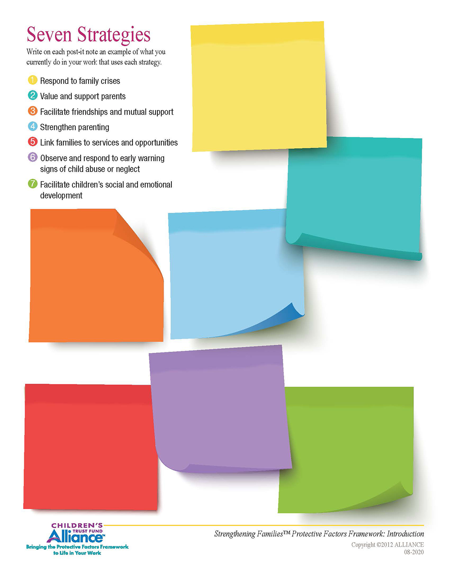




Seven Strategies
Value and Support Parents
Respond to Family Crises
Facilitate Friendships and Mutual Support
Facilitate Children’s Social and Emotional Development
The Protective Factors in Our Work
How are you already doing this?
Observe and Respond to Early Warning Signs of Child Abuse or Neglect
Strengthen Parenting
Link Families to Services and Opportunities
Notes:
Activity: The Protective Factors in Our Work
Time: 30 minutes
Materials: chart paper, markers, small packets of sticky notes (enough for all your participants)
Face-to-face: Place the seven strategies around the room on poster-size static paper – one strategy per sheet. All the participants have a pack of sticky notes. Instructions are to place sticky note under each strategy, giving an example of something the participant is doing to promote that strategy. Each of the seven sheets should have as many post-it notes on it as there are participants
Virtual: Provide the “Seven Strategies” handout, which can be downloaded from the INT Toolbox section of the Trainer Support Site. Each participant will write down one example for each strategy. If you have time, ask for volunteers to share an example for each strategy.
Rationale: This exercise makes the strategies personal. People realize that we are not asking them to do something unfamiliar or that they must learn. These strategies are things most of us are doing already but perhaps now need to be done with greater intentionality so that they become everyday actions.
You are already doing this work! The Protective Factors Framework is not a curriculum or a program – it is an approach!

Slide 14


Understanding and Putting Aside Our Biases
Notes:
One of the challenges in using a strength-based approach to families is that it forces us to come face-to-face with our own perspectives about families. Sometimes, our own experiences and values may keep us from recognizing and appreciating genuine strengths in families that are different than our own.
Here is a very general example of what that might look like: If your background and experiences have caused you to have reservations about childbearing outside of marriage or even divorce – it may be difficult for you to see the strengths in families headed by single parents. Unless you recognize that bias and find a way to set it aside, you will likely struggle to work with single parents without judgement and in a genuinely positive way. Parents will very likely pick up on your disapproval, whether they understand the reason behind it or not.
One helpful strategy for identifying family strengths is to look at the family from the child’s point of view. Is the child experiencing nurturing, comfort, and love? Are the child’s needs being met? Is the child getting guidance to grow and learn in a positive way? Often, the answers to these questions will help you recognize whether your concerns about a family are warranted – or whether they could be based on biases that have little to do with how well a family can raise and protect children.
A great quote from one the participants from a previous training is “NAME it, CLAIM it, BUT MOST IMPORTANTLY TAME IT!” This means recognize your bias, there is likely a name for it, claim it – understand it and where it comes from. TAME IT – consciously change your lens when looking at this family – what is the child’s point of view. Tame it also means beyond changing your lens – change your conversation – what we say about families to other people and other families is contagious.

Slide 15
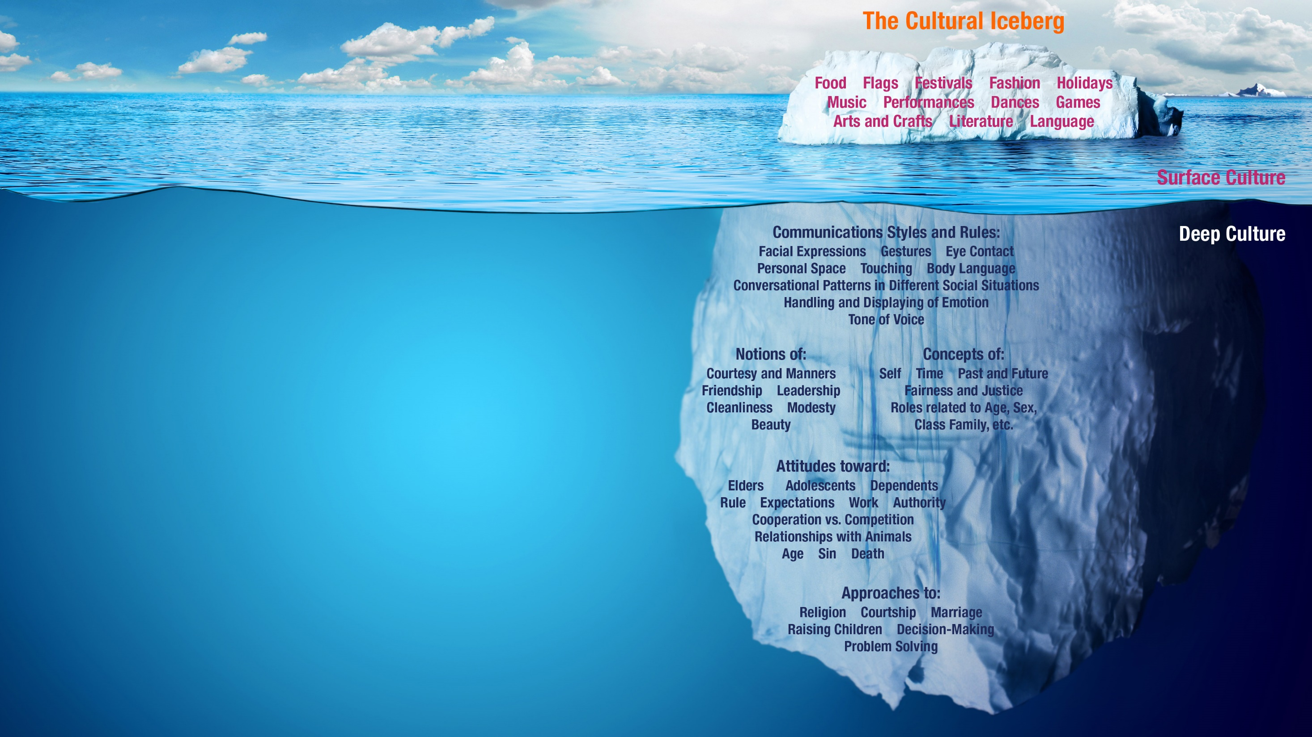
Culture and Family Strengths
As we consider each protective factor, ask yourself these three questions:
How does culture impact this protective factor in a family?
How does your own culture shape how you feel, how you react and what you say or think?
How does culture impact what and how you are teaching?
Notes:
Culture and Family Strengths
Discuss the difference between surface culture and deep culture.
Working across cultures can sometimes make it difficult to appreciate another family’s strengths. We are often not even aware of the way culture influences our beliefs about children and their care. Our goals and expectations for our children come, in large part, from our culture’s beliefs, values, and assumptions. This includes how we express love and nurturing as well as how we maintain discipline and set limits for children. Our parenting practices guide children into developing the qualities and behaviors that are valued in our culture.
We interpret behavior and interactions based in part on our own culture. When a family’s culture is similar to ours, these interpretations may be accurate. When a family’s culture is different from ours, we may interpret a message or behavior differently than the family intended.
Example: Independence vs. Interdependence
For example, the majority culture in the United States values independence and self-sufficiency very highly, and many parents encourage their children to increase their independence as soon as they are able. We can see this in the push for young toddlers to feed themselves, for example, and in parents’ encouragement of independent exploration and rejection of “clingy” behavior. However, many other cultures value interdependence. Parents in these cultures may discourage toddlers’ attempts at self-feeding and encourage more physical closeness and dependence in their young children.
Depending on your own perspective and cultural backgrounds, one of these sets of behaviors may seem different and even “wrong” to you at first encounter. You may feel that some parents are stifling their children’s development – if your culture values independence above interdependence. If you’re coming from a value of interdependence, you may feel that some parents are pushing their children away and forcing them to grow up too quickly. It is important to remember that each approach reflects parents’ love of their children and their attempts to nurture the values they hold dear.
Focus on Intent
When it comes to strength-based work with families, it is critical to take a family’s culture into account as you observe their family situation and interactions. By being aware of the influence your own culture has on your reactions, and trying to see the intent behind another person’s decisions and actions, you may be more able to identify a family’s strengths and work with them in a positive way.

Slide 16
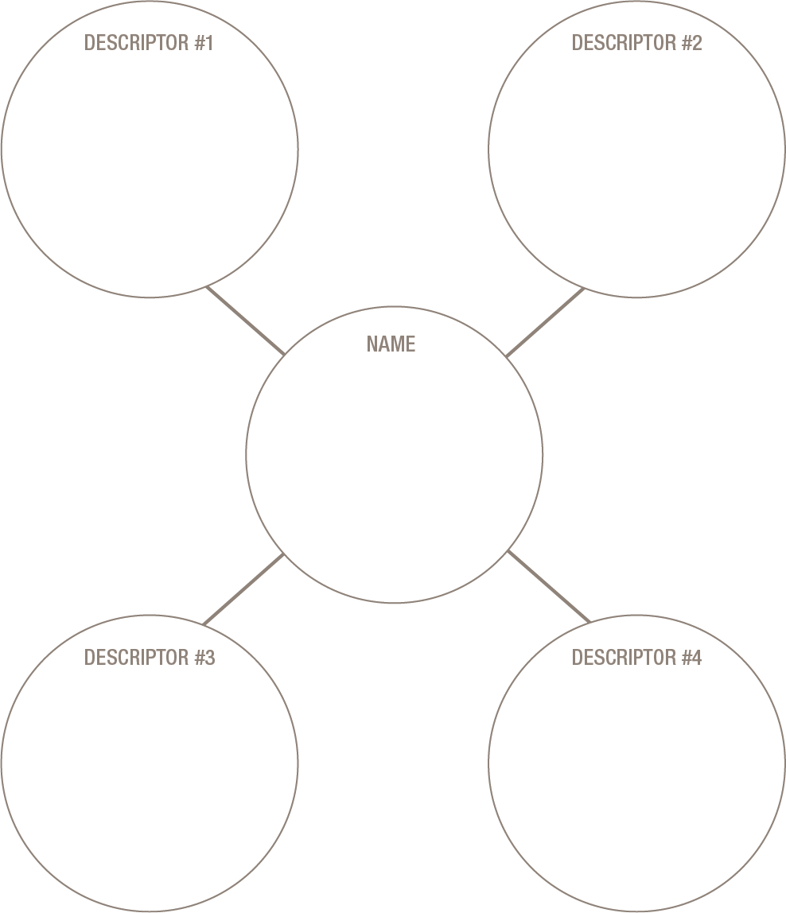
Circles of My Multicultural Self
Share a story about a time when you were especially proud to identify with one of the descriptors you used.
Share a story about a time it was especially painful to be identified with one of your identifiers or descriptors.
Name a stereotype associated with one of the groups with which you identified that is not consistent with who you are. Fill in the following sentence:
  I am (a/an) ______ but I am NOT (a/an) ______.
Notes:
Activity: Circles of My Multicultural Self
Time: 30 minutes
Materials: The “Circles of My Multicultural Self” handout in participant packet, and for download at the Trainer Support Site.
This activity highlights the multiple dimensions of who we are. It addresses the relationships between our desires to self-define our identities and how society seems to label us regardless of how we define ourselves.
Each participant receives a handout with the circle diagram on it. They are asked to place their name in the center circle. Then, to write an important aspect of their identity in each of the satellite circles – an identifier or descriptor they feel is important in defining who they are.
Once they complete the circles, they are asked to do the following with an elbow partner:
Share a story about a time you were especially proud to identify with one of the descriptors you used above.
Share a story about a time it was especially painful to be identified with one of your identifiers or descriptors.
Next, name a stereotype associated with one of the groups with which you identify that is not consistent with who you are.
Fill in the following sentence:
I am (a/an) _____________________ but I am
NOT (a/an) _____________________.
(So if one of my identifiers was “Dreamer” and I thought a stereotype was that all Dreamers are unrealistic, my sentence would be: “I am a dreamer, but I am NOT unrealistic.”)
Virtual: Instead of an elbow partner, put participants randomly in breakout rooms of two.
Rationale: This exercise is very effective in encouraging participants to think about the stereotypes people have and to make a conscious effort to think more deeply about how we can eventually eliminate them.
Trainer’s Tip: As with most activities, it can be especially effective if you model the “Circles of My Multicultural Self” exercise. If you are willing to share your own experiences, participants are more likely to feel open to share their own. It is crucial, especially for the final part of the activity when participants are sharing their stereotypes, to allow for silences. People will be hesitant to share initially, but once the ball starts rolling, the activity carries a lot of energy. Allow time at the end for participants to talk more about whatever stereotype they shared.

Slide 17

Notes:
Building Adult Capabilities to Improve Child Outcomes – A Theory of Change
Center on the Developing Child at Harvard University

