Slide 1




Community Resilience Builder Program
Session 2

Slide 2
Today’s OBJECTIVES
We will grow your understanding of the mechanisms that promote resilience in individuals
You will gain insights into the factors that foster well-being in individuals
You will be able to connect the science of resilience with the concepts that make up healthy and regenerative communities

Slide 3
Today’s Agenda
Morning
Warming up the topic through reflection
The Biology of Stress and Well-being
Afternoon
The Science of Resilience with Anastasia
Including concepts of disaster mental health

Slide 4

Community Guideline

Slide 5

Resilient Communities that Regenerate well-being are built in our imagination first
Reflect on a belief and turn it around

Slide 6
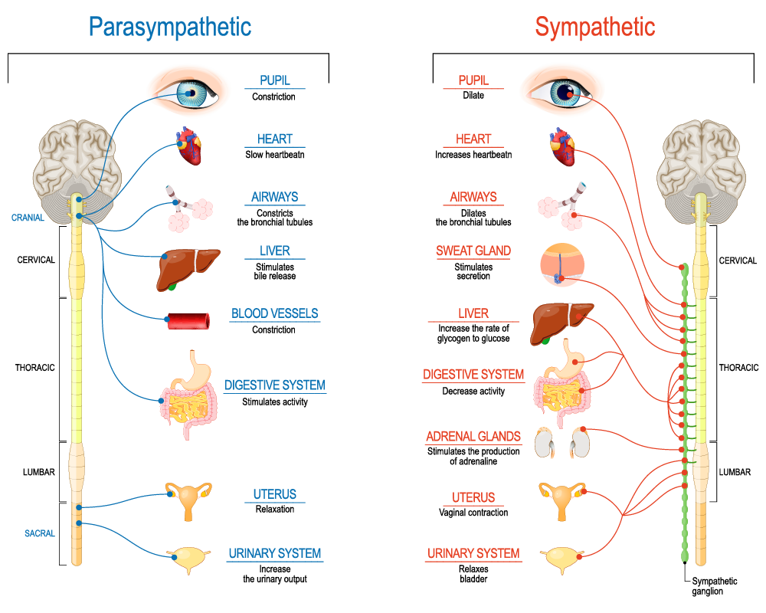
Parasympathetic
Typical Functioning | Rest & Digest
Sympathetic
Stress Response | Fight – Flight – Freeze
Two parallel systems…
Notes:
Facilitator:
(Goal is to create a brief understanding without becoming too technical.)
There are two parts to our autonomic nervous system – the part of our nervous system that is considered to be outside of our voluntary control. They are the parasympathetic and sympathetic nervous systems. The sympathetic nervous system is involved in preparing the body for stress-related activities; the parasympathetic nervous system is associated with returning the body to routine, day-to-day operations. The two systems have complementary functions, operating in tandem to maintain the body’s homeostasis – or equilibrium. The sympathetic nervous system is activated when we are faced with stressful or high-arousal situations. Once the threat has been resolved, the parasympathetic nervous system takes over and returns bodily functions to a relaxed state.
Responses in Each System
Sympathetic: Acceleration (gas pedal)
Fight/Flight
Breathing rapid/shallow
Increased
- heart rate
- blood pressure
- blood sugar
Digestion off-line
Alert level is high
Parasympathetic – Deceleration (brakes)
Rest/Digest
Breathing calm/even
Resting heart rate
Normal:
- blood pressure
- blood sugar and
Digestion on-line
Alert level is low

Slide 7

Timeline Activity
Notes:
Facilitator:
We can’t remove exposure to traumatic experiences, but we can shift the response to exposure in self, others and community/organizations through trauma responsive practices. With knowledge comes opportunities for resilience.
When we think about trauma, it’s useful to remember the three E’s:
Emotional or Psychological trauma results from an Event, series of events such as accidents, disasters rape or abuse, or set of circumstances that could include living with severe poverty or in a chronically stressful home.
The event is Experienced by an individual as physically or emotionally harmful, threatening or life altering, outside of their control or overwhelming their ability to cope and has lasting Effects on a person’s mental, physical, social, emotional, or spiritual well-being.
The person’s subjective experience of the event or events is the critical feature of emotional trauma. Two people exposed to the same event, events or set of circumstances can have very different outcomes depending on complex relationships between the individual and their environment, past experiences, cultural and gender identities, developmental stage and protective factors.
Emphasize that the Experience represents our opportunity to BUFFER. By listening to the whole story of what happened to the individual, we can better help people cope with the short- and long-term impact of trauma.

Slide 8


WHAT IS RESILIENCE?
STABILITY
GROWTH
DECAY
REORGANIZATION
RENEWAL

Slide 9

WHAT IS TRAUMA?
The 3 Es of Traumatic Response
Event: an exposure to a single or on-going event that heightens the human stress response
Experience: an event is experienced as a threat to our physical and/or psychological safety
Effects: impacts one or more domains of wellness: mental, physical, social, emotional, or spiritual
Notes:
Facilitator:
We can’t remove exposure to traumatic experiences, but we can shift the response to exposure in self, others and community/organizations through trauma responsive practices. With knowledge comes opportunities for resilience.
When we think about trauma, it’s useful to remember the three E’s:
Emotional or Psychological trauma results from an Event, series of events such as accidents, disasters rape or abuse, or set of circumstances that could include living with severe poverty or in a chronically stressful home.
The event is Experienced by an individual as physically or emotionally harmful, threatening or life altering, outside of their control or overwhelming their ability to cope and has lasting Effects on a person’s mental, physical, social, emotional, or spiritual well-being.
The person’s subjective experience of the event or events is the critical feature of emotional trauma. Two people exposed to the same event, events or set of circumstances can have very different outcomes depending on complex relationships between the individual and their environment, past experiences, cultural and gender identities, developmental stage and protective factors.
Emphasize that the Experience represents our opportunity to BUFFER. By listening to the whole story of what happened to the individual, we can better help people cope with the short- and long-term impact of trauma.

Slide 10
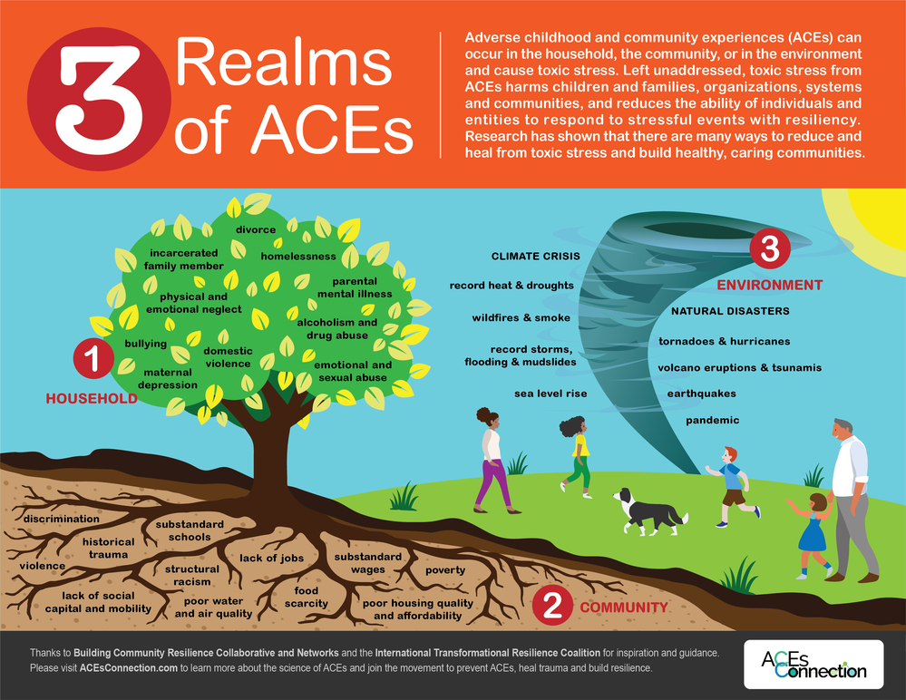

Slide 11
Types of trauma - Key Vocab
Acute Situational Trauma
Toxic Chronic Stress
Complex Trauma
Historical Trauma
Intergenerational Trauma
Racism

Slide 12
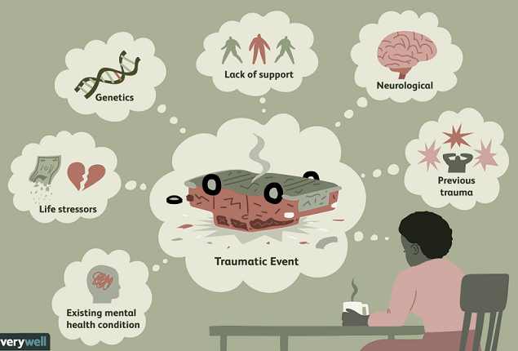
Acute-Situational Trauma…
What is it?
Single Event or fairly constrained in time
Examples/Causes:
Accidents, Assaults, Rape, Exposure to War, Natural Disasters, Mass Disaster Events, Intrusive Medical Procedures, Witnessing Violence
Symptoms:
Re-experiencing/Intrusive Thoughts, Avoidance, Hypervigilance/Anxiety, Changes in Mood and Thinking
Notes:
Facilitator:
Review slide
Acute Trauma or Situational Trauma: results from exposure to a single overwhelming event. For example, a person exposed to a serious accident, a natural disaster, or a single instance of sexual abuse. These kinds of experiences are often associated with posttraumatic stress disorder. Common symptoms of PTSD include: re-experiencing the event or intrusive thoughts about the event, avoidance of people places and things that remind the person of the event, hypervigilance, anxiety or a heightened startle response and changes in mood (irritability) and thinking (thoughts about the self such as self-loathing or self-blame or about the world being unsafe and unfair).

Slide 13
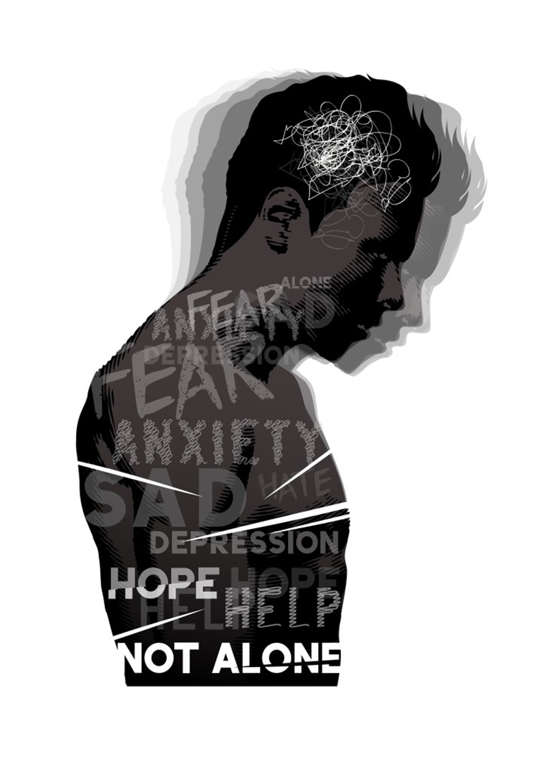
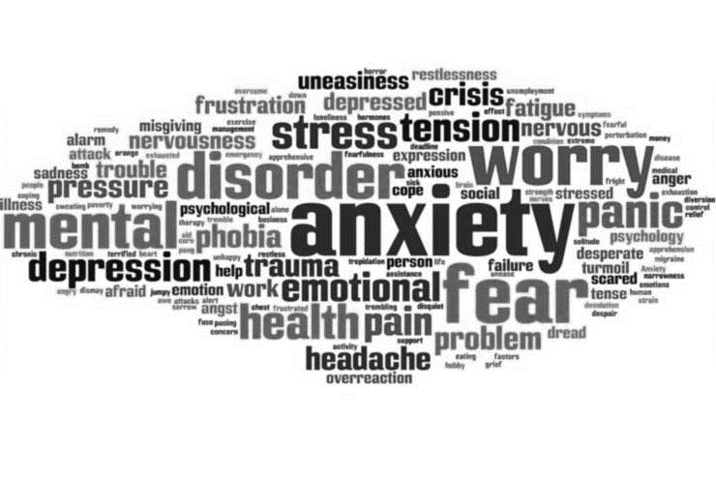
Toxic | Chronic stress…
What is it?
Exposure to stressful life events over a prolonged period of time
Examples:
Chronic Poverty, Community Violence, Parental Substance Use/Mental Illness, Harsh/Abusive Parenting
Symptoms/Outcomes:
Difficulties regulating emotions, Irritability, Fatigue, Headaches, Sleep Problems, Digestion Problems, Difficulties with Appetite, Long-term Physiological ​
Notes:
Facilitator:
Review slide
Recall the ACEs study that highlighted many experiences of what we term toxic stress.
Chronic stress: can result from the adverse experiences in childhood, like ACEs, that threaten childhood development. This kind of stress exposure is associated with physical and behavioral health problems.

Slide 14
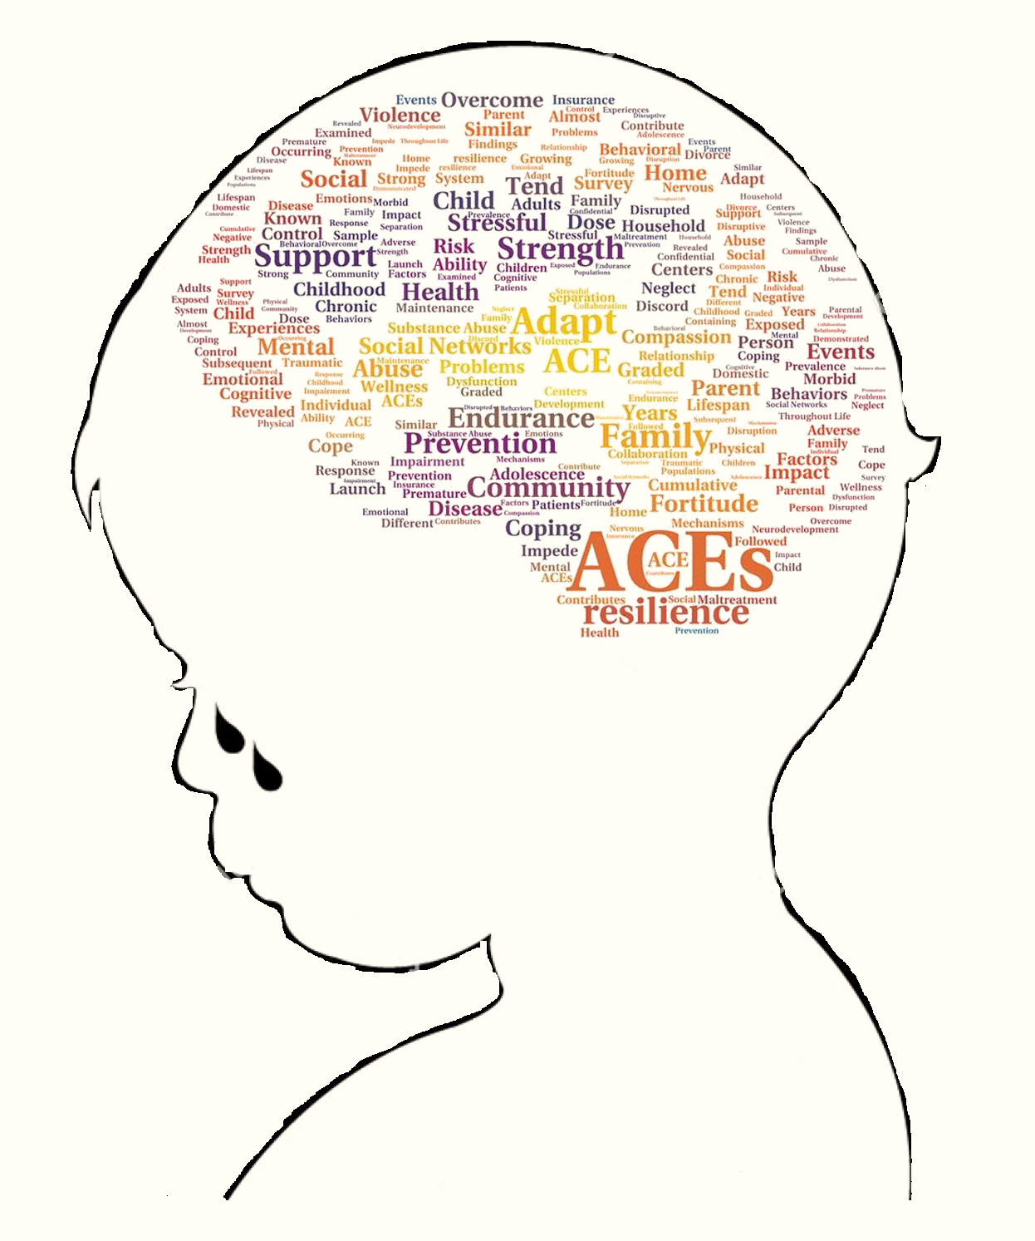
complex Trauma…
What is it?
Refers to both children’s exposure to multiple traumatic events (in the absence of nurturing caregiving) and the impact of that exposure ​
*Can occur across the lifespan
Might be the result of…
Severe and Chronic Neglect or Emotional Abuse, Repeated Physical or Sexual Abuse/Incest, Caregiver Substance Abuse or Mental Illness
Effects…
Behavioral Health Problems, Difficulties with Functioning,
Long-term Health Problems, Developmental Challenges
*May vary based on age & developmental level
Notes:
Facilitator:
Review slide
Complex Trauma: can result from exposure to toxic stress or prolonged abuse and neglect. A major difference between chronic stress and complex trauma is that complex trauma entails exposure to trauma in the absence of stable and nurturing caregiving. Indeed the abuse often comes at the hands of caretakers. Complex trauma can lead to profound disruptions of social, emotional and cognitive development resulting from exposure to toxic stress This set of categories is offered as a way of thinking about the effects of different forms of traumatic events or adversities.

Slide 15

historical Trauma…
What is it?
Multigenerational Trauma experienced by a specific cultural, racial or ethnic group related to major events and oppressive acts of human design
Results from…
Slavery, The Holocaust, Native American Genocide
Effects May Include…
Low Self-Esteem, Internalized Racism/Oppression, Behavioral Health Problems, Health Problems, Historical Trauma Response (e.g. Compensatory Fantasies, Identification with Ancestral Pain, Intrusive Historical Imagery)
Notes:
Facilitator:
Review slide
Historical Trauma: refers to the cumulative trauma over both the life span and across generations that results from massive catastrophic events of human design. Historical trauma includes acts of genocide, the effects of colonization, tribalism, dispossession or dislocation. The roots of historical trauma is racism, discrimination, xenophobia.

Slide 16
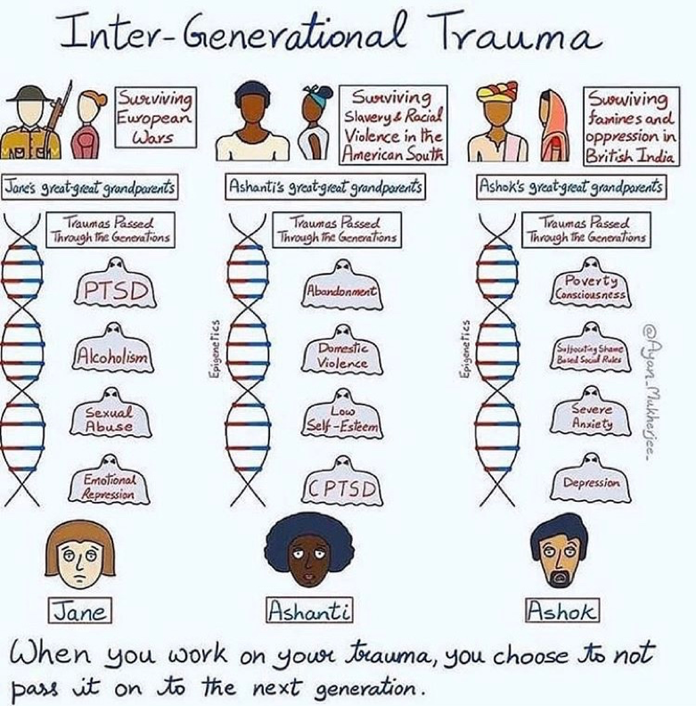
intergenerational Trauma…
What is it?
Multigenerational Trauma [untreated] that can be transferred generation to generation and caregiver to child through a complex psychological and physiological mechanisms within the family
May be a Result Of…
Chronic Neglect, Physical Abuse, Poor Attachment, Inconsistent Caretaking, Epigenetics, Systemic Disparities
Effects may include…
Anxiety, Poor Impulse Control, Developmental Delays, Difficulties Expressing Emotions, Difficulties Forming Relationships, Interpersonal Problems​
Notes:
Facilitator:
Review slide
Intergenerational trauma – refers to trauma that is transmitted from one generation to the next via complex genetic, psychological, biological and social factors. This can occur when a parent who has been exposed to trauma or ACEs has difficulty attaching to their child, thus creating the possibility for the child’s exposure to ACEs or traumatic events.
These forms of trauma can overlap. For example, intergenerational can overlap significantly with both historical trauma and complex trauma.

Slide 17

racism…
What is it?
A complex interplay of systemic oppression, acute acts of bigotry and violence, microaggressions, and disparities
Results From…
Violence and Oppression based on the faulty belief of racial superiority
Effects…
are both Internal and External and span the continuum of other forms of trauma
Notes:
Facilitator:
Review slide
Lastly, there’s the trauma of racism and discrimination. Due to the complex nature of the trauma of racism, we are going to explore this more deeply.
Discussing trauma in all its forms means including a very clear understanding of racism as a chronic stressor that can lead to many of the same long-term health outcomes we see with ACEs. Research demonstrates that exposure to racism can have many of the kinds of effects (e.g. long-term health problems and mental health challenges) that the ACEs demonstrated.
While original ACEs study did not include exposure to racism as a childhood adversity, but it has been added to the list of ACEs.

Slide 18

Trauma of racism & discrimination…
  Racial Trauma
  is the psychological and emotional injury of an individual or group caused by the act or repetition of discriminatory or oppressive practices that cause:
Physical Harm
EXCLUSION
Barriers to social or economic opportunities
Notes:
Facilitator:
Review slide
Racial trauma can be the result of a single incident or repetitive incidents over time. This demonstrates how racism and discrimination can be both an acute trauma and example of toxic stress. Acute, because of the effects of racism in the moment it occurs, and an example of toxic stress brought on by the cumulative effects of many instances of racism over time. These repetitive acts accumulate to have a direct affect on physical and mental health.
Studies have demonstrated that there is a relationship between Racial Trauma and diagnosis of:
Heart Disease
Hypertension
Post Traumatic Stress Syndrome (PTSD)

Slide 19
Understanding racial Trauma
Racial Trauma is distinct from other traumas because… …It is rooted in the history of racism.
The Event(s) that cause the trauma are enacted by the oppressive force of a dominant racial group on a subordinate racial group.
Notes:
Facilitator:
Review slide and further discuss the below definitions
Racism - The marginalization and/or oppression of people of color based on a socially constructed racial hierarchy that privileges white people. The term Privilege within this definition can trip us up. Within this context, privilege refers to the relative power, autonomy and ease of access that a population has related to their race. It does not mean that white individuals are immune for trauma, poverty, challenges. It simply means that race is not a contributing factor in these challenges.
Systemic Racism – Read definition. Add “It is grounded in the history of our laws and institutions which were created on a foundation of white supremacy*, Exists in institutions and policies that advantage white people and disadvantage people of color and includes interpersonal communication and behavior (e.g., slurs, bullying, offensive language) that maintains and supports systemic inequities and systemic racism.
Implicit Bias – Can also be referred to as Unconscious Bias. Perceptions.org defines it this way: Thoughts and feelings are “implicit” if we are unaware of them or mistaken about their nature. We have a bias when, rather than being neutral, we have a preference for (or aversion to) a person or group of people. Thus, we use the term “implicit bias” to describe when we have attitudes towards people or associate stereotypes with them without our conscious knowledge.
Implicit bias refers to mental models, constructs or stereotypes that are formed as a function of how our brains work, and how culture influences us. Based on all the “data” we take in our unconscious brains create short-hand imperfect snapshots that can drive our words, actions, behaviors and beliefs. Everyone has them, does not make us bad people. It makes us human. The challenge and responsibility is to make the unconscious conscious and live into our values and conscious beliefs.

Slide 20
Features oF racial Trauma…
Vicarious racial trauma | “witnessing” others being harmed
Microaggressions Micro-assaults Micro-insults Micro-invalidations | Daily behavioral or environmental indignities that promote stigma and marginalization
Chronic stress | The impact of marginalization (i.e., poverty, blocked opportunity, miseducation, poor housing, criminalization)
Collective experiencing | …of racism and discrimination (e.g., history of slavery, genocide, internment, misogyny)
Generational transmission | …of racism and discrimination – the vicious cycle that results from all of the above.
Notes:
Facilitator:
Racial trauma has several notable elements that, when broken down, better supports our understanding of its impact.
Vicarious Racial Trauma - This can occur in everyday life in communities, schools, neighborhoods as we bear witness to racial injustice. It is significant to note the effects of prolonged exposure to racial trauma of others through the media (social media too), significantly impacts an individual’s experiencing of Vicarious Racial Trauma.
Microaggressions - Actions or words from a racial dominant group to a racially subordinate group that cause psychological or emotional harm. Microaggressions are subtle, indirect and can be intentional or unintentional but occur frequently.
Micro-assaults – Overt, intentional acts of discrimination (e.g. racial epithets, driving while Black)
Micro-insults – messages or actions that communicate disrespect of a group (e.g. “They’re rapists and drug dealers.”)
Micro-invalidations – comments or actions that dismisses the experience of a marginalized group (e.g. I don’t really see you as Black.)
Chronic Stress – This was covered in our understanding of Toxic Stress. It is the cumulative effects of trauma over time on our bodies.
Collective Experiencing – many members of the targeted group can be connected by this collective understanding of the events.
Generational Transmission – we touched on this earlier when we spoke of historical trauma. Can include acts of remembering (e.g. celebrating Juneteenth to mark the end of slavery) or attempted acts of forgetting (e.g. parents or grandparents being fearful of sharing about the experiences of the Holocaust or Japanese internment or Indian school experiences)

Slide 21
experiencing racism impacts personhood
Racial
Group
Personal Experience
Personal Experience as a Group Member
Individuals experience racism in multiple domains as:
A racial group as a function of history and systems
An Individual as a function of personal experience
As an individual that is part of a racial group
Notes:
Facilitator:
Racism impacts people across several domains of identity. These include one’s personal identity/experience, one’s experience as a member of a specific racial group, and one’s racial group itself. The frequency of racial assault, exposure to structural racism and being a part of a stigmatized group creates a complex interplay of determinants that make it difficult to create protective factors to minimize risk.
Personal Experience - Racial trauma occurs when an individual feels threatened or experiences a highly emotional reaction to a racialized interaction personally or between individuals or groups (Harrell 2000). When racial trauma is repetitive, the effects of exposure accumulate and there is a higher psychological and biological cost to an individual that may have lasting or permanent effects.
Personal Experience as a Group Member – Racial trauma occurs when one is within a group that feels threatened in reaction to any element (i.e. microaggressions, toxic/chronic stress, implicit bias) of racism or discrimination.
Racial Group - Experiences of racism provide an increased psychological and biological cost specifically because racial trauma is deeply rooted in history. Although many persons have had a personal experience with racial trauma, a personal experience is not a necessary component, as trauma is created from a real or perceived threat to self. Hence an individual can become traumatized by proxy as a member of a racial group.

Slide 22

Neurobiology…
How Stress Affects the Body and the Brain
Notes:
Facilitator:
Neurobiology is a scientific field in which researchers study the nervous system and brain function. Each region of the brain affects a different area of behavior and neurobiology aims to understand these behaviors and the connection to different parts of the brain. We’ll be looking at how stress affects the body & brain.

Slide 23
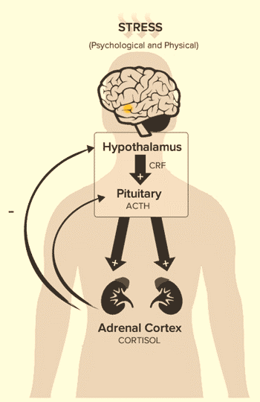


The human stress response…
Notes:
Facilitator:
The human stress response is commonly known as Fight, Flight, or Freeze. It is activated in response/reaction to a perceived threat from internal worry or external circumstance. This response actually corresponds to an area of our brain called the hypothalamus, which – when stimulated – initiates a sequence of nerve cell firing and chemical release that prepares our body for running or fighting.
Chemicals such as adrenaline, noradrenaline and cortisol are released into the blood stream.
Respiration increases, blood is forced away from digestion into our muscles and limbs, pupils dilate, awareness intensifies, sight sharpens, pain diminishes, and the immune system mobilizes with increased activation.
We are focused on short-term survival. This is the body’s stress response to immediate physical danger.
The problem is that prolonged and repeated activation of the human stress response can make it difficult for those exposed to be able to distinguish from real threats and perceived threats. And this excessive stress leads to disorders of the ANS (autonomic nervous system), muscle tension, headache, upset stomach, racing heartbeat, shallow breathing, anxiety or depression.

Slide 24
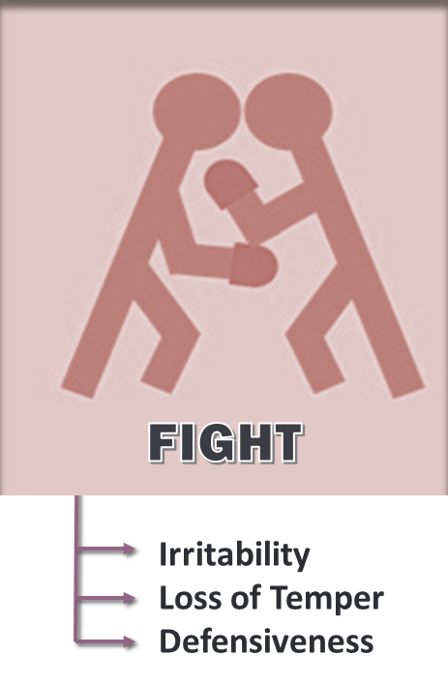
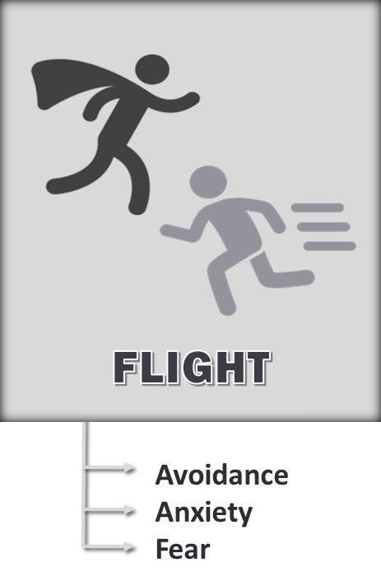
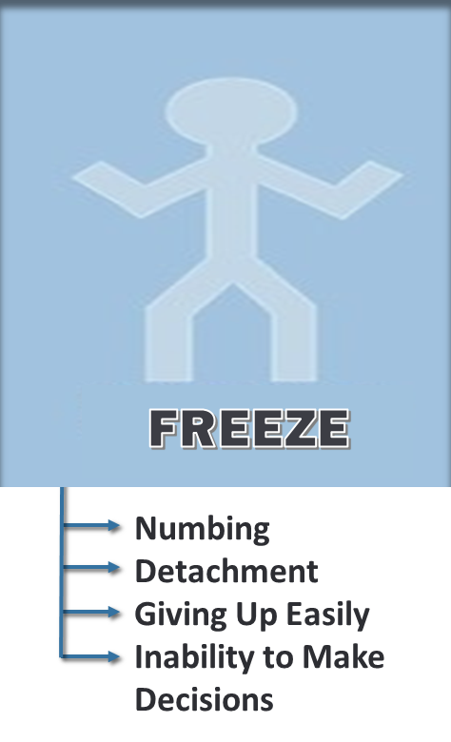
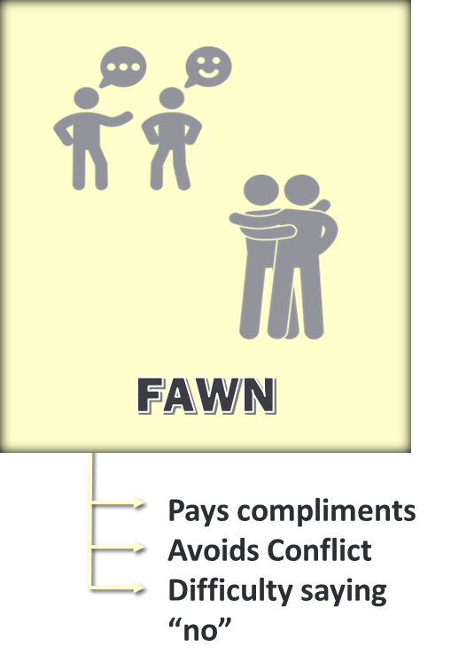
Fight-flight-freeze-fawn: how it shows up…
Notes:
Facilitator:
The Human Stress Response is normal and part of human evolution.
It’s our body’s primitive automated, inborn response that prepares the body to “fight” (face), “flee” (avoid), freeze, or fawn in response to perceived attack, harm or threat to our survival
This response is hardwired into our brains and represents a genetic wisdom designed to protect us from bodily harm.
Many of the major stressors today trigger full activation of the fight or flight response causing us to become aggressive and over-reactive (road rage)
Excessive exposure to trauma can lead a person to be perpetually in survival - fight, flight, freeze, or fawn mode. In everyday interactions:
Fight can appear as irritability, loss of temper, or defensiveness
Fight can appear as avoidance, withdrawal, anxiety and fear.
Freeze can appear as emotional numbness, detachment, giving up easily or inability to make decisions.
Fawn can appear as wanting to please people, overly apologetic, indecisive, or asking a lot of questions
DOES THIS SOUND LIKE PEOPLE YOU WORK WITH?
Fight Response:
Clench Fists
Heart Beating Fast
Argumentative
Says No
Grinding Teeth or Jaw
Wants to Kick or Punch
Shouting
Flight Response
Wants to hide
Wants to run away
Shallow Breathing
Feels Tense
Feels Trapped
Eyes Widen
Restless Legs
Freeze Response
Wants to hide
Feels “Stuck”
Heart Pounds or Slows
Trembling or Shaky
Can’t Speak
Refuses instructions
Wants to be Alone
Fawn Response
Wants to please people
Pays Compliments
Says ‘yes’ to Others
Has lots of questions
Overly apologetic
Doesn’t want to be alone
Scared to say what they are thinking

Slide 25

Physical Changes occur throughout the body quickly without thought
Inability to access Thinking – “Upstairs Brain”
Short-Term
Emotionally Reactive or Shut Down
May misperceive others’ intentions
Notes:
Facilitator:
Review summary of short-term effects of trauma

Slide 26
STRESS ACCUMuLATION…
Blood Sugar
Inflammatory Systems
Parasympathetic Sympathetic Nervous System
HPA Axis (F-F-F)
Cardiovascular System
Lipids (i.e., cholesterol)
Allostatic Load…
is the wear and tear in the body that accumulates as an individual is exposed to repeated or chronic stress
As we experience doses of toxic stress and acute trauma, we are adding weight to this load.
Without intervention and support, over time this stress burden takes a toll on our physical and mental health and well-being
Allostatic Load
Notes:
Facilitator:
Review slide
When our bodies are exposed to constant or repeated toxic stress or traumas, we often don’t have an opportunity to come back to a state of equilibrium (remind participants of parasympathetic & sympathetic nervous systems here). Instead, our bodies have elevated levels of Fight/Flight/Freeze hormones that stay at a chronic low level. This constant low levels of hormones affects health and well-being and leads to disparate outcomes. Imagine it as a backpack or bag you carry around that feels light at first, but as you are unable to put it down and add to it, it becomes burdensome – arms ache, back aches… etc.
In his book, The Body Keeps the Score, Bessel van der Kolk uses research to demonstrate how trauma reshapes the brain and body. More importantly he outlines different paths to recovery that help to rewire the brain in a sense.

Slide 27

ACE Study & Trauma-Informed Care
The original ACE study was a collaboration between the Centers for Disease Control and Kaiser Permanente, a large health care provider in California.
The ACE study was conducted from 1995-1997.
The study included over 17,000 people who received healthcare at Kaiser Permanente facilities, Departments of Preventive Medicine.
The researchers asked adult participants 10 questions about childhood adversity experiences, as well as questions about their health.
Responses were compared with Kaiser medical records
Researcher Dr. Robert Anda (CDC Epidemiologist) said: “I saw how much people had suffered and I wept.”
Notes:
ACEs Research
Facilitator:
Although there’s a long history of research on trauma in the mental health field it largely focused on the development of PTSD in people exposed to things like war or torture, or victims of rape.
The Adverse Childhood Experiences study was one of the first to demonstrate just how common early childhood adversity and trauma can be. This study has helped to usher in the trauma informed care movement. The original ACE study was a collaboration between the Centers for Disease Control and Kaiser Permanente, a large health care provider in California. The study was conducted from 1995-1997. The study included 17,000 people who received healthcare at Kaiser Permanente facilities. The researchers asked adult participants questions about childhood adversity, as well as questions about their health.
Findings of ACE Study:
Diabetes, CVA, cancer, obesity, heart disease, COPD, depression, substance use disorders linked with higher scores (just to name a few)
16% of us have an ACE score of 4 or more
People with a score of 6 or more have life expectancy that is 20 years shorter than folks with no ACEs
ACEs cross all socio-economic and cultural groups
Between ACE score of 0 to a score of 6 the risk for suicide attempt rises 5000%
ACE score of 4 or more we are seven times more likely to have alcohol use disorder
ACE score of 6 or more we are 4,600% more likely to use IV drugs
Other increased social risks include teenage pregnancy, multiple sex partners, incarceration

Slide 28
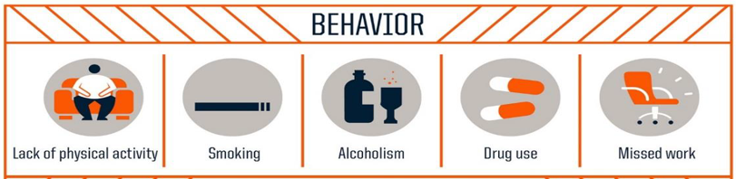
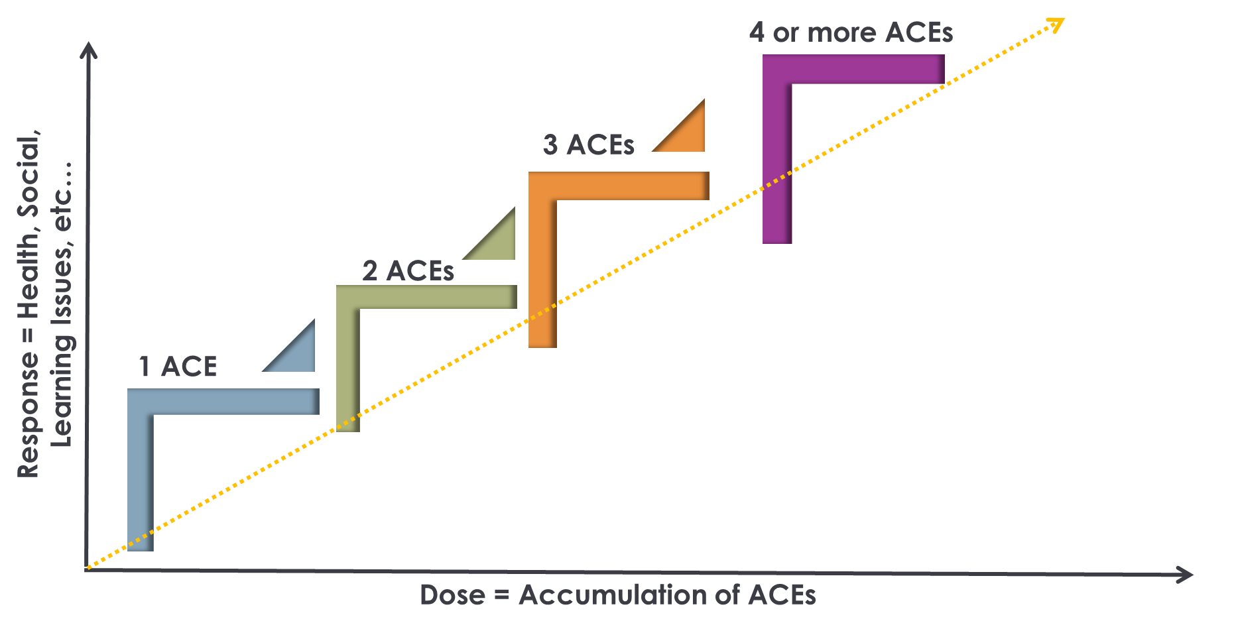
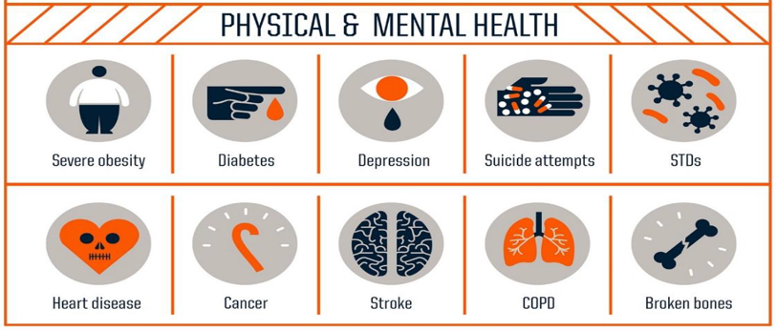
DOSE-RESPONSE RELATIONSHIP
Centers for Disease Control and Prevention | Credit: Robert Wood Johnson Foundation
Notes:
Facilitator:
Review slide
First, the researchers found that ACEs are incredibly common. Approximately 66% of participants had at least on ACE.
Second, and more importantly, the researchers found that the higher the ACE sore of an individual, the higher the risk of significant health problems in adulthood. This is called a dose-response effect. ACEs were associated with engagement in things like risky health behaviors, such as smoking, alcoholism, lack of activity, drug use and problems attending work. People with higher ACES also had health problems like pulmonary and heart disease, diabetes, and strokes; and mental health problems like depression and suicide.
These are just a few of things associated with high ACEs scores.

Slide 29

LONG-TERM
Areas of Brain Adaptively Develop
Genetic Expression Affected
Possible Extended State of Over/Under Arousal
Immune System is Compromised
Body Adapted for Survival
Notes:
Facilitator:
Review summary of long-term effects of trauma

Slide 30
Impact of Racism on the Body
There is growing evidence that self-reported discrimination is associated with…
Increased Allostatic Load
Inflammation
Coronary Artery Calcification
Dysregulation in Cortisol
Impact on Genetic Expression (shorter telomere length; oxidative stress)
(Lewis, Cogburn, and Williams, 2015)
Notes:
Facilitator:
Point of emphasis for this slide– Studies on the impact of racism have demonstrated the same outcomes as the studies on stress response and ACEs. This tells us that BIPOC are likely carrying racism as an extra toxic stress/trauma burden underneath (baseline) with individual or community level aces loaded on top. (Reference the prior slide of 3 Realms of ACE’s graphic to bring this point to life)
Shorter telomere length – impacts at chromosomal level related to increase in cancer, illness, and toll of aging
Greater oxidative stress – can also shorten telomeres. This is in early stages of scientific understanding. It may be tied to some of the mechanisms of epigenetics.

Slide 31
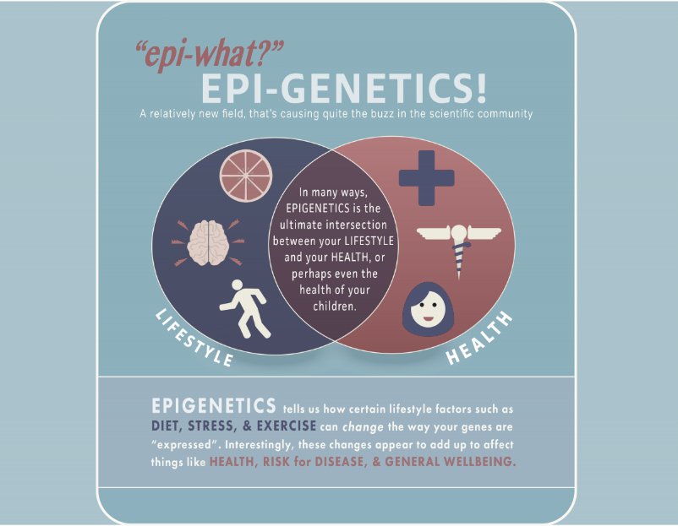
We are learning that changes may be passed down from parent to child, directly affecting genes that control risk for conditions such as obesity, depression and anxiety.
Watch Video
© Genetic Alliance 2015 | Infographic by Colin Wiles
Notes:
Facilitator:
Epigenetics is an emerging field of study, but one particularly relevant to our understanding on the pervasive impact of racism and historical trauma. There is a growing body of evidence that it is not a question of Nature vs Nurture. Instead it is Nature AND Nurture.
Show video (2:47)

Slide 32
EPIGENETICS SUMMARY
Biological mechanisms that can switch genes "on" and "off"
Environmental factors that can impact genes
Epigenetic factors are everywhere
Nature AND Nurture are what make us unique
Epigenetic factors are reversible or plastic
Epigenetic Factors:
Exposure to stress
Environmental toxins
Prenatal environment
Diet
Exercise
Developmental (critical) periods
Aging
Virus/infection
Shorter telomere length
Greater oxidative stress
Notes:
Facilitator:
Review slide
Epigenetic Factors – experiences that may lead to gene expression being turned on or off
Points from video
Even though your genes are set at birth, one’s environment and exposure to trauma can turn gene expression on or off.
Epigenetics can help us understand how behavior is transmitted intergenerationally.
This field of study can also help us to understand how resilience can lead to adaptations in future generations.
If epigenetics can help us understand how the trauma can be transmitted it can also help us understand how to break the cycle of intergenerational trauma
Some of the factors that can lead to switches being turned on or off include:
Exposure to stress – remember our ACEs
Toxins in the environment – remember the three realms of ACES
Prenatal environment in both positive ways (i.e. stress-free supportive environment with high quality prenatal care or negative ways (stressful environments, parental substance use, and poor or non-existent quality care.
Etc.

Slide 33
wellness…
Definition: The active pursuit of activities, choices and lifestyles that lead to a state of holistic health.
Wellness is:
An active and ongoing process
Holistic and multi-dimensional
An interplay between individual factors and the social determinants of health
The same components that are part of wellness are also part of resilience and healing
Wellness is not:
Just surviving but thriving
Addressing illness but promoting health
Corrective but Preventive
Notes:
Facilitator:
There are two important aspects to this definition.
First, wellness is not a passive or static state but rather an “active pursuit” that is associated with intentions, choices and actions as we work toward an optimal state of health and well-being.
Second, wellness is linked to holistic health—that is, it extends beyond physical health and incorporates many different dimensions that should work in harmony.
We can think of wellness is an individual pursuit in that we have self-responsibility for our own choices, behaviors and lifestyles. However, wellness is also significantly influenced by the physical, social and cultural environments in which we live.
Wellness is often confused with terms such as health, wellbeing and happiness. While there are common elements among them, wellness is distinguished by not referring to a static state of being (i.e., being happy, in good health, or a state of wellbeing). Rather, wellness is associated with an active process of being aware and making choices that lead toward an outcome of optimal holistic health and well-being.

Slide 34
Dimensions of wellness…
Physical: A healthy body through exercise, nutrition, sleep, etc.
Mental: Engagement with the world through learning, problem-solving, creativity, etc.
Emotional: Being in touch with, aware of, accepting of, and able to express one’s feelings (and those of others).
Spiritual: Our search for meaning and purpose in human existence.
Social: Connecting with, interacting with, and contributing to other people and our communities.
Environmental: A healthy physical environment free of hazards; awareness of the role we play in bettering rather than denigrating the natural environment.
Physical
Mental
Environmental
Social
Emotional
Spiritual
Notes:
Facilitator:
Provide handout and discuss Dimensions of Wellness
Wellness includes all of these dimensions.
These are not static.
At any given time, some areas may be stronger than others
Each component overlaps the others and affects the others for example – lack of movement/exercise affects mental and emotional wellness as well as physical wellness.
Each individual develops their own wellness strategies
Many strategies support more than one component – breathing practice/mindfulness may support mental, emotional and spiritual wellness.
Physical - Caring for your body - nutrition, exercise, sleep, preventive medical visits
Mental - Growing intellectually, maintaining curiosity, responding positively to intellectual challenges, expanding knowledge and skills, nurturing creativity
Emotional - Awareness and acceptance of our feelings, values, and attitudes; ability to manage feelings
Relational/Social - Our connection with others. This includes maintaining healthy relationships, caring about others, and letting others care about you, being part of and active in a community
Spiritual - finding purpose, value, and meaning in your life, participating in activities that are consistent with your beliefs and values.

Slide 35
Reflect
  What experience challenged you in a way that forced you to be resilient?
  What challenged a person you know in a way that they had to be resilient?
  What factors supported your resilience?
  What belief did you have that helped you be resilient?
  What would it have made hard to be resilient?
  What factors do you see in your community that impact the well-being of people around you?
  What factors contribute to their resilience/well-being?
Notes:
Facilitator:
We can’t remove exposure to traumatic experiences, but we can shift the response to exposure in self, others and community/organizations through trauma responsive practices. With knowledge comes opportunities for resilience.
When we think about trauma, it’s useful to remember the three E’s:
Emotional or Psychological trauma results from an Event, series of events such as accidents, disasters rape or abuse, or set of circumstances that could include living with severe poverty or in a chronically stressful home.
The event is Experienced by an individual as physically or emotionally harmful, threatening or life altering, outside of their control or overwhelming their ability to cope and has lasting Effects on a person’s mental, physical, social, emotional, or spiritual well-being.
The person’s subjective experience of the event or events is the critical feature of emotional trauma. Two people exposed to the same event, events or set of circumstances can have very different outcomes depending on complex relationships between the individual and their environment, past experiences, cultural and gender identities, developmental stage and protective factors.
Emphasize that the Experience represents our opportunity to BUFFER. By listening to the whole story of what happened to the individual, we can better help people cope with the short- and long-term impact of trauma.

Slide 36
Realize
The prevalence of trauma and adversity
Recognize
How trauma affects all individuals involved with programs, organizations and systems, including the workforce
Respond
By putting knowledge into practice
Resist Re-Traumatization
By creating healthy environments for staff and clients
the 4 r’s of Trauma-informed care…
Notes:
Facilitator:
When we consider a trauma informed approach, we are really looking at how a treatment provider, program, agency, organization or community thinks about and responds to those who have experienced or may be at risk for experiencing trauma
The 4 R’s Of Trauma Informed Care
Realizing (Knowing)–New York State has provided significant investment in increasing capacity around realizing the prevalence of trauma and adversity as well as the impact on growth and development. We need to stay vigilant and make sure that new professionals continue to gain this knowledge. In this module we are taking a deeper dive into the more nuanced aspects of Recognizing and Responding
All people at all levels of an organization should have a basic understanding about trauma & the effects of trauma
Trauma should be systematically addressed in treatment and recovery settings
Because trauma experiences are not confined to the behavioral health service sector, it should be understood across systems of care for the most effective outcomes
Recognizing (Seeing)
People in organizations/systems are able to recognize signs of trauma and how trauma affects how an individual perceives and interacts with the world
May be experienced by both those seeking services and those providing
Everyone would benefit from trauma-informed approach
Responding (Action/Doing)
Programs, organizational systems respond by applying principals of trauma-informed care
Responses can include: services, policies/procedures, environmental changes
Organizations have a culture based on beliefs about resilience, recovery & healing
Resist Re-Traumatization
Create physically and emotionally safe environments for staff and clients
Teach staff to recognize how organizational practices may trigger painful memories (re-traumatizing clients)

Slide 37
Cultural, Historical & Gender Issues
Trauma Informed Rationale:
People from marginalized groups (e.g., BIPOC, Women, LGBTQ, Disabilities, Immigrants, etc.) can be exposed to racism and discrimination that are direct forms of trauma and adversity and and/or make them more vulnerable to its effects.
Strategies
Actively move past cultural stereotypes and biases | Incorporate policies, protocols, and processes that are responsive to the racial, ethnic and cultural needs of both individuals served and staff | Recognize and address historical trauma Educate Advocate
Notes:
Facilitator:
We know that people from historically marginalized groups are more vulnerable to exposure to racism and discrimination, so we must deliver services in a way that integrates knowledge of the impact of racism and discrimination in society with attention to the unique experiences of individuals.
Review strategies for building and maintaining equitable environments from the slide
Actively move past cultural stereotypes and biases (e.g. based on race, ethnicity, sexual orientation, age, religion, gender identity, geography, etc.); offers access to gender responsive services; leverages the healing value of traditional cultural connections; incorporates policies, protocols, and processes that are responsive to the racial, ethnic and cultural needs of individuals served; and recognizes and addresses historical trauma.
Incorporate policies, protocols, and processes that are responsive to the racial, ethnic and cultural needs of individuals served and those on staff
Leverage the healing value of traditional cultural connections
Create access to gender responsive services, LGBTQ Affirming Care
Recognize and address social injustice
Macroaggressions
Historical trauma
Includes: genocide, slavery, pandemics, forced relocation, destruction of cultural practices

Slide 38
Embedding National Standards for Culturally and Linguistically Appropriate Services (CLAS) in Health and Health Care into organization policies and procedures
Strategies for Building Culturally Responsive Organizations
Creating and sustaining an organizational culture where policies and procedures are not just on paper
    Purposeful implementation and progress monitoring
    Purposeful reflection of diversity of staff & clients in all organization materials
    On-going professional development as a part of staff workdays
Notes:
Resources
National Standards for Culturally & Linguistically Appropriate Services (CLAS):
https://thinkculturalhealth.hhs.gov/assets/pdfs/EnhancedNationalCLASStandards.pdf
https://thinkculturalhealth.hhs.gov/assets/pdfs/class-infographic-what-why-how.pdf
Facilitator:
Review strategies for building and maintaining equitable environments from the slide
Highlight the CLAS resource
Create & sustain purposeful policies & procedures

Slide 39
Building Cultural responsiveness:
Cultural Humility
A life-long process of self-reflection & self-critique to understand personal biases & to develop & maintain mutually respectful partnerships based on mutual trust.
From First Nations Health Authority, 2015
A - Ask questions in a humble, safe manner
S - Seek Self-Awareness
S - Suspend Judgment
E - Express kindness and compassion
S - Support a safe & welcoming environment
S - Start where the client is at
From TheLinkBetweenWorlds.com from Google Images
Know yourself. Be curious about others.
Notes:
Facilitator:
The journey toward Culturally Responsive & thus, trauma responsive, organizations starts with us each as individuals through the practice of Cultural Humility
Cultural humility is a term coined by Melanie Tervalon and Jann Murray-Garcia in 1998 to describe a way of incorporating multiculturalism into their work as healthcare professionals. Replacing the idea of cultural competency, cultural humility was based on the idea of focusing on self-reflection and lifelong learning.
To encourage personal reflection and growth around culture in order to increase service providers' awareness
Introspection
Co-learning
Encourages lifelong learning with no end goal but rather an appreciation of the journey of growth and understanding
Puts professionals and clients in a mutually beneficial relationship and attempts to diminish damaging power dynamic
Review action steps from slide:
Practice Cultural Humility – Being Compassionately Curious
ASSESS:
A – Ask questions in a humble safe manner
S – Seek self-Awareness
S – Suspend judgment
E – Express kindness & compassion
S – Support a safe and welcoming environment
S – Start where your client is at

Slide 40
Building cultural responsiveness…
If YES, how can I promote these actions at an institutional or systematic level? If NO, what do I need to do differently?
With all interactions/situations, have I thought about my power, privilege, and social location and HOW it impacts my actions?
Have I questioned/challenged dominant ways of thinking to transform power towards equity?
Have I ensured the actions I have taken are equitable, collaborative, and power sharing? How can I measure this?
Notes:
Facilitator:
Take a moment to read through this slide as a precursor to the activity on the following slide. You may prompt the participants’ thinking with the below questions. Move to the next slide for an activity & processing.
What are ways individuals can become more mindful of these questions?
How do we hold these reflection questions in the forefront throughout our daily interactions with colleagues and clients?

Slide 41
cultural HUMILITY ACTIVITY…
REFLECT
Bring to mind the diversity of those you interact with in your role.
Recognize
How are unconscious or conscious power differentials present in these interactions?
RESPOND
Identify 1-3 actions you can take to more effectively share power (to better understand and be responsive to needs & preferences) of those different from you.
Notes:
Facilitator:
Read through activity with participants.
Provide 5-7 minutes for individuals to reflect and respond to the questions.
Allow time for several to share out in the large group.

Slide 42
SAFETY
Peer Support
Cultural, Historical & Gender Issues
Reflection...
Select a core value and identify how you can grow this in your place of work
TRUST & TRANSPARENCY
Trauma Responsive Care
Restoring Power, Voice
& Choice
Collaboration & Mutuality
Source: Substance Abuse Mental Health Services Administration
Notes:
Facilitator:
Read the prompt on the slide and allow a few minutes of individual thoughtful reflection. Allow sharing only, if time permits.
Choose one of SAMSHA's Trauma Informed Core Values
How can you support this core value in your work environment?
Core values originally framed by Roger Fallot and Maxine Harris and adopted/expanded by SAMHSA.
These values infuse into all of the work of a trauma responsive organization and apply to both staff and those with whom we work.
Safety: Ensuring physical and emotional safety. Is there adequate lighting in the parking light. Do staff, customers and client feel like they can voice concerns.
Trust and Transparency: Making roles and responsibilities are clear, and maintaining appropriate boundaries – supervisor/supervisee, staff/staff, staff/consumer or client
Restore Power, Voice and Choice: Creating the conditions so that people have the opportunity to exercise their power – voice and choice – can be stepping back to create the space for others or stepping up to exercise our voice
Collaboration and Mutuality: sharing power with others through authentic collaboration
Peer Support: the process of giving encouragement and assistance to others having similar lived experiences as the supporter
Explicit intersection with racial equity work and working to implement anti-racist and anti-oppressive practices as well addressing other biases and disparities based on gender, sexual orientation

Slide 43

the 3rd Shift…
Responding to the impact of toxic stress and trauma by applying what we know through resilience development, healing-centered engagement, and trauma-informed approaches.
Notes:
Facilitator:
We revisit the 3rd shift as the conclusion of this learning module, because creating Trauma Responsive and Trauma Specific environments is truly about collaborating with clients to identify what can heal and help them grow. It is about creating spaces where a client is the expert on themselves and feels safe enough and trusts enough to voice ideas and solutions.

Slide 44

“The expectation that we can be immersed in suffering and loss daily and not be touched by it is as unrealistic as expecting to be able to walk through water without getting wet.”
Rachel Naomi Remen, MD,
Kitchen Table Wisdom: Stories that Heal, 1996
Notes:
Facilitator:
Read quote aloud.
From Kitchen Table Wisdom: Stories That Heal, by Rachel Naomi Remen.
We should not think of these reactions as a disorder or a failure to cope. Rather, they should be considered a normal, occupational hazard for those working with clients suffering from traumatic stress conditions.
This content from NCTSN STS slide deck

Slide 45
COMPASSION SATISFACTION…
The pleasure you derive from being able to do your work…
Feel satisfied and enjoy your work
Feel positive towards those with whom you work
Feel that you are actually helping others (“I make a difference.”)
Feel that you are able to keep up with the work
Notes:
Facilitator:
We can look at care for helpers from several viewpoints. We’ll start with Compassion Satisfaction, because this, when felt, is most likely what brings most of to helping careers or helping roles. Compassion satisfaction can be described as the pleasure and satisfying feeling that comes from helping others. Many people enter these types of fields because they have empathetic attitudes for others difficulties as well as a strong desire to assist in alleviating the difficulties.
Compassion Satisfaction is correlated with the levels with which you:​
Feel satisfied and enjoy your work​
Feel positive towards those with whom you work​
Feel you actually are helping others (“I make a difference.”)​
Feel you are able to keep up with the work
This is what we want to create. Maintaining Compassion Satisfaction supports our professional resilience.

Slide 46
STEPS TO COMPASSION RESILIENCE…
By understanding and talking about stressful experiences that relate to our professional lives we can:
Normalize these experiences
Reduce negative aspects of working with trauma that can affect professional functioning as well as quality of life
Adopt organizational and individual strategies to prevent and mitigate more harmful experiences of stress
Notes:
Facilitator:
As you review the slide content with participants, weave in the below information as appropriate.
Now that we know the goal of Compassion Satisfaction and/or Compassion Resilience we need to be on the look out for signs of concern. Doing so helps us stay well and allows us to support colleagues, too.
Standards of care necessitate strong empathic engagement and in some cases, processing of the trauma narrative of others. This can include listening and/or processing a traumatic experience with an individual.
The essential act of listening to others’ trauma stories may take an emotional toll that compromises professional functioning and diminishes quality of life.
Indirect trauma exposure is not the only workplace stressor. It may be accompanied by:
Direct trauma on the job (e.g., assaults or injuries to staff, witnessing violence or aggression, youth suicide or self-harm attempts, deaths)
High turnover
Lay-offs
Inconsistent communication in workplace
Lack of resources needed to complete work effectively and efficiently
Many professionals also have past or present experiences of significant adversity, loss, and historical trauma, which can increase risk for these experiences.

Slide 47

FORMS OF WORK-RELATED STRESS…
Burn-out
Compassion/Empathy Fatigue
Vicarious Trauma
Secondary Traumatic Stress
Moral Injury
Notes:
Facilitator:
When we manage stress effectively, we can thrive even when faced with incredibly hard challenges or the painful experiences of others. When unchecked, it takes its toll on our brains, bodies and behaviors.
Trauma-Informed care recognizes that trauma not only affects those who seek help but it can also impact those who provide services or work in provider organizations. The impact can range from compassion satisfaction on the positive end to burnout on the negative end.
There are five ways that working with people with trauma may affect providers.
Burnout
Compassion/empathy Fatigue
Vicarious Trauma
Secondary Traumatic Stress
Moral Injury
Burnout, Compassion Fatigue and Moral Injury may affect any worker in the helping professions.
Vicarious Trauma and Secondary Traumatic Stress are specific to those who are working with people who have experienced trauma. We'll speak about each of these in more detail.
It is important to note that though we will be speaking about these from the perspective of an individual, each needs to be addressed on and organizational/systems level as well as through strategies that an individual can use.
As we offer this training, we want to acknowledge the current events that we are all experiencing which are resulting in this broad range of helper experiences. (pandemic, the greater awareness of racism in our culture, the political events)

Slide 48

WORK-RELATED STRESS…
BURNOUT
A severe form of work-related stress.
Physical and emotional exhaustion
Cynicism and detachment
Feelings of ineffectiveness and lack of accomplishment
An inability to function effectively on a personal or professional level
Notes:
Facilitator:
Burnout is a severe form of work related stress. It results from prolonged stress or frustration, resulting in exhaustion of physical strength, emotional strength and/or motivation.
Burnout is associated with high workloads and non-supportive work environments.
Symptoms include feelings of hopelessness, being emotionally exhausted and overextended by the work. It can also lead to negative, cynical attitudes toward the people served and even co-workers.
Physical and emotional exhaustion - chronic fatigue, insomnia, forgetfulness/impaired concentration and attention, physical symptoms
Cynicism and detachment- loss of enjoyment, pessimism, isolation, detachment
Feelings of ineffectiveness and lack of accomplishment - feelings of apathy and hopelessness, increased irritability, lack of productivity and poor performance
An inability to function effectively on a personal or professional level.
https://www.psychologytoday.com/us/blog/high-octane-women/201311/the-tell-tale-signs-burnout-do-you-have-them
Burnout doesn't happen suddenly. It can be insidious, creeping up on us over time like a slow leak. Can be hard to recognize.
Resources
When providing the below articles to participants, be certain to acknowledge that an individual can take actions to diminish burnout, HOWEVER, if an organization in which one works has a culture of toxic stress, the individual has not FAILED at diminishing burnout. Responsibility also lays with the organization to create a trauma informed environment.
https://www.theatlantic.com/politics/archive/2021/03/how-tell-if-you-have-burnout/618250/ - Organization has responsibility to support TIC environments
https://www.forbes.com/sites/learnvest/2013/04/01/10-signs-youre-burning-out-and-what-to-do-about-it/#2ac7dc6a625b – Individual actions to diminish burnout

Slide 49
WORK-RELATED STRESS…
Compassion Fatigue
Deep physical, emotional, spiritual exhaustion
Vicarious Trauma
A post-traumatic response resulting from exposure to others’ traumatic stories
over time
Secondary
Traumatic Stress
Presence of PTSD symptoms as a result of even a single exposure to another person’s experience of trauma
Feelings of “nothing left to give”
Difficulty maintaining balance between empathy and objectivity
Decline in hope and optimism related to the value of work
Growing evidence to re-name: Empathy Fatigue
Happens over time
Accumulation of exposure
Results in a profound shift in world view (e.g., psychological, spiritual)
Can happen suddenly, even with single exposure
Preoccupation with thoughts of the event
Results in irritability, agitation specific to details of what was shared
Notes:
Facilitator:
Compassion Fatigue:
A growing body of research (Compassionomics by S. Trzeciak & A. Mazzarelli)) shows us that this should really be re-named “Empathy Fatigue.”
Empathy – allows us to meaningfully connect with others’ experiences. But is organized in a way that taps into our own pain centers. To feel empathy we need to connect with our own experience of something similar.
Compassion fatigue usually affects those who do their work well. The essential act of listening to trauma stories may take an emotional toll. Compassion fatigue can be defined as the deep physical, emotional, and spiritual exhaustion of seeing and hearing the problems and suffering of those we work with.
It happens when you feel like you've given everything you have to give. You are left feeling drained, empty. You might even feel guilty that you feel this way. However, a distinguishing factor is that it's not that you stop caring anymore, it's just sometimes hard to keep caring that much *and* sustain that degree of caring. And honestly, it’s a natural part of the helping profession. Just as an untreated cold can turn into something more serious, compassion fatigue that is not addressed may turn into burnout.
Compassion fatigued practitioners continue to give themselves fully to their clients, finding it difficult to maintain a healthy balance of empathy and emotional distance.
Experience a decrease in hope and optimism about the value of the work.
Can be a typical response to work overload; can come and go depending on demands.
Vicarious Trauma:
A response to exposure to trauma and toxic stress through the experiences of the people served . It happens over time and accumulates as the worker is exposed to more and more stories, and it can lead to a profound shift in world view. The worker may begin to develop the belief that the world is a scary, unsafe place and that people cannot be trusted, just as the people they serve have come to believe because of their exposure to trauma and toxic stress.
Secondary Traumatic Stress:
This is slightly different from Vicarious Trauma. Secondary Traumatic Stress is when the worker may experience some symptoms of traumatic stress after hearing the story of someone else’s trauma. The worker may be preoccupied with thoughts about the event, become irritable or agitated specifically related to what was shared.

Slide 50
MORAL INJURY…
Stress that occurs when one believes they know the right thing to do, but institutional or other constraints make it difficult to pursue a course of action.
Psychological
Biological
Spiritual
Behavioral
Social Impact
National Child Traumatic Stress Network
Stress that occurs when one believes they know the right thing to do, but institutional or other constraints make it difficult to pursue a course of action.
Notes:
Facilitator:
Moral Injury - This is vicarious trauma related to what I see in the word vs what I see in my work (i.e. inequities, racialized violence, atrocities in the world).
As defined by NCTSN (National Child Traumatic Stress Network)
"Stress that occurs when one believes they know the right thing to do, but institutional or other constraints make it difficult to pursue the desired course of action."
Result from "violations of deeply held beliefs about what is right".
“Moral injury can result from a variety of additional causes: inability to stop others from committing atrocities; carrying out management directives that violate personal values; witnessing random suffering caused by natural disasters; tolerating overwhelming injustice.“
The Headington Institute refers to moral injury as another type of emotional pain that is caused by the work that helping professionals do or by other work (such as the work of our military or law enforcement). https://www.headington-institute.org/resource/moral-injury/
National Center for PTSD defines Moral Injury as: "An event occurs where someone’s values and morals are violated by perpetrating, failing to prevent, or bearing witness to acts that transgress deeply held moral beliefs and values. The person feels moral pain (involving emotions and cognitions) in response to the event. Moral injury is the lasting psychological, biological, spiritual, behavioral, and social Impact of the morally injurious event." https://www.ptsd.va.gov/professional/consult/2019lecture_archive/05152019_lecture_slides.pdf
Resource links
https://www.headington-institute.org/resource/moral-injury/
https://www.ptsd.va.gov/professional/consult/2019lecture_archive/05152019_lecture_slides.pdf National Center for PTSD

Slide 51

Individual & Organizational Approaches
Notes:
Facilitator:
Much of the focus of self-care, burnout prevention, compassion satisfaction has landed in the laps of individuals. There are certainly active steps and protective factors that individuals can put in place to mitigate and/or prevent negative outcomes and sustain joy in one’s work. However, it is just as critical for organizations to review their own contributions to the positive work-life balance of employees. Let’s review some of these factors.

Slide 52
WE WORK WITH OUR WHOLE SELVES…
People bring a past and present story to everything they do:​
Schemas and beliefs​ | Personal history of trauma and adversity​
Stigma beliefs​ | Families and close friends
Social support systems​ | Economic situation
Positive support​ | Cultural Identity
Negative support​
A. Hildebrand & C. Parker 2019
Notes:
Facilitator:
Resource
Vignette
Share a vignette here for highlighting this slide/talking points.
Read vignette with participants and identify factors from the slide rather than a deeper processing of the person in the vignette
This is a starting point of thinking about supporting colleagues who identify with marginalized groups (yet we know that all of us are impacted by stress in the workplace)
Schemas & Beliefs
How we organize categories of information and the relationships among them. What we believe about categories of information.
Stigma Beliefs
Categories that are marked by negative beliefs such as shame or disrespect especially having to do with race, gender, sexual orientation, mental health status
Acknowledge slide:
We need to recognize this and respond through care for ourselves and each other to support our ability to stay healthy in this work. To do this we need a combination of both individual and community support practices.

Slide 53
DESERVING OF FOCUSED ATTENTION…
Common background/experiences with those they serve
Higher caseloads and being asked to take on additional responsibilities
Exposure to oppression and institutional racism
Lack of safety or support in their agency
Colleagues minimizing or avoiding topics of racial, cultural and historical trauma
  Staff who are members of marginalized groups warrant our special attention due to…
National Child Traumatic Stress Network
Notes:
Facilitator:
Resource: National Child Traumatic Stress Network
Review slide
Exposure to the same oppression and institutional racism as those they work with
Providers may experience elevated levels of STS and/or moral distress when working with marginalized individuals and/or communities that do not have equal access to resources and/or who are overrepresented in systems such as child welfare and juvenile justice.
This can be especially challenging for providers of color, who are often experiencing exposure to the same oppression and racism as the children and families they are working with. These providers are likely to have their own experiences of racism and microaggressions, both in their immediate experience and in their surrounding environment. Providers may also be experiencing oppression and institutional racism in the agencies, systems, and/or communities in which they work.
In all of these situations, they may be experiencing primary trauma as well as secondary trauma.
Similar background or similar experiences as those they serve
Providers who are working with clients of a similar background or with similar experiences may identify with clients’ experiences and may feel more impacted because of this identification.
For example, an African-American child welfare worker whose job involves removing African-American children from their parents may feel heightened distress knowing that African-American children are over-represented in the child welfare system and tend to have longer stays compared to their white counterparts.
Lack of safety or support in their agency
Providers of color and/or those who hold marginalized identities (e.g., providers who identify as LGBTQ+) may experience lack of safety or support in their agency, especially if they do not have colleagues who share their identities or experiences.
It is hard to help clients feel safe when you as a provider do not feel safe.
Colleagues minimizing or avoiding topics of racial, cultural, and historical trauma
Issues of culture, race, and historical trauma can make people feel uncomfortable, and therefore colleagues may avoid talking about these issues and/or may minimize the impact of culture, race, and historical trauma.
This avoidance and minimization can also contribute to a workplace feeling unsafe.
Higher caseloads and being asked to take on additional responsibilities
Providers of color (especially bilingual providers) often have higher caseloads and additional job responsibilities which can add to feeling overwhelmed and more vulnerable to STS.
For example, bilingual providers are often called on to translate for colleagues and/or translate written materials in addition to their regular workload.
They may also be asked to contribute expertise about cultural, racial, or other identities in addition to expertise related to their formal role.
Providers of color may also feel a sense of responsibility to educate others on racism and the impact of cultural or historical trauma, especially if they witness or experience bias among colleagues.

Slide 54
PROTECTIVE FACTORS - INDIVIDUAL…
Self-awareness | Lower doses of exposure​
Healthy professional boundaries​ | Experience to draw from
Working with compassion​ | Sense of competence
Positive work-life balance​ | Individual coping strategies
Supportive relationships ​
Notes:
Facilitator:
Note: This slide is purposefully reframed from “Risk Factors” to Protective Factors” to validate risk factors AND focus on actions we can take (offering hope & resiliency).
We know that staff who work in helping professions can be vulnerable to experiencing negative levels of stress related to work. There are some factors that increase risk like (give one-three examples from list below that might resonate most with your audience). Having an awareness of your own levels of risk and leaning into personal protective factors build our professional compassion resilience.
Examples of personal risk:
Gender: women are at greater risk for STS
Dose of exposure: Carrying a heavy caseload of individuals who have experienced trauma
Unresolved direct trauma exposure
Level of support: Being socially or organizationally isolated. Social, peer and supervisory support are key
Providers who are new to trauma work/ just beginning career
Sense of competence: Lack of training in evidence-based trauma treatments
Tendency towards negative coping styles (e.g., overworking, bottling up or numbing emotional responses, isolating, passivity)
Sources:
Bride, B.E., Hatcher, S.S., & Humble, M.N. (2009). Trauma training, trauma practices, and secondary traumatic stress among substance abuse counselors. Traumatology, 15, 96-105.
Craig, C.D., & Sprang, G. (2010). Compassion satisfaction, compassion fatigue, and burnout in a national sample of trauma treatment therapists. Anxiety, Stress, & Coping, 23(3), 319-339.
Sprang, G., Whitt-Woosley, A., & Clark, J. (2007). Compassion fatigue, burnout and compassion satisfaction: Factors impacting a professional’s quality of life. Journal of Loss and Trauma, 12, 259-280.
Go over slide’s examples of Protective Factors that Individuals have control over and can strengthen to decrease stress levels.
May have a discussion about what is in a worker’s control and what is not.

Slide 55
REFLECTIVE EXERCISE…
Consider how the information shared so far in this presentation leads you to reflect upon your own experiences
How do you know when you are becoming overly stressed? What do you notice about yourself?
What are your particular vulnerabilities or risk factors?
What protective factors help you stay healthy while doing the challenging work that you do?
What do you do at the end of a workday to put stresses or exposures to others’ trauma away before you go home?
Notes:
Facilitator:
Resource
ProQOL - The Professional Quality of Life (ProQOL) scale is a commonly used measure of compassion fatigue and compassion satisfaction. It is a 30 item self-report measure of the positive and negative effects of working with people who have experienced extremely stressful events. The ProQol contains three subscales measuring Compassion Fatigue, Burnout and Compassion Satisfaction.
Reference the ProQOL as a tool here. In addition to using standardized tools for self-assessment, we can also engage in reflection about our own signs and symptoms, risk factors, and practices. You can use these reflective questions to help build your own self awareness.
Note to facilitator:
You can engage in this reflective exercise during the presentation or you can offer these questions for participants to consider on their own time after the presentation. If you do engage in this reflective exercise during the presentation, you can invite your audience to take 8-10 minutes to silently write and reflect before partnering up to discuss their responses (sharing only what they choose to disclose). Principles of psychological safety and choice should be utilized in decisions of whether to suggest that participants select a partner to reflect on what came up for them, as this may not be advisable in all audiences or settings.
Alternatively or additionally, you can suggest the following post-training exercise:
Consider writing down your own STS narrative on your own. You may decide to share it with a trusted colleague or friend in a setting that feels private and safe for disclosure, taking care not to include graphic images or traumatic stories.
Reference: Mathieu, 2012, The Compassion Fatigue Workbook, pg. 22.

Slide 56
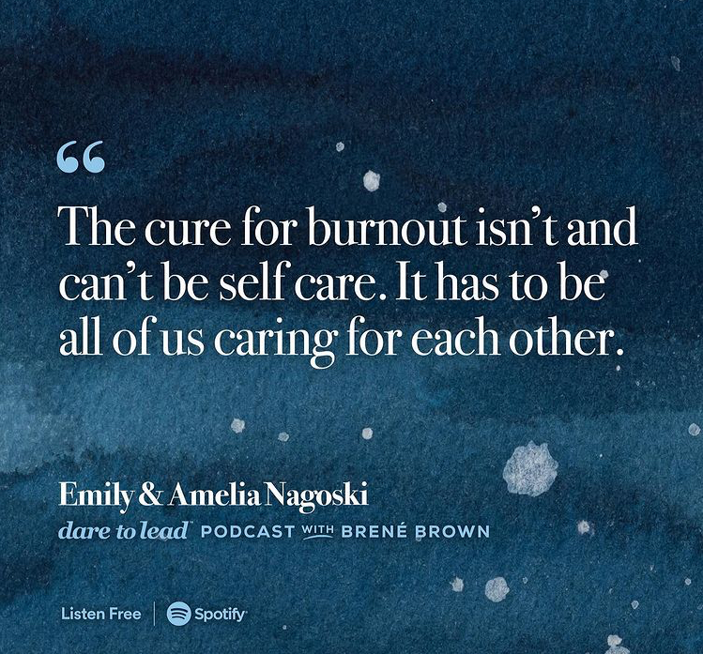
Self & Community Care
An Essential Skill in a Trauma-Informed Organization
Notes:
Facilitator:
Both individual and organizational approaches are needed in order to address STS. As individuals, we have goals to stay healthy in our work and to take care of ourselves so we can do our jobs effectively.
An exclusive focus on coping strategies for service-providers, without acknowledging the organization's role, implies that individuals experiencing STS are at fault! (Killian, 2008). A worker cannot be expected to refill and refuel constantly, while working in an environment where there is limited physical or psychological safety. The best approach is a two-pronged approach to address STS, with both organizations and individuals implementing different strategies.
Resource links from NCTSN
Webinar: Organizational Secondary Traumatic Stress
https://www.nctsn.org/resources/organizational-secondary-traumatic-stress
For more information, see the 3-part series on Creating Secondary Traumatic Stress-Informed Organizations
Part 1: https://www.nctsn.org/sites/default/files/resources//impact_summer_2013.pdf
Part 2: https://www.nctsn.org/sites/default/files/resources//impact_fallwinter_2013.pdf
Part 3: https://www.nctsn.org/sites/default/files/resources//impact_spring_2014.pdf
“What we’re talking about is creating a culture shift: combining individual efforts with a more systemic approach to create healthier working conditions, and more of an early intervention and resiliency-building model.” (Leslie Ross, from NCTSN Impact Newsletter)

Slide 57
CONNECT: RACE, CULTURE, & IDENTITY
Build mutual support around how your identities, culture, race, and history may affect your responses to your work.
  Informal, supportive discussions with peers
  Regular peer processing groups
  Peer support and/or mentorship (internal and/or external)
Adopt a holistic mindset to employee wellness. Support individuals connecting with their own cultural backgrounds to enhance their protective factors
(i.e, healing practices, traditional ceremonies, and cultural supports, etc.)
Be honest and real about current injustices and challenges while also holding space for idealism, hope, and building change for future generations.
Notes:
Facilitator:
Connection is critical to resiliency in the work. Making purposeful time to connect with others builds our own resilience and those of our peers, colleagues, friends etc! If connections that focus on race, culture and identity are not available to you in your organization, here are strategies for building these into your environment. (Reflect: How can we support this as opportunities within our workspaces so that it is not always resting on the shoulders of individuals?)
Review slide:
Informal peer support discussions are helpful. You may also want to consider creating a regular peer processing group to address these issues. You may also want to seek peer support, consultation, and/or mentorship outside of your organization, especially if you do not have colleagues at your agency who relate to your experience.
If helpful, seek out and participate in traditional healing, traditional ceremonies, and cultural supports.
Be honest and real about current injustices and challenges while also holding space for idealism and building hope and change for future generations. It is important to be realistic but not hopeless. Focus on what you can do within your role to make a difference.

Slide 58
STEPS SPECIFIC TO ORGANIZATIONS
Adopt practices such as Reflective Supervision
Assess for staff experience from a trauma-informed, equity lens. Take actions in response
Health and Human Service Organizations benefit from screens to identify and respond to individuals experiencing symptoms of STS
Review and revise policies from a trauma-informed, equity lens
Take steps to become a trauma-informed organization!
Notes:
Facilitator:
Be sure to link this learning to the deeper dive in the next module
Adopt Policies
Organizations should proactively recognize and address the impact of secondary trauma on the workforce. “Part of being proactive is considering secondary traumatic stress in the planning of organizational policies, and making sure that there are mechanisms in place to screen for and respond to individuals who are suffering from the symptoms of secondary traumatic stress.” (Ginny Sprang, from NCTSN Impact Newsletter)
Reflective Supervision
(An opportunity for assessing staff experiences, screening for STS)
This is an important resilience-building and relationship-based practice that helps organizations and workers at different levels in a system to increase their awareness on how they are impacted by their work with individuals who have experienced trauma. It is about recognizing that sometimes our work with clients can take a toll on us, both personally and professionally as well as across our organizations. This work changes us over time.
Reflective supervision goes beyond having your supervisor or manager monitor how you are performing on the job and asks them to recognize how this work is impacting you. At the same time, reflective supervision offers a safe place for workers to develop their capacity to reflect on how they are being impacted by their work with individuals who have experienced trauma and to feel supported without fear of punishment.
Even without formal reflective supervision, workers can use reflective practices to help them to think about their own histories and intersectionality at it relates to their work, as well as the impact of the work on them over time. It is important to recognize that service providers often have personal histories of adversity. Also, structural issues and policies in service systems can add to these adversities. Part of addressing these issues involves first uncovering them and reflecting on what they mean to you and your work, and how your work is affected.
For example, a worker who experienced a major stress reaction in response to a certain child came to realize how she was triggered by aspects of this child’s story that resembled her own which led her to respond in an avoidant, shut down manner with this child.
Take steps to become a trauma informed organization
This includes providing on-going professional development and training for staff and is looked at again in the next learning module.

Slide 59







Individual: Start with yourself
Practice
seeing through a new lens
Be generous
with yourself and others
Self Care
Educate
Yourself and Others
Notes:
Facilitator:
Review the slide noting that individuals will begin where it makes sense for them. It may be in one area or in several.
Self-care - Provide handouts for participants to create own self-care plans
Start with ourselves – if we are depleted we are unable to give to others
Pace yourself; take breaks when possible and take time off from work
Develop your own list of self-soothing activities that “fit” at work - and use them
Breathing, relaxation, meditation
Walk
Stand in the sun
Stretch
Text or call a friend
Watch a funny video on your phone
Color
Educate Self
Engage in education/training for new understanding and skills
Take advantage of supervision/consultation
Seeing Through a New Lens
It can be easy to revert to habitual thinking. How do you keep new perspectives in the forefront?
Reminds yourself that interpretation drives intervention
Why might someone be reacting that way? What is the unmet need?
Be Generous
Identify strengths
Your own
Colleagues’
Clients’
Share them with others – “I noticed you are really good at managing your time. Can you give me a pointer?”

Slide 60
As part of a Trauma-Responsive Team
Keep Trauma- Responsive Care “On the Agenda”
Learn Together
Take Care of Each Other
Notes:
Facilitator:
While we can all adopt trauma responsive strategies, actions, behaviors etc. as individuals, creating trauma sensitive environments as a team is even more effective for the wellness of our clients, our colleagues and ourselves.
Keep Trauma Responsive Care on the Agenda
Identify how this is not lost in day-to-day work. What are reminders for the team so that trauma responsive work becomes second nature in culture and language of the organization?
How do we approach our work whether its actual direct service to a client, providing consultation to a customer or working between departments? Are there different ways that this work shows up?
Learn Together
Share new information
Include book learning, professional development etc., AND personal/professional experiences (especially lessons learned)
Take Care of Each Other
Create a culture where we know signs of Burnout, STS, Compassion Fatigue and feel comfortable telling a colleague you are concerned about them
Create a culture where it is OK AND encouraged to take wellness breaks, days off, vacations

Slide 61
Reflection
What has learning looked like in your life?
What was different from others?
What was the same as others?

