Slide 1




Community Resilience Builder Program
Session 1

Slide 2
Community Resilience Builder Orientation
- A Master Volunteer Program like:
- the Master Gardeners
- the Master Food Preservers
- Master Wellness
Designed to build community capacity through volunteer service
Join a national network of Extension Volunteers

Slide 3
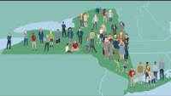
Cornell Cooperative Extension Overview

Slide 4
Mission, vision & Strategic Initiatives
OUR MISSION:
Cornell Cooperative Extension Orange County enables people to improve their lives and communities by bringing local experience and research-based solutions together.
OUR VISION:
Cornell Cooperative Extension Orange County creates measurable change in order to positively affect Agriculture, Families, Youth, Environment, and Economic Development within communities.
OUR STRATEGIC INITIATIVES:
Agricultural Sustainability – To encourage farmers in Orange County to adopt proven production and/or business management practices that have been shown to improve profitability.
Enhancing the Environment – To improve the quality and sustainability of the environment and natural resources by promoting environmental stewardship, sound decision-making and best management practices.
Strengthening Youth and Families – To empower youth and families to reach their fullest potential through experiential learning opportunities that develop critical life skills, foster civic responsibility and strengthen the community.
Economic Development – To effectively utilize the research based resources and appropriate local partnerships to educationally program and to positively impact Orange County economic vitality.

Slide 5
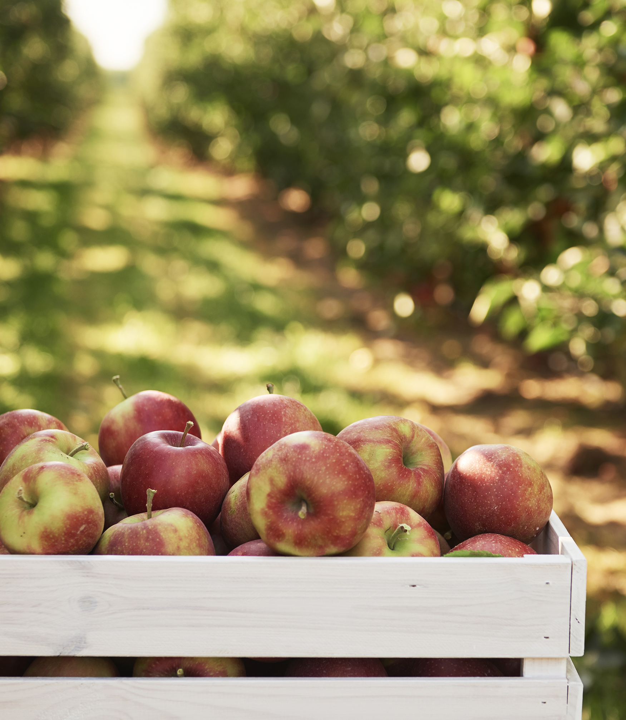

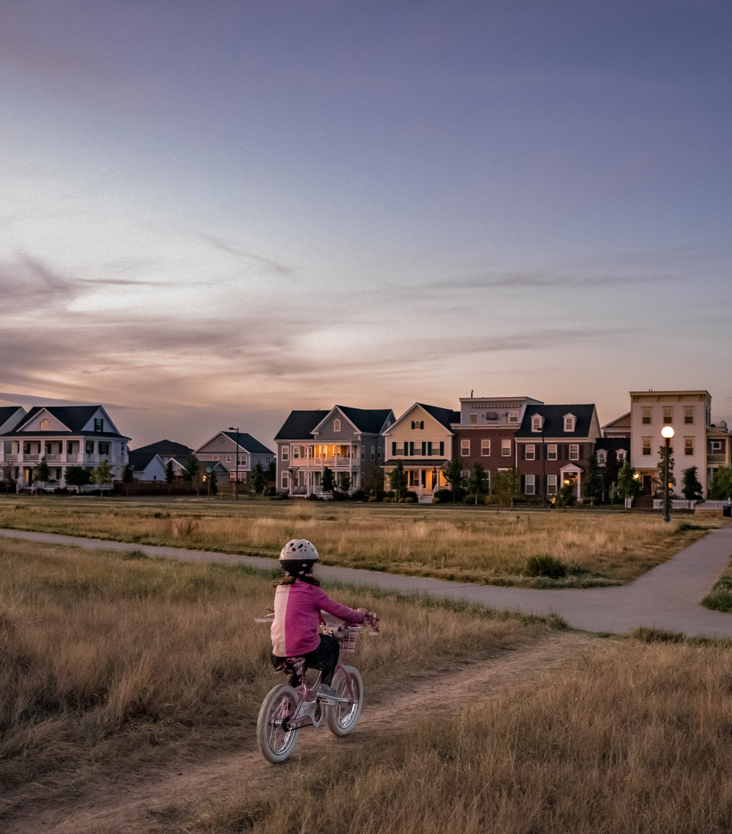
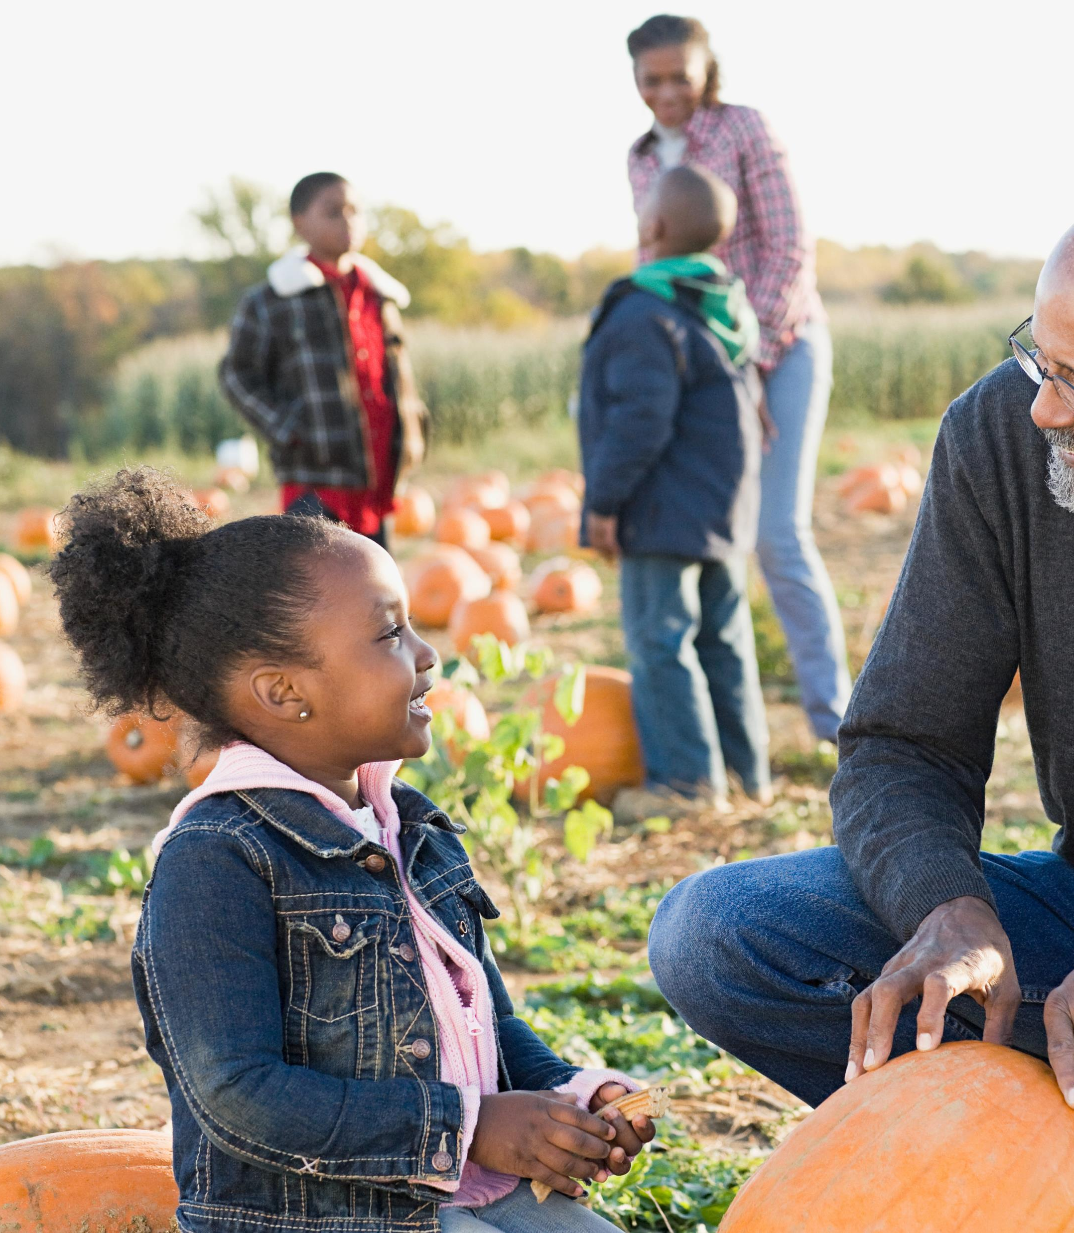
Major CCE programs
Ag
Community & Economic Vitality
Family Well-Being
4-H Youth Development

Slide 6
Who is Who at CCE Orange
https://cceorangecounty.org/about-us/cceoc-staff-and-board

Slide 7
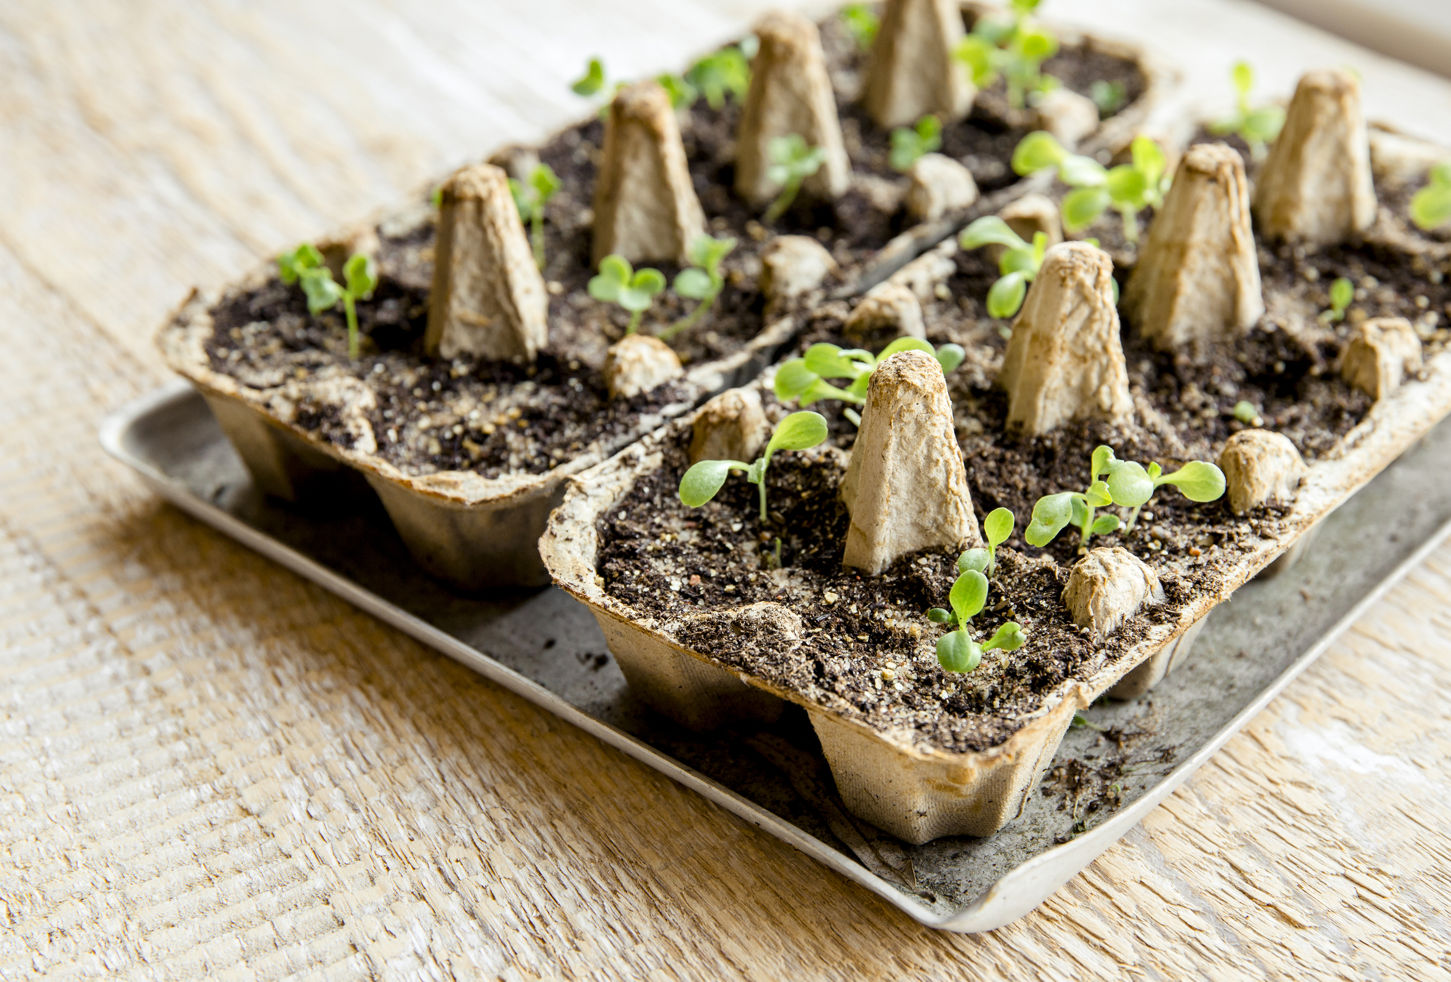
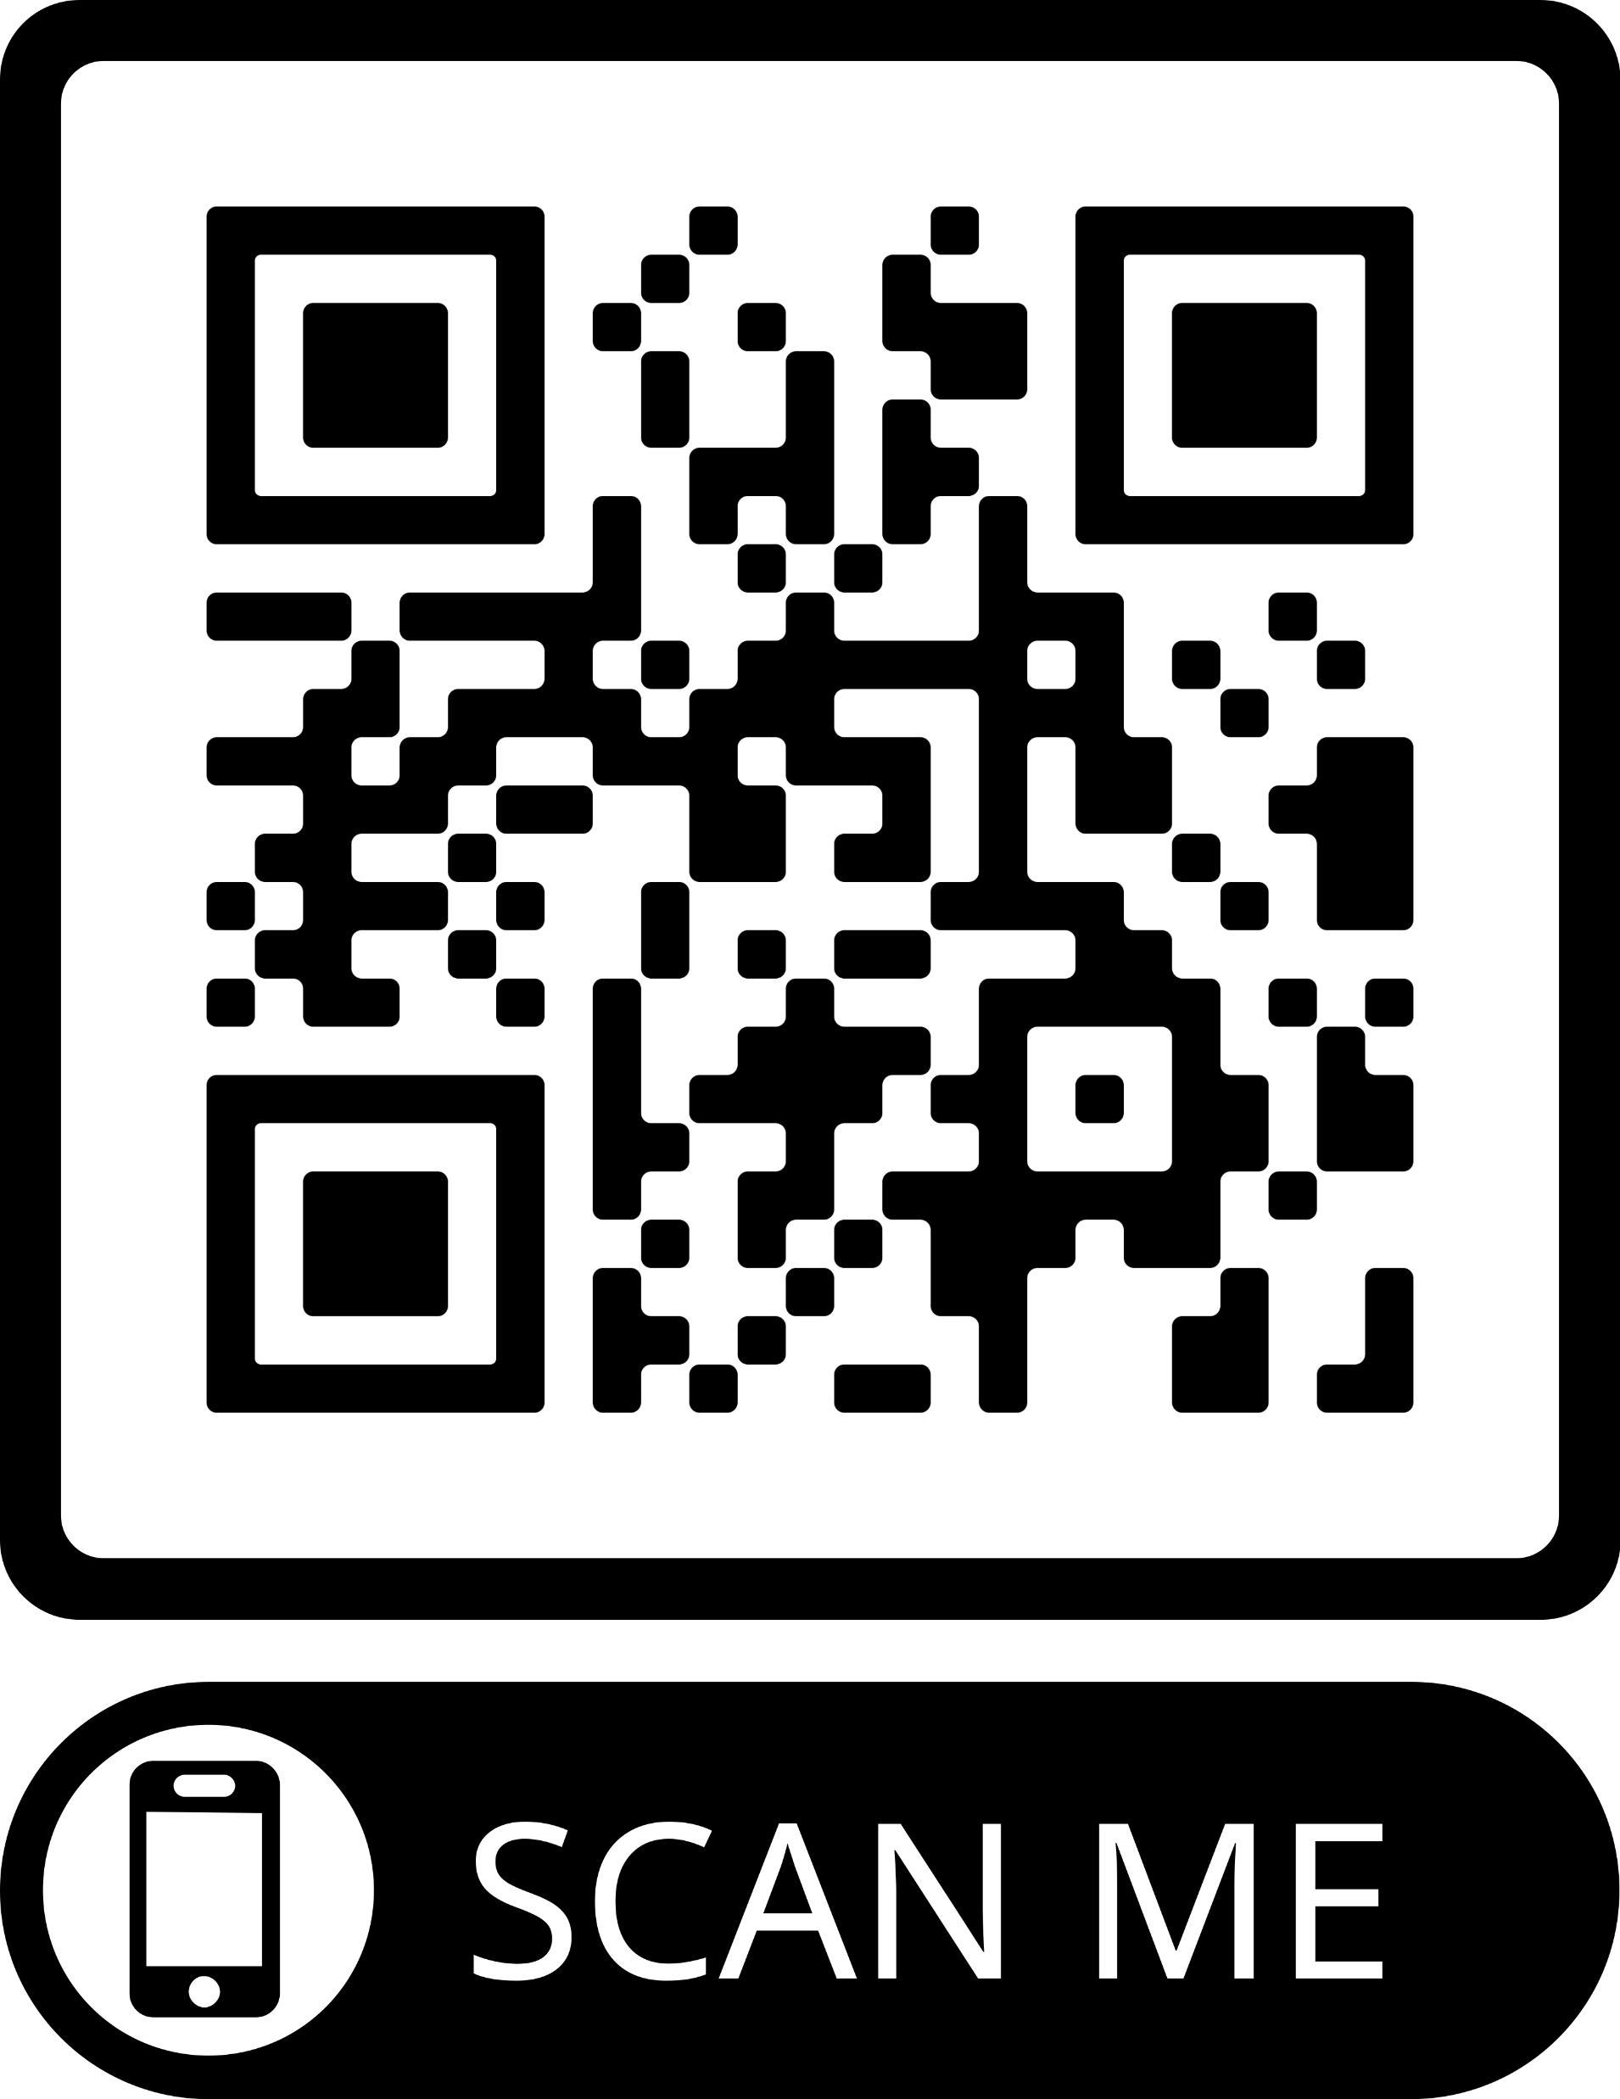
Volunteers volunteers volunteers

Slide 8

Climate Justice &
Building Community Resilience in Western Orange County
CCE Orange – funded by Orange & Rockland Utilities

Slide 9
Grant Overview
Timeframe: 3 years, starting 10/01/2024
Grant Amount: $360K total
Population Reach: Marginalized community members in Middletown, Port Jervis, and Warwick
Overall Goal: build capacity, address and mitigate climate change, provide education and resources, and initiate a community-led climate justice and community resilience action group.

Slide 10
Need
Impact of extreme weather events, such as ice storms, floods, droughts, heat waves, hurricanes, and major storms are particularly devastating for vulnerable communities, such as marginalized communities, individuals with specific health conditions, children, and older adults.
OC faces several hurdles: limited resources in local governments, lack of community engagement, and gaps in data and information.

Slide 11
Goals
Goal 1: Build Community Capacity using the Community Resilience Builder and Climate Steward Programs
Goal 2: Creating Community Resources
Goal 3: Generate Disaster Education Resources and Connect People

Slide 12
CCE Orange Climate Justice and Community Resilience Project
Climate Justice and Community Resilience
Program Advisory Committee (PAC)
Climate Steward Program
Resilient Port Jervis Community Action Group
Resilient Middletown Community Action Group
Community Resilience Builder Program
Community Engagement
Building Volunteer Capacity

Slide 13
Syllabus & Faculty

Slide 14
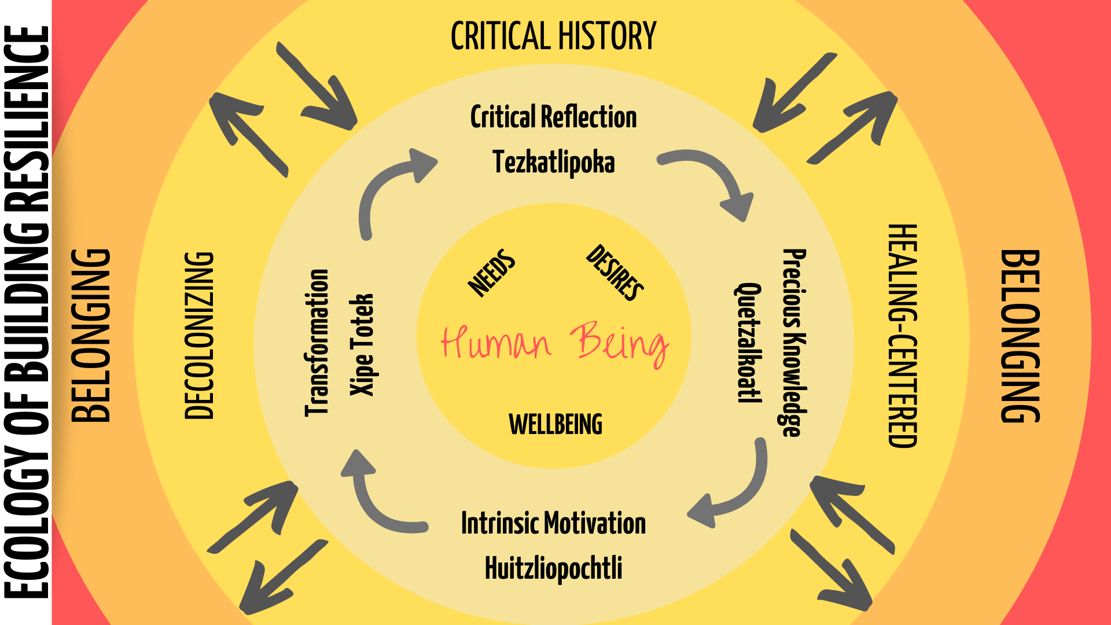

Slide 15
Community Café…
What factors have made a community you know resilient?

Slide 16
Community Café…
What do you or would you consider a regenerative community?

Slide 17
Community Café…
What promotes belonging in a community?

